Slide 1
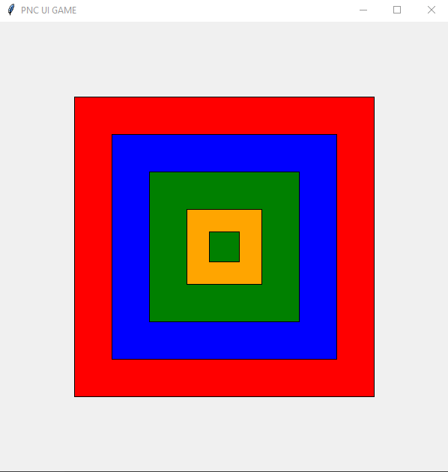
# ACTIVITY 01 15mn
Draw the shape following the picture
Window size: 600x600
Title: PNC UI GAME

Slide 2
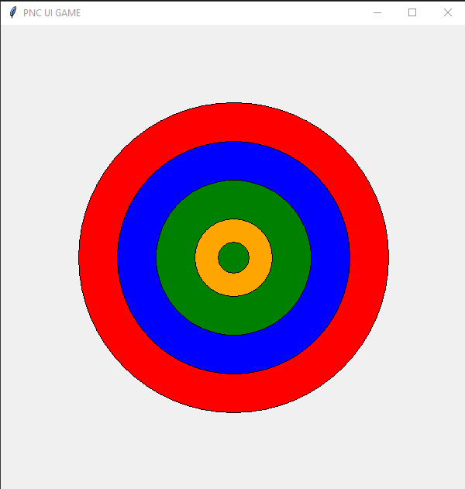
# ACTIVITY 02 15mn
Draw the shape following the picture
Window size: 600x600
Title: PNC UI GAME

Slide 3
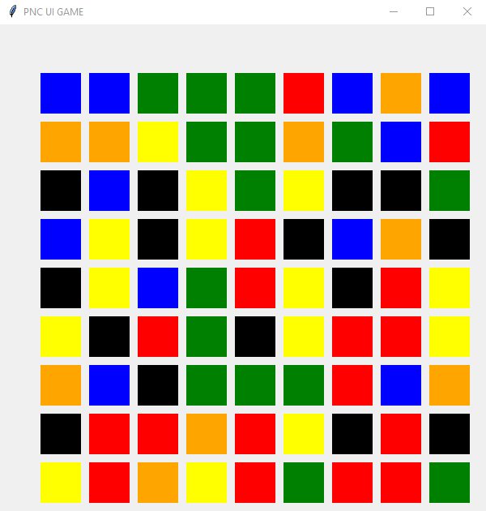

# ACTIVITY 03 60mn
Draw the shape following the picture
Window size: 600x600
Title: PNC UI GAME
Color need to be random
colors = ['red', 'blue', 'green', 'orange', 'yellow', 'black', 'purple']
You need to use loop to draw those shape!

