Slide 1
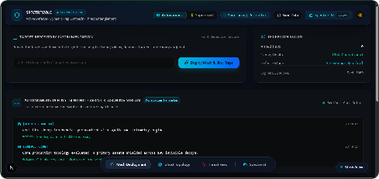
SpectreSync
~/deck — zsh — 160×90
$ ./present main.typ
Deception mesh for JAI 2026: Every probe becomes a signal
Utkarsh Mishra
Riya Aggarwal
Kartikey Mishra
Bhavy Mahawar
Tanishk Soni

Slide 2
$ detection starts after the incident
So the pitch starts where detection leaves off.
We plant controlled assets so an unauthorized attempt shows up as a signal
The README’s premise: artificial assets reveal unauthorized access attempts and give useful signals for investigation.
SpectreSync

Slide 3
$ Three agents watch one perimeter
So the watching is split between three agents.
01
Triage
02
Deception
03
Entanglement
Scores each probe from
Crafts decoy
Injects artificial
request headers, User-Agent fingerprints and
endpoints, mock payload schemas and
response delays and jitter from 500ms to
traffic velocity, 0 to 100%.
embedded canary tracking tokens on demand.
10,000ms to lock attacker sockets.
Runs on Python, Streamlit, Pandas, FastAPI, Uvicorn, SqLite, Express on Node.js, Next.js, React, TypeScript and Tailwind CSS.
SpectreSync

Slide 4
$ Six steps turn a repo into a trap field
Then one deploy walks the six steps the README lays out.
Step What happens
Discover Scan the directory for config files Analyze Find candidate key patterns Synthesize Generate artificial honeytokens Monitor Receive canary webhook events Record Store the events in a database Review Read the dashboard or web console
SpectreSync

Slide 5
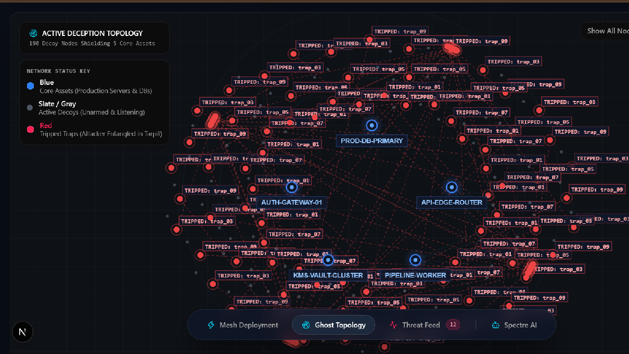
190 decoys cover the core services
Blue nodes are core assets; red nodes are tripped traps. Grey nodes are dormant traps.

Slide 6
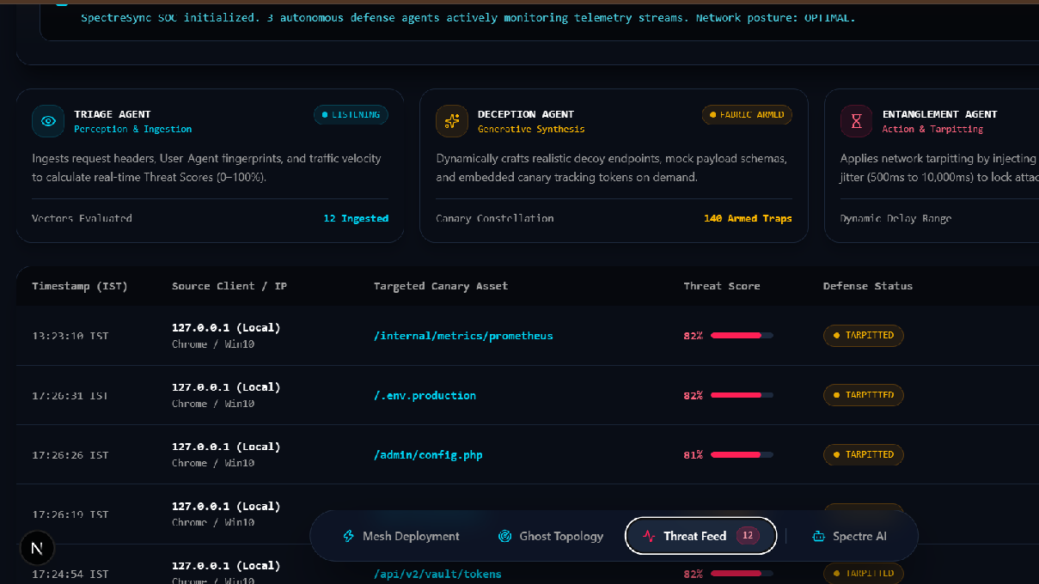
Every trip is scored and mitigated
82% on /.env.production, 81% on /admin/config.php, both Auto-Mitigated.

Slide 7
$ High-risk fixes wait for approval
Because a machine decides the mitigation, the policy
engine sets what runs alone.
01 02 03
04
05
Ingest alert
Propose actions
Policy engine
Execute or queue
Write config
source IP,
tarpit,
risk and
low risk
tarpit and
asset,
decoy,
privilege
runs alone
firewall
severity
quarantine
rules
> In supervised mode every action queues an approval request for the operator.
SpectreSync
7/9

Slide 8
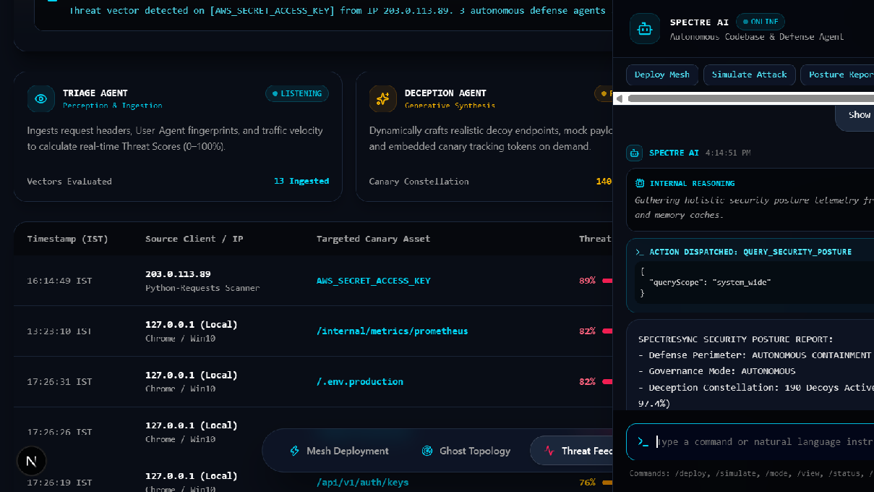
Spectre AI reports posture in chat
190 decoys active and a 97.4% deception ratio.

Slide 9
deploy the mesh on
~/deck — exit 0
your own repository
pip install streamlit pandas fastapi uvicorn, then streamlit run app.py on a target path; the backend, canary listener and Next.js console run as separate services.
https://github.com/LY-UtkarshMishra-09/SpectreSync

