Slide 1
INDIGENOUS AI ECOSYSTEM · DATA AS-OF MID-2026
The Stack China Is Building
A value-chain map of China's indigenous AI ecosystem — where capability, capital and captive demand meet, and where a professional investor can (and cannot) get exposure.
Prepared for financial-market experts, economists & industry analysts · Every figure carries a source ID + A–D confidence grade

Slide 2
THE THESIS · 02
One line, then the map
China is building a PARALLEL, vertically-indigenized AI stack under export-control pressure — one to several years behind the US frontier at almost every layer, but with the direction, coordination and capital to create a distinct investable ecosystem whose value is migrating to hardware, power and embodied AI.
Constrained: lithography is the binding chokepoint · software (CUDA) the deepest gap (3–5+ yr) · compute rationed (~2.5 GW inference).
Working: a system-level bet (lose at the chip, win at the rack) · power, the one clear edge · a 'slow-bull' IPO wave as the 2026 catalyst.

Slide 3
WHY IT'S ITS OWN UNIVERSE · 03
Two doctrines of AI
United States — a race to superintelligence: frontier labs treat a few months' lead as potentially permanent; effort concentrates on the frontier model.
China — AI as infrastructure: like electricity or water, to be diffused across the whole economy, with a pronounced tilt to the PHYSICAL world (manufacturing, robotics).
This sets where capital flows (systems & diffusion, not only frontier training), and why China tolerates a chip deficit while racing on rack-scale systems, power and embodied AI. Export controls reframed every dependency as a weaponizable vulnerability — so China indigenizes every choke point.

Slide 4
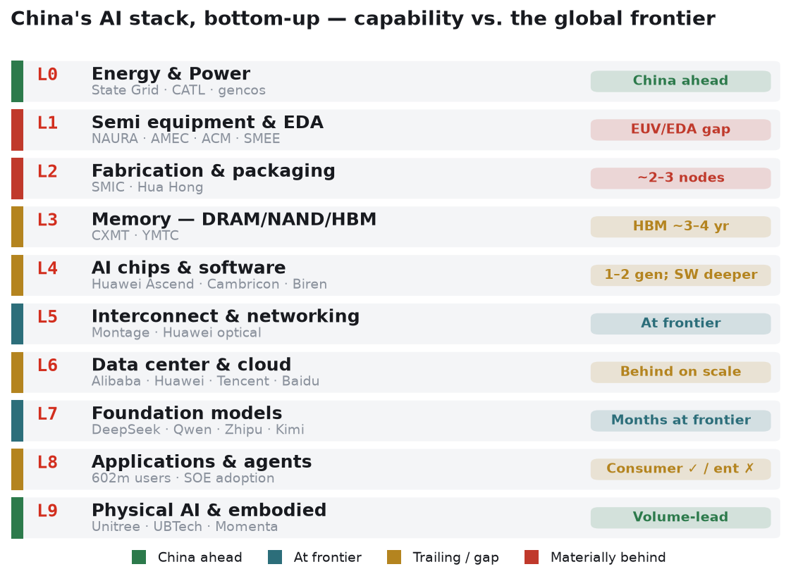
THE MAP · 04 · Hero
The stack, bottom-up — and China's position
Highlighted layers (L1 equipment · L4 chips · L9 physical AI) are where the report concentrates.

Slide 5
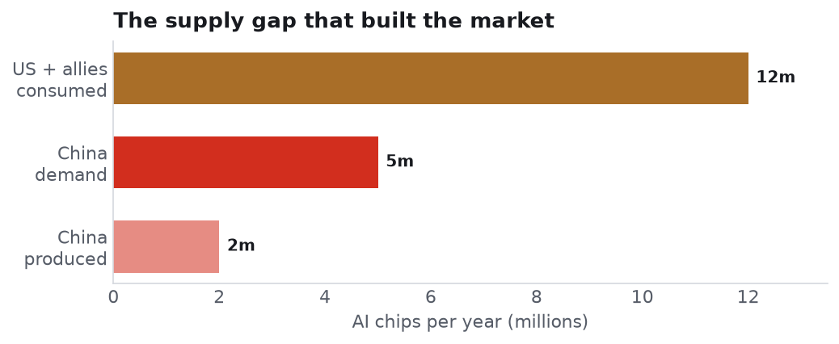
MACRO FRAME · 05
A low compute base — and prices are turning
After years of discounting, Alibaba/Baidu/Tencent RAISED AI-compute list prices in 2026 — compute, not demand, is the binding constraint. REF-BW-01/SANDS-01.

Slide 6
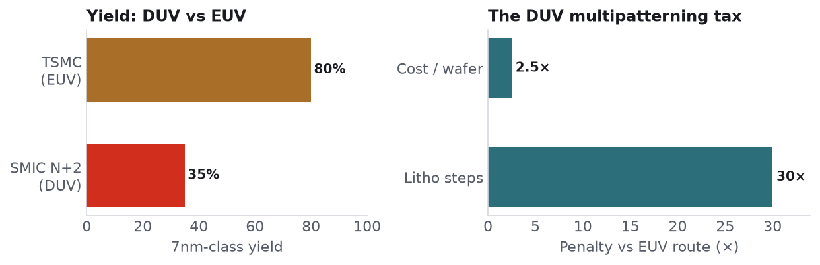
L1 · THE BINDING CONSTRAINT · 06
Without EUV, everything upstream is rationed
Indigenous EUV light source ~100–150W mid-2025 vs >250W needed for HVM — the '2028 goal' is a lab prototype, not parity. WEB-014/007.

Slide 7
L4 · L5 · THE CENTRAL BATTLEGROUND · 07
Lose at the chip, win at the rack
Device level: Ascend 910C ≈ 60% of an H100 on inference (DeepSeek's own benchmark) — ~1–2 generations behind.
System level: CloudMatrix / Atlas 950 lash up to 8,192 NPUs into one logical machine (16 PB/s interconnect), competing with Nvidia's GB200 NVL72 at the rack — at ~4× the power.
The deep moat is SOFTWARE: CANN/MindSpore vs CUDA is a 3–5+ year gap, even as Huawei open-sources CANN and DeepSeek/Zhipu train without Nvidia.
Demand engine: state-DC domestic-chip rules escalated 50% → full foreign-accelerator ban → ≥80%-domestic national grid. (Nvidia's China share reporting is unreconciled.)

Slide 8
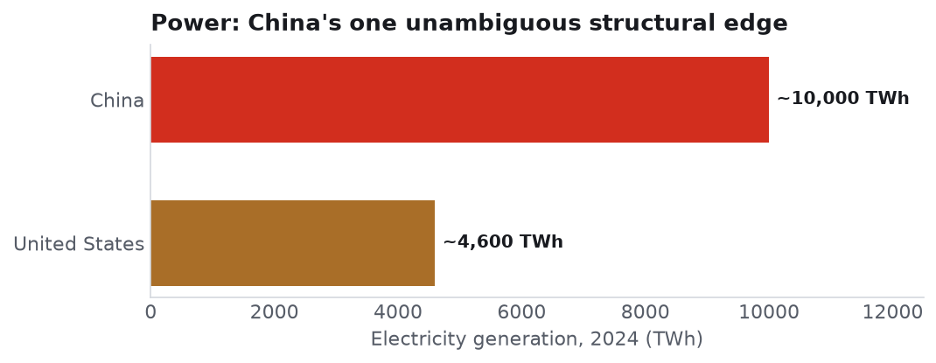
L0 · THE STRUCTURAL EDGE · 08
Power is the one unambiguous advantage
But it is NECESSARY, NOT SUFFICIENT — the payoff is gated on domestic silicon closing the compute gap (a D-grade inference). Cleanest proxy: CATL.

Slide 9
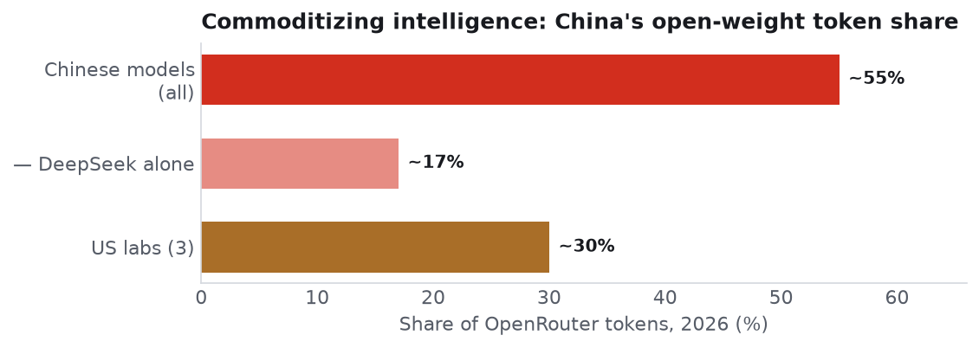
L7 · L8 · MODELS & DIFFUSION · 09
Commoditize intelligence — on purpose
Chinese open-weight models take up to ~55% of OpenRouter tokens. Strategy: make good-enough intelligence cheap infrastructure — pressuring Western labs' pricing.

Slide 10
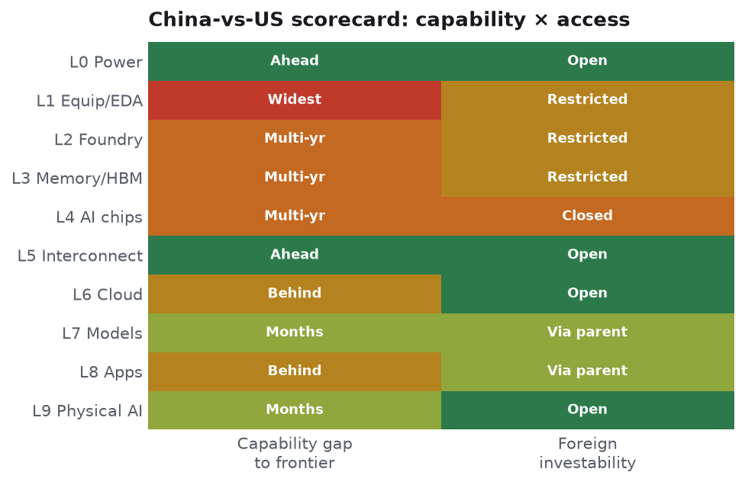
SYNTHESIS · 10
China-vs-US scorecard: capability × access
Green = ahead / open · red = behind / closed. The purest exposure (L4 chips) is the least accessible to US capital.

Slide 11
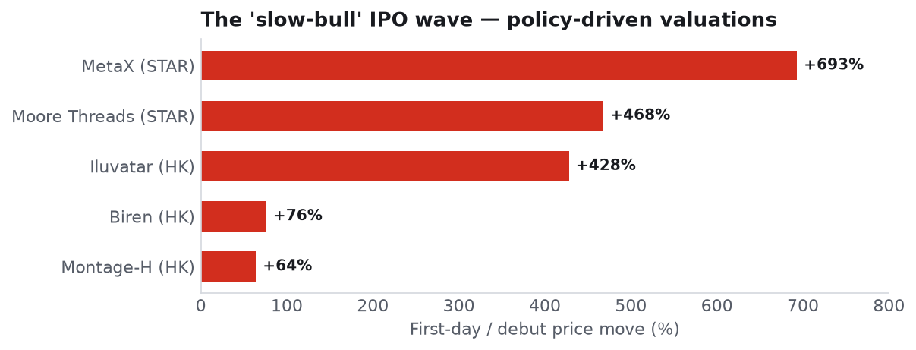
CAPITAL MARKETS · 11
The 'slow-bull' IPO wave is the 2026 catalyst
Montage's A/H premium inverted (H from a 44% discount to a premium). CXMT (~$4.3bn) & YMTC are the next, much larger tests.

Slide 12
DECISIVE FOR ALLOCATORS · 12
Investability ≠ listing
Treasury's OISP now overlaps Entity-List flags: the highest-momentum GPU names trade freely in Hong Kong yet are effectively CLOSED to US capital.
Open · high-conviction: Alibaba, Tencent, Montage, CATL, Baidu.
Access-constrained: NAURA, AMEC, ACM, SMIC, Hua Hong, Cambricon (HK lines / Connect where eligible).
Closed / pipeline: Moore Threads, MetaX, Biren, Kunlunxin, Huawei, ByteDance; CXMT/YMTC (IPO).
Cleaner embodied-AI access: WeRide, Pony.ai, Momenta, UBTech, Horizon Robotics.

Slide 13
SCENARIOS & RISK · 13
2027 / 2030 paths
Base: uneven indigenization — foundry/memory/interconnect/power progress, EUV lags; competitive rack-scale systems & open models; equities compound off a low base, high dispersion.
Bull: an EUV or HBM breakthrough closes the compute gap; the power edge converts; champions re-rate toward global peers.
Bear: EUV stalls, yields stay low, mandate outruns capability; a Taiwan / rare-earth flashpoint or OISP tightening strands foreign capital; policy-inflated multiples de-rate.
Key gating risk: technology failure at EUV / HBM. Most underappreciated practical risk: the Entity-List + OISP overlay stranding US capital.

Slide 14
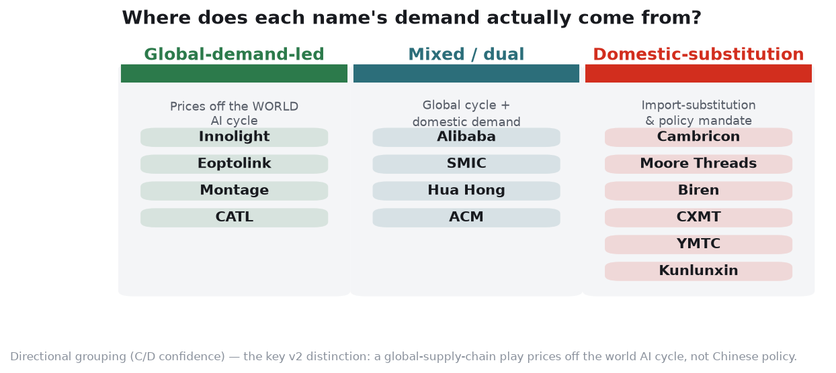
PART II · DEMAND · 14
Not all 'China-AI' is a bet on China
The diversifying, low-correlation thesis applies ONLY to the domestic-substitution bucket. Global-demand names price off the world AI cycle.

Slide 15
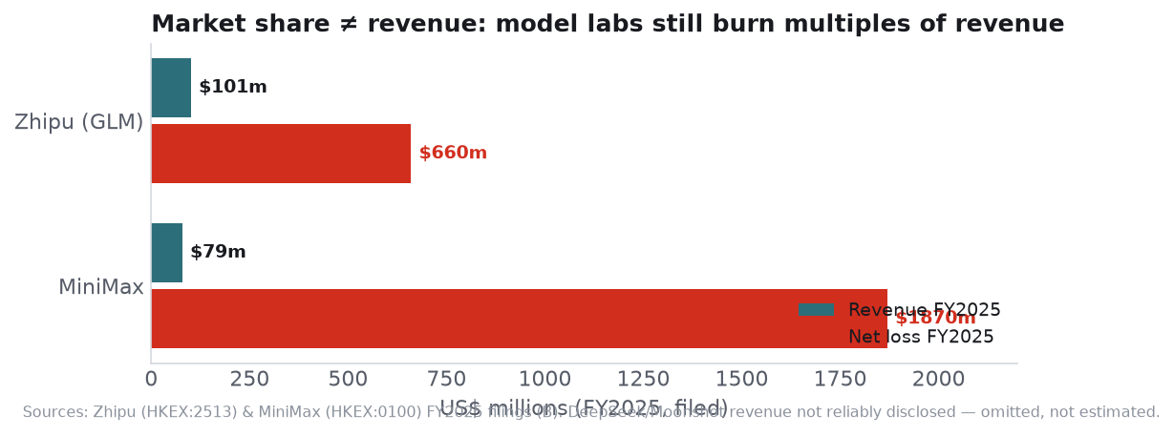
PART II · ECONOMICS · 15
Market share ≠ revenue
Open models win token share but earn little directly. DeepSeek/Moonshot/ByteDance revenue not reliably disclosed — declined to state. Baidu 6-K: AI-Apps revenue ~flat YoY.

Slide 16
PART II · ACCESS · 16
The US is the outlier, not the norm
EU · UK · Japan · Korea · Singapore · Gulf: NO domicile-specific legal bar on most listed China-AI names (incl. Entity-Listed GPU IPOs) — access gated by market mechanics (Stock Connect, QFII, STAR pro-only), not law.
United States: the exception (Entity List + OISP; small passive-index holdings exempt).
Taiwan: the one symmetric legal barrier (restricts its own capital into mainland tech). Japan's GPIF voluntarily excludes China A (2025–30).
Swing factor: a single-sourced report that Beijing may curb foreign access to its AI firms — the first China-side capital wall if enacted (monitor).

Slide 17
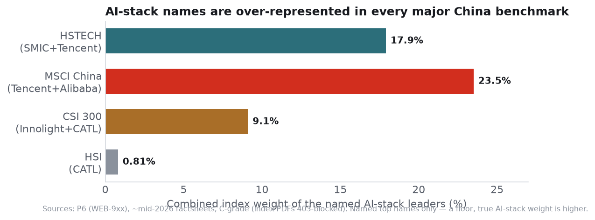
PART II · INDEX · 17
You may already own the stack
Tencent+Alibaba ≈ 23.5% of MSCI China; SMIC+Tencent ≈ 17.9% of HSTECH; Innolight the top CSI-300 weight. Passive China exposure already carries heavy AI-stack beta.

Slide 18
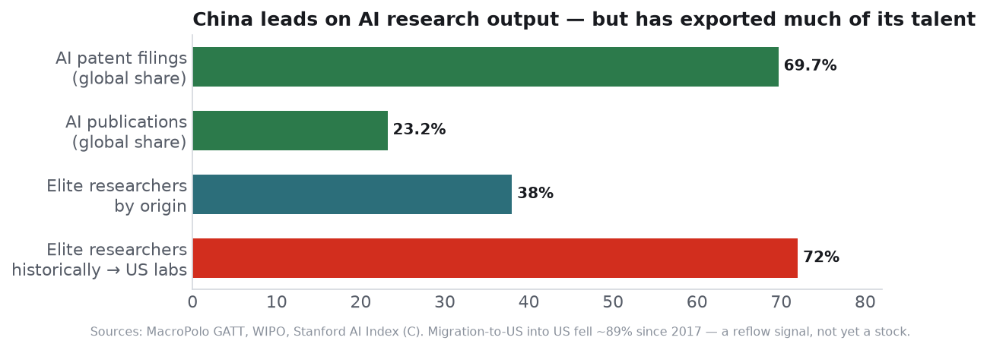
PART II · TALENT · 18
Leads on research output; has exported its talent
China: 69.7% of AI patent filings, 38% of elite researchers by origin — but historically 72% went to US labs. Migration into the US fell ~89% since 2017 (reflow signal).

Slide 19
DELIVERABLES & METHOD · 19
What backs this deck
Report — long-form value-chain map + Part II (demand, economics, access) + glossary; 12 charts.
Database — 43 companies, metrics, policy/funding, model & chip catalogs, company_reference (ISIN/GICS/index), 100+ sources.
Evidence — 12 analyst pod memos across two rounds, plus an adversarial red-team review.
Every figure is source-tagged and A–D confidence-graded. Key open questions are documented, not smoothed: Nvidia's true China share, CXMT/YMTC valuations, indigenous-EUV timeline, model-lab revenue.
Reference scaffolding: Bridgewater ×3, Sands Capital, Exponential View. Analysis, not investment advice.

