Slide 1
40 hrs
Working in front of a computer per week

Slide 2
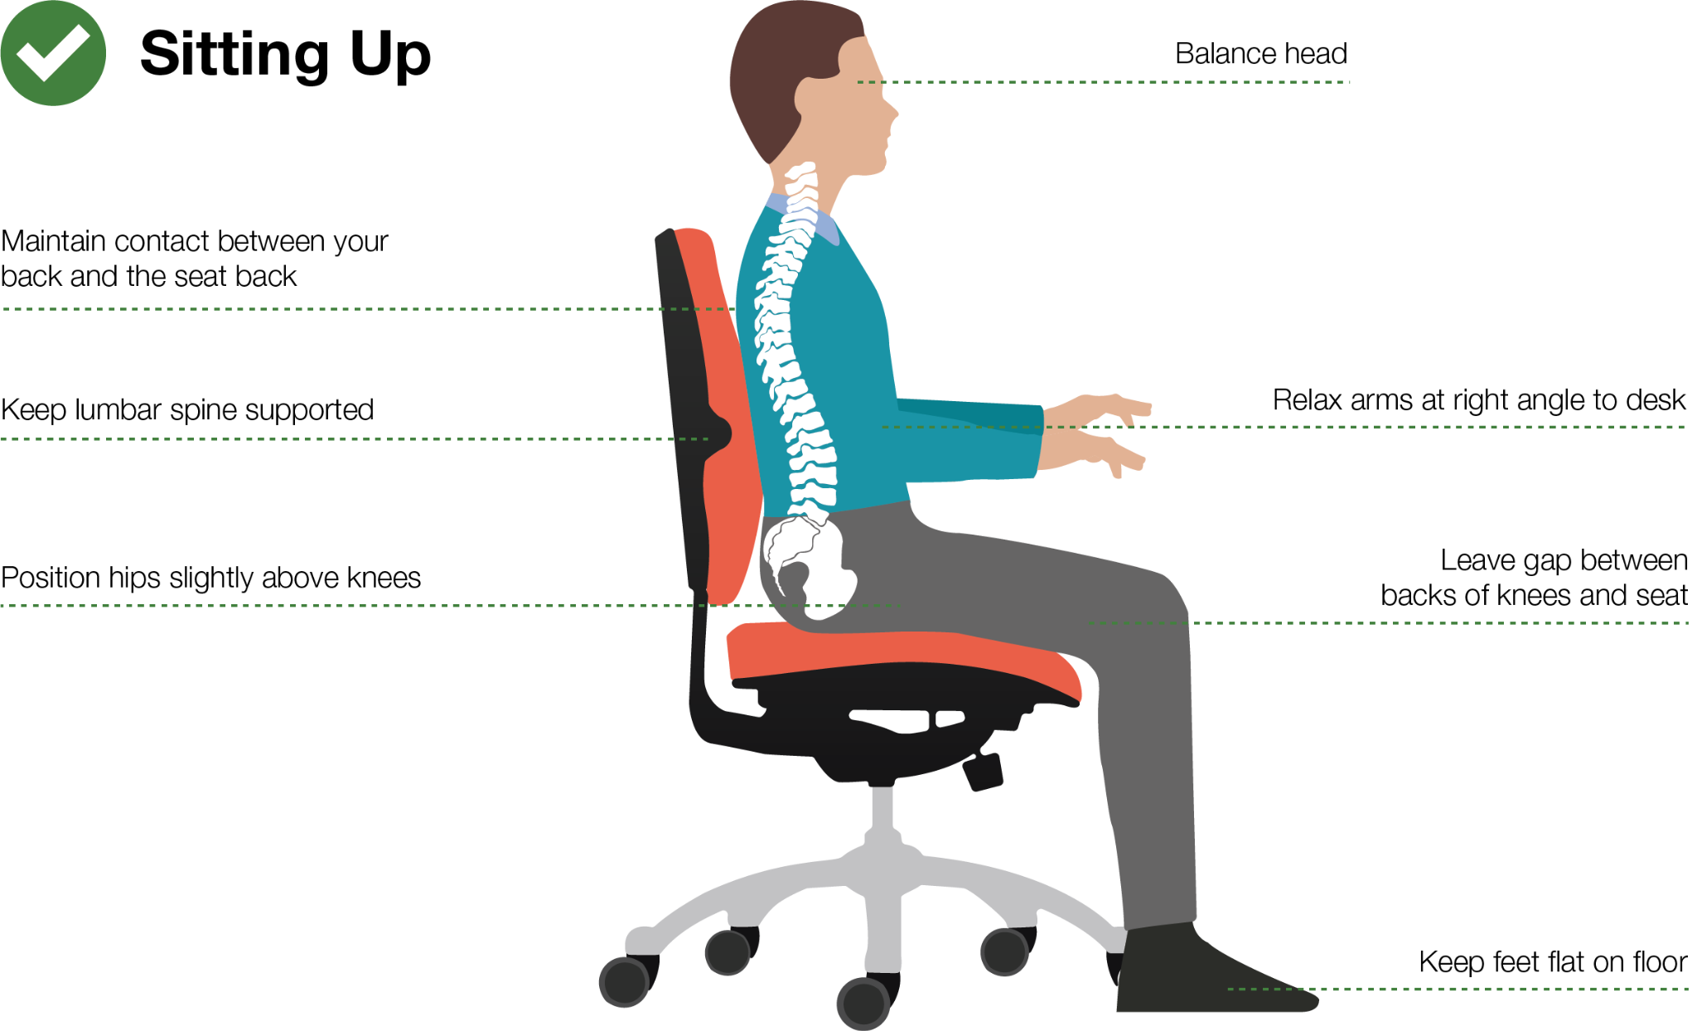

Slide 3
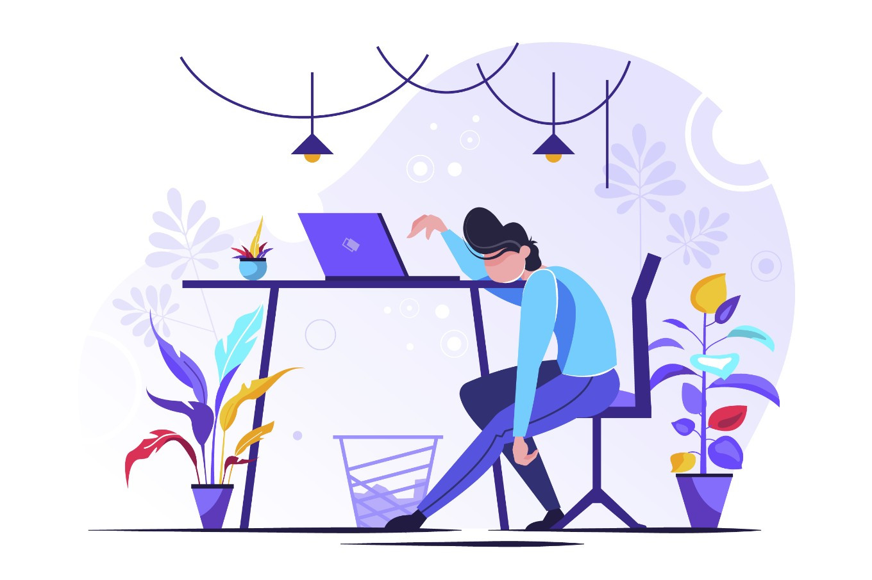

Slide 4
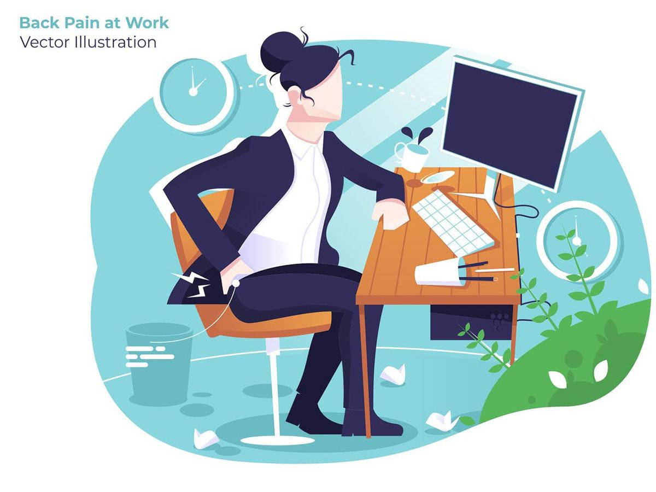

Slide 5
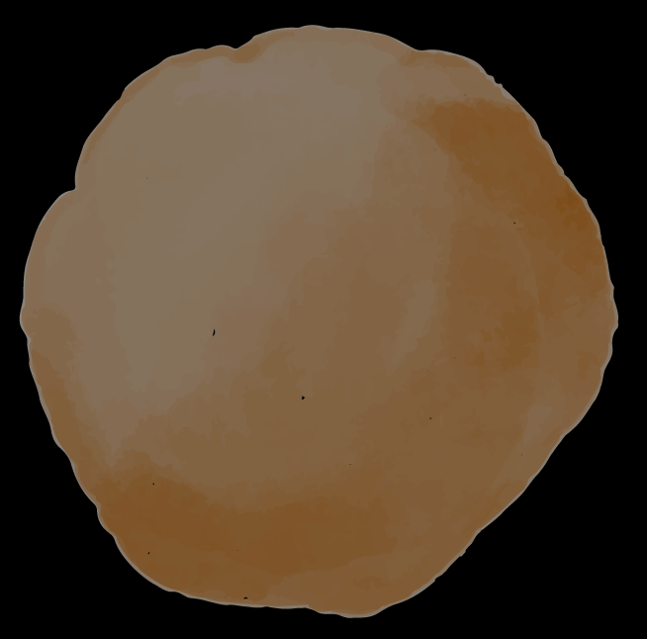
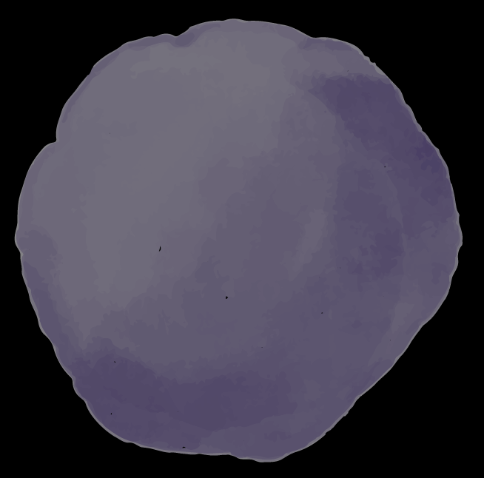
Our Team - Into the Unknown
Tang Yi Qwan
Bian Si Yuan
Wang Yujing
Yu Xinhui
MACS/2
MACS/2
MACS/2
CS/2

Slide 6
Demonstration

Slide 7
Posturitor
A solution to bad postures at a desk

Slide 8
Functions
Advice
Detect
Encourage
Users to adjust posture
Unhealthy sitting postures
Users for maintaining good sitting posture

Slide 9
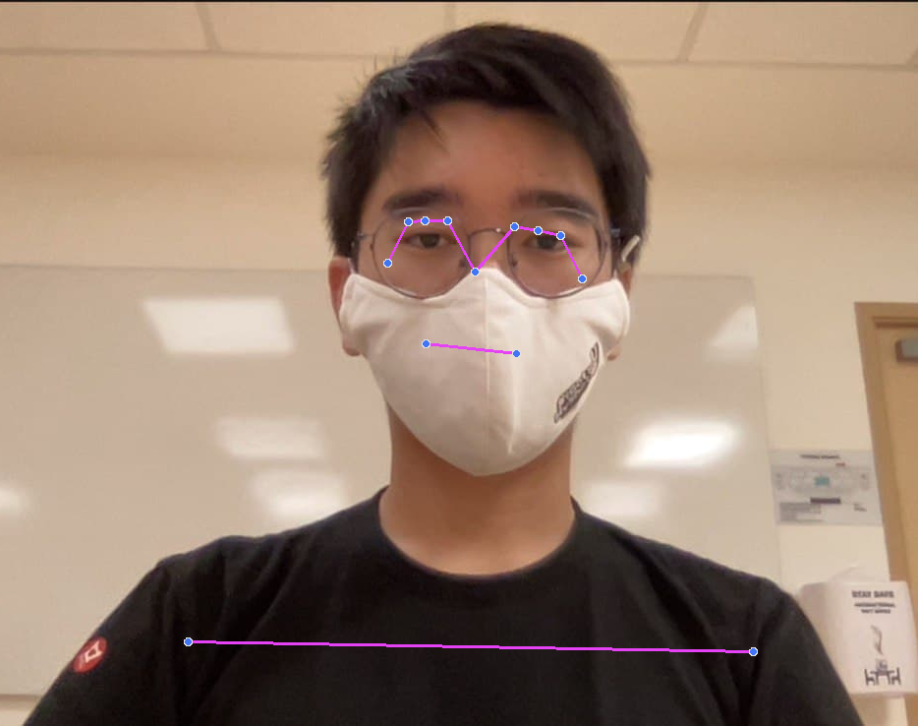
An AI Solution
Dataset Based on Real Life
Feature Extraction
Deep Neural Network
Notes:
Posturitor is developed using an AI solution. We created a novel dataset based on real-life scenarios
13 landmarks were extracted for the upper body using Mediapipe pose, on top of that, features like Eye & shoulder alignment and Displacement from standard posture are analysed
We then built a deep neural network model to Identify 3 different types of incorrect postures

Slide 10
Model Performance
94.1%
94.1%
60.3%
Slouching forward
Slouching backward
Unbalanced shoulders
87.5% recall rate
88.5% recall rate
23.3% recall rate
Notes:
Our model achieved high accuracy and recall rate, especially for detecting slouching forward and backward. When users sit in an unhealthy posture, Posturitor would be able to detect and send reminders to our users.

Slide 11
Positive Impact
Personal
Social
Industrial
Sustainability
Low cost, smart solution
Develop a good habit when using computers
Raise awareness on the importance of good sitting postures
Set up a healthy & caring workplace
Promote health & happiness for people
Notes:
We believe that Posturitor has a positive impact on personal, social and industrial levels. It is a low cost, smart solution to unhealthy sitting postures. It helps raise awareness of ….. Companies could integrate Posturitor into their software and devices to create a healthy & caring workplace for their employees. We believe that Posturitor can contribute to sustainability by promoting health & happiness for people.

Slide 12
Thank you
Posturitor - by Into the Unknown
Notes:
Presenting to you , Posturitor, by team into the unknown. TY

Slide 13
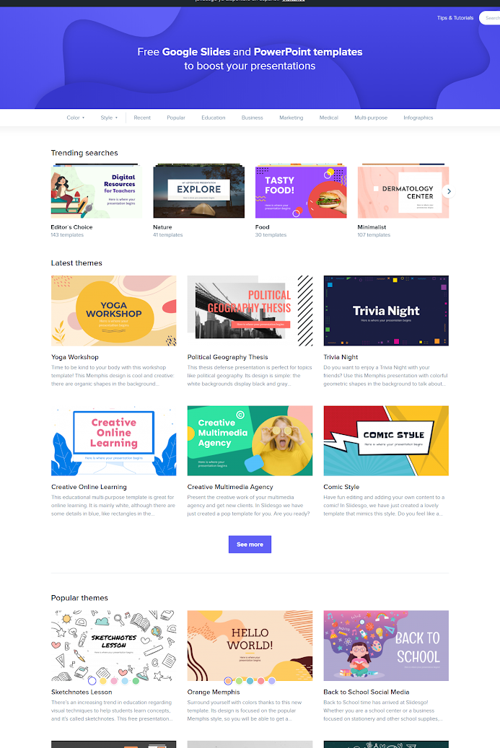
MOBILE APP
You can replace the image on the screen with your own work. Just delete this one, add your and place it in the center of the device

Slide 14
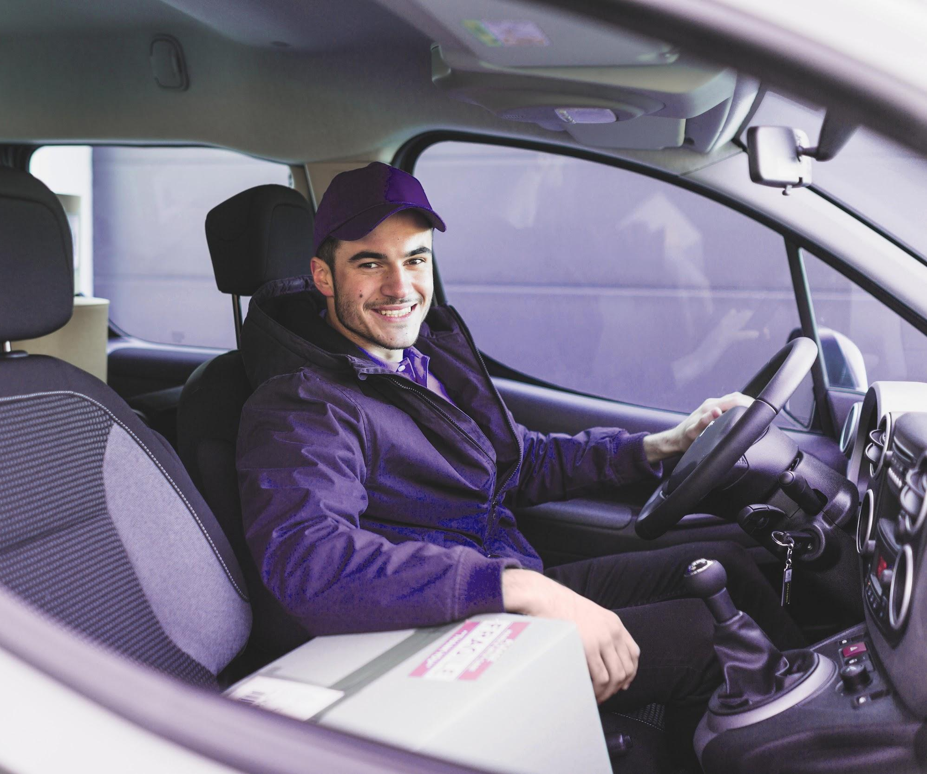
MERCURY
Mercury is the closest planet to the Sun and the smallest one in the Solar System—it’s only a bit larger than the Moon

Slide 15
OUR SOLUTIONS
MARS
JUPITER
Despite being red, Mars is a cold place. The planet is full of iron oxide dust
Mercury is the closest
planet to the Sun and the smallest of them all

Slide 16
MAIN COMPETITORS
Healthy
Slouching
VENUS
MARS

Slide 17
01
OUR SERVICES
You can enter a subtitle here if you need it

Slide 18
OUR COMPANY
Mercury is the closest planet to the Sun and the smallest one in the Solar System—it’s only a bit larger than the Moon

Slide 19
TWO COLUMNS
VENUS
SATURN
Venus has a beautiful name, but it’s terribly hot, even hotter than Mercury
Saturn is the ringed one. It’s a gas giant, composed mostly of hydrogen and helium

Slide 20
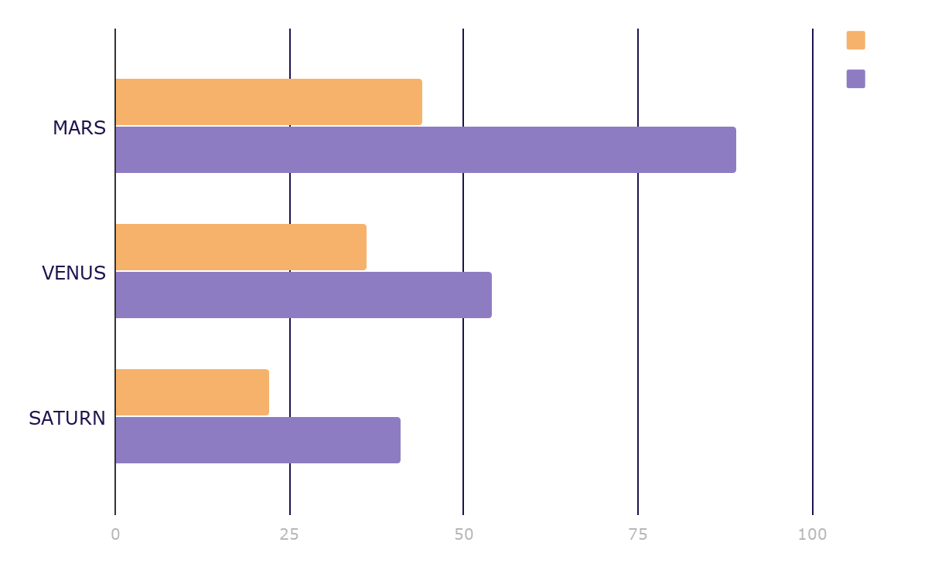
MARKET RESEARCH
JUPITER
Jupiter is a gas giant and the biggest planet in the Solar System
MERCURY
Mercury is the smallest planet in the Solar System
To modify this graph, click on it, follow the link, change the data and paste the resulting graph here

Slide 21
ANALYSIS
TOP RATED VALUES
OUTREACH
Saturn
Venus
Mars
15,000,000
Worldwide Users

Slide 22
CUSTOMER PROFILE
40%
60%
$50.00
20-35
36-45
46-50
Average Spend Per Customer
AGE

Slide 23
OUR PROCESS
DAY 3
DAY 1
DAY 2
DAY 4
Mercury is the
closest planet to the Sun
Saturn is composed
mostly of hydrogen
and helium
The Sun is the star at
the center of the
Solar System
Despite being red,
Mars is actually a cold place

Slide 24
OUR CONSULTANTS
JOHN JAMES
JENNA DOE
JANE PATTERSON
Here you could talk a bit about this person
Here you could talk a bit about this person
Here you could talk a bit about this person

Slide 25
02
NAME OF THE SECTION
You can enter a subtitle here if you need it

Slide 26
TESTIMONIALS
HELENA JAMES
JENNA DOE
JOHN PATTERSON
“Mercury is the closest
planet to the Sun and the
smallest one”
“Venus has a beautiful name and is the second planet from the Sun”
“Jupiter is a gas giant and
the biggest planet in the
Solar System”

Slide 27
Functions
Detect
Venus has a beautiful name and is the second planet from the Sun
Mercury is the closest planet to the Sun and the smallest one
Advice
Report
Jupiter is a gas giant and the biggest planet in the Solar System

Slide 28
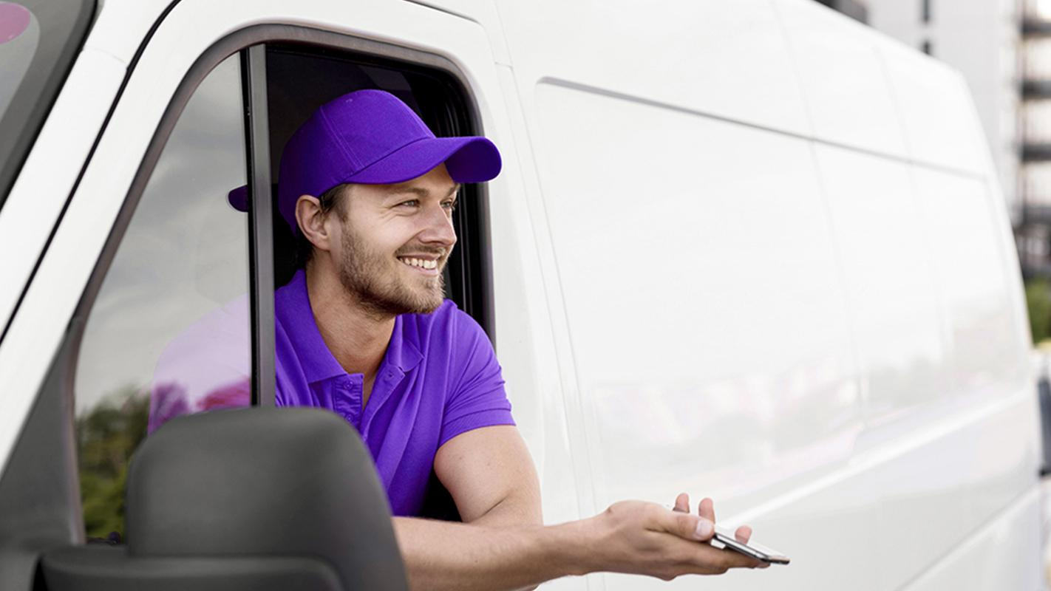
A PICTURE IS WORTH A THOUSAND WORDS

Slide 29
OUR PARTNERS
JUPITER
SATURN
Jupiter is the biggest planet in the Solar System
Saturn is composed of hydrogen and helium
MARS
VENUS
Despite being red, Mars is actually a cold place
Venus has a beautiful name, but it’s terribly hot

Slide 30
UPCOMING GOALS
Jupiter is a gas giant and the biggest planet
GOAL 1
Venus has a beautiful name, but it’s terribly hot
GOAL 2
Despite being red, Mars is actually a cold place
GOAL 3
GOAL 4
Mercury is the closest planet to the Sun

Slide 31
THANKS
Do you have any questions?
addyouremail@freepik.com
+91 620 421 838
yourcompany.com
Please keep this slide for attribution

Slide 32
ALTERNATIVE RESOURCES

Slide 33
RESOURCES
VECTORS
Taxi app concept
App development concept with flat design
Taxi app concept illustration
Delivery service with masks concept
Taxi app concept illustration
Delivery service with masks concept
People avatar concept for illustration concept
Humanitarian help concept
Welcome to italy colorful landing page
Checking body temperature concept
PHOTOS
Cheerful courier in car smiling at camera
Smiley delivery man in car with mobile

Slide 34
Fonts & colors used
This presentation has been made using the following fonts:
Oswald Semi-Bold
(https://fonts.google.com/specimen/Oswald)
Lato Regular
(https://fonts.google.com/specimen/Lato)
#f6b26bff
#d9d2e9ff
#b4a7d6ff
#8e7cc3ff
#351c75ff
#20124dff

