Slide 1
Computer Graphics Homework 2
Hard shadow casting with stencil test
Deadline: 2017/11/23 23:59:59

Slide 2
Objective
Utilizing stencil and depth buffer to cast hard shadow
Understanding the meaning of local coordinate

Slide 3
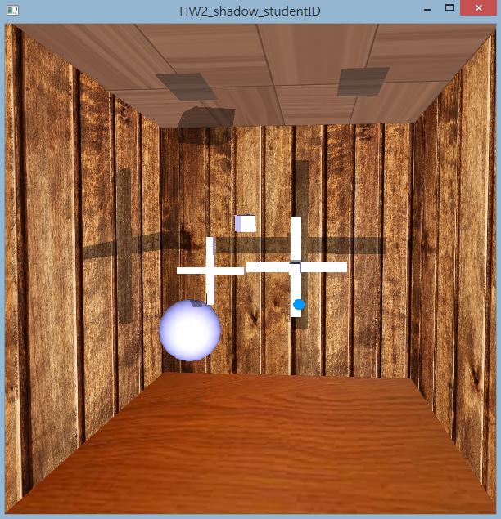
Result

Slide 4
Algorithm Overview
Draw the whole scene without shadow
Transform the light position to certain model coordinate
Draw shadow facets to update stencil buffer
Only facets facing light source cast shadow facets
Calculate shadow facets casted and draw them to update stencil buffer
Shadow facets facing camera: stencil buffer +1
Shadow facets back to camera: stencil buffer -1
Draw a large shadow in front of whole screen and mask it by stencil test

Slide 5
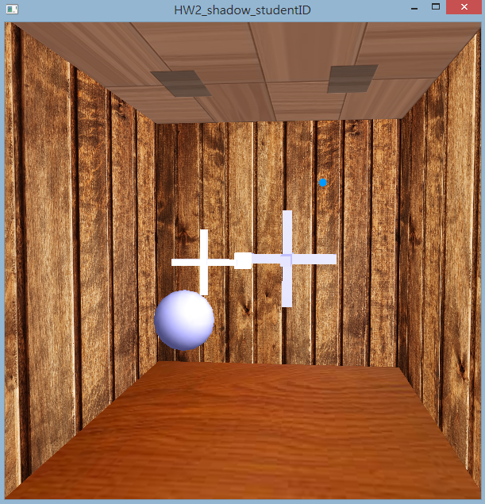
Draw the scene
Draw the whole scene without shadow first to build the proper depth map

Slide 6
Algorithm Overview
Draw the whole scene without shadow
Transform the light position to certain model coordinate
Draw shadow facets to update stencil buffer
only facets facing light source cast shadow facets
calculate shadow facets casted and draw them to update stencil buffer
shadow facets facing camera: stencil buffer +1
shadow facets back to camera: stencil buffer -1
Draw a large shadow in front of whole screen and mask it by stencil test

Slide 7
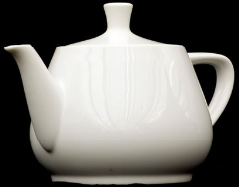
Local coordinate
Since vertices information is stored in local coordinate of the object, we need local pose of light to find the relationship between light source and the facets of the shadow-casting object.
Thus we can find all facet facing light source.
local pose
global pose

Slide 8
How to obtain local position of light
L:global position
L’:local position
M:transformation from local to global
M is the Model Matrix(IMPORTANT)
L=ML’
L’=M⁻¹L
L’
L
M

Slide 9
How to obtain local position of light
Choose model-view matrix mode(actually not necessary)
Load identity(remember to push/pop if you need!!!)
Perform inverse transformation of model pose(rotate,translate)
ex: A then B then C -> C⁻¹ then B⁻¹ then A⁻¹
Obtain the transformation matrix of opengl
Multiply the light source global position to obtain its local position
You need to get one light source local position for each shadow-casting item with different coordinate system!!!

Slide 10

How to obtain a transformation matrix
glGetFloatv(GL_MODELVIEW_MATRIX , return_matrix);
The matrix obtained is column dominant and stored in float[16] !!!
$M=\left[\begin{matrix}M0 & M4 & M8 & M12 \\ M1 & M5 & M9 & M13 \\ M2 & M6 & M10 & M14 \\ M3 & M7 & M11 & M15\end{matrix}\right]$

Slide 11
Algorithm Overview
Draw the whole scene without shadow
Transform the light position to certain model coordinate
Draw shadow facets to update stencil buffer
only facets facing light source cast shadow facets
Calculate shadow facets casted and draw them to update stencil buffer
Shadow facets facing camera: stencil buffer +1
Shadow facets back to camera: stencil buffer -1
Draw a large shadow in front of whole screen and mask it by stencil test

Slide 12
Finding facets facing light source(方法一)
n=(v2-v1) cross (v3-v2)
(light – point on the triangle) dot n > 0
light
v1
n
v2
v3

Slide 13
Finding facets facing light source(方法二)
3 points to calculate plane equation
We have
x1,y1,z1
x2,y2,z2
x3,y3,z3
We want
ax+by+cz+d=0
Then we can feed light:(lx,ly,lz) into ax+by+cz+d to check ax+by+cz+d>0?

Slide 14
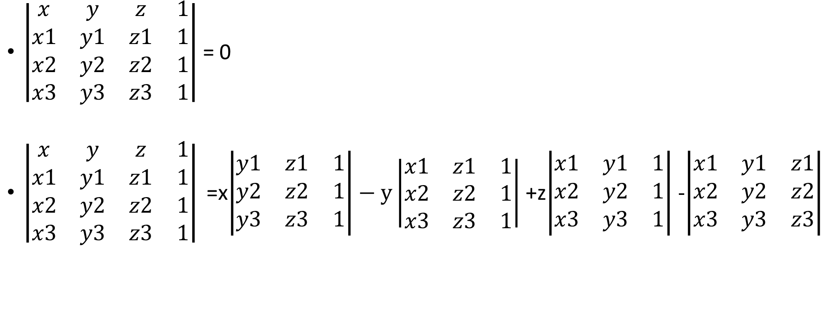
Finding facets facing light source(方法二)
$\left|\begin{matrix}x & y & z & 1 \\ x1 & y1 & z1 & 1 \\ x2 & y2 & z2 & 1 \\ x3 & y3 & z3 & 1\end{matrix}\right|$ = 0
$\left|\begin{matrix}x & y & z & 1 \\ x1 & y1 & z1 & 1 \\ x2 & y2 & z2 & 1 \\ x3 & y3 & z3 & 1\end{matrix}\right|$=x$\left|\begin{matrix}y1 & z1 & 1 \\ y2 & z2 & 1 \\ y3 & z3 & 1\end{matrix}\right|−y\left|\begin{matrix}x1 & z1 & 1 \\ x2 & z2 & 1 \\ x3 & z3 & 1\end{matrix}\right|$+z$\left|\begin{matrix}x1 & y1 & 1 \\ x2 & y2 & 1 \\ x3 & y3 & 1\end{matrix}\right|$-$\left|\begin{matrix}x1 & y1 & z1 \\ x2 & y2 & z2 \\ x3 & y3 & z3\end{matrix}\right|$
+
-
+
-
a b c d

Slide 15
Finding facets facing light source(方法二)
a=y1*(z2-z3) + y2*(z3-z1) + y3*(z1-z2)
b=z1*(x2-x3) + z2*(x3-x1) + z3*(x1-x2)
c=x1*(y2-y3) + x2*(y3-y1) + x3*(y1-y2)
d=-(x1*(y2*z3-y3*z2) + x2*(y3*z1-y1*z3) + x3*(y1*z2-y2*z1))
最後將光相對於物體的位置(local adress)代入就能求解

Slide 16
Algorithm Overview
Draw the whole scene without shadow
Transform the light position to certain model coordinate
Draw shadow facets to update stencil buffer
Only facets facing light source cast shadow facets
Calculate shadow facets casted and draw them to update stencil buffer
Shadow facets facing camera: stencil buffer +1
Shadow facets back to camera: stencil buffer -1
Draw a large shadow in front of whole screen and mask it by stencil test

Slide 17
Please mind the orientation(edited)
Front
Back
n
n
n
c
c
c
a
b
a
b
a
b
c’
c’
c’
a'
b'
a'
b'
a'
b'
Ensure shadow polygons face outside.

Slide 18
Algorithm Overview
Draw the whole scene without shadow
Transform the light position to certain model coordinate
Draw shadow facets to update stencil buffer
Only facets facing light source cast shadow facets
Calculate shadow facets casted and draw them to update stencil buffer
Shadow facets facing camera: stencil buffer +1
Shadow facets back to camera: stencil buffer -1
Draw a large shadow in front of whole screen and mask it by stencil test

Slide 19
OpenGL pipeline fragment review
0: Culling
1: Stencil test
2: Depth test
3: Blending(stencil/depth/color buffer wirting)

Slide 20
Drawing shadow facets
Turn on stencil and depth test
Enable only stencil buffer writing and disable lighting
glDepthMask(false);
glColorMask(0,0,0,0);
glDisable(GL_LIGHTING);
……
Remember to turn the parameters back after drawing shadow facets

Slide 21
Drawing shadow facets (cont.)
Set stencil test rule
glStencilFunc(func,ref,mask);
func: GL_LESS, GL_EQUAL,GL_ALWAYS……
ref/mask: 8-bit reference value/ 8-bit mask
if (stencil_value func (ref_value & mask)) then stencil test passed
Set stencil buffer modifying strategy under 3 conditions
glStencilOp(sfail,dpfail,dppass)
sfail: stencil test fail condition
dpfail: stencil test pass but depth test fail condition
dppass: stencil test pass and depth test pass condition
parameters: GL_KEEP, GL_DECR, GL_INCR, GL_REPLACE……

Slide 22
Drawing shadow facets (cont.)
Enable back facet culling(by default, it is enabled)
Set CCW(counter-clockwise) facets as front facets
glFrontFace(GL_CCW);
Use GL_INCR as dppass strategy (GL_KEEP for others)
Draw shadow facets
Set CW(clockwise) facets as front facets
glFrontFace(GL_CW); //mind the effects afterward~~~
Use GL_DECR as dppass strategy (GL_KEEP for others)
Draw shadow facets again
You may just cull front facets to get the same result as glFrontFace(GL_CW);

Slide 23
Operation desired
stencil buffer
0

Slide 24
Operation desired
stencil buffer
0
1
1
+1
dpfail
+1

Slide 25
Operation desired
stencil buffer
dpfail
-1
dpfail
-1

Slide 26
Operation desired
stencil buffer
dpfail
-1
dpfail
-1

Slide 27
Algorithm Overview
Draw the whole scene without shadow
Transform the light position to certain model coordinate
Draw shadow facets to update stencil buffer
Only facets facing light source cast shadow facets
Calculate shadow facets casted and draw them to update stencil buffer
Shadow facets facing camera: stencil buffer +1
Shadow facets back to camera: stencil buffer -1
Draw a large shadow in front of whole screen and mask it by stencil test

Slide 28
Drawing large shadow
Enable only stencil test, color buffer writing and blending
Set stencil pass condition
NotEqual to zero
Set blending strategy(shadowed region can’t be plain black)
Draw a polygon that is ensured to cover up the whole screen
You must consider the intrinsic/extrinsic parameters of camera, namely, camera pose and projection matrix
The polygon does not really have to be large

Slide 29
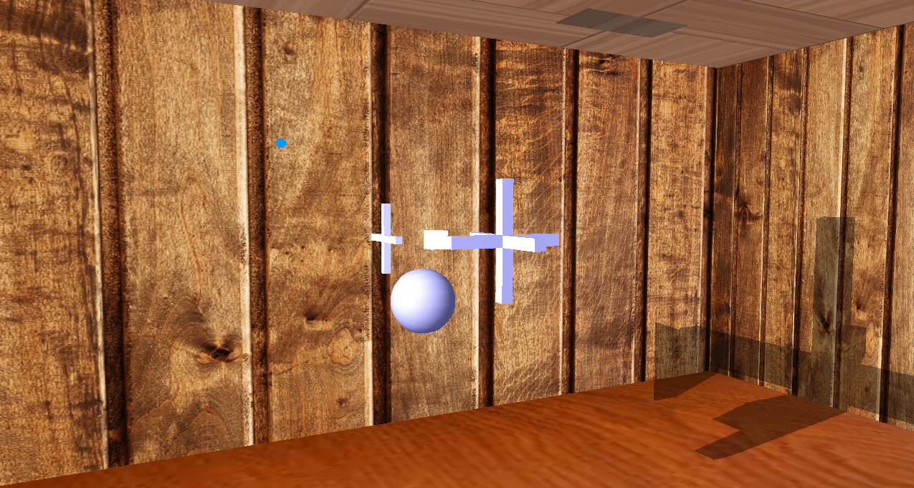
“Large” shadow not “large” enough…
shadow clipped

Slide 30
Drawing large shadow
stencil buffer
draw shadow
accordingly

Slide 31
Result

Slide 32
Hints
Don’t move the object at first. 0,0,0 will be easier when computing.
We don’t use lighting when writing stencil buffer: glDisable(GL_LIGHTING)
Use glColorMask and glDepthMask when writing stencil buffer (not glDepthFunc nor glDisable)
Use glCullFace or glFrontFace
Remember to turn the parameters back after drawing shadow facets

Slide 33
Score
Casting shadow with single object 50% (no shadow mapping)
Casting shadow with multiple objects 10%
Casting shadow with moving lighting 10%
Casting shadow with moving objects 10%
Casting shadow with rotating objects 10%
Report 10%
Briefly explain how you finish the tasks with your code, with pictures of your work.
If you have special project settings, additional functions, or the bonus part, please specify in your report.
Bonus: Silhouette Edges 10%

Slide 34
Score
Please hand in your project file and report as STUDENT_ID.zip to e3 platform. (example: 0656602.zip)
Please name your window with your student id.
Please delete XXX.vc (.db) file in your Visual Studio project.

Slide 35
The Source Code We Provided
The files
main.cpp
object_class.h
image_class.h
Please feel free to modify all the source code we provided if needed.
The tasks you should do (you can finish them in main or object_class)
Turn the light position into local coordinate
Casting shadow
No need to do (you can still try to modify them)
Draw the scene: DrawGLRoom(), obj.draw()
Keyboard events: Keyboard()
Focus on these two files if you are confused! /* You may need to do something here */

Slide 36
Bonus Part

Slide 37
Silhouette Edges(bonus)
light

Slide 38
Silhouette Edge Detection(bonus)
Why?
-1
+1
+1-1 =0

Slide 39
n
front
n
How?
front
light
Edge A
n
back
front
Edge B
n
Edge C
back
back
n
n

