Slide 1
OpenGL Shader & GLSL
2017/11/23

Slide 2
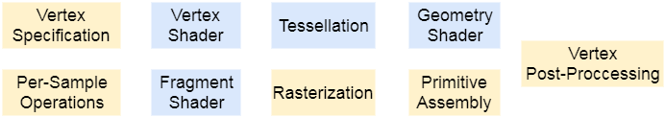
Rendering Pipeline Review
Per vertex operations
Clipping
Stencil test
Depth test
Texture
Back face culling
Per pixel operations
Notes:
Vertex shader負責做點和點的轉換
Fragment shader負責做pixel(fragment)的轉換，可以改變color和depth值，不能改stencil值
Geometry shader負責做primitive的轉換，不過這是比較新的功能，我們這次不會用到

Slide 3
Shader & Shader Program
char* vertex_shader_resource = "...void main(){...}"; // shader source code
GLuint vert_id = glCreateShader(GL_VERTEX_SHADER); // GL_FRAGMENT_SHADER
glShaderSource(vert_id, 1, &vertex_shader_resource, NULL);
glCompileShader(vert_id);
GLuint program_id = glCreateProgram();
glAttachShader(program_id, vert_id);
/* you can attach another shader (fragment shader) */
glLinkProgram(program_id);
glDetachShader(program_id, vert_id);
/* detach another shader (fragment shader)*/
Notes:
void glShaderSource(GLuint shader, GLsizei count, const GLchar **string, const GLint *length);
第一個參數指要用哪個Shader物件。
第二個(count) the number of elements in the string and length arrays.
第三個(string) an array of pointers to strings containing the source code
第四個(length) an array of string lengths，使用NULL代表就是不指定，讀取到NULL為止。
Link 之後就可以對原shader物件隨便操作(無關) 所以detach釋放空間

Slide 4
Shader & Shader Program
void display() {
glUseProgram(program_id);
/* Shader program affect in this block. */
glUseProgram(0);
glUseProgram(another_program_id);
/* Another shader program effect. */
glUseProgram(0);
}

Slide 5
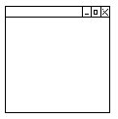
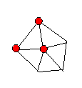
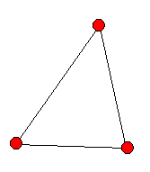
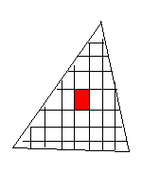

Data Connection: Qualifiers
Uniform
application → any shader
Attribute (deprecated)
application → vertex shader
Varying (deprecated)
vertex shader → fragment shader
varying
attribute
in
(x,y,z)
(x’,y’,z’)
in
out
Vertex
Shader
rasterizer
Fragment Shader
varying
varying
uniform

Slide 6
Data Connection: Qualifiers
// vertex shader
uniform mat4 ModelViewMatrix;
uniform float delta;
attribute vec3 Normal; //old syntex
layout(location = 0) in vec3 Normal;
varying vec3 vNormal; //old syntex
out vec3 vNormal;
void main() {
/* ... */
}
// fragment shader
uniform float gamma;
uniform float delta;
varying vec3 vNormal; //old syntex
in vec3 vNormal;
void main() {
/* ... */
}

Slide 7
Data Connection: Uniform
/* in vertex shader */
#version 400
uniform mat4 Projection;
uniform vec3 Light_position;
void main() {
/* use the uniform values */
}
Can’t be modify in shaders
void display(){
glUseProgram(program);
GLfloat mtx[16];
glGetFloatv(GL_PROJECTION_MATRIX, mtx);
GLfloat light_position[3] = { /* ... */ };
GLint loc = glGetUniformLocation(program, "Projection");
glUniformMatrix4fv(loc, 1, GL_FALSE, mtx);
loc = glGetUniformLocation(program, "Light_position");
glUniform3fv(loc, 1, light_position);
glDrawArrays(GL_TRIANGLES, vertex_index, vertex_count); // draw objects
glUseProgram(NULL);
}
Notes:
glUniformMatrix4fv(loc, 1, GL_FALSE, mtx);
//false for transpose or not
// 1 for 數目 (mtx可以是陣列)
**********一系列都叫glUniform的函數********
glDrawArrays()按照丟進去的頂點畫形狀

Slide 8
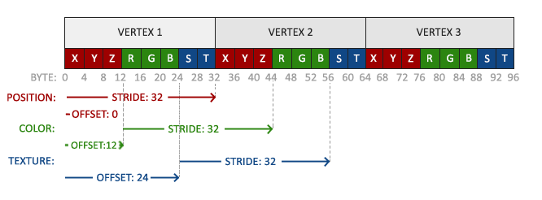
Data Connection: VBO
VBO: Vertex Buffer Object
Notes:
VBO: 儲存頂點資料的buffer
可以有很多個

Slide 9
/* in vertex shader */
#version 400
layout(location = 0) in vec3 pos;
void main() {
gl_Position = vec4(pos, 1.0);
}
struct VertexAttribute{
GLfloat position[3];
};
GLunint vbo_id;
glGenBuffers(1, &vbo_id);
glBindBuffer(GL_ARRAY_BUFFER, vbo_id);
VertexAttribute *vertices = [ /* the data set of each vertex */ ];
glBufferData(GL_ARRAY_BUFFER,
sizeof(VertexAttribute) * vertices_length, // size of the data set
vertices,
GL_STATIC_DRAW); //GL_STREAM_DRAW, GL_DYNAMIC_DRAW
glEnableVertexAttribArray(0); // index in vertex shader
glVertexAttribPointer(0, // same as above
3, // # of components ex: (x,y,z)
GL_FLOAT, // type of components
GL_FALSE, // normalized
sizeof(VertexAttribute), // stride
(void*)(offsetof(VertexAttribute, position)) // offset
);
Notes:
GL_STREAM_DRAW,GL_DYNAMIC_DRAW: 數值變化的頻率
GenBuffer: 產生(1個)我們要使用的buffer
Bind Buffer: 綁定要用的buffer和剛才得到的buffer id
EnableVertexAttribArray 開啟vertex shader的第index個屬性

Slide 10
Data Connection: VAO
VAO: Vertex Array Object
attr [0]
vbo
buffer 0 (x, y, z)
attr [1]
vbo
buffer 1 (r, g, b)
attr [2]
vbo
buffer 2 (u, v)
VAO

Slide 11
GLuint vaoHandle;
GLunit vbo_ids[2];
void init(){
glGenBuffers(2, vbo_ids);
glBindBuffer(GL_ARRAY_BUFFER, vbo_ids[0]);
glBufferData( /* ... */ );
glBindBuffer(GL_ARRAY_BUFFER, vbo_ids[1]);
glBufferData( /* ... */);
glGenVertexArrays(1,&vaoHandle);
glBindVertexArray(vaoHandle);
glEnableAttribArray(0);
glEnableAttribArray(1);
glBindBuffer(GL_ARRAY_BUFFER, vbo_ids[0]);
glVertexAttribPointer(0, /* ... */ );
glBindBuffer(GL_ARRAY_BUFFER, vbo_ids[1]);
glVertexAttribPointer(1, /* ... */ );
}
void display(){
glUseProgram(program);
glBindVertexArray(vaoHandle);
/* draw objects with the vao */
glDrawArrays(GL_TRIANGLES,0,3);
glBindVertexArray(0);
glUseProgram(NULL);
}

Slide 12
Data Connection: Texture
/* in fragment shader */
#version 400
uniform sampler2D MyTexture_1;
in vec2 texcoord;
out vec4 outColor;
void main() {
outColor = texture2D(MyTexture_1, texcoord);
}
void display(){
GLuint texture_id = /* ... */;
glEnable(GL_TEXTURE_2D);
glUseProgram(program);
GLint loc = glGetUniformLocation(program, "MyTexture_1");
glActiveTexture(GL_TEXTURE0 + 0); //GL_TEXTUREi = GL_TEXTURE0 + i
glBindTexture(GL_TEXTURE_2D, tex);
glUniform1i(loc, 0);
/* draw objects */
glBindTexture(GL_TEXTURE_2D, NULL);
glUseProgram(NULL);
}
Notes:
GL_TEXTUREi = GL_TEXTURE0+i

Slide 13
Other GLSL Syntax
Variables
Functions
Examples
vec2, vec3, vec4, ... // orders: xyzw, rgba, stpq
mat2, mat3, mat4, ...
float, int, bool, ...
sampler2D, ...
max, min, sin, cos, pow, log, ..
dot, normalize, reflect, ...
transpose, inverse, ...
+, -, *, /
vec3 c8 = vec3(1.0, 1.0, 9.0);
vec4 v2 = (c8 * 7.63).xyxz + vec4(5.0, 5.0, 6.0, 6.0);
vec3 c1 = normalize(v2.rgb);
mat3x2 m1 = mat3x2(c8, c1); // column major
mat4 m2 = mat4(v2, vec4(1.0), vec4(c8, 0.0), c1.gggg);
mat3 m3 = mat3(m2); // get left top of mat4
ivec2 iv1 = ivec2(c8.z, c1.r);
Notes:
向量支援swizzle操作

Slide 14
Vertex Shader
/* Example of vertex shader */
#version 400
layout(location = 5) in vec4 in_Pos;
layout(location = 6) in vec4 in_Norm;
uniform mat4 MV;
uniform mat4 P;
out vec3 normal;
void main() {
gl_Position = P * MV * in_Pos;
normal = vec3(
/* normal after modelview transform */
);
}
Must have gl_Position
Use flat for flat interpolation
flat out float delta

Slide 15
Fragment Shader
The LAST out vec4 is for color buffer
You must have one!
/* Example of fragment shader */
#version 400
in vec3 normal;
out vec4 outColor;
void main() {
if(abs(normal.z) < 0.3) {
outColor = vec4(1.0);
}
else {
outColor = vec4(1.0, vec2(0.0), 1.0);
}
}

Slide 16
Homework 3
Due: 2017/12/14 23:59:59

Slide 17
Project Setting
For Visual Studio Users
Select tools version carefully
Select available build setting
Win32/ x64/ x86
Not Visual Studio Users
Make sure your project has all the library files!
glut32, glew32, opengl32, …

Slide 18
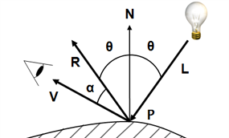
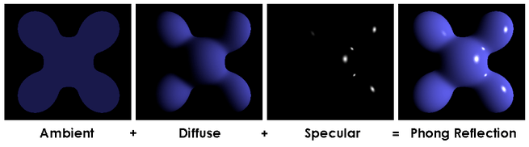
Review: Phong Lighting Model
$$I={K_{a}L}_{a}+K_{d}L_{d}(L∙N)+K_{s}L_{s}{(V∙R)}^{α}$$
Object color affects K_{a} and K_{d}, and light color affects K_{s}
Use ambient color as K_{a}
Use texture color/ diffuse color as K_{d}
α for shininess
α is bigger, the specular area gets smaller
The “dot values” must > 0

Slide 19
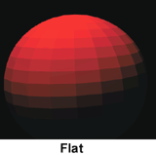
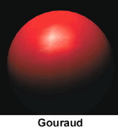
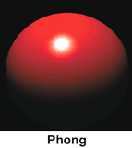
Phong Shading
Different interpolation strategy(over a facet/ among vertices)
$$No interpolation$$
$$Color interpolation$$
$$Normal interpolation$$
$$Image source:http://www.yourdictionary.com/flat−shading$$

Slide 20
Phong Shading
Why not Gouraud shading?
$$Image source:https://commons.wikimedia.org/wiki/File:Gouraud_low.gif$$

Slide 21
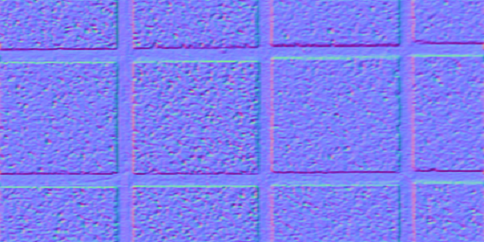
Bump Mapping
Modifiy the origin normal
new normal = origin normal + normal map value(the ‘+’ is conceptual)
Normal map: rgb for xyz
rgb range: [0, 1]
xyz(normalized) range: [-1, 1]
Do some transform!
rgb * 2 – 1 = xyz

Slide 22
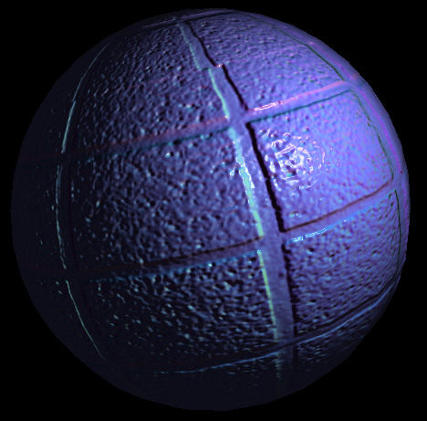
Tangent Space
R
Q
R’
P
Q’
P’
$$Tangent space$$
$$(facet coordinate)$$
$$Model coordinate$$

Slide 23
Tangent Space
normal N
bitangent B
tangent T
v
bitangent B
u x v
tangent T
u
normal N
Tangent space matrix
$$Tangent space$$
$$(facet coordinate)$$
$$Model coordinate$$

Slide 24
Tangent Space
v
R’
u
Q’
Tangent space matrix
Solving the equations to find T and B
T, B, N forms the tangent space
P’
$$\left\{\begin{aligned}\overset{⃑}{PQ}=\overset{⃑}{P^{′}Q′}.u ∗T+\overset{⃑}{P^{′}Q^{′}}.v∗B \\ \overset{⃑}{PR}=\overset{⃑}{P^{′}R′}.u ∗T+\overset{⃑}{P^{′}R^{′}}.v∗B\end{aligned}\right.$$
normal N
bitangent B
tangent T
R
Q
$$tangent space matrix= \left[\begin{matrix}T_{x} & B_{x} & N_{x} \\ T_{y} & B_{y} & N_{y} \\ T_{z} & B_{z} & N_{z}\end{matrix}\right] \\ bump normal$$
$$:=tangent space matrix ∗normal from texture$$
P

Slide 25
Tangent Space
v
R’
u
Q’
Tangent space matrix
Solving the equations to find T and B
P’
$$\left\{\begin{aligned}\overset{⃑}{PQ}=\overset{⃑}{P^{′}Q′}.u ∗T+\overset{⃑}{P^{′}Q^{′}}.v∗B \\ \overset{⃑}{PR}=\overset{⃑}{P^{′}R′}.u ∗T+\overset{⃑}{P^{′}R^{′}}.v∗B\end{aligned}\right.$$
normal N
bitangent B
tangent T
r = 1/($\overset{⃑}{P^{′}Q′}.u$ * $\overset{⃑}{P^{′}R^{′}}.v$ - $\overset{⃑}{P^{′}Q′}.v$ * $\overset{⃑}{P^{′}R^{′}}.u$)
T = ($\overset{⃑}{PQ}$ * $\overset{⃑}{P^{′}R^{′}}.v$ - $\overset{⃑}{PR}$ * $\overset{⃑}{P^{′}Q^{′}}.v$) * r
B = ($\overset{⃑}{PR}$ * $\overset{⃑}{P^{′}Q^{′}}.u$ - $\overset{⃑}{PQ}$ * $\overset{⃑}{P^{′}R^{′}}.u$) * r
T and B: same value over whole triangle
N: should be interpolated over the triangle
you can just calculate [TBN] in vertex shader
and pass it to fragment shader to interpolate it
R
Q
P

Slide 26
How to Get Data of Vertices from GLMmodel?
model->triangles[i] : i-th triangle structure of the mesh
model->triangles[i].vindice[j] : j-th vertex index of i-th triangle
model->vertices[3 * i + 0] : x value of i-th vertex position
model->vertices[3 * i + 1] : y value of i-th vertex position
model->vertices[3 * i + 2] : z value of i-th vertex position
model->groups[i] : i-th triangle group structure of the model
only 1 group in the .obj file of HW3
What you need : position, normal, texture coordinate, material of the group(K_{a}, K_{s}, Shininess)……
Please refer to glm.h for more information

Slide 27
Score
Render the model with texture(by VBO or VAO) (25%)
Don’t just leave glmDraw() to get pass!!!
Phong shading/lighting model works (20%)
Phong model works when moving object/light (20%)
Bump mapping works (15%)
You should also implement the bump mapping toggle
Bump mapping works when moving object/light (10%)
Report (10%)
Briefly explain your code and have a screenshot in your report
If you use some skills from web, please specify the website, too
Please hand in your files as student_id.zip on e3 platform

Slide 28
Limits
Your GLSL version should ≥ #version 330
Please specify your GLSL version in your shader
You can check the versions here
The #version 330 means the shader need the version above 330 to work
No attribute, varying in your code
They are deprecated
No built-in uniform variables
gl_ModelViewMatrix, gl_NormalMatrix, ...
You can only use glUniform* to pass uniform values
You can only use VBO/VAO and VertexAttributePointer to pass values

Slide 29
More…
討論區
You can pop questions here and TAs (or your kind classmates) will answer them
You can still email your questions to TAs

