Slide 1


Building Database for Network Communication System
CSCI 4140 DATABASE PROJECT
Qi Yang, Yuanjiang Lin,
Xuhui Liu & Yucheng Liu

Slide 2
Outline
Application Scenario
ER-Diagram
Tables
Implementation
Results
Demo
Evaluation

Slide 3
Application Scenario
Used for social network communication system
Can store large scale of data
Contain some basic functions
Sign up and log in
View and post topics, write comments
Point system

Slide 4
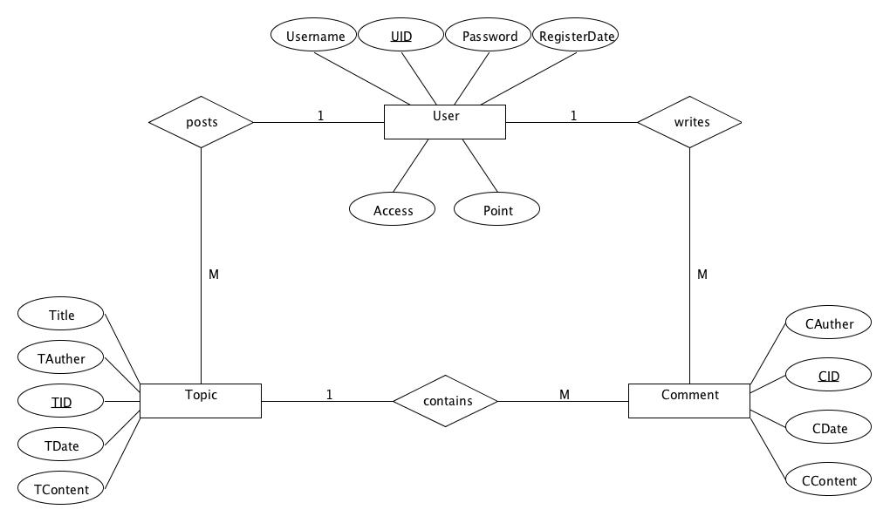
ER-Diagram

Slide 5
Tables
3 Entity Tables
User (UID, Username, Password, RegisterDate, Access, Point)
Topic (TID, Title, TAuther, TDate, TContent)
Comment (CID, CAuther, CDate, CContent)
3 Relation Tables
posts (UID, TID)
writes (UID, CID)
contains (TID, CID)

Slide 6
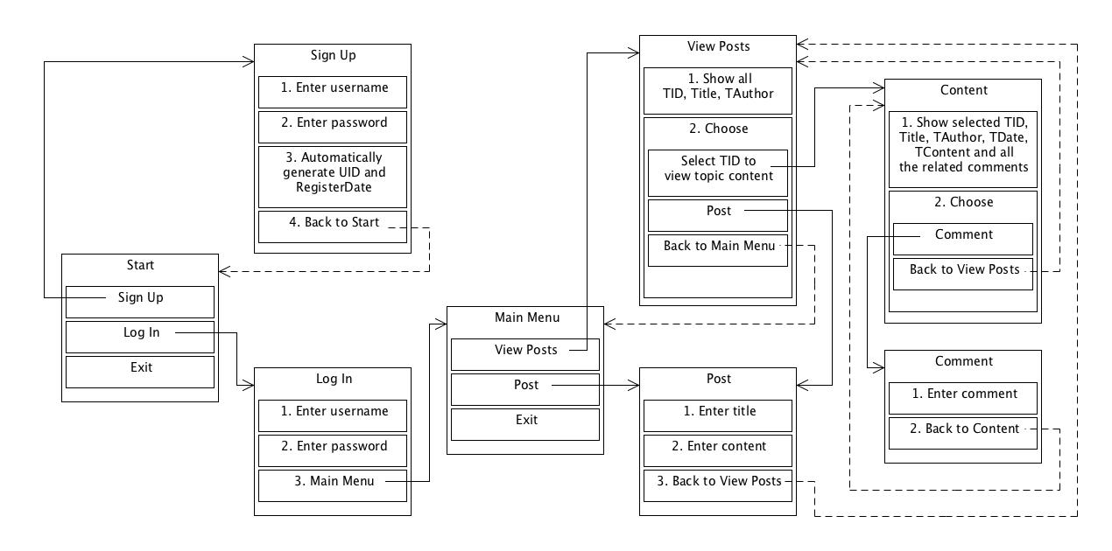
Implementation

Slide 7
Results
Sign up, and then log in this system
View all the current topics and add a new topic
Select one topic and see the related comments
Add a new comment
Edit and delete functions

Slide 8
Demo

Slide 9
Evaluation
In scope
Realized most of the functionalities
Log in and registration mechanism
View and post comment mechanism
View and post topic mechanism
Out of scope (will be considered afterwards)
Unable to implement some functionalities
Point system is not implemented
User’s access level is not implemented
GUI designed will be added in order to promote a higher UE

Slide 10
References
http://zetcode.com/db/mysqlc/

Slide 11
Thank you
Any question?

