Slide 1
Application of K-Means Clustering Algorithm for Prediction of Students’ Academic Performance
CSCI 4144 DATA MINING PROJECT
Yucheng Liu
Yiying Zhang

Slide 2
Outline
Application Scenario
Principle & Method
Evaluation
Dataset & Preprocessing
Results
Contributions

Slide 3
Application Scenario
Students‘ performance evaluation
To obtain a comprehensive view of the state of the students’ performance
Discover important details from their time to time performance
Help academic planners to make more efficient plans
Applying K-means
Discover the key characteristic from students’ performance
Helpful for future prediction

Slide 4
Data Mining Solution
Principle:
K-means
Method:
Algorithm

Slide 5
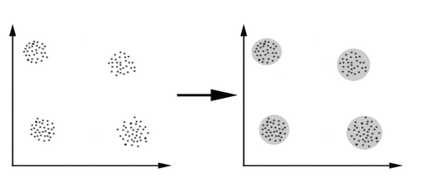
K-means
How to find these four clusters of students?
Distance between points
Red points - > the center of each clusters
●
●
●
●

Slide 6
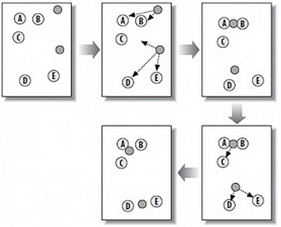
K-means
Give k centers (grey points)
Measure Euclidean distance between points and centers
‘closer’ points become one cluster
Provide k clusters

Slide 7
Pseudocode of K-means
Step 0 : Add shuffle method to rearrange the order of dataset
Reduce noise
Step 1: Accept the number of clusters to group data into the dataset to cluster as input value
Step 2: Initialize the first K clusters
Two choices
Step 3: Calculate the arithmetic means of each cluster formed in the dataset.
Step 4: K-means assigns each record in the dataset to only one of the initial clusters
Step 5: K-means re-assigns each record in the dataset to the most similar cluster and re-calculates in the arithmetic mean of all the cluster in the dataset

Slide 8
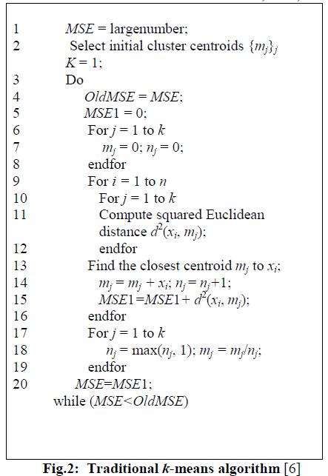
Algorithm
Step 1
Step 2
Step 3
Step 4
Step 5

Slide 9
Evaluation
Cluster # | Cluster Size | Overall Performance
1 | 25 | 62.22
2 | 15 | 45.73
3 | 29 | 53.03
70 and above | Excellent
60-69 | Very Good
50-59 | Good
45-49 | Very Fair
40-45 | Fair
Below 45 | Poor
Performance Index

Slide 10
Evaluation
Cluster # | Cluster Size | Overall Performance
1 | 24 | 50.08
2 | 16 | 65.00
3 | 30 | 58.89
4 | 9 | 43.65
70 and above | Excellent
60-69 | Very Good
50-59 | Good
45-49 | Very Fair
40-45 | Fair
Below 45 | Poor

Slide 11
Evaluation
Cluster # | Cluster Size | Overall Performance
1 | 19 | 49.85
2 | 17 | 60.97
3 | 9 | 43.65
4 | 14 | 64.93
5 | 20 | 55.79
70 and above | Excellent
60-69 | Very Good
50-59 | Good
45-49 | Very Fair
40-45 | Fair
Below 45 | Poor

Slide 12
Dataset & Preprocessing
Dataset:
Use Iris dataset from the http://archive.ics.uci.edu/ml/
Data Preprocessing:
Replace the iris name into number
Iris-setosa → 0
Iris-versicolor → 1
Iris-Virginica → 2
Data Shuffle

Slide 13
Results
Compare our result with RBF and MLP
Run k-means, RBF and MLP 1000 times because the results would be changed according to the principle of each method
Analyze results
mean value
max value
Accuracy comparison

Slide 14
Contributions
A good method to monitor the progression of students’ academic performance to help the academic planners to make decisions
Used in various topics in the real world

Slide 15
Reference
Oyelade, O. J, Oladipupo, O. O, Obagbuwa, I. C. (2010). Application of k-Means Clustering algorithm for prediction of Students’ Academic Performance. Retrieved from http://arxiv.org/pdf/1002.2425.pdf

Slide 16
Thank You!

