Slide 1




Urban Infrastructure Inspection System
CPT204 Group Project
Sorting Algorithms·Graph Shortest Path·Object-Oriented Design
Project Purpose:
Process three candidate location datasets(1000 records each)
· Select top 10 highest-priority inspection targets from each dataset
· Compute efficient routes on a weighted infrastructure graph
· Demonstrate object-oriented Java application design
Candidate Data
Sort &Select Top 10
Build Graph
Shortest Paths
Team Members: Yihan Zhang(2364252)
Yifei Li (2364053)
1

Slide 2
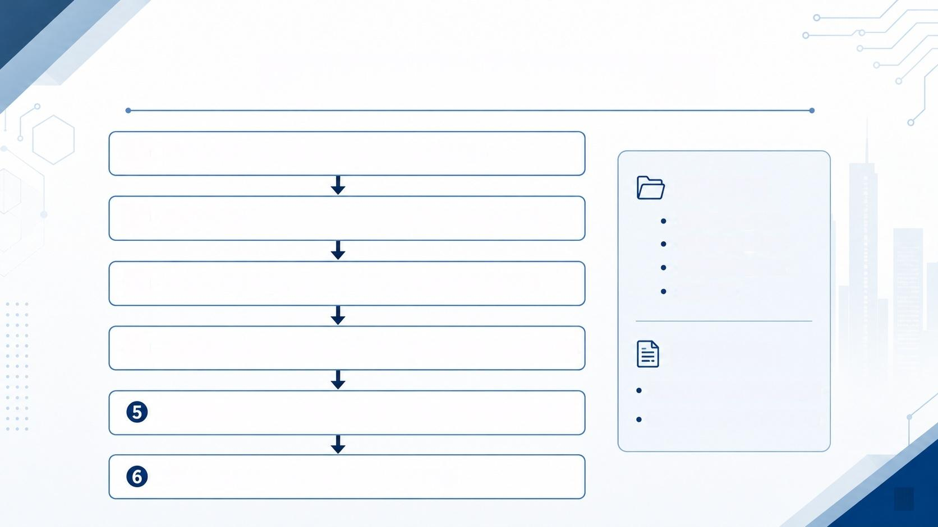
Overall System Workflow
① Read candidates_A/B/C.csv(1000 records each)
Input Files:
② ③ | Apply Bubble Sort,Quick Sort,Merge Sort to each dataset Select Top 10 highest-priority locations from each dataset | candidates_A.csV candidates_B.csV candidates_C.csv paths.csV
④ | Read paths.csv→ Build undirected weighted graph (1000 nodes) | Final Output:
 | Run Dijkstra's algorithm for four required shortest-path queries | 30 selected inspection targets 4 shortest-path query results
Output:path nodes+total cost for each case
2

Slide 3
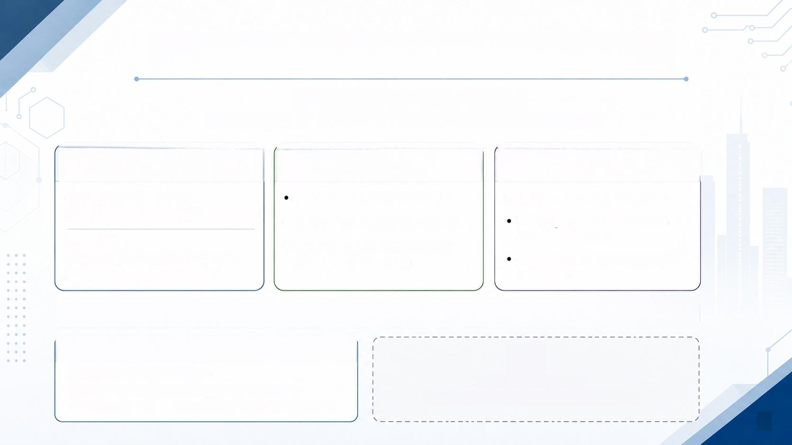



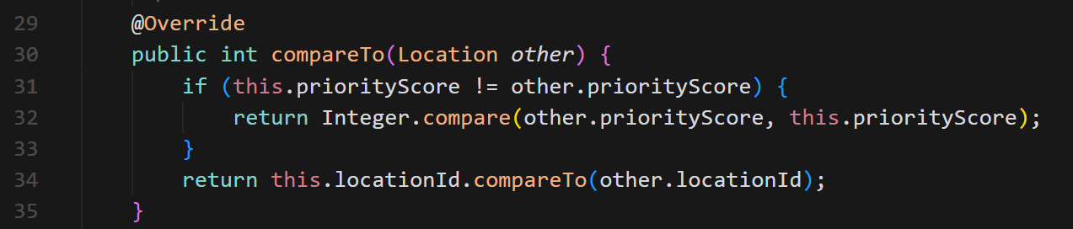
Task A:Sorting Algorithm Design
CPT204 Group Project
Sorting Algorithms·Graph Shortest Path·Object-Oriented Design
1. Ranking Rule
2. Three Algorithms Implemented
3. Runtime Measurement
Priority(Descending)→
Bubble Sort(with early-exit optimisation)
·System.nanoTime()for precision
Each algorithm runs 3 times on a fresh copy of data
Location ID (Ascending,tie-breaker)
·Quick Sort(median-of-three pivot)
·Merge Sort(top-down recursive, O(n log n)guaranteed)
Example:
score=9999 before score=9998; if equal,L0001 before LO002
Report average runtime in both ns and ms
All algorithms share the same comparison rule via Location.compareTo()
Code Snippet:Location.compareTo()
//Location. compareTo ()
if score differs→higher score first if score equal →smaller location_id first
3

Slide 4


Task A Results:Runtime Comparison and Top-10 Selection
Dataset | Bubble Sort(ms) | Quick Sort(ms) | Merge Sort(ms) | Top 10 Selected
A | 0.1110 | 0.3454 | 0.2936 | L0001-L0010
B | 5.1864 | 0.1949 | 0.5803 | L0101-L0110
C | 0.7261 | 0.1692 | 0.4878 | L0201-L0210
Q
Key Findings
Dataset A≈already sorted→ Bubble Sort fastest (early-exit triggers) Dataset B is randomly shuffled→ Bubble Sort degrades to O(n²),slowest Quick Sort is fastest on B and C
Merge Sort is most consistent:O(n log n)regardless of input order
Dataset C has equal scores →tie-breaking by location_id verified (L0201-L0210)
4

Slide 5


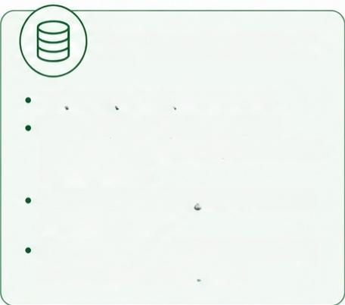
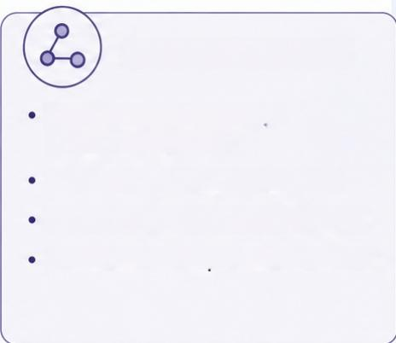
Task B:Graph Representation and Dijkstra's Algorithm
CPT204 Group Project
Sorting Algorithms·Graph Shortest Path·Object-Oriented Design
Graph Input
Graph Data Structure
Dijkstra's Algorithm
File:paths.csV
Adjacency list implementation HashMap<String,List<int[]>> (node ID→list of {neighbourlndex, weight}pairs)
Suitable because all edge weights are positive
Undirected weighted graph 1000 nodes,multiple edges per node
Uses binary-heap priority queue
Time complexity:O(V+E)log V) Returns shortest path and total cost
Each undirected edge stored twice (both directions)
Each edge:from_location, to_location,weight(positive integer)
O(1)average node lookup,memory- efficient for sparse graphs
15
A
B
5

Slide 6


Task B Results:Four Shortest-Path Query Cases
CPT204 Group Project
Sorting Algorithms·Graph Shortest Path ·Object-Oriented Design
Case | Start→End | Required Waypoint(s) | Total Cost | Nodes
1 | L0001→L0001 | None (self-to-self) | 0 | 1
2 | L0001→L0010 | None | 27 | 8
3 | L0001→L0101 | via L0105 | 39 | 15
4 | L0001→L0201 | via L0105,then L0205 | 48 | 18
Waypoint Handling
Case 3: Dijkstra(L0001→ L0105)+Dijkstra(L0105→ L0101) cost =22 +17 =39
Case 4:Dijkstra(L0001→ L0105)+Dijkstra(L0105→ L0205)+Dijkstra(L0205→ L0201) cost =22+18 +8=48
6

Slide 7

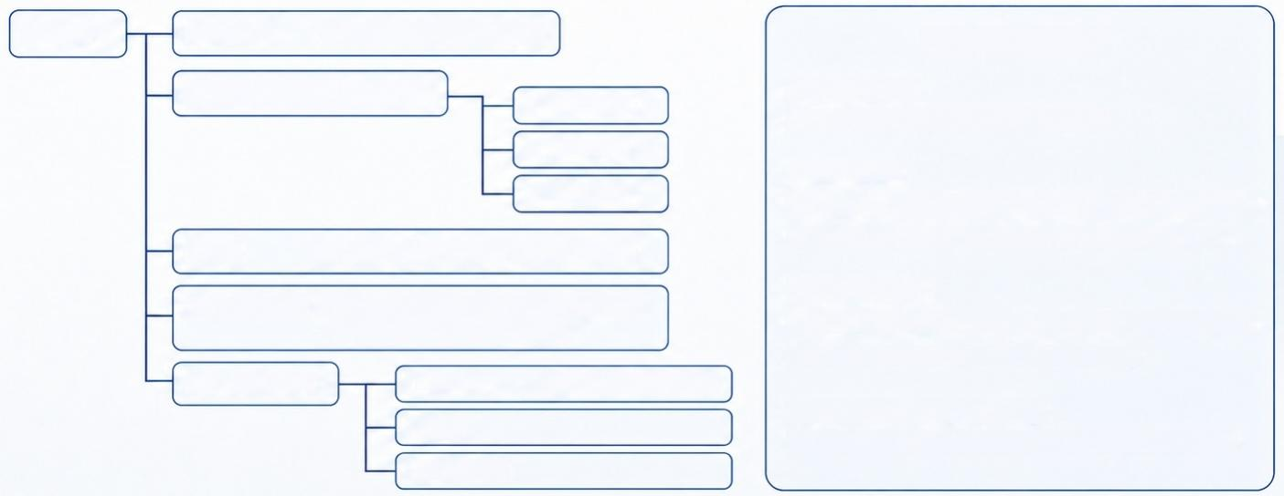
Task C:Object-Oriented Application Design
CPT204 Group Project
Main CSVReader ^{(readLocations,readEdges)} _{OOP} _{Principles}
^{SortingAlgorithm} ^{[abstract]} BubbleSort
Encapsulation:
All fields are private;accessed via getters only
QuickSort
Abstraction:
MergeSort
Graph (adjacency list,addEdge,getNeighbours)
SortingAlgorithm defines sort()and measureAverageTimeNs() as a shared template;subclasses implement sortArray()
DijkstraSolver (shortestPath,shortestPathViaWaypoint, shortestPathViaTwoWaypoints)
Polymorphism:
SortingAlgorithm[]array holds BubbleSort,QuickSort,MergeSort Main loop calls the same methods uniformly
Model Classes
^{Location} (implements Comparable)
Edge
Separation of Responsibility:
Each class has one clear role (I/O,sorting,graph,model)
PathResult
7

Slide 8
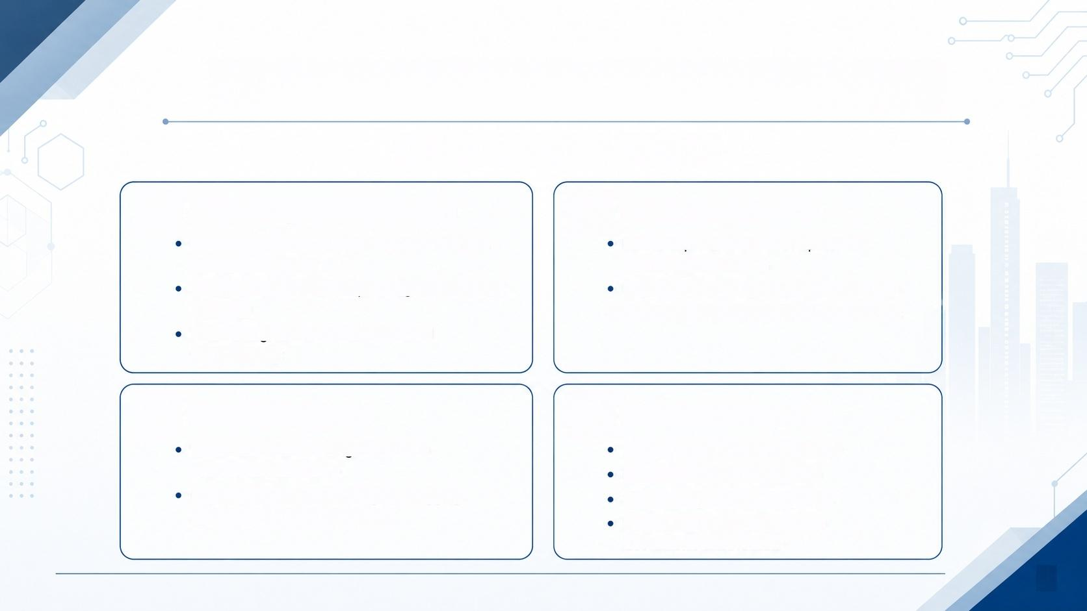




Reflection and Future Development
CPT204 Group Project
1.Planning and Collaboration
2.EDI Considerations
Work divided:sorting,graph algorithm,testing, report,presentation
Future improvement:text-to-speech for visually impaired users
Al-assisted tools used for planning and workflow checking
High-contrast display mode for accessibility ● Multilingual output support for diverse users
All code logic verified and understood independently
3.Life-long Learning
4.Future Development
Connected classroom algorithms to a realistic urban scenario
Add graphical user interface(GUI) Export inspection route reports Support larger real-world graphs Use A*algorithm when location coordinates are available
Improved skills in:OOP design,debugging, graph algorithm implementation
8

