Slide 1
Chapter 10
Update Transaction

Slide 2
ch10 Update Transaction
Def. 10.1 Transaction
  A transaction is a means to package together a number of database operations performed by a process, so the database system can provide several guarantees, called the ACID properties.
BEGIN TRANSACTION
  op₁;
  op₂;
  ......
  op_{N};
END TRANSACTION
Update Transaction

Slide 3
ch10 Update Transaction
BEGIN TRANSACTION
  op₁;
  op₂;
  ......
  op_{N};
END TRANSACTION
Begin a transaction
  first database operation
End a transaction by executing
exec sql commit work;
  or
exec sql rollback work;
Update Transaction

Slide 4
What Does a Transaction Do?
Return information from the database
  RequestBalance transaction: Read customer’s balance in database and output it
Update the database to reflect the occurrence of a real world event
  Deposit transaction: Update customer’s balance in database
Update Transaction

Slide 5
Transactions
Many enterprises use databases to store information about their state
  e.g., Balances of all depositors at a bank
When an event occurs in the real world that changes the state of the enterprise, a program is executed to change the database state in a corresponding way
  e.g., Bank balance must be updated when deposit is made
Such a program is called a transaction
Update Transaction

Slide 6
Transactions
The execution of each transaction must maintain the relationship between the database state and the enterprise state
Update Transaction

Slide 7
Example: banking applications with file system
problems
  Creating an inconsistent result
  Errors of concurrent execution
  Uncertainty as to when changes become permanent
Update Transaction

Slide 8
Problems:
  Creating an inconsistent result
    Our application is transferring money from one account to another (different pages).
    One account balance gets out to disk (run out of buffer space)
    and then the computer crashes.
Update Transaction

Slide 9
problems
  Errors of concurrent execution
    Teller 1 transfers money from Acct A to Acct B of the same customer, while Teller 2 is performing a credit check by adding balances of A and B.
    Teller 2 can see A after transfer subtracted, B before transfer added.
Update Transaction

Slide 10
problems
  Uncertainty as to when changes become permanent
    At the very least, we want to know when it is safe to hand out money: don't want to forget we did it if system crashes, then only data on disk is safe.
Update Transaction

Slide 11
Transactions
Therefore additional requirements are placed on the execution of transactions beyond those placed on ordinary programs:
  Atomicity
  Consistency
  Isolation
  Durability
ACID properties
Update Transaction

Slide 12
Atomicity （原子性）
  The set of record updates that are part of a transaction are indivisible (either they all happen or none happen).
  This is true even in presence of a crash.
Consistency （一致性）
  If all the individual processes follow certain rules (money is neither created nor destroyed) and use transactions right,
  then the rules won't be broken by any set of transactions acting together.
Update Transaction

Slide 13
Isolation （隔离性）
  Means that operations of different transactions seem not to be interleaved in time
  as if ALL operations of one Tx before or after all operations of any other Ty.
Durability （持久性）
  When the system returns to the logic after a Commit Work statement, it guarantees that all Tx Updates are on disk.
  Now ATM machine can hand out money.
Update Transaction

Slide 14
10.1 Transactional Histories
Actions in the database
  Reads and Writes of data items
    R_{i}(A) : transaction with identification number i (T_{i}) reads data item A.
    W_{j}(B) : transaction T_{j} writes B.
  A Update Statement will result in a lot of operations:
R_{j}(B₁) W_{j}(B₁) R_{j}(B₂) W_{j}(B₂) . . . R_{j}(B_{n}) W_{j}(B_{n})
Update Transaction

Slide 15
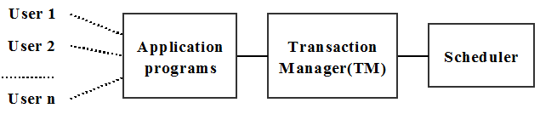
[10.1.2] history or schedule（调度）
  Figure 10.1 The job of the Scheduler
    look at the history of operations as it comes in and
    provide the Isolation guarantee, by sometimes delaying some operations, and occasionally insisting that some transactions be aborted.
R₂(A,50)W₂(A,20)R₁(A,20)R₁(B,50)R₂(B,50)W₂(B,80) C₁ C₂
Update Transaction

Slide 16
10.1 Transactional Histories
serial schedule（串行调度）
  all operations of a T_{x} are performed in sequence with no interleaving with other transactions.
T₁; T₂; T₃; ......; T_{x};
Op_{1,1}; Op_{1,2}; ......; Op_{1,i1};
Op_{2,1}; Op_{2,2}; ......; Op_{2,i2};
........................
Op_{x,1}; Op_{x,2}; ......; Op_{x,ix};
Update Transaction

Slide 17
Scheduler（调度器）
若干个事务的访问操作，混杂在一起形成的一个执行序列
come in
history
Scheduler
operations
operations
隶属于同一个事务的访问操作，其到达顺序是固定的；
来自于不同事务的访问操作，它们到达的先后次序是不确定的。
Update Transaction

Slide 18
10.1 Transactional Histories
come in
history
Scheduler
operations
operations
Scheduler（调度器）
  Scheduler assures that the sequence of operations in history is equivalent in effect to some serial schedule.
  maybe
    delaying some operations
    some transactions be aborted
Update Transaction

Slide 19
Example 10.1.1
  The two elements A and B in (10.1.2) are account records with each having balance 50 to begin with.
    T₁ is adding up balances of two accounts
    T₂ is transferring 30 units from A to B
R₂(A,50)W₂(A,20)R₁(A,20)R₁(B,50)R₂(B,50)W₂(B,80) C₁ C₂
    result of transaction (schedule 10.1.2)
      T₁: A+B = 70
      T₂: A = 20, B = 80
      (fails the credit check)
Update Transaction

Slide 20
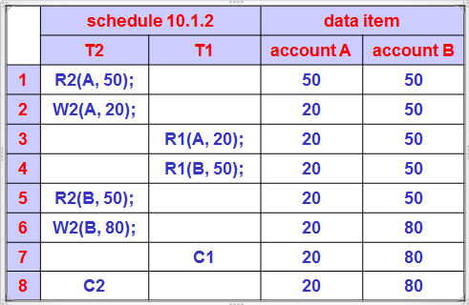
Example 10.1.1 (cont.)
Update Transaction

Slide 21
10.1 Transactional Histories
Example 10.1.1 (cont.)
  But this could never have happened in a serial schedule, where all operation of T₁ occurred before or after all operations of T₂. (following)
R₁(A,50)R₁(B,50) C₁ R₂(A,50)W₂(A,20) R₂(B,50)W₂(B,80) C₂
or
R₂(A,50)W₂(A,20) R₂(B,50)W₂(B,80) C₂ R₁(A,20)R₁(B,80) C₁
Update Transaction

Slide 22
ACID (1)
Atomic
  The set of updates contained in a transaction must succeed or fail as a unit.
Consistent
  Complete transactional transformations on data elements bring the database from one consistent state to another.
Update Transaction

Slide 23
ACID (2)
Isolated
  Even though transactions execute concurrently, it appears to each successful transaction that it has executed in a serial schedule with the others.
Durable
  Once a transaction commits, the changes it has made to the data will survive any machine or system failures.
Update Transaction

Slide 24
10.2 Interleaved Read/Write Operations
If a serial history is always consistent, why don't we just enforce serial histories?
Figure 10.3
  T_{x} has relatively small CPU bursts and then I/O during which CPU has nothing to do.
What do we want to do?
  Figure 10.4: Let another T_{y} run during slack CPU time.
Update Transaction

Slide 25
10.2 Interleaved Read/Write Operations
Figure 10.5 ~ 6
  If we have many disks in use, we can keep the CPU 100% occupied.
  When one thread does an I/O, want to find another thread with completed I/O ready to run again.
Update Transaction

Slide 26
10.3 Serializability and the Precedence Graph
Serializability Schedule（可串行化调度）
  The series of operations is EQUIVALENT to a Serial schedule
Scheduler（调度器）
  find a set of rules for the Scheduler to allow operations by interleaved transactions and guarantee Serializability.
  How can we guarantee this?
Update Transaction

Slide 27
10.3 Serializability and the Precedence Graph
First
  If two transactions never access the same data items, so
    We can commute operations in the history of requests permitted by the scheduler until all operations of one T_{x} are together (serial history).
    The operations don't affect each other, and order doesn't matter.
Update Transaction

Slide 28
If we have operations by two different transactions that do affect the same data item, what then?
  There are only four possibilities
    ... R₁(A) ...... R₂(A) ...
      This can be commuted.
      If there is a third transaction T3, where:
        ... R₁(A) ... W₃(A) ... R₂(A) ...
        then the reads (R₁ and R₂) cannot be commuted.
    ... R₁(A) ...... W₂(A) ...
    ... W₁(A) ...... R₂(A) ...
    ... W₁(A) ...... W₂(A) ...
      These two operations cannot commute.
Update Transaction

Slide 29
10.3 Serializability and the Precedence Graph
Def. 10.3.1 Conflicting Operations（冲突动作）
  Two operations X_{i}(A) and Y_{j}(B) in a history are said to conflict (i.e., the order matters) if and only if the following three conditions hold:
    A ≡ B
    i ≠ j
    One of the two operations X or Y is a write (W).
      Other can be R or W.
Update Transaction

Slide 30
Def. 10.3.1 Conflicting Operations（冲突动作）
  Two operations X_{i}(A) and Y_{j}(B) in a history
    A ≡ B
      Operations on distinct data items never conflict.
    i ≠ j
      Operations conflict only if they are performed by different transactions.
        Two operations of the SAME transaction also cannot be commuted in a history, why ?
    One of the two operations X or Y is a write (W).
      Other can be R or W.
Update Transaction

Slide 31
10.3 Serializability and the Precedence Graph
Figure 10.7 The Three Types
  R_{i}(A) → W_{j}(A)
    meaning, in a history, R_{i}(A) followed by W_{j}(A)
  W_{i}(A) → R_{j}(A)
  W_{i}(A) → W_{j}(A)
Update Transaction

Slide 32
10.3 Serializability and the Precedence Graph
Def. 10.3.2 An interpretation of an arbitrary history H consists of 3 parts.
  A description of the purpose of the logic being performed.
  Specification of precise values for data items being read and written in the history.
  A consistency rule, a property that is obviously preserved by isolated transactions of the logic defined in 1).
Update Transaction

Slide 33
10.3 Serializability and the Precedence Graph
Example 10.3.1
H₁:
    R₂(A) W₂(A) R₁(A) R₁(B) R₂(B) W₂(B) C₁ C₂
Here is an interpretation
  T₁ is doing a credit check, adding up the balances of A and B.
  T₂ is transferring money from A to B.
  The Consistency Rule: Neither transaction creates or destroys money.
Update Transaction

Slide 34
Example 10.3.1
H₁:
    R₂(A) W₂(A) R₁(A) R₁(B) R₂(B) W₂(B) C₁ C₂
The schedule H₁ is not serializability (SR) because
  If schedule H₁ is equivalent to serializability schedule S(H₁), then
    W₂(A) & R₁(A) is conflicting operations, and
    W₂(A) <<_{H1} R₁(A), so W₂(A) <<_{S(H1)} R₁(A)
      It means that T₂ <<_{S(H1)} T₁
    R₁(B) & W₂(B) is conflicting operations, and
    R₁(B) <<_{H1} W₂(B), so R₁(B) <<_{S(H1)} W₂(B)
      It means that T₁ <<_{S(H1)} T₂
  so, schedule H₁ is not serializability. (non-SR)
Update Transaction

Slide 35
10.3 Serializability and the Precedence Graph
Example 10.3.2 lost update ( dirty write )
    H₂: R₁(A) R₂(A) W₁(A) W₂(A) C₁ C₂
    operations 3 and 4 imply that T₁ <<_{S(H2)} T₂
    operations 2 and 3 imply that T₂ <<_{S(H2)} T₁
  so, H₂ is non-SR
an example of H₂
  R₁(A,100) R₂(A,100) W₁(A,140) W₂(A,150) C₁ C₂
schedule | H₂ | T₁ & T₂ | T₂ & T₁
value of A | 150 | 190 | 190
Update Transaction

Slide 36
10.3 Serializability and the Precedence Graph
Example 10.3.3 Blind Writes
    H₃: W₁(A) W₂(A) W₂(B) W₁(B) C₁ C₂
    operations 1 and 2 imply that T₁ <<_{S(H3)} T₂
    operations 3 and 4 imply that T₂ <<_{S(H3)} T₁
  so, H₃ is non-SR
an example of H₃
  W₁(A,50) W₂(A,80) W₂(B,20) W₁(B,50) C₁ C₂
schedule | H₃ | T₁ & T₂ | T₂ & T₁
value of A | 80 | 80 | 50
value of B | 50 | 20 | 50
Update Transaction

Slide 37
10.3 Serializability and the Precedence Graph
Def. 10.3.3. The Precedence Graph
  A precedence graph for a history H is a directed graph denoted by PG(H).
    The vertices of PG(H) correspond to the transactions that have COMMITTED in H
      Uncommitted transactions don't count.
    An edge T_{i} → T_{j} exists in PG(H) whenever two conflicting operations X_{i} and Y_{j} occur in that order in H.
      Thus, T_{i} → T_{j} should be interpreted to mean that T_{i} must precede T_{j} in any equivalent serial history S(H).
Update Transaction

Slide 38
Theorem 10.3.4 The Serializability Theorem
  A history H has an equivalent serial execution S(H) iff the precedence graph PG(H) contains no circuit.
Proof.
  Assume there are m transactions involved, and label them T₁, T₂, . . ., T_{m}.
  Because In any directed graph with no circuit there is always a vertex with no edge entering it, thus there is a vertex, or transaction T_{k}, with no edge entering it. We choose T_{k} to be T_{i}(1).
Update Transaction

Slide 39
Proof.(cont.)
  Note that since T_{i}(1) has no edge entering it, there is no conflict in H that forces some other transaction to come earlier.
  Now remove this vertex, T_{i}(1), from PG(H) and all edges leaving it. Call the resulting graph PG¹(H) with no circuit.
  Continue in this fashion, removing T_{i}(2) and all it's edges from PG¹(H), and so on, choosing T_{i}(3) from PG²(H), . . ., T_{i}(m) from PG^{m-1}(H).
Update Transaction

Slide 40
10.4 Locking Ensures Serializability
Two-Phase Locking ( 2PL )
封锁（lock）
封锁类型
  常用的两种类型封锁
  锁相容矩阵
Update Transaction

Slide 41
10.4 Locking Ensures Serializability
封锁（lock）
  使用封锁技术的前提
    在一个事务访问数据库中的数据时，必须先获得被访问的数据对象上的封锁，以保证数据访问操作的正确性和一致性。
  封锁的作用
    在一段时间内禁止其它事务在被封锁的数据对象上执行某些类型的操作（由封锁的类型决定）
    同时也表明：持有该封锁的事务在被封锁的数据对象上将要执行什么类型的操作（由系统所采用的封锁协议来决定）
Update Transaction

Slide 42
10.4 Locking Ensures Serializability
封锁类型
  常用的封锁类型有两种
    排它锁 (eXclusive lock，简称X锁)
      又被称为 ‘写封锁’ (WL – Write Lock)
    共享锁 (Sharing lock，简称S锁)
      又被称为 ‘读封锁’ (RL – Read Lock)
Update Transaction

Slide 43
10.4 Locking Ensures Serializability
排它锁（X锁）
  特性
    只有当数据对象A没有被其它事务封锁时，事务T才能在数据对象A上施加‘X锁’；
    如果事务T对数据对象A施加了’X锁’，则其它任何事务都不能在数据对象A上再施加任何类型的封锁。
Update Transaction

Slide 44
10.4 Locking Ensures Serializability
排它锁（cont.）
  作用
    如果一个事务T申请在数据对象A上施加‘X锁’并得到满足，则：事务T自身可以对数据对象A作读、写操作，而其它事务则被禁止访问数据对象A
    这样可以让事务T独占该数据对象A，从而保证了事务T对数据对象A的访问操作的正确性和一致性
  缺点：降低了整个系统的并行性
  ‘X锁’必须维持到事务T的执行结束
Update Transaction

Slide 45
10.4 Locking Ensures Serializability
共享锁（S锁）
  特性
    如果数据对象A没有被其它事务封锁，或者其它事务仅仅以 ‘S锁’ 的方式来封锁数据对象A时，事务T才能在数据对象A上施加 ‘S锁’；
Update Transaction

Slide 46
共享锁（cont.）
  作用
    如果一个事务T申请在数据对象A上施加‘S锁’并得到满足，则：事务T可以‘读’数据对象A，但不能‘写’数据对象A
    不同事务所申请的‘S锁’可以共存于同一个数据对象A上，从而保证了多个事务可以同时‘读’数据对象A，有利于提高整个系统的并发性
    在持有封锁的事务释放数据对象A上的所有‘S锁’之前，任何事务都不能‘写’数据对象A
  ‘S锁’不必维持到事务T的执行结束(依封锁协议而定)
Update Transaction

Slide 47
10.4 Locking Ensures Serializability
‘排它锁’与‘共享锁’的相互关系可以用如下图所示的‘锁相容矩阵’来表示。
其它事务已持有的锁
X锁
S锁
-
当前事务申请的锁
X锁
No
No
Yes
S锁
No
Yes
Yes
锁相容矩阵
Update Transaction

Slide 48
10.4 Locking Ensures Serializability
合适(well formed)事务
  如果一个事务在访问数据库中的数据对象A之前按照要求申请对A的封锁，在操作结束后释放A上的封锁，这种事务被称为合适事务。
‘合适事务’是保证并发事务的正确执行的基本条件。
Update Transaction

Slide 49
10.4 Locking Ensures Serializability
Def. 10.4.1 Two-Phase Locking ( 2PL )
  Locks taken in released following three rules.
  锁申请规则
  锁申请的等待规则
  单个事务的锁申请与释放规则(2PL)
Update Transaction

Slide 50
10.4 Locking Ensures Serializability
Def. 10.4.1 Two-Phase Locking ( cont. )
  Before T_{i} can read a data item, R_{i}(A), scheduler attempts to Read Lock the item on it's behalf, RL_{i}(A);
    before W_{i}(A), try Write Lock, WL_{i}(A).
Update Transaction

Slide 51
10.4 Locking Ensures Serializability
Def. 10.4.1 Two-Phase Locking ( cont. )
  2) If conflicting lock on item exists, requesting T_{i} must WAIT.
    Conflicting locks corresponding to conflicting operations:
      two locks on a data item conflict if they are attempted by different T_{i}s and at least one of them is a WL.
Update Transaction

Slide 52
10.4 Locking Ensures Serializability
  There are two phases to locking
    phaseⅠ: the growing phase (增长阶段)
    phaseⅡ: the shrinking phase (收缩阶段)
      when locks are released: RU_{i}(A);
      The scheduler must ensure that can't shrink (drop a lock) and then grow again (take a new lock).
  Rule 3) implies can release locks before Commit;
  More usual to release all locks at once on Commit, and we shall assume this in what follows.
Update Transaction

Slide 53
10.4 Locking Ensures Serializability
  Note that a transaction can never conflict with its own locks!
    If T_{i} holds RL on A, can get WL on A so long as no other T_{x} holds a lock on A (must be RL).
    a T_{x} with a WL doesn't need a RL
      WL more powerful than RL
Update Transaction

Slide 54
10.4 Locking Ensures Serializability
Clearly locking is defined to guarantee that a circuit in the Precedence Graph can never occur.
  The first T_{x} to lock an item forces any other T_{x} that gets to it second to "come later" in any SG.
  But what if other T_{x} already holds a lock the first one now needs?
    This would mean a circuit, but in the WAIT rules of locking it means NEITHER T_{x} CAN EVER GO FORWARD AGAIN.
    This is a DEADLOCK.
Update Transaction

Slide 55
 | Schedule | Explanation | A | B
 | RL₁(A) |  | 50 | 50
1 | R₁(A, 50) |  | 50 | 50
 | RL₂(A) |  | 50 | 50
2 | R₂(A, 50) |  | 50 | 50
 | WL₂(A) | T₂ WAIT | 50 | 50
 | RL₁(B) |  | 50 | 50
6 | R₁(B, 50) |  | 50 | 50
7 | C₁ | T₂ can get WL₂(A) | 50 | 50
3 | W₂(A, 20) |  | 20 | 50
 | RL₂(B) |  | 20 | 50
4 | R₂(B, 50) |  | 20 | 50
 | WL₂(B) |  | 20 | 50
5 | W₂(B, 80) |  | 20 | 80
8 | C₂ |  | 20 | 80
Example 10.4.1
 | H4
1 | R₁(A)
2 | R₂(A)
3 | W₂(A)
4 | R₂(B)
5 | W₂(B)
6 | R₁(B)
7 | C₁
8 | C₂
non-SR
Serializability
Update Transaction

Slide 56
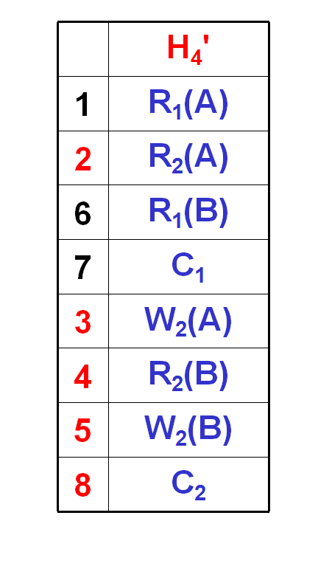
Example 10.4.1
 | Schedule | Explanation | A | B
 | RL₁(A) |  | 50 | 50
1 | R₁(A, 50) |  | 50 | 50
 | RL₂(A) |  | 50 | 50
2 | R₂(A, 50) |  | 50 | 50
 | WL₂(A) | T₂ WAIT | 50 | 50
 | RL₁(B) |  | 50 | 50
6 | R₁(B, 50) |  | 50 | 50
7 | C₁ | T₂ can get WL₂(A) | 50 | 50
3 | W₂(A, 20) |  | 20 | 50
 | RL₂(B) |  | 20 | 50
4 | R₂(B, 50) |  | 20 | 50
 | WL₂(B) |  | 20 | 50
5 | W₂(B, 80) |  | 20 | 80
8 | C₂ |  | 20 | 80
 | H₄
1 | R₁(A)
2 | R₂(A)
3 | W₂(A)
4 | R₂(B)
5 | W₂(B)
6 | R₁(B)
7 | C₁
8 | C₂
non-SR
Serializability
Update Transaction

Slide 57
Example 10.4.2
 | Schedule |  | A | B
 | T₁ | T₂
 | RL₁(A) |  | 50 | 50
1 | R₁(A, 50) |  | 50 | 50
 |  | RL₂(B) | 50 | 50
2 |  | R₂(B, 50) | 50 | 50
 |  | WL₂(B) | 50 | 50
3 |  | W₂(B, 80) | 50 | 80
 |  | RL₂(A) | 50 | 80
4 |  | R₂(A, 50) | 50 | 80
 |  | WL₂(A) | 50 | 80
 |  | T₂ waiting ......
 | RL₁(B)
 | T₁ waiting ......
 | H₅
1 | R₁(A)
2 | R₂(B)
3 | W₂(B)
4 | R₂(A)
5 | W₂(A)
6 | R₁(B)
7 | C₁
8 | C₂
non-SR
Deadlock !
Update Transaction

Slide 58
10.4 Locking Ensures Serializability
Theorem. 10.4.2 Locking Theorem
  A history of transactional operations that follows the 2PL discipline is SR (Serializability).
Update Transaction

Slide 59
10.5 Levels of Isolation
隔离级别 (level of isolation)
  每一个事务都可以自主选择，它自己与其它并发事务之间的隔离级别。
  一个事务所选择的隔离级别，决定了它在运行过程中(调度器)所采用的封锁策略。
Update Transaction

Slide 60
10.5 Levels of Isolation
  四种不同的隔离级别及其设置命令
  SET TRANSACTION ISOLATION LEVEL
      READUNCOMMITTED |
      READCOMMITTED |
      READREPEATABLE |
      SERIALIZABLE
Update Transaction

Slide 61
10.5 Levels of Isolation
READUNCOMMITTED：未提交读
  在该方式下，当前事务不需要申请任何类型的封锁，因而可能会‘读’到未提交的修改结果
  禁止一个事务以该方式去执行对数据的‘写’操作，以避免‘写’冲突现象。
READCOMMITTED：提交读
  在‘读’数据对象A之前需要先申请对数据对象A的‘共享性’封锁，在‘读’操作执行结束之后立即释放该封锁。
  以避免读取未提交的修改结果。
Update Transaction

Slide 62
10.5 Levels of Isolation
READREPEATABLE：可重复读
  在‘读’数据对象A之前需要先申请对数据对象A的‘共享性’封锁，并将该封锁维持到当前事务的结束。
  可以避免其它的并发事务对当前事务正在使用的数据对象的修改。
SERIALIZABLE：可序列化(可串行化)
  并发事务以一种可串行化的调度策略实现其并发执行，以避免它们相互之间的干扰现象。
Update Transaction

Slide 63
10.5 Levels of Isolation
不管采用何种隔离级别，在事务 ‘写’ 数据对象 A 之前需要先申请对数据对象 A 的 ‘排它性’ 封锁(write-lock)，并将该封锁维持到当前事务的结束。
Update Transaction

Slide 64
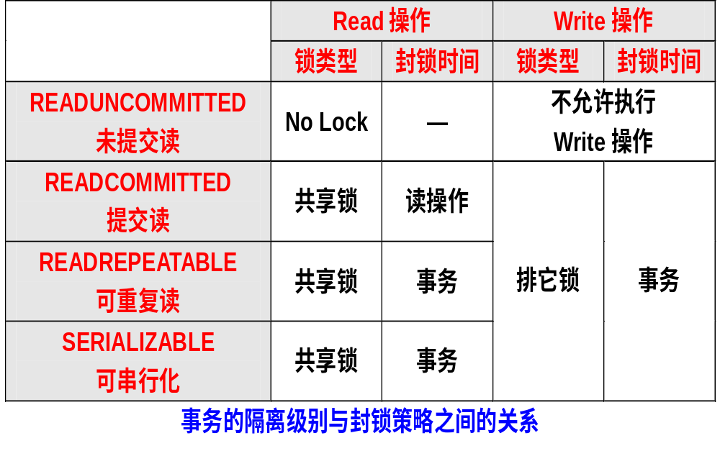
10.5 Levels of Isolation

Slide 65
10.5 Levels of Isolation
short-term locks
  A lock is taken prior to the operation (R or W) and released IMMEDIATELY AFTERWARD.
long-term locks
  A lock are held until EOT (End Of Trans.).
Update Transaction

Slide 66
10.5 Levels of Isolation
Levels of Isolation
Types of Locks
Write locks
Read Locks
( row )
Read Locks
(Predicates)
Problem
Read Uncommitted
No
(Read Only)
No
No
Dirty Reads
Read Committed
Yes
short-term
short-term
Lost Update
Repeatable Read
Yes
long-term
short-term
Update Anomaly
Serializable
Yes
long-term
long-term
No
Update Transaction

Slide 67
10.6 Transactional Recovery
Logs
  The log entries contain "Before Images" and "After Images" of every update made by a Transaction.
    Before Image
    After Image
Update Transaction

Slide 68
10.6 Transactional Recovery
Before Image
  In recovery, we can back up an update that shouldn't have gotten to disk (the transaction didn't commit) by applying a Before Image.
After Image
  In recovery, we can apply After Images to correct for disk pages that should have gotten to disk (the transaction did commit) but never made it.
Update Transaction

Slide 69
10.6 Transactional Recovery
Three types of Logs
  UNDO Logs
    only Before Image
    Recovery for the transaction didn’t commit.
  REDO Logs
    only After Image
    Recovery for the transaction did commit.
  UNDO/REDO Logs
    Before Image & After Image
    Recovery for all transactions.
Update Transaction

Slide 70
Figure 10.13 ( pg. 485 )
Operation | Log entry
R₁(A, 50) | (S, 1) | ＊
W₁(A, 20) | (W,1,A,50,20)
R₂(C, 100) | (S, 2) | ＊
W₂(C, 50) | (W,2,C,100,50)
C₂ | (C, 2)
R₁(B, 50)
W₁(B, 80) | (W,1,B,50,80)
C₁ | (C, 1)
＊: Log entry for Start transaction
Update Transaction

Slide 71
Figure 10.13 ( pg. 673 )
Operation | Log entry
R₁(A, 50) | (S, 1) | ＊
W₁(A, 20) | (W,1,A,50,20)
R₂(C, 100) | (S, 2) | ＊
W₂(C, 50) | (W,2,C,100,50)
C₂ | (C, 2)
R₁(B, 50) |  | ＊
W₁(B, 80) | (W,1,B,50,80)
C₁ | (C, 1)
＊: no log entry is written for a Read operation.
Update Transaction

Slide 72
Figure 10.13 ( pg. 673 )
Operation | Log entry
R₁(A, 50) | (S, 1)
W₁(A, 20) | (W,1,A,50,20) | ＊
R₂(C, 100) | (S, 2)
W₂(C, 50) | (W,2,C,100,50) | ＊
C₂ | (C, 2)
R₁(B, 50)
W₁(B, 80) | (W,1,B,50,80) | ＊
C₁ | (C, 1)
＊:
  Write log for update operation.
  with Before Image (BI) & After Image (AI)
Update Transaction

Slide 73
Figure 10.13 ( pg. 673 )
Operation | Log entry
R₁(A, 50) | (S, 1)
W₁(A, 20) | (W,1,A,50,20)
R₂(C, 100) | (S, 2)
W₂(C, 50) | (W,2,C,100,50)
C₂ | (C, 2) | ＊
R₁(B, 50)
W₁(B, 80) | (W,1,B,50,80)
C₁ | (C, 1) | ＊
＊:
  Log entry for commit transaction
  write Log Buffer to Log File
Update Transaction

Slide 74
10.7 Recovery in Detail: Log Formats
Operation | Log entry | Explanation
R₁(A, 50) | (S, 1) | Start transaction T₁ - no log entry is written for a Read operation.
W₁(A, 20) | (W,1,A,50,20) | T₁ Write log for update of A.balance. The value 50 is the Before Image (BI) for A.balance column in row A, 20 is the After Image (AI) for A.balance
R₂(C, 100) | (S, 2) | Another start transaction log entry.
W₂(C, 50) | (W,2,C,100,50) | Another Write log entry.
C2 | (C, 2) | Commit T₂ log entry. (Write Log Buffer to Log File)
R₁(B, 50) |  | No log entry
W₁(B, 80) | (W,1,B,50,80)
C1 | (C, 1) | Commit T₁ (Write Log Buffer to Log File)
Figure 10.13 ( pg. 673 )
Update Transaction

Slide 75
10.7 Recovery in Detail: Log Formats
Assume that a System Crash occurred immediately after the W₁(B,80) operation.
Operation | Log entry
R₁(A, 50) | (S, 1)
W₁(A, 20) | (W,1,A,50,20)
R₂(C, 100) | (S, 2)
W₂(C, 50) | (W,2,C,100,50)
C₂ | (C, 2)
R₁(B, 50)
W₁(B, 80) | (W,1,B,50,80)
crash !!!
Update Transaction

Slide 76
 | Log entry
5 | (S, 1)
4 | (W,1,A,50,20)
3 | (S, 2)
2 | (W,2,C,100,50)
1 | (C, 2)
 | Failure
ROLL BACK ACTION PERFORMED
Make a note that T₁ is no longer "Active". Now that no transactions were active, we can end the ROLL BACK phase.
Transaction T₁ has never committed (it's last operation was a Write). Therefore, the system performs UNDO of this update by Writing the Before Image value (50) into data item A. Put T₁ into "Uncommitted List“.
Make a note that T₂ is no longer "Active"
Since T₂ is on "Committed List", we do nothing.
Put T₂ into "Committed List"
Update Transaction

Slide 77
 | Log entry | ROLL FORWARD ACTION PERFORMED
6 | (S, 1) | No action required.
7 | (W,1,A,50,20) | T₁ is Uncommitted — No action required.
8 | (S, 2) | No action required.
9 | (W,2,C,100,50) | Since T₂ is on Committed List, we REDO this update by writing After Image value (50) into data item C.
10 | (C, 2) | No action required.
11 |  | We note that we have rolled forward through all log entries and terminate Recovery.
Update Transaction

Slide 78
10.8 Checkpoints ( 检查点 )
Def. 10.8.1: The Commit-Consistent Checkpoint
  No new transactions can start until the checkpoint is complete.
  Database operation processing continues until all existing transactions commit, and all their log entries are written to disk.
  The current log buffer is written out to the log file, and after this the system ensures that all dirty pages in buffers have been written out to disk.
  When steps 1-3 have been performed, the system writes a special log entry, (CKPT), to disk, and the checkpoint is complete.
Update Transaction

Slide 79
10.8 Checkpoints ( 检查点 )
Def. 10.8.2: The Cache-Consistent Checkpoint
  No new transactions are permitted to start.
  Existing transactions are not permitted to start any new operations.
  The current log buffer is written out to disk, and after this the system ensures that all dirty pages in cache buffers have been written out to disk.
  Finally a special log entry, (CKPT, List), is written out to disk, and we say that the checkpoint is complete. The List in this log entry contains a list of active transactions at the time the checkpoint is taken.
Update Transaction

Slide 80
Def. 10.8.3: The Fuzzy Checkpoint
Prior to checkpoint start, the remaining pages dirty as of the previous checkpoint are forced out to disk (but the rate of writes should leave I/O capacity to support current transactions in progress; there is no critical hurry in doing this).
At the start of the checkpoint process, no new transactions are permitted to start. Existing transactions cannot start any new operations.
Update Transaction

Slide 81
Def. 10.8.1: The Fuzzy Checkpoint (cont.)
The current log buffer is written out to disk with an appended log entry, (CKPT_{N}, List), as in the cache-consistent checkpoint procedure.
The set of pages in buffer that are dirty since the last checkpoint log, CKPT_{N-1}, is noted. This will probably be accomplished by special flags on the buffer directory. There is no need for this information to be made disk resident, since it is used only to perform the next checkpoint, not in case of recovery. The checkpoint is now complete.
Update Transaction

Slide 82
10.8 Checkpoints
Examples of Checkpoints
Update Transaction

Slide 83
10.9 Media Recovery
10.10 Performance: The TPC-A Benchmark
Update Transaction

