Slide 1
Example of
GROUP BY & HAVING
    SELECT DEP, JOB, AVG(SAL)
    FROM EMPL
    WHERE JOB <> 'M'
    GROUP BY DEP, JOB
    HAVING AVG(SAL) > 28000
    ORDER BY AVG(SAL) DESC

Slide 2
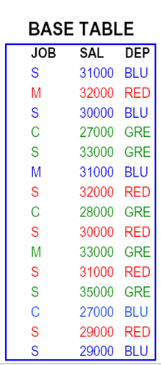
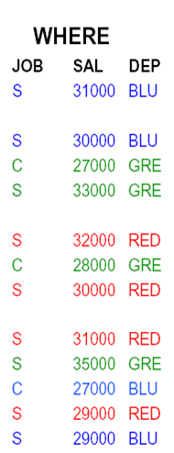
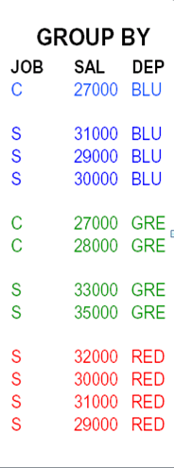
GROUP BY DEP, JOB
WHERE JOB<>'M'

Slide 3
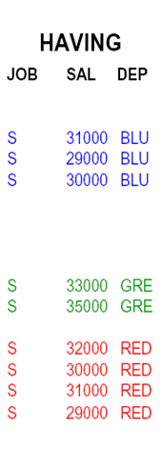
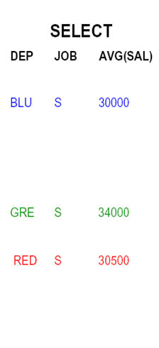
SELECT DEP,JOB,AVG(SAL)
HAVING AVG(SAL) > 28000

Slide 4
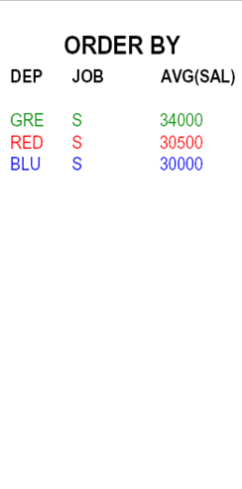
ORDER BY AVG(SAL) DESC

