Slide 1

Chapter 7:
Measures of Association for Nominal and Ordinal Variables
Proportional Reduction of Error (PRE)
Degree of Association
For Nominal Variables
  Lambda
For Ordinal Variables
  Gamma
Using Gamma for Dichotomous Variables

Slide 2
Measures of Association
Measure of association—a single summarizing number that reflects the strength of a relationship, indicates the usefulness of predicting the dependent variable from the independent variable, and often shows the direction of the relationship.

Slide 3
Take your best guess?
If you know nothing else about a person except that he or she lives in United States and I asked you to guess his or her race/ethnicity, what would you guess?
The most common race/ethnicity for U.S. residents (e.g., the mode)!
Now, if we know that this person lives in San Diego, California, would you change your guess?
With quantitative analyses we are generally trying to predict or take our best guess at value of the dependent variable. One way to assess the relationship between two variables is to consider the degree to which the extra information of the independent variable makes your guess better.

Slide 4
Proportional Reduction of Error (PRE)
PRE—the concept that underlies the definition and interpretation of several measures of association. PRE measures are derived by comparing the errors made in predicting the dependent variable while ignoring the independent variable with errors made when making predictions that use information about the independent variable.

Slide 5
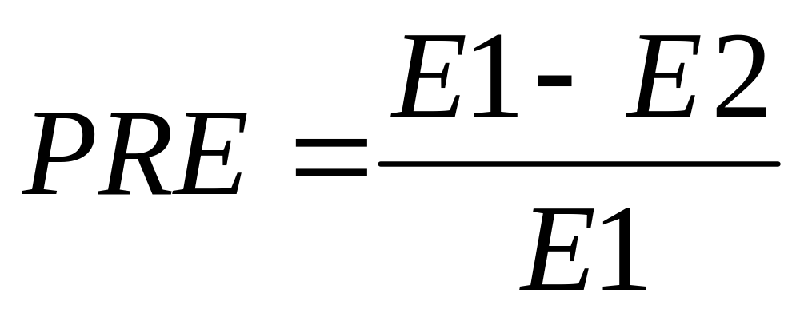
Proportional Reduction of Error (PRE)
where: E1 = errors of prediction made when the independent variable is ignored
E2 = errors of prediction made when the prediction is based on the independent variable

Slide 6


Two PRE Measures:
Lambda & Gamma
Appropriate for…
Lambda NOMINAL variables
Gamma ORDINAL & DICHOTOMOUS NOMINAL variables

Slide 7
Lambda
Lambda—An asymmetrical measure of association suitable for use with nominal variables and may range from 0.0 (meaning the extra information provided by the independent variable does not help prediction) to 1.0 (meaning use of independent variable results in no prediction errors). It provides us with an indication of the strength of an association between the independent and dependent variables.
A lower value represents a weaker association, while a higher value is indicative of a stronger association

Slide 8

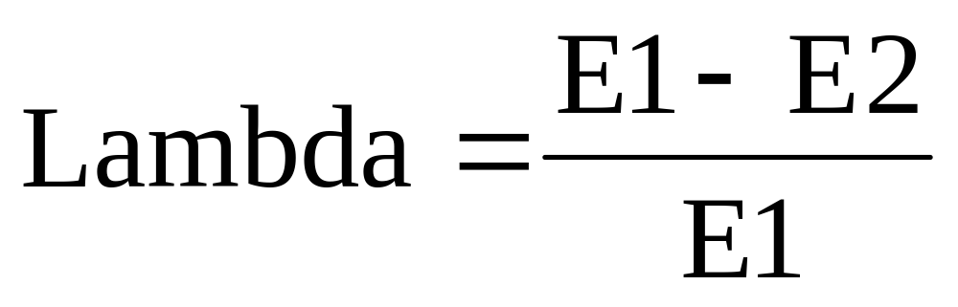
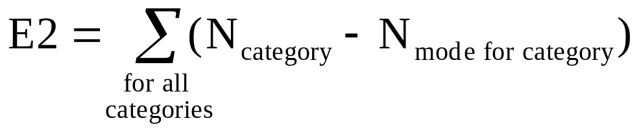
Lambda
where:
E1= N_{total} - N_{mode of dependent variable}

Slide 9
Example 1: 2000 Vote By Abortion Attitudes
Table 7.2 2000 Presidential Vote by Abortion Attitudes
Abortion Attitudes (for any reason)
Vote Yes No Row Total
Gore 46 39 85
Bush 41 73 114
Total 87 112 199
Source: General Social Survey, 2002
Step One—Add percentages to the table to get the data in a format that allows you to clearly assess the nature of the relationship.

Slide 10
Example 1: 2000 Vote By Abortion Attitudes
Table 7.2 2000 Presidential Vote by Abortion Attitudes
Abortion Attitudes (for any reason)
Vote Yes No Row Total
Gore 52.9% 34.8% 42.7% 46 39 85
Bush 47.1% 65.2% 57.3% 41 73 114
Total 100% 100% 100% 87 112 199
Source: General Social Survey, 2002
Now calculate E1
E1 = N_{total} – N_{mode} = 199 – 114 =
85

Slide 11
Example 1: 2000 Vote By Abortion Attitudes
Table 7.2 2000 Presidential Vote by Abortion Attitudes
Abortion Attitudes (for any reason)
Vote Yes No Row Total
Gore 52.9% 34.8% 42.7% 46 39 85
Bush 47.1% 65.2% 57.3% 41 73 114
Total 100% 100% 100% 87 112 199
Source: General Social Survey, 2002
Now calculate E2
E2 = [N_{(Yes column total)} – N_{(Yes column mode)}] +
[N_{(No column total)} – N_{(No column mode)}]
= [87 – 46] + …

Slide 12
Example 1: 2000 Vote By Abortion Attitudes
Table 7.2 2000 Presidential Vote by Abortion Attitudes
Abortion Attitudes (for any reason)
Vote Yes No Row Total
Gore 52.9% 34.8% 42.7% 46 39 85
Bush 47.1% 65.2% 57.3% 41 73 114
Total 100% 100% 100% 87 112 199
Source: General Social Survey, 2002
Now calculate E2
E2 = [N_{(Yes column total)} – N_{(Yes column mode)}] +
[N_{(No column total)} – N_{(No column mode)}]
= [87 – 46] +
[112 – 73]

Slide 13
Example 1: 2000 Vote By Abortion Attitudes
Table 7.2 2000 Presidential Vote by Abortion Attitudes
Abortion Attitudes (for any reason)
Vote Yes No Row Total
Gore 52.9% 34.8% 42.7% 46 39 85
Bush 47.1% 65.2% 57.3% 41 73 114
Total 100% 100% 100% 87 112 199
Source: General Social Survey, 2002
Now calculate E2
E2 = [N_{(Yes column total)} – N_{(Yes column mode)}] +
[N_{(No column total)} – N_{(No column mode)}]
= [87 – 46] + [112 – 73] =
80

Slide 14
Example 1: 2000 Vote By Abortion Attitudes
Table 7.2 2000 Presidential Vote by Abortion Attitudes
Abortion Attitudes (for any reason)
Vote Yes No Row Total
Gore 52.9% 34.8% 42.7% 46 39 85
Bush 47.1% 65.2% 57.3% 41 73 114
Total 100% 100% 100% 87 112 199
Source: General Social Survey, 2002
Lambda = [E1– E2] / E1
= [85 – 80] / 85 =
.06

Slide 15
Example 1: 2000 Vote By Abortion Attitudes
Table 7.2 2000 Presidential Vote by Abortion Attitudes
Abortion Attitudes (for any reason)
Vote Yes No Row Total
Gore 52.9% 34.8% 42.7% 46 39 85
Bush 47.1% 65.2% 57.3% 41 73 114
Total 100% 100% 100% 87 112 199
Source: General Social Survey, 2002
Lambda = .06
So, we know that six percent of the errors in predicting the relationship between vote and abortion attitudes can be reduced by taking into account the voter’s attitude towards abortion.

Slide 16
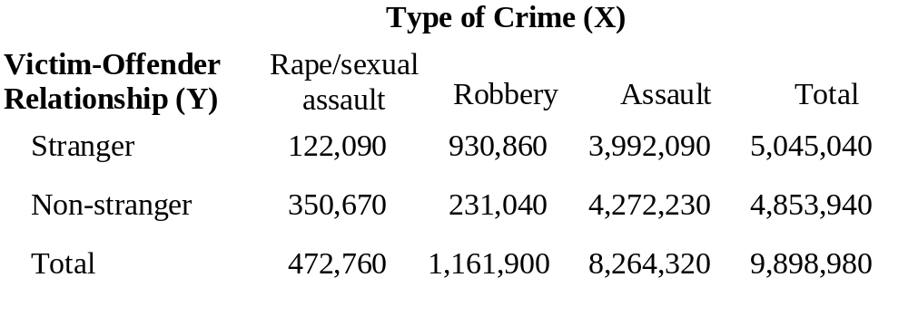
EXAMPLE 2:
Victim-Offender Relationship and Type of Crime: 1993
Step One—Add percentages to the table to get the data in a format that allows you to clearly assess the nature of the relationship.
*Source: Kathleen Maguire and Ann L. Pastore, eds., Sourcebook of Criminal Justice Statistics 1994., U.S. Department of Justice, Bureau of Justice Statistics, Washington, D.C.: USGPO, 1995, p. 343.

Slide 17
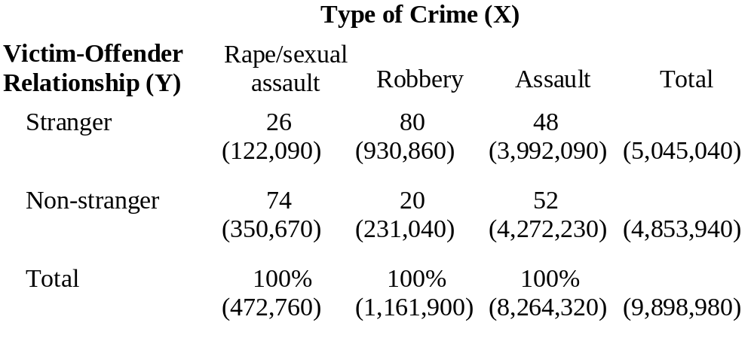
Victim-Offender Relationship & Type of Crime: 1993
Now calculate E1
E1 = N_{total} – N_{mode} = 9,898,980 – 5,045,040 =
4,835,940

Slide 18
Victim-Offender Relationship & Type of Crime: 1993
Now calculate E2
E2 = [N(rape/sexual assault column total) – N(rape/sexual assault column mode)] +
[N_{(robbery column total)} – N_{(robbery column mode)}] +
[N_{(assault column total)} – N_{(assault column mode)}]
= [472,760 – 350,670] + …

Slide 19
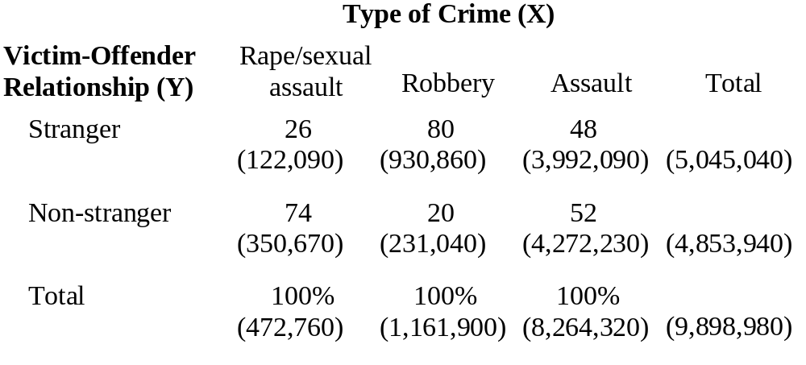
Victim-Offender Relationship and Type of Crime: 1993
Now calculate E2
E2 = [N(rape/sexual assault column total) – N(rape/sexual assault column mode)] +
[N_{(robbery column total)} – N_{(robbery column mode)}] +
[N_{(assault column total)} – N_{(assault column mode)}]
= [472,760 – 350,670] +
[1,161,900 – 930,860] + …

Slide 20
Victim-Offender Relationship and Type of Crime: 1993
Now calculate E2
E2 = [N(rape/sexual assault column total) – N(rape/sexual assault column mode)] +
[N_{(robbery column total)} – N_{(robbery column mode)}] +
[N_{(assault column total)} – N_{(assault column mode)}]
= [472,760 – 350,670] +
[1,161,900 – 930,860] +
[8,264,320 – 4,272,230] = 4,345,220

Slide 21
Victim-Offender Relationship and Type of Crime: 1993
Lambda = [E1– E2] / E1
= [4,835,940 – 4,345,220] / 4,835,940 =
.10
So, we know that ten percent of the errors in predicting the relationship between victim and offender (stranger vs. non-stranger;) can be reduced by taking into account the type of crime that was committed.

Slide 22
Asymmetrical Measure of Association
A measure whose value may vary depending on which variable is considered the independent variable and which the dependent variable.
Lambda is an asymmetrical measure of association.

Slide 23
Symmetrical Measure of Association
A measure whose value will be the same when either variable is considered the independent variable or the dependent variable.
Gamma is a symmetrical measure of association…

Slide 24
Before Computing GAMMA:
It is necessary to introduce the concept of paired observations.
Paired observations – Observations compared in terms of their relative rankings on the independent and dependent variables.

Slide 25
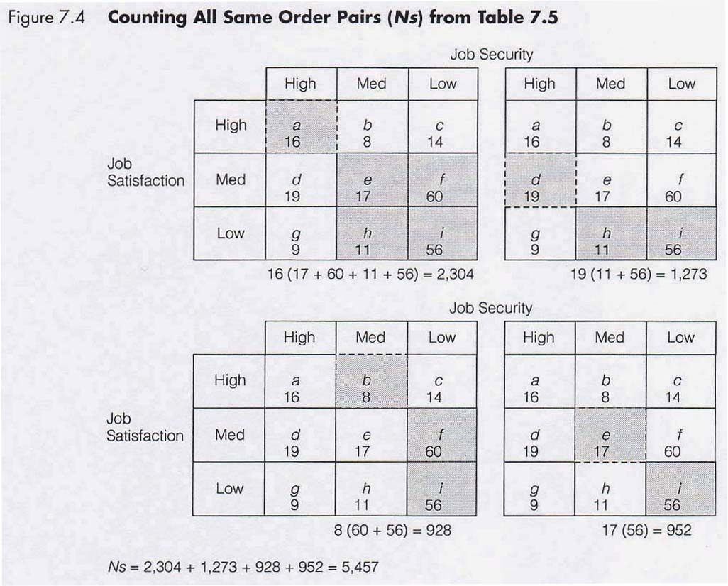
Tied Pairs
Same order pair (Ns) – Paired observations that show a positive association; the member of the pair ranked higher on the independent variable is also ranked higher on the dependent variable.

Slide 26
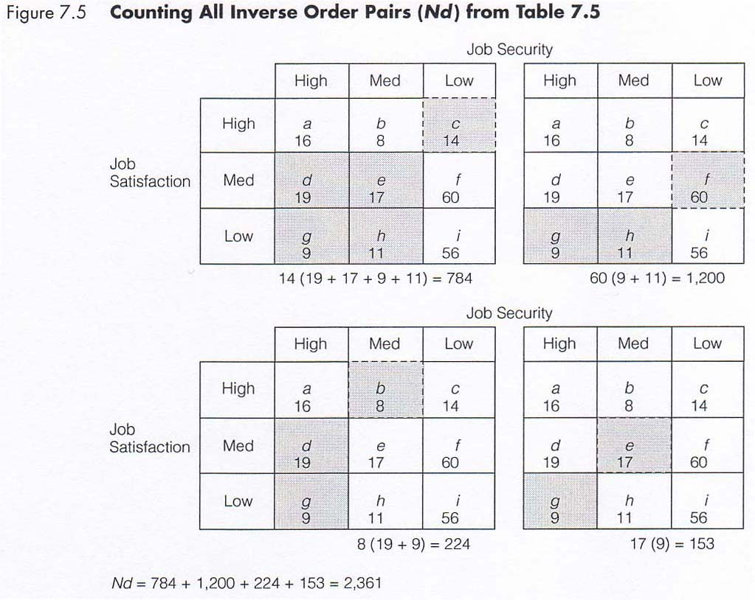
Tied Pairs
Inverse order pair (Nd) – Paired observations that show a negative association; the member of the pair ranked higher on the independent variable is ranked lower on the dependent variable.

Slide 27

Gamma
Gamma—a symmetrical measure of association suitable for use with ordinal variables or with dichotomous nominal variables. It can vary from 0.0 (meaning the extra information provided by the independent variable does not help prediction) to ±1.0 (meaning use of independent variable results in no prediction errors) and provides us with an indication of the strength and direction of the association between the variables. When there are more Ns pairs, gamma will be positive; when there are more Nd pairs, gamma will be negative.

Slide 28
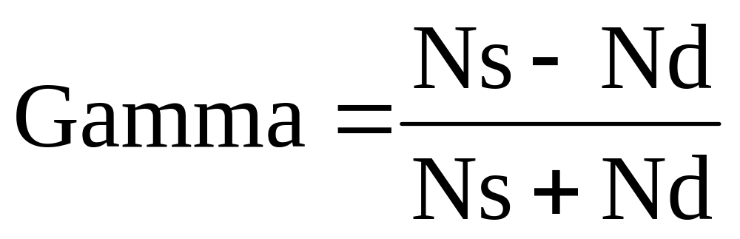
Gamma

Slide 29
Interpreting Gamma
The sign depends on the way the variables are coded:
+ the two “high” values are associated, as are the two “lows”
– the “highs” are associated with the “lows”
.00 to .24 “no relationship”
.25 to .49 “weak relationship”
.50 to .74 “moderate relationship”
.75 to 1.00 “strong relationship”

Slide 30
Measures of Association
Measures of association—a single summarizing number that reflects the strength of the relationship. This statistic shows the magnitude and/or direction of a relationship between variables.
Magnitude—the closer to the absolute value of 1, the stronger the association. If the measure equals 0, there is no relationship between the two variables.
Direction—the sign on the measure indicates if the relationship is positive or negative. In a positive relationship, when one variable is high, so is the other. In a negative relationship, when one variable is high, the other is low.

