Slide 1
GARCH and VaR

Slide 2
Downloads
Today’s work is in: matlab_lec05.m
Functions we need today: simGARCH.m, simsecSV.m
Datasets we need today: data_msft.m

Slide 3
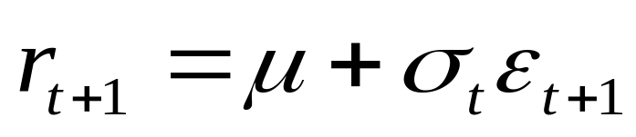
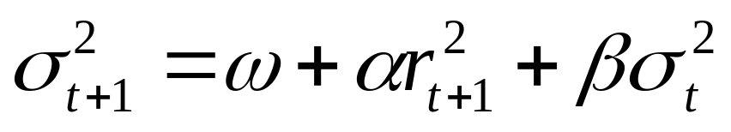
GARCH(1,1)
Assume returns follow:
Where ε_{t} is i.i.d. standard normal and µ=0
  Zero mean is not a bad assumption for daily data
  We saw that moving averages of r² and σ² look very similar for daily data
  Don’t need µ=0 but it makes math easier

Slide 4
Simulating GARCH
%this function simulates GARCH(1,1) w/ params w,a,b
%output is Tx2 matrix with r in 1st column, sigmasq in 2nd
function out=simGARCH(w,a,b,T);
r=zeros(T+100,1);
sigmasq=zeros(T+100,1);
r(1)=0; sigmasq(1)=w/(1-a-b);
for t=1:T-1+100;
r(t+1)=randn(1)*sqrt(sigmasq(t));
sigmasq(t+1)=w+a*(r(t+1)^2)+b*sigmasq(t);
end;
out=[r(101:T+100) sigmasq(101:T+100)];

Slide 5
Simulating GARCH
%simulate and look at output
>>w=.05; a=.1; b=.8; T=1000;
>>out=simGARCH(w,a,b,T);
>>subplot(3,1,1); plot(out(:,1));
>>title('r');
>>subplot(3,1,2); plot(out(:,1).^2);
>>title('r^{2}');
>>subplot(3,1,3); plot(out(:,2));
>>title('\sigma^{2}');

Slide 6
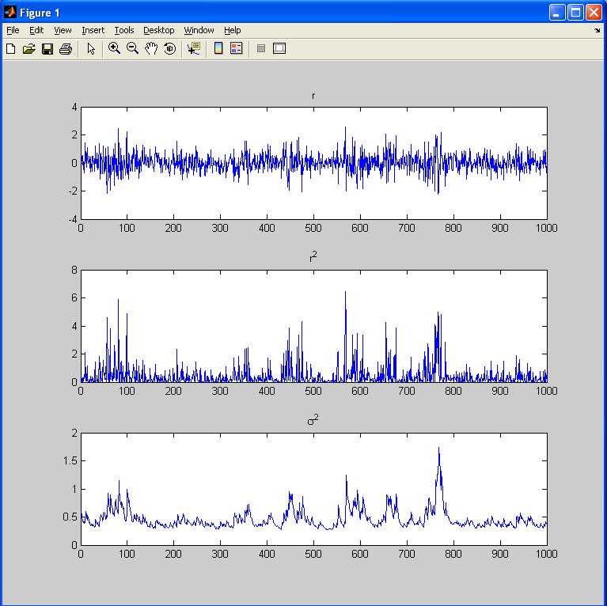

Slide 7
Estimating GARCH
We can now simulate GARCH(1,1)!
However what we really care about is knowing today’s volatility σ_{t}
We cannot observe σ_{t} in the data; we only observe r_{t}
  Simulation does not really help
How to find σ_{t} from r_{t}?
  If we know ω, α, and β we can estimate σ_{t} from r_{t}
  How to find ω, α, and β ?

Slide 8
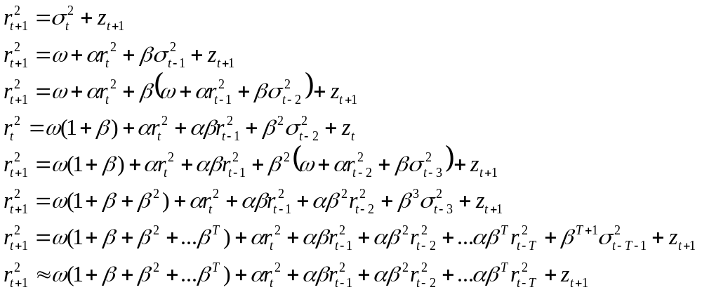
Estimating GARCH
Note that E[r_{t+1}²]=σ_{t}² and we can always write r_{t+1}²=E[r_{t+1}²]+z_{t+1}=σ_{t}²+z_{t+1} where z_{t+1} is some zero mean variable

Slide 9
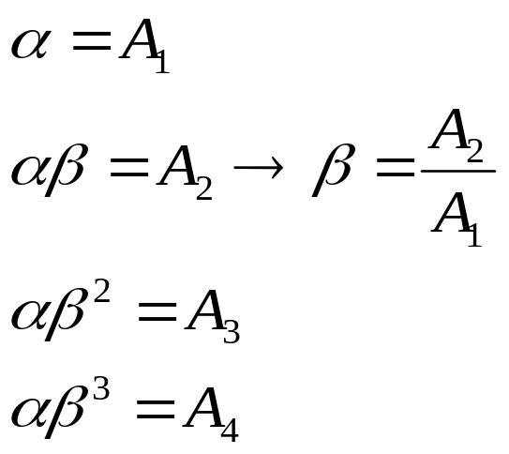
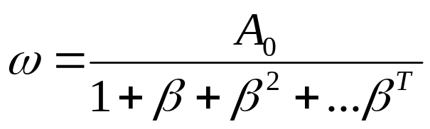
Estimating GARCH
GARCH(1,1) implies:
We can regress r_{t}² on its lags:
Now we can use coefficients of regression to find out ω, α, and β

Slide 10
Estimating GARCH
>>w=.05; a=.1; b=.8; T=100000; out=simGARCH(w,a,b,T);
>>clear X; n=100;
>>for i=1:n;
X(:,i)=out(n-i+1:T-i,1).^2;
end;
>>Y=out(n+1:T,1).^2;
>>regcoef=regress(Y,[ones(T-n,1) X]);
>>aest=regcoef(2);
>>best=regcoef(3)/regcoef(2);
>>west=regcoef(1)/((1-best^n)/(1-best));
>>disp([w a b; west aest best]);
>>
0.0500 0.1000 0.8000
0.0517 0.0973 0.8024

Slide 11
Estimating GARCH
Note that we only used A₁ and A₂ to find α and β, however all of the other equations must hold as well
  These are called over-identifying restrictions
If T was very large each equation would hold exactly
Because of estimation error the other equations only hold approximately

Slide 12
Estimating GARCH
We can see how well they hold:
>>subplot;
>>plot(a*b.^[0:8],regcoef(2:10),'.'); hold on;
>>plot(regcoef(2:10),regcoef(2:10),'k')
%all points should line up along the 45 degree line
There are more efficient ways of estimating GARCH using more equations
Using A₁ and A₂ only is less efficient, but still unbiased and works well if T is large enough

Slide 13
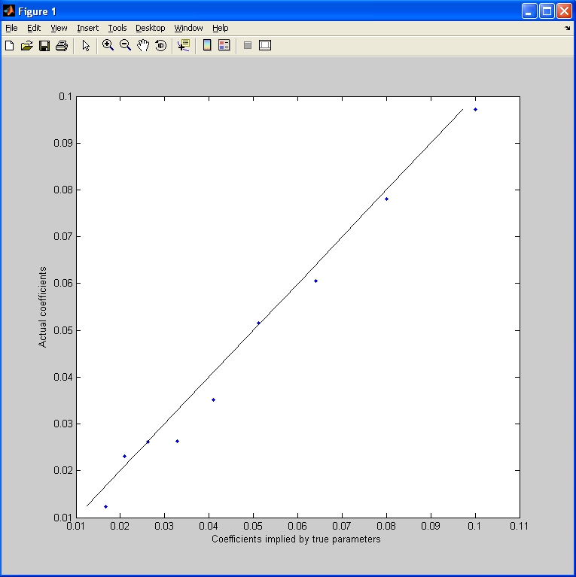

Slide 14
Estimating GARCH
Matlab has functions that use more efficient (and slower) methods to estimate GARCH
function ugarch(r,p,q) estimates garch(p,q) on the timeseries r
  p and q are the lags on variance and squared returns terms in GARCH(p,q)
  We are using p=1, q=1
The output is [ω β α]
  Note the different order from our convention

Slide 15
>>[w b a]=ugarch(out(:,1),1,1)
%%%%%%%%%%%%%%%%%%%%%%%%%%%%%%%%%%%%%%%%%%%%%%%%%%%%%%%%%%%
Diagnostic Information
Number of variables: 3
Functions
Objective: ugarchllf
Gradient: finite-differencing
Hessian: finite-differencing (or Quasi-Newton)
Constraints
Nonlinear constraints: do not exist
Number of linear inequality constraints: 1
Number of linear equality constraints: 0
Number of lower bound constraints: 3
Number of upper bound constraints: 0
Algorithm selected
medium-scale
%%%%%%%%%%%%%%%%%%%%%%%%%%%%%%%%%%%%%%%%%%%%%%%%%%%%%%%%%%%
End diagnostic information
Max Line search Directional First-order
Iter F-count f(x) constraint steplength derivative optimality Procedure
0 4 104763 -0.0493
1 12 104473 -0.04622 0.0625 2.49e+003 3.35e+004
2 24 104473 -0.04789 0.00391 1.99e+003 5.24e+003
3 33 104458 -0.06058 0.0313 343 2.39e+003
4 40 104458 -0.05415 0.125 93.8 4.9e+003
5 47 104456 -0.04748 0.125 48.4 1.5e+003
6 51 104453 -0.05498 1 4.8 1.06e+003
7 55 104452 -0.05318 1 -0.0914 30.1
8 59 104452 -0.05291 1 0.000356 2.79
9 63 104452 -0.05292 1 2.75e-007 0.132
Optimization terminated: magnitude of directional derivative in search
direction less than 2*options.TolFun and maximum constraint violation
is less than options.TolCon.
No active inequalities.
>> disp([w a b])
0.0529 0.1016 0.7913

Slide 16
Estimating GARCH
Now lets estimate GARCH(1,1) on (i) Microsoft data (ii) simulated data with stochastic volatility (with parameters calibrated to Microsoft)
Note that the simulated data does not come from a GARCH model but does come from a different model with predictable volatility
GARCH is just a convenient way to estimate volatility

Slide 17
Data
>>data_msft;
>>rmsft=msft(:,4);
>>sigma=std(rmsft); mu=mean(rmsft)-.5*sigma^2; T=length(rmsft);
>>timeline=round(msft(1,2)/10000)+(round(msft(T,2)/10000)-round(msft(1,2)/10000))*([1:T]-1)/(T-1);
>>nlow=sum(rmsft<-.1);
>>nhigh=sum(rmsft>.1);
>>p1=nlow/T; p2=nhigh/T;
>>J1=-.15; J2=.15;
>>sigmaS=.0025; rho=.96;
>>rsim=simsecSV(mu,sigma,J1,J2,p1,p2,rho,sigmaS,T);
>>subplot(2,1,1); plot(timeline,rmsft(1:T));
>>title('MSFT'); axis([timeline(1) timeline(T) -.2 .2]);
>>subplot(2,1,2); plot(timeline,rsim(1:T));
>>title('Simulated'); axis([timeline(1) timeline(T) -.2 .2]);

Slide 18
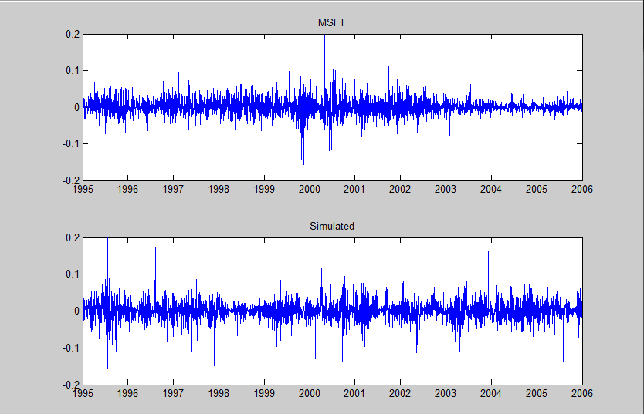


Slide 19
Estimating GARCH
MSFT
>>n=100; clear X;
>>for i=1:n;
X(:,i)=rmsft(n-i+1:T-i,1).^2;
>>end;
>>Y=rmsft(n+1:T,1).^2;
>>regcoef=regress(Y,[ones(T-n,1) X]);
>>a=regcoef(2);
>>b=regcoef(3)/regcoef(2);
>>w=regcoef(1)/((1-b^n)/(1-b));
>>disp([w a b]);
0.0000 0.0558 0.9241
%Note strong evidence of persistence in volatility

Slide 20
Estimating GARCH
Simulated DATA
>>n=100; clear X;
>>for i=1:n;
X(:,i)=rsim(n-i+1:T-i,1).^2;
>>end;
>>Y=rsim(n+1:T,1).^2;
>>regcoefS=regress(Y,[ones(T-n,1) X]);
>>asim=regcoefS(2);
>>bsim=regcoefS(3)/regcoefS(2);
>>wsim=regcoefS(1)/((1-bsim^n)/(1-bsim));
>>disp([wsim asim bsim]);
0.0000 0.0623 0.9604

Slide 21
Overidentifying
Restrictions
subplot;
plot(a*b.^[0:8],regcoef(2:10),'sb','MarkerSize',10);
hold on;
plot(asim*bsim.^[0:8],regcoefS(2:10),'ro','MarkerSize',10);
plot(regcoef(2:10),regcoef(2:10),'k');
xlabel('Coefficients implied by \alpha, \beta');
ylabel('Actual coefficients');
legend('MSFT','Simulated');

Slide 22
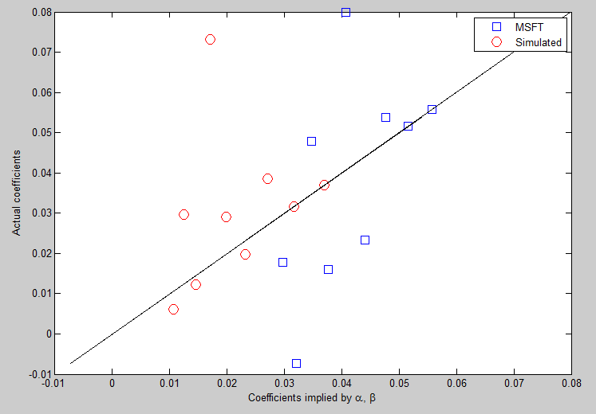

Slide 23
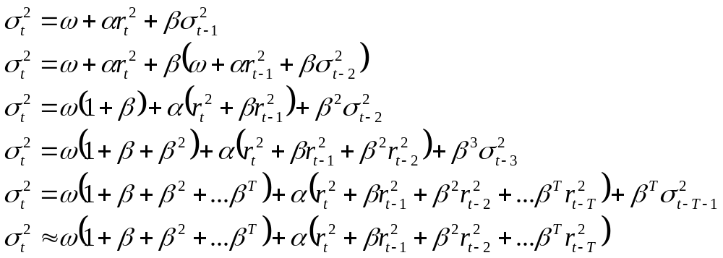
Estimating
Volatility

Slide 24
Estimating Volatility:
MSFT
>>vmsft=zeros(T,1);
>>n=100;
>>for t=n+1:T;
k=0; s=0;
for i=1:n;
k=k+b^(i-1);
s=s+(rmsft(t-i)^2)*b^(i-1);
end;
vmsft(t)=sqrt(w*k+a*s);
end;
>>vmsft(1:n)=mean(vmsft(n+1:T));
>>subplot(2,1,1); plot(timeline,rmsft(1:T));
>>title('MSFT Return'); axis([timeline(1) timeline(T) -.2 .2]);
>>subplot(2,1,2); plot(timeline,vmsft(1:T));
>>title('MSFT Volatility'); axis([timeline(1) timeline(T) 0 .06]);

Slide 25
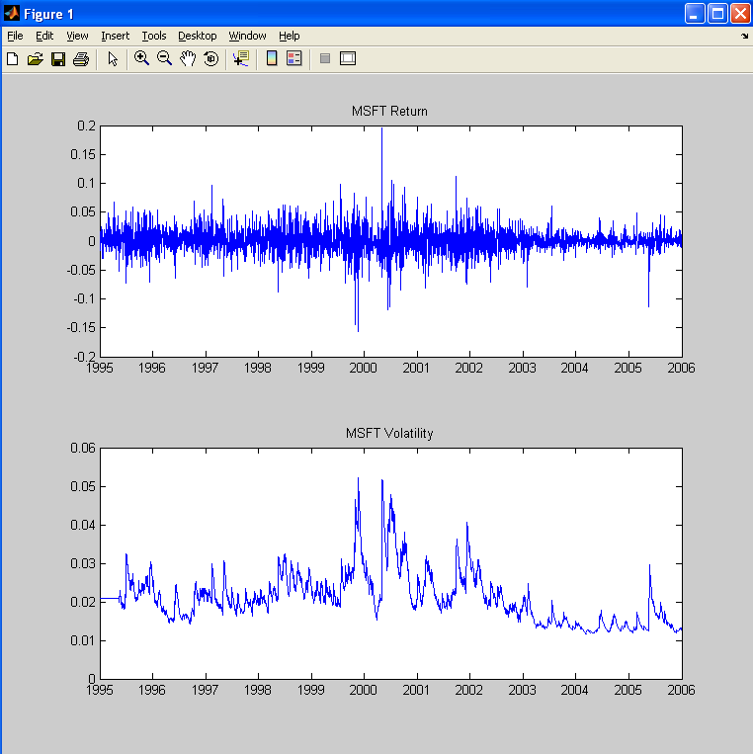

Slide 26
VaR
Value at Risk
Maximum loss not exceeded given a probability
The loss will be greater than r^{var} with probability p^{var}

Slide 27
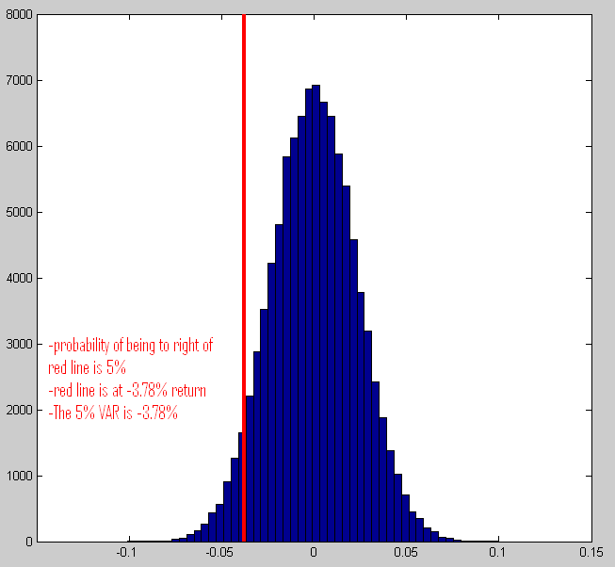

Slide 28
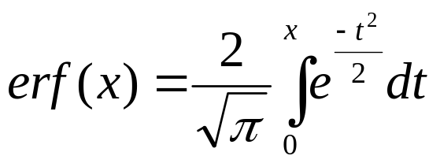
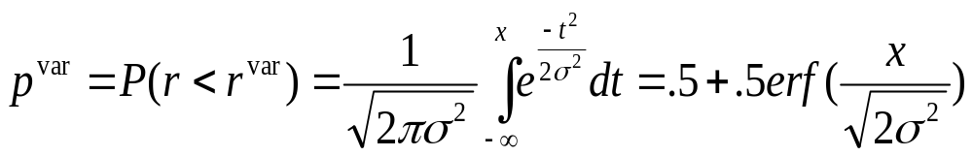
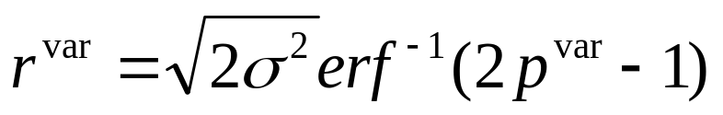
Error Function
The error function is defined as:
The normal CDF gives the probability that a normally distributed variable is below some value, it can be rewritten in terms of the erf()
The inverse of a normal CDF gives the cut off value for the lowest p of the distribution, it can be rewritten in terms of the erf⁻¹()

Slide 29
VaR
>>T0=100000; sigma=.023;
>>x=randn(T0,1)*sigma;
>>rvar5=sqrt(2*sigma^2)*erfinv(2*.05-1);
>>hist(x,50); axis([-.15 .15 0 8000]); hold on;
>>plot(rvar5*ones(6,1),0:8000/5:8000,'r','LineWidth',3);
>>disp([rvar5 sum(x<rvar5)/T0]);
-0.0378 0.0504

Slide 30
GARCH VaR
If we believe that volatility changes through time, then VaR also changes through time
In particular if we believe GARCH, we can use GARCH to calculate today’s volatility and use it to predict value at risk
  Note that we don’t have to use GARCH, we can use any volatility model we like
  For example a simplistic model is constant volatility
We can then test whether the value at risk estimate was actually correct by comparing the total number of returns violating VaR(p) with the expected number of violations
  The expected number of violations is p

Slide 31
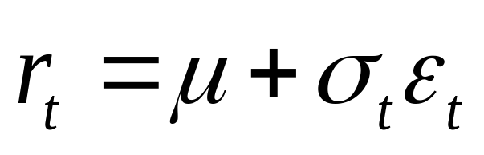
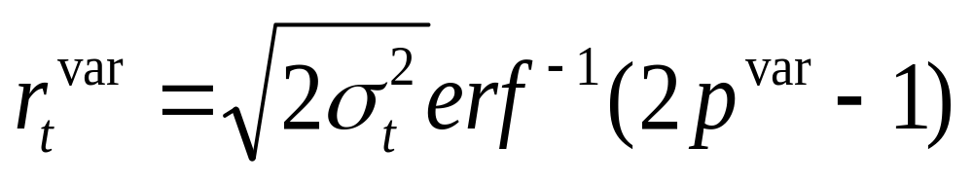
GARCH VaR
Returns are normally distributed with volatility given by GARCH
Therefore r^{var}(t) will be a function of σ(t) just as before

Slide 32
MSFT VaR
%%create VaR for GARCH(1,1) volatilty
var5msft=sqrt(2*vmsft.^2)*erfinv(2*.05-1);
%%plot MSFT volatility on top panel
subplot(2,1,1); plot(timeline,vmsft);
title('MSFT Volatility'); axis([timeline(1) timeline(T) 0 .06]);
%%plot MSFT returns on lower panel
subplot(2,1,2);
plot(timeline,rmsft,'b'); hold on;
%%on same panel plot MSFT VaR
plot(timeline,var5msft,'r','LineWidth',3);
title('MSFT VaR 5%'); axis([timeline(1) timeline(T) -.1 0]);

Slide 33
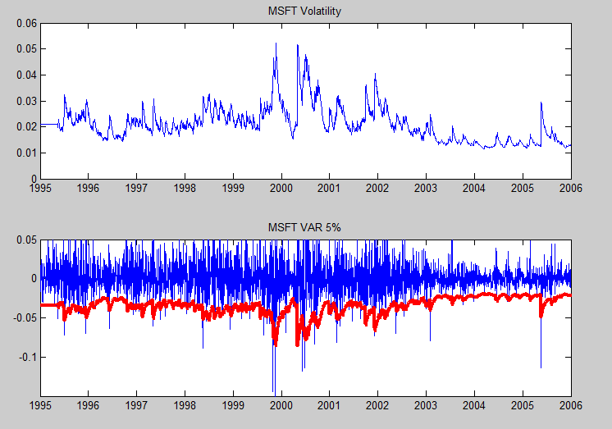

Slide 34
Back Testing
VaR
%compute fraction of times returns violate VaR
disp('Percent Violations GARCH VaR 5%');
disp(sum(rmsft<var5msft)/T);
%compute a constant volatility VaR for MSFT
var5msftconstv=sqrt(2*std(rmsft).^2)*erfinv(2*.05-1);
disp('Percent Violations Constant Vol VaR 5%');
disp(sum(rmsft<var5msftconstv)/T);
Percent Violations GARCH VaR 5%
0.0338
Percent Violations Constant Vol VaR 5%
0.0344
%Note that both overestimate MSFT's number of extreme returns and therefore MSFT's risk

