Slide 1
From Network Models to Intelligent Cyber Control
DEAKIN
Foundation, game learning, and PINN/PIDL companions
Deakin-style student onboarding deck
Built from the current public repositories and generated figures
Threat
>
Model
>
Solver
>
Evidence
>
Paper
Slide 1 | Three-repo tutorial family
Notes:
Purpose: Use the three repositories as one learning path: model, solve, learn, validate, and write.
Explain: Open with the idea that the repos are not separate demos. They are a staged route from equations to paper-level experiments.
Demo cue: connect this slide to the relevant README section.
Common misconception: a plotted curve or training loss is evidence to interpret, not an automatic proof of optimality or generalization.

Slide 2
Learning outcomes
Orientation
DEAKIN
After this deck, students should know where to start and what to change next.
- Run the first smoke tests from a clean checkout.
- Map each equation term to a Python variable and output figure.
- Choose between PMP/FBSM, RL/MARL, PINN/PIDL, and hybrid games.
- Design baselines, ablations, and paper-ready figures.
After this deck, students should know where to start and what to change next.
Network control tutorial family | Deakin University CRICOS Provider Code: 00113B
02
Notes:
Purpose: After this deck, students should know where to start and what to change next.
Explain: Emphasize practical fluency: run, inspect, modify, validate.
Demo cue: connect this slide to the relevant README section.
Common misconception: a plotted curve or training loss is evidence to interpret, not an automatic proof of optimality or generalization.

Slide 3
The project pipeline
Orientation
DEAKIN
Every example follows the same research pattern.
- State the cyber process and control surface.
- Pick a solver or learner that matches timing and information.
- Compare with baselines and write the evidence trail.
Threat scenario
Mathematical model
Method
Experiment
Manuscript
>
>
>
>
Every example follows the same research pattern.
Network control tutorial family | Deakin University CRICOS Provider Code: 00113B
03
Notes:
Purpose: Every example follows the same research pattern.
Explain: Use this as the mental map for all later sections.
Demo cue: connect this slide to the relevant README section.
Common misconception: a plotted curve or training loss is evidence to interpret, not an automatic proof of optimality or generalization.

Slide 4
Three repositories at a glance
Orientation
DEAKIN
The family is staged: foundation first, then game learning, then PINN/PIDL.
- Foundation: notation, shared package, continuous/impulse/hybrid examples.
- Note 1: ODE-to-MDP, DDQN, compact CTDE, node-SIPRS MAPPO.
- Note 2: inverse PINN, PIDL, neural control, PMP-informed residuals.
Foundation
math, package, examples
Note 1
RL, CTDE, MAPPO
Note 2
PINN, PIDL, PMP residuals
The family is staged: foundation first, then game learning, then PINN/PIDL.
Network control tutorial family | Deakin University CRICOS Provider Code: 00113B
04
Notes:
Purpose: The family is staged: foundation first, then game learning, then PINN/PIDL.
Explain: Make clear that Note 1 and Note 2 build on the foundation package instead of redefining the basic cyber dynamics.
Demo cue: connect this slide to the relevant README section.
Common misconception: a plotted curve or training loss is evidence to interpret, not an automatic proof of optimality or generalization.

Slide 5
Recommended learning sequence
Orientation
DEAKIN
Students should run before extending.
- First 15 minutes: install and run smoke examples.
- First week: trace one equation to code and change one parameter.
- Second week: add a baseline and explain the output figure.
- Project stage: extend states, agents, losses, or graph settings.
1
2
3
4
15 min
1 week
2 weeks
Project
Students should run before extending.
Network control tutorial family | Deakin University CRICOS Provider Code: 00113B
05
Notes:
Purpose: Students should run before extending.
Explain: This slide sets expectations for students who may otherwise jump straight to a complex paper model.
Demo cue: connect this slide to the relevant README section.
Common misconception: a plotted curve or training loss is evidence to interpret, not an automatic proof of optimality or generalization.

Slide 6
Prerequisites and environment
Orientation
DEAKIN
The examples are intentionally small, but the workflow is research-shaped.
- Python 3.10+ with NumPy, SciPy, Matplotlib, pandas, and PyTorch for neural examples.
- Optional python-igraph for scale-free graph generation and scalability figures.
- Device setting: auto picks MPS, CUDA, then CPU when supported.
- Use a sibling-folder workspace for all three repos.
The examples are intentionally small, but the workflow is research-shaped.
Network control tutorial family | Deakin University CRICOS Provider Code: 00113B
06
Notes:
Purpose: The examples are intentionally small, but the workflow is research-shaped.
Explain: Point students to the README quick starts. Hardware acceleration helps for neural diagnostics, but smoke tests are CPU-friendly.
Demo cue: connect this slide to the relevant README section.
Common misconception: a plotted curve or training loss is evidence to interpret, not an automatic proof of optimality or generalization.

Slide 7
Workspace and install
Orientation
DEAKIN
Keep the foundation package installed once and reused by both companion notes.
git clone https://github.com/LYang910920/network-control-differential-games
git clone https://github.com/LYang910920/note1-cyber-control-games
git clone https://github.com/LYang910920/note2-pinn-pidl-cyber-control
cd note1-cyber-control-games
pip install -e ../network-control-differential-games
pip install -r requirements.txt
Run it
Use the full command in speaker notes or README.
Then inspect the generated CSV and figure.
Keep the foundation package installed once and reused by both companion notes.
Network control tutorial family | Deakin University CRICOS Provider Code: 00113B
07
Notes:
Purpose: Keep the foundation package installed once and reused by both companion notes.
Explain: Explain that editable install makes shared fixes immediately visible to Note 1 and Note 2.
Demo cue: pip install -e ../network-control-differential-games
Common misconception: a plotted curve or training loss is evidence to interpret, not an automatic proof of optimality or generalization.

Slide 8
The first 15-minute success path
Orientation
DEAKIN
A fast smoke run gives students a known-good baseline.
cd network-control-differential-games
pip install -e .
python run_all.py --skip-reference --skip-scalability
cd ../note1-cyber-control-games
bash scripts/run_smoke_tests.sh
cd ../note2-pinn-pidl-cyber-control
bash scripts/run_smoke_tests.sh
Run it
Use the full command in speaker notes or README.
Then inspect the generated CSV and figure.
A fast smoke run gives students a known-good baseline.
Network control tutorial family | Deakin University CRICOS Provider Code: 00113B
08
Notes:
Purpose: A fast smoke run gives students a known-good baseline.
Explain: The point is not full convergence; it is to confirm the environment and locate the first generated figures.
Demo cue: bash scripts/run_smoke_tests.sh
Common misconception: a plotted curve or training loss is evidence to interpret, not an automatic proof of optimality or generalization.

Slide 9
Read equations and code together
Orientation
DEAKIN
Every mathematical object should have a concrete code location.
- Equation: state, control, parameter, payoff, constraint.
- Code: RHS function, solver step, update rule, metric, plot label.
- Output: CSV row, figure caption, and README interpretation.
x(t)
>
state array
u(t)
>
control profile
f(x,u)
>
rhs(...)
J
>
metric/payoff
Every mathematical object should have a concrete code location.
Network control tutorial family | Deakin University CRICOS Provider Code: 00113B
09
Notes:
Purpose: Every mathematical object should have a concrete code location.
Explain: This sets up the notation-to-code habit students need before modifying models.
Demo cue: connect this slide to the relevant README section.
Common misconception: a plotted curve or training loss is evidence to interpret, not an automatic proof of optimality or generalization.

Slide 10
Shared notation and state shapes
Orientation
DEAKIN
Most mistakes are shape mistakes, so name the shape first.
Aggregate: one population vector.
Degree level: one state per degree class k.
Node level: one state vector per node i.
Graph pressure: A[i,j] contributes from j to i.
Most mistakes are shape mistakes, so name the shape first.
Network control tutorial family | Deakin University CRICOS Provider Code: 00113B
10
Notes:
Purpose: Most mistakes are shape mistakes, so name the shape first.
Explain: Reinforce that labels and captions must say selected node, selected degree, or aggregate mean.
Demo cue: connect this slide to the relevant README section.
Common misconception: a plotted curve or training loss is evidence to interpret, not an automatic proof of optimality or generalization.

Slide 11
Model granularity
Common foundation
DEAKIN
Aggregate, degree-level, and node-level models answer different questions.
- Aggregate: compact and transparent.
- Degree level: keeps heterogeneity by k while staying low-dimensional.
- Node level: keeps topology and local interventions at higher cost.
Aggregate
Degree k
Node i
few states
degree-class states
graph-size states
Aggregate, degree-level, and node-level models answer different questions.
Network control tutorial family | Deakin University CRICOS Provider Code: 00113B
11
Notes:
Purpose: Aggregate, degree-level, and node-level models answer different questions.
Explain: Connect this to the earlier scalability work: node-level FBS is expensive because the state dimension grows with nodes.
Demo cue: connect this slide to the relevant README section.
Common misconception: a plotted curve or training loss is evidence to interpret, not an automatic proof of optimality or generalization.

Slide 12
SIR, SIPS, and SIPRS
Common foundation
DEAKIN
The state diagram tells students what each compartment can and cannot do.
- SIR: susceptible, infected, recovered.
- SIPS: susceptible, infected, patched, susceptible again.
- SIPRS: adds recovered or aware state and waning transitions.
patch >
P
S
infection >
I
wane >
recover >
R
The state diagram tells students what each compartment can and cannot do.
Network control tutorial family | Deakin University CRICOS Provider Code: 00113B
12
Notes:
Purpose: The state diagram tells students what each compartment can and cannot do.
Explain: Explain that P is a patch/protected state, not the same as R recovery/awareness.
Demo cue: connect this slide to the relevant README section.
Common misconception: a plotted curve or training loss is evidence to interpret, not an automatic proof of optimality or generalization.

Slide 13
Network pressure convention
Common foundation
DEAKIN
The code uses one explicit adjacency direction.
- A[i,j] is the influence from node j into node i.
- Pressure at node i is a weighted sum over neighbor infection states.
- Normalize pressure when comparing graph sizes.
- Sparse and dense paths should match on small tests.
The code uses one explicit adjacency direction.
Network control tutorial family | Deakin University CRICOS Provider Code: 00113B
13
Notes:
Purpose: The code uses one explicit adjacency direction.
Explain: This prevents transposed adjacency bugs when students move to paper-level graph data.
Demo cue: connect this slide to the relevant README section.
Common misconception: a plotted curve or training loss is evidence to interpret, not an automatic proof of optimality or generalization.

Slide 14
Continuous control
Common foundation
DEAKIN
A continuous control is a time-indexed curve, not a single scalar.
- The solver samples u(t) on a mesh.
- The true interpretation is a continuously adjustable intervention.
- Plots should show the curve against time, with units or normalized intensity.
u(t)
time
sampled mesh represents a continuous intervention curve
A continuous control is a time-indexed curve, not a single scalar.
Network control tutorial family | Deakin University CRICOS Provider Code: 00113B
14
Notes:
Purpose: A continuous control is a time-indexed curve, not a single scalar.
Explain: Contrast this with the sampled learning action later; sampled decisions are held or applied at epochs.
Demo cue: connect this slide to the relevant README section.
Common misconception: a plotted curve or training loss is evidence to interpret, not an automatic proof of optimality or generalization.

Slide 15
Sampled decisions versus solver substeps
Common foundation
DEAKIN
RL decisions happen at t_k; RK4 substeps only integrate the flow.
- Observe x(t_k).
- Choose action a_k.
- Integrate ODE with internal substeps.
- Return x(t_{k+1}).
Decision epochs t_k
t_0
t_1
t_2
t_3
t_4
RK4 substeps are internal
RL decisions happen at t_k; RK4 substeps only integrate the flow.
Network control tutorial family | Deakin University CRICOS Provider Code: 00113B
15
Notes:
Purpose: RL decisions happen at t_k; RK4 substeps only integrate the flow.
Explain: This distinction matters for DDQN, CTDE, and MAPPO examples.
Demo cue: connect this slide to the relevant README section.
Common misconception: a plotted curve or training loss is evidence to interpret, not an automatic proof of optimality or generalization.

Slide 16
Impulse and hybrid control
Common foundation
DEAKIN
Impulse control changes the state at event times; hybrid control combines jumps and flow.
- Continuous: u(t) changes rates over time.
- Impulse: x(tau_j+) = G(x(tau_j-), q_j).
- Hybrid: flow between impulses plus jumps at selected times.
jump
jump
Decision epochs t_k
t_0
t_1
t_2
t_3
t_4
RK4 substeps are internal
Impulse control changes the state at event times; hybrid control combines jumps and flow.
Network control tutorial family | Deakin University CRICOS Provider Code: 00113B
16
Notes:
Purpose: Impulse control changes the state at event times; hybrid control combines jumps and flow.
Explain: Mention that captions and labels should explicitly say continuous, impulse, or hybrid.
Demo cue: connect this slide to the relevant README section.
Common misconception: a plotted curve or training loss is evidence to interpret, not an automatic proof of optimality or generalization.

Slide 17
Single-controller objective
Common foundation
DEAKIN
Optimal-control examples balance cyber harm against intervention cost.
- State exposure: infected, compromised, or propaganda-active mass.
- Control cost: patching, filtering, isolation, or awareness effort.
- Terminal cost: final risk or cleanup burden.
- Constraints: state simplex and bounded control.
Optimal-control examples balance cyber harm against intervention cost.
Network control tutorial family | Deakin University CRICOS Provider Code: 00113B
17
Notes:
Purpose: Optimal-control examples balance cyber harm against intervention cost.
Explain: Use this to introduce why baselines matter: reducing infection by spending infinite control is not a useful method.
Demo cue: connect this slide to the relevant README section.
Common misconception: a plotted curve or training loss is evidence to interpret, not an automatic proof of optimality or generalization.

Slide 18
Differential-game payoff
Common foundation
DEAKIN
A game adds strategic response to the same dynamical system.
- Defender action reduces harm but costs resources.
- Attacker action increases pressure but also costs effort.
- Open-loop candidates need unilateral-deviation checks before strong claims.
- Response matrices are clearer than isolated payoff numbers.
A game adds strategic response to the same dynamical system.
Network control tutorial family | Deakin University CRICOS Provider Code: 00113B
18
Notes:
Purpose: A game adds strategic response to the same dynamical system.
Explain: Keep the claim discipline explicit. Avoid saying Nash unless the evidence supports it.
Demo cue: connect this slide to the relevant README section.
Common misconception: a plotted curve or training loss is evidence to interpret, not an automatic proof of optimality or generalization.

Slide 19
Open-loop and feedback strategies
Common foundation
DEAKIN
Open-loop plans depend on time; feedback policies also observe the state.
- Open-loop: u(t) is computed before deployment.
- Feedback: pi(x,t) reacts to observed state.
- FBSM often returns open-loop schedules.
- RL/MARL examples learn sampled feedback policies.
Open-loop schedule
Feedback policy
time-indexed plan
state-aware policy
Open-loop plans depend on time; feedback policies also observe the state.
Network control tutorial family | Deakin University CRICOS Provider Code: 00113B
19
Notes:
Purpose: Open-loop plans depend on time; feedback policies also observe the state.
Explain: This prepares the comparison between nominal-beta FBSM and feedback DDQN robustness.
Demo cue: connect this slide to the relevant README section.
Common misconception: a plotted curve or training loss is evidence to interpret, not an automatic proof of optimality or generalization.

Slide 20
Method-selection map
Common foundation
DEAKIN
Choose the method from data, control timing, and information structure.
- Known equations + continuous control -> PMP/FBSM.
- Sampled decision-making -> DDQN or CTDE/MAPPO.
- Sparse data or missing mechanism -> PINN/PIDL.
- Jump interventions -> impulse or hybrid games.
Known ODE -> PMP/FBSM
Sampled actions -> DDQN / CTDE / MAPPO
Sparse data -> PINN / PIDL
Jumps -> Impulse / hybrid game
Choose the method from data, control timing, and information structure.
Network control tutorial family | Deakin University CRICOS Provider Code: 00113B
20
Notes:
Purpose: Choose the method from data, control timing, and information structure.
Explain: Students should be able to justify method choice before coding.
Demo cue: connect this slide to the relevant README section.
Common misconception: a plotted curve or training loss is evidence to interpret, not an automatic proof of optimality or generalization.

Slide 21
Foundation repo code map
Foundation repository
DEAKIN
The foundation repo owns the canonical shared pieces.
- src/cybercontrol: reusable numerics, dynamics, diagnostics, Torch helpers.
- examples/foundations: beginner-readable continuous, game, node, and hybrid examples.
- examples/reference: small smoke runs for paper-level code snapshots.
src/cybercontrol
shared reusable package
examples/foundations
clean beginner examples
examples/reference
paper-level smoke runs
The foundation repo owns the canonical shared pieces.
Network control tutorial family | Deakin University CRICOS Provider Code: 00113B
21
Notes:
Purpose: The foundation repo owns the canonical shared pieces.
Explain: Point out that Note 1 and Note 2 import these utilities to keep semantics aligned.
Demo cue: python run_all.py --skip-reference --skip-scalability
Common misconception: a plotted curve or training loss is evidence to interpret, not an automatic proof of optimality or generalization.

Slide 22
PMP intuition
Foundation repository
DEAKIN
Costates measure how future cost changes when the state is perturbed.
- Forward: simulate the state under a candidate control.
- Backward: propagate marginal value information.
- Update: improve control from the Hamiltonian condition.
- Repeat until the control update is small.
Costates measure how future cost changes when the state is perturbed.
Network control tutorial family | Deakin University CRICOS Provider Code: 00113B
22
Notes:
Purpose: Costates measure how future cost changes when the state is perturbed.
Explain: Do not over-formalize. This is intuition before equations.
Demo cue: python run_all.py --skip-reference --skip-scalability
Common misconception: a plotted curve or training loss is evidence to interpret, not an automatic proof of optimality or generalization.

Slide 23
PMP optimality system
Foundation repository
DEAKIN
The numerical solver follows the state, costate, and stationarity equations.
state: x_dot = f(x, u, theta)
costate: lambda_dot = -H_x(x, u, lambda)
control: H_u(x, u, lambda) = 0
bounds: u_min <= u(t) <= u_max
diagnose: ||u_new - u_old|| over iterations
Run it
Use the full command in speaker notes or README.
Then inspect the generated CSV and figure.
The numerical solver follows the state, costate, and stationarity equations.
Network control tutorial family | Deakin University CRICOS Provider Code: 00113B
23
Notes:
Purpose: The numerical solver follows the state, costate, and stationarity equations.
Explain: Tie each line to code: RHS, adjoint, projection, and convergence plot.
Demo cue: python run_all.py --skip-reference --skip-scalability
Common misconception: a plotted curve or training loss is evidence to interpret, not an automatic proof of optimality or generalization.

Slide 24
FBSM loop
Foundation repository
DEAKIN
FBSM alternates forward simulation, backward adjoints, and relaxed updates.
- Initialize control.
- Forward integrate state.
- Backward integrate costate.
- Update and project control.
- Check convergence.
Initialize control.
Check convergence.
Forward integrate state.
Update and project control.
Backward integrate costate.
repeat until convergence
FBSM alternates forward simulation, backward adjoints, and relaxed updates.
Network control tutorial family | Deakin University CRICOS Provider Code: 00113B
24
Notes:
Purpose: FBSM alternates forward simulation, backward adjoints, and relaxed updates.
Explain: The iteration axis in convergence figures is the algorithm loop, not physical time.
Demo cue: python run_all.py --skip-reference --skip-scalability
Common misconception: a plotted curve or training loss is evidence to interpret, not an automatic proof of optimality or generalization.

Slide 25
FBSM code-to-math walkthrough
Foundation repository
DEAKIN
The same model terms appear in RHS, adjoint, update, metric, and plot label.
for it in range(max_iter):
x = forward_state(u)
lam = backward_costate(x, u)
u_candidate = hamiltonian_update(x, lam)
u = relax_and_project(u, u_candidate)
history.append(norm(u - u_old))
Run it
Use the full command in speaker notes or README.
Then inspect the generated CSV and figure.
The same model terms appear in RHS, adjoint, update, metric, and plot label.
Network control tutorial family | Deakin University CRICOS Provider Code: 00113B
25
Notes:
Purpose: The same model terms appear in RHS, adjoint, update, metric, and plot label.
Explain: This is pseudocode, not a verbatim source listing. It shows where students should inspect the real functions.
Demo cue: python run_all.py --skip-reference --skip-scalability
Common misconception: a plotted curve or training loss is evidence to interpret, not an automatic proof of optimality or generalization.

Slide 26
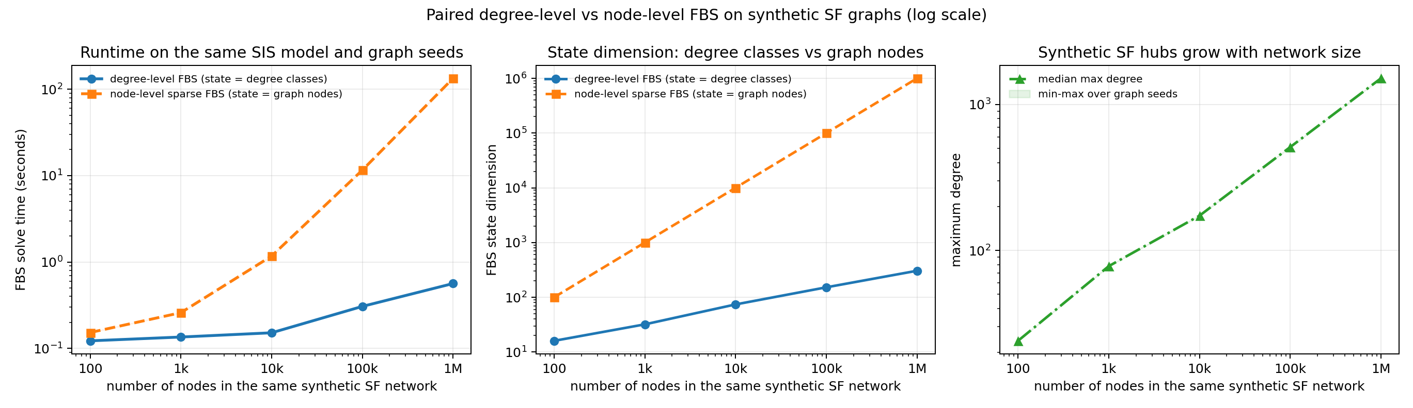
Degree versus node-level scalability
Foundation repository
DEAKIN
The same epidemic-control problem becomes much larger at node level.
- Same synthetic scale-free graph seed for each size.
- Degree-level state uses observed degree classes.
- Node-level state uses one entry per graph node.
The same epidemic-control problem becomes much larger at node level.
Network control tutorial family | Deakin University CRICOS Provider Code: 00113B
26
Notes:
Purpose: The same epidemic-control problem becomes much larger at node level.
Explain: Use the actual checked-in scalability figure. Stress that log scaling helps compare 100 to 1,000,000 nodes.
Demo cue: python run_all.py --skip-reference --skip-scalability
Common misconception: a plotted curve or training loss is evidence to interpret, not an automatic proof of optimality or generalization.

Slide 27
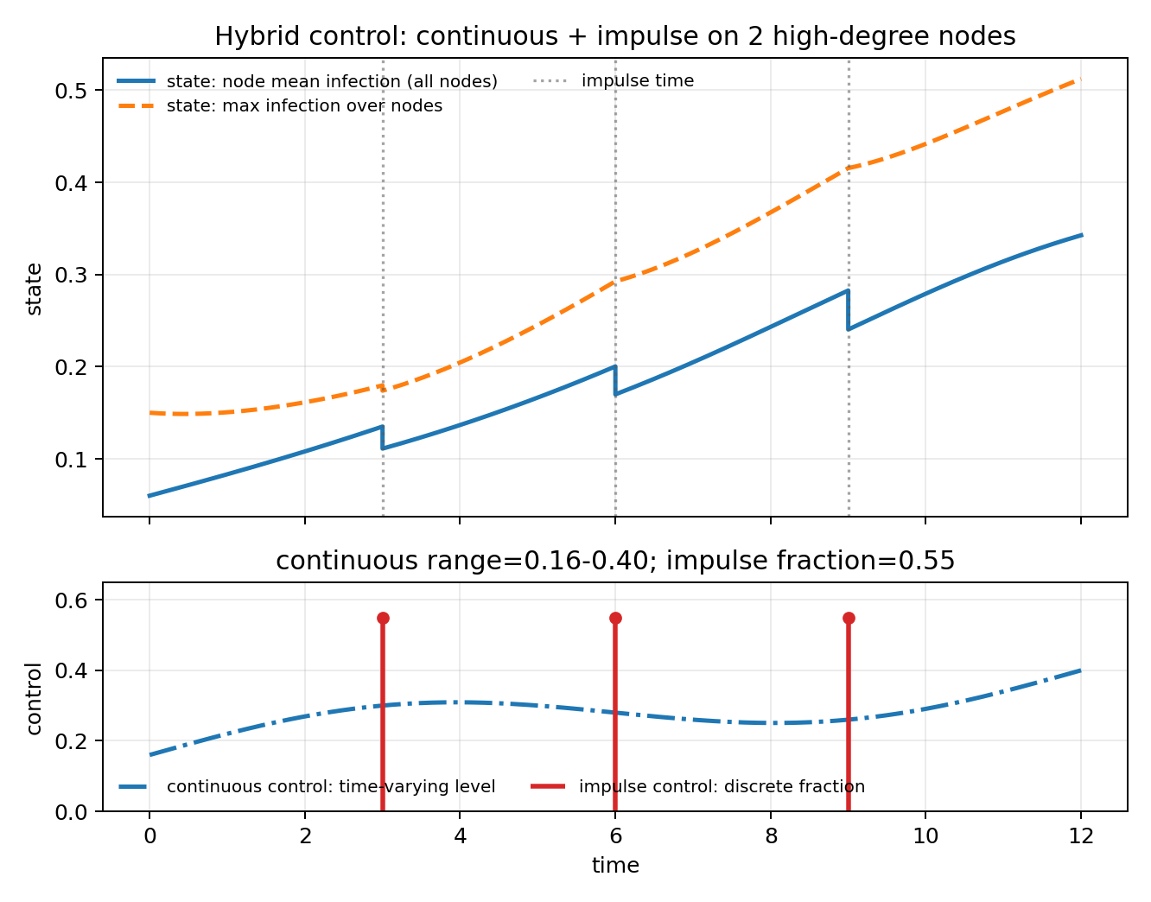
Hybrid/impulse workflow
Foundation repository
DEAKIN
Hybrid examples must label both continuous flow and discrete jumps.
- Continuous dynamics evolve between event times.
- Impulse events are shown as vertical markers.
- Captions say whether curves are node, degree-class, or aggregate averages.
Hybrid examples must label both continuous flow and discrete jumps.
Network control tutorial family | Deakin University CRICOS Provider Code: 00113B
27
Notes:
Purpose: Hybrid examples must label both continuous flow and discrete jumps.
Explain: This reinforces the user's prior requirement about clear labels and captions.
Demo cue: python run_all.py --skip-reference --skip-scalability
Common misconception: a plotted curve or training loss is evidence to interpret, not an automatic proof of optimality or generalization.

Slide 28
Foundation hands-on checkpoint
Foundation repository
DEAKIN
Students should leave the foundation repo able to change one model responsibly.
- Run python run_all.py --skip-reference --skip-scalability.
- Open docs/NOTATION_TO_CODE.md and trace one term.
- Change beta or cost weight and predict the figure change.
- Add one baseline and update the caption.
Students should leave the foundation repo able to change one model responsibly.
Network control tutorial family | Deakin University CRICOS Provider Code: 00113B
28
Notes:
Purpose: Students should leave the foundation repo able to change one model responsibly.
Explain: This checkpoint is intentionally concrete.
Demo cue: python run_all.py --skip-reference --skip-scalability
Common misconception: a plotted curve or training loss is evidence to interpret, not an automatic proof of optimality or generalization.

Slide 29
Why convert the ODE to an MDP?
Game-learning companion
DEAKIN
Learning methods need observations, actions, rewards, and transitions.
- Continuous model gives the flow.
- Environment wrapper selects decision epochs.
- Reward summarizes cyber harm and action cost.
- Policy learns from sampled rollouts.
ODE flow
Env wrapper
Reward
Policy
>
>
>
Learning methods need observations, actions, rewards, and transitions.
Network control tutorial family | Deakin University CRICOS Provider Code: 00113B
29
Notes:
Purpose: Learning methods need observations, actions, rewards, and transitions.
Explain: This is the conceptual bridge from optimal control to RL.
Demo cue: bash scripts/run_smoke_tests.sh && python scripts/generate_figures.py
Common misconception: a plotted curve or training loss is evidence to interpret, not an automatic proof of optimality or generalization.

Slide 30
One sampled transition
Game-learning companion
DEAKIN
A learning step wraps a continuous-time simulation interval.
- observe x(t_k-)
- choose action
- apply jump if any
- flow to t_{k+1}
- return reward and next state
observe x(t_k-)
choose action
apply jump if any
flow to t_{k+1}
return reward and next state
>
>
>
>
A learning step wraps a continuous-time simulation interval.
Network control tutorial family | Deakin University CRICOS Provider Code: 00113B
30
Notes:
Purpose: A learning step wraps a continuous-time simulation interval.
Explain: Use t_k for decision epochs and tau_j for exogenous or designed impulse points.
Demo cue: bash scripts/run_smoke_tests.sh && python scripts/generate_figures.py
Common misconception: a plotted curve or training loss is evidence to interpret, not an automatic proof of optimality or generalization.

Slide 31
State, observation, action, reward
Game-learning companion
DEAKIN
Good RL code states exactly what the agent can see and change.
State: simulator variables used by the environment.
Observation: features exposed to the policy.
Action: discrete or continuous intervention choice.
Reward: signed scalar aligned with cyber objective.
Good RL code states exactly what the agent can see and change.
Network control tutorial family | Deakin University CRICOS Provider Code: 00113B
31
Notes:
Purpose: Good RL code states exactly what the agent can see and change.
Explain: This is where terms like nominal and unknown proxy must be clear in docs.
Demo cue: bash scripts/run_smoke_tests.sh && python scripts/generate_figures.py
Common misconception: a plotted curve or training loss is evidence to interpret, not an automatic proof of optimality or generalization.

Slide 32
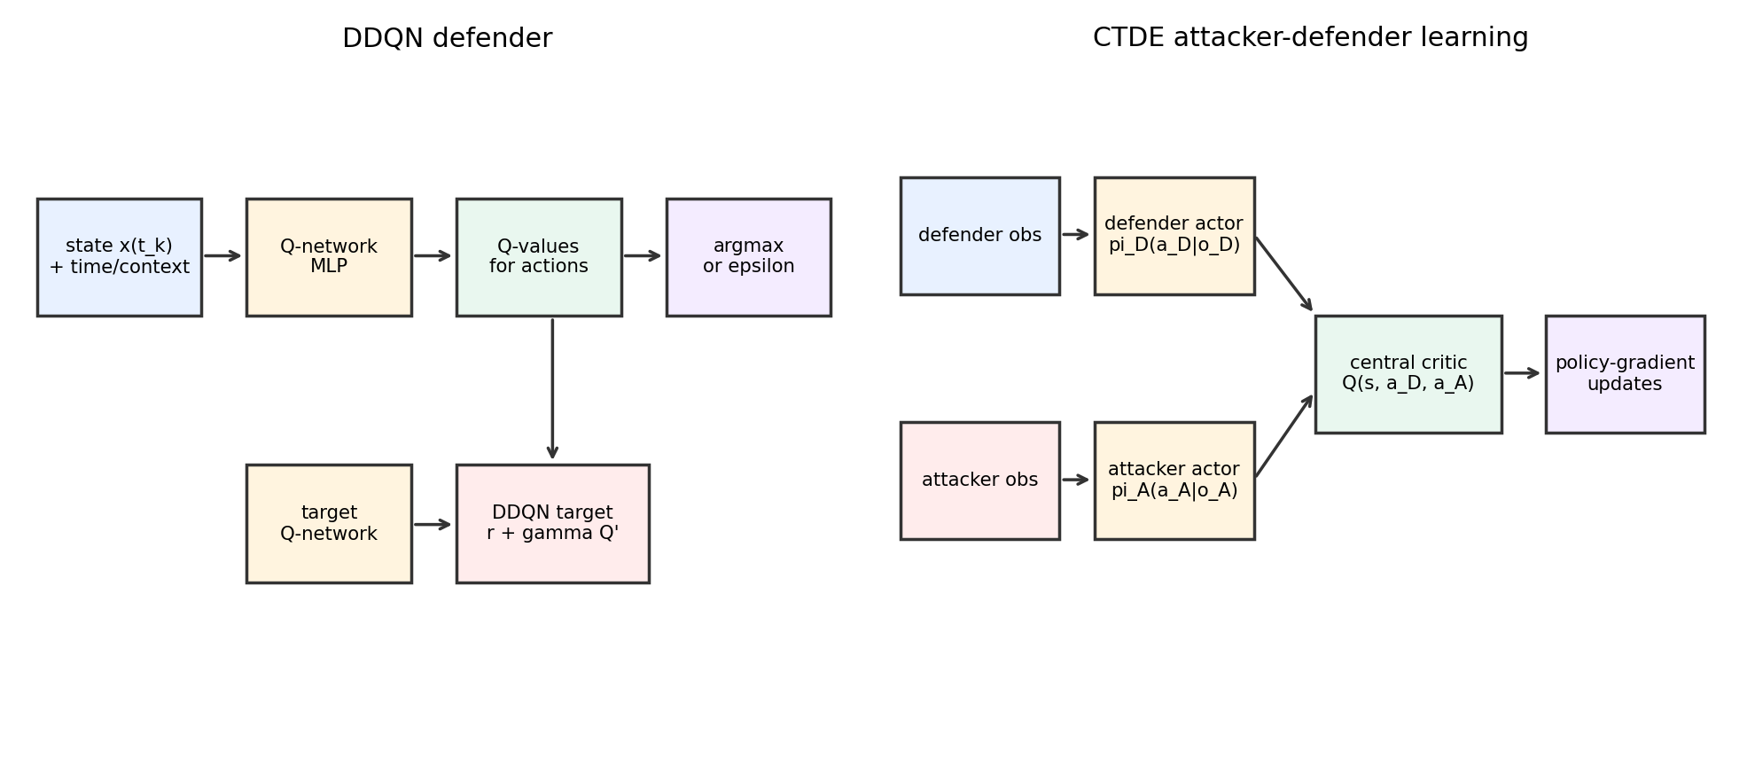
DDQN architecture
Game-learning companion
DEAKIN
DDQN is the beginner-friendly bridge from policy rules to learned feedback.
- Replay buffer stabilizes updates.
- Target network slows the moving target.
- Evaluation uses deterministic rollouts separate from training noise.
DDQN is the beginner-friendly bridge from policy rules to learned feedback.
Network control tutorial family | Deakin University CRICOS Provider Code: 00113B
32
Notes:
Purpose: DDQN is the beginner-friendly bridge from policy rules to learned feedback.
Explain: Use the existing Note 1 architecture figure.
Demo cue: bash scripts/run_smoke_tests.sh && python scripts/generate_figures.py
Common misconception: a plotted curve or training loss is evidence to interpret, not an automatic proof of optimality or generalization.

Slide 33
DDQN run command
Game-learning companion
DEAKIN
The smoke path is short; the longer diagnostics are optional.
cd note1-cyber-control-games
bash scripts/run_smoke_tests.sh
python scripts/generate_figures.py
python scripts/run_training_iterations.py --profile quick
python scripts/run_training_iterations.py --profile gpu --device auto
Run it
Use the full command in speaker notes or README.
Then inspect the generated CSV and figure.
The smoke path is short; the longer diagnostics are optional.
Network control tutorial family | Deakin University CRICOS Provider Code: 00113B
33
Notes:
Purpose: The smoke path is short; the longer diagnostics are optional.
Explain: Explain that smoke tests confirm code paths; longer profiles show learning behavior.
Demo cue: bash scripts/run_smoke_tests.sh && python scripts/generate_figures.py
Common misconception: a plotted curve or training loss is evidence to interpret, not an automatic proof of optimality or generalization.

Slide 34
From one defender to multiple agents
Game-learning companion
DEAKIN
Multi-agent control starts by deciding what is local and what is shared.
- Agent: community, region, node group, or player.
- Local observation: what each agent sees.
- Centralized critic input: global training context.
- Evaluation: decentralized policies acting from local observations.
Multi-agent control starts by deciding what is local and what is shared.
Network control tutorial family | Deakin University CRICOS Provider Code: 00113B
34
Notes:
Purpose: Multi-agent control starts by deciding what is local and what is shared.
Explain: This slide introduces CTDE without calling every multi-agent baseline MAPPO.
Demo cue: bash scripts/run_smoke_tests.sh && python scripts/generate_figures.py
Common misconception: a plotted curve or training loss is evidence to interpret, not an automatic proof of optimality or generalization.

Slide 35
Markov game and CTDE
Game-learning companion
DEAKIN
A Markov game adds multiple policies and coupled rewards.
- Each agent chooses an action at the same decision epoch.
- The environment applies joint action and continuous flow.
- Training may use centralized information.
- Deployment should respect the observation design.
Actor 1
Centralized critic
Actor 2
global training signal
local observations
A Markov game adds multiple policies and coupled rewards.
Network control tutorial family | Deakin University CRICOS Provider Code: 00113B
35
Notes:
Purpose: A Markov game adds multiple policies and coupled rewards.
Explain: Stress the distinction between concept and algorithm.
Demo cue: bash scripts/run_smoke_tests.sh && python scripts/generate_figures.py
Common misconception: a plotted curve or training loss is evidence to interpret, not an automatic proof of optimality or generalization.

Slide 36
Compact CTDE versus full MAPPO
Game-learning companion
DEAKIN
Do not call a compact baseline MAPPO unless it has the MAPPO machinery.
Compact CTDE
Full MAPPO
- Short tutorial baseline
- Limited claims
- Readable first
- Full algorithmic machinery
- Multi-seed evaluation
- Research-ready next
Do not call a compact baseline MAPPO unless it has the MAPPO machinery.
Network control tutorial family | Deakin University CRICOS Provider Code: 00113B
36
Notes:
Purpose: Do not call a compact baseline MAPPO unless it has the MAPPO machinery.
Explain: This responds directly to the prior audit requirement.
Demo cue: bash scripts/run_smoke_tests.sh && python scripts/generate_figures.py
Common misconception: a plotted curve or training loss is evidence to interpret, not an automatic proof of optimality or generalization.

Slide 37
MAPPO rollout and update
Game-learning companion
DEAKIN
MAPPO separates data collection from clipped policy updates.
- Collect rollout.
- Compute returns and GAE.
- Shuffle minibatches.
- Update actor and critic with clipping.
- Evaluate on fixed seeds.
Collect rollout.
Evaluate on fixed seeds.
Compute returns and GAE.
Update actor and critic with clipping.
Shuffle minibatches.
repeat until convergence
MAPPO separates data collection from clipped policy updates.
Network control tutorial family | Deakin University CRICOS Provider Code: 00113B
37
Notes:
Purpose: MAPPO separates data collection from clipped policy updates.
Explain: Define rollout as a complete sequence under a policy, not just one transition.
Demo cue: bash scripts/run_smoke_tests.sh && python scripts/generate_figures.py
Common misconception: a plotted curve or training loss is evidence to interpret, not an automatic proof of optimality or generalization.

Slide 38
Node-SIPRS community environment
Game-learning companion
DEAKIN
The node-level SIPRS wrapper is the bridge to paper-level graph MARL.
- Nodes carry S, I, P, and R shares or probabilities.
- Communities map node groups to defender agents.
- Actions allocate patching, filtering, or recovery effort.
- Rewards combine infected exposure and intervention costs.
The node-level SIPRS wrapper is the bridge to paper-level graph MARL.
Network control tutorial family | Deakin University CRICOS Provider Code: 00113B
38
Notes:
Purpose: The node-level SIPRS wrapper is the bridge to paper-level graph MARL.
Explain: Keep this aligned with the foundation network_models.py specification.
Demo cue: bash scripts/run_smoke_tests.sh && python scripts/generate_figures.py
Common misconception: a plotted curve or training loss is evidence to interpret, not an automatic proof of optimality or generalization.

Slide 39
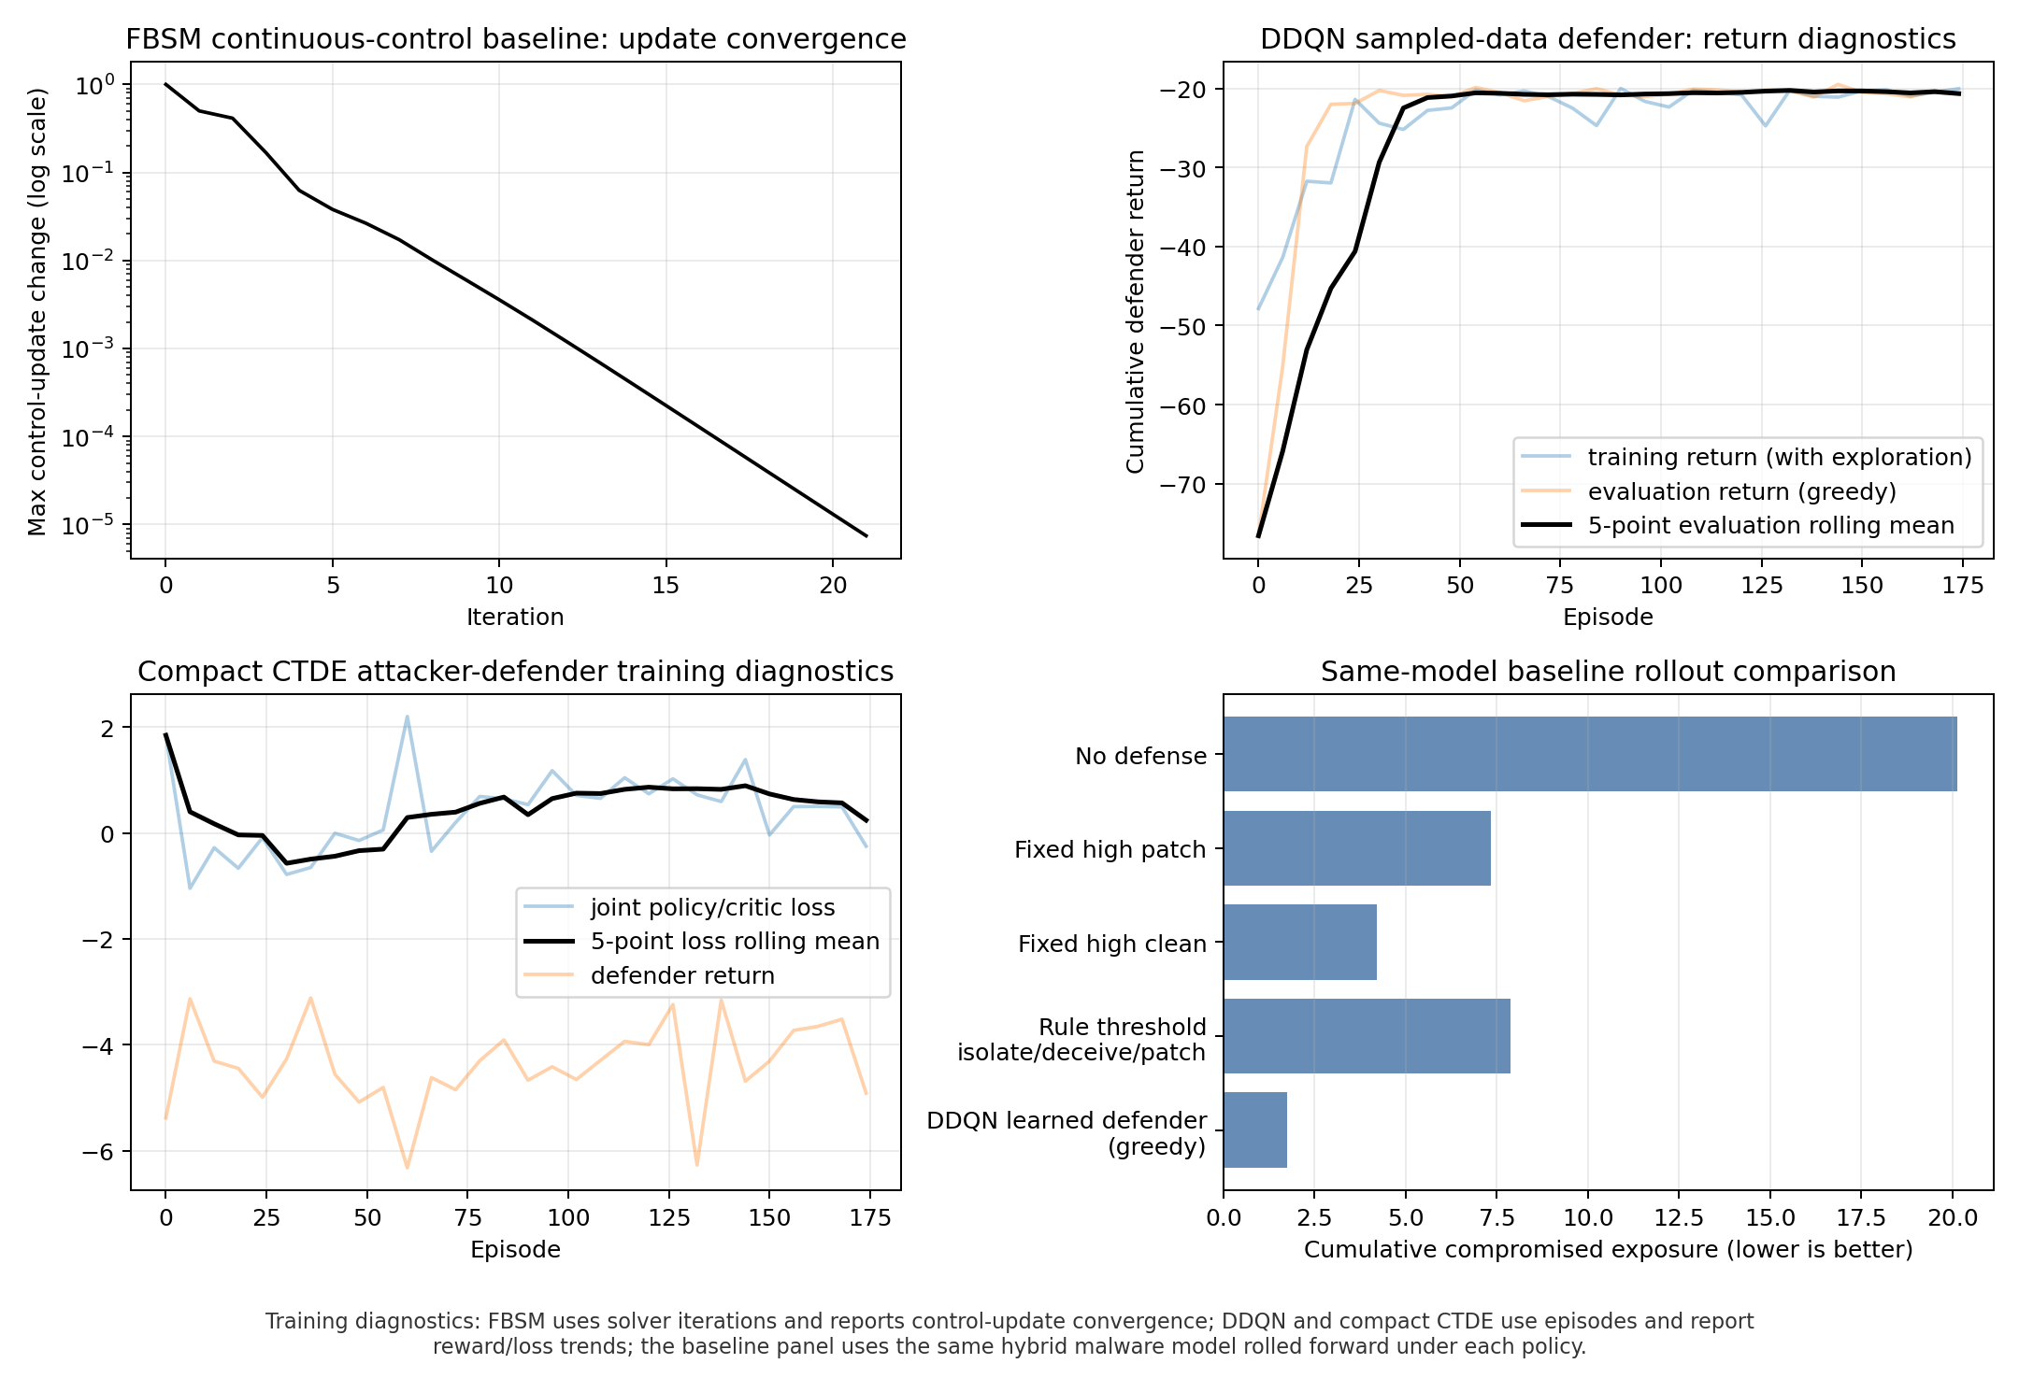
Cooperative community defense
Game-learning companion
DEAKIN
The cooperative setting asks regions to reduce global exposure under local observations.
- The smoke baseline is small enough to inspect.
- Use multiple seeds before making learning claims.
- Report infection exposure, cost, peak, final state, and constraint errors.
The cooperative setting asks regions to reduce global exposure under local observations.
Network control tutorial family | Deakin University CRICOS Provider Code: 00113B
39
Notes:
Purpose: The cooperative setting asks regions to reduce global exposure under local observations.
Explain: Use the training diagnostics as a visual anchor while warning about stochastic learning curves.
Demo cue: bash scripts/run_smoke_tests.sh && python scripts/generate_figures.py
Common misconception: a plotted curve or training loss is evidence to interpret, not an automatic proof of optimality or generalization.

Slide 40
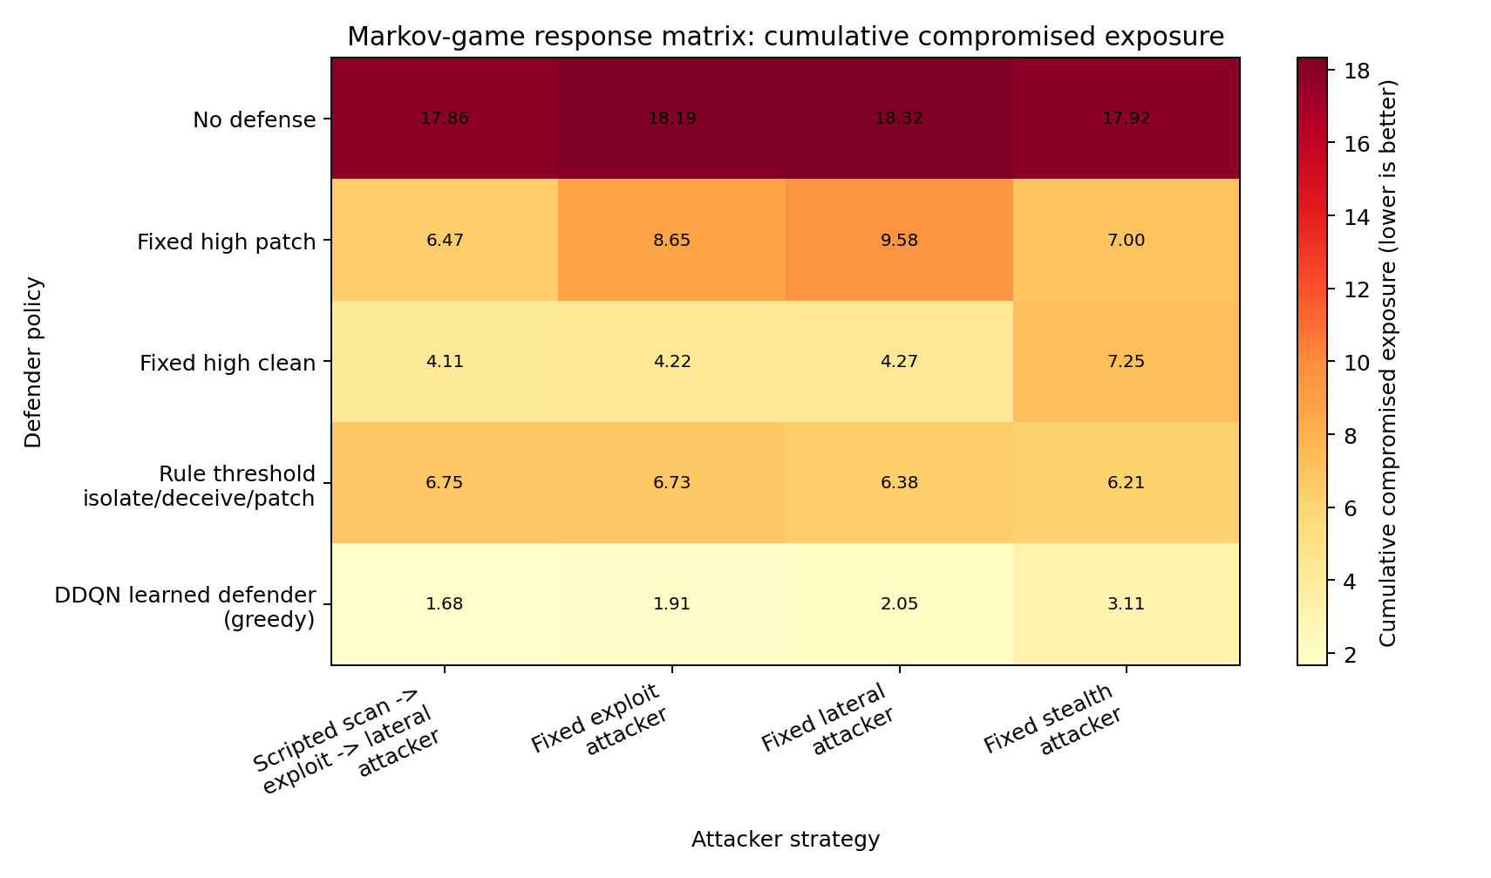
Attacker-defender response example
Game-learning companion
DEAKIN
Game outputs should compare responses, not only one learned curve.
- Fix attacker and vary defender policies.
- Fix defender and vary attacker policies.
- Use payoff or exposure metrics with clear directionality.
Game outputs should compare responses, not only one learned curve.
Network control tutorial family | Deakin University CRICOS Provider Code: 00113B
40
Notes:
Purpose: Game outputs should compare responses, not only one learned curve.
Explain: This matches the user's request for baseline comparison framing.
Demo cue: bash scripts/run_smoke_tests.sh && python scripts/generate_figures.py
Common misconception: a plotted curve or training loss is evidence to interpret, not an automatic proof of optimality or generalization.

Slide 41
Evaluation terms
Game-learning companion
DEAKIN
Use plain definitions before showing training curves.
- Nominal: parameter setting used for training or planning.
- Robustness: lower exposure under specified mismatch, not a guarantee.
- Unknown proxy: observable feature used when the true hidden count is unavailable.
- Rollout: simulator trajectory under a fixed policy or parameter set.
Use plain definitions before showing training curves.
Network control tutorial family | Deakin University CRICOS Provider Code: 00113B
41
Notes:
Purpose: Use plain definitions before showing training curves.
Explain: These terms were previously flagged as unclear; the deck repeats the clarified definitions.
Demo cue: bash scripts/run_smoke_tests.sh && python scripts/generate_figures.py
Common misconception: a plotted curve or training loss is evidence to interpret, not an automatic proof of optimality or generalization.

Slide 42
Game-learning hands-on checkpoint
Game-learning companion
DEAKIN
Students should be able to add one policy and one metric.
- Run bash scripts/run_smoke_tests.sh.
- Open docs/PARAMETERS.md before changing hyperparameters.
- Add a rule-based baseline in the policy comparison table.
- Explain whether the curve is training, evaluation, or rollout behavior.
Students should be able to add one policy and one metric.
Network control tutorial family | Deakin University CRICOS Provider Code: 00113B
42
Notes:
Purpose: Students should be able to add one policy and one metric.
Explain: Give a concrete end state for Note 1.
Demo cue: bash scripts/run_smoke_tests.sh && python scripts/generate_figures.py
Common misconception: a plotted curve or training loss is evidence to interpret, not an automatic proof of optimality or generalization.

Slide 43
Why physics-informed learning?
PINN/PIDL companion
DEAKIN
PINN/PIDL methods use equations when data are sparse, noisy, or partial.
- Data loss fits observations.
- Residual loss penalizes violation of known dynamics.
- Boundary or initial losses anchor the trajectory.
- Control or PMP losses encode decision structure.
PINN/PIDL methods use equations when data are sparse, noisy, or partial.
Network control tutorial family | Deakin University CRICOS Provider Code: 00113B
43
Notes:
Purpose: PINN/PIDL methods use equations when data are sparse, noisy, or partial.
Explain: This orients students before the neural examples.
Demo cue: bash scripts/run_smoke_tests.sh && python scripts/generate_figures.py
Common misconception: a plotted curve or training loss is evidence to interpret, not an automatic proof of optimality or generalization.

Slide 44
PINN as constrained regression
PINN/PIDL companion
DEAKIN
The network is trained to fit data and satisfy differential constraints.
- Neural state function.
- Autograd derivative.
- ODE residual.
- Data and boundary loss.
- Validation rollout.
Network
Autograd
Residual
Loss
Validation
>
>
>
>
The network is trained to fit data and satisfy differential constraints.
Network control tutorial family | Deakin University CRICOS Provider Code: 00113B
44
Notes:
Purpose: The network is trained to fit data and satisfy differential constraints.
Explain: Emphasize that residual consistency is not the same as real-world validation.
Demo cue: bash scripts/run_smoke_tests.sh && python scripts/generate_figures.py
Common misconception: a plotted curve or training loss is evidence to interpret, not an automatic proof of optimality or generalization.

Slide 45
Forward, inverse, control, PMP-informed tasks
PINN/PIDL companion
DEAKIN
The same building blocks support several learning questions.
Forward PINN: learn state trajectory with known parameters.
Inverse PINN: estimate hidden parameters from sparse data.
Control PINN: learn control and state networks together.
PMP-informed PINN: add costate and stationarity residuals.
The same building blocks support several learning questions.
Network control tutorial family | Deakin University CRICOS Provider Code: 00113B
45
Notes:
Purpose: The same building blocks support several learning questions.
Explain: Students should name the task before choosing a loss.
Demo cue: bash scripts/run_smoke_tests.sh && python scripts/generate_figures.py
Common misconception: a plotted curve or training loss is evidence to interpret, not an automatic proof of optimality or generalization.

Slide 46
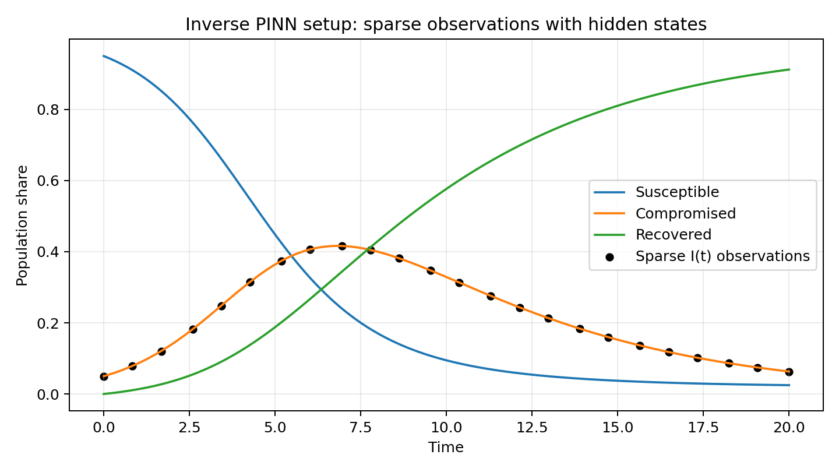
Inverse PINN sparse-observation example
PINN/PIDL companion
DEAKIN
Sparse observations become usable when the residual supplies structure.
- Observed points are not a full trajectory.
- The residual links hidden states and parameters.
- Held-out state error checks whether the reconstruction is meaningful.
Sparse observations become usable when the residual supplies structure.
Network control tutorial family | Deakin University CRICOS Provider Code: 00113B
46
Notes:
Purpose: Sparse observations become usable when the residual supplies structure.
Explain: Use the actual Note 2 figure.
Demo cue: bash scripts/run_smoke_tests.sh && python scripts/generate_figures.py
Common misconception: a plotted curve or training loss is evidence to interpret, not an automatic proof of optimality or generalization.

Slide 47
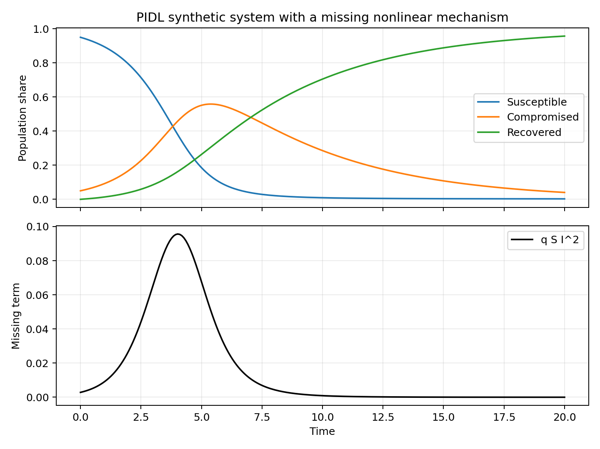
PIDL: known mechanism plus correction
PINN/PIDL companion
DEAKIN
PIDL is useful when part of the mechanism is trusted and part is missing.
- Keep known SIR/SIPRS terms explicit.
- Train a correction network for the missing term.
- Evaluate learned correction and rollout behavior separately.
PIDL is useful when part of the mechanism is trusted and part is missing.
Network control tutorial family | Deakin University CRICOS Provider Code: 00113B
47
Notes:
Purpose: PIDL is useful when part of the mechanism is trusted and part is missing.
Explain: Make the known-plus-unknown split concrete.
Demo cue: bash scripts/run_smoke_tests.sh && python scripts/generate_figures.py
Common misconception: a plotted curve or training loss is evidence to interpret, not an automatic proof of optimality or generalization.

Slide 48
Direct neural control
PINN/PIDL companion
DEAKIN
Direct control PINNs optimize a neural policy against dynamics and objective terms.
- State network approximates trajectory.
- Control network outputs bounded intervention intensity.
- Objective loss represents exposure plus effort.
- Constraint penalties keep state and control feasible.
Direct control PINNs optimize a neural policy against dynamics and objective terms.
Network control tutorial family | Deakin University CRICOS Provider Code: 00113B
48
Notes:
Purpose: Direct control PINNs optimize a neural policy against dynamics and objective terms.
Explain: Direct control is not automatically PMP-consistent; that comes in the next slide.
Demo cue: bash scripts/run_smoke_tests.sh && python scripts/generate_figures.py
Common misconception: a plotted curve or training loss is evidence to interpret, not an automatic proof of optimality or generalization.

Slide 49
PMP-informed residuals
PINN/PIDL companion
DEAKIN
PMP-informed PINNs add optimality conditions to the training objective.
loss = data_loss
loss += w_ode * ||x_t - f(x,u)||^2
loss += w_adj * ||lambda_t + H_x||^2
loss += w_stat * ||H_u||^2
loss += w_bc * boundary_loss
Run it
Use the full command in speaker notes or README.
Then inspect the generated CSV and figure.
PMP-informed PINNs add optimality conditions to the training objective.
Network control tutorial family | Deakin University CRICOS Provider Code: 00113B
49
Notes:
Purpose: PMP-informed PINNs add optimality conditions to the training objective.
Explain: These are schematic terms. Students should inspect the actual loss names in docs/PARAMETERS.md.
Demo cue: bash scripts/run_smoke_tests.sh && python scripts/generate_figures.py
Common misconception: a plotted curve or training loss is evidence to interpret, not an automatic proof of optimality or generalization.

Slide 50
Node/graph SIPRS extension
PINN/PIDL companion
DEAKIN
The graph inverse PINN bridge reuses the same node-SIPRS equations.
- Generate synthetic truth from the shared graph simulator.
- Observe sparse nodes, states, or times.
- Train against data, graph residual, and constraint losses.
- Report state, parameter, residual, and held-out graph metrics.
The graph inverse PINN bridge reuses the same node-SIPRS equations.
Network control tutorial family | Deakin University CRICOS Provider Code: 00113B
50
Notes:
Purpose: The graph inverse PINN bridge reuses the same node-SIPRS equations.
Explain: This is the route from toy inverse PINN to paper-level graph experiments.
Demo cue: bash scripts/run_smoke_tests.sh && python scripts/generate_figures.py
Common misconception: a plotted curve or training loss is evidence to interpret, not an automatic proof of optimality or generalization.

Slide 51
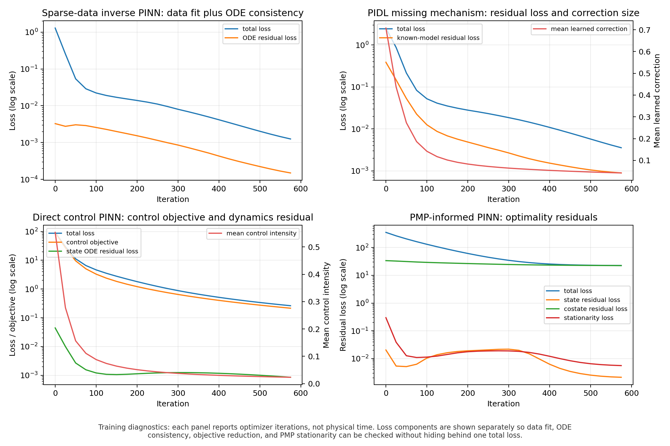
Evaluation with ground truth
PINN/PIDL companion
DEAKIN
Synthetic truth lets students measure errors directly.
- Use held-out time points and nodes.
- Track separate losses rather than one aggregate loss.
- Compare to interpolation, wrong-parameter rollout, and known-only baselines.
Synthetic truth lets students measure errors directly.
Network control tutorial family | Deakin University CRICOS Provider Code: 00113B
51
Notes:
Purpose: Synthetic truth lets students measure errors directly.
Explain: This slide encourages honest metrics.
Demo cue: bash scripts/run_smoke_tests.sh && python scripts/generate_figures.py
Common misconception: a plotted curve or training loss is evidence to interpret, not an automatic proof of optimality or generalization.

Slide 52
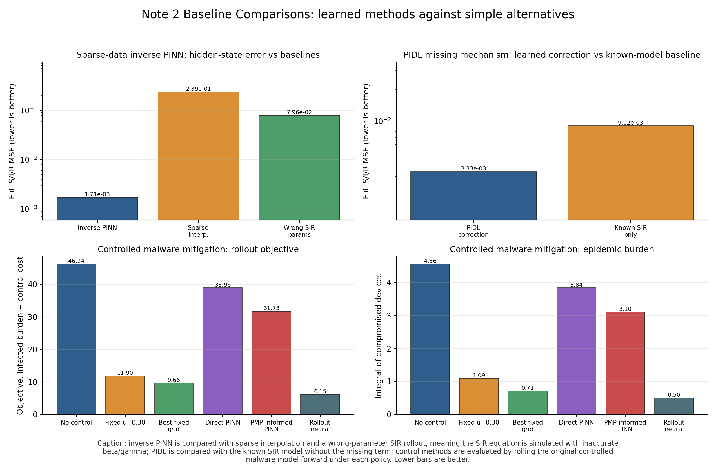
Evaluation without ground truth
PINN/PIDL companion
DEAKIN
When real truth is unavailable, use residual checks and predictive validation.
- Held-out observations: does the model predict unseen data?
- Residual consistency: does it obey known equations?
- Rollout stability: does the learned mechanism produce plausible trajectories?
When real truth is unavailable, use residual checks and predictive validation.
Network control tutorial family | Deakin University CRICOS Provider Code: 00113B
52
Notes:
Purpose: When real truth is unavailable, use residual checks and predictive validation.
Explain: Avoid claiming identifiability without stronger evidence.
Demo cue: bash scripts/run_smoke_tests.sh && python scripts/generate_figures.py
Common misconception: a plotted curve or training loss is evidence to interpret, not an automatic proof of optimality or generalization.

Slide 53
PINN/PIDL hands-on checkpoint
PINN/PIDL companion
DEAKIN
Students should be able to add one loss term and one validation metric.
- Run bash scripts/run_smoke_tests.sh.
- Open docs/PARAMETERS.md for loss weights and network widths.
- Remove or change one loss term and predict the failure mode.
- Add a held-out metric before increasing model complexity.
Students should be able to add one loss term and one validation metric.
Network control tutorial family | Deakin University CRICOS Provider Code: 00113B
53
Notes:
Purpose: Students should be able to add one loss term and one validation metric.
Explain: Give students a safe extension route.
Demo cue: bash scripts/run_smoke_tests.sh && python scripts/generate_figures.py
Common misconception: a plotted curve or training loss is evidence to interpret, not an automatic proof of optimality or generalization.

Slide 54
One cross-repo research question
Integration
DEAKIN
Paper-level work needs model, method, baselines, and evidence.
- Foundation: define the node-SIPRS model.
- Note 1: learn feedback/game policies.
- Note 2: infer unknown graph mechanisms.
- Paper: compare under clear limits.
Foundation
model and simulator
Note 1
feedback/game learning
Note 2
inverse/missing terms
Paper-level work needs model, method, baselines, and evidence.
Network control tutorial family | Deakin University CRICOS Provider Code: 00113B
54
Notes:
Purpose: Paper-level work needs model, method, baselines, and evidence.
Explain: This is the cross-repo synthesis slide.
Demo cue: connect this slide to the relevant README section.
Common misconception: a plotted curve or training loss is evidence to interpret, not an automatic proof of optimality or generalization.

Slide 55
From model to paper
Integration
DEAKIN
The final deliverable is a disciplined evidence chain, not just a trained model.
- Question
- Equations
- Baselines
- Method
- Ablations
- Validation
- Figures
- Claims
1
2
3
4
5
Question
Model
Method
Evidence
Paper
The final deliverable is a disciplined evidence chain, not just a trained model.
Network control tutorial family | Deakin University CRICOS Provider Code: 00113B
55
Notes:
Purpose: The final deliverable is a disciplined evidence chain, not just a trained model.
Explain: Close the core deck by sending students to docs/from_model_to_paper.md and companion PAPER_WORKFLOW.md files.
Demo cue: connect this slide to the relevant README section.
Common misconception: a plotted curve or training loss is evidence to interpret, not an automatic proof of optimality or generalization.

Slide 56
Command cheat sheet
Appendix
DEAKIN
Most workflows use a small set of repeatable commands.
python run_all.py --skip-reference --skip-scalability
bash scripts/run_smoke_tests.sh
python scripts/generate_figures.py
python scripts/run_training_iterations.py --profile quick
pytest
python -m compileall .
Run it
Use the full command in speaker notes or README.
Then inspect the generated CSV and figure.
Most workflows use a small set of repeatable commands.
Network control tutorial family | Deakin University CRICOS Provider Code: 00113B
56
Notes:
Purpose: Most workflows use a small set of repeatable commands.
Explain: Use this as the live-demo slide if time is short.
Demo cue: connect this slide to the relevant README section.
Common misconception: a plotted curve or training loss is evidence to interpret, not an automatic proof of optimality or generalization.

Slide 57
File and function index
Appendix
DEAKIN
The fastest way to extend is to start from the right file.
Foundation: src/cybercontrol/network_models.py.
Foundation examples: examples/foundations/code/.
Note 1 profiles: src/scenario_profiles.py.
Note 2 profiles: src/experiment_profiles.py.
The fastest way to extend is to start from the right file.
Network control tutorial family | Deakin University CRICOS Provider Code: 00113B
57
Notes:
Purpose: The fastest way to extend is to start from the right file.
Explain: Students should not start by editing generated outputs.
Demo cue: connect this slide to the relevant README section.
Common misconception: a plotted curve or training loss is evidence to interpret, not an automatic proof of optimality or generalization.

Slide 58
Hyperparameter starting points
Appendix
DEAKIN
Keep hyperparameters visible and small before scaling.
- Read docs/PARAMETERS.md first in each repo.
- Smoke runs use short horizons and few iterations by design.
- Neural diagnostics expose learning rate, width, epochs, seeds, and device.
- Scale one axis at a time: graph size, horizon, seeds, or network width.
Keep hyperparameters visible and small before scaling.
Network control tutorial family | Deakin University CRICOS Provider Code: 00113B
58
Notes:
Purpose: Keep hyperparameters visible and small before scaling.
Explain: This aligns with the user's request that parameters and hyperparameters be easy to see.
Demo cue: connect this slide to the relevant README section.
Common misconception: a plotted curve or training loss is evidence to interpret, not an automatic proof of optimality or generalization.

Slide 59
Common errors and debugging
Appendix
DEAKIN
Most failures are environment, shape, or timing mismatches.
- Import error: install the foundation package in editable mode.
- Shape error: check aggregate, degree, or node-level state dimensions.
- Flat control curve: check cost weights and bounds.
- Unclear plot: fix label before changing the method.
Most failures are environment, shape, or timing mismatches.
Network control tutorial family | Deakin University CRICOS Provider Code: 00113B
59
Notes:
Purpose: Most failures are environment, shape, or timing mismatches.
Explain: Frame debugging as a reproducibility habit.
Demo cue: connect this slide to the relevant README section.
Common misconception: a plotted curve or training loss is evidence to interpret, not an automatic proof of optimality or generalization.

Slide 60
Glossary
Appendix
DEAKIN
Use terms consistently across notes and figures.
- Nominal: parameter setting used for planning or training.
- Rollout: simulator trajectory under fixed policy/parameters.
- Robustness: performance under a named shift, not a proof.
- Hybrid: continuous flow plus discrete jumps.
Use terms consistently across notes and figures.
Network control tutorial family | Deakin University CRICOS Provider Code: 00113B
60
Notes:
Purpose: Use terms consistently across notes and figures.
Explain: This reinforces the terminology cleanup in the repositories.
Demo cue: connect this slide to the relevant README section.
Common misconception: a plotted curve or training loss is evidence to interpret, not an automatic proof of optimality or generalization.

Slide 61
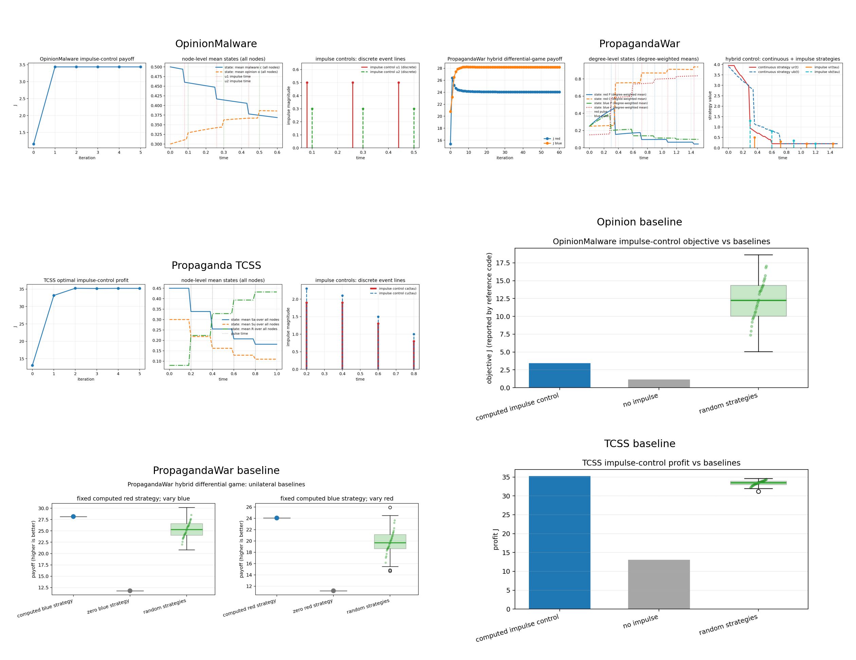
Repository URLs and references
Appendix
DEAKIN
The public repos are the authoritative source for commands and figures.
- Foundation URL: see the README.
- Note 1 and Note 2 URLs: see related repos.
- Reference snapshots keep upstream notices.
- Do not redistribute private templates without rights.
The public repos are the authoritative source for commands and figures.
Network control tutorial family | Deakin University CRICOS Provider Code: 00113B
61
Notes:
Purpose: The public repos are the authoritative source for commands and figures.
Explain: End with the licensing reminder: do not redistribute private templates or third-party assets without rights.
Demo cue: connect this slide to the relevant README section.
Common misconception: a plotted curve or training loss is evidence to interpret, not an automatic proof of optimality or generalization.

