Slide 1


OI Trainer 3D
Migration to Immersive 3D Environments

Slide 2

Core Objectives
Immersive Scene
Logic Retention
Migrate the 2D UI-only game into a first-person 3D classroom with spatial interaction.
Keep the original legacy gameplay logic intact by hosting it on a 3D whiteboard.

Slide 3
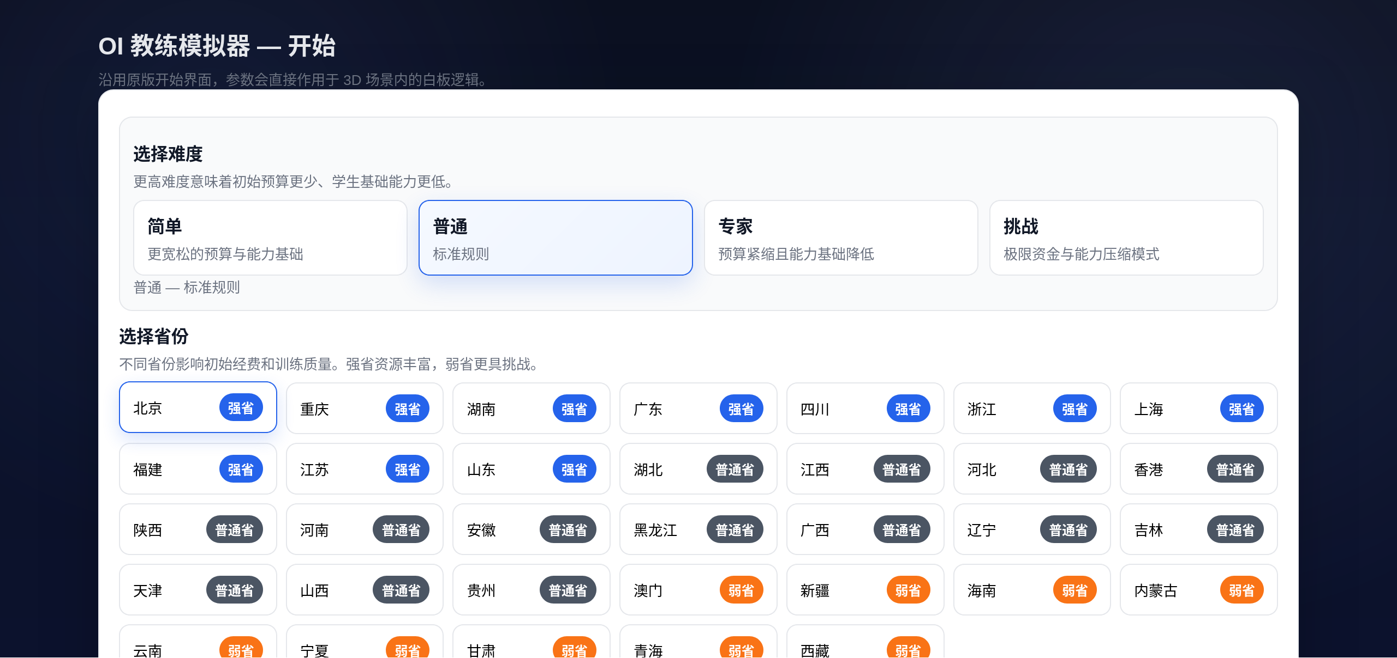
Results & Demo

Slide 4
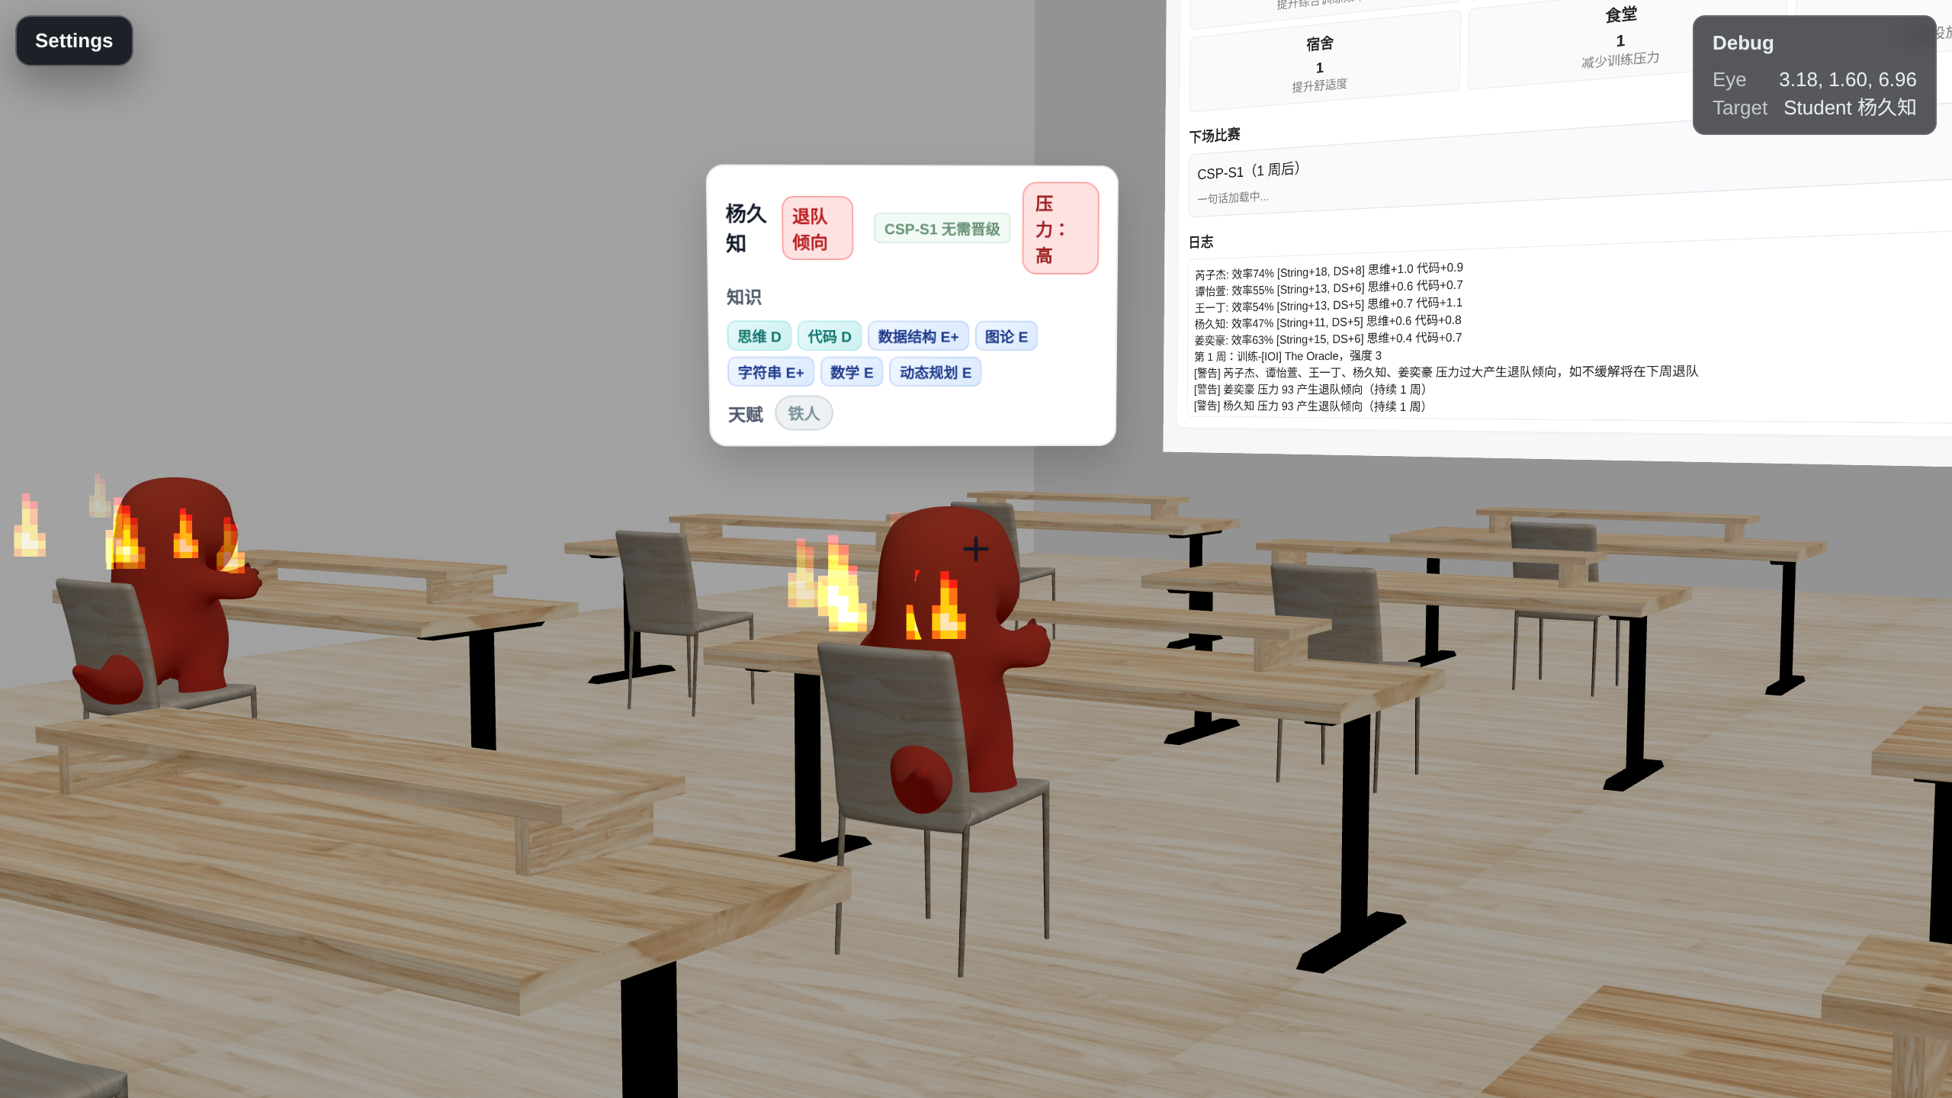
Results & Demo

Slide 5
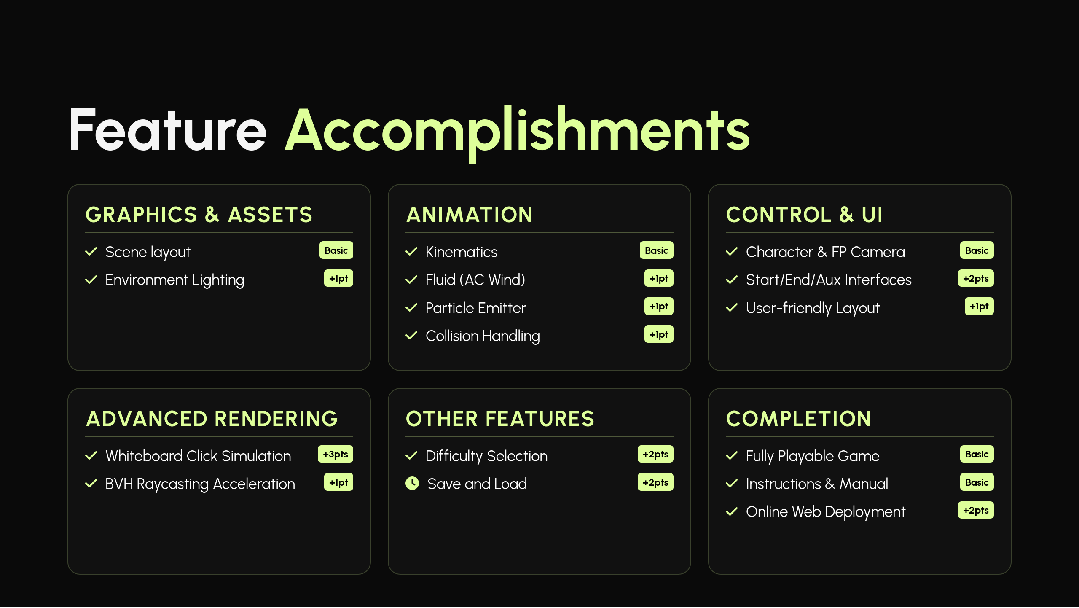

Slide 6






Tech: Interactive Whiteboard
Mechanism: simulateClick routes 3D Raycasts to DOM elements.

Slide 7

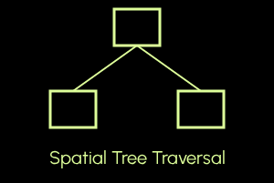
Tech: Picking Acceleration
BVH Hierarchy
Standard raycasting scales linearly with triangle count O(N).
We use three-mesh-bvh to reduce expected picking time to O(log N).

Slide 8
Stability Architecture
Asset Prefetch
DOM Persistence
Network loading manager pre-loads GLB models to prevent long waiting time.
On-demand regeneration of the whiteboard root avoids DOM tracking bug.

Slide 9
Thanks for listening!

