Slide 1

Veterans Affairs Participatory Systems Dynamics
Sankey Diagrams – Discussion
30 November, 2017

Slide 2
Context
We are investigating how we may be able to incorporate Sankey diagrams into the simulation outputs
This document (and related discussions) will help us determine IF we can do the Sankey diagrams, and HOW we may be able to provide them through the simulation.

Slide 3
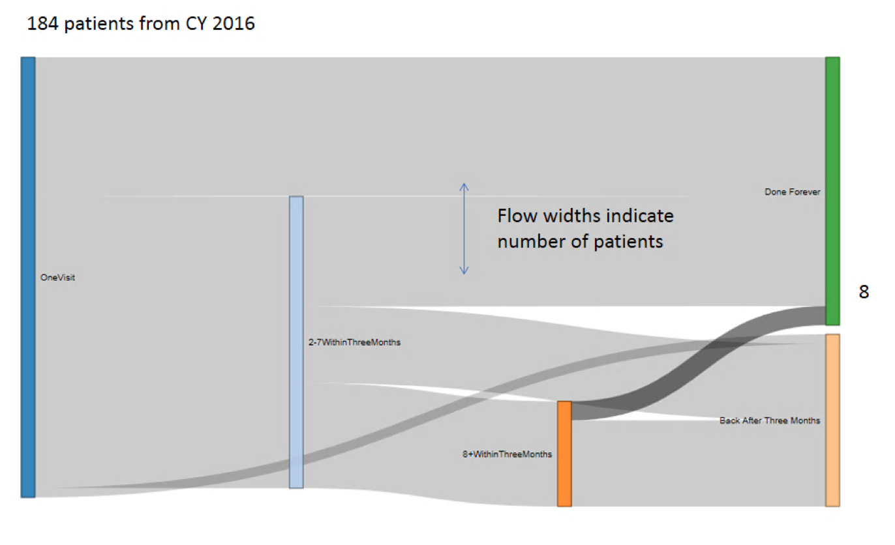
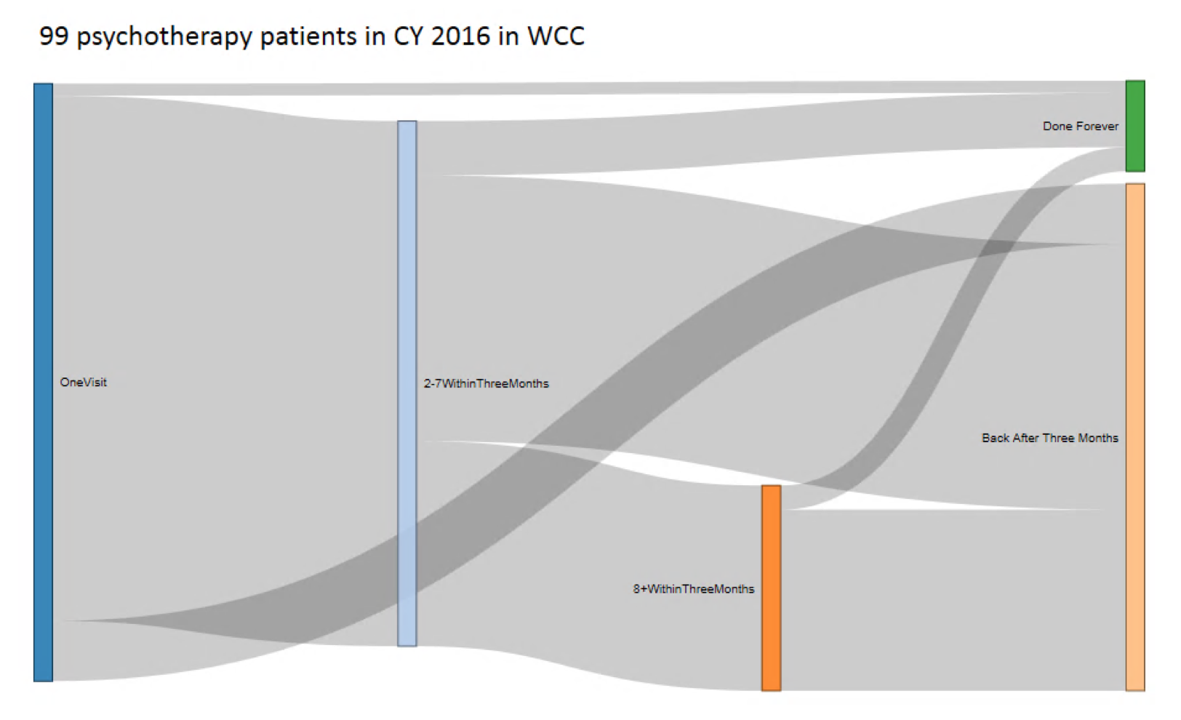
Example from Previous

Slide 4
Confirmation of Logic (all possible flows)
Done Forever
One Visit
2-7 Within Three Months
8+ Within Three Months
Back After Three Months

Slide 5
Key Questions
Where do we get values?
Vensim variables? At what time?
Accumulation? Point-in-time?
What happens if we are in Week 10 of a 40 week total run?

