Slide 1

Veterans Affairs Participatory Systems Dynamics
Takouba Status and Review
30 November, 2017

Slide 2
Topics
Questions and Issues to resolve
Revised Schedule
How we are managing Teams and Groups
Iteration C

Slide 3
Questions and Issues to resolve
Have you been able to access Iteration A (PROD)?
There’s some content we need.
Decisions and design we need to validate for Iteration C.
Section 508 testing (prep, communications).
Agg model availability (for Iteration C Design).

Slide 4
Schedule (Revised on 28-Nov)
Iteration | Description | Design Finalized | Development Finished | Delivered to PSD Team
A | Logon, basic UI, screen flows, initial input/output (few example elements). | 09-Oct | 30-Oct 01-Nov | 06-Nov 08-Nov
B | Initial reports and output, initial user input, gameplay and session, chat, compare scenarios/teams. CC/MM/ Psy, no Phone, no Admin/Fac Expanded Output Tile. | 30-Oct 08-Nov | 20-Nov 04-Dec 29-Dec | 27-Nov 11-Dec 05-Jan
C | Iteration C: User/access management, videos and training-related, additional inputs and outputs. CC/MM/Psy/Agg, Phone, Admin/Fac Expanded Output Tile. | 27-Nov 04-Dec 18-Dec | 18-Dec 01-Jan 29-Jan | 25-Dec 08-Jan 05-Feb
D | Full feature v1.0. | 02-Jan 15-Jan | 22-Jan 05-Feb 19-Feb | 29-Jan 12-Feb 26-Feb

Slide 5
How we are managing Teams and Groups
Requirements
Administrator/Facilitator needs to access/compare run results across teams.
Expansion to many more teams.
Constraints
Forio’s concept of Facilitator only exists at a “Group” level. A Facilitator does not have access to other Groups.
Forio can have multiple Worlds in a Group, but the Worlds are numbered (and cannot be named). Users can be assigned to one World.
Resolution
We have one Group. All Teams are in the same Group.
Each Team is one World in the Group.
Implications
Individuals on multiple Teams need multiple logons. Benefit is that the Individual can be playing in more than one Team at a time (on different browsers).
We need to maintain a mapping list of Worlds to Team Names. Example: World 001 = “Team ATS, Menlo Park”.
For a Facilitator to “play” a game, we can set up the Facilitator with a Team Login or they can Impersonate a Player.

Slide 6
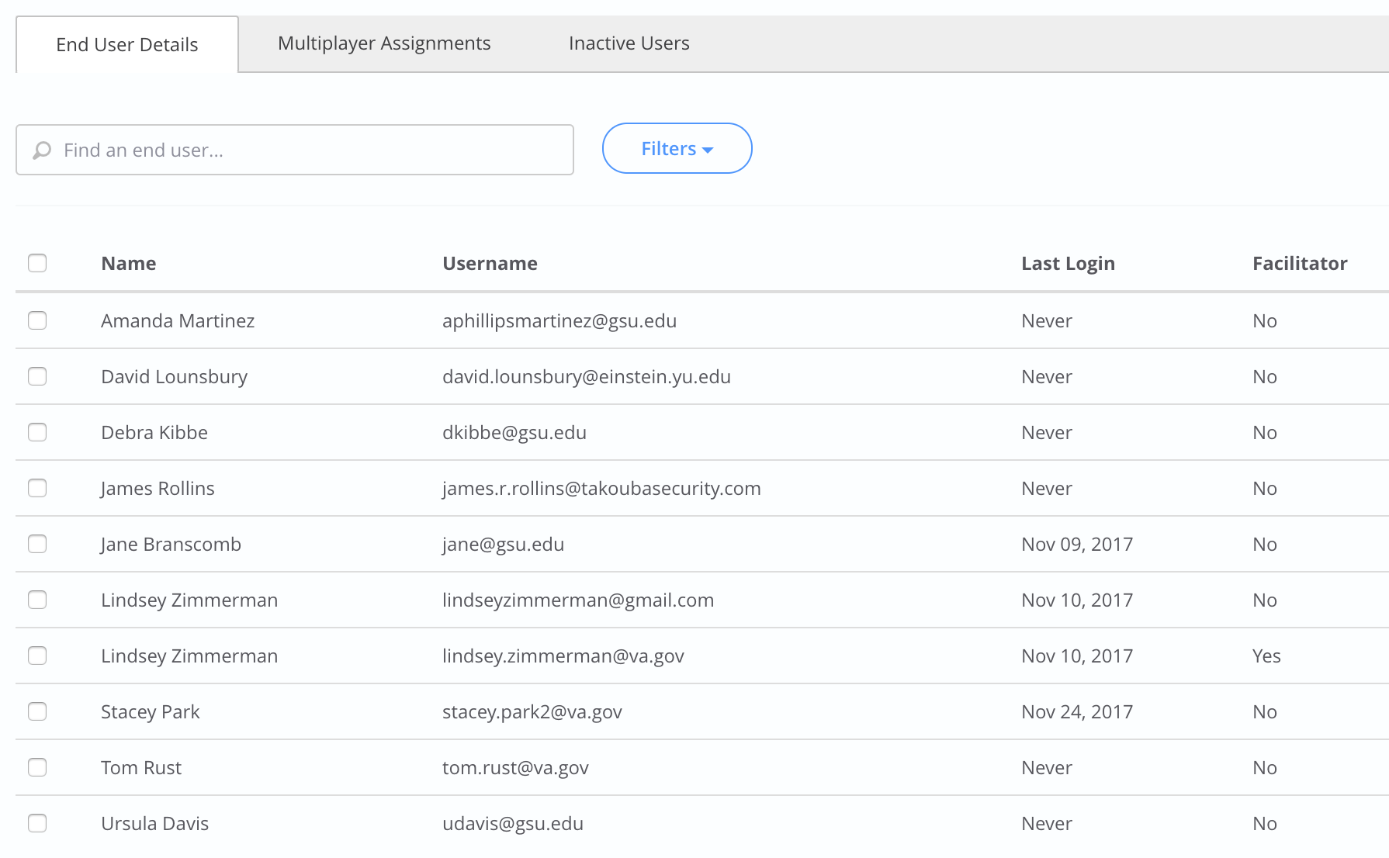
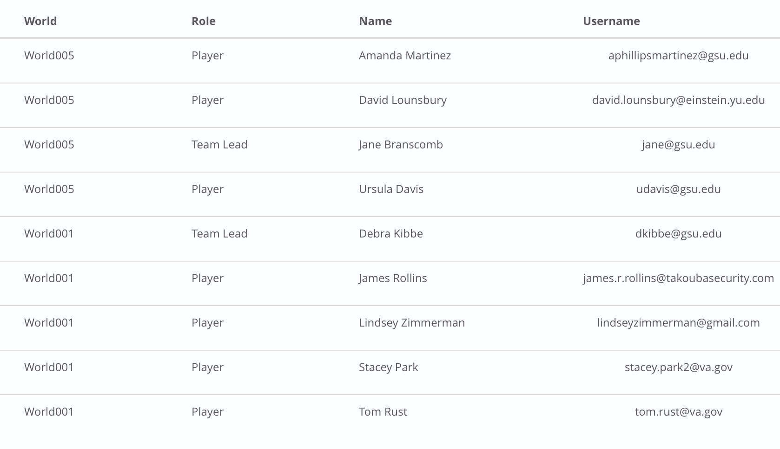
How we are managing Teams and Groups In Forio Epicenter

Slide 7
Iteration C – What we are working on
Administrator/Facilitator Expanded Outputs Tile (4 milestones)
Options for Phone – no Diagram
Sankey Diagram
SAIL Metrics
Agg model (diagram, list of decision and output variables, test, etc).

