Slide 1
NLP基础
凌春阳 2018.9.6

Slide 2
Outline
Introduction
Word Representation
Document representation
Text classification

Slide 3
Introduction
Artificial/Formal language VS Natural Language
Ambiguity on many levels: words level, syntax level, semantic/discourse level…
Rules but also exceptions
机器缺乏知识
Methodology
Rationalism vs Empiricism, rule-based vs data-driven
统计方法目前主流，但容易忽视语言深层结构，结果也不好解释分析

Slide 4
Introduction
Artificial/Formal language VS Natural Language
Ambiguity on many levels: words level, syntax level, semantic/discourse level…
Rules but also exceptions
机器缺乏知识
Methodology
Rationalism vs Empiricism, rule-based vs data-driven
统计方法目前主流，但容易忽视语言深层结构，结果也不便于解释分析
NLP tasks
As input: Natural language understanding, e.g. information extraction, text classification…
As output: Natural language generation, e.g. summarization, dialogue…
More complicated: MT, QA…

Slide 5
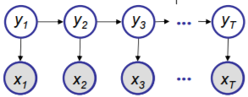

Word Segmentation
分词目的
词：能独立使用的最小音义结合体
歧义：交集型与组合型，e.g. 重庆市长江大桥，学生会写文章
分词方法
基于词典匹配 VS 基于统计学习
Sequence tagging problem： 0/1， BMES label
算法：HMM, CRF…
工具：jieba, THULAC, 语言云( LTP-Cloud) …
B M E B M M E
重 庆 市 长 江 大 桥
-> 重庆市 / 长江大桥
$$y^{∗}={argmax}_{y} P(y|x)$$
Notes:
专业术语 缩略词，人名，机构名
基于前缀词典实现高效的词图扫描, 对于未登录词，采用了基于汉字成词的 HMM 模型

Slide 6
Word Segmentation
领域特定词汇表
自定义的词典都是重要的，未登录词问题
data/user_dict.txt，可加入搜狗细胞词库更新
停用词表
无实际意义和信息量很少的词，e.g. 符号，助词，介词，语气词..
data/stopwords，需要手动更新
util.nlp.tokenize
基于jieba分词，加载自定义词汇表和停用词表
tokenizer = Tokenizer()
wordlist = tokenizer.tokenize(text, rm_stopwords=True, filter_num=True)
uitl.nlp.windnews_parser
parse_raw_files(news_basedir, output_dir)：wind新闻预处理，提取文本并分词
Notes:
专业术语 缩略词，人名，机构名
基于前缀词典实现高效的词图扫描, 对于未登录词，采用了基于汉字成词的 HMM 模型

Slide 7
Word Representation
One-hot
[0 0 0 0 0 0 0 0 0 0 1 0 0 0 0] -- 茫茫0海中的那个1
Dimension is very large (=|vocabulary|), while preserved little information
Distributed representation
Intuition: 经常一起出现的词；具有相似上下文的词
Key idea:
produce dense vector based on the context of words
Why dense？
Dimensionality reduction:
easy for learning parameters, de-noising, generalize better
Capture more features：
Similar contexts and similar relations.

Slide 8
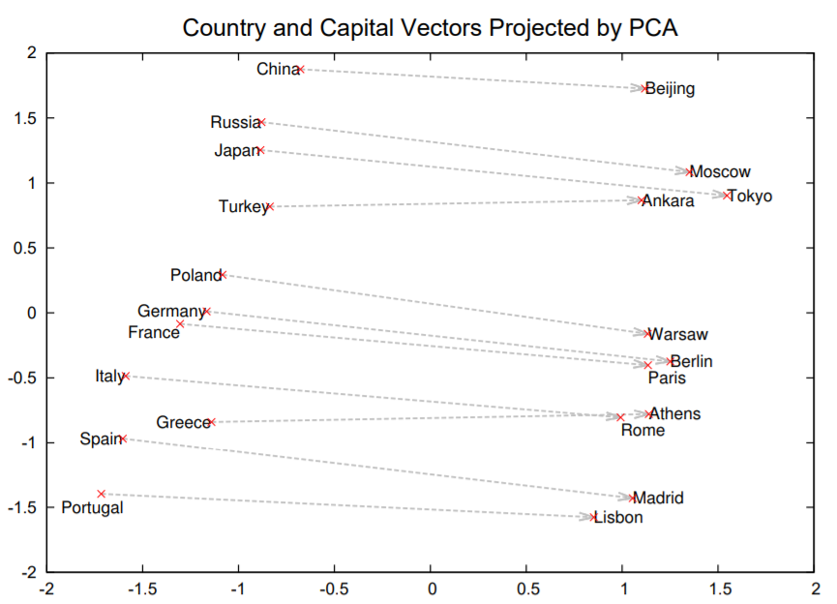

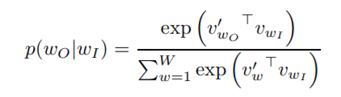
Word Representation
Word2vec: skip-gram & CBOW
Skip-gram predicts context given target
Maximize log-likelihood
Defining the probability
Softmax is very slow: hierarchical softmax and negative sampling
e.g. The cat sat on the mat.

Slide 9



Document Representation
Bag of words
A set of different words in a document.
Word counts based.
TF-IDF
Term frequency: (假设词频高的更重要)
Inverse document frequency: (假设文本频率高的词更不重要)
Word i in document j:
Pros: 试图调整权重，抑制噪声
Cons: 高维稀疏的向量表示(d = |Vocabulary|); 没有考虑单词的位置信息，句子的结构信息等
$${tf}_{i,j} = \frac{n_{i, j}}{\sum_{k}{n_{k, j}}}$$
$${idf}_{i} =log\frac{|D|}{|\{j: t_{i}∈d_{j}\}|}$$
$${tfidf}_{i,j} ={tf}_{i,j} ×{idf}_{i}$$

Slide 10
Document Representation
util.nlp.vectorize
build_vocabulary(docs, filename, vocab_size, min_df)
为文档集构建词汇表，单词的文档频率必须大于min_df，取词频最高的vocab_size个词。
convert_to_one_hots(docs, vocab_path, max_seq_len)
将文档集转化为one_hot形式，并padding为相同长度，小于该长度补0，大于该长度截断。
tf_idf(docs, vocab_path)
将文档集转化为tf_idf形式

Slide 11
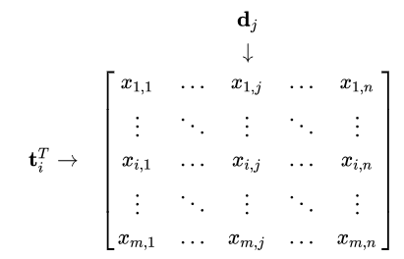
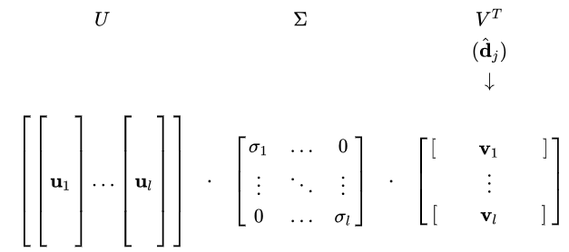
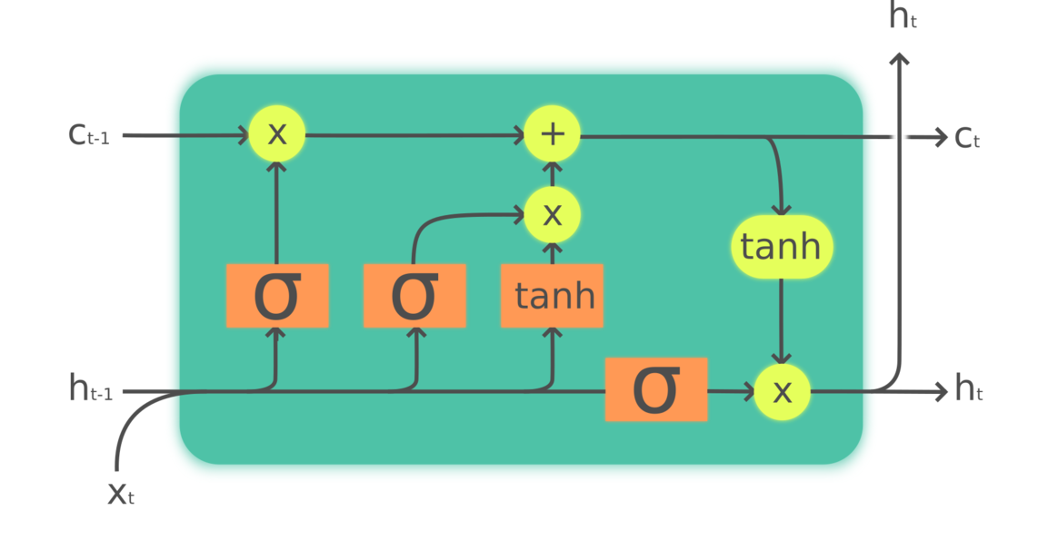
Document Representation
LSA (Latent Semantic Analysis)
Term-document matrix
Matrix decomposition like SVD
Neural Networks
CNN
One dimensional convolution to capture local context features.
RNN / LSTM
Long dependency in time series; bidirectional.
Only consider sequences, no more structures.

Slide 12
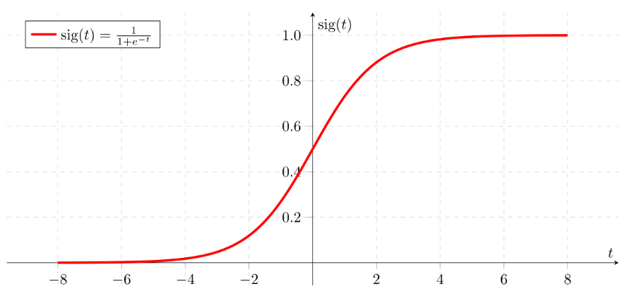

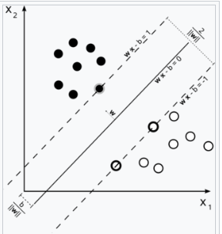
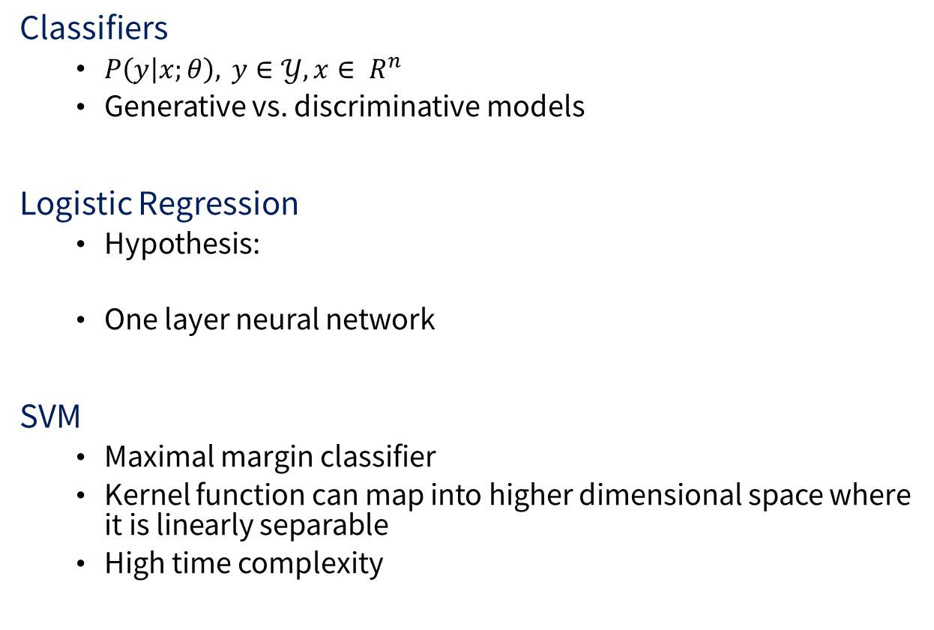
Text classification
Classifiers
$P\left(y | x;θ\right), y∈𝒴, x∈ R^{n}$
Generative vs. discriminative models
Logistic Regression
Hypothesis:
One layer neural network
SVM
Maximal margin classifier
Kernel function can map into higher dimensional space where it is linearly separable
High time complexity

Slide 13
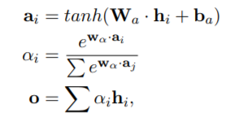
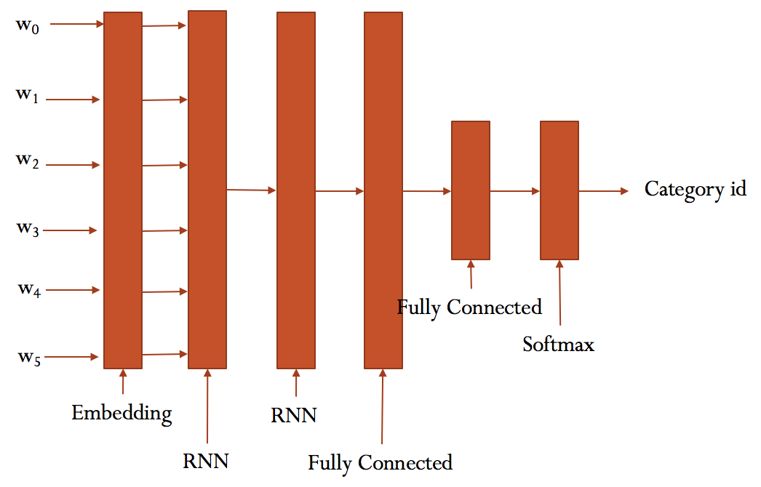
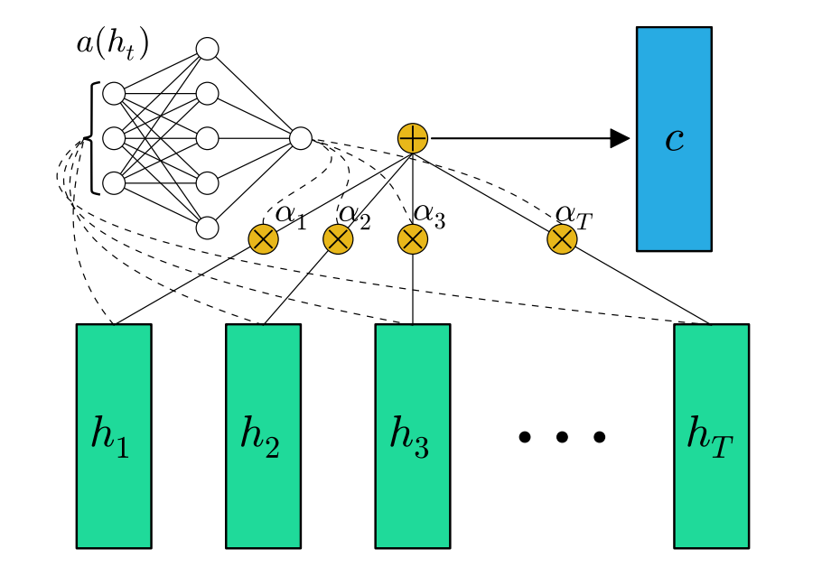
Text classification
Neural network
Attention mechanism
Attention/Mean over Time Pooling

Slide 14
Text classification
util.nlp.simple_model
benchmark(clf, name, X_train, Y_train, X_test, Y_test)：训练并评估一个分类器
run_logistic_regression(basedir, test_percent=0.1)：训练一个逻辑回归模型
util.nlp.neural_model
class Attention(Layer)：实现attention的keras层
get_LSTM_model(embedding_dim, vocab_size, max_seq_len, lstm_units, dense_units)：keras模型
Embedding_dim: embedding维度
Vocab_size: 词汇表大小
Max_seq_len: 文本序列长度
Lstm_units: LSTM层单元数量
Dense_units: dense层单元数量

Slide 15
Experiments
Dataset
Wind 正负面新闻，正面新闻17-18年共61,553条，负面新闻14-18年共119,813条。10%作为验证集。
新闻长度统计信息：平均值542，中位数387, 最大值56821，0.8分位数818。选择Padding-length = 800
Result
Training：约200min per epoch，20个epoch中第15个达到最佳准确率，趋于收敛。
Accuracy：训练集92.8%，验证集91.0%

Slide 16


