Slide 1

Programing Clinic
Project reports-Bookstore
reporting person：Duan Youzhen&Ding Yiming
reporting time：26.02.2024
Notes:
模板来自于： 第一PPT https://www.1ppt.com/

Slide 2
行业PPT模板http://www.1ppt.com/hangye/
CONTENTS
1 Overview of Engineering Documents OUTLINED
2 Ding Yiming in charge
3 Duan Youzhen in charge
4 Problems encountered during programming PROBLEM

Slide 3
Part I
Overview of Engineering Documents OUTLINED
Relevant code overview and effect implementation

Slide 4
Project ideas
Book store：
The use of Django comes with Admin and ORM framework will be able to easily implement a many-to-many table relationship between add, delete and retrieve.
Notes:
模板来自于： 第一PPT https://www.1ppt.com/

Slide 5
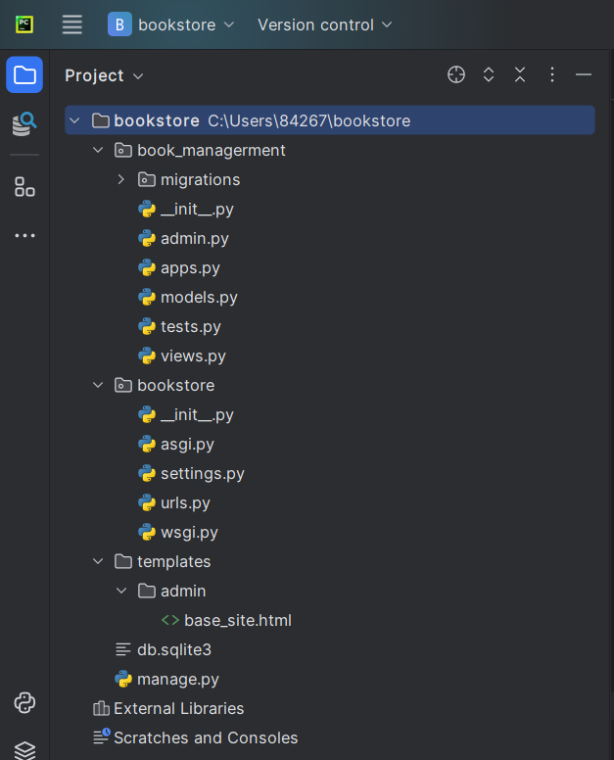
Project Catalogue

Slide 6
Screenshot of function running
Find books by author name
Add a book
Search for books by title
Show all books
arrange in order
Modify Book Information
Delete function

Slide 7
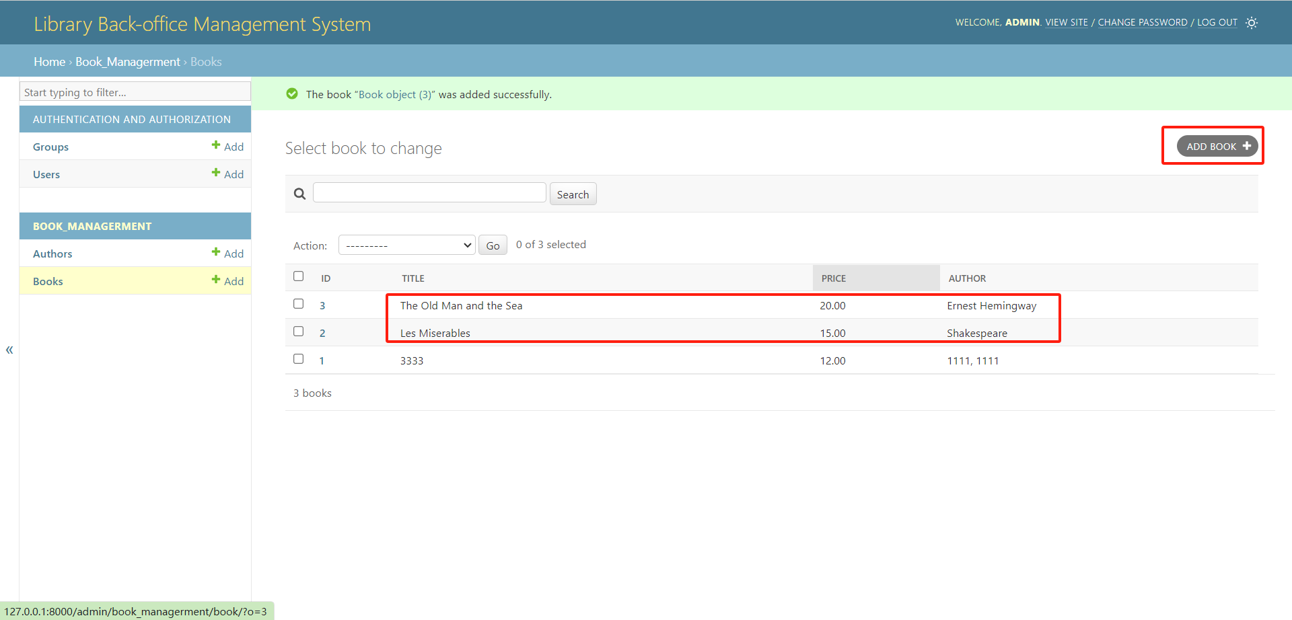
Add a book（Les Miserables and The Old Man and the Sea）
Notes:
模板来自于： 第一PPT https://www.1ppt.com/

Slide 8
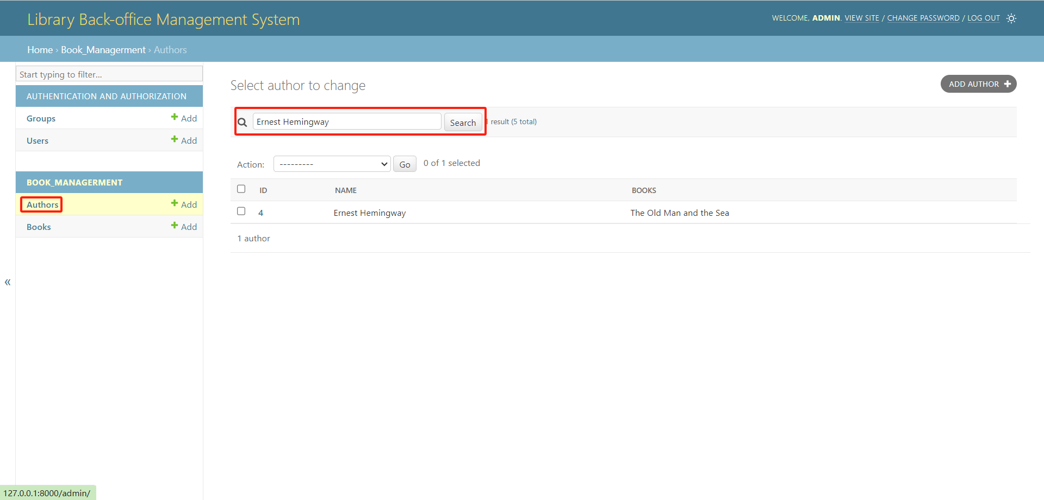
Find books by author name
（Take Ernest Hemingway, author of The Old Man and the Sea）
Notes:
模板来自于： 第一PPT https://www.1ppt.com/

Slide 9
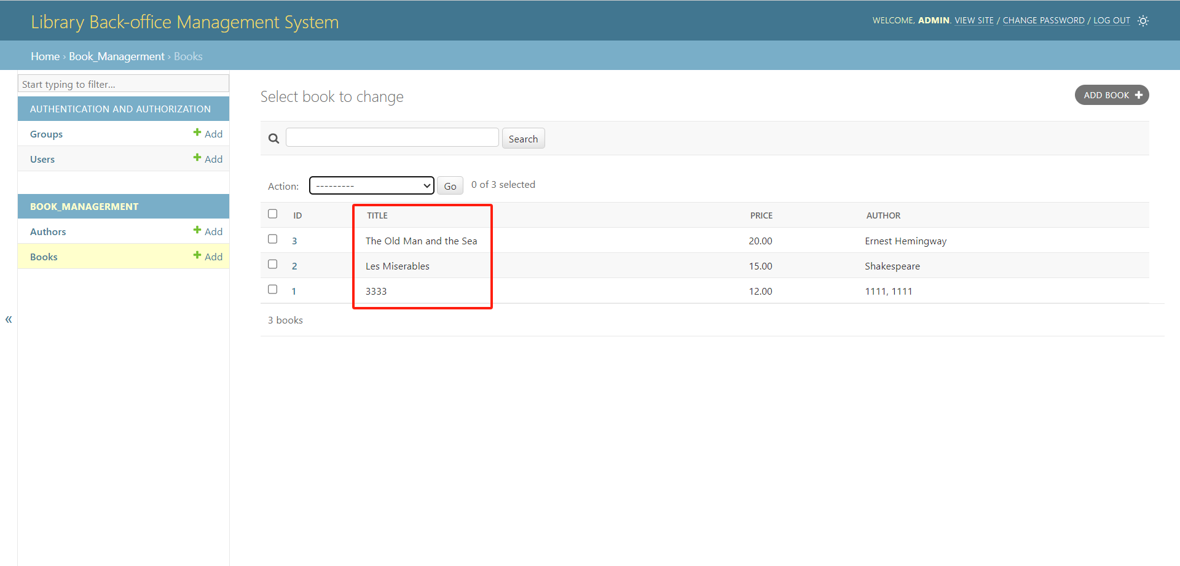
Show all books
Notes:
模板来自于： 第一PPT https://www.1ppt.com/

Slide 10
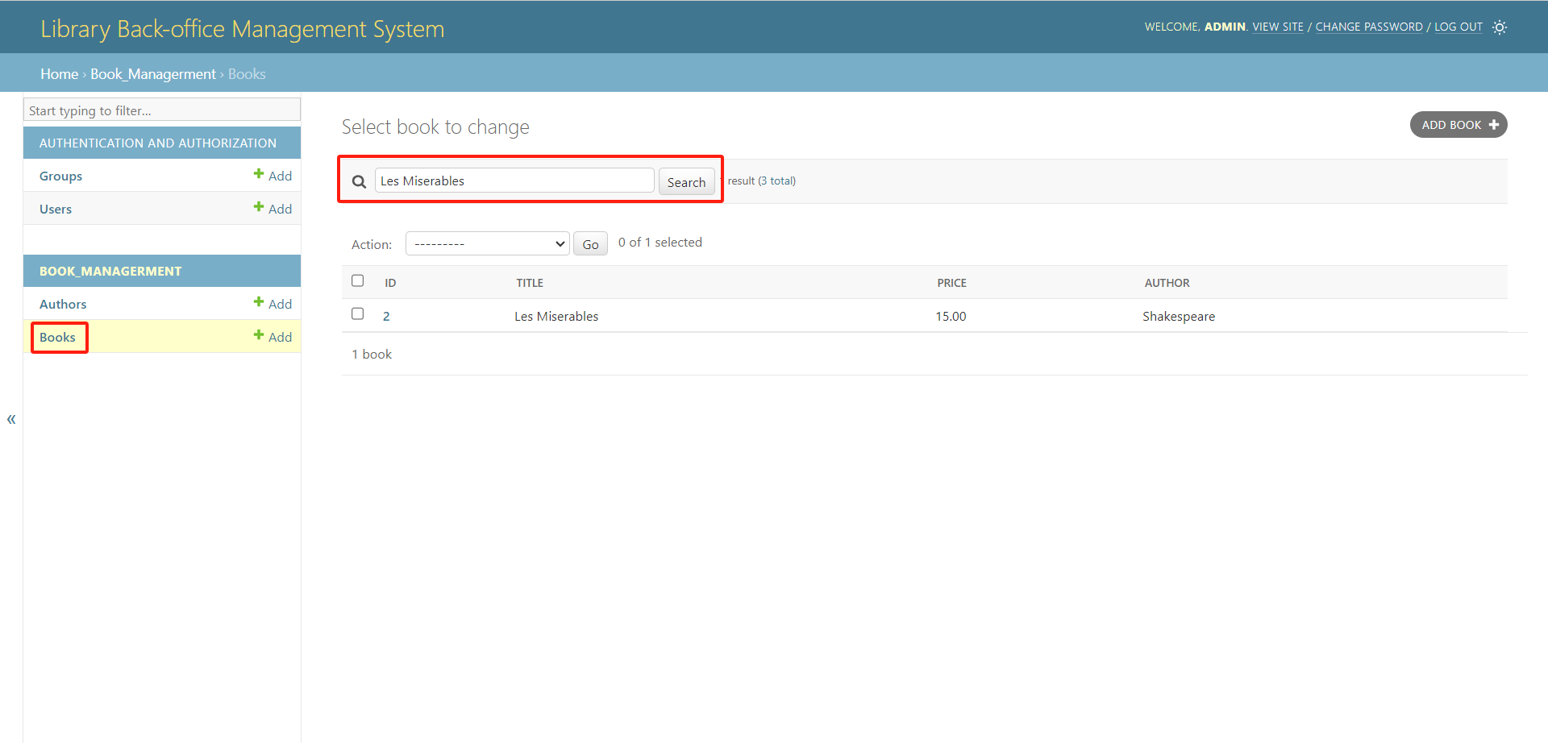
Search for books by title（Take Les Miserables for example）
Notes:
模板来自于： 第一PPT https://www.1ppt.com/

Slide 11
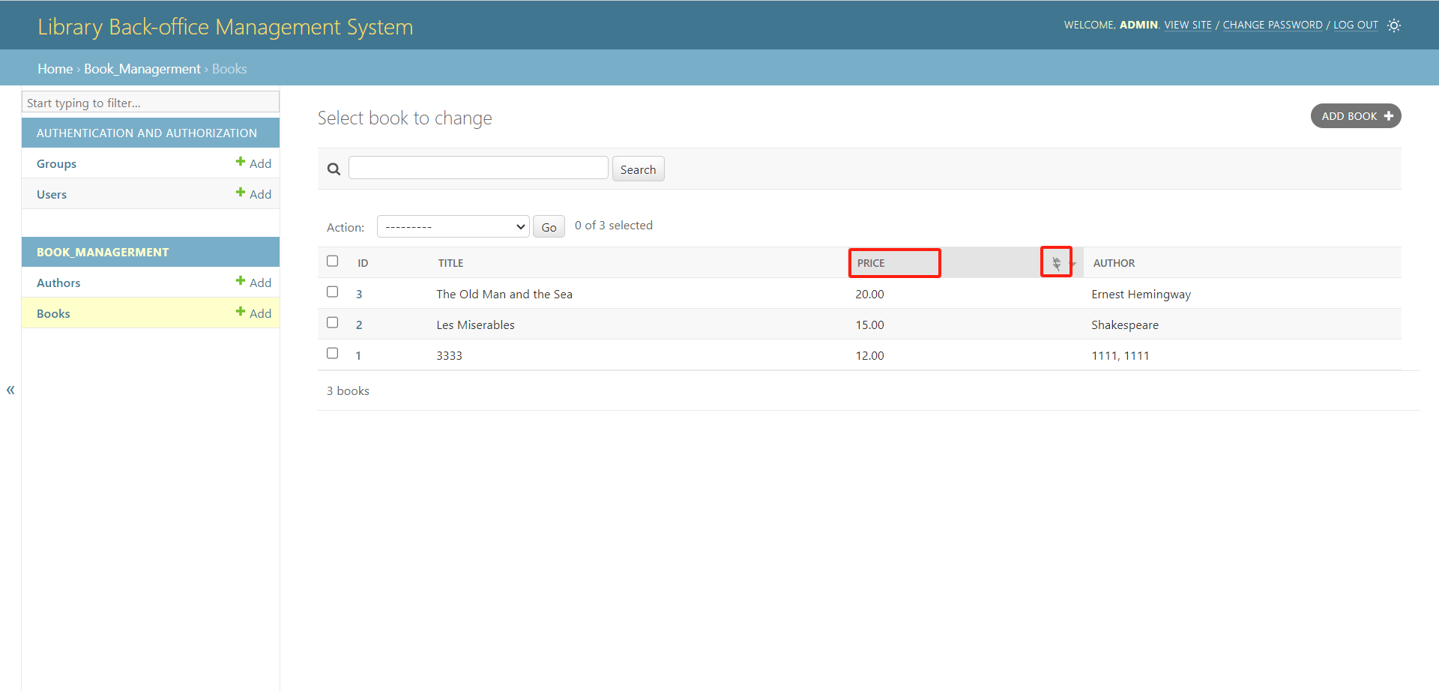
Arrange in order（Price from high to low）
Notes:
模板来自于： 第一PPT https://www.1ppt.com/

Slide 12
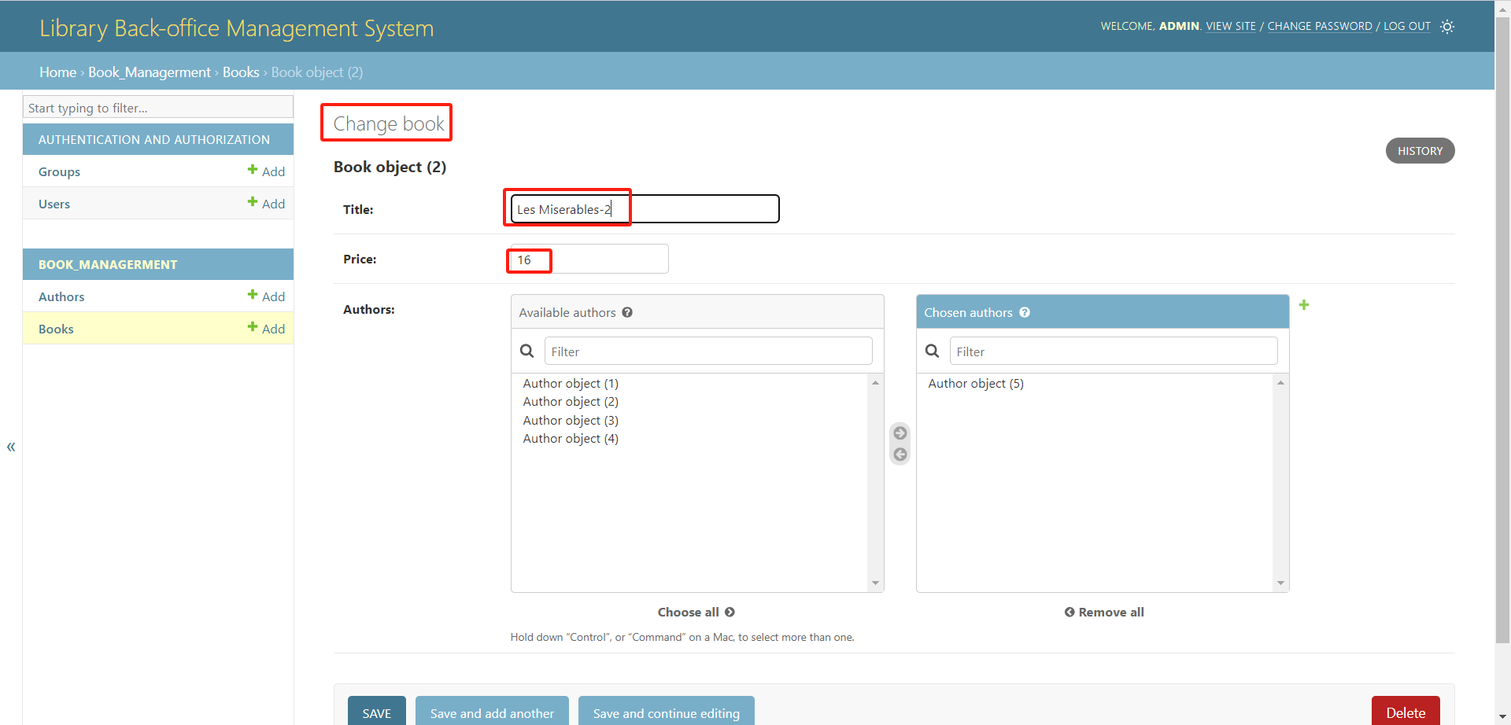
Modify Book Information（tittle and price）
Notes:
模板来自于： 第一PPT https://www.1ppt.com/

Slide 13
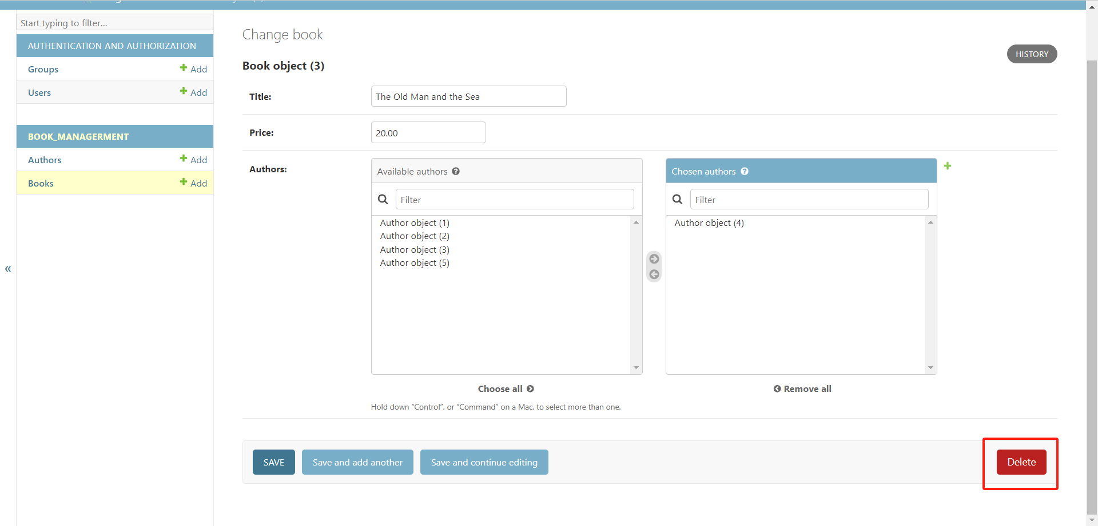
Delete function
Notes:
模板来自于： 第一PPT https://www.1ppt.com/

Slide 14
Part II
Ding Yiming in charge

Slide 15
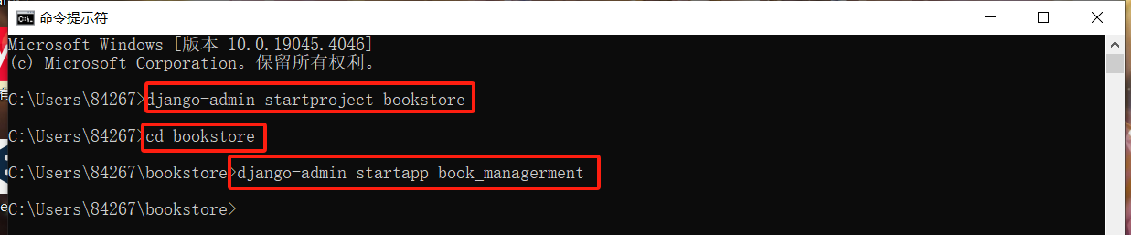
Create projects and apps （Ding Yiming in charge）
Enter the code to create the project in the terminal using Django's own Admin and ORM frameworks to create the project.
After the operation you get the directory structure in part1.

Slide 16
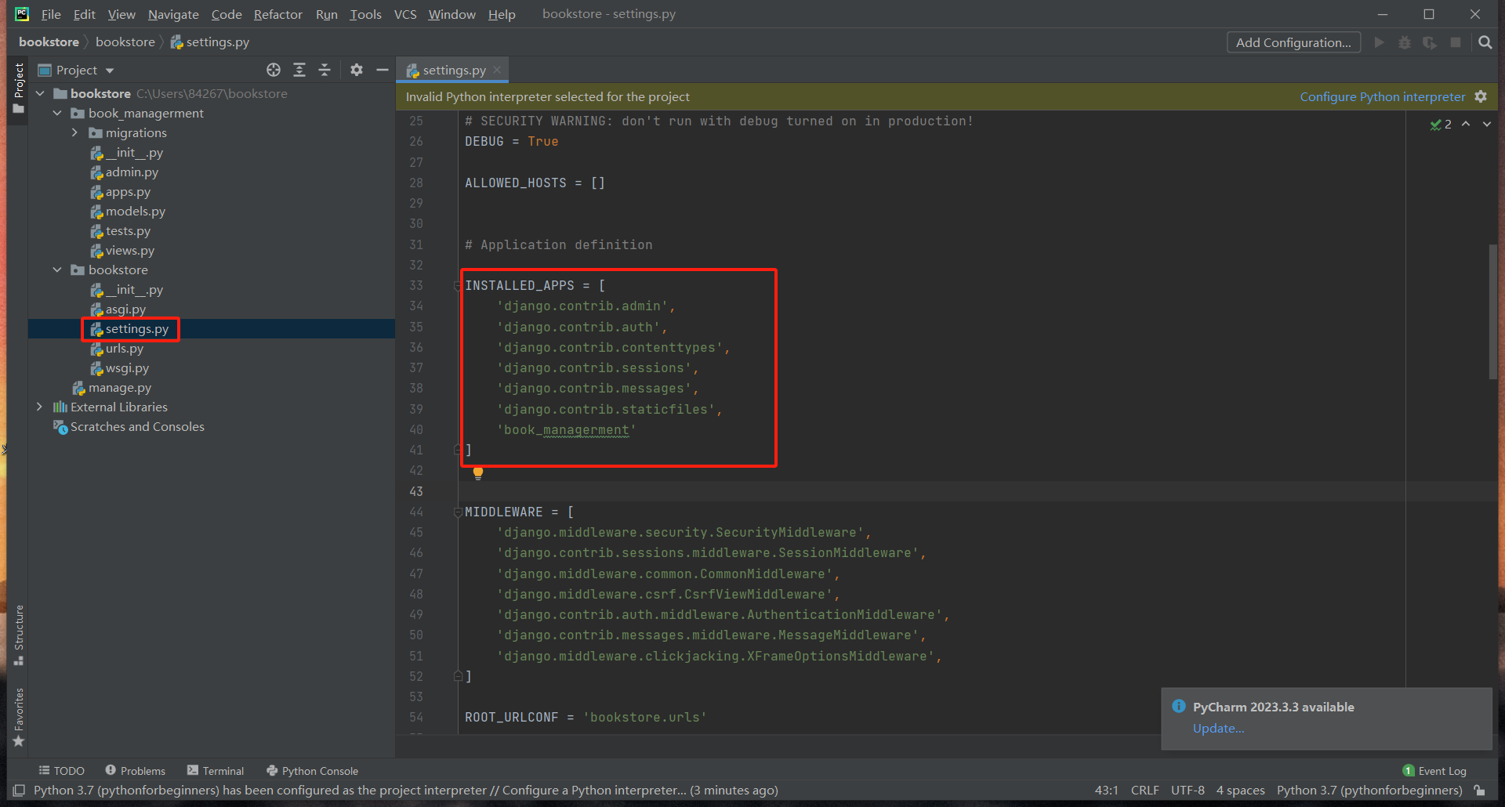
Installation of applications （Ding Yiming in charge）
In booktest\booktest\settings.py, find the item INSTALLED_APPS and change it as follows.

Slide 17
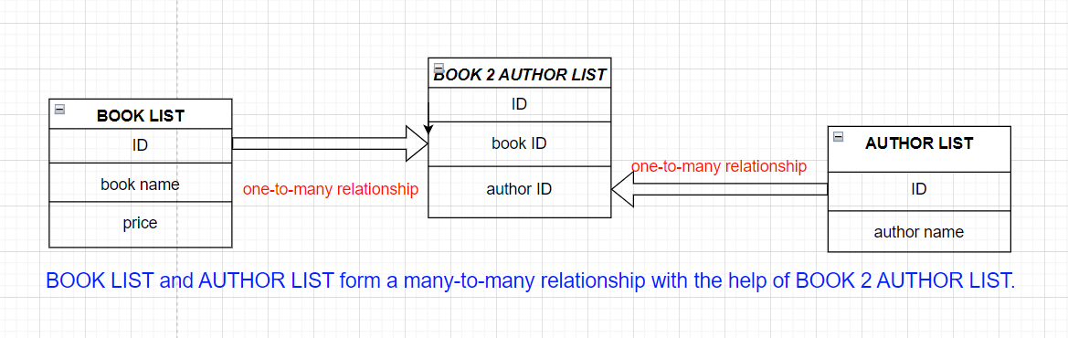
Design model-1 （Ding Yiming in charge）
Table structure:
book table Book: title, price, authors (many to many)
author table Author: name

Slide 18
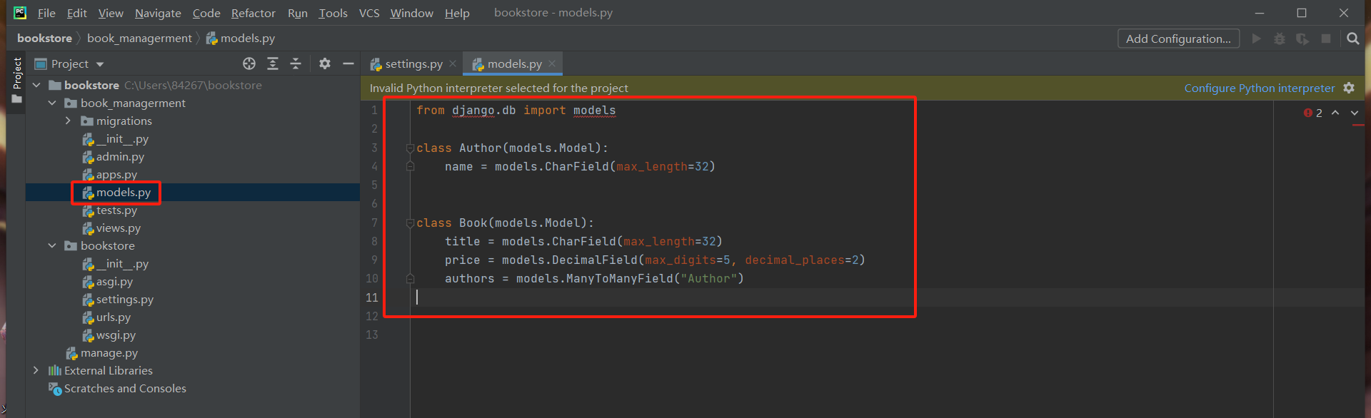
Design model-2 （Ding Yiming in charge）
Modify booktest\book_managerment\models.py to define the model classes as follows:
Two model classes, Author and Book, are defined to represent the author and book data models, respectively. Each model class is a Python class that inherits from models.

Slide 19
Generate local database files-1 （Ding Yiming in charge）
1.Generate migration file: Generate statements to create tables based on model classes
2.Execute the migration: create tables in the database according to the statements generated in the first step.
command cord:
python manage.py makemigrations
python manage.py migrate
* With the combination of these two commands, developers can easily manage changes to model classes in a Django project and ensure that the database structure stays in sync with the model class definitions.

Slide 20
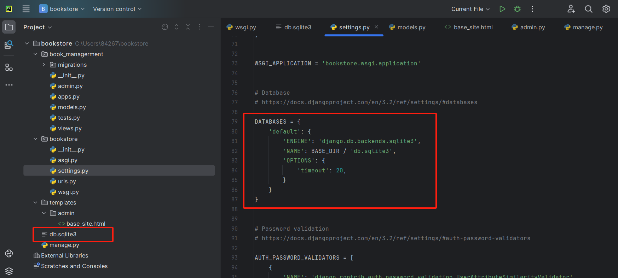
Generate local database files-2 （Ding Yiming in charge）
The file generated after execution:
Generate db.sqlite3 database file

Slide 21
Part III
Duan Youzhen in charge

Slide 22
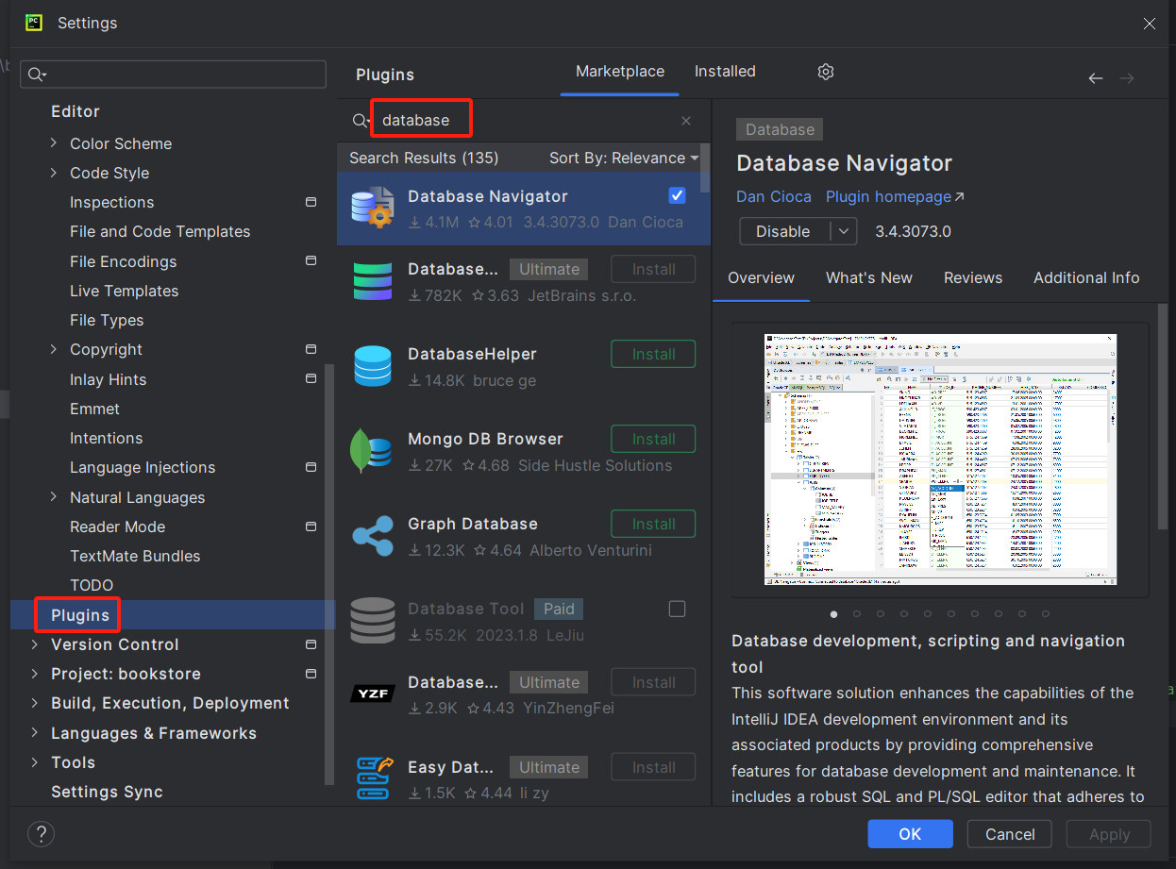
Opening a db.sqlite3 file with DataSource-1
（Duan Youzhen in charge）
Use pycharm's plugins function to search and download the database plugin Database Navigator.

Slide 23
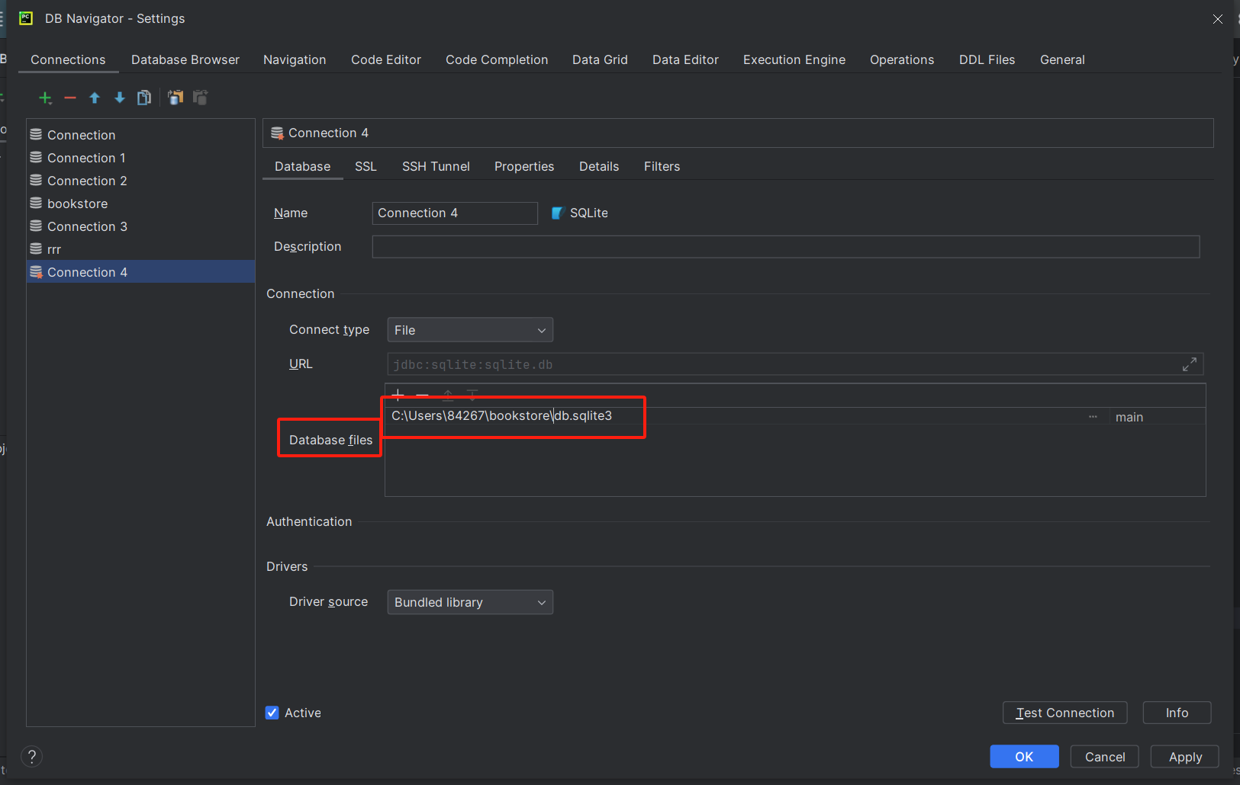
Opening a db.sqlite3 file with DataSource-2
（Duan Youzhen in charge）
Create a new database in Database Navigator and enter the correct location for the database files.

Slide 24
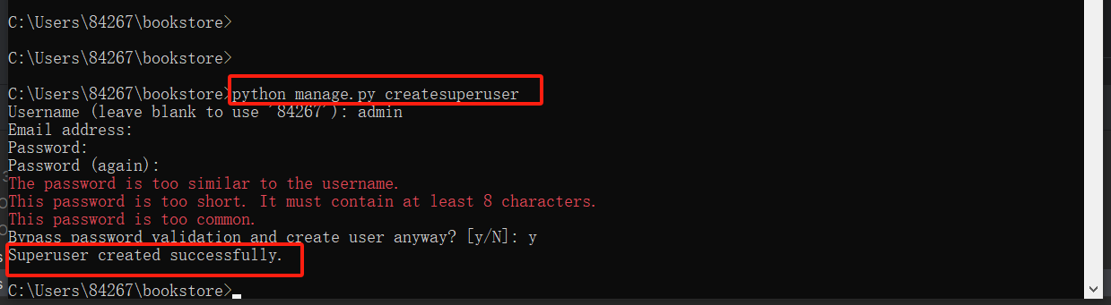
Back-office management （Duan Youzhen in charge）
Create Administrator:
Set user name and password as admin

Slide 25
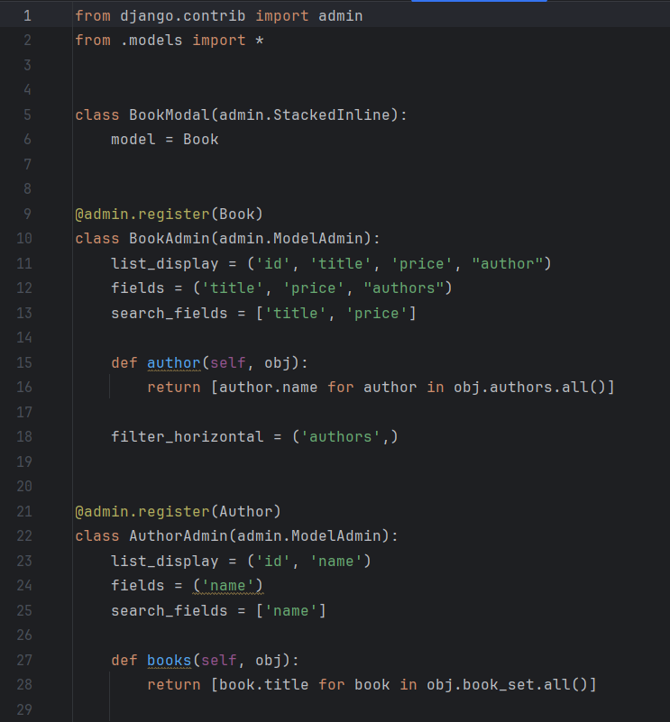
Registered Model Classes （Duan Youzhen in charge）
Open the booktest\booktest\admin.py file and write the following code
The list_display property defines which fields are displayed in the list display page.
The fields property defines which fields are displayed on the edit page.
The search_fields property defines which fields can be searched by.
The author method defines a custom column that displays the author of the book.
The filter_horizontal property defines a horizontal filter that allows the user to select the author using a multi-select box.
The AuthorAdmin class is the management class for the Author model. Use the @admin.register(Author) decorator to register this class as the management interface for the Author model.

Slide 26
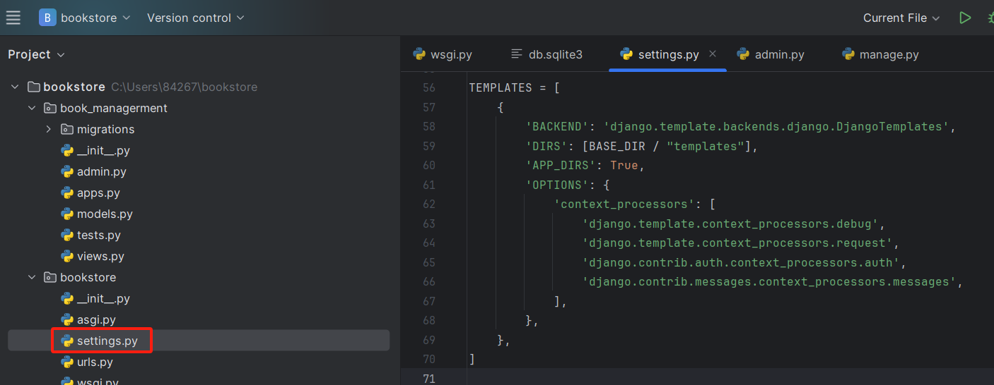
Customised admin page templates-1 （Duan Youzhen in charge）
Modify the DIRS of TEMPLATES in booktest/booktest/settings.py to the specified path:

Slide 27
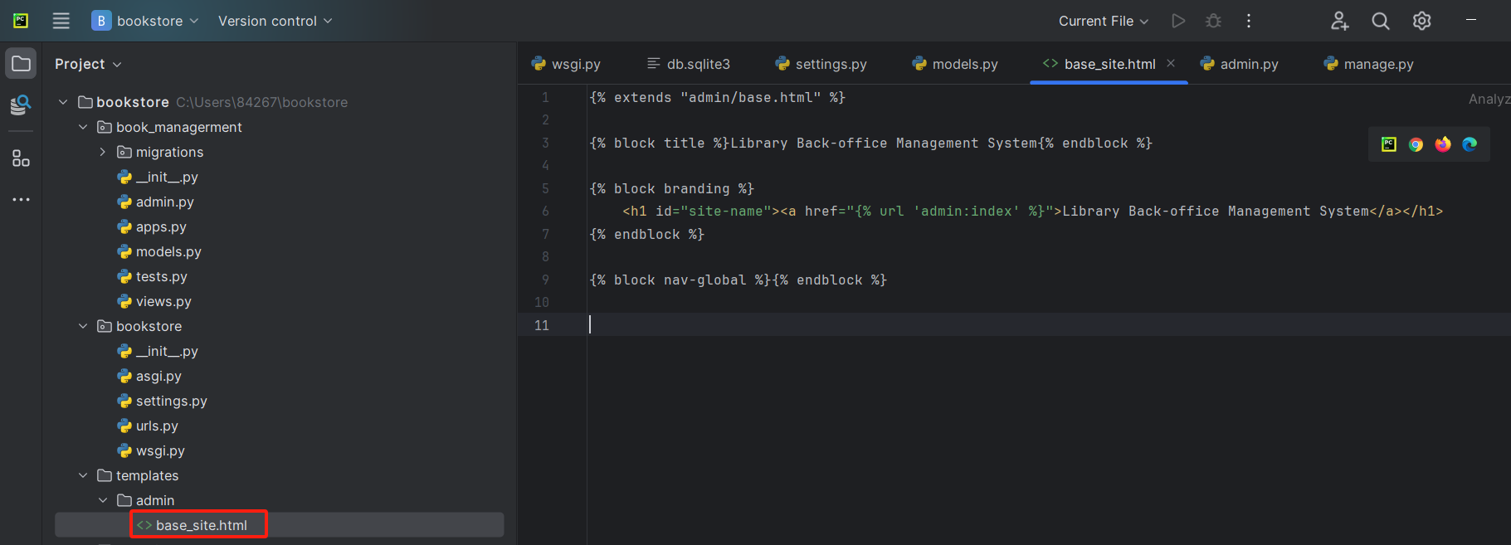
Customised admin page templates-2 （Duan Youzhen in charge）
Create the directory booktest/templates/admin, copy the base_site.html file under Lib\site-packages\django\contrib\admin\templates\admin in the python installation path to that directory and change it to the following:

Slide 28
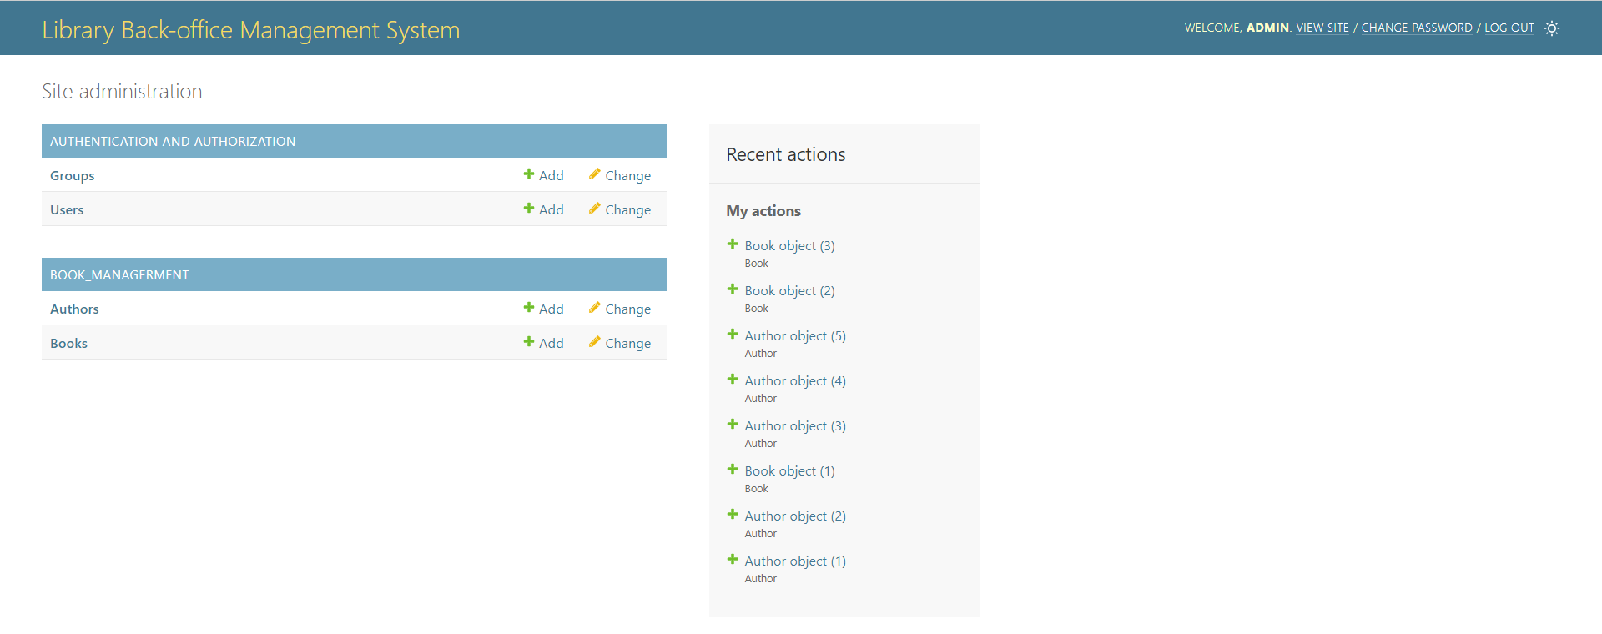
Initiation of projects （Duan Youzhen in charge）
After executing the command:
python manage.py runserver
Open http://127.0.0.1:8000/admin

Slide 29
Part IV
Problems encountered

Slide 30
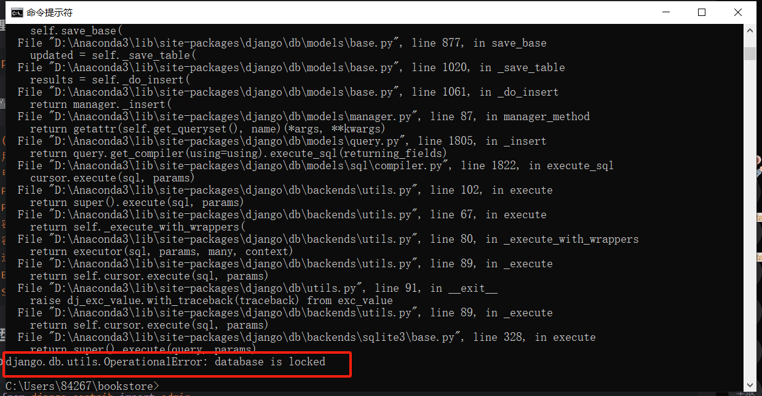
Problem 1
Error django.db.utils.OperationalError: database is locked when using sqlite3 files.

Slide 31
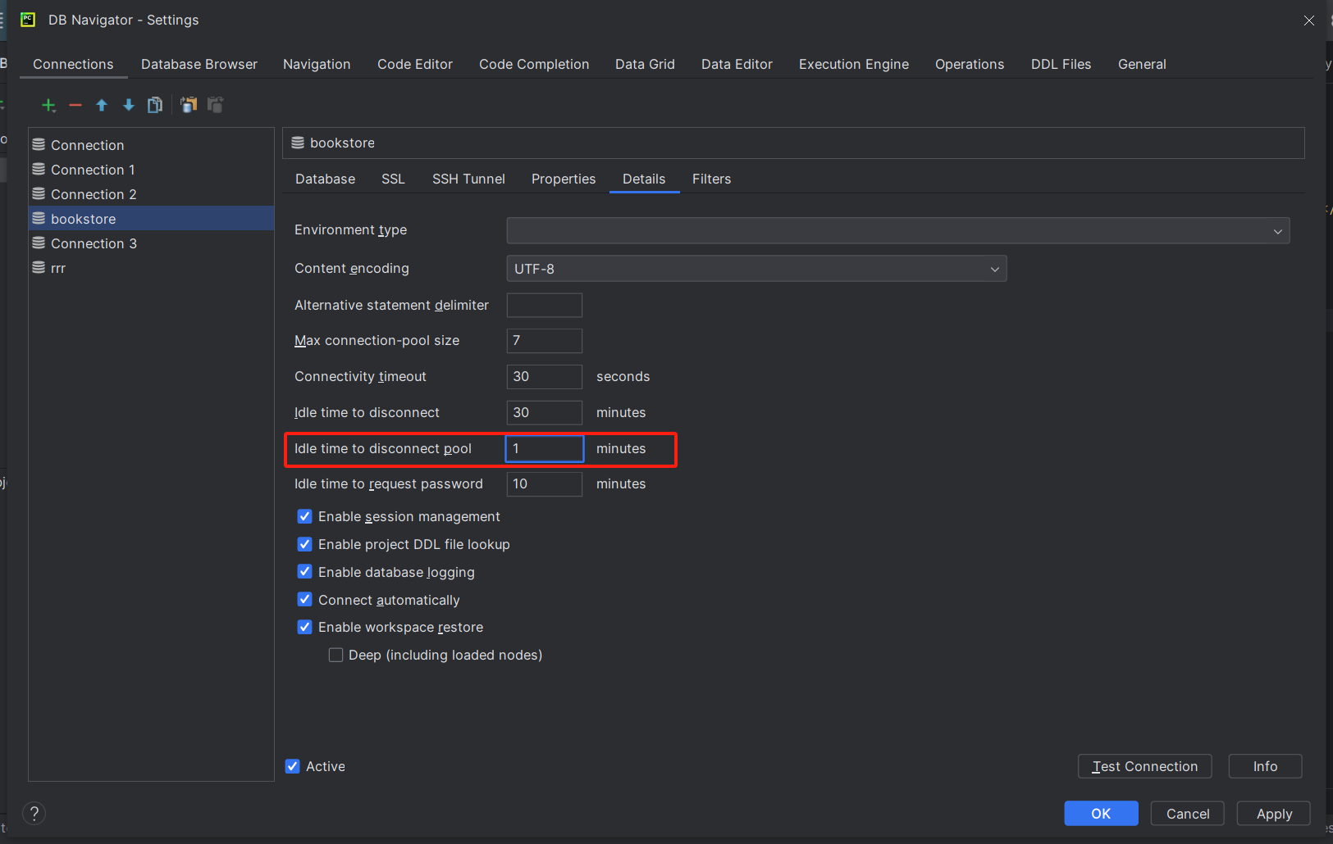
Problem 1 Solution
1.Set disconnection pool: Database->Settings->Details, set the disconnection pool to 1 minute.

Slide 32
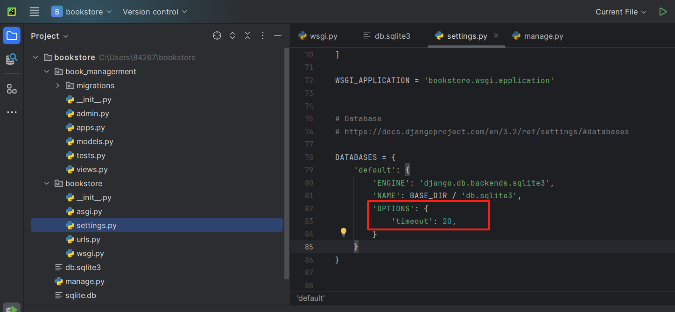
Problem 1 Solution
2.Add the timeout option to the settings file

Slide 33
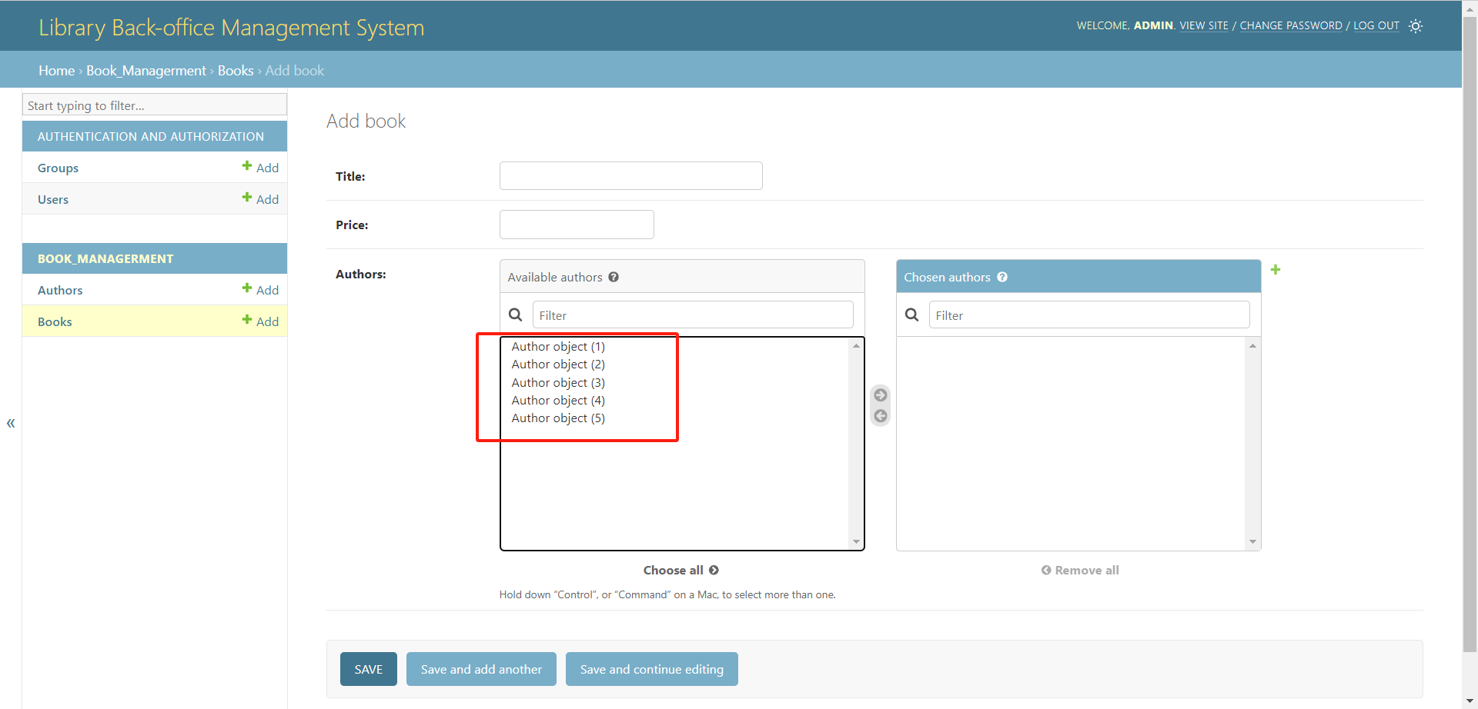
Problem 2
When adding a book and selecting an author, the author's name can only be displayed as "Author project".

Slide 34
Thanks for watching.

