Slide 1
ViT-LSLA: Vision Transformer with Light Self-Limited-Attention

Slide 2
INTRODUCTION
文章的主要贡献:
A light self-attention mechanism (LSA) is provided as a plug-and-play module. The current Transformers can save the number of parameters and FLOPs conveniently without losing the accuracy by applying the LSA in self-attention blocks.
A self-limited-attention mechanism (SLA) is introduced. Based on positional information, an outer position bias is adopted to powerfully limit the large attention weights. Thus, Transformers can capture truly meaningful information rather than which just has high similarity.
Establishing a simple Transformer model with the above components can not only remarkably reduce the computation cost and the number of parameters, but also significantly improve the performance.

Slide 3
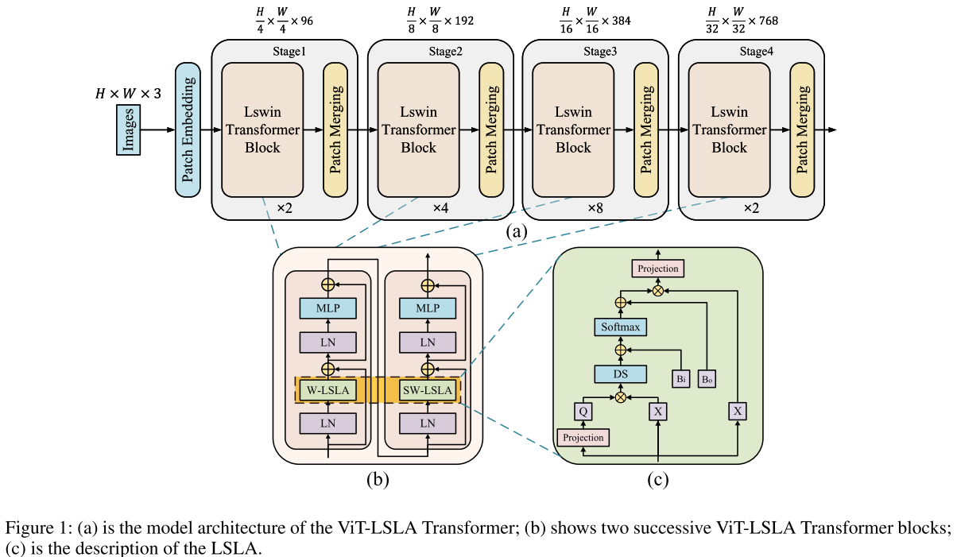
THE METHOD

Slide 4
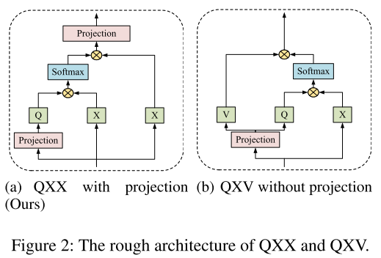
THE METHOD

Slide 5
THE METHOD
本文使用桥结构
Input: Images and learnable parameters(tokens) 其中tokens维度为M*d M and d are the number and dimension of tokens.
Output(Image Classification):
Output(Object Detection):

Slide 6
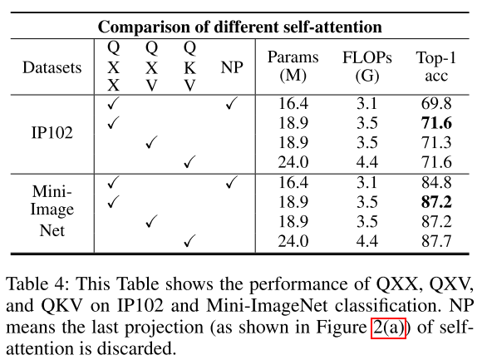
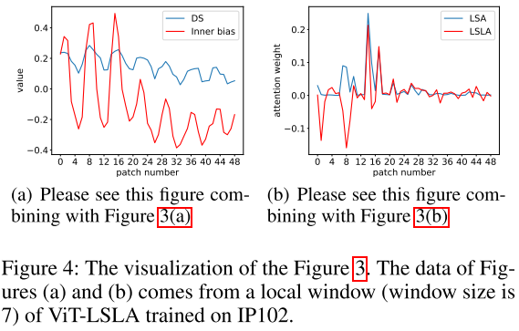
Experimental Results(Ablation experimental)

Slide 7
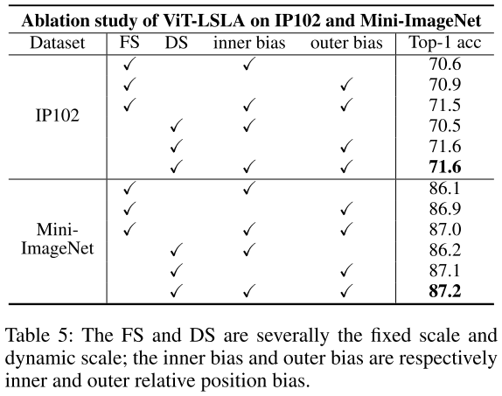
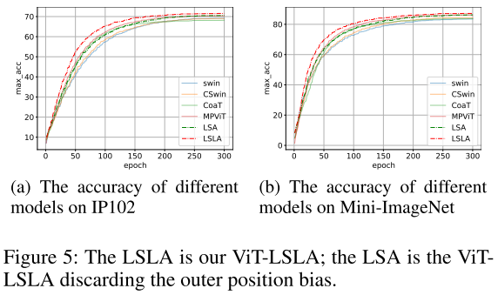
Experimental Results(Ablation experimental)

