Slide 1

MultiFact
Multimodal Misinformation Detection on Social Media
INFO 442 Data Science Projects — Milestone 6
Group 25 | June 2026
Jianwen Han (Lead) · Chuhao Wang (Data) · Ke Meng (Modeling) · Zhirun Han (Visualization)

Slide 2
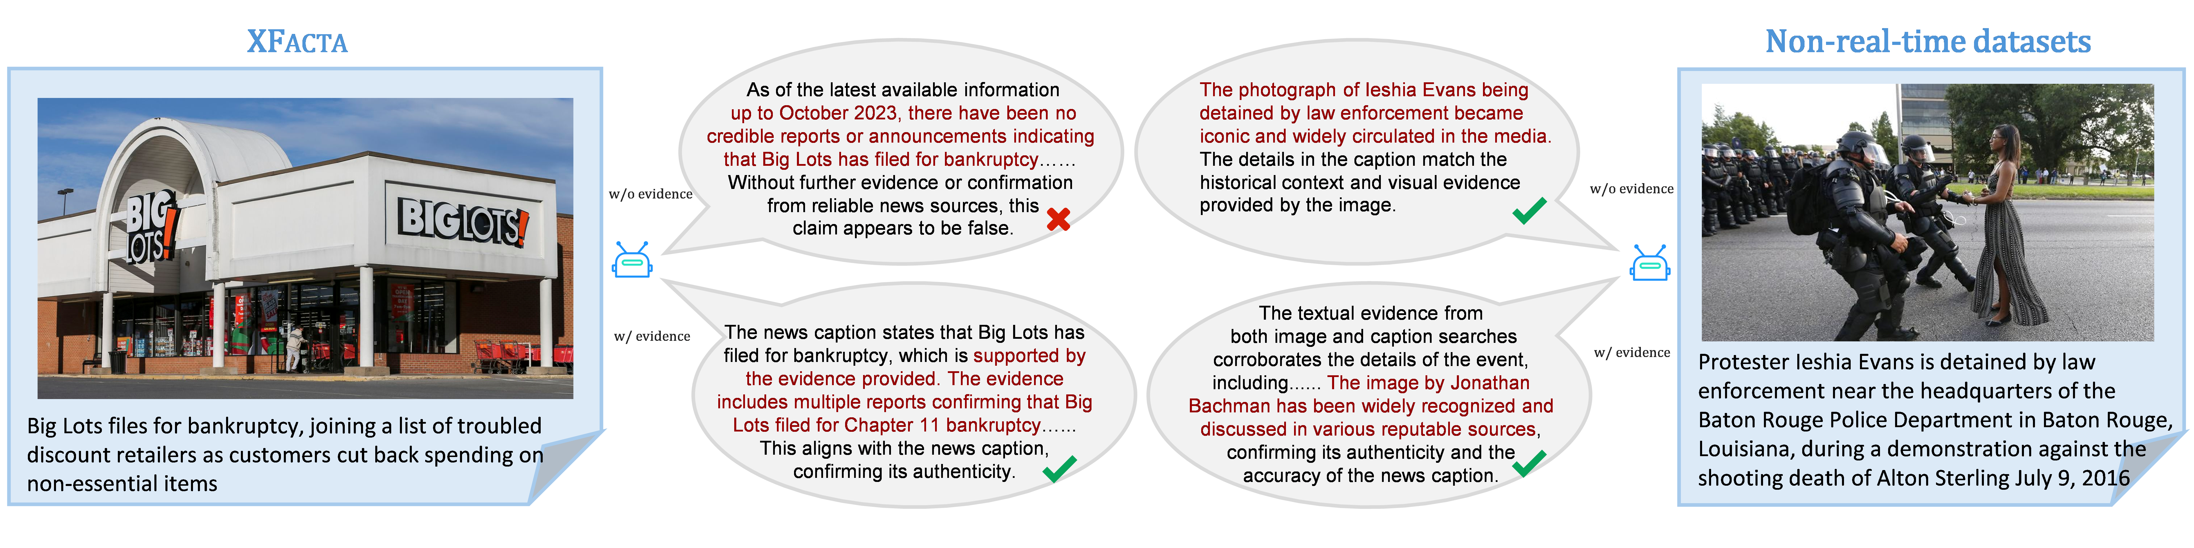
The Problem: Misinformation Crisis
74%
6×
Multi-
of internet users encounter misinformation weekly
false news spreads faster than truth on social media
most misinformation now combines text with images
Pew Research, 2024
MIT / Science, 2018
XFacta, 2025
Core Research Question
Can multimodal LLMs effectively detect real-world misinformation by
combining evidence retrieval with structured reasoning — and which
reasoning strategy performs best?
Our Approach: Compare 3 reasoning pipelines on a contemporary 2024–2025
dataset to find the optimal detection strategy.
MultiFact — Multimodal Misinformation Detection | Group 25
2

Slide 3
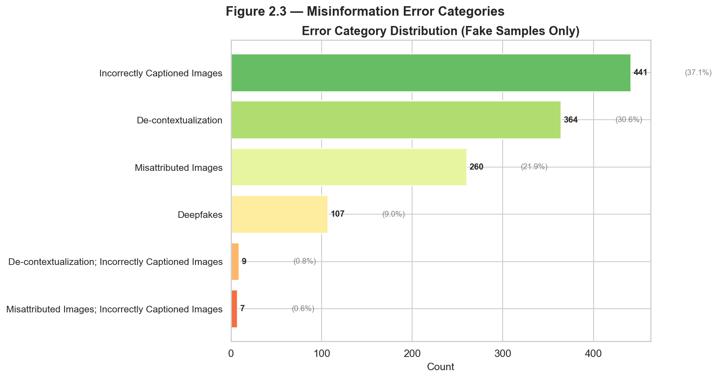
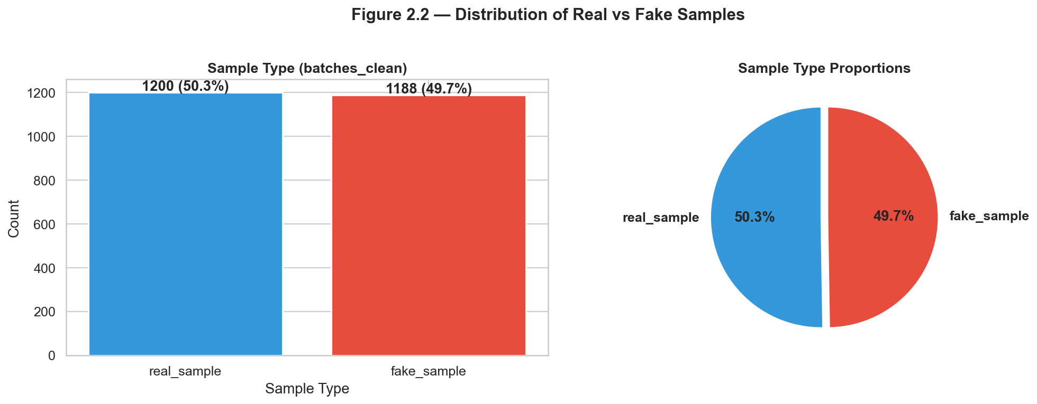
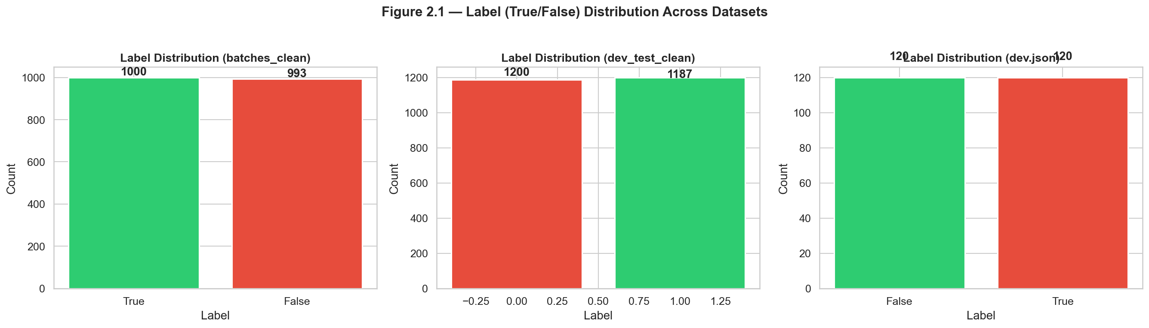
Data: Acquisition, Preprocessing & Dataset Profile
2,400 balanced multimodal posts from X (Twitter) · arXiv 2508.09999
Dataset Profile
1,200 authentic + 1,200 misinformation
50/50 balanced, 14 topics, 7 error types
2024-2025, covers US Election + conflicts
Misinformation Error Categories
Multimodal Content
>99% posts have images
Text + image(s) per sample
Fact-checker flagging text included
Cross-modal reasoning essential
Preprocessing
26 JSON files → 2 unified CSVs
Flatten nested JSON, normalize image paths
Map numeric error codes → readable labels
Drop 25 empty-text records (0.5%)
Output Files
batches_clean.csv: 2,388 rows, 15 columns
dev_test_clean.csv: 2,387 rows, 4 columns
91.9% dev/test-batch overlap (documented)
395 unlabeled records preserved
11 transformation steps · 25 records dropped · 395 unlabeled preserved · Full pipeline: preprocess.py
3
MultiFact — Multimodal Misinformation Detection | Group 25

Slide 4
System Architecture: Evidence → Reasoning → Decision
① Evidence Retrieval
② Reasoning Engine
③ Final Decision
8 retrieval strategies
Image→Text Text→Text Caption→Image
Query generation + search engines
LLM-based evidence extraction
Domain filtering for quality control
4 reasoning paradigms
Chain-of-Thought (Baseline)
Prompt Ensembles
Self-Consistency Voting
Multi-Step Structured (Best)
LLM-based · LLMs · open-source models
Binary classification:
True (Authentic) / False (Misinfo)
+ Error type identification
+ Confidence score (0-100)
+ Traceable reasoning path
→
→
📱 Social Media Post (text + images)
▸
🔍 search engines LLM-based Extraction
▸
🧠 LLM backends open-source models
▸
✅ True / False + Confidence Score
MultiFact — Multimodal Misinformation Detection | Group 25
4

Slide 5
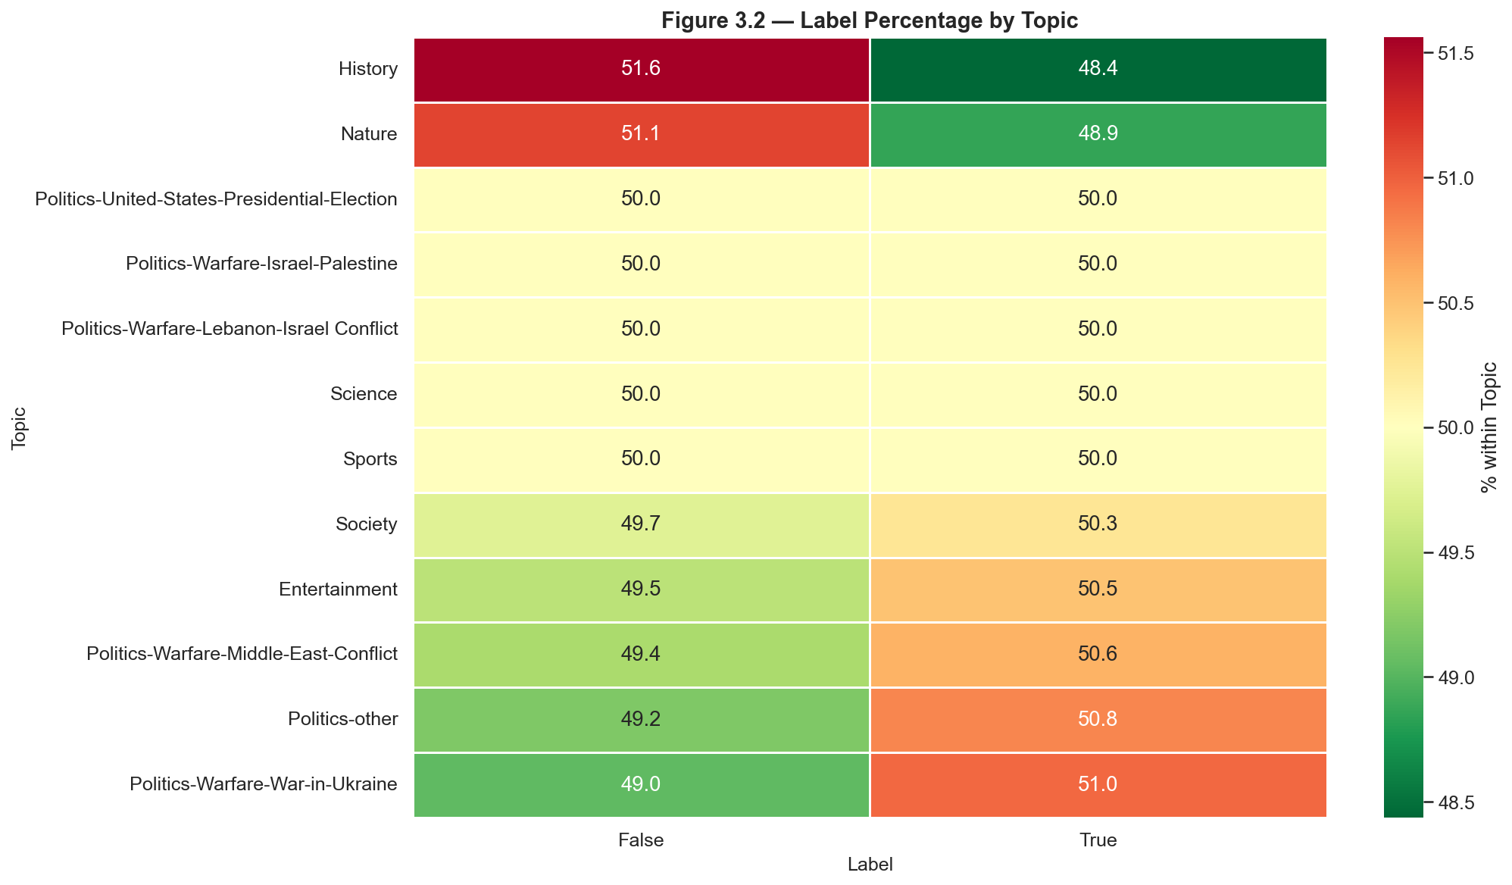
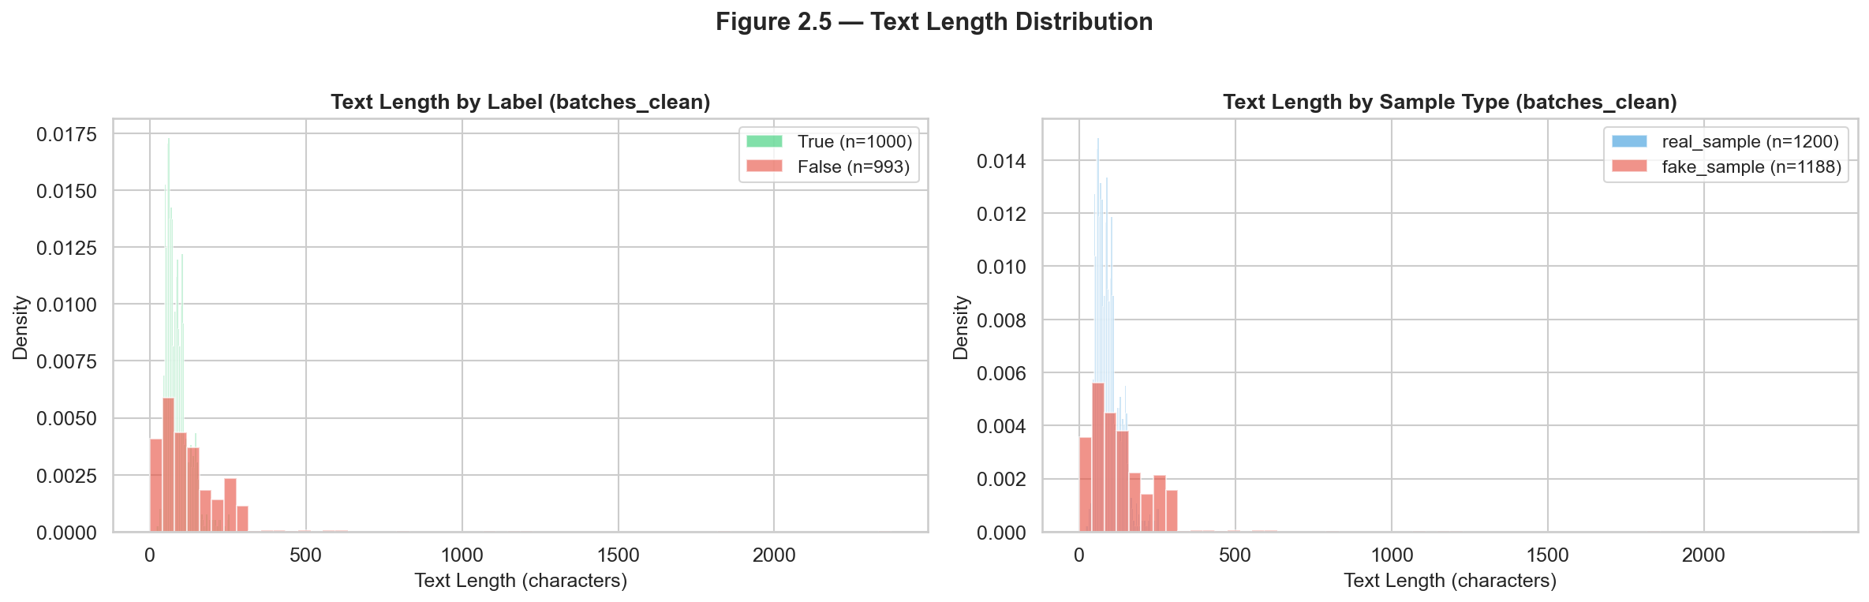
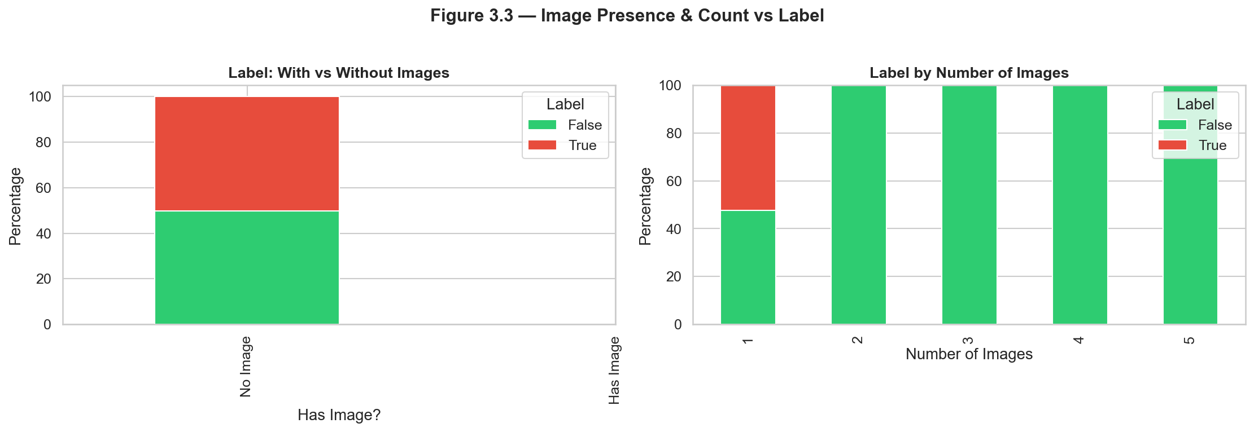
EDA Insights: What the Data Tells Us (1/2)
🔍 Finding #1
Most Misinformation Uses Real Images Deceptively — Not Deepfakes
Incorrectly Captioned Images: 37% — dominant error type
De-contextualization: 30% — real images in wrong context
Deepfakes: only ~8% — pure AI generation is rare in real-world data
→ Cross-modal reasoning is essential; just spotting fake images is not enough
⚠️ Finding #2
Author Identity Is a Critical Confound — Must Be Excluded
News organizations → almost always labeled True
Individual/flagged accounts → almost always labeled False
A model using author features would learn this shortcut and fail on new data
→ Author information must be excluded from all modeling pipelines
MultiFact — Multimodal Misinformation Detection | Group 25
5

Slide 6
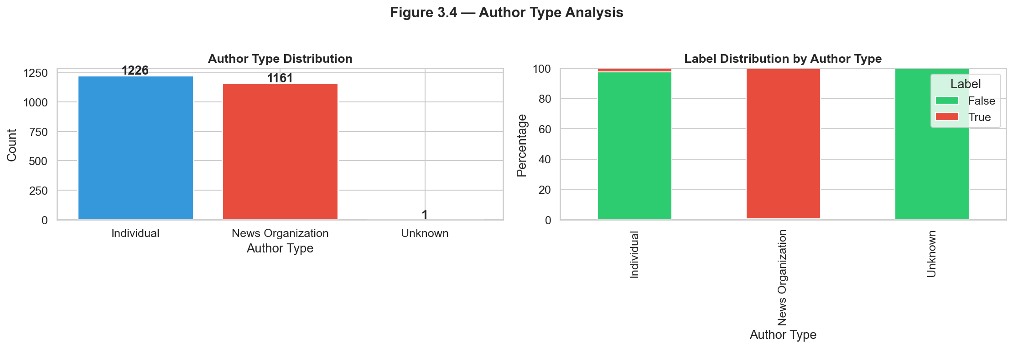
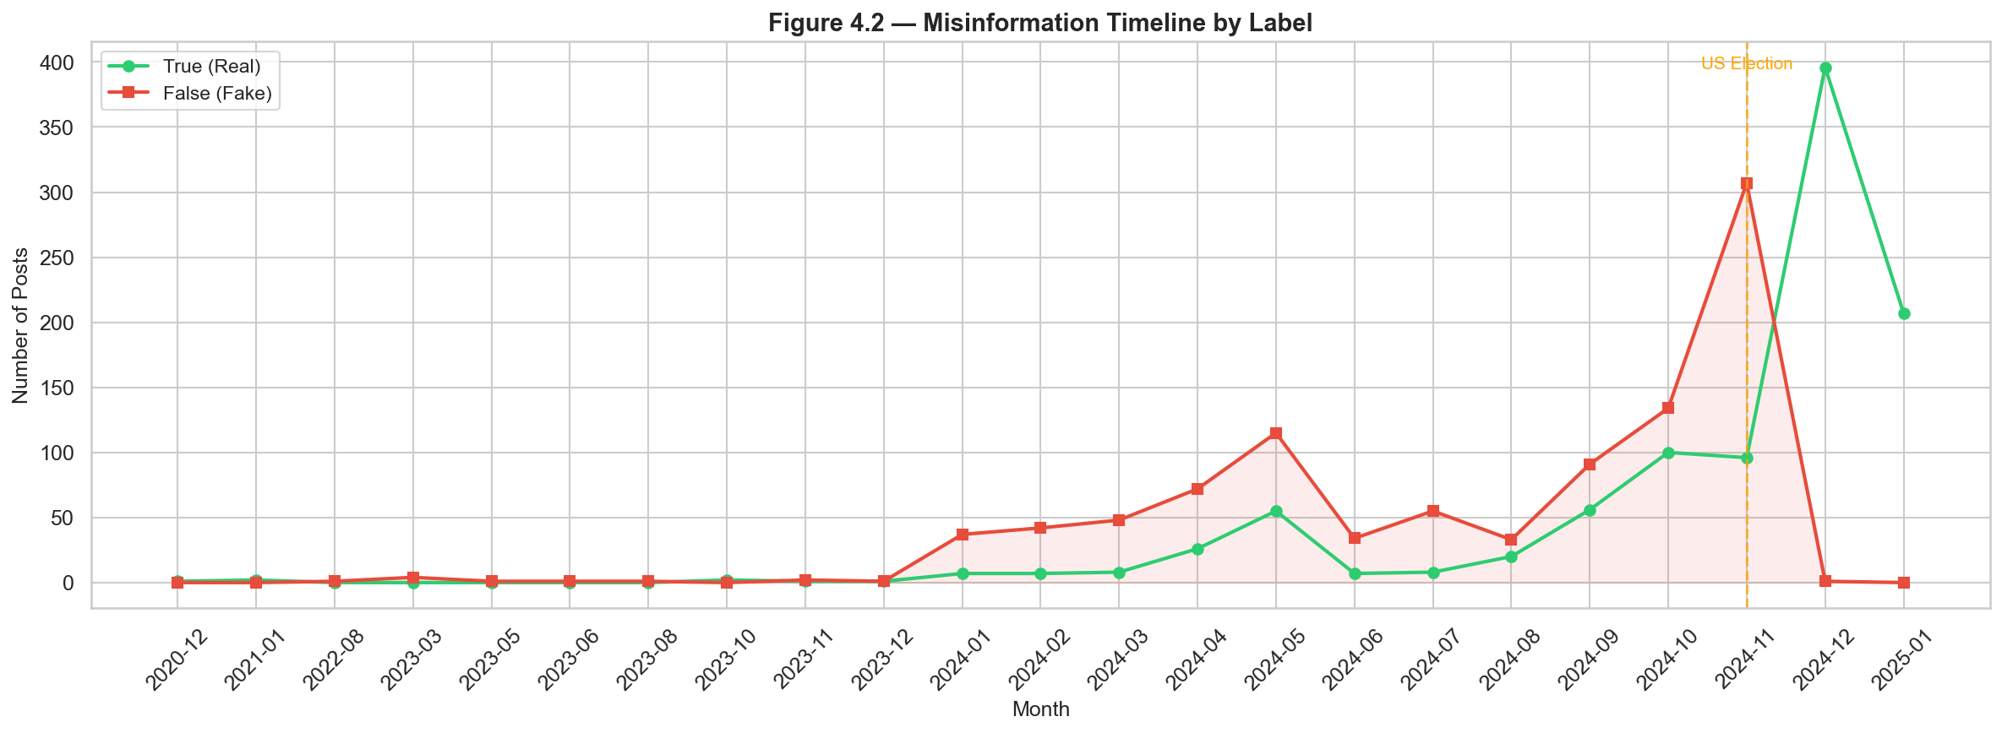
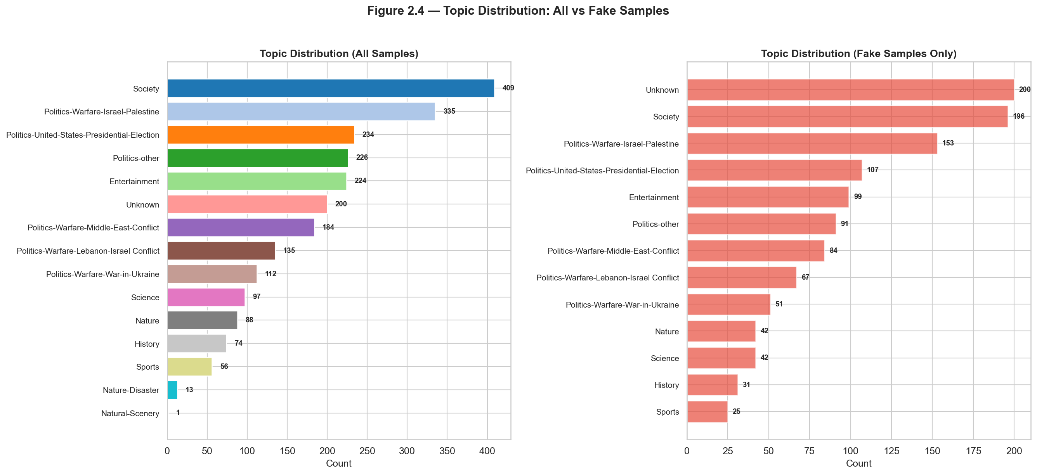
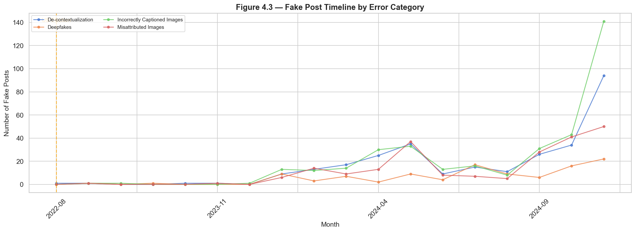
EDA Insights: Visual Evidence (2/2)
Author Type: A Near-Perfect Confound
Temporal Patterns: Event-Driven Misinformation
Misinformation spikes sharply around US Election (Nov 2024).
→ Temporal context matters for robust detection.
News orgs ≈ 100% True · Individuals ≈ 100% False
→ Author identity carries perfect label signal but zero generalization value.
MultiFact — Multimodal Misinformation Detection | Group 25
6

Slide 7
M5: Comparing Three Reasoning Strategies
All models share the same evidence retrieval. Only the reasoning logic differs.
CoT Evidence (Baseline)
Prompt Ensemble
Multi-Step Reasoning ★ Best Model
Single-stage Chain-of-Thought: all evidence → one reasoning chain → final label. Simple, interpretable, widely used in misinformation research. Input: Image-search + Caption-search + Web-text retrieval
Multiple prompt templates voted via majority rule. Tests whether prompt diversity stabilizes output and reduces wording sensitivity. Input: Image-search + Caption-search + Web-text retrieval
Staged verification pipeline: ① Caption truthfulness check ② Image misuse detection ③ Cross-modal final verdict Input: Image-search + Caption-search → Separates text & visual deception
MultiFact — Multimodal Misinformation Detection | Group 25
7

Slide 8
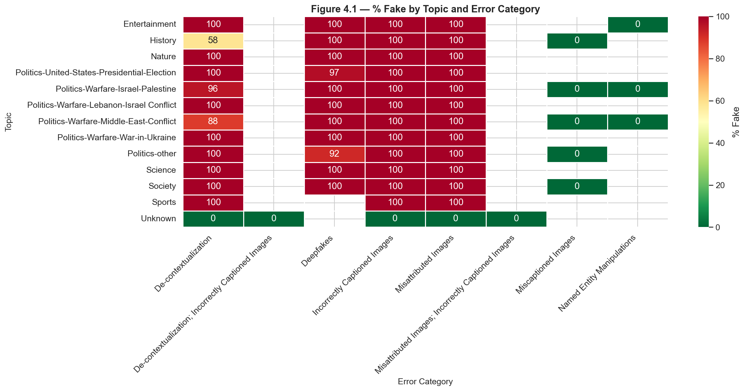
M5: Comparing Three Reasoning Strategies
All models share the same evidence retrieval. Only the reasoning logic differs.
CoT Evidence (Baseline)
Prompt Ensemble
Multi-Step Reasoning ★ Best Model
Single-stage Chain-of-Thought: all evidence → one reasoning chain → final label. Simple, interpretable, widely used in misinformation research. Input: Image-search + Caption-search + Web-text retrieval
Multiple prompt templates voted via majority rule. Tests whether prompt diversity stabilizes output and reduces wording sensitivity. Input: Image-search + Caption-search + Web-text retrieval
Staged verification pipeline: ① Caption truthfulness check ② Image misuse detection ③ Cross-modal final verdict Input: Image-search + Caption-search → Separates text & visual deception
MultiFact — Multimodal Misinformation Detection | Group 25
7

Slide 9
Results: Multi-Step Outperforms Across All Metrics
Model | Accuracy | Precision | Recall | F1 Score
CoT Evidence | 0.778 | 0.794 | 0.750 | 0.771
Prompt Ensemble | 0.819 | 0.829 | 0.806 | 0.817
★ Multi-Step | 0.847 | 0.838 | 0.861 | 0.849
Key Takeaways
• Multi-Step: +6.9% accuracy over CoT, +2.8% over Prompt Ensemble — a substantial margin
• Recall 86.1% is the business-critical metric — fewer undetected misinformation posts escape
• Staged verification eliminates image-caption mismatch errors (the dominant CoT failure mode)
• Prompt Ensemble provides marginal gains but cannot fix structural reasoning flaws
MultiFact — Multimodal Misinformation Detection | Group 25
8

Slide 10
Results: Multi-Step Outperforms Across All Metrics
Model | Accuracy | Precision | Recall | F1 Score
CoT Evidence | 0.778 | 0.794 | 0.750 | 0.771
Prompt Ensemble | 0.819 | 0.829 | 0.806 | 0.817
★ Multi-Step | 0.847 | 0.838 | 0.861 | 0.849
Key Takeaways
• Multi-Step: +6.9% accuracy over CoT, +2.8% over Prompt Ensemble — a substantial margin
• Recall 86.1% is the business-critical metric — fewer undetected misinformation posts escape
• Staged verification eliminates image-caption mismatch errors (the dominant CoT failure mode)
• Prompt Ensemble provides marginal gains but cannot fix structural reasoning flaws
MultiFact — Multimodal Misinformation Detection | Group 25
8

Slide 11
Model Performance: Visual Comparison
Accuracy by Topic
CoT
Evidence Coverage by Retrieval Source
Multi
Image-search
93%
Caption-search
88%
Web-text
81%
Gen-question
78%
Celebrity
Conflict
Disaster
Economy
Election
Health
Multi-Step maintains highest accuracy across all 6 topics — including Election & Health (hardest cases).
Image & caption search provide most evidence. Web & generated queries have lower coverage.
Error Reduction: Multi-Step vs CoT Baseline
Error Type
CoT
Multi-Step
Change
Ambiguous Context
3
2
Same
Entity/Date Mismatch
5
3
↓ 40%
Image-Caption Mismatch
3
2
↓ 33% — key improvement
Missing Evidence
3
3
Same (shared ceiling)
Satire/Rhetoric
2
1
↓ 50%
MultiFact — Multimodal Misinformation Detection | Group 25
9

Slide 12
Error Analysis: Where Models Still Fail
Five shared misclassification patterns (CoT / Ensemble / Multi-Step error counts)
Ambiguous Context
Entity/Date Mismatch
Image-Caption Mismatch
Missing Reliable Evidence
Satire or Rhetoric
Errors: CoT:3 Ens:2 MS:2
Errors: CoT:5 Ens:4 MS:3
Errors: CoT:3 Ens:2 MS:2
Errors: CoT:3 Ens:3 MS:3
Errors: CoT:2 Ens:2 MS:1
Unclear factual background leads to guesswork
Minor factual errors confused with real misinformation
Real image + fake caption. CoT cannot separate these.
Universal limitation: no evidence → forced to guess
Humorous/satirical tone misread as false claims
Slice-Based Error Analysis
• Election & Health topics → universal accuracy decline — ambiguous, polarized claims lack definitive evidence
• Image-caption mismatch is the #1 CoT failure → Multi-Step eliminates this via independent image misuse inspection
• Missing evidence affects ALL pipelines equally → retrieval quality is the shared performance ceiling
MultiFact — Multimodal Misinformation Detection | Group 25
10

Slide 13
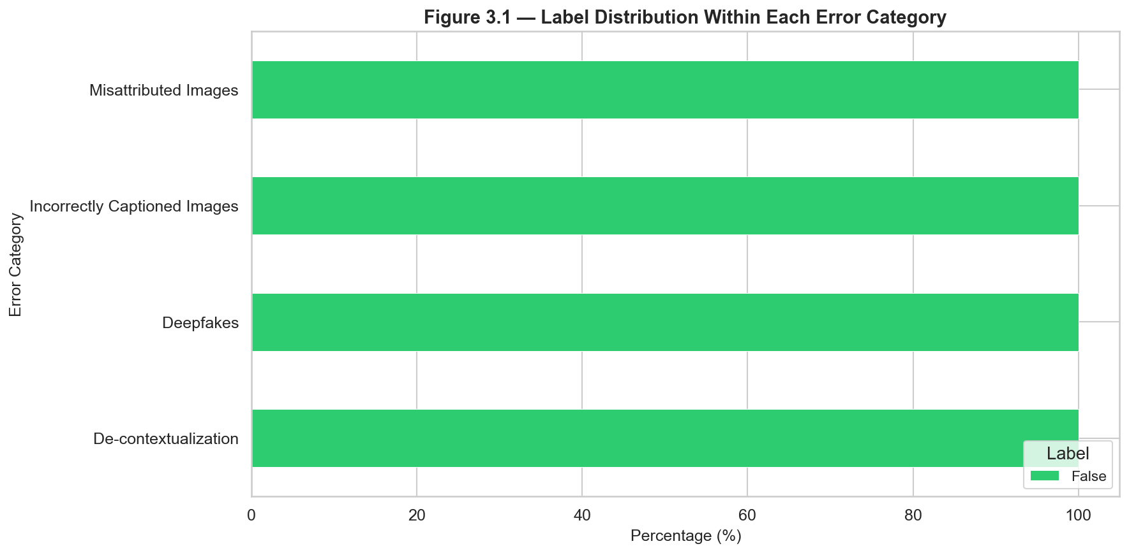
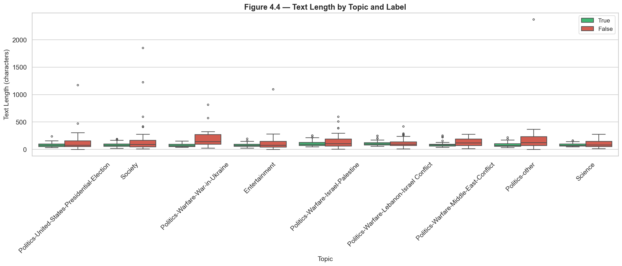
Error Analysis: Where Models Still Fail
Five shared misclassification patterns (CoT / Ensemble / Multi-Step error counts)
Ambiguous Context
Entity/Date Mismatch
Image-Caption Mismatch
Missing Reliable Evidence
Satire or Rhetoric
Errors: CoT:3 Ens:2 MS:2
Errors: CoT:5 Ens:4 MS:3
Errors: CoT:3 Ens:2 MS:2
Errors: CoT:3 Ens:3 MS:3
Errors: CoT:2 Ens:2 MS:1
Unclear factual background leads to guesswork
Minor factual errors confused with real misinformation
Real image + fake caption. CoT cannot separate these.
Universal limitation: no evidence → forced to guess
Humorous/satirical tone misread as false claims
Slice-Based Error Analysis
• Election & Health topics → universal accuracy decline — ambiguous, polarized claims lack definitive evidence
• Image-caption mismatch is the #1 CoT failure → Multi-Step eliminates this via independent image misuse inspection
• Missing evidence affects ALL pipelines equally → retrieval quality is the shared performance ceiling
MultiFact — Multimodal Misinformation Detection | Group 25
10

Slide 14
Model Limitations & Future Directions
🔌 API Dependency
📡 Retrieval Noise
🌍 OOD Generalization
🖼️ No Pixel-Level Detection
Full pipeline requires paid LLM, image recognition, and search service credentials. Cannot run fully offline.
Search outputs may be outdated, duplicated, or unsubstantiated. Contradictory evidence can distort all models' reasoning.
Trained on 2024-2025 English social media posts. Performance drops on long videos, low-resource languages, other content types.
All architectures only evaluate cross-modal semantic alignment. No dedicated module for detecting Photoshop or subtle AI edits.
Future Work
• Evidence filtering & deduplication — reduce retrieval noise for more reliable reasoning
• Lightweight multi-step — distill LLM-based's reasoning chain into a smaller, faster model
• Pixel-level forgery detection — add dedicated image forensic modules to complement semantic checks
• Detection-in-the-loop — semi-automatic continuous dataset updates to maintain temporal relevance
MultiFact — Multimodal Misinformation Detection | Group 25
11

Slide 15
Summary & Conclusions
🏆
Multi-Step > Ensemble > CoT
Staged verification outperforms single-stage reasoning across all 4 metrics. +6.9% accuracy improvement over the baseline is a substantial margin.
🎯
Recall Matters Most for Misinformation
The cost of missing fake news far exceeds the cost of a false alarm. Multi-Step's 86.1% recall is the key metric for real-world deployment.
🔗
Evidence Retrieval = Shared Ceiling
All models degrade under evidence-poor conditions. Better retrieval infrastructure benefits every reasoning strategy.
⚠️
EDA Drove Better Modeling
Identifying author as a confound and real-image deception as the main threat directly shaped our experimental design choices.
All code, data, and reports available on GitHub · Thank you for listening
12
MultiFact — Multimodal Misinformation Detection | Group 25

Slide 16
Questions & Answers
MultiFact — Multimodal Misinformation Detection
Group 25 | INFO 442 Data Science Projects | June 2026

Slide 17
