Slide 1
数据结构与算法导论
商品进销货系统

Slide 2
01
主菜单和功能对应部分&链表的创建
02
添加、进货与销售商品的实现
Contents
03
根据编号实时查询商品状况或对全体商品进行总展示
04
计算商品总成本、保存数据至文件和从文件加载数据

Slide 3
typedef struct Product {
int id;
char name[50];
float price;
float cost;
int stock;
struct Product* next;
} Product;
Product* head = NULL;
void show_menu();
int is_id_exist(int id);
void add_product();
void update_stock(int mode);
void display_products();
void search_product_by_id();
void calculate_total_cost();
void save_to_file();
void load_from_file();
void free_all();
主菜单和功能对应部分&链表的创建
void show_menu() {
system("cls"); // 清屏
printf("=== 商品管理系统 ===\n");
printf("1. 添加商品\n");
printf("2. 商品进货\n");
printf("3. 商品销售\n");
printf("4. 显示所有商品\n");
printf("5. 查询商品信息\n");
printf("6. 计算总成本\n");
printf("7. 保存数据\n");
printf("8. 加载数据\n");
printf("0. 退出系统\n");
}

Slide 4
int main() {
int choice;
load_from_file();
do {
show_menu();
printf("请选择操作：");
scanf("%d", &choice);
switch(choice) {
case 1: add_product(); break;
case 2: update_stock(2); break;
case 3: update_stock(3); break;
case 4: display_products(); break;
case 5: search_product_by_id(); break;
case 6: calculate_total_cost(); break;
case 7: save_to_file(); break;
case 8: load_from_file(); break;
case 0: printf("正在退出...\n"); break;
default: printf("无效选择！\n");
}
主菜单和功能对应部分&链表的创建
if (choice != 0) {
printf("按任意键继续...");
while(getchar() != '\n');
getchar(); }
} while(choice != 0);
save_to_file();
free_all();
return 0;
}

Slide 5
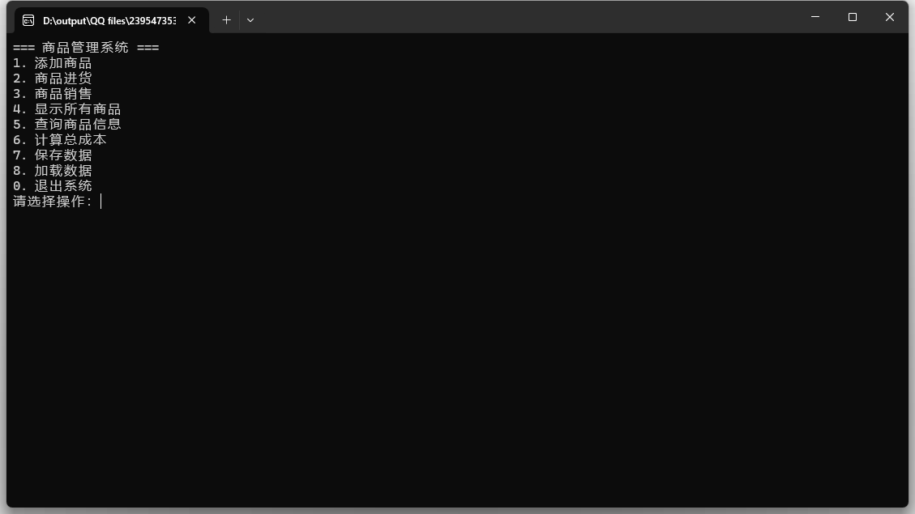

Slide 6
添加、进货与销售商品的实现
printf("输入商品名称：");
scanf("%s", new_prod->name);
do {
printf("输入销售价：");
scanf("%f", &new_prod->price);
} while (new_prod->price <= 0);
do {
printf("输入成本价：");
scanf("%f", &new_prod->cost);
} while (new_prod->cost <= 0);
do {
printf("输入库存：");
scanf("%d", &new_prod->stock);
} while (new_prod->stock < 0);
new_prod->next = head;
head = new_prod;
printf("添加成功！\n");
}
int is_id_exist(int id) {
Product* p = head;
while (p) {
if (p->id == id) return 1;
p = p->next;
}
return 0;
}
void add_product() {
Product* new_prod = (Product*)malloc(sizeof(Product));
printf("\n输入商品编号：");
scanf("%d", &new_prod->id);
if (is_id_exist(new_prod->id)) {
printf("编号已存在！\n");
free(new_prod);
return;
}

Slide 7
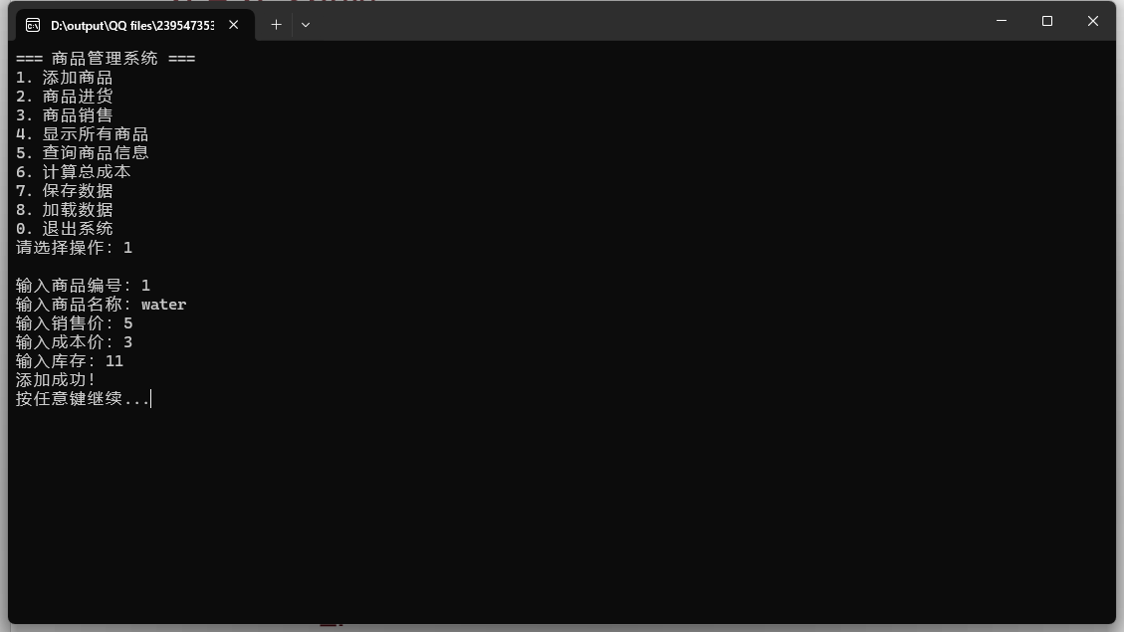

Slide 8
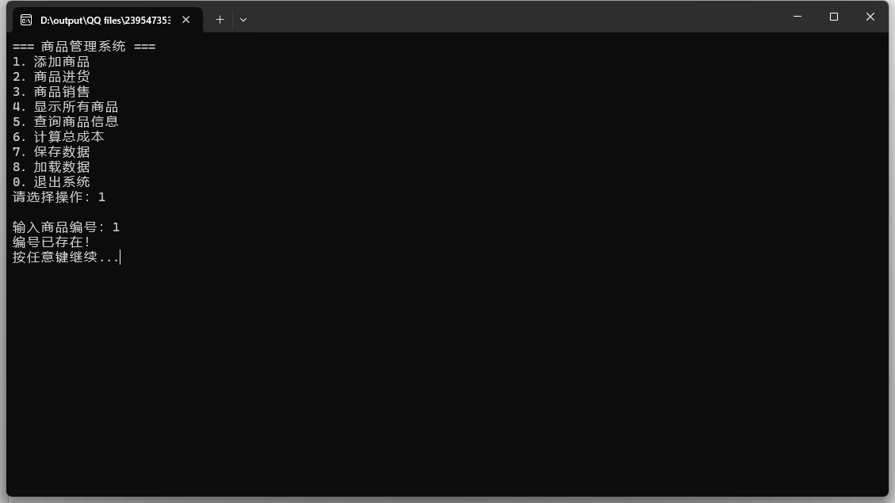

Slide 9
添加、进货与销售商品的实现
//mode: 2-进货, 3-销售
void update_stock(int mode) {
int target_id, quantity;
printf("\n输入商品编号：");
scanf("%d", &target_id);
Product* p = head;
while (p && p->id != target_id) p = p->next;
if (!p) {
printf(“商品不存在。\n");
return;
}
printf("当前库存：%d\n输入数量：", p->stock);
scanf("%d", &quantity);
if (mode == 3) { // 销售模式
if (p->stock < quantity) {
printf("库存不足！\n");
return;
}
p->stock -= quantity;
} else { // 进货模式
p->stock += quantity;
}
printf("当前库存：%d\n", p->stock);
}

Slide 10
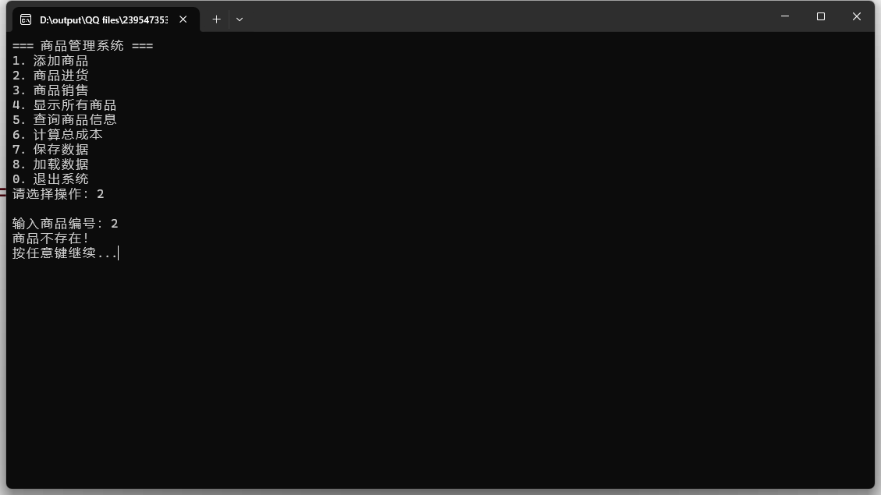

Slide 11
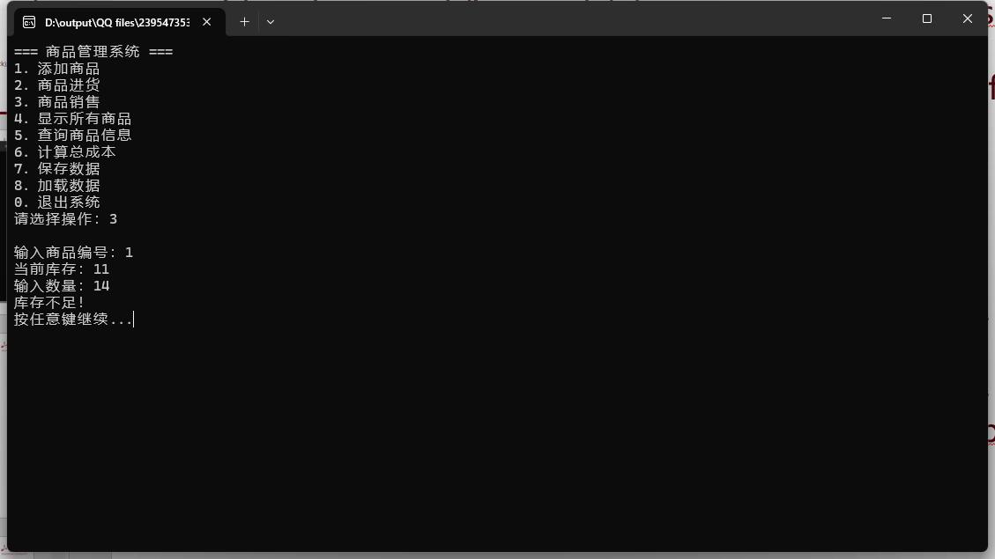

Slide 12
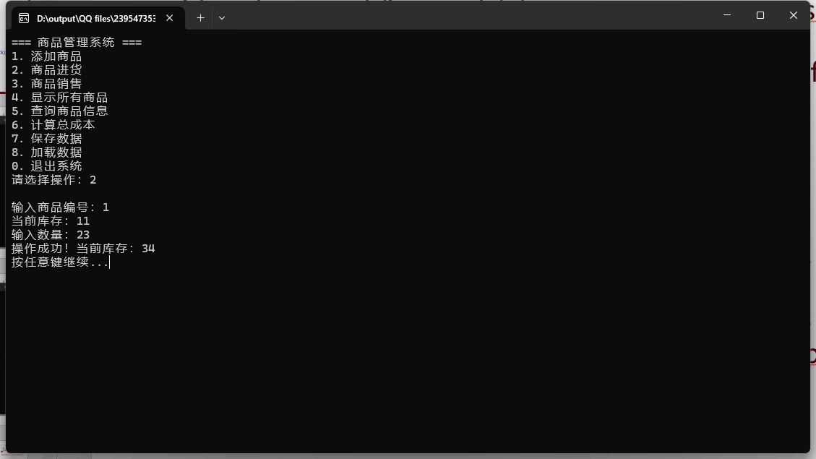

Slide 13
void search_product_by_id() {
int target_id;
printf("\n输入查询的商品编号：");
scanf("%d", &target_id);
Product* p = head;
while (p && p->id != target_id) p = p->next;
if (!p) {
printf(“未找到该商品。\n");
return;
}
// 格式化输出商品信息
printf("\n===== 详细信息 =====\n");
printf("商品编号: %d\n", p->id);
printf("商品名称: %s\n", p->name);
printf("销售价格: %.2f\n", p->price);
printf("成本价格: %.2f\n", p->cost);
printf("库存数量: %d\n", p->stock);
printf("========================\n");
}
根据编号实时查询商品状况或对全体商品进行总展示
void display_products() {
printf("\n%-8s%-20s%-10s%-10s%-8s\n", "编号", "名称", "销售价", "成本价", "库存");
printf("---------------------------------------------------\n");
Product* p = head;
while (p) {
printf("%-8d%-20s%-10.2f%-10.2f%-8d\n",
p->id, p->name, p->price, p->cost, p->stock);
p = p->next;
}
printf("\n");
}

Slide 14
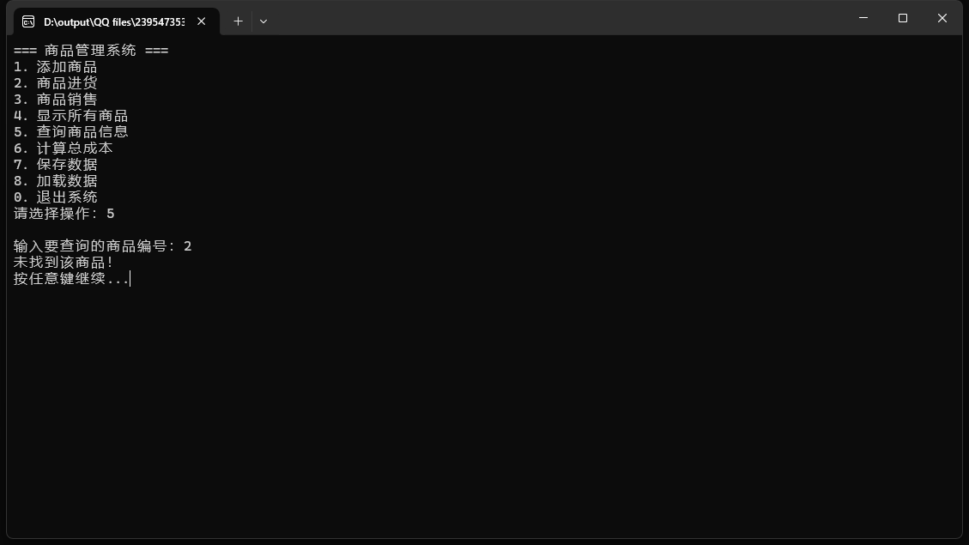

Slide 15
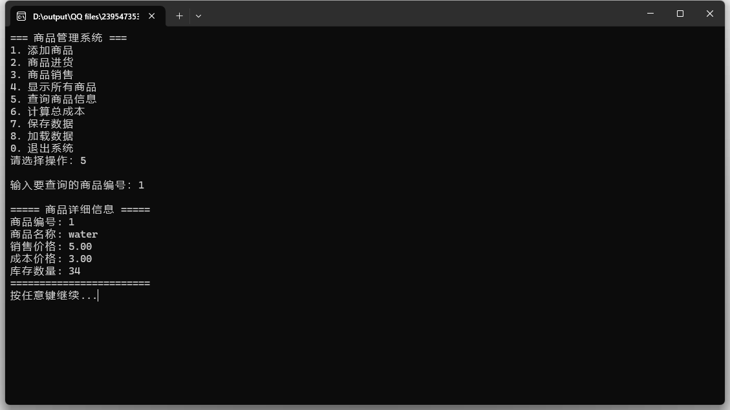

Slide 16
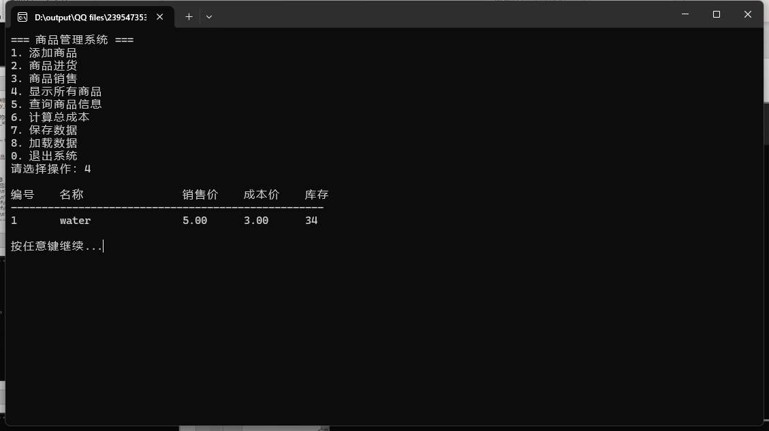

Slide 17
计算商品总成本、保存数据至文件和从文件加载数据
void save_to_file() {
FILE* fp = fopen("data.txt", "w");
if (!fp) {
printf("保存失败！\n");
return;
}
Product* p = head;
while (p) {
fprintf(fp, "%d %s %.2f %.2f %d\n",
p->id, p->name, p->price, p->cost, p->stock);
p = p->next;
}
fclose(fp);
printf(“数据已保存至data.txt。\n");
}
void calculate_total_cost() {
float total_cost = 0;
Product* p = head;
while (p) {
total_cost += p->cost * p->stock;
p = p->next;
}
printf("\n商品总成本: %.2f\n", total_cost);
}

Slide 18
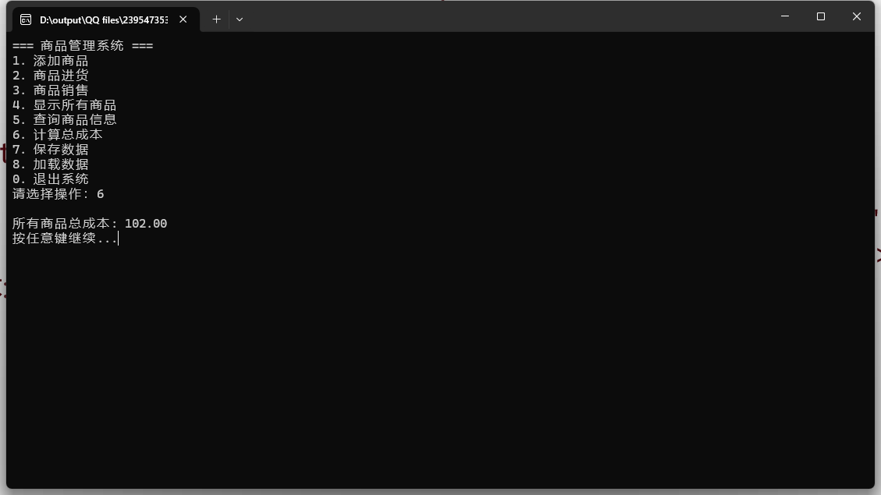

Slide 19
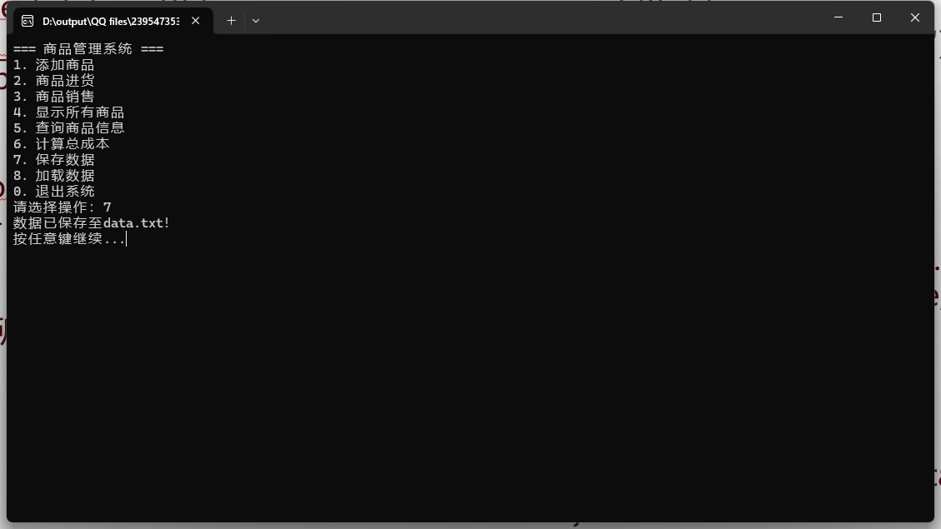

Slide 20
void load_from_file() {
FILE* fp = fopen("data.txt", "r");
if (!fp) {
printf("未找到数据文件！\n");
return;
}
free_all(); // 清空当前链表
Product temp, *new_node;
while(fscanf(fp, "%d %s %f %f %d",
&temp.id, temp.name, &temp.price, &temp.cost, &temp.stock) != EOF) {
new_node = (Product*)malloc(sizeof(Product));
*new_node = temp;
new_node->next = head;
head = new_node;
}
fclose(fp);
printf("数据加载成功！\n");
}
计算商品总成本、保存数据至文件和从文件加载数据
void free_all() {
Product* p = head;
while (p) {
Product* temp = p;
p = p->next;
free(temp);
}
head = NULL;
}

Slide 21
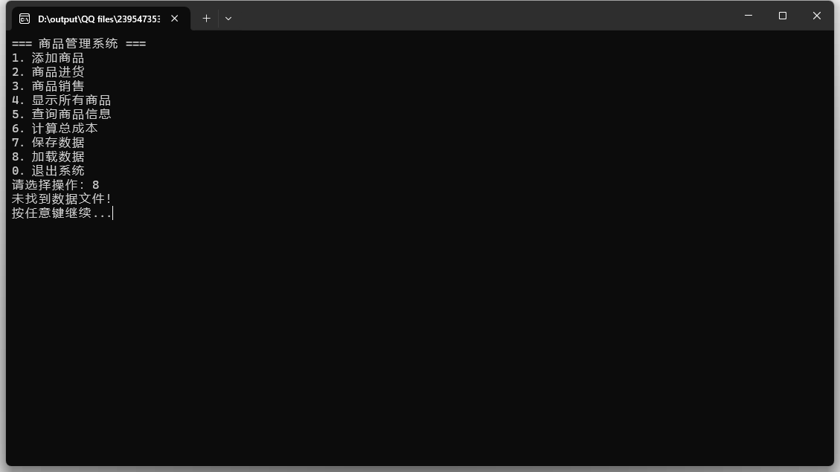

Slide 22
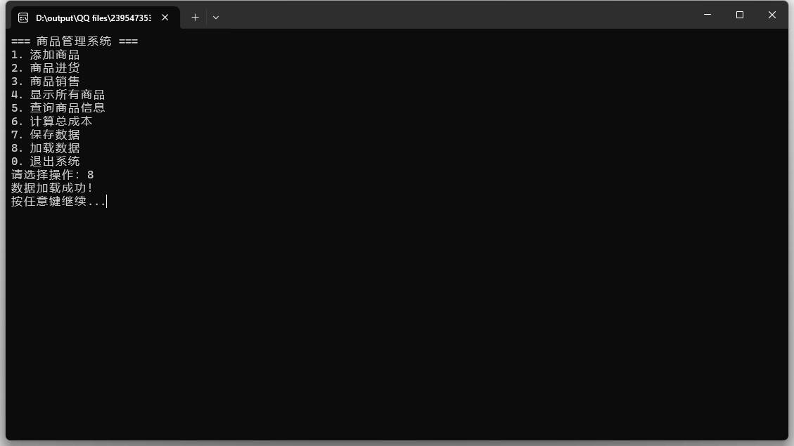

Slide 23
谢谢
THANK YOU

