Slide 1
Welcome to CS272!
Introduction to Web Development
Cole Nelson | Computer Sciences

Slide 2
Welcome to CS272!
This is the inaugural offering of the course!
Your feedback is welcome ☺
CS272 | Introduction to Web Development | Welcome!

Slide 3
What is, and why take, CS272?
You are interested in being more than just a consumer, but rather a builder of the web.
You want to learn to build websites by…
Using Content Management Systems, such as WordPress.
Writing code, such as HTML, CSS, and JS.
There is no programming pre-requisite to this class!
You want to be able to thoughtfully structure information and craft user experiences.
This course is designed to be beginner-friendly. There are no pre-requisites; you are welcome here!
Consider sister courses, CS200 and CS220, as well!
CS272 | Introduction to Web Development | Welcome!

Slide 4
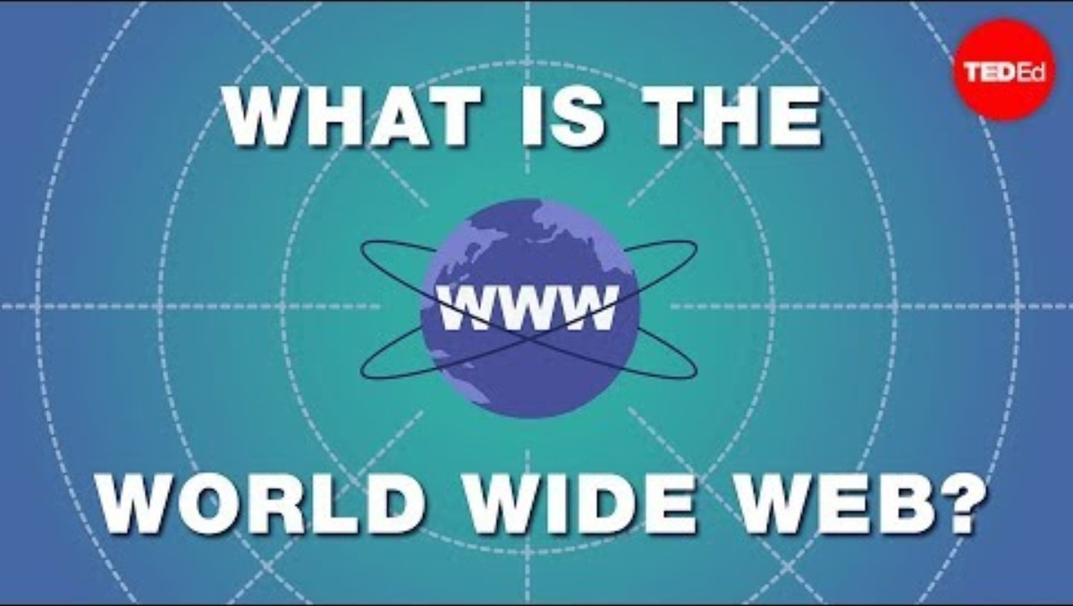

Slide 5
This sounds a lot like CS571…
CS272
CS571
Anyone!
Upperclassmen CS students
Use of CMS (e.g. WordPress)
No mention of CMS
Focus on fundamentals
The Web
Quickly go over fundamentals
Introduction of trendy libraries & frameworks
Some HCI Topics
Extensive use of trendy libraries & frameworks
HTML/CSS/JS
No mobile/voice component
Covers mobile & voice
☺
Formative assessment
Summative assessment
Extremely new, first class!
Very new, ~3 years!
CS272 | Welcome!
CS272 | Introduction to Web Development | Welcome!

Slide 6

About Me
Education
B.S. Software Engineering, UW-Platteville
M.S. Computer Science, UW-Madison
Other Courses
CS220: Data Science Programming I
CS571: Building User Interfaces
Hobbies & Interests
The outdoors! Running, biking, hiking…
Cybersecurity
CS272 | Introduction to Web Development | Welcome!

Slide 7

Who are you?
Get to know your neighbors! ☺
Why are you interested in this course?
What other classes are you taking?
How is your first week on campus?

Slide 8
Course Logistics

Slide 9
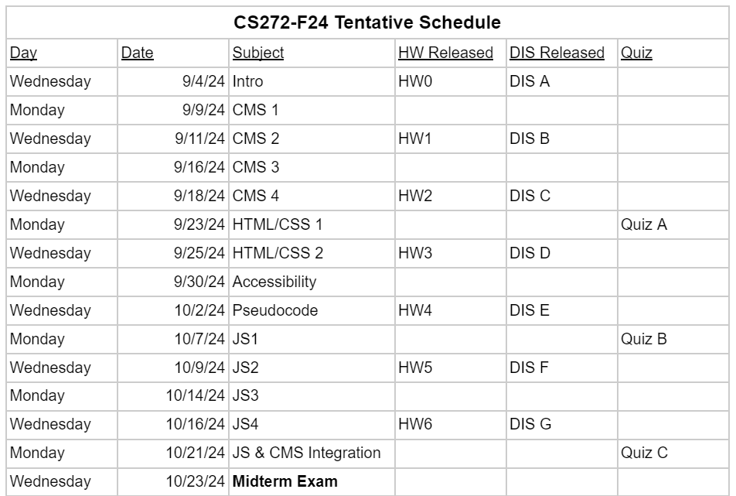

Slide 10
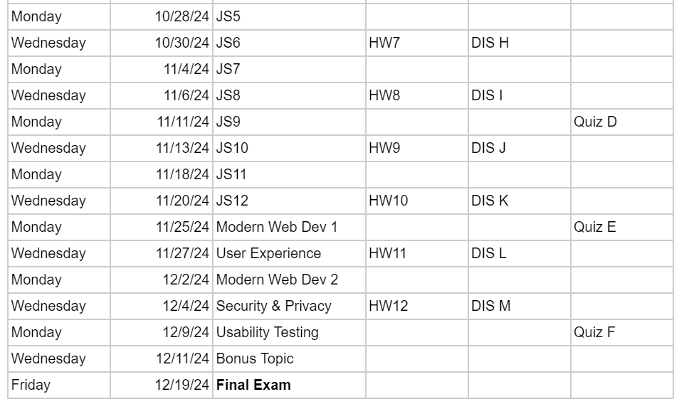

Slide 11
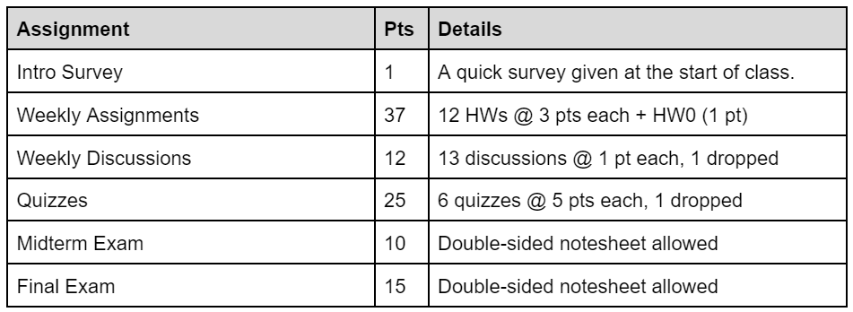
Grading
CS272 | Introduction to Web Development | Welcome!

Slide 12
Course Schedule
Important Dates
The Intro Survey is a quick survey to gauge a student’s current understanding of web development. It will not be shared with others.
Quizzes are formative assessments of material that has been learned since the previous quiz and will be held at the beginning of class periodically throughout the semester.
The Midterm Exam and Final Exam are summative assessments of material covered throughout the semester.
Quizzes (In-Class)
Sept 23rd
Oct 7th
Oct 21st
Nov 11th
Nov 25th
Dec 9th
Exams (Outside Classtime)
Midterm Exam
Wednesday, Oct 23rd @ 5:45 pm
Final Exam
Thursday, Dec 19th @ 7:45 am
CS272 | Introduction to Web Development | Welcome!

Slide 13
Weekly Assignments
Weekly Assignments are relevant to and develop on a student’s understanding of that week’s material. They are graded on a rubric specific to that assignment’s implementation.
Students have a total of 5 late days that can be used on weekly assignments throughout the semester. When all 5 late days are depleted, each day late will be 10% off that assignment’s grade.
No assignment can be turned in >7 days late. Days late are rounded up to the nearest whole number – e.g. an assignment turned in at 12:01 am will use a late day.
Be judicious in your use of late days!
CS272 | Introduction to Web Development | Welcome!

Slide 14
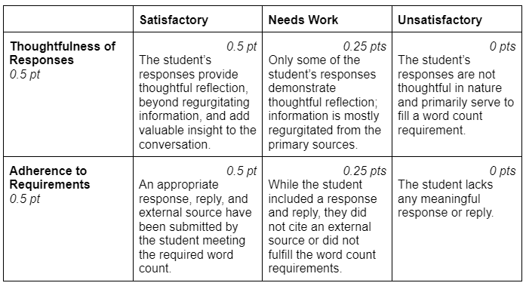
Weekly Discussions
Weekly Discussions will be held via Canvas. Students will reflect with a 300-word (± 50) response to a prompt regarding that week’s material. As a part of their response, they will also find and analyze a source of their choosing. Additionally, students will reflect on each others’ responses through a 200-word (± 50) reply. Late discussions are not accepted.
CS272 | Introduction to Web Development | Welcome!

Slide 15
Academic Integrity
Do not use ChatGPT/generative AI for your discussion posts.
Read also: Dead Internet Theory
When using generative AI for weekly assignments, cite your usage.
Do not copy and paste the assignment into ChatGPT, use it like a tutor!
Do not copy code from other students.
Do not share code with other students.
All violations of academic integrity are reported to the Office of Student Conduct – be honest in your work!
CS272 | Introduction to Web Development | Welcome!

Slide 16
Today’s Topic
Content Management Systems (CMS)

Slide 17
What is a Content Management System (CMS)?
A content management system (CMS) is software that helps users create, manage, store, and modify their digital content. (IBM)
A CMS, short for content management system, is a software application that allows users to build and manage a website without having to code it from scratch, or know how to code at all. (HubSpot)
What are some Content Management Systems that you know of?
CS272 | Introduction to Web Development | Welcome!

Slide 18
WordPress
A type of Content Management System.
“The open-source publishing platform of choice for millions of websites worldwide—from creators and small businesses to enterprises.” – wordpress.org
Approximately 20-40% of websites use WordPress!
Not to be confused with wordpress.com!
wordpress.org – the open-source WordPress software
wordpress.com – a paid host for WordPress
BlueHost, DreamHost, Hostinger, UW-Madison CS Dept, among others…
CS272 | Introduction to Web Development | Welcome!

Slide 19
WordPress – A Word of Caution
Because of WordPress’s popularity, it is a commonly attacked!
Keep your WordPress site and plugins up-to-date.
UW-Madison requires the use of a VPN to access your WordPress site.
Instructions found here.
Let’s get connected to the WiscVPN!
CS272 | Introduction to Web Development | Welcome!

Slide 20
Let’s get started with WordPress!

Slide 21
Start HW0, DIS A, and the Intro Survey!

