Slide 1
Content Management Systems 2
CS272: Introduction to Web Development
Cole Nelson | Computer Sciences

Slide 2
Information Sciences Majors
Please consider taking LIS640 instead!

Slide 3
Discussion A Review
What makes a “bad website”?

Slide 4
What makes a “bad website”?
A website can be defined both by its user interface and user experience.
User Interface
2-dimensional view
What is displayed on the screen
Focuses on the aesthetics, layout, and interactions
User Experience
3-dimensional view
What is around the screen
Focuses on user flow, feelings, and surrounding environment
Both are important!
CS272 | Introduction to Web Development | CMS 2

Slide 5
Did you make comments on the UI or UX?
Both are valid and meaningful! :)

Slide 6
On the UI…
“Having no visual- hierarchy”
“Terrible color combination”
“Overly fancy backgrounds, or links hidden in unseen locations”
“Although the information is easy to find, it's not arranged in the most readable way”
“Failing to consider [mobile design] leads to a website that is not readily accessible to large groups of people”
CS272 | Introduction to Web Development | CMS 2

Slide 7
On the UX…
“There were so many clicks just to find specific products”
“When a webpage takes too long to load, it unnecessarily consumes users' time, making it a bad experience.”
“Has too many CAPTCHAs”
“Auto-refresh and bring me to the top of the page when the recipe is at the bottom”
CS272 | Introduction to Web Development | CMS 2

Slide 8
On the UI…

Slide 9
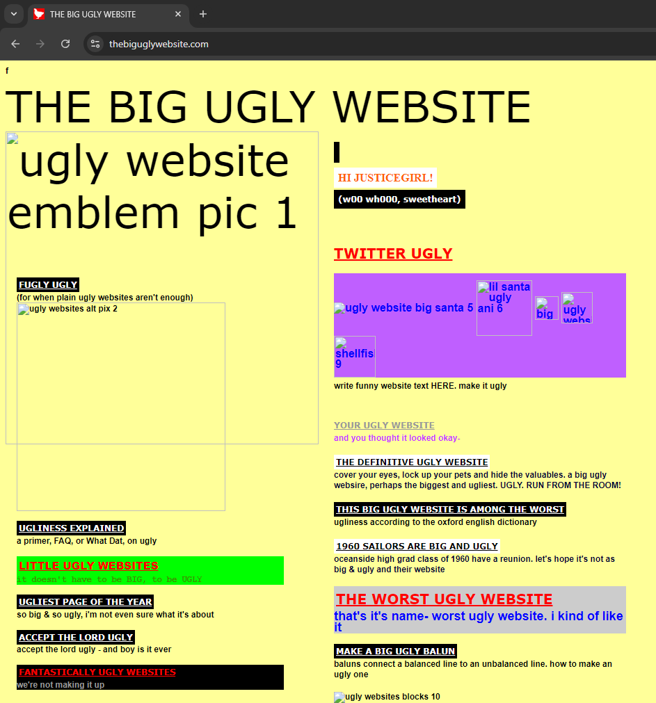

Slide 10
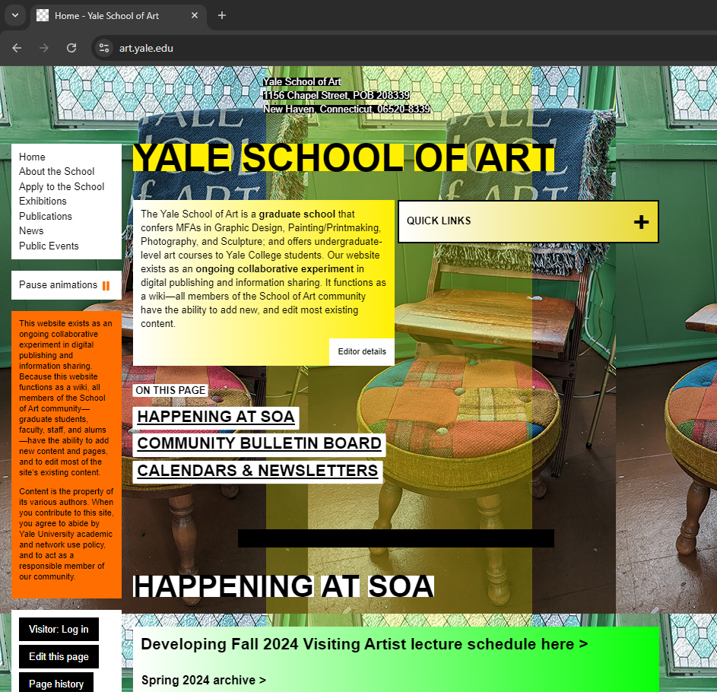

Slide 11
On the UX…

Slide 12
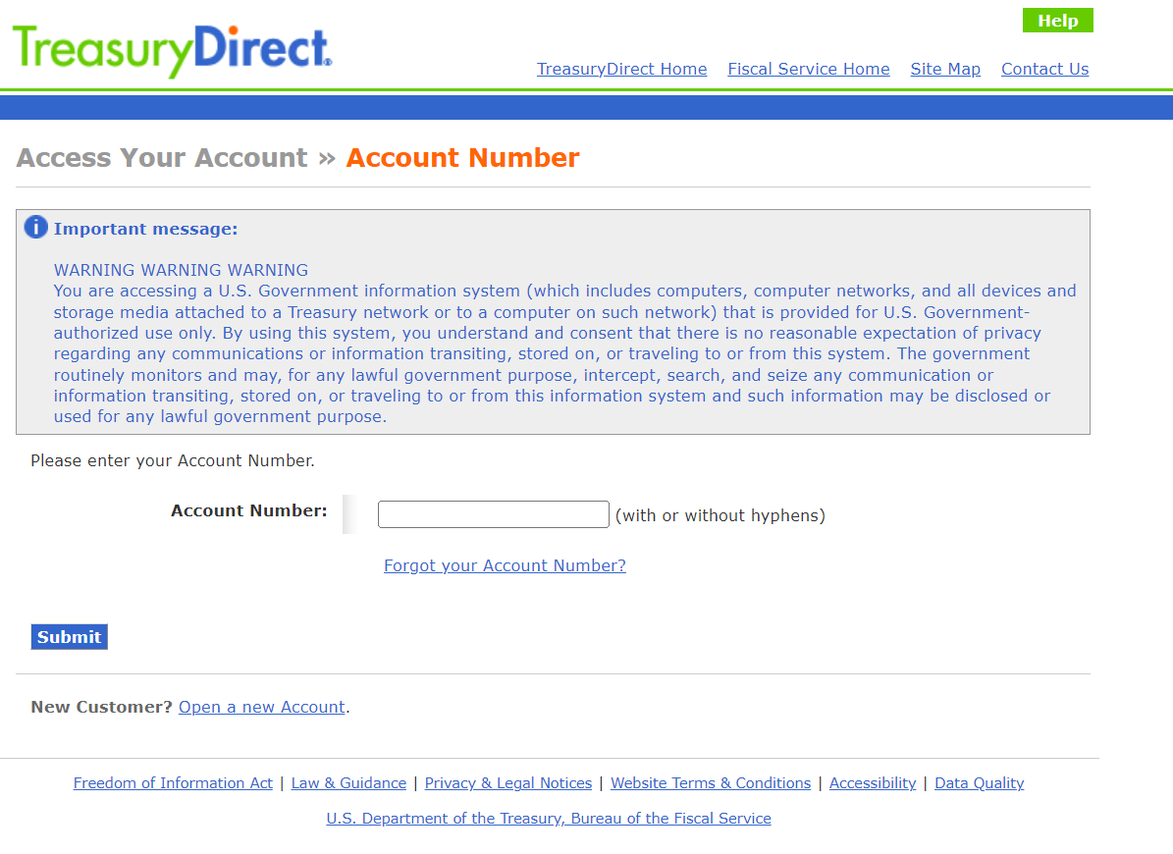

Slide 13
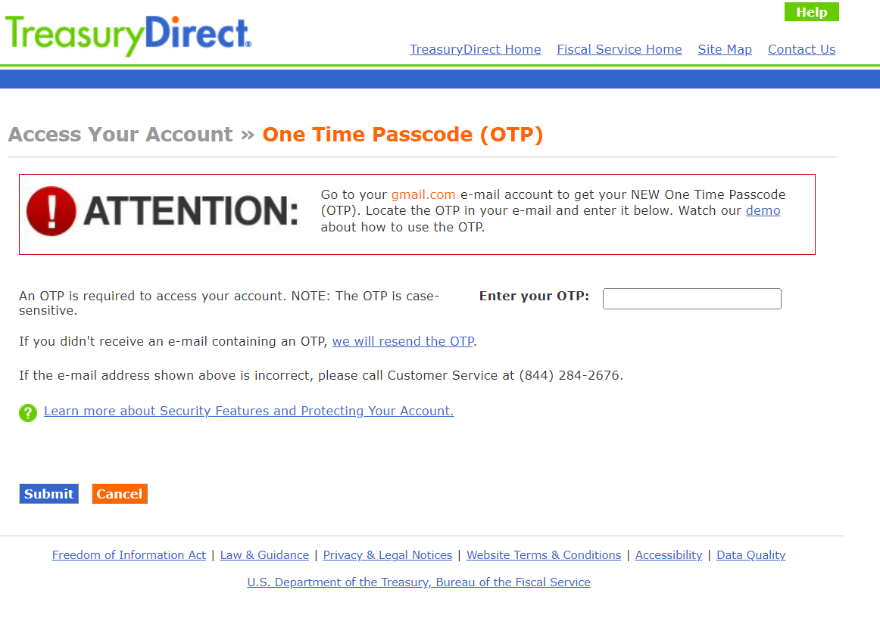

Slide 14
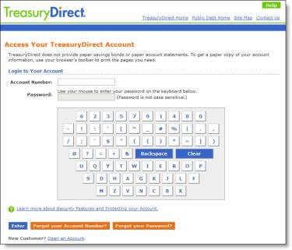

Slide 15
Learning Objectives
After this lecture, students should be able to…
Identify the difference between “UI” and “UX”
Define content as a “post” or “page”
Categorize and tag the content of a post
Use Gutenberg Blocks including…
Heading
Paragraph
Image
Button
Group
Column
Define synced and not-synced patterns using these blocks.
CS272 | Introduction to Web Development | CMS 2

Slide 16
WordPress Essentials
The theme dictates how pages and posts are displayed.
For now, let’s stick with the default theme!
Please do not change this.
Both pages and posts hold content; this could be…
Headings
Text
Images
… and much more!
Pages are intended for static content that doesn't change frequently.
Posts are intended for blog entries or articles that are time-sensitive.
Posts can also be tagged and categorized – more on this today!
CS272 | Introduction to Web Development | CMS 2

Slide 17
Let’s build a website!
Categorize topics as either a Page and Post.

Slide 18
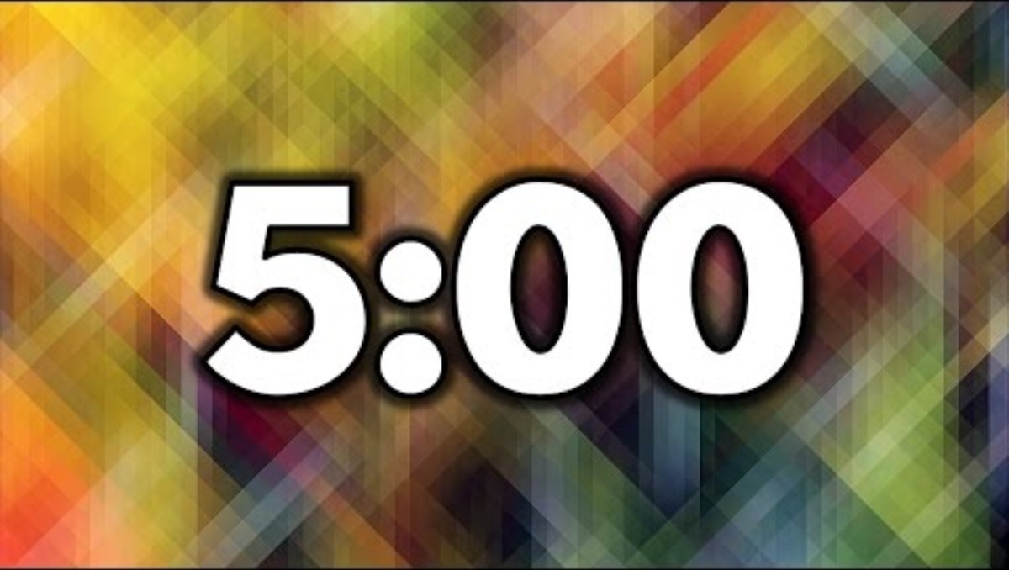
Gatos Galore (An Animal Shelter)
Adoption Policy
New Shelter Found!
FAQs
Meet Pepper
About Us
Dry Food Needed!
Meet Whiskers
Frida’s New Home!
Donate
Meet Charlie
Lyon’s Adoption
CS272 | Introduction to Web Development | CMS 2

Slide 19
Gatos Galore (An Animal Shelter)
Meet Pepper
Frida’s New Home!
About Us
Meet Whiskers
Lyon’s Adoption
Donate
Meet Charlie
New Shelter Found!
Adoption Policy
FAQs
Dry Food Needed!
Posts
Pages
CS272 | Introduction to Web Development | CMS 2

Slide 20
Gatos Galore (An Animal Shelter)
Success Stories
Meet Pepper
Frida’s New Home!
About Us
Meet Whiskers
Lyon’s Adoption
Donate
Meet Charlie
New Shelter Found!
Adoption Policy
FAQs
Dry Food Needed!
New
Posts
Pages
Misc
CS272 | Introduction to Web Development | CMS 2

Slide 21
What’s in a post?
Posts can be categorized and tagged.
Pages cannot be.
A category provides hierarchical structure and broad grouping. You can even have sub-categories!
available
adopted
misc – default is uncategorized
A tag is not hierarchical and is used primarily as a descriptor.
calico
shorthair
uplifting
CS272 | Introduction to Web Development | CMS 2

Slide 22
Tom’s Tech Tips (A Technology Website)
Where To Find Us
Intel i3-8100 Review
Contact Us
Intel i7-7700 Review
About Us
WordPress Rocks!
AMD A6 Review
Privacy Policy
Wix Stinks!
New Website Announced
Our Hours Changed!
CS272 | Introduction to Web Development | CMS 2

Slide 23
Tom’s Tech Tips (A Technology Website)
Intel i3-8100 Review
New Website Announced!
About Us
Intel i7-7700 Review
Our Hours Changed!
Contact Us
AMD A6 Review
WordPress Rocks!
Where To Find Us
Wix Stinks!
Privacy Policy
Posts
Pages

Slide 24
Tom’s Tech Tips (A Technology Website)
Misc
Intel i3-8100 Review
New Website Announced!
About Us
Intel i7-7700 Review
Our Hours Changed!
Contact Us
AMD A6 Review
WordPress Rocks!
Where To Find Us
Wix Stinks!
Privacy Policy
Processor Reviews
Posts
Pages
Host Reviews
CS272 | Introduction to Web Development | CMS 2

Slide 25
Tom’s Tech Tips (A Technology Website)
Misc
Intel i3-8100 Review
New Website Announced!
About Us
Intel i7-7700 Review
Our Hours Changed!
Contact Us
AMD A6 Review
WordPress Rocks!
Where To Find Us
Wix Stinks!
Privacy Policy
reviews/processor
Posts
Pages
reviews/host
CS272 | Introduction to Web Development | CMS 2

Slide 26
Let’s dive into WordPress!
Categorizing and tagging your posts.

Slide 27
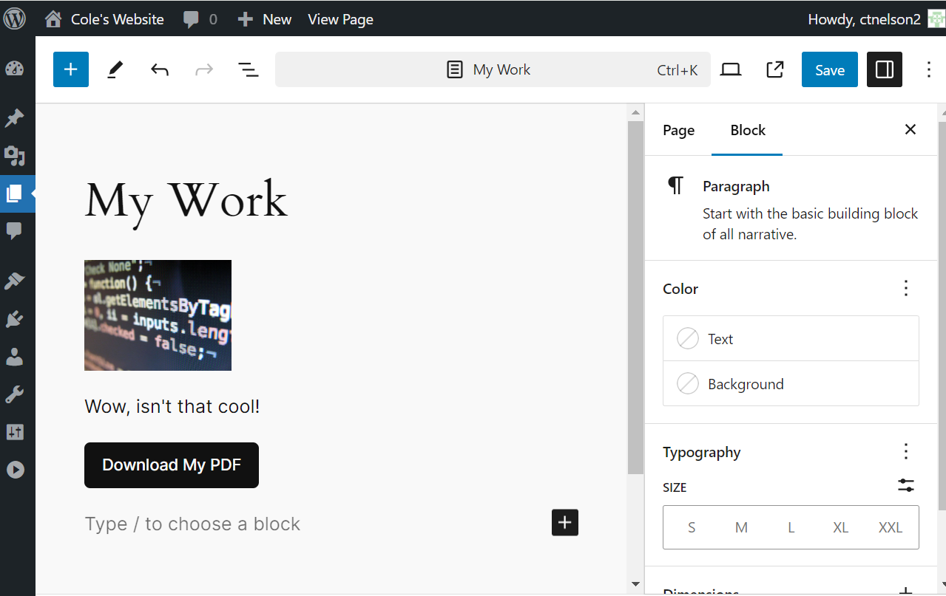
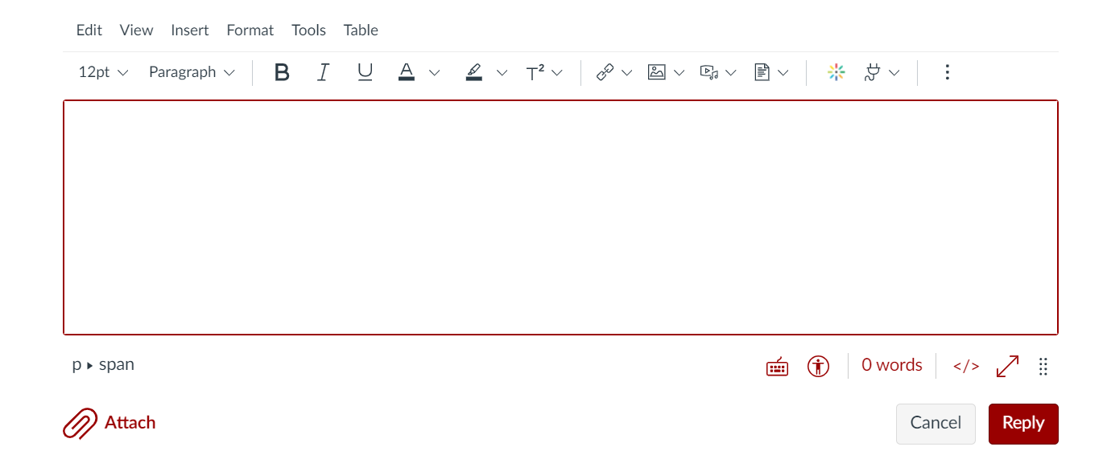
The Page & Post Editor
The “Classic” Editor*
The Gutenberg “Block” Editor
*Not exactly, but similar to the Canvas editor.
CS272 | Introduction to Web Development | CMS 2

Slide 28
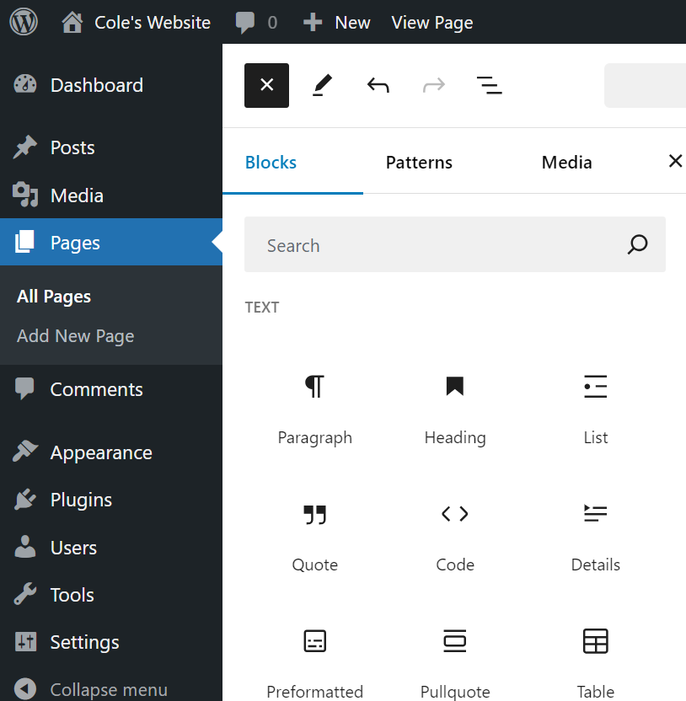
The Gutenberg Editor
Many, many blocks to choose from!
For now, you should know…
Heading
Paragraph
Image
Button
Group
Column
CS272 | Introduction to Web Development | CMS 2

Slide 29
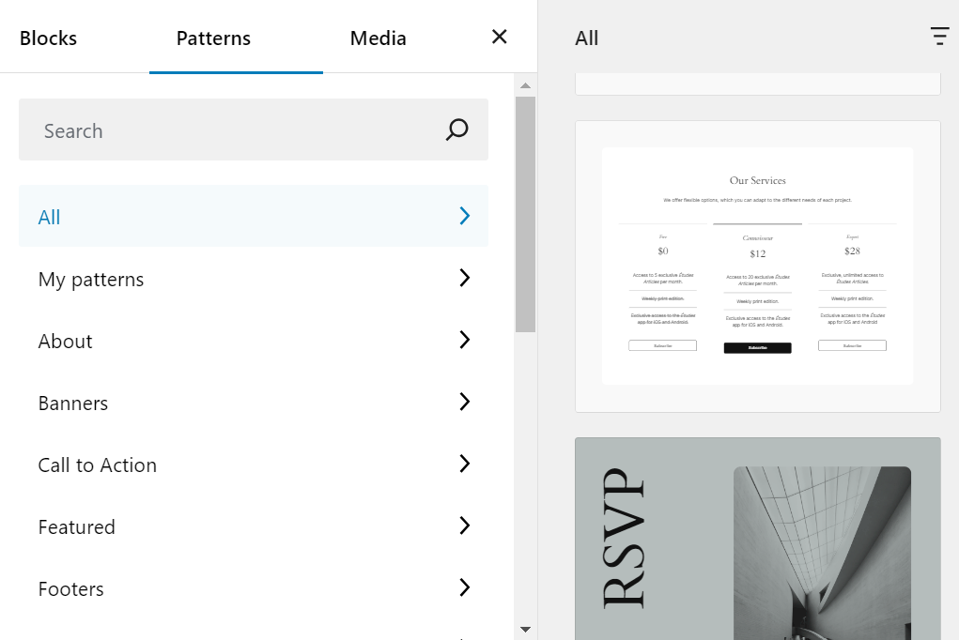
Patterns
Generally accepted formats for combining blocks into a typical use case.
e.g. project description, pricing, calls to action, etc.
Your theme provides some patterns, but you can also create your own!
CS272 | Introduction to Web Development | CMS 2

Slide 30
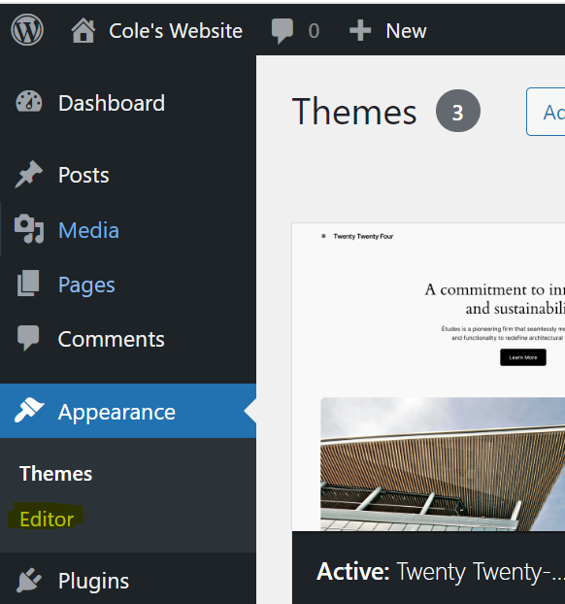
Patterns
Patterns can be managed via the full-site-editor.
This is a new feature of some WordPress themes!
Be careful what you change, it could affect your entire site!
CS272 | Introduction to Web Development | CMS 2

Slide 31
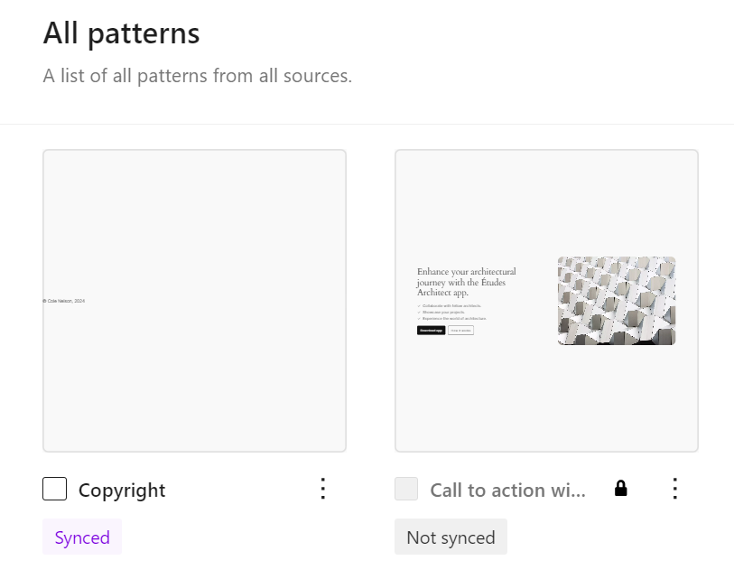
Patterns
Patterns can be synced or not synced.
A pattern that is synced will look the same everywhere that it is used!
A pattern that is not synced can be changed to meet the needs of a specific part of the webpages that it is being used.
CS272 | Introduction to Web Development | CMS 2

Slide 32
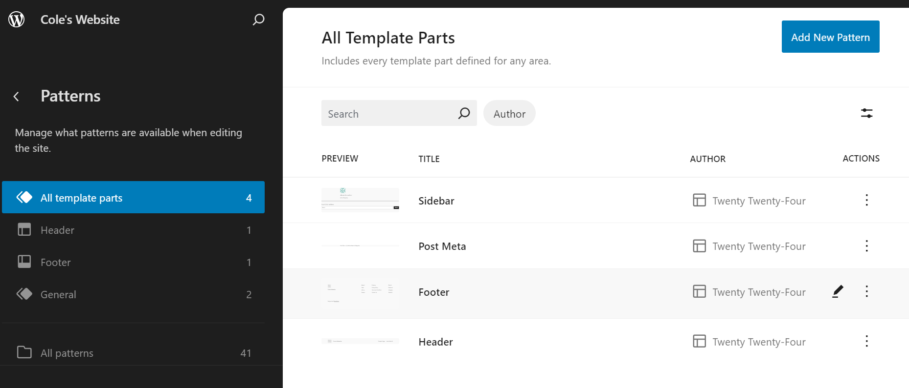
Template Parts
A template part is a synced pattern used in specific parts of a theme (e.g. header, footer)
CS272 | Introduction to Web Development | CMS 2

Slide 33
Let’s dive into WordPress!
Customize your headers and footers and create a new “Copyright” pattern. Use this copyright on each one of your posts and pages.

Slide 34
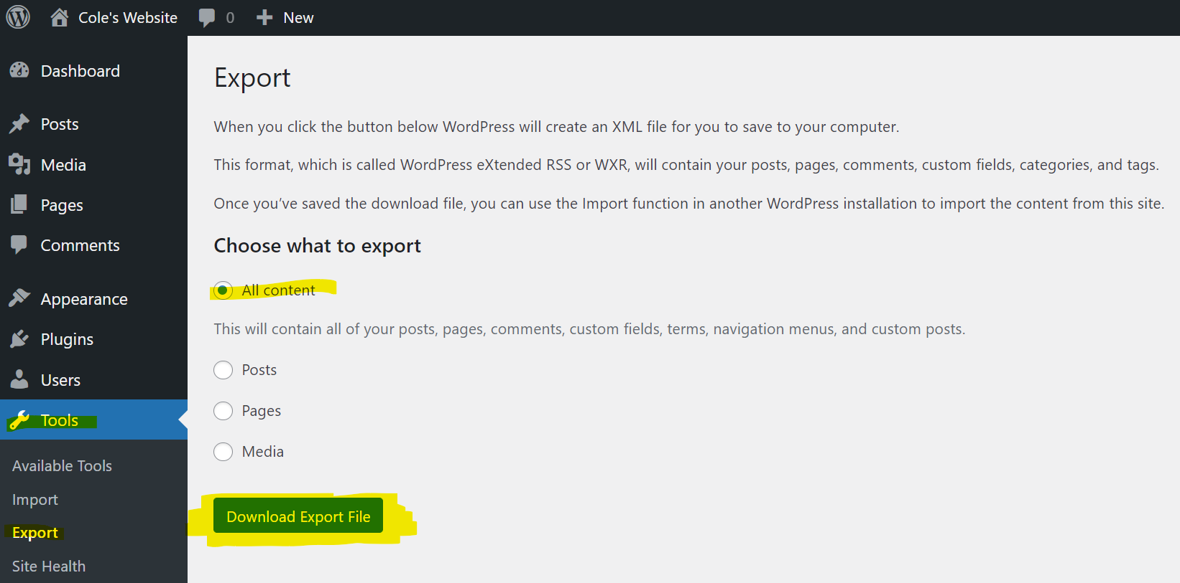
Exporting Your Site
Please do this for HWs 1 and 2!
CS272 | Introduction to Web Development | CMS 2

Slide 35
Start HW1 and DIS B!

