Slide 1
Content Management Systems 4
CS272: Introduction to Web Development
Cole Nelson | Computer Sciences

Slide 2
Quiz A will be at the end of Monday’s class!
10 multiple-choice questions on CMS 1-4.

Slide 3
Review the Full-Site-Editor
Navigation, Templates, and Patterns

Slide 4
Learning Objectives
After this lecture, students should be able to…
Install and use custom plugins and themes
Consider the pros and cons of using custom plugins and themes
Consider security and maintainability for WordPress sites
Consider hosted vs. self-hosted services
Consider alternative content management systems
Embed basic HTML and CSS into their pages and posts
CS272 | Introduction to Web Development | CMS 4

Slide 5
Themes & Plugins

Slide 6
Themes
Dictate the overall layout and appearance of your website, including…
Default fonts, colors, and other CSS styles
Available templates and template parts
Navigation options
WordPress team themes vs custom themes
Custom themes can be free, freemium, or premium!
Block themes (Full-Site Editing) vs Classic Themes
e.g. Twenty-Twenty-Four vs. Twenty-Twenty
Classic themes do not have a full-site editor!

Slide 7
Plugins
Can be free, freemium, or premium!
Add additional features to WordPress such as…
Search-Engine Optimization (SEO), e.g. Yoast
Auditing and tracking, e.g. Simple History
Security features, e.g. WPS Hide Login
Forums, e.g. bbPress
Forms, e.g. Contact Form 7
Much, much more!
Vary greatly in size and complexity.
Not an endorsement of any particular plugin.

Slide 8
Plugins and Themes
Plugins and themes from the official wordpress.org marketplace are “trusted”.
This does not mean they are “endorsed”!
There may still be security vulnerabilities!
What impact might custom plugins and themes have on security and maintainability of your site?
Remember DIS B ☺

Slide 9

Your turn!
Add and enable a plugin on your site! Please keep your theme.

Slide 10
Congrats!
You now know how to use WordPress! ☺

Slide 11
Discussion B Review
What impact might custom plugins and themes have on security and maintainability of your site?

Slide 12
The Good
“Having an open-source marketplace allows users to tap into a wide range of expertise”
“Users can customize their websites in various ways”
“The thriving and diverse plugin selection for WordPress can provide many handy features to assist in creating and maintaining my website”

Slide 13
The Bad
“Third-party plugins and themes could have malware or other harmful coding or security flaws”
Official marketplace → not intentionally harmful
“Each plugin or theme introduces another potential weak spot in your website's security.”
An increase in surface area!
“Using too many [plugins and themes] can lead to compatibility issues that is difficult to trace.”
Especially plugins that do a similar thing.

Slide 14
The Bad
“Different open source software projects may adopt different licensing agreements.”
e.g. Akami Anti-Spam
“The creator of those plugins are consistently update the plugins in order to keep them functional, especially as WordPress itself receives updates”
Maintainability is key!

Slide 15
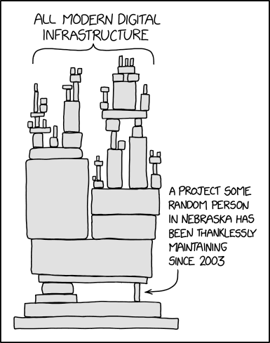
XKCD 2347

Slide 16
Considerations
What else should we consider when using a CMS?

Slide 17
Questions we still need to address…
Outside of cs272-wordpress.cs.wisc.edu, how can we host our own WordPress site?
What do we need to do to maintain our WordPress site?
What alternatives CMS options exist?

Slide 18
Can we host our own WordPress site?
Yes, but…

Slide 19
Self-Hosted vs Hosted WordPress Sites
Self-Hosted WordPress
e.g. running on your computer
High technical skill required
Only available when your computer is on
Visitors connect to you
No restrictions on WordPress content
Free*
Hosted WordPress
e.g. running on a dedicated host
Low technical skill required
Available 24/7
Visitors connect to your host
Often has restrictions on WordPress content
Paid
If you are interested in self-hosting a WordPress site, see XAMPP

Slide 20
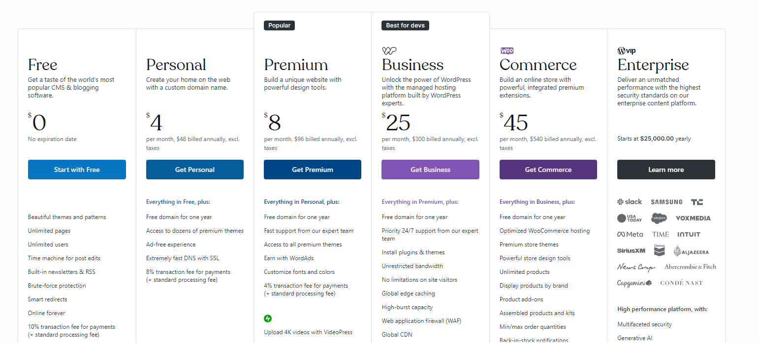
Hosted WordPress Sites
From wordpress.com

Slide 21
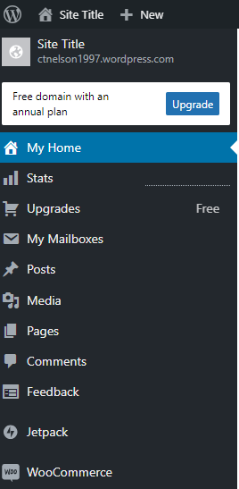
Hosted WordPress Sites
Because they host your WordPress site, they get to add/remove WordPress content on your behalf.
What you see will be a little bit different from what we’ve done with wordpress.org
From wordpress.com

Slide 22
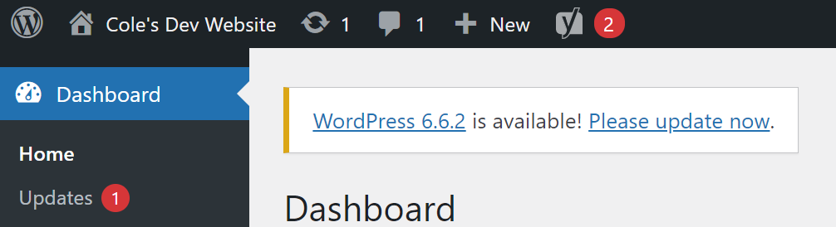
WordPress Maintenance
Keep your WordPress version up-to-date!
Some hosts do this for you ☺
Keep your plugins up-to-date!
Usually, this is on you!

Slide 23
WordPress Maintenance
Most software follows semantic versioning.
MAJOR.MINOR.PATCH
An increase in PATCH suggests backward compatible bug fixes
An increase in MINOR suggests added functionality in a backward compatible manner
An increase in MAJOR suggests new functionality replacing old functionality
PATCH and MINOR updates are frequent and generally safe changes, MAJOR updates are less frequent and often involve breaking changes.
6.6.1 → 6.6.2 😊
2.2.3 → 6.6.2 😱
Some would argue WordPress does not follow SemVer

Slide 24
Why update?
Pros
Stay with the latest security patches and bug fixes.
Older versions often become unsupported.
Documentation often follows the latest version.
Cons
Requires time and effort
May involve breaking changes
May involve learning new things
We update out of necessity, at the cost of time and effort.

Slide 25
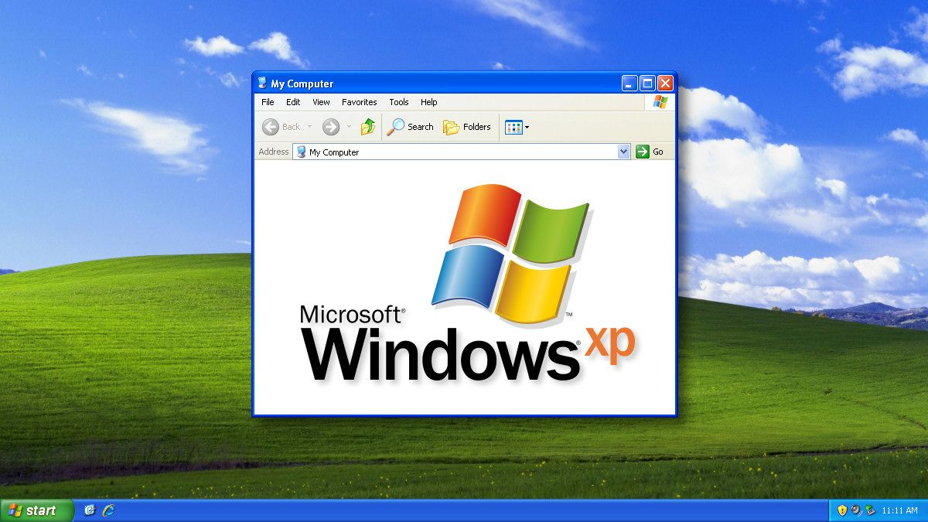
Image from HowToGeek

Slide 26
Embedding Custom Content
When you need more than what WordPress gives you!

Slide 27



What is the web?
CS272 | Introduction to Web Development | CMS 1

Slide 28

What about PHP?
PHP is used by the server to generate HTML, CSS, and JS files.
CS272 | Introduction to Web Development | CMS 1

Slide 29
Hyper-Text Markup Language (HTML)
<html>
<h1>Hello World!</h1>
<p>Welcome to my personal website!</p>
<p style="color: red">I go to UW-Madison...</p>
<img src="./wisc-logo.png" alt="UW-Madison Logo"/>
<button id="hero-btn">Click here to learn more!</button>
</html>

Slide 30
Cascading Style Sheets (CSS)
header {
background-color: #333;
color: #fff;
text-align: center;
padding: 20px;
}
h1 {
font-size: 36px;
}

Slide 31
JavaScript (JS)
let hasClicked = false;
function displayMessage() {
if (!hasClicked) {
alert("Welcome to my personal website!");
hasClicked = true;
} else {
alert("Feel free to explore!");
}
}

Slide 32
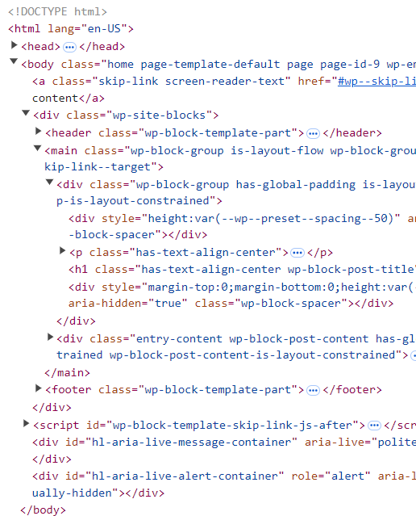
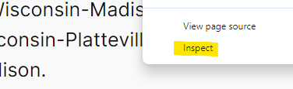
Where is this in WordPress?
Right-Click → Inspect

Slide 33
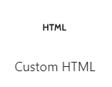
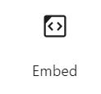


How do I embed custom HTML & CSS?
Add a “Custom HTML” block
Use the preview toggler

Slide 34
Start HW2 and DIS C!

