Slide 1
HTML/CSS 1
CS272: Introduction to Web Development
Cole Nelson | Computer Sciences

Slide 2
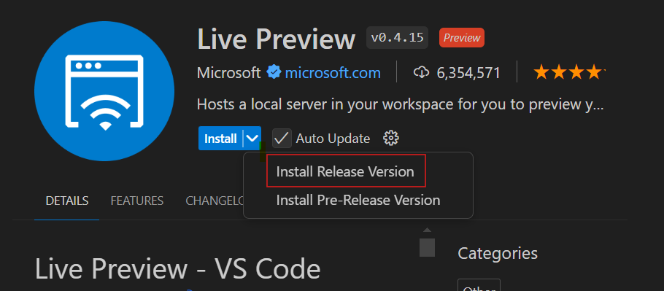
Before Class
Download & install Visual Studio Code.
When installed, add the “Live Preview” extension, Release version.

Slide 3
Quiz A will be at the end of today’s class!
10 multiple-choice questions on CMS 1-4.

Slide 4



What is the web?
CS272 | Introduction to Web Development | CMS 1

Slide 5




What happens with HTML, CSS, and JS?
A web browser displays them to us!
CS272 | Introduction to Web Development | CMS 1

Slide 6
Hyper-Text Markup Language (HTML)
<html>
<h1>Hello World!</h1>
<p>Welcome to my personal website!</p>
<p style="color: red">I go to UW-Madison...</p>
<img src="./wisc-logo.png" alt="UW-Madison Logo"/>
<button id="hero-btn">Click here to learn more!</button>
</html>

Slide 7
Cascading Style Sheets (CSS)
header {
background-color: #333;
color: #fff;
text-align: center;
padding: 20px;
}
h1 {
font-size: 36px;
}

Slide 8
JavaScript (JS)
let hasClicked = false;
function displayMessage() {
if (!hasClicked) {
alert("Welcome to my personal website!");
hasClicked = true;
} else {
alert("Feel free to explore!");
}
}

Slide 9
The Webpage
HTML defines the structure of the webpage
Defined with tags in a tree-like structure
CSS defines the styling of the webpage
Defined with decoration blocks defining style attributes
JS defines the behavior of the webpage
Defined with functions executing some sort of behavior
Check out the CodePen Example!

Slide 10
HTML
Defining the structure of our webpages.

Slide 11
Hyper-Text Markup Language (HTML)
First released in 1993.
HTML defines the structure of the website by using tags to define HTML elements (also called HTML nodes).
There are many different tags! We will only cover a few of them.
These elements form a tree, a data structure we’ll talk about later in lecture!

Slide 12
Hyper-Text Markup Language (HTML)
<!DOCTYPE html>
<html>
<head>
<title>Page Title</title>
</head>
<body>
<h1>This is a heading</h1>
<p>This is a paragraph.</p>
</body>
</html>
HTML has nested elements of head and body.
Metadata goes in head, visible elements go in body.

Slide 13
Hyper-Text Markup Language (HTML)
HTML is very forgiving! Even if we mess up our use of the syntax, it will still likely render to the webpage!
Syntax is the set of rules that define how to write valid code in a programming language.
We should always validate our HTML
<!DOCTYPE html>
<html>
<head>
<title>Page Title</title>
</head>
<body>
This is a heading</h1>
<p>This is a paragraph</p>
</body>
</html>

Slide 14
Hyper-Text Markup Language (HTML)
<!DOCTYPE html>
<html>
<head>
<!-- This is the head -->
</head>
<body>
<!-- This is the body -->
</body>
</html>
<!-- comments -->
Comments can be placed by following the above syntax.
They are ignored by the browser.

Slide 15
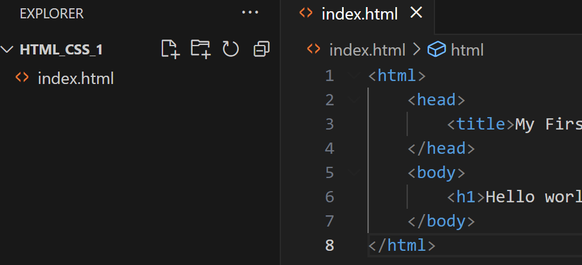
Writing HTML with VS Code
Create a new folder and open it using VS Code.
Using VS Code’s “Explorer”, create a new file called index.html
VS Code will help us with syntax highlighting and auto-completion!

Slide 16
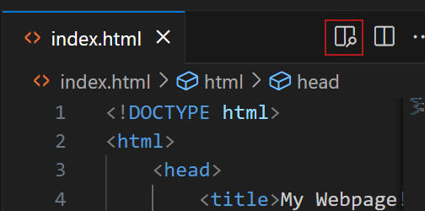
Your Turn!
Create your first webpage!
To test your code, click the preview icon in the top-right of the pane.
<!DOCTYPE html>
<html>
<head>
<title>My Webpage!</title>
</head>
<body>
<h1>Hello world!</h1>
</body>
</html>
Not seeing it? Make sure you installed the “Live Preview” extension.

Slide 17
Common HTML Tags
Purpose | Tag | Example
Headers | <h1></h1> | <h2>About Me</h2>
Text | <p></p> | <p>Hello world!</p>
Bold Text | <strong></strong> | <strong>Yes!</strong>
Italic Text | <em></em> | <em>No!</em>
Images | <img/> | <img src="./me.png" alt="A selfie of Cole!" />
Links | <a></a> | <a href="https://google.com" target="_blank" >Go to Google!</a>
Line Break | <br/> | <br/>
Divisions | <div></div> | <div><p>a</p><p>b</p></div>

Slide 18
Hyper-Text Markup Language (HTML)
Whitespace (new lines, tab characters, spaces) doesn’t matter!
An element can have many attributes.
Often, these attributes depend on the tag being used, e.g. an img can have src and alt attributes, whereas an a can have href and target attributes.
Many, many attributes exist!
See MDN documentation.
Elements are often nested.

Slide 19
<!DOCTYPE html>
<html>
<head>
<title>Page Title</title>
</head>
<body>
<h1>This is a heading</h1>
<p>This is a paragraph.</p>
</body>
</html>
The browser takes your HTML…

Slide 20
html
head
body
title
h1
p
“Page Title”
“This is a heading”
“This is a paragraph.”
…and represents it as a tree! This will be important in JavaScript.

Slide 21
Lists
Can be an ordered list (ol) or unordered list (ul) containing many list items (li)
Ordered lists are numbered (e.g. 1, 2, 3…)
Unordered lists are bulleted.
<ul>
<li>apples</li>
<li>bananas</li>
<li><strong>coconuts</strong><li>
</ul>
Check out the CodePen Example!

Slide 22
Tables
Use many tags!
table, thead, tbody, tr, th, and td
A table contains…
A thead contains…
A tr contains…
Many th
A tbody contains…
Many tr containing…
Many td
Check out the CodePen Example!

Slide 23

Your Turn!
Begin creating your “About Me” or “My Work” page in HTML!

Slide 24
CSS
Defining the styling of our webpages.

Slide 25
Cascading Style Sheets (CSS)
First released in 1996.
CSS defines the styling of the website by assigning certain values to style attributes.
Can be done with “decoration blocks”, or...
Inline on specific elements with a style attribute.
<h1 style="background-color: red">My Webpage!</title>

Slide 26
Common CSS Attributes
Attribute | Example | Notes
color | color: green color: #fefefe
background-color | background-color: red
font-size | font-size: 16px font-size: 1em | Prefer to use em for accessibility!
text-align | text-align: center
height / width | height: 400px width: 10em | Prefer to use em for accessibility!
border | border: 2px solid black | Goes in order of size, style, color.
margin | margin: 12px | Gives space outside the border.
padding | padding: 0.5em | Gives space inside the border.
An em is a flexible unit that depends on a user’s browser setting!

Slide 27
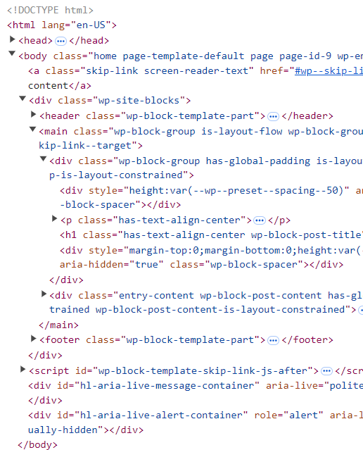
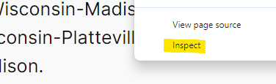
How do I ask “what-if”?
Right-Click → Inspect

Slide 28
Your Turn!
Add some CSS to your HTML!

Slide 29
Quiz A

