Slide 1
HTML/CSS 2
CS272: Introduction to Web Development
Cole Nelson | Computer Sciences

Slide 2
Discussion C
WordPress Security

Slide 3
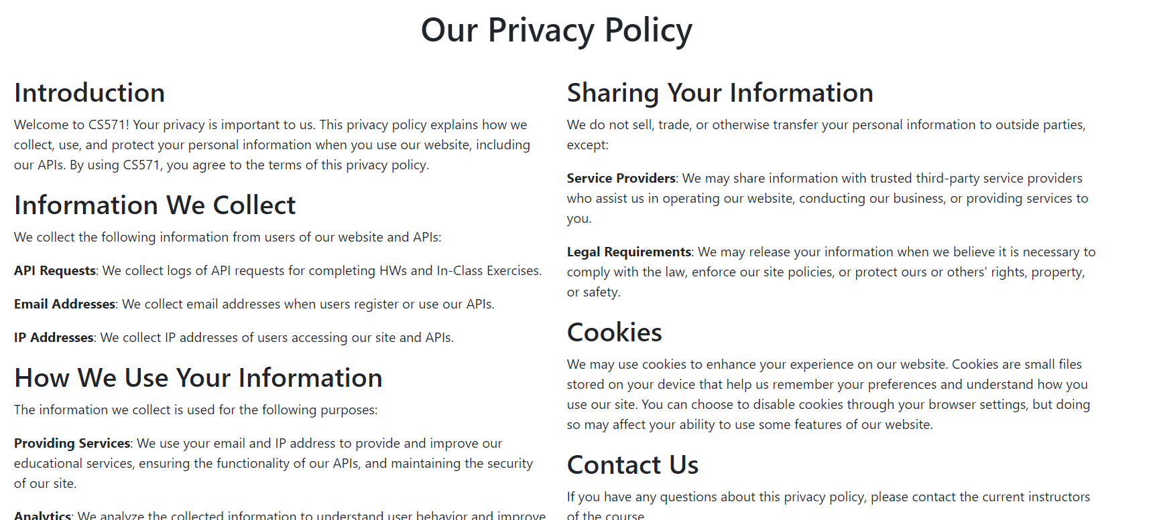
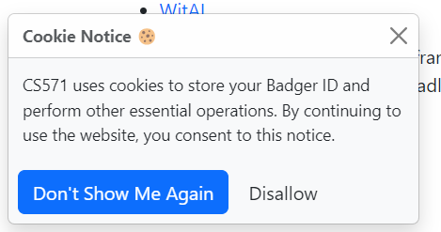
WP-GDPR Plugin
Brought up by one of you!
GDPR introduced in 2016, enacted in 2018.
Websites had to be quick to comply!
Only affects websites with European Traffic

Slide 4
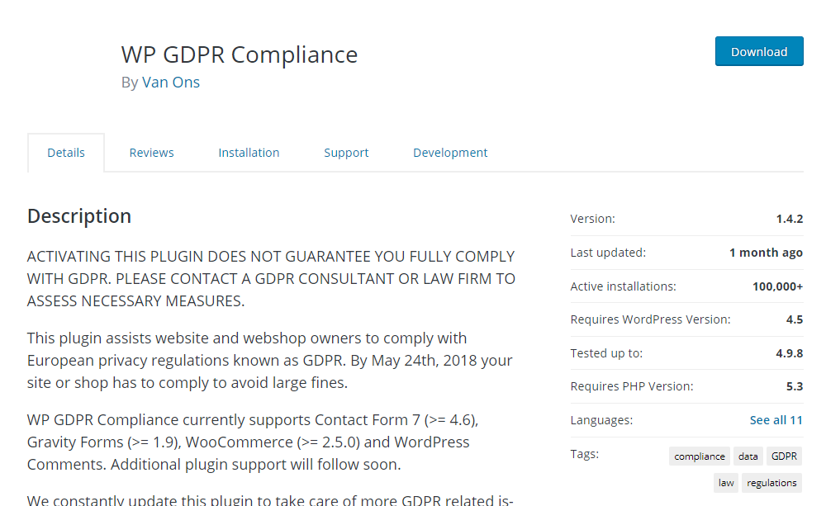
WP-GDPR Plugin
Via the WayBackMachine

Slide 5
WP-GDPR Plugin
This vulnerability allowed unauthorized users to create new admin accounts on website using this plugin.
https://cve.mitre.org/cgi-bin/cvename.cgi?name=CVE-2018-19207
https://www.wordfence.com/blog/2018/11/trends-following-vulnerability-in-wp-gdpr-compliance-plugin/
Why? The developers of this plugin did not do a permissions check before updating the database.
Missing an if statement – next week’s topic!
Vulnerabilities range in severity; this is about as bad as it gets!

Slide 6
Discussion C
Let’s do a demo! Don’t attack resources unless you have explicit permission to do so! ☺
You do NOT have permission to use plugins with known vulnerabilities on your WordPress site.
This is for educational purposes only!

Slide 7
Quiz A
Results will be returned by the end of next week!

Slide 8



What is the web?
CS272 | Introduction to Web Development | CMS 1

Slide 9
Common HTML Tags
Purpose | Tag | Example
Headers | <h1></h1> | <h2>About Me</h2>
Text | <p></p> | <p>Hello world!</p>
Bold Text | <strong></strong> | <strong>Yes!</strong>
Italic Text | <em></em> | <em>No!</em>
Images | <img/> | <img src="./me.png" alt="A selfie of Cole!" />
Links | <a></a> | <a href="https://google.com" target="_blank" >Go to Google!</a>
Line Break | <br/> | <br/>
Divisions | <div></div> | <div><p>a</p><p>b</p></div>

Slide 10

Your Turn!
Make sure you have some HTML content to style ☺

Slide 11
Common CSS Attributes
Attribute | Example | Notes
color | color: green color: #fefefe
background-color | background-color: red
font-size | font-size: 16px font-size: 1em | Prefer to use em for accessibility!
text-align | text-align: center
height / width | height: 400px width: 10em | Prefer to use em for accessibility!
border | border: 2px solid black | Goes in order of size, style, color.
margin | margin: 12px | Gives space outside the border.
padding | padding: 0.5em | Gives space inside the border.
An em is a flexible unit that depends on a user’s browser setting!

Slide 12
Cascading Style Sheets (CSS)
Can be done inline or externally with “decoration blocks”
Inline Styling
<h1 style="background-color: red">My Webpage!</h1>
External Styling
h1 {
background-color: red;
}

Slide 13
Cascading Style Sheets (CSS)
Selector(s)
Decoration Block
header, h1 {
background-color: #333;
color: #fff;
text-align: center;
padding: 20px;
}
Styles

Slide 14
Cascading Style Sheets (CSS)
We must include our stylesheet(s) in the head of our HTML!
<!DOCTYPE html>
<html>
<head>
<title>Page Title</title>
<link rel="stylesheet" href="styles.css">
</head>
<body>
<h1>This is a heading</h1>
</body>
</html>

Slide 15
Cascading Style Sheets (CSS)
We can also apply styles to a specific element by ID (unique) by preceding the selector with a “#”...
index.html
<h2 id="sub-heading">My Subtitle!</h2>
styles.css
#sub-heading {
background-color: red;
}

Slide 16
Cascading Style Sheets (CSS)
…or we can apply styles to specific elements by class (non-unique) by preceding the selector with a “.”
index.html
<li class="important">Do your homework!</li> <li class="important">Go to class!</li>
styles.css
.important {
background-color: red;
}

Slide 17
Cascading Style Sheets (CSS)
We can mix and match our selectors as well!
index.html
<p class="important">Do your homework!</p> <li class="important">Go to class!</li>
styles.css
p.important {
background-color: red;
}
See the StackBlitz example.

Slide 18
Your Turn!
Add a CSS stylesheet to your “About Me” and “My Work” pages!

Slide 19
CSS Conflicts
Isn’t there a good chance that CSS styles conflict? Yes!
In case of conflicts, CSS follows the “cascading algorithm”.
It defines three different origins…
User-agent stylesheets: those provided by the browser
Author stylesheets: those written by you
User stylesheets: those demanded by the user

Slide 20
CSS Cascading
What if you demand a style to be set? Use !important
<h2 style="color: red !important">My Subtitle!</h2>
Origin | !important
User-Agent | Yes
User | Yes
Author | Yes
Author | No
User | No
User-Agent | No
Most priority
Least priority

Slide 21
CSS Cascading
Can there still be conflicts? Yes!
Additional steps include…
Calculations to see which rule is the most specific.
Calculations to see which rule is the most finely-scoped.
Still tied? Last one to appear wins!
In general, the “closer” styling wins.
See the StackBlitz example.

Slide 22
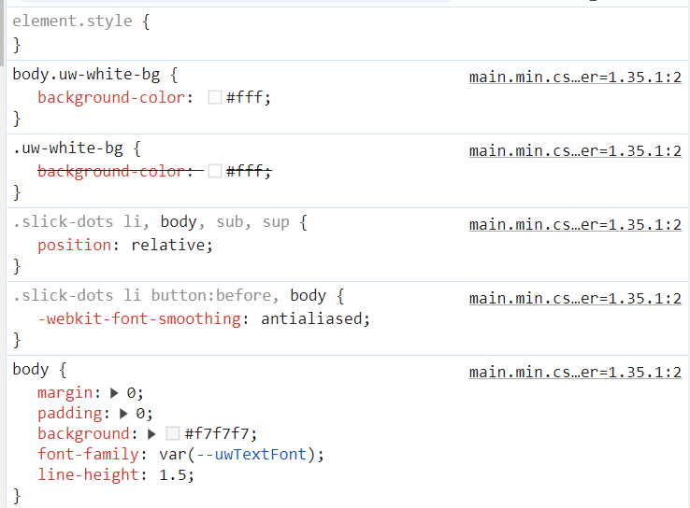
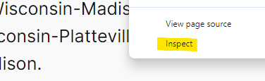
CSS Cascading
Right-Click → Inspect

Slide 23
Which style wins?
Raise your hand to indicate your answer.

Slide 24
Left Hand
A user style selecting p elements
Right Hand
A user style selecting p elements marked as !important
Wait for the count of 3 before raising your hand! ☺

Slide 25
Left Hand
An author style selecting p elements
Right Hand
A user style selecting p elements marked as !important
Wait for the count of 3 before raising your hand! ☺

Slide 26
Left Hand
An author style selecting p elements
Right Hand
A user style selecting p elements
Wait for the count of 3 before raising your hand! ☺

Slide 27
Left Hand
An author style selecting p elements
Right Hand
An author style selecting p#my-text elements
Wait for the count of 3 before raising your hand! ☺

Slide 28
Left Hand
An author style selecting p elements
Right Hand
A user-agent style selecting p#my-text elements
Wait for the count of 3 before raising your hand! ☺

Slide 29
CSS Libraries
Making use of other’s existing work.

Slide 30
What are CSS Libraries?
We say CSS libraries “abstract away” the low-level implementations of user-facing elements.
In other words, they give us CSS classes that we can easily use in our HTML! This allows us to focus on the HTML while being consistent in our styling.
Many exist!
Bootstrap (Open Source)
Material (Google)
Unifi (Nelnet)
Ionic (Madison, WI)

Slide 31
How do we use CSS Libraries?
<!DOCTYPE html>
<html>
<head>
<title>Page Title</title>
<link
href="https://cdn.jsdelivr..."
rel="stylesheet"
integrity="sha384-QWTKZyjH..."
crossorigin="anonymous">
</head>
We must include our stylesheet(s) in the head of our HTML, just like any other CSS stylesheet!
When making cross-origin requests, we will often define integrity as a security measure.
Get the Bootstrap stylesheet.

Slide 32
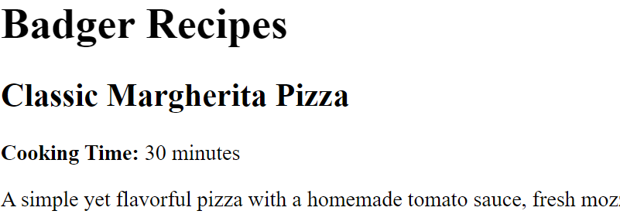
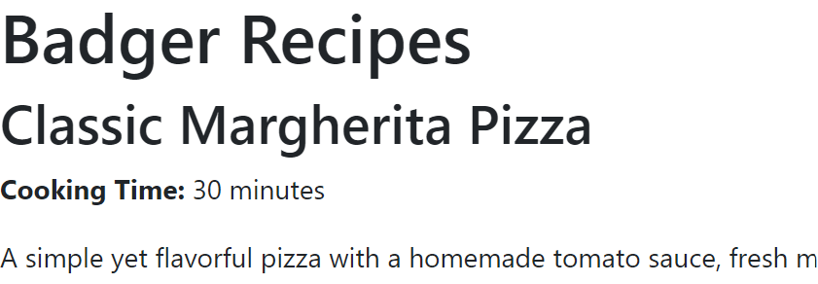
Check out Bootstrap!
https://cdn.jsdelivr.net/npm/bootstrap@5.3.3/dist/css/bootstrap.min.css
It’s just one big CSS stylesheet!
Defines default stylings for certain tags.
Defines many CSS classes for us to use!
w/o Bootstrap
w/ Bootstrap

Slide 33
Your Turn!
Add Bootstrap to your project.

Slide 34
Bootstrap Classes
Like HTML tags and CSS attributes, there are way too many Bootstrap classes for us to cover!
Read the docs.
We’ll cover the most common and helpful ☺
Margin & Padding
Responsive Grid Design

Slide 35
Margin & Padding
<p class="m-2">Hello world!</p>
Remember: Whitespace doesn’t matter!
Class names have the format of {property}{sides}-{size}
property can be margin or padding
sides can be omitted, top, bottom, start, end, x, or y
size can be between 0 and 5
Examples
mt-3: Adds some margin to the top.
pb-1: Adds a little bit of padding to the bottom
ms-5: Adds a lot of margin to the left (LTR) or right (RTL)
LTR or RTL
LTR: left-to-right (e.g. American)
RTL: right-to-left (e.g. Arabic)
More on Margin & Padding

Slide 36
Bootstrap Responsive Grid Design
Does our website “respond” to the size of device we’re on?
How does it look on desktop vs. tablet vs. mobile device?
Use Bootstrap’s responsive grid system!
Divide our website into containers, rows, and columns.
Decide how it will “respond” to the size of device it is on.
Navbar
Navbar
Navbar
Card
Card
Card
Card
Card
Card
Card
Card
Card
Card
Card
Card
Desktop
Tablet
Mobile

Slide 37
Bootstrap Responsive Design
Every container has many rows which has many columns.
However, we still need to make this responsive!
<div class="container">
<div class="row">
<div class="col">1 of 2</div>
<div class="col">2 of 2</div>
</div>
</div>

Slide 38
Bootstrap Responsive Design
We can divvy up our content over 12 columns using the col class.
<div class="col-4"><p>hello world!</p></div>
spans 33% of the screen
<div class="col-6"><p>hello world!</p></div>
spans 50% of the screen
col-4
col-6
col-2
col-12
col-6
col-6

Slide 39
Bootstrap Responsive Design
<div class="container">
<div class="row">
<div class="col-12 col-md-6 col-xl-3"></div>
<div class="col-12 col-md-6 col-xl-3"></div>
<div class="col-12 col-md-6 col-xl-3"></div>
<div class="col-12 col-md-6 col-xl-3"></div>
</div>
</div>
Check out the StackBlitz Example.

Slide 40
Your Turn!
Begin on HW3, starting with the starter code.

Slide 41
Begin HW3 and DIS D!

