Slide 1
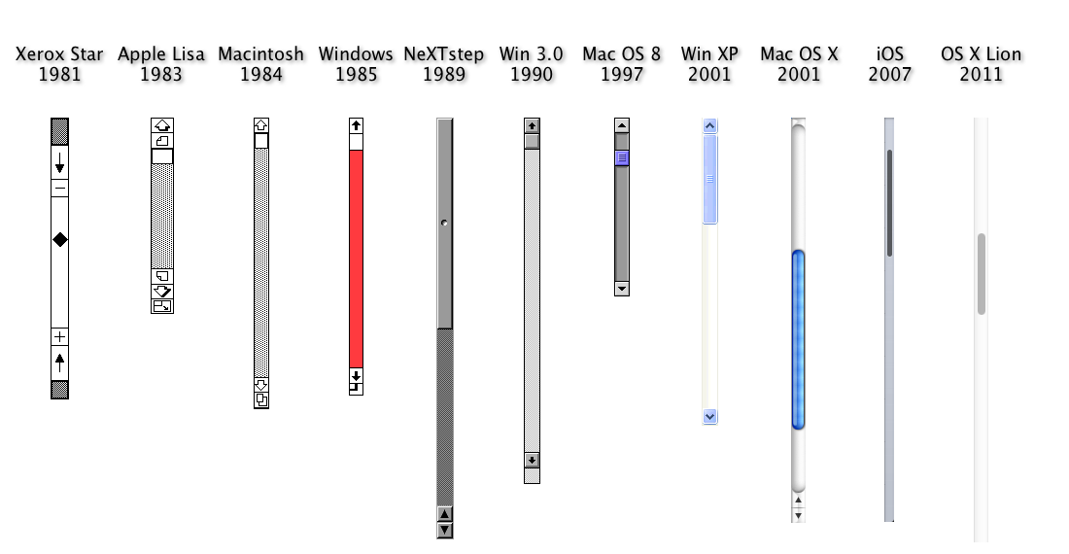
05-899A/05-499A: Interaction Techniques, Spring, 2014
http://www.cs.cmu.edu/~bam/uicourse/2014inter/
Brad Myers
Human Computer Interaction Institute
Lecture 1 Spring, 2014

Slide 2
Course:
05-899A/05-499A: Interaction Techniques
Intended for undergraduates and graduates
Both numbers are for the identical course
Graduates should be in 899A and undergrads in 499A
Same assignments
Mondays & Wednesdays, 1:30pm – 2:50pm
All lectures videotaped & available from schedule page
So have a permanent record, in case want to do something with the content
But attendance in lectures is required
Room: NSH 1305

Slide 3
Course Web page:
Course Web page:
http://www.cs.cmu.edu/~bam/uicourse/2014inter/
Course schedule is tentative
Note required readings
Note homework schedule
Some readings are CMU-only, use CMU network or VPN

Slide 4

Instructor
Brad Myers
Human Computer Interaction Institute
Office: Newell-Simon Hall (NSH) 3517
Phone: x8-5150
E-mail: bam@cs.cmu.edu
http://www.cs.cmu.edu/~bam
Office hours: By appointment.
Secretary & Course Administrator: Indra Szegedy,
NSH 3501B
x8-4431

Slide 5
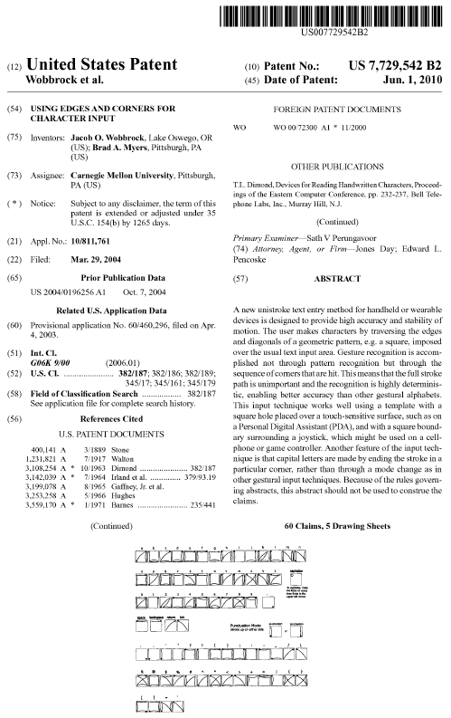
Why am I teaching this course?
I was at MIT Media Lab (then “Architecture Machine Group), 1976-1979
At Xerox PARC, 1976-1980
Designed one of the first commercial window managers, 1980-1984
First to put progress bars into icons, and collect icons in a window, etc.
Studies of two handed UIs and progress bars with Bill Buxton, 1984 - 1988
“All the Widgets” history video, 1990
"A Brief History of Human Computer Interaction Technology.” ACM interactions, 1998
With student, invented new text input technique
Significant consulting on patents on interaction techniques, 1988-present

Slide 6

Teaching Assistant
Jeffrey Rzeszotarski
jrzeszot@cs.cmu.edu
Newell-Simon Hall 3529
(412) 268-8285
http://jeffrz.com/
(rez-oh-tar’-ski)
Office hours: Wednesdays after class (3:00pm-4:00pm) in NSH 4605

Slide 7
Course Requirements
This course does not require any programming
Prerequisites:
Students should preferably have taken UCRE/Methods or DHCS or Intro. HCI Tech Execs
However, I am allowing students interested in history of technology to enroll without any background in HCI or experience in programming

Slide 8
Education Goals
After taking this course, students will be able to:
Articulate design issues regarding interaction techniques.
Design a new interaction technique given a set of requirements and constraints.
Evaluate interaction techniques using the appropriate tests for performance and usability.
Describe the historical progression of the most important interaction techniques and the factors that impacted their evolution and eventual widespread adoption.

Slide 9
Lecture Topics
General topics
Many specific kinds of interaction techniques
Talks by inventors
See schedule: http://www.cs.cmu.edu/~bam/uicourse/2014inter/schedule.html
What else?

Slide 10
Grading
Homeworks
Midterm
Final Project
Final Exam??
Taking it Pass/Fail is fine

Slide 11
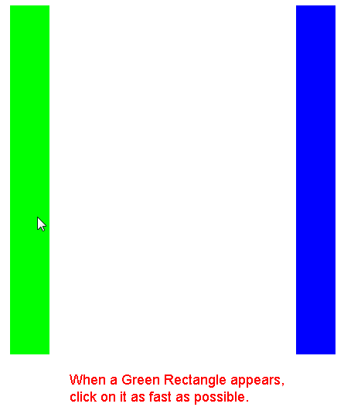
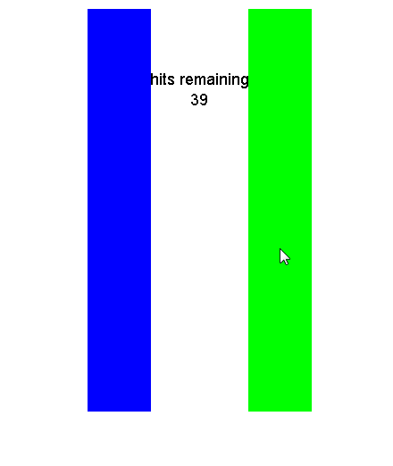
Homeworks
Mostly measurement activities on your own
First one:
Measuring the speed and accuracy of clicking with various pointing devices
Mouse, laptop touchpad, IBM pointing stick, fingers on smartphone, fingers on tablet, stylus on phone, stylus on tablet, Nintendo Wii controller, … (what else?)
Discussion of your measurements with respect to the historical record

Slide 12
Final Project Ideas
See course homepage: http://www.cs.cmu.edu/~bam/uicourse/2014inter/
Create or edit a Wikipedia page about an interaction technique or about an inventor of one, with appropriate citations
Document, evaluate and critique one or more existing interaction techniques with appropriate evidence
Interview an inventor of a particular interaction technique
Pick a particular, important milestone design, and enumerate and describe all of the novel interaction techniques introduced in that system.
Invent a new interaction technique and evaluate it
Create a project of your own design, in consultation with the professor.

Slide 13
Introduction to this Course: What is an Interaction Technique and Why are they Important?
Lecture 1 Spring, 2014

Slide 14



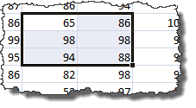
“Interaction Techniques”
Scroll bars, buttons, text fields
But also:
Drawing a new object in an editor
Copy-and-paste
Selecting a cell in a spreadsheet
How high level? Text editor widget, but not Word
Scroll bar is composed of buttons, etc.

Slide 15
What are some other examples?
Notes:
Menus, check boxes, radio buttons, sliders, increment buttons, option buttons, pull-down menus, right-click pop-up menus, multi-level pull-out menus, hierarchical file viewer, object editing, undo mechanisms

Slide 16
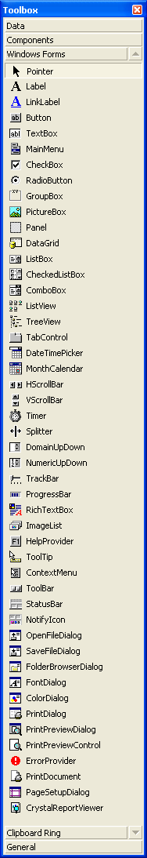
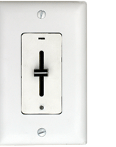
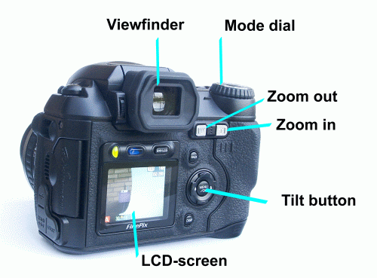
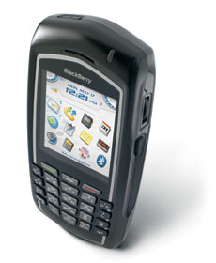
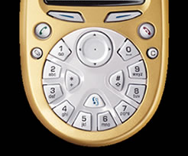
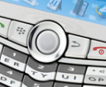
Some examples
Visual Basic
Physical controls

Slide 17
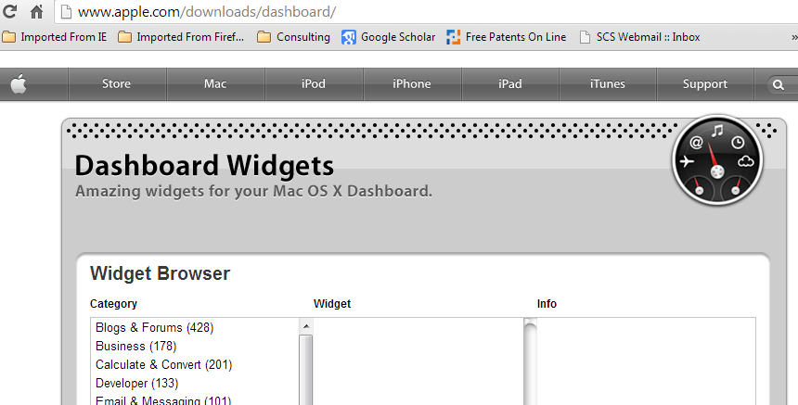
Other names
“Widgets” (Wikipedia: “GUI Widget”)
Note that there are no cross references in Wikipedia between “Interaction Technique” and “Widget”
See my video “All the Widgets”
But not the same as Apple dashboard widgets
GUI “elements”
“Gadgets”
But not the same as Scott Hudson’s
“Controls”
(Windows)
“Components”
Too generic
“Behaviors”
= the interaction part

Slide 18
Definitions
My definition: An “interaction technique” starts when the user does something that causes a computer to respond, and includes the direct feedback from the computer to the user. Interaction techniques are generally reusable across various applications.

Slide 19
Definitions
Wikipedia’s definition: “An interaction technique, user interface technique or input technique is a combination of hardware and software elements that provides a way for computer users to accomplish a single task.”

Slide 20
Definitions
Foley & van Dam, 1990: “An interaction technique is a way of using a physical input/output device to perform a generic task in a human-computer dialogue.”

Slide 21
What is not an interaction technique?
Whole applications (Microsoft Word)
Dashboard “widgets” – small apps for the desktop
Output only (no interactions)
Visualizations
But many come with specialized interactions, then they might count?
Animations
Movies
…

Slide 22
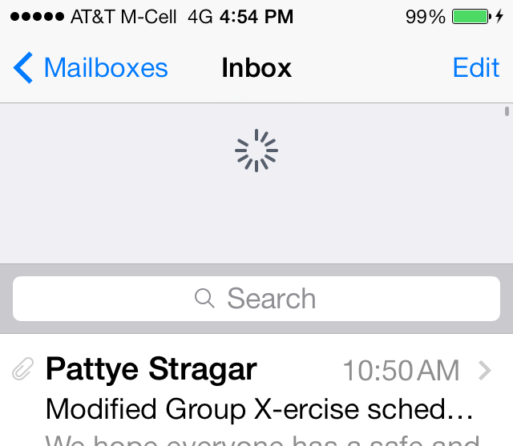
Why Study Interaction Techniques?
Used extensively
Everyone who uses a computer uses copy-paste, etc.
So can have an enormous impact
Interesting historically
Why do we do things the way we do?
Is there a good reason?
Example: which way does the arrow point in a scroll bar?
And new interaction techniques are created all the time:
Patent on “Bounce at end of scrolling” for iPhone submitted by Bas Ording in 2007 (right before 1st iPhone was released in 2007) US 7,469,381
Try it! iPhone vs. Samsung
“Pull down to refresh” – patent submitted in 2010 by Twitter, became popular in 2013!
US 8,448,084
Many new CHI & UIST conference papers every year with new ones

Slide 23
Why Study Interaction Techniques, cont.
Interaction Techniques have a high economic value
Often the subject of patents and lawsuits
Can’t patent overall look and feel
“Apple Wins Over Jury in Samsung Patent Dispute, Awarded $1.05 Billion in Damages (Live Blog)” link
“Jury orders Samsung to pay $290M to Apple in patent case” link
Need new ones
“Desktop metaphor” is getting tired
Macs & PCs look and work pretty similar to each other and to the designs of the 1980’s (30 years ago)
Text entry on smartphones is a big barrier
Selecting individual elements, characters on smartphones

Slide 24
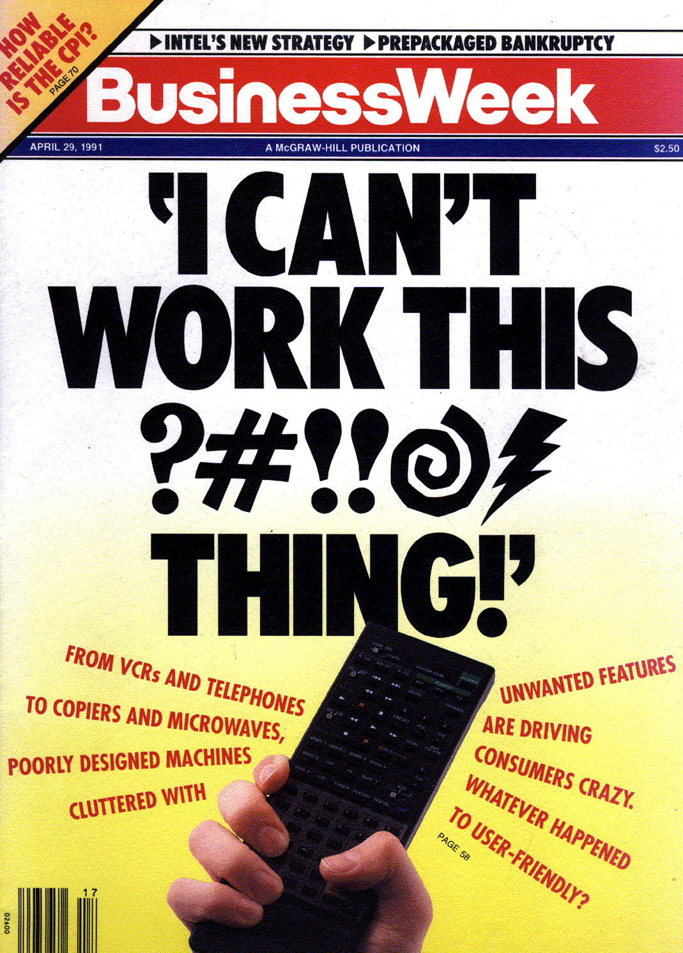
Problem
April 29, 1991

Slide 25
Problem
Appliances are too complex

Slide 26
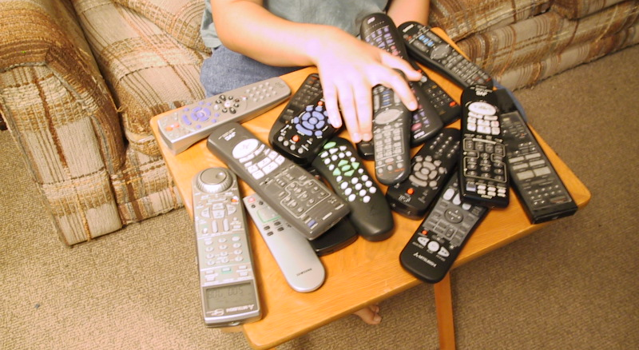
Problem
Too many remotes

Slide 27
Why are Interaction Techniques Hard to Design?
Surprisingly large number of design decisions
Individual differences and preferences
Lots of details that impact human performance
How far does the cursor move when you move the mouse 1 inch?
Trick question – depends on mouse speed
Complex formula developed through experimentation
How far does the content move on an iPhone when you flick your finger?
Needs to work for long distance, and highly accurate local movements
Nokia phones released just after the iPhone got this all wrong

Slide 28
Example: check box
How many “states” can it be in?
Notes:
Checked, not-checked,
Disabled, not-disabled
Hover, not-hover (can’t be hover+disabled)
Focus, not-focus (can’t be hover+focus)
Pressed-inside, pressed-outside, not-pressed (can’t be pressed + disabled, can’t be pressed-inside + not-hover)
2^5 = 32

Slide 29


Example: check box
How many “states” can it be in?
Checked, not-checked,
Disabled, not-disabled
Hover, not-hover (can’t be hover+disabled)
Pressed-inside, pressed-outside, not-pressed (can’t be pressed + disabled, can’t be pressed-inside + not-hover)
Keyboard focus, not-focus
2^4 * 3 = 48, but many are not possible
Often forget about the release-outside case & interface gets confused (Flash implementations)
Notes:
Checked, not-checked,
Disabled, not-disabled
Hover, not-hover (can’t be hover+disabled)
Focus, not-focus (can’t be hover+focus)
Pressed-inside, pressed-outside, not-pressed (can’t be pressed + disabled, can’t be pressed-inside + not-hover)
2^5 = 32

Slide 30
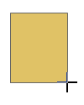

Example2: Drawing a new object
What happens when move upwards past start point?

Slide 31
Measuring Interaction Techniques
What are relevant quality metrics for interaction techniques?
For evaluating them

Slide 32
Measuring Interaction Techniques
What are relevant quality metrics for interaction techniques?
(same as other HCI usability metrics!)
Efficiency (speed)
Error rate
Learnability
Discoverability
Memorability
Aesthetics & emotional impact
Satisfaction (Pleasurable)
Consistency with other interactions
Etc.

Slide 33
Measuring Interaction Techniques
But also generalizability
How often can be used?
Different applications?
Different kinds of input values?
Dimensionality
One D (menu, slider) or 2-D (mouse), or more
How many items? (pick among 5 items vs. among 100 or 1,000)

Slide 34
Designing Interaction Techniques
Taking into account device characteristics
Taking into account human characteristics
Look
Styling
3D look and feel – Smith’s ARK (1986), up through Windows 7
Flat squares – Windows Phone and Windows 8
Feedback for behaviors
Animation effects – from 1993
Feel
Specific implementation of the behavior
Details matter

Slide 35


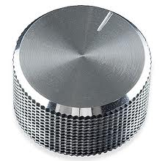
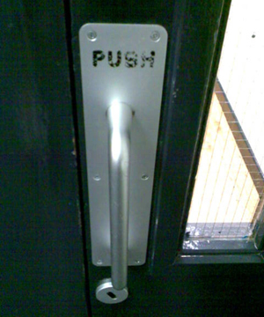


Affordances
“Perceived and actual properties of the thing, primarily those fundamental properties that determine how the thing could possibly be used.” (Norman DOET book, p. 9)
“When affordances are taken advantage of, the user knows what to do just by looking”
Helps people understand what to do with the control

