Slide 1

∞ Aionis Partners: Investing in Business Transformation & Technology with Ownership and Ethics
A distinguished long-only public and private equity fund strategically investing through two core pillars: Transformation and Technology. Our diverse team brings extensive operational expertise, fostering a culture that is both meritocratic and inclusive, driving sustainable value creation.

Slide 2
EXECUTIVE SUMMARY
Aionis Partners Overview: Long-only public equity fund focused on generating long-term value for investors through strategic investments in mid- and large-cap listed companies across Europe and the United States. While our primary emphasis is on public equities, we remain opportunistic and will consider select private investments when exceptionally attractive opportunities arise. Our approach combines fundamental value investing with an active ownership mindset, leveraging our partners' decades of experience in activist hedge funds, private equity, and operational/board roles.
Addressing the Market Gap: Traditional public and private equity funds have limitations that hinder optimal returns and ethical standards. Public funds often lack operational expertise and active ownership, facing short-term pressures, while private equity deals with scarcity, competition, and fundraising/deployment demands that lead to rushed, agenda-driven decisions. Aionis Partners bridges this gap by focusing on public markets for conviction-based investing, while applying private equity's ownership mindset with high ethical standards.
Investment Strategy: We believe alpha can be generated through two core strategies:
(I) Technology: backing visionary founders and companies at the forefront of transformative, century-defining technologies like AI, robotics, electrification, and autonomous driving, and
(II) Transformation: uncovering undervalued quality assets with significant value creation potential—those where catalysts for change, such as activist shareholders, planned portfolio optimization, restructuring initiatives, potential takeover approaches, or management transitions, create opportunities for value crystallization.
Where necessary, we are prepared to drive change directly by engaging as active shareholders and securing board representation. We allocate approximately 50/50 across these two pillars within a concentrated portfolio of 10–15 holdings.
To enhance our investment process, we leverage advanced, scalable and cost-efficient AI-driven research & tools to generate differentiated insights.
Experienced Team with Values: Our diverse and experienced team brings deep investment and operational expertise. We foster a meritocratic culture rooted in fairness, performance, socio-economic mobility, diversity of thought and our core value of "doing the right thing."
Fund Target and Terms: Phase I consists of raising approximately €20–50 million from friends, family, and select institutional investors. A comprehensive Phase II fundraising effort is planned within the next 2–3 years, targeting a total fund size of €200-500 million. The fund structure will feature tiered lock-up periods and investor-friendly terms. Once the fund surpasses €200 million asset under management, we intend to donate 20% of our performance fees to philanthropic causes.

Slide 3


MARKET PROBLEMS WE SOLVE
Public Market Shortcomings
Private Market Limitations
Aionis Advantage
Limited Active Ownership
Deal Scarcity
Active Ownership Mindset
Traditional public investors lack operational expertise and a long-term mindset, hindering value creation.
Limited opportunities and fundraising pressure can lead to suboptimal deal selection and quality.
We leverage deep operational experience and a long-term focus to drive sustainable value creation.
Operational Expertise Gap
Liquidity Constraints
Conviction Driven with Liquidity Flexibility
Investment teams often lack operational backgrounds, limiting their ability to influence management effectively.
Lack of exit flexibility and limited portfolio adjustment capabilities pose significant challenges.
Identification of unique investment opportunities across sectors without running into private bidding wars.
Short-term Pressure
High Competition
Meritocratic and Fair Culture
Focus on quarterly earnings prevents long-term value creation and drives premature exits.
Intense competition inflates valuations and makes operational improvements harder to achieve.
Our diverse team fosters innovation and provides a competitive edge in talent and insights.
Industry-Wide Diversity Challenge
Representation Gap
Talent Underutilization
Underrepresentation of women and minorities limits advancement and fosters non-meritocratic cultures.
Undervalued diverse perspectives hinder innovation and access to differentiated
insights.

Slide 4


INVESTMENT STRATEGY
Our differentiated approach combines deep operational expertise with technological insight, deployed across two complementary
investment pillars.
Technology Pillar (50%)
Transformation Pillar (50%)
Focus: Mid-to-large cap companies poised to capitalize on transformative technology trends or actively shaping new markets.
Focus: Undervalued companies with value creation potential and near-term catalysts, e.g., activist in shareholder register, portfolio optimization, potential takeover approach, management change, restructuring plan.
Key Themes:
Key Strategies:
Artificial Intelligence: Infrastructure, software, applications
Operational Enhancement
Electrification: EV ecosystem, battery/charging tech, grid infrastructure
Strategic Repositioning and Portfolio Optimization
Autonomous Driving & Mobility: Fleets and services
Management Upgrade
Robotics & Automation: Industrial automation, physical AI
Capital Allocation and M&A
AI-Powered Insights
Proprietary AI Tools & Processes
Leveraging artificial intelligence to analyze vast datasets, identify market trends, and uncover unique investment opportunities across public and private markets.
Bespoke AI tools & processes providing a competitive edge and cost advantage in research, due diligence, and risk assessment, tailored to our strategic focus.

Slide 5
TEAM STRUCTURE AND FUND ECONOMICS
Team Structure
Fund Terms
Investment Partners
Phase I: €20-50M; Phase II: €200-500M Target
Investment sourcing & due diligence
Management Fee: 1.5% (declining with longer lock-up period)
Portfolio construction & risk management
Performance Fee: 15% with 8% Hurdle Rate and High Watermark
10+ years public / private markets & sector expertise
Minimum cheque & lock-up: €200k, 2 years
Proven alpha generation
Fund Type: GmbH & Co KG with min. 5-10% GP commitment
Operating Partners
Risk Management
Operational due diligence & value creation
Maximum 10% position size in any single investment
Board representation & management engagement
Geographic and sector diversification
Former C-suite executives with industry expertise
ESG risk assessment and monitoring
Transformation experience
Liquidity and risk management across portfolio
Advisory Board: Composed of former public company CEOs / Board members, tech leaders, institutional investor representatives, and ESG experts.
Fee Structure Rationale: Competitive economics align with long-term value creation, ensuring investor returns priority and reflecting scale economies.

Slide 6
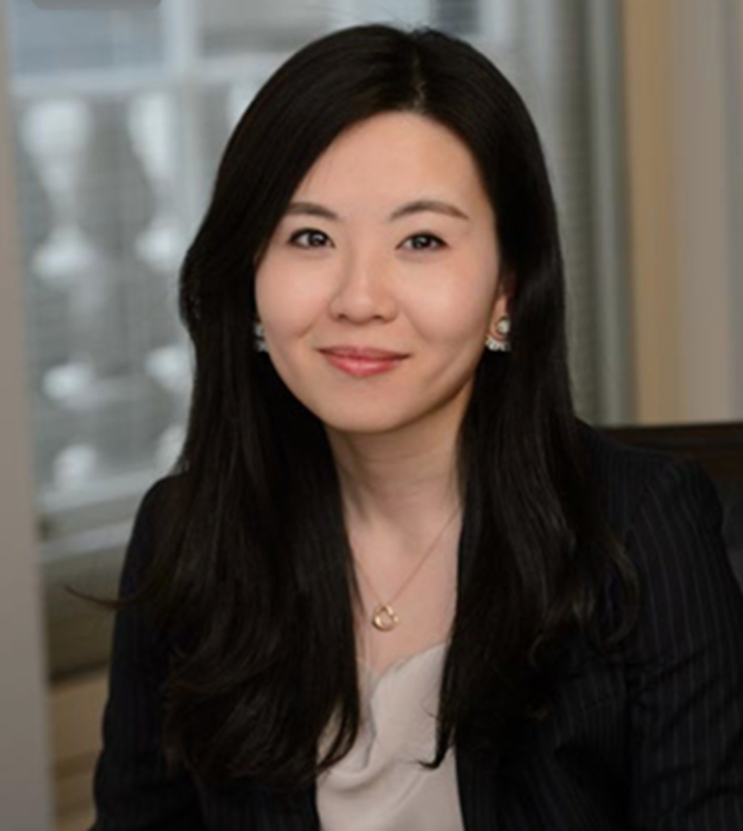


TEAM MEMBERS
Investment Partners
Operating Partners and Board Members
Our Investment Partners combine deep market insights with proven financial acumen, specializing in identifying and executing high-potential public and private equity opportunities.
Our Operating Partners bring hands-on executive experience, collaborating with portfolio companies to drive operational excellence and strategic transformation, also via board seats if required.
Lina Zhou
Founding Partner and Chief Investment Officer with over a decade of investment experience spanning both public and private markets. Brings deep expertise in active ownership and transformation strategies, through roles at Cevian Capital, Europe’s largest dedicated activist hedge fund, and Bain Capital, one of the world’s leading private equity firms.
Committed to making investment decisions based on independent judgment, a rigorous selection process and high ethical standards. Will invest 95% of own liquid wealth into fund to ensure alignment with investors’ interest.
TBD

Slide 7
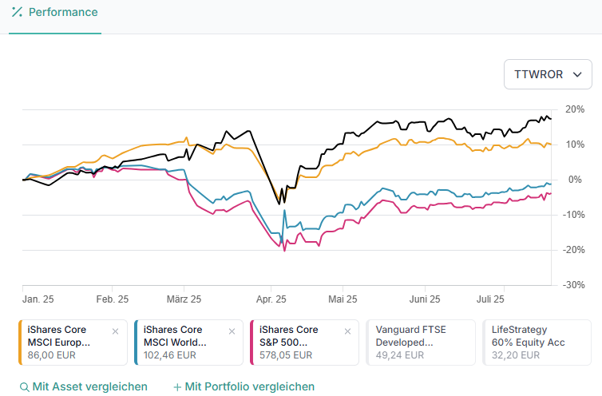
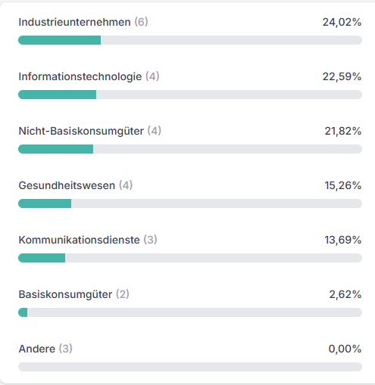
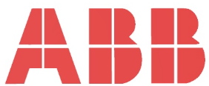

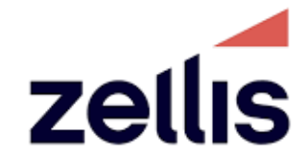
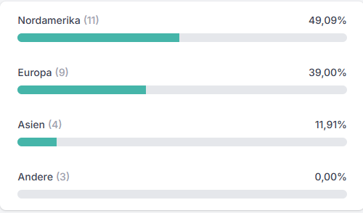

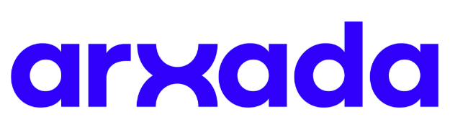
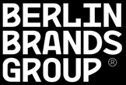
TRACK RECORD
Public Equities (YTD 2025)
Sector Exposure
Investment Experience
Public Activist Positions:
~5% stake in listed company with main activist thesis around portfolio optimization
Aionis
~12% stake in listed company with main activist thesis around operational improvement
Private Equity Transactions:
Carve-out of UK mid-market payroll software from NGA, subsequently exited to Apax
Geographic Exposure
Public take private of leading UK P&C insurance company, later exited to Ageas
YTD Performance (True Time-Weighted Rate of Return¹):
Aionis 17.30%
iShares Core MSCI Europe UCITS ETF Acc 10.10%
iShares Core MSCI World UCITS ETF Acc -1.14%
iShares Core S&P 500 UCITS ETF Acc -3.78%
Carve-out of microbial control solutions division from Lonza
+7-20% YTD
outperformance
vs benchmarks
Minority investment in German e-commerce business
¹TTWROR stands for True Time-Weighted Rate of Return, a financial metric used to measure the performance of an investment portfolio by calculating its compound growth rate over time, while eliminating the impact of external cash flows such as deposits and withdrawals
Data extracted from Trade Republic Account

Slide 8


DISCIPLINED INVESTMENT PROCESS
1
2
3
4
5
6
Theme Identification
Universe Screening
In-Depth Due Diligence
Investment Decision
Active Engagement
Value Realization
Analyze macro technology trends, market sizing, adoption timelines, and competitive landscapes to identify compelling investment areas
Screen for undervalued assets with operational improvement potential or technology differentiation via desktop and network, assess management and governance
Conduct in-depth due diligence through proprietary research, expert networks, customer interviews / surveys, and market / competitive analysis to arrive at future earnings and risk assessment
Partner committee review, position sizing based on conviction level, and integration into portfolio construction with risk management
Establish positions, engage with management teams, board as well as other key stakeholders; prepared to take board seats where relevant
Monitor progress against milestones, provide ongoing engagement and support, and develop and execute exit strategies when appropriate
AI-Powered Insights
Proprietary AI Tools & Processes

Slide 9
Disclaimer
This presentation (the "Deck") is provided for informational purposes only and does not constitute an offer to sell, a solicitation of an offer to buy, or a recommendation for any securities or investment in Aionis Partners or any related fund. No part of this Deck should be construed as investment advice, a public offer, or marketing under the German Investment Code (KAGB) or any other applicable laws.
The information herein is confidential and intended solely for the recipient. It may not be reproduced, distributed, or shared with third parties without prior written consent. This Deck is not a prospectus, key investor information document, or any other regulatory filing, and has not been reviewed or approved by BaFin or any other authority.
Any potential investment in the fund would require compliance with all relevant regulations, including possible BaFin notification for marketing activities. Past performance is not indicative of future results, and investments involve risks, including the potential loss of principal. Recipients should conduct their own due diligence and consult independent legal, tax, and financial advisors before considering any investment.
This Deck is based on information available as of July 2025 and may change without notice. No representations or warranties are made regarding its accuracy or completeness. If you have received this Deck in error, please destroy it immediately and notify the sender.
By reviewing this Deck, you acknowledge that it is shared privately and not as part of any marketing or promotional effort.

Slide 10
∞ Aionis Partners

