Slide 1
CSS430 Introduction Textbook Chapter 1
Instructor: Stephen G. Dame
e-mail: sdame@uw.edu
These slides were adapted from the OSC textbook slides (Silberschatz, Galvin, and Gagne), Professor Munehiro Fukuda and the instructor’s class materials.

Slide 2
“Computer science is no more about computers than astronomy is about telescopes.“- Edsger Dijkstra
Edsger Wybe Dijkstra (Dutch pronunciation: [ɛtsxər ʋibə dɛikstra]); (1930–2002) was a Dutch computer scientist. He received the 1972 Turing Award for fundamental contributions to developing programming languages, and was the Schlumberger Centennial Chair of Computer Sciences at The University of Texas at Austin from 1984 until 2000.

Slide 3
Course Objectives
You will:
Study the fundamental concepts of operating systems
Practice the logical design using Java
But not:
Learn how to build web sites or mobile applications
If this is your main objective, you should take UW Computing Training or other classes with that focus
http://www.washington.edu/lst/workshops/fundamentals
Increase your C/C++ programming skills
Program 1 will deal with several system C/C++ calls, but for more C/C++ skill building please refer to CSS432, CSS434 or other C/C++ programming courses.

Slide 4
Important Timelines*
Program 1: System calls and shell
Program 2: Scheduler
Midterm Exam: Process Management
Program 3: Synchronization
Program 4: Paging
Final Exam: Memory/File Management
Final Project: Unix-like file system
(* Check the syllabus for due dates)

Slide 5
Important Web Pages and Email Addresses
Our class web:
http://courses.washington.edu/css430
Textbook:
http://codex.cs.yale.edu/avi/os-book/OS8/os8j/
Java (JavaSE7):
http://download.oracle.com/javase/7/docs/api/
Instructor’s email:
{ ksung, mfukuda, sdame, …}@u.washington.edu
Class discussion mailing list:
css430b_sp14@u.washington.edu
Canvas Discussion Board for CSS430B
Assignment submission:
Submit your tar-archived file to CollectIt
(accessible from the class web).

Slide 6
What is an Operating System?
Goals
Execute user programs and make solving user problems easier
Making the computer system convenient to use
Using computer hardware in an efficient manner
Definitions
Resource allocator – manages and allocates resources
Control program – controls the execution of user programs and operations of I/O devices
Kernel – the one program running at all times (all else being application programs)

Slide 7
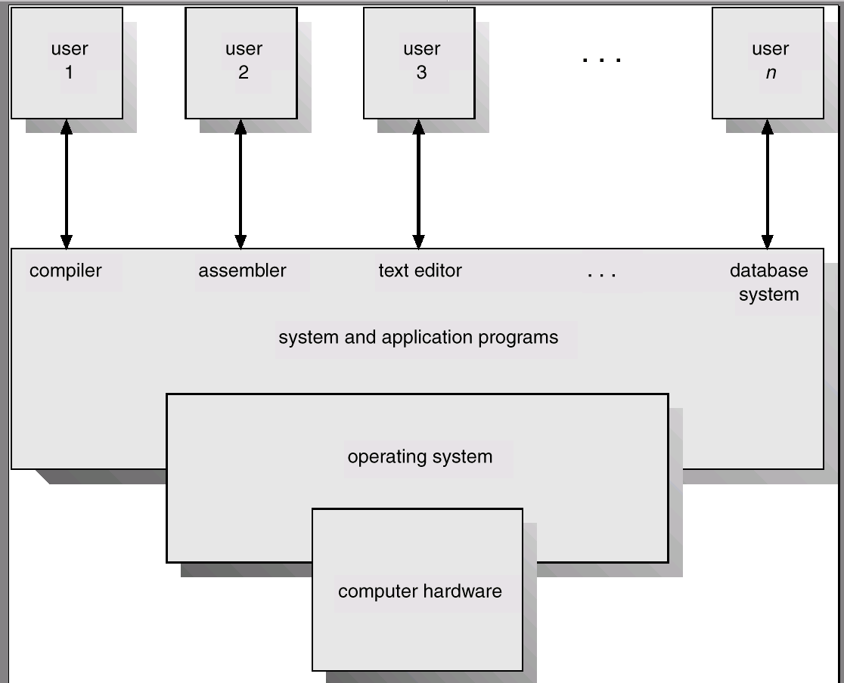
Computer System Components

Slide 8
Operating System History
Batch systems: OS/390, z/OS, VAX/VMS
Multiprogramming: IBM360
Time-sharing systems: Multics, Unix
Personal-computer command OS: CP/M, Dos
Personal-computer systems: Windows, Linux, MacOSX
Symmetric multiprocessors; Mercury, Sun
Dual-core system: Intel Core 2 Duo,
2/4/6/8-core systems: Intel i3, i5, i7 Core
ARM based: Arch Linux, Android, iOS, Window RT
Embedded: QNX, ThreadX, TinyOS, MQX, VxWorks,…
Cluster systems: Hydra, PVM, MPI, MapReduce

Slide 9
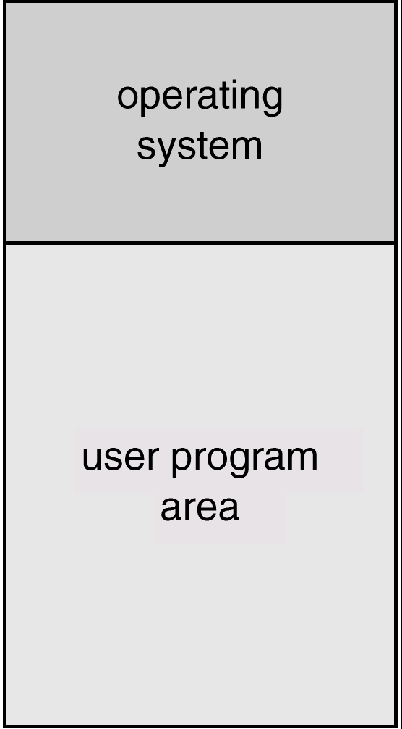
Batch Systems
A job is assembled of the program, the data, and some control information (in control cards).
Programmers pass their jobs to an operator.
The operator batches together jobs.
OS transfers control from one job to another.
Each job output is sent back to the programmer.

Slide 10
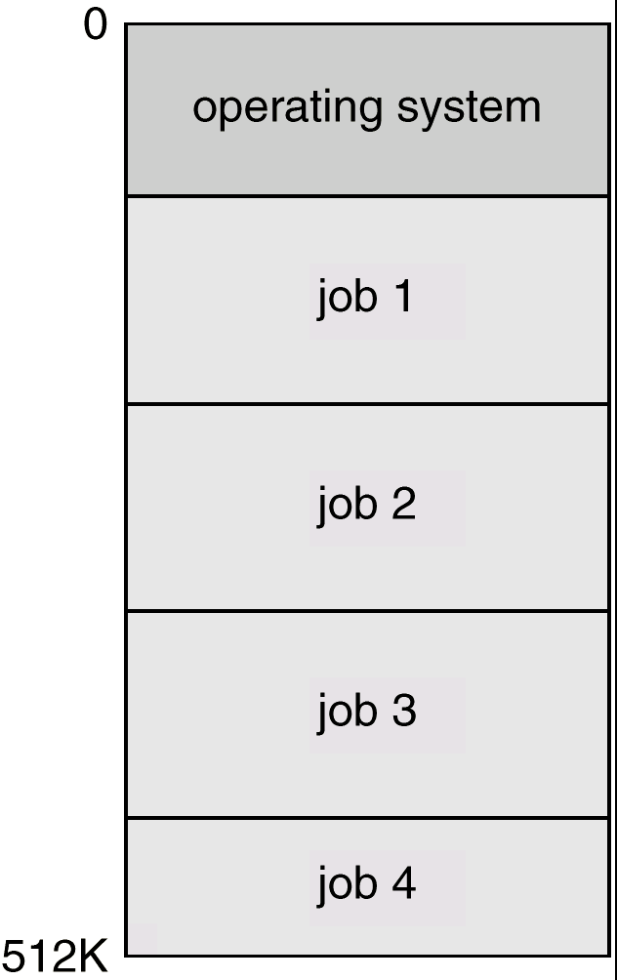
Multiprogramming
Several jobs are kept in main memory at the same time.
OS picks one of them to execute.
The job may have to wait for a slow I/O operation to complete.
OS switches to and executes another job.
To facilitate multiprogramming, OS needs:
Job scheduling
Memory management

Slide 11
Time-Sharing Systems
This is a logical extension of multiprogramming.
Each user has at least one separate program in memory.
A program in execution is referred to as a process.
Process switch occur so frequently that the users can interact with each program while it is running.
File system allows users to access data and program interactively.

Slide 12
Personal-Computer Systems
Personal computers – computer system dedicated to a single user.
User convenience and responsiveness
Can adopt technology developed for larger operating systems’ features.
At its beginning, a single user system did not need advanced CPU utilization and protection.
Later, file protection was necessary to avoid viruses.
Overall, the same OS concepts are appropriate for the various different classes of computers.

Slide 13
Symmetric Multiprocessing Architecture
Multiprocessor systems with more than one CPU in close communication (in one box).
Tightly coupled system – processors share memory and a clock; shared-memory-based communication.
Advantages of parallel multiprocessor systems:
Increased throughput
Economical
Increased reliability
CPU₀
CPU₁
CPU₂
registers
registers
registers
cache
cache
cache
Memory

Slide 14
Dual-Core Design
An MPU chip has two CPU cores, each:
owning its own small L1 cache,
sharing a large L2 cache, and
accessing the main memory through L2.
CPU core₀
CPU core₁
registers
registers
cache
cache
Memory

Slide 15
Quad-Core Design
An MPU chip has four CPU cores, each:
owning its own small L1 cache,
sharing a large L2 cache, and
accessing the main memory through L2.
CPU core₀
CPU core₁
CPU core₂
CPU core₃
registers
registers
registers
registers
cache
cache
cache
cache
Memory

Slide 16
Cluster Systems
Client
Takes a client-server model
Server
Consists of many PC/workstations connected to a high-speed network or a storage-area network (SAN).
Puts more focus on high-performance computing (HPC)
serves for requests in parallel.
Workstation
Workstation
Workstation
100Mbps
LAN
http server2
http server1
http server N
Master
node
Slave
1
Slave
2
Slave
N
1Gbps SAN

Slide 17
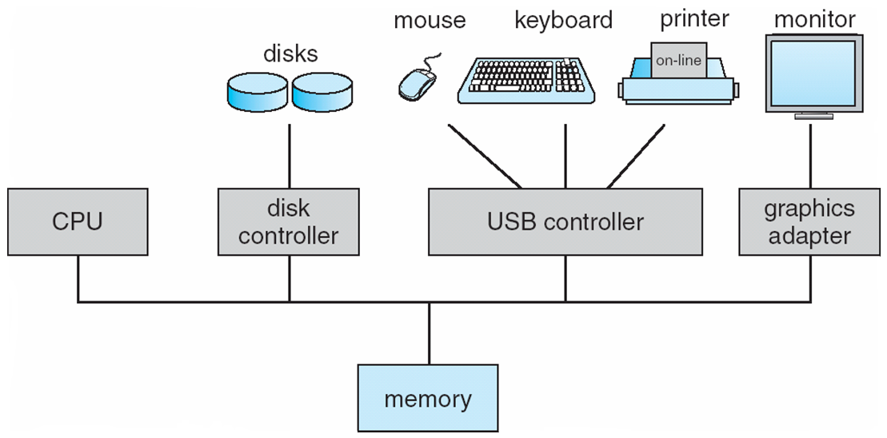
Computer Hardware

Slide 18
Synchronous I/O
During execution, each program needs I/O operations to receive keyboard inputs, open files, and print out results.
In the early computer era, a program had to wait for an I/O operation to be completed. (Synchronous I/O)
This frequently causes CPU idle.
Requesting process
waiting
user
Device Driver
kernel
Interrupt Handler
Hardware
data transfer
time

Slide 19
Async I/O and Interrupts
Asynchronous I/O returns control to a user program without waiting for the I/O to complete.
When the I/O is completed, an interrupt occurs to CPU that temporarily suspends the user program and handles the I/O device.
Requesting process
continuing
user
Device Driver
kernel
Interrupt Handler
Hardware
data transfer
time

Slide 20
Discussion 1
1. Timers can be used to compute the current time. How do operating systems acquire and manage to keep accurate time?
2. What is a context switch and what is the main challenge an OS during a context switch?
3. How does a real-time OS differ from a standard OS?

Slide 21
Hardware Protection
Purpose:
With resource sharing, many programs could be affected by a bug in one program.
Incorrect or malicious resource accesses cause a hardware trap to the operating system.
Dual-Mode Operation:
User mode: no privileged instructions allowed.
Kernel mode: Privileged instructions allowed.
I/O Protection: all privileged
Memory Protection: A region from the base to the limit register allowed to use
CPU Protection: CPU allowed to use until the timer gets 0.

Slide 22
Dual-Mode Operations
Provides hardware support to differentiate between at least two modes of operations.
1. User mode – execution done on behalf of a user.
2. Monitor mode (also supervisor mode, system mode, or kernel mode) – execution done on behalf of operating system.
Switching between two modes
Device interrupts, hardware traps, system calls cause a trap to the kernel mode
The operating system returns to the user mode after servicing requests.
user process
user mode
(mode bit=1)
user process
executing
calls
system call
return from system call
kernel
trap
mode bit=0
return
mode bit=1
kernel mode
(mode bit=0)
execute system call

Slide 23
Process Management
A program running within a process needs:
CPU Execution Time (allocation)
Memory (for instructions and data)
Files
I/O Devices (keyboards, mouse, graphics, printers, …)
Process is the fundamental unit of work in a system.
Operating System Processes (system code)
User Processes (user code)
A process can have 1 or more (concurrent) threads
Each thread has a program counter on a program sequence
Each thread is considered a separate execution sequence
5 Major OS Process Management activities:
Scheduling of processes and threads
Creating/Deleting processes (system and user)
Suspending and Resuming processes
Process Synchronization
Process Communication

Slide 24
Memory Management
Main Memory
CPUs are only able to access programs and data in main memory.
Very large, but volatile and varies in speed
Contains bytes or words each with their own address
Programs
Mapped to absolute addresses
Loaded into main memory
Accessible to multiple threads (via different program counters)
Memory Management
Different algorithms are optimized for different systems
Dependent on specific hardware support
3 Major OS Memory Management activities:
Keeping track of memory used and by whom
Deciding which processes and data to move in/out of memory.
Allocating and Deallocating memory as necessary.

Slide 25
File System Management
File
The logical unified view of information storage
Logical storage unit abstracted from the details of the device by OS
File System
Controls access from multiple users (e.g. read, write, append)
Organizes the structure (e.g. directories / subdirectories of files)
Interacts with storage device drivers (abstracting details)
Memory Management
Different algorithms are optimized for different systems
Dependent on specific hardware support
5 Major OS File Management activities:
Creating and Deleting files
Creating and Deleting folders(directories) to organize files
Primitives for manipulating files and directories
Mapping files to secondary storage media
Backing up files to non-volatile storage media

Slide 26
Open Source Operating Systems
Open Source
Software Industry started in an Open Source culture (~1950s)
“Homebrew Clubs” and MITs Model Railroad Club source code
Open Source may be more secure and bug free due to large community
Copyright vs. Copyleft
Binary only releases and source code copyrights (closed source)
Digital Rights Management (DRM) =illegal to reverse engineer
Free Software Foundation (FSF) – GNU project (“GNU’s Not Unix”)
GPL – General Public License – must ship source with binaries
GNU/Linux
Hundreds of unique distributions from the core…
https://www.kernel.org/pub/linux/kernel/v2.6/
4 Major Open Source OS Distributions:
Red Hat / Fedora/Centos – (Redhat $s, Fedora/Centos – FREE)
SUSE/OpenSUSE - Enterprise FREE
Debian – Popular on small Linux platforms (e.g. Raspberry PI)
Ubuntu – (e.g. Our UW Bothell Lab OS!)

Slide 27
Summary
OS is the SW that manages the computer hardware and provides the application program run-time environment.
Programs run in main memory that is optimized according to speed, size and cost. Main memory is volatile.
Secondary storage (e.g. disks) are used to hold non-volatile programs and data in a typical computer system
Contemporary computer architectures today are SMP Multicore systems connected by a shared memory and cluster-based parallel and HPC systems connected by a LAN.
For operational protection OS is divided into Kernel mode and User mode.
Processes are the fundamental unit of work in an operating system.
OS contain protection measures for securing access to resources by users and processes
Open Source Linux Systems provide an easy way to dissect OS functionality in a legal free operating environment

Slide 28
Discussion 3
There are two main categories of operating systems available in the world --Open Source and Closed Source.
List several PRO/CONs of each category.
Open Source |  | Closed Source
PROS | CONS | PROS | CONS

Slide 29
Linux Lab Orientation

Slide 30
Linux Commands
Little tips to make life easier in the Linux lab ☺
Basic Commands: (Brackets:<> means required, [] means optional)
cd <dir name> | Change directory
mkdir <dir name> rmdir <dir name> | Make directory Remove directory (get in the habit of using this)
ls ls –l ls -al | Basic listing of the current directory Listing in list format with more details Listing in list format with all details
mv <source> <dest> | Move files and/or entire directories
rm rm –r rm -rf | Remove a file Remove a full path (VERY DANGEROUS–USE WITH CARE) FORCED recursive remove (EVEN MORE DANGEROUS!!)
cp <source> <dest> cp –r <source> <dest> | Copy files Copy files recursively (for full multilevel folder cp)
man <command name> | Unix manual for a given command
chmod <permissions> <filename> | Changes permissions on a file or directory Ex. $chmod 700 <directory> - readable only by owner $chmod –R 755 <directory> - sets contents readable and writable by anyone
~mynetid . .. | Shortcut name for your home directory Shortcut name for the current directory Shortcut name for the parent folder above

Slide 31
Linux Lab
Little tips to make life easier in the Linux lab ☺
TASK | DESCRIPTION
Servers | UW1-321 : 16 Ubuntu x86-64bit Machines #(00-15) 00-15 connected to 1000Mbps network
Login | $ ssh uwnetid@uw1-320-lab.uwb.edu (generic machine) $ ssh uwnetid@uw1-320-07.uwb.edu (specific machine)
Goto my home | $ cd ~mynetid
Transferring Files→ UWB | $ scp foo.tgz uwnetid@uw1-320-07.uwb.edu:
Transferring UWB→local | $ scp uwnetid@uw1-320-07.uwb.edu:bar.tgz .
sshkeys | $ cd ~/.ssh $ ssh-keygen (UNIX ONLY! - on Windows machines use putty-gen)
Fingerprint | md5sum foobar.tgz → 3fd1de80dfa62bce793b01663b70e46d
Printing | Basic Printing $ lpr -Puw1-320-p1 foo.java Printing with name on header (in postscript) $ a2ps -Puw1-320-p2 *.java

Slide 32
Editors/Compilers
NAME | DESCRIPTION
pico | Simple file.txt oriented editor
Vim | (or vi) the most widely used editor in the Unix world
Emacs | Hardcore programmer editor – very powerful in the right hands
Notepad++ | Great editor on Windows platform
Textmate | Great editor on Mac platform, but check out …
Sublime | Cross platform beautiful code editor – many plugins
 | …Just to name a few
Compiling | gcc filename.c → successful compile/link to ➔ a.out gcc filename.c –o filename → compiles to ➔ filename g++ filename.cpp → successful compile/link to ➔ a.out g++ filename.cpp –o filename → compile/link to ➔ filename javac Classname.java → Classname.class
Running | $ ./a.out $ ./filename $ java Classname

Slide 33
VIM
VIM TIPS WIKI
VIM CMD | EDITOR ACTION
<ESC> :q :w :wq i A ^ $ | switches to command mode (bottom of editor screen) “: commands” quits with no save :w - writes changes to file :wq - writes changes and exits VIM insert text (transitions to insert mode) append to current cursor position jump to the beginning of a line jump to the end of a line
nY X R dw D dd nD u <ctrl>-r nG <shift>G P J /foo %s/foo/bar/g | copy n line(s) to clipboard delete a character Replace a character dw - delete the rest of a word D - delete the rest of the line dd - delete a line [n]d - delete n lines u - undo last action redo last command [n]G - go to line number n <shift>G - go to the last line in the document P - paste entire clipboard J - joins the following line to the current line finds and highlights all occurrences of “foo” global search and replace of “foo” to “bar”
gg=G | Coolest command of them all!

Slide 34
IDEs
NAME | DISCRIPTION
Netbeans | Free IDE from Sun/Oracle – great, easy to use Java IDE
Eclipse | Most popular Open Source IDE – takes some time adapting, terse
Visual Studio | Very powerful IDE for C/C++/C# - Windows platform only
IntelliJ IDEA | Industrial Strength Cross Platform/Cross Language IDE – large plugin ecosystem
Xcode | Mac OSX IDE (mainly) for Objective-C, Java possible
 | …Just to name a few

Slide 35
…Next Class we’ll Show IDE Use

