Slide 1
CSS430 Threads Textbook Chapter 4
Instructor: Stephen G. Dame
e-mail: sdame@uw.edu
These slides were adapted from the OSC textbook slides (Silberschatz, Galvin, and Gagne), Professor Munehiro Fukuda and the instructor’s class materials.

Slide 2
WKP 17
“I have not failed. I've just found 10,000 ways that won't work.” – Thomas Edison

Slide 3
Thread Concepts
Process-oriented computing
Multithreaded computing
code
files
data
code
files
data
thread
code
files
data
process
code
files
data
code
files
data
process
Operating System
Operating System

Slide 4
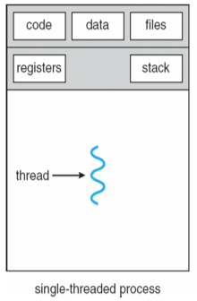
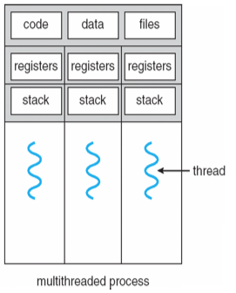
Single vs. Multithreaded Processes
Processes
Carries everything such as an address space, code, data, and files
Heavyweight in terms of creation/termination/context switching
Threads
Shares an address space, code, data and files if they belong to the same process
Lightweight in terms of creation/termination/context switching
Then, what is uniquely carried by each thread?

Slide 5
Threads in Java vs. C/C++
Java
Threads are built-in to the Java API
Portable
JVM uses threads as well for running programs and housekeeping (e.g. garbage collection)
C/C++
Threads not available in core C/C++
Can be implemented via platform dependent thread libraries (e.g. Pthreads)

Slide 6
Multithreaded Server
new Thread to service each Request
Client
Request
Server
Thread
Thread
Thread
Listen for
additional
requests

Slide 7
Thread Benefits
Responsiveness
Create new threads to process requests while receiving new requests
Resource sharing
Threads share an address space, files, code, and data
Economy
~25-30x faster to create new threads vs. processes
~ 5x faster to context switch
Scalability
Better utilization of multiprocessor architecture

Slide 8
Concurrent Programming (preview of coming attractions...)
“Programming concurrent applications is a difficult and error-prone undertaking” – Dietel**
When thread synchronization is required use the following guidelines (in order of complexity):
Use existing classes from the Java API (e.g. import java.util.concurrent.*)
Use synchronized keyword and Object methods wait, notify and notifyAll
Use Lock and Condition interfaces
** (p.678) Java for Programmers, Deitel & Deitel, 2nd Edition, Prentice Hall, 2011

Slide 9
Benefit: Responsiveness Multithreaded Server
Web Server
Clients
DB1
DB2
CGI
http
pages

Slide 10
Benefit: Deadlock avoidance
Process 1
Process 2
Bounded buffer
send
send
receive
receive
Bounded buffer
A sequence of send and then receive does not work!
Send and receive must be executed concurrently with threads.

Slide 11
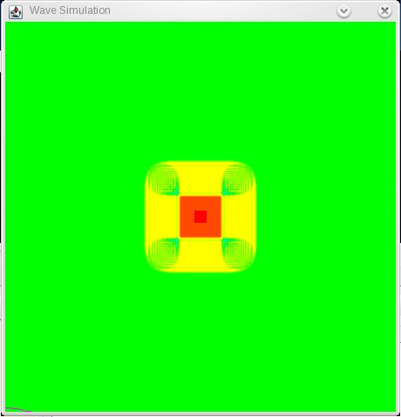
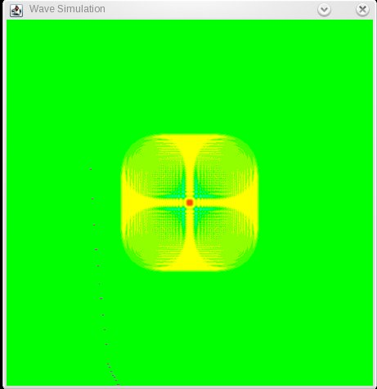
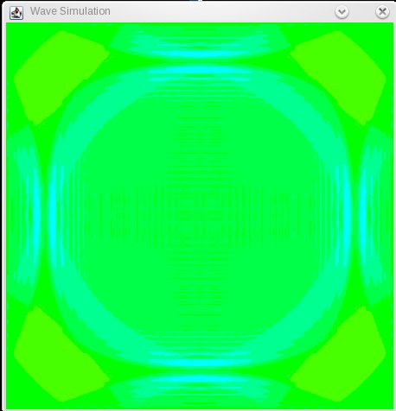
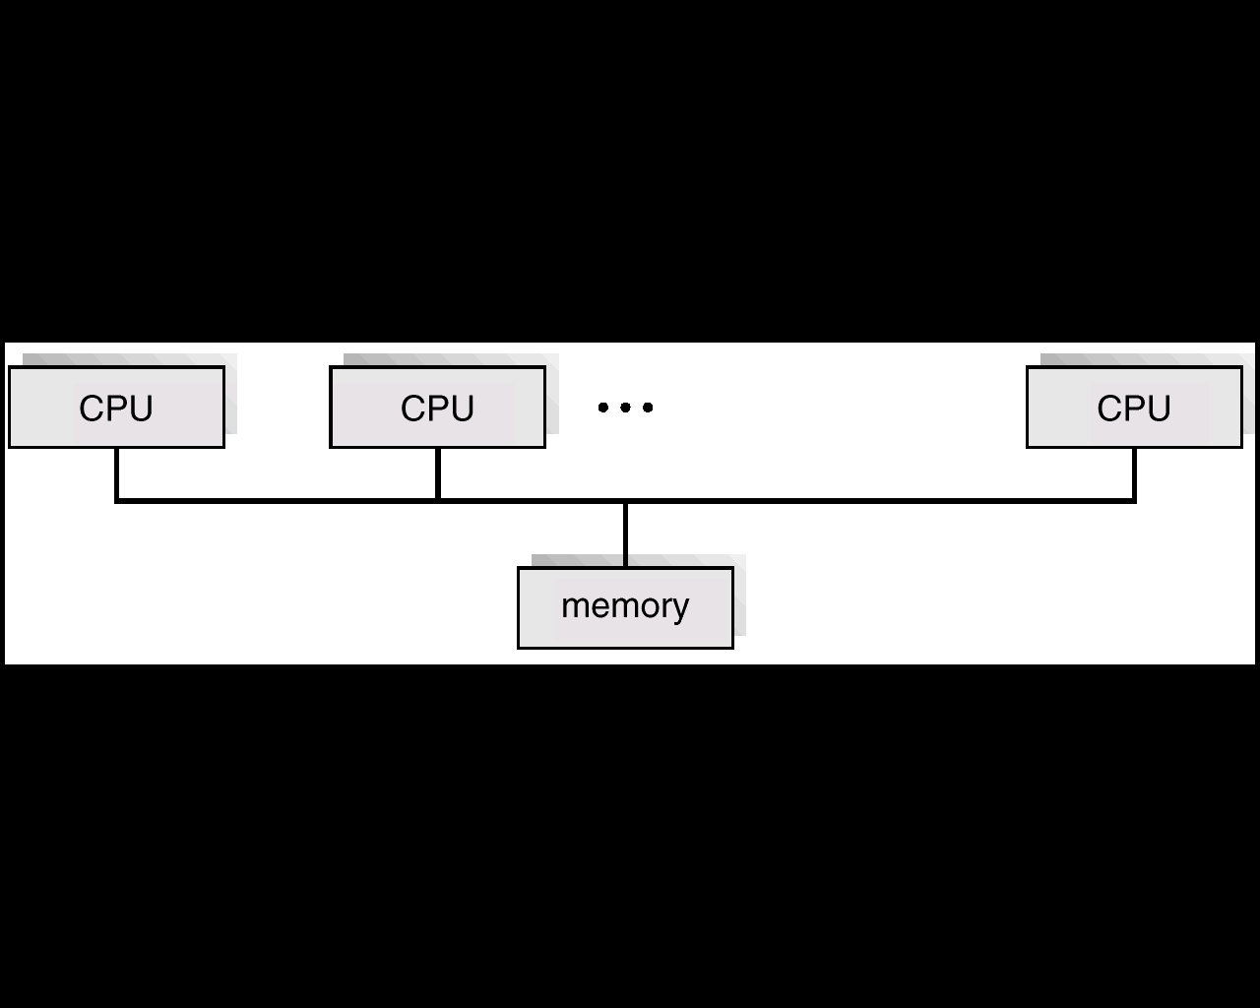
Benefit: Utilization of multicore multiprocessor architecture
time = t
time = t + x
Place code, files and data in the main memory.
Distribute threads to each of CPUs, and
Let them execute in parallel.
time = t + 2x
…
code
files
data
data

Slide 12
Discussion 1
Why do threads context switch much faster than processes? What data structure must threads carry within their own resources? What data structure can they share? What if we use processes rather than threads for the previous three cases?
a) Responsiveness
b) Deadlock avoidance
c) Utilization of multiprocessor architecture
Provide one programming example of multithreading giving improved performance over a single-threaded solution.
Provide one programming example of multithreading that would not improve performance over a single-threaded solution.

Slide 13
CSS430 ThreadOS
Processes are managed by the real operating system, and cannot be handled by ThreadOS.
Threads are multiple execution entities inside a process
ThreadOS is a process, therefore
ThreadOS executes multiple java application programs as threads.

Slide 14
Simple Thread (ThreadOS)

Slide 15
User and Kernel Threads
User Threads
Thread Management Done by User-Level Threads Library
Examples
- POSIX Pthreads
- Win32 threads
- Java threads
Kernel does not care how many user threads exist.
Kernel Threads
Supported by the Kernel
Examples
- Linux
- Windows XP/2000
- Solaris lightweight processes

Slide 16
Many-to-One Model
Many user-level threads mapped to a single kernel thread.
Used on systems that do not support kernel threads.
Examples: Solaris Green Threads, GNU Portable Threads
user thread
PRO | CONS
Fast | Non preemption or version complicated to handle preemption and I/O No use of MP architecture
k
kernel thread

Slide 17
One-to-One Model
Each user-level thread maps to kernel thread.
Examples
- Windows NT/XP/2000
- Linux
- Solaris 9 or later
PRO | CONS
1. Everything supported by OS 2. Uses MP architecture | Slower than many-to-one model. Too many threads do not help
user thread
k
k
k
k
kernel thread

Slide 18
Many-to-Many Model
Addresses the shortcomings of the previous two models
Examples
- Windows XP fiber library
- AIX Pthreads
- HP_UX
user thread
k
k
k
kernel thread

Slide 19
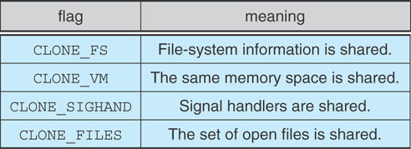
Linux Thread Implementation
Process provide by traditional fork() system call
Linux doesn’t distinguish between processes and threads
Each thread is viewed as a process inside the kernel
Linux rather creates tasks using clone()system call
Uses flags to manage resources
no flags → fork()

Slide 20
Lightweight Process (LWP)
A virtual CPU that is available for executing code. *
Can perform independent system calls
Can incur independent page faults
Multiple LWPs, in the same process, can run in parallel on multiple processors
LWP
“effectively we can say that threads and light weight processes are same. It’s just that thread is a term that is used at user level while light weight process is a term used at kernel level.” **
LWP ID
priority
Intr. mask
registers
* Multithreaded Programming with JAVA™ Technology, Lewis/Berg
** What are Linux Processes, Threads, Light Weight Processes, and Process State

Slide 21
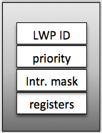
Process Structure
Kernel schedules each light-weight process separately.
Traditional UNIX Process
Multi-threaded Process
Process ID
Process ID
UID GID EUID EGID
UID GID EUID EGID
Directory Entry
Directory Entry
TTY
TTY
Signal Dispatch
Table
Signal Dispatch
Table
Memory Map
Memory Map
LWP1
LWP2
0
stdin
priority
0
stdin
1
stdout
Intr. mask
1
stdout
2
stderr
registers
2
stderr
3
3
CPU Status
File Descriptors
File Descriptors

Slide 22
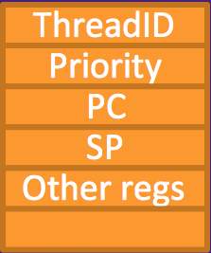
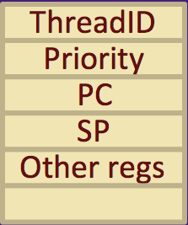
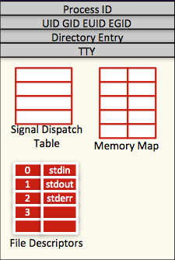

Thread Structure
Process
Thread library runs in a user space.
All threads shared the same address space.
Each thread maintains its own information and stack space.
Once a thread is mapped to a LWP, it runs on a CPU.
Thread3
thread info
Java Threads
stack
red zone
Thread2
thread info
stack
JVM
red zone
Thread1
thread info
stack
Thread1
Thread2
Thread3
red zone
heap
Pthreads
Win32 threads
Thread3
code + global data
Thread to LWP mapping
User mode
Kernel mode
LWP1
LWP2

Slide 23
Pthreads
A POSIX standard (IEEE 1003.1c) API for thread creation and synchronization
API specifies behavior of the thread library, implementation is up to development of the library
Common in UNIX operating systems (Solaris, Linux, Mac OS X)

Slide 24
Pthreads (in C)

Slide 25
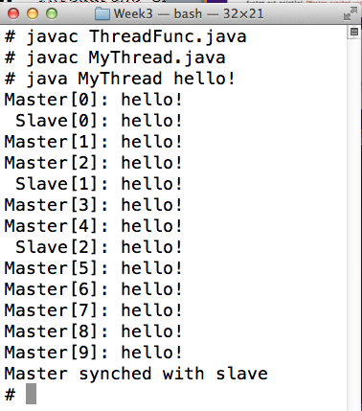
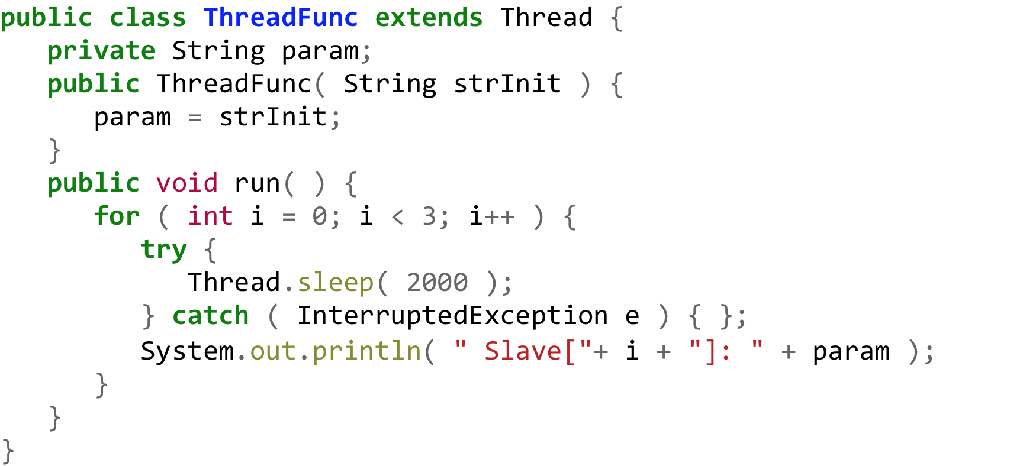
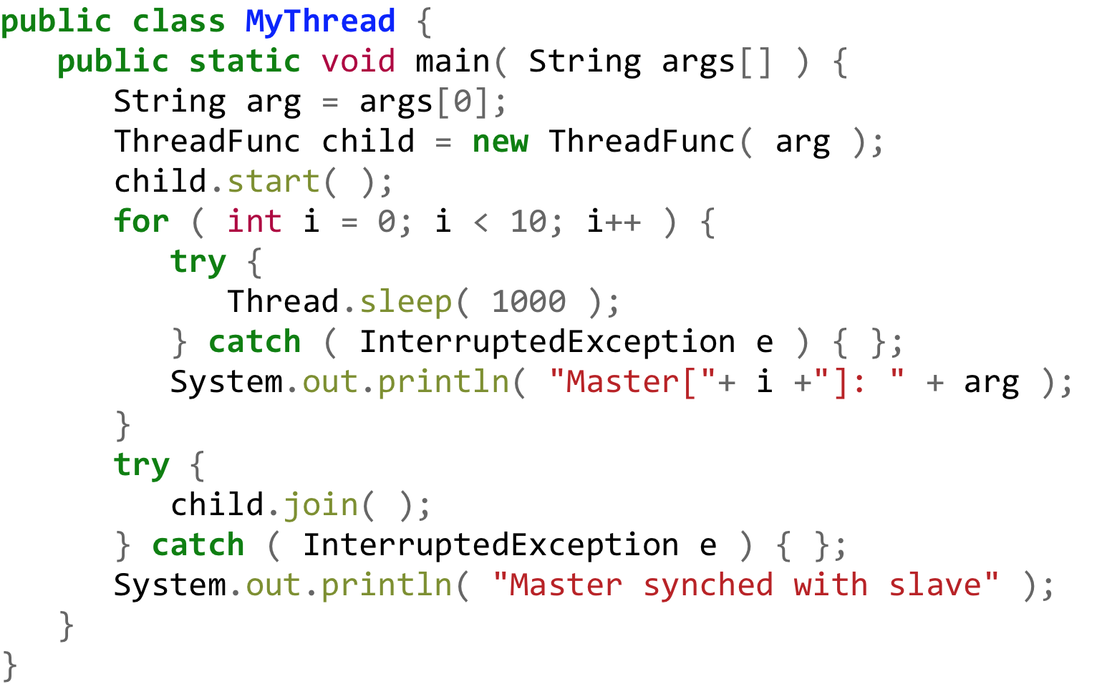
Threads (Java)
MyThread.java
Compile and run
ThreadFunc.java

Slide 26
Java Threads
Java threads may be created one of 2 ways:
Extending thread class
Implementing the Runnable interface

Slide 27
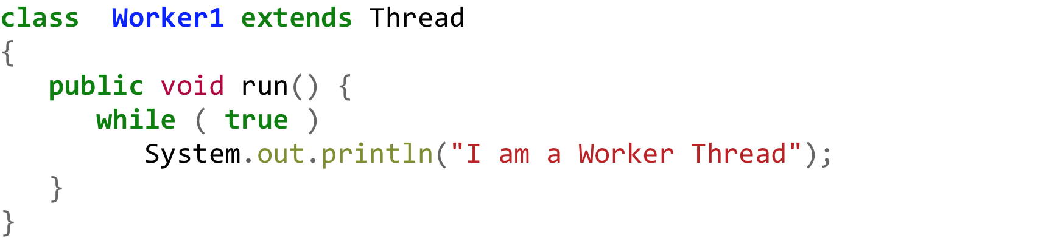
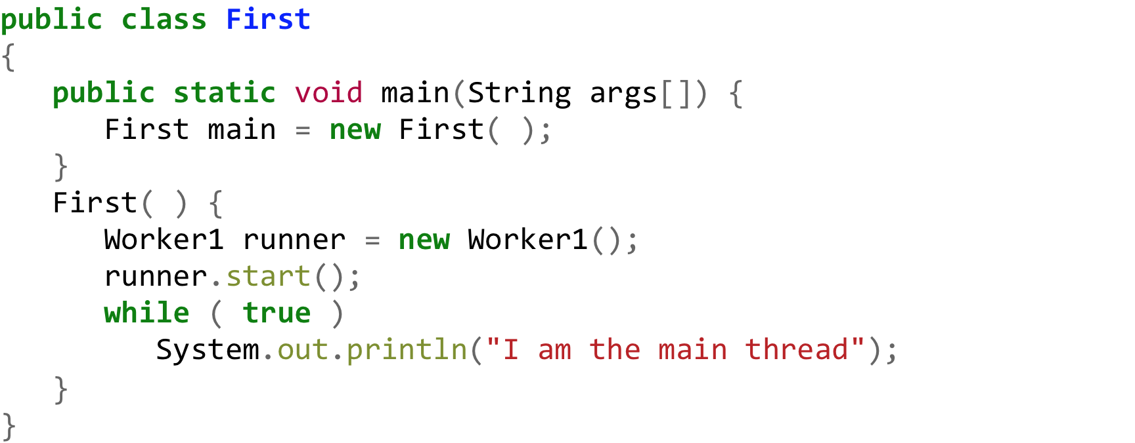
Extending thread class
Worker1.java
First.java {Thread creation}

Slide 28
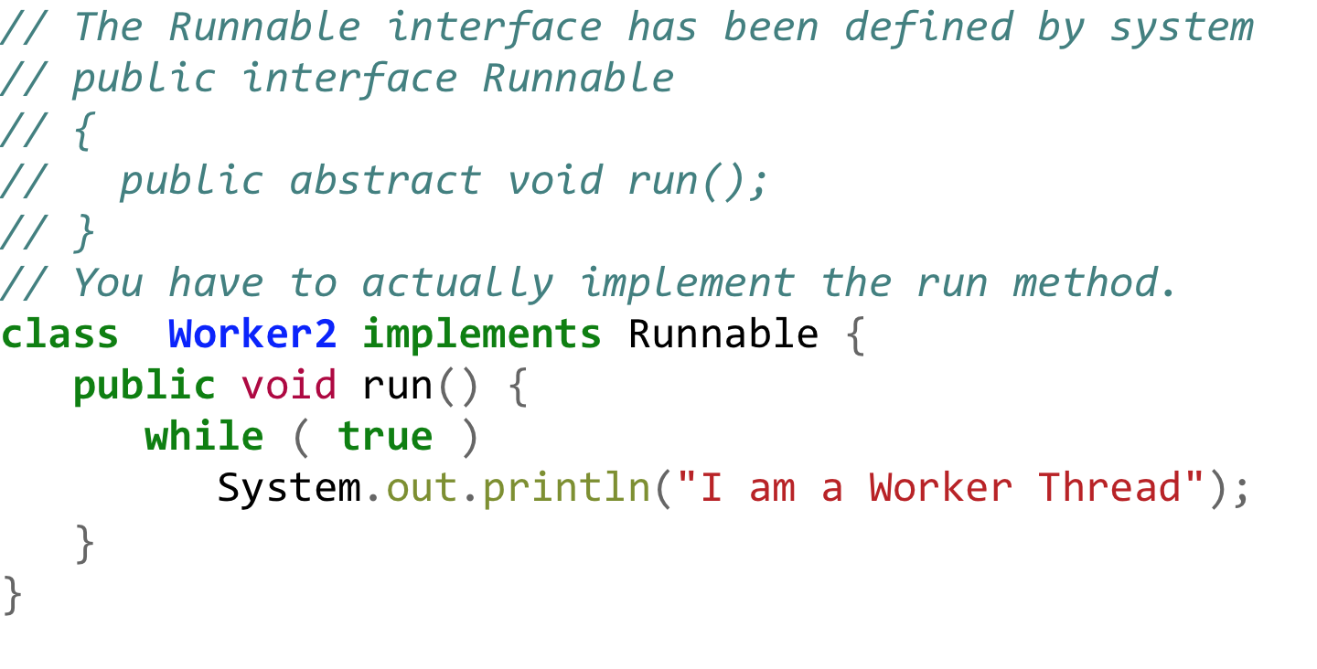
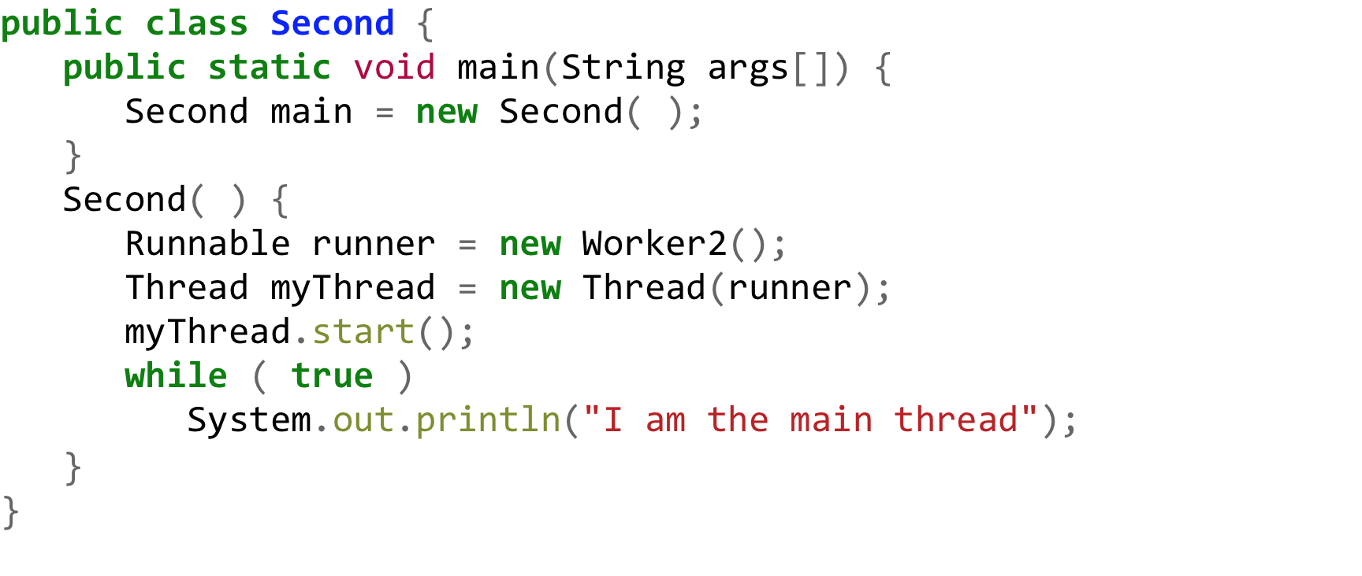
Runnable Interface
Worker2.java
Second.java {Thread creation}

Slide 29
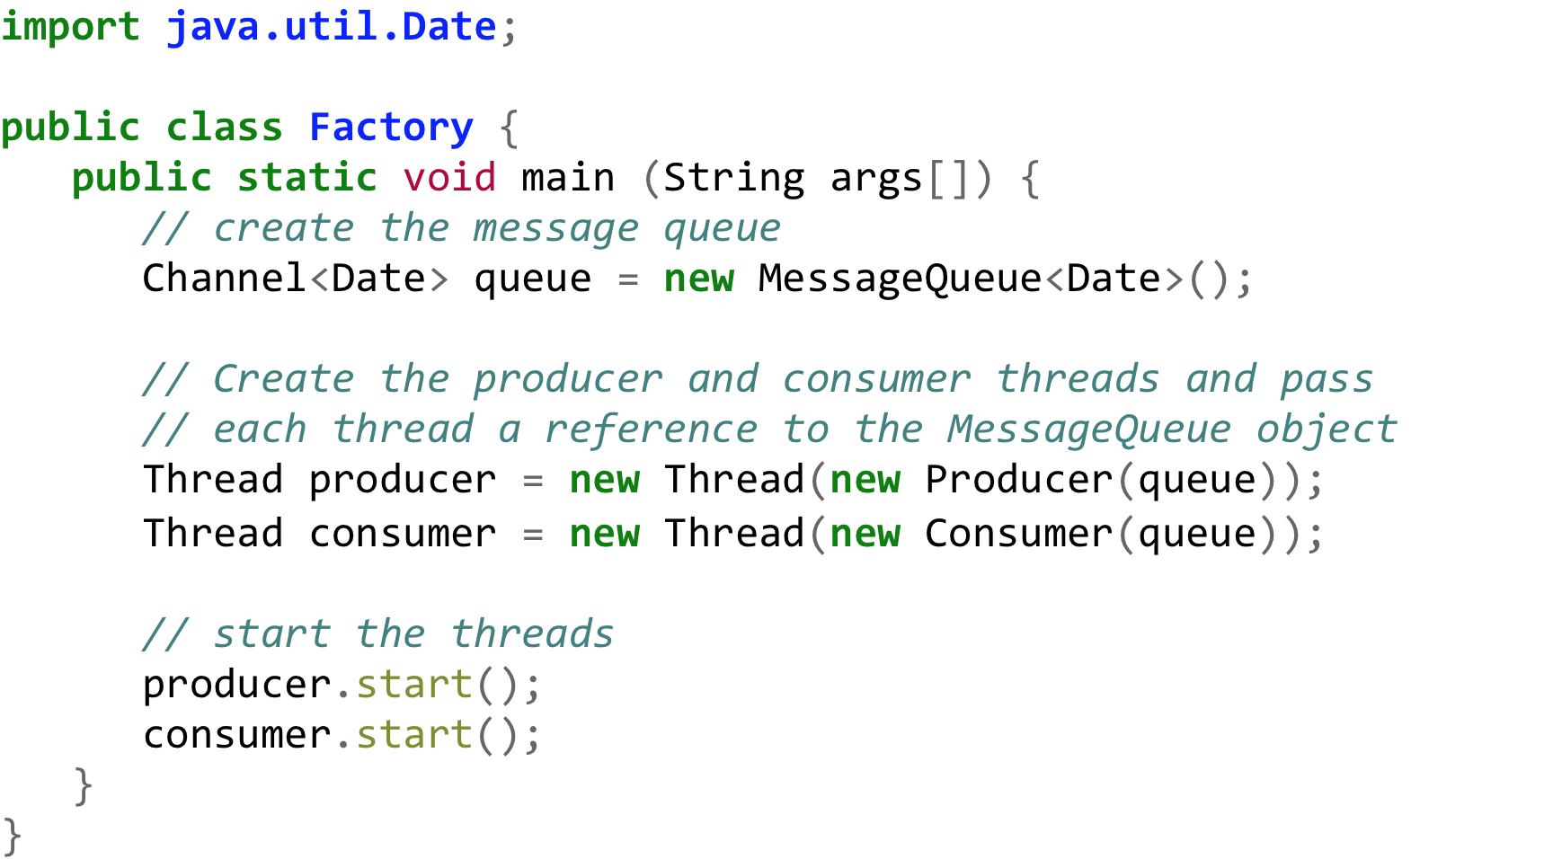
Java Threads Producer-Consumer

Slide 30
Java Threads Producer

Slide 31
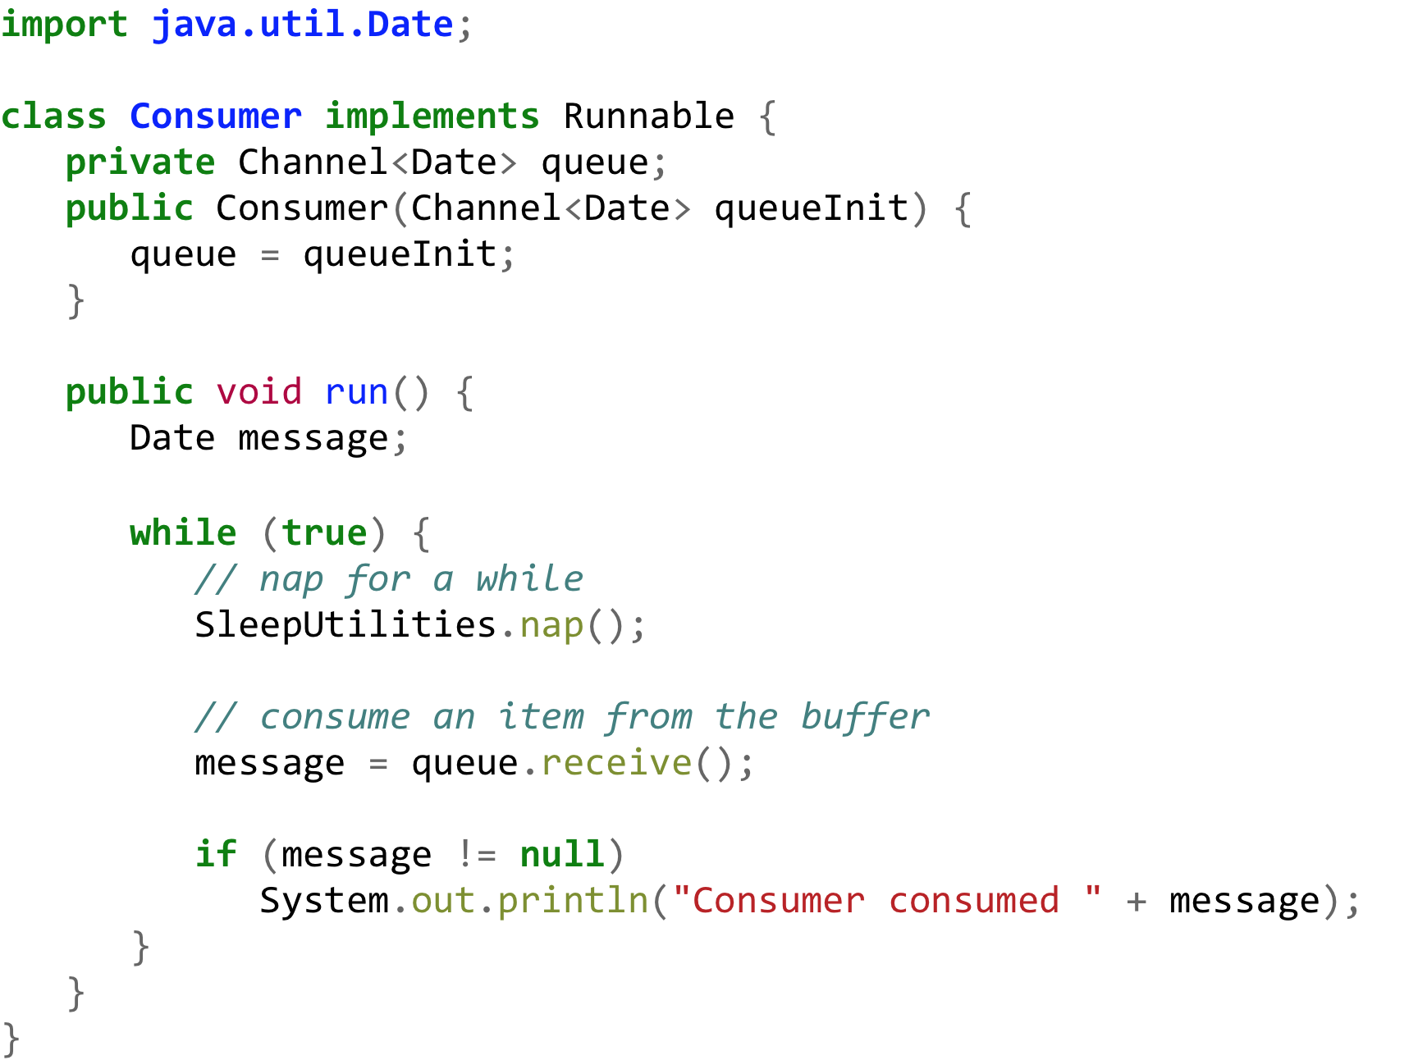
Java Threads Consumer

Slide 32
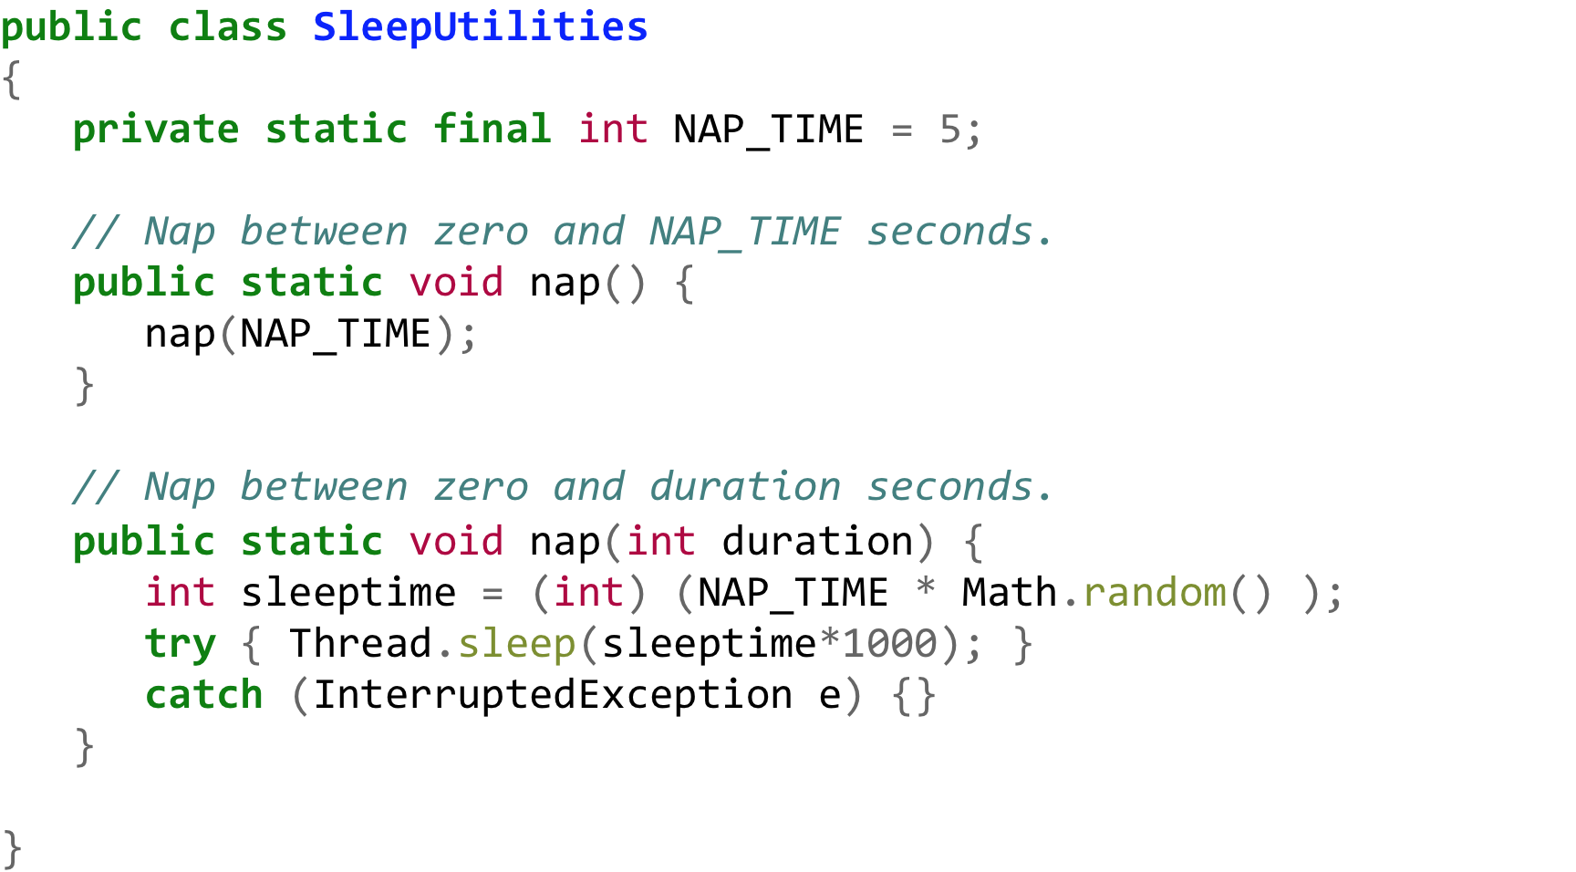
Java Threads Utilities

Slide 33
Java Thread Management
setPriority( ) – changes this thread’s priority.
sleep() – puts the currently running thread to sleep for a specified amount of time.
suspend() – suspends execution of the currently running thread.
resume() – resumes execution of a suspended thread.
stop() – stops execution of a thread.
For more information, visit:
JAVA SE7 API THREAD CLASS
Suspend, resume, and stop are currently deprecated in the specification.

Slide 34
Thread Pools
Key Benefits of TPs are:
Servicing incoming request is faster with existing threads than creating new threads
Thread Pools limit the total number of threads in the system.

Slide 35
Thread Pools PrintTask (worker example)

Slide 36
Thread Creation w/o Pools Driver (TaskCreator)

Slide 37
Thread Creation using Pools Driver (TaskExecutor)
* Better way to manage programs with many threads!

Slide 38
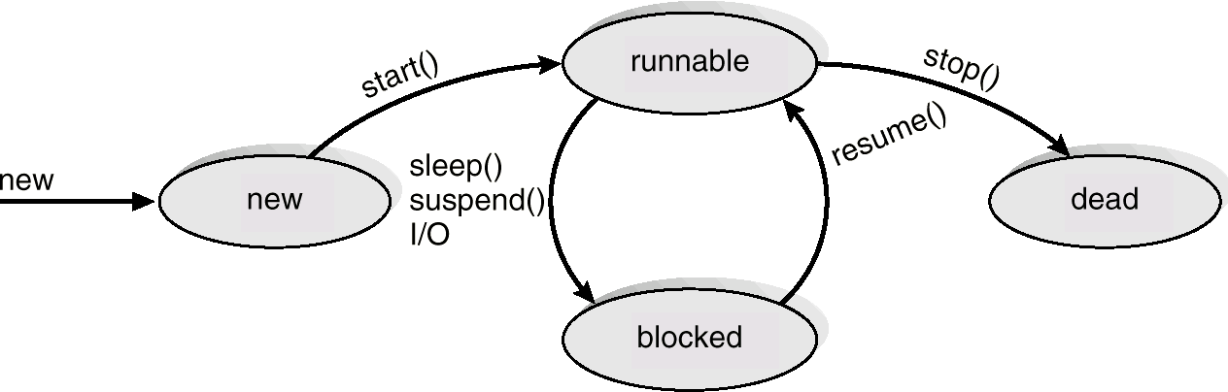
Java Thread States

Slide 39
Thread Life-cycle UML State Model
New
acquire lock, interrupt,
I/O completes
runnable
notify
notifyAll
enter synchronized
statement
wait
sleep
Interval expires
Notify
notifyAll
task completes
wait
issue I/O request
waiting
timed waiting
terminated
blocked

Slide 40
Exercises
(no-turn in) build and run all code snippets provided in the slides.
(turn-in) Exercise 4.6 - A Pthread program that performs the summation function was provided in Section 4.3.1.
Rewrite this program in Java.
...for next Monday midnight deadline ☺
Note: more homework will be added to Thursday night’s lecture on scheduling

