Slide 1
CSS430 Scheduling Textbook Chapter 5
Instructor: Stephen G. Dame
e-mail: sdame@uw.edu
These slides were adapted from the OSC textbook slides (Silberschatz, Galvin, and Gagne), Professor Munehiro Fukuda and the instructor’s class materials.

Slide 2
CPU Scheduling Learning Objectives
Basic Concepts
Scheduling Criteria
Scheduling Algorithms (FCFS, SJF, etc.)
Thread Scheduling
Multi-Processor Scheduling
OS Examples
Algorithm Evaluation

Slide 3
Glossary
Term | Definition
PCB | Process Control Blocks
FCFS | First-Come First-Served scheduling algorithm
SJF | Smallest-Job-First scheduling algorithm
RR | Round Robin
FIFO | First In First Out (Queue)
quantum | smallest schedulable time interval (“time slice”)
Foreground | interactive processes
Background | batch (or system) processes
PCS | process-contention scope
SCS | system-contention scope
TAT | Turnaround Time

Slide 4
Processes vs. Threads
Based on last class...
A fine distinction between processes and threads in Linux (e.g. tasks)
Terms (in chapter 5) used interchangeably
Process scheduling
Thread scheduling
Kernel level threads being scheduled – not processes.

Slide 5
CPU Scheduling Goal
The main objective of multiprogramming is to maximize CPU resource utilization for a given computer environment though optimal
CPU scheduling.
Example Computing Environments:
System Processes
Interactive processes
Batch oriented processes

Slide 6
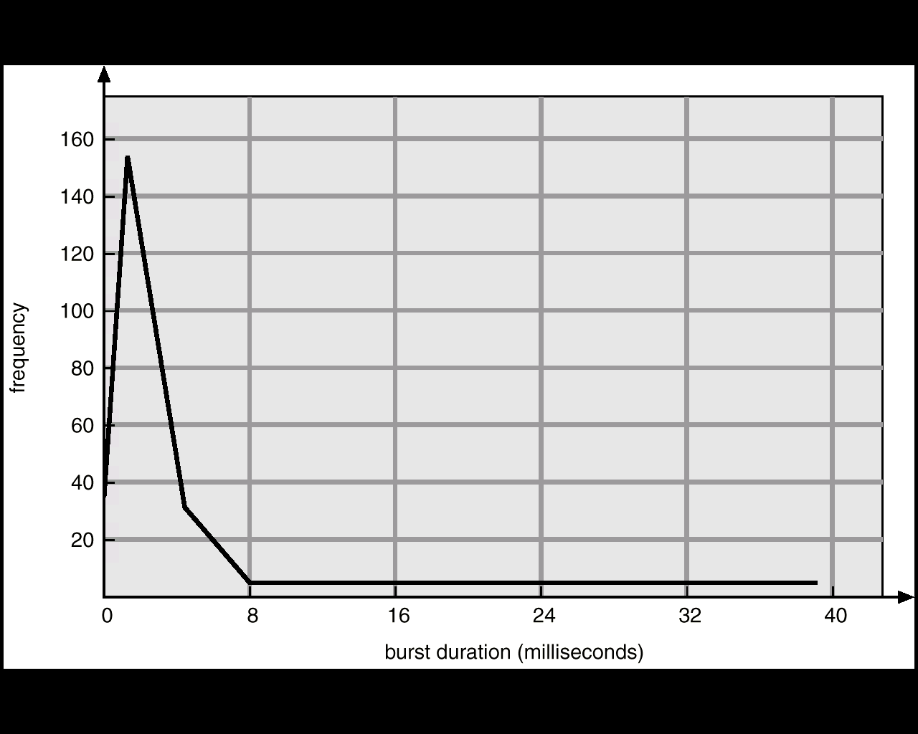
Histogram of CPU-burst Times
CPU Burst Duration | TYPE OF PROGRAM
SHORT | I/O Bound
LONG | CPU Bound

Slide 7
CPU-I/O Burst Cycles
.
.
.
load store
add store
read from file
.
.
.
CPU burst
load store
add store
read from file
Cycle n
CPU burst
wait for I/O
I/O burst
wait for I/O
I/O burst
store increment
index
write to file
CPU burst
Process A
Cycle n+1
store increment
index
write to file
CPU burst
wait for I/O
I/O burst
Process B
wait for I/O
I/O burst
load store
add store
read from file
CPU burst
Cycle n+2
load store
add store
read from file
CPU burst
wait for I/O
I/O burst
wait for I/O
I/O burst
.
.
.
.
.
.

Slide 8
CPU Scheduler
Ready
Ready Queue
2
Interrupt
PCBs
I/O
Complete
Short-term
Scheduler
3
Running
Wait
1
If only and then
scheduling = non-preemptive
else
scheduling = preemptive
1
4
Waiting
Exit
4
Process Termination
1 | Running → Waiting
2 | Running → Ready
3 | Waiting → Ready
4 | Waiting → Termination
UML Process State Diagram

Slide 9
Scheduling Criteria
Term | Definition
CPU Utilization | Typically ranges from 40% to 90% - keep the CPU as busy as possible.
Throughput | Number of processes completed per unit of time.
Turnaround Time (TAT) | Time of process submission to time of completion.
Waiting Time | Total amount of time a process spends waiting in the ready queue.
Response Time | Time a process takes from submission to start of response.

Slide 10
First-Come First-Served (FCFS)
The process that requests the CPU first is allocated the CPU first.
Example: Process Burst Time
P₁ 24
P₂ 3
P₃ 3
Suppose that the processes arrive in the order: P₁ , P₂ , P₃
Suppose that the processes arrive in the order: P₂ , P₃ , P₁ .
Non-preemptive scheduling
Troublesome for time-sharing systems
Convoy effect short process behind long process
P₁
P₂
P₃
Waiting time for P₁ = 0; P₂ = 24; P₃ = 27
Average waiting time: (0 + 24 + 27)/3 = 17
0
24
27
30
P₂
P₃
P₁
Waiting time for P₁ = 6; P₂ = 0; P₃ = 3
Average waiting time: (0 + 3 + 6)/3 = 3
0
3
6
30

Slide 11
Shortest-Job-First (SJF) Non-preemptive
Process | CPU Burst Time
P1 | 7
P2 | 4
P3 | 2
P4 | 3
P₃
P₄
P₂
P₁
P₃(0)
2
5
9
P₃‘s waiting time = 0
P₄‘s waiting time = 2
P₂‘s waiting time = 5
P₁‘s waiting time = 9
P₄(2)
P₂(5)
P₁(9)
(SJF) Average waiting time = (0 + 1 + 5 + 9)/4 = 3.75
(FCFS) Average waiting time = (0 + 7 + 11 + 13)/4 = 7.75

Slide 12
Shortest-Job-First (SJF) Preemptive
Process | Arrival Time | CPU Burst Time
P1 | 0 | 7
P2 | 2 | 6
P3 | 4 | 2
P4 | 5 | 3
P₁
P₂
P₃
P₄
~P₂
~P₁
P₁(0)
2
4
6
9
P₃‘s waiting time = 0
P₂‘s waiting time = 2
P₃‘s waiting time = 4
P₄‘s waiting time = 6
18
P₂(2)
P₃(4)
P₄(6)
(SJF) Average waiting time = (0 + 2 + 4 + 6)/4 = 3
(FCFS) Average waiting time = (0 + 7 + 13 + 15)/4 = 8.75

Slide 13
Discussion 1
1. Compute average wait time (FCFS) for all unique permutations of P1, P2, P3 where:
2. What is the difference between preemptive and non-preemptive schedulers?
3. Can an OS satisfy all the scheduling criteria: CPU utilization, throughput, TAT, waiting time, and response time?
Process | CPU Burst Time (msec)
P1 | 34
P2 | 16
P3 | 37

Slide 14
Shortest-Job-First (SJF)
Optimal scheduling
Preemptive SJF is superior to non-preemptive SJF.
However, there are no accurate estimations to know the length of the next CPU burst
Estimation in Figure 5.3 (recursive smoothing filter):
Exponential Averaging Filter (recursive smoothing filter)

Slide 15
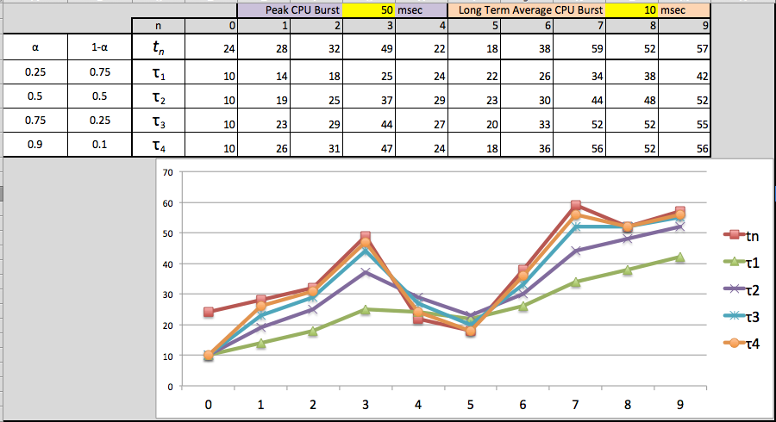
SJF Predicted CPU Burst Example (Random Data)

Slide 16
Priority Scheduling
A priority number (integer) is associated with each process
The CPU is allocated to the process with the highest priority (smallest integer ≡ highest priority in Unix but lowest in Java).
Preemptive
Non-preemptive
SJF is a special case of priority scheduling
priority is the predicted next CPU burst time.
Problem ≡ Starvation – low priority processes may never execute.
Solution ≡ Aging – as time progresses increase the priority of the process.

Slide 17
Priority Scheduling Non-preemptive
Process | CPU Burst Time | Priority
P1 | 7 | 3
P2 | 1 | 1
P3 | 3 | 4
P4 | 1 | 5
P5 | 5 | 2
P₂
P₅
P₁
P₃
P₄
1
6
9
12
13
P₃(0)
P₅(1)
P₁(6)
P₃(9)
P₄(12)
(Priority) Average waiting time = (0 + 1 + 6 + 9+12)/5 = 5.6
(FCFS) Average waiting time = (0 + 7 + 8 + 11 + 12)/5 = 7.6

Slide 18
Round Robin Scheduling
Each process is given CPU time in turn, (i.e. time quantum: usually 10-100ms)
...thus waits no longer than ( n – 1 ) * time quantum
time quantum = 20ms
Process | CPU Burst Time (ms) | Wait Time (ms) | TAT (ms)
P1 | 53 | 57+24 = 81 | 134
P2 | 17 | 20 | 37
P3 | 68 | 37 + 40 + 17= 94 | 162
P4 | 24 | 57 + 40 = 97 | 121
AVERAGE | 41ms | 73ms | 114ms
P₁
P₂
P₃
P₄
P₁
P₃
P₄
P₁
P₃
P₃
0
20
37
57
77
97
117
121
134
154
162
P₁(53)
P₁(33)
P₁(13)
57
24
P₂(17)
20
P₃(48)
P₃(68)
P₃(28)
P₃(8)
37
40
P₄(4)
17
P₄(24)
57
40

Slide 19
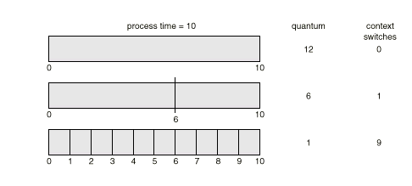
Round Robin Scheduling
Typically, higher average turnaround than SJF, but better response.
Performance (q = quantum)
q large ⇒ FCFS
q small ⇒ q must be large with respect to context switch, otherwise overhead is too high.

Slide 20
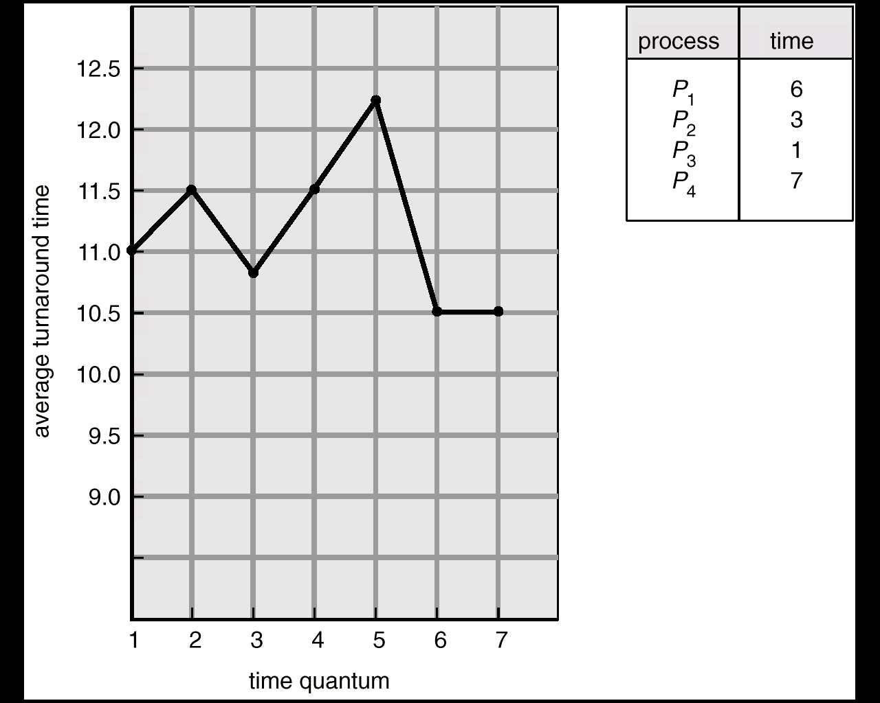
Turnaround Time (TAT) Varies With The Time Quantum
TAT can be improved if most processes
finish their next CPU burst in a single
time quantum.

Slide 21
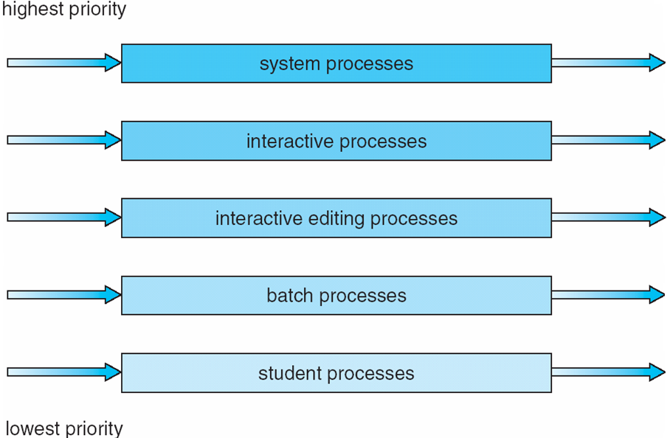
Multilevel Queue Scheduling fixed distribution based on priority
Each queue has its own scheduling algorithm,
foreground (interactive) – RR, 80% CPU time
background (batch) – FCFS, 20% CPU time

Slide 22
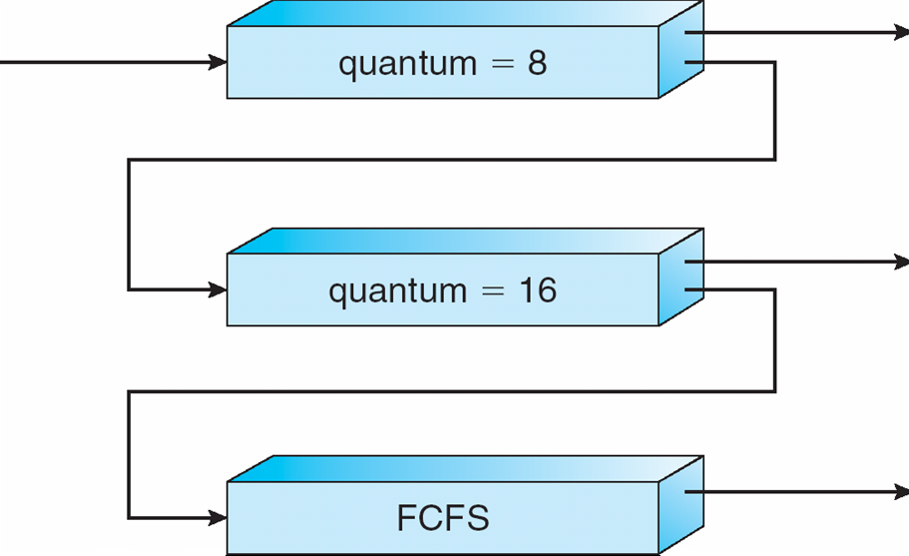
Multilevel Feedback-Queue Scheduling (MFQS) – Variable based on consumption
A new job enters queue Q₀ which is scheduled via FCFS. When it gains CPU, the current job receives 8 milliseconds. If it does not finish in 8 milliseconds, the job is moved to queue Q₁.
At Q₁ job is again scheduled via FCFS and receives 16 additional milliseconds.
If it still does not complete, it is preempted and moved to queue Q₂.

Slide 23
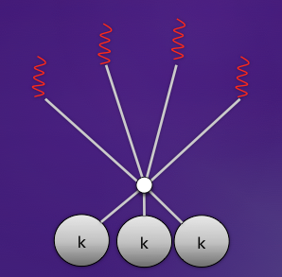
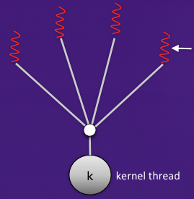
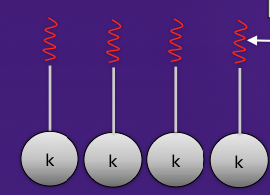
Contention Scope
Term | Definition
PCS | Many-to-many and many-to-one thread models schedule user-level threads to run on an available LWP
SCS | Mapping kernel threads onto a CPU
NOTE: Linux, Windows only use SCS because they are one-to-one thread models.

Slide 24
Discussions 2
What is the main problem in MFQS?
How can you address this problem? Briefly think about your own personal scheduling algorithm?

Slide 25
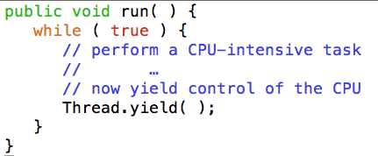
Cooperative multithreading in Java
A thread voluntary yielding control of the CPU is called cooperative multitasking.
Thread.yield( ) is OS-dependent.
Linux does not care about it.
Solaris allows a thread to yield its execution when the corresponding LWP exhausts a given time quantum.
Conclusion: Don’t write programs based on yield( ).

Slide 26
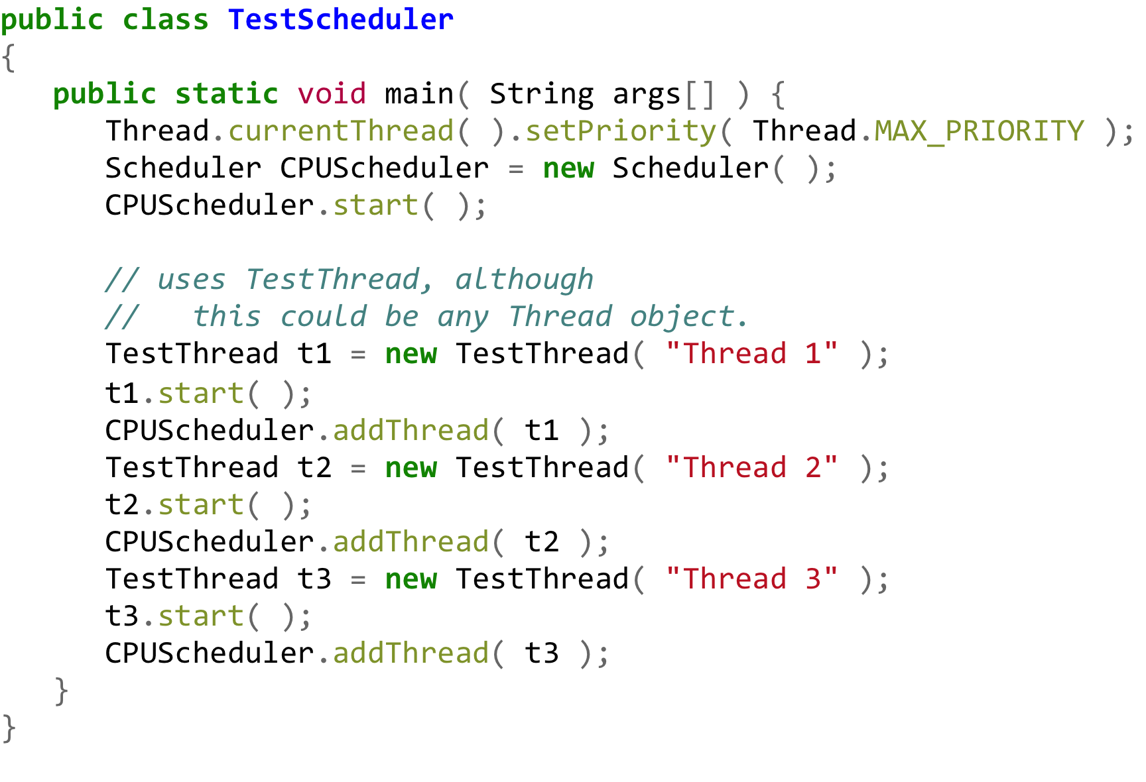
Java-Based Round-Robin Scheduler (Naïve Example)

Slide 27
Why does this not work?
Java: runs threads with a higher priority until they are blocked. (Threads with a lower priority cannot run concurrently.)
This may cause starvation or deadlock.
Java’s strict priority scheduling was implemented in Java green threads.
In Java 2, thread’s priority is typically mapped to the underlying OS-native thread’s priority.
OS: gives more CPU time to threads with a higher priority. (Threads with a lower priority can still run concurrently.)
If we do not want to depend on OS scheduling, we have to use:
Thread.suspend( )
Thread.resume( )

Slide 28
Multiprocessor Scheduling
OS code and user process mapping:
Asymmetric multiprocessing
Symmetric multiprocessing (SMP)
Scheduling criteria:
Processor affinity
Load balancing
Thread context switch:
Coarse-grained software thread
Fine-grained hardware thread

Slide 29
Algorithm Evaluation
Define the selection criteria (i.e.):
Optimize CPU Utilization OR
Maximize throughput
Evaluation Methods
Deterministic Modeling (analytic method)
Queueing Models (see Little’s formula next)
Simulations
Implementation

Slide 30
Little’s Formula
n | Average queue length
λ | Average arrival rate for new processes in queue
W | Average waiting time in queue

Slide 31
Little’s Formula - Examples
Ex: | n | λ (processes/sec) | W (sec) | Narrative
1 | 256 | 1000 | 0.256 | What's the average wait time for 1000 p/sec in a 256 element queue?
2 | 1501 | 15000 | 0.1 | How deep should a queue be for a desired wait time of 1/10 sec if processes arrive every 67usec?
3 | 64 | 22 | 3 | If average wait time is 3 sec and queue depth is 64 what is the average throughput of processes that can be accomodated?

Slide 32
Exercises
Program #2: Check the syllabus for its due date
(turn-in) Exercise 5.12 - Build a table or spreadsheet .
...for next Monday midnight deadline ☺
Note: this is in addition to the Tuesday assignment.

