Slide 1
CSS430 Operating-System Structures Textbook Chapter 2
Instructor: Stephen G. Dame
e-mail: sdame@uw.edu
These slides were adapted from the OSC textbook slides (Silberschatz, Galvin, and Gagne), Professor Munehiro Fukuda and the instructor’s class materials.

Slide 2
“People who are more than casually interested in computers should have at least some idea of what the underlying hardware is like. Otherwise the programs they write will be pretty weird.” - D. Knuth
Donald Ervin Knuth (born 1938) is an American computer scientist, Professor Emeritus at Stanford University, and winner of the 1974 Turing Award.

Slide 3
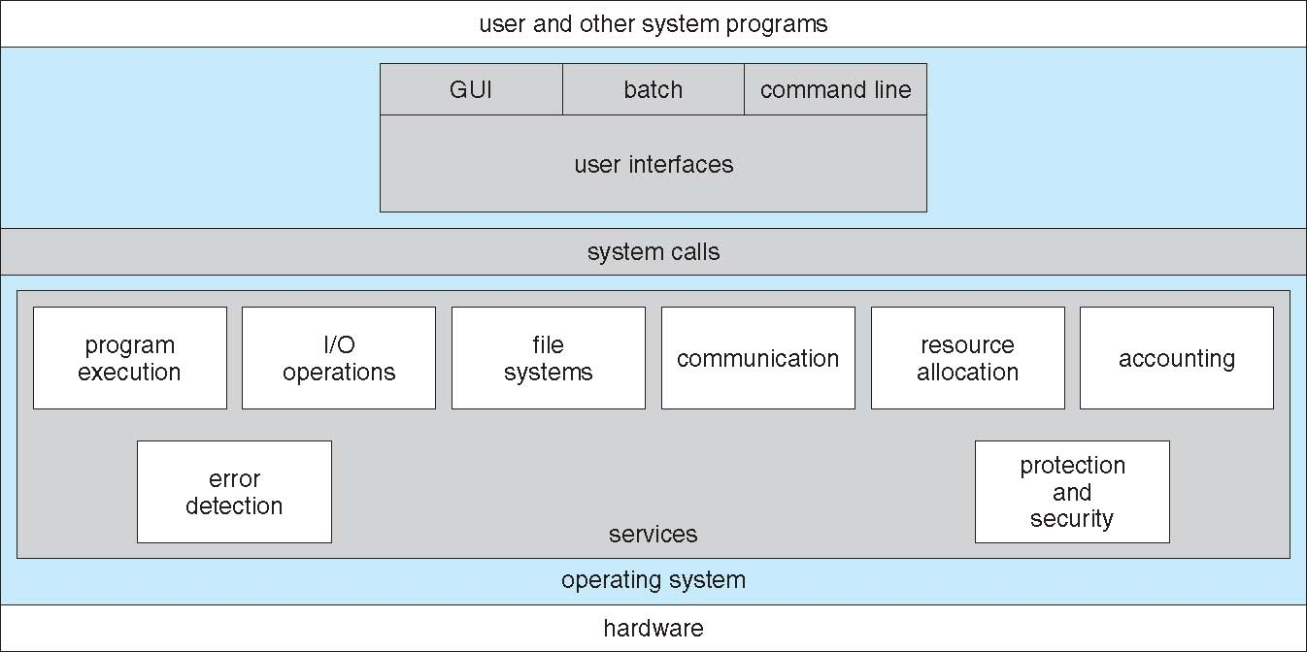
A View of OS Services

Slide 4
OS Features
Process Management Week 2-5
Main Memory Management Week 6-7
File Management Week 8-9
Secondary-Storage Management if time allows
I/O System Management if time allows
Networking CSS432
Protection System Week 10
Command-Interpreter System Today

Slide 5
Process Management
A process is a program in execution. A process needs CPU time, memory, files, and I/O devices, to accomplish its task.
The operating system is responsible for
Process creation and deletion (starting and terminating a program execution)
Process suspension and resumption (letting a program wait for an I/O operation or a next turn)
Process synchronization (letting a program wait for another program’s termination)
Process communication (allowing a program to send/receive data from another executing program)

Slide 6
Memory Management
Memory is a large array of words or bytes, each with its own address.
Main memory is a volatile data storage shared by the CPU and I/O devices.
The operating system is responsible for:
Keeping track of which parts of memory are currently being used and by whom.
Deciding which processes to load when memory space becomes available.
Allocating and deallocating memory space as needed.

Slide 7
File Management
Files represent programs and data.
The operating system is responsible for:
File creation and deletion.
Directory creation and deletion.
Support of primitives for manipulating files and directories (open, read, write, seek, and close).
Mapping files to secondary storage (HDrive)
and tertiary storage (R/W CDs, tapes, Flash Drv).
File backup on stable (nonvolatile) storage media.

Slide 8
Other Management Functions
I/O Systems:
Buffering, caching, and spooling of I/O data (I/O devices are typically slow.)
Device drivers (program and control of peripheral devices)
Secondary/Mass-Storages:
Disk management (for free and allocated spaces)
Disk scheduling (for an optical sequence of disk accesses)
Swap-space management (disk area used as virtual memory)
Network:
Supporting various network protocols: TCP/IP, FTP, NFS, and HTTP, etc.
Protection/Security:
Authentication (password, defending ext. I/O, bytecode verifier )
Access authorization (access mode, java sandbox model)
Cryptography

Slide 9
Virtualization
non-virtual machine
virtual machine system
Processes
Processes
Processes
Processes
Programming
Interface
Kernel
(ex. RedHat)
Kernel
(ex. Win8)
Kernel
(ex. Ubuntu)
VM1
VM2
VM3
Kernel
(ex. RedHat)
“Bare-metal” OS (e.g. Mac OSX)
Hardware
Hardware
VM Ware, Virtual Box, Parallels, etc.

Slide 10
Discussion 1
List at 3 or more reasons for why virtual machines are beneficial.
What would be a reason to share a file system between a host OS and VM OS?
What are some of the challenges of implementation of VMs?
Are VMs possible without some level of HW support from the host OS?

Slide 11
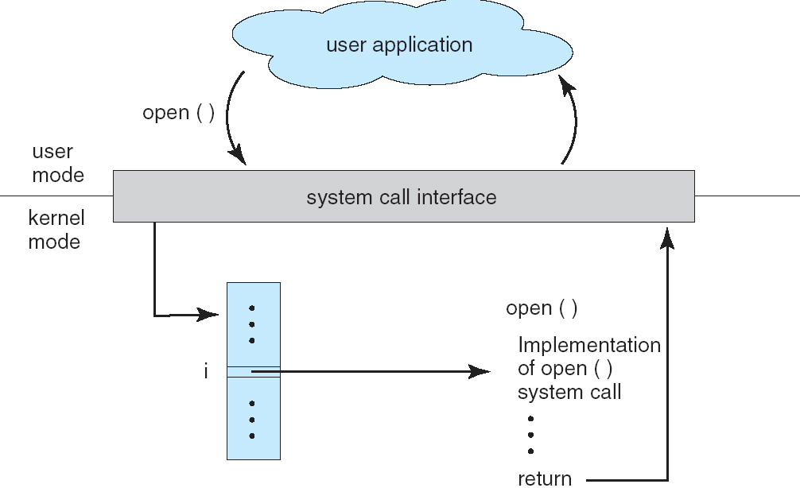
System Calls
All management functions in slides 4-7 must be performed through a system call.

Slide 12
System Calls (Continued)
Process control
end, abort
load, execute
create process, terminate process
get process attributes, set process attributes
wait for time
wait event, signal event
allocate and free memory
File management
create ﬁle, delete ﬁle
open, close
read, write, reposition
get ﬁle attributes, set ﬁle attributes
Device management
request device, release device
read, write, reposition
get device attributes, set device attributes
logically attach or detach devices
Information maintenance
get time or date, set time or date
get system data, set system data
get process, ﬁle, or device attributes
set process, ﬁle, or device attributes
Communications
create, delete communication connection
send, receive messages
transfer status information
attach or detach remote devices

Slide 13
Command Interpreters
The program that reads and interprets control statements
command-line interpreter (in DOS)
shell (in UNIX)
What control statements can you pass the command interpreter?
Program execution: a.out, g++, vim, emacs
Process management: ps, kill, sleep, top, nice, pstack
I/O operations: lpr, clear, lprm, mt
File-system manipulation: ls, mkdir, mv, rm, chmod, [u]mount
Communication: write, ping, mesg

Slide 14
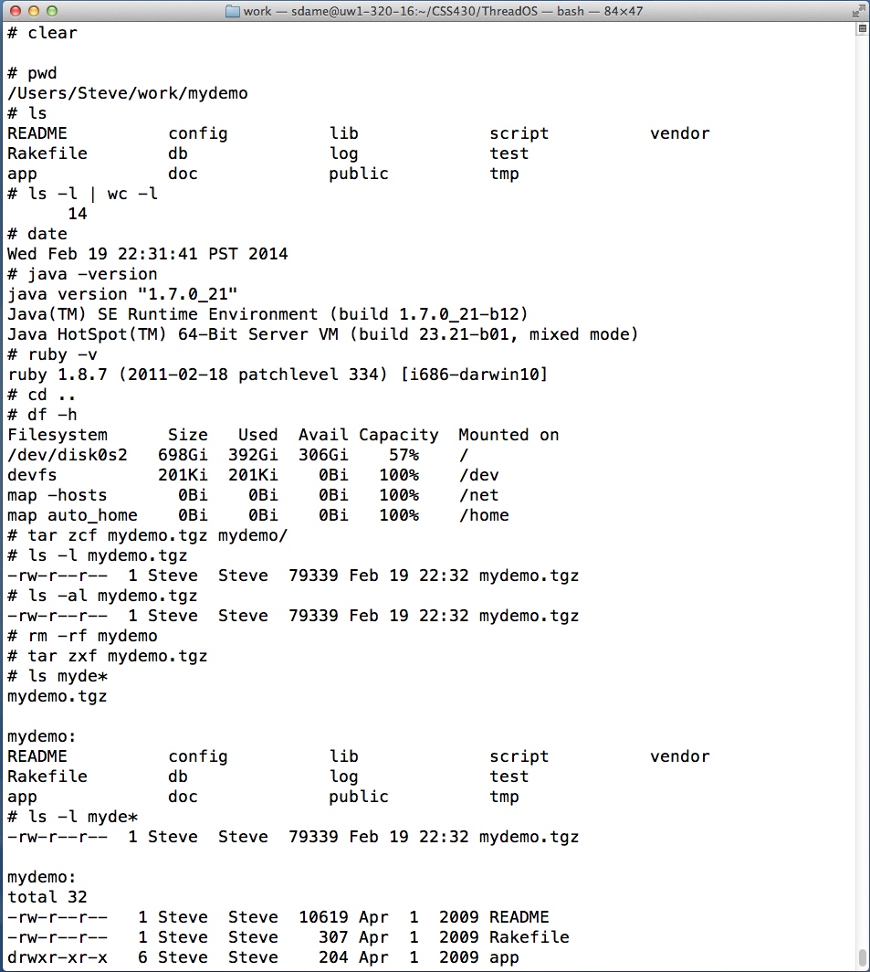
Bash Shell Command Interpreter

Slide 15
Shell (bash)
Fork, exec, wait and dup are System calls
# ssh sdame@uw1-320-15.uwb.edu
sshd
fork, exec and wait
[sdame@uw1-320-15 ~]$
bash
(1) fork & wait
(5) exit
Shell
wc -l
(3) fork
Shell
who
[sdame@uw1-320-15 ~]$ who | wc -l
(4) exec
(4) exec
cin
cout
(2) pipe

Slide 16
CSS430-Unique ThreadOS
Shell.java
Other
User
Threads
Test1.java
Loader.java
exec, join, exit, cin, cout, rawread, rawwrite
SysLib.java
interrupt
addThread
Disk.java
Power on
Boot.java
Kernel.java
deleteThread
read
write
Scheduler.java

Slide 17
Discussion 2
Class Discussion
Is Windows a more advanced OS than Linux, from the following view points? Windows temporarily keeps deleted files in Recycle Bin, while Linux rm deletes them instantly. Windows task manager allows us to kill processes with their program names, while Linux uses IDs to kill specific processes. Windows starts an appropriate application for a file double-clicked, while Linux needs a specific application to be typed from the command line (i.e. more command line script oriented).

Slide 18
Java Technology
Programming-language specification
C++-like object oriented programming language
No system-dependent descriptions
Variable sizes are universally defined over different machines
No system calls are supported
Automatic memory operations: no address concept and no delete
Multithreaded support
Application-programming interfaces (API)
Various system-provided classes: graphics and I/O
Virtual-machine specification
Interpretation of architecturally independent bytecode

Slide 19
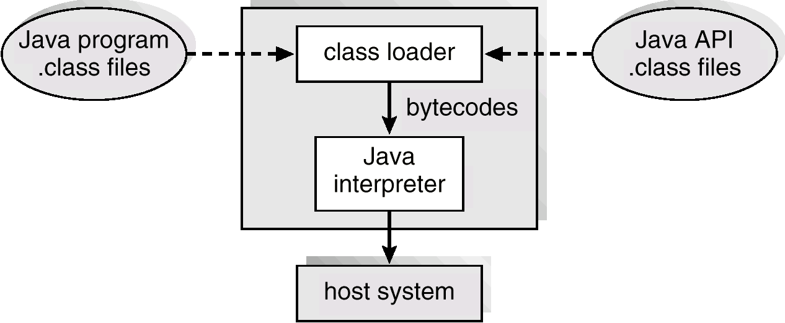
Java Virtual Machine

Slide 20
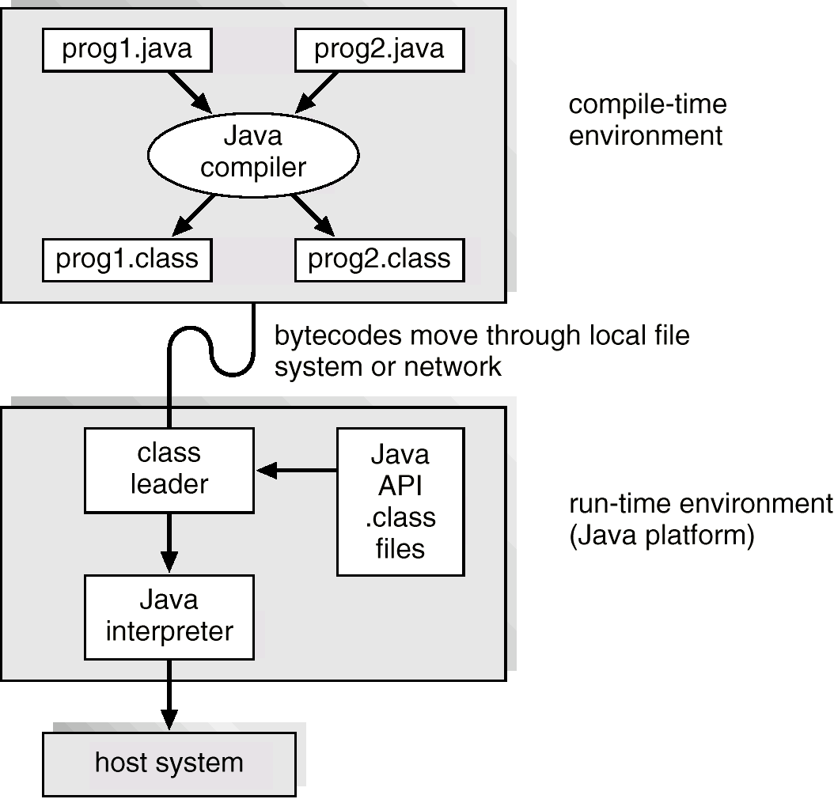
Java Development Environment

Slide 21
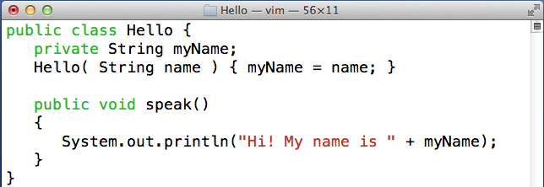
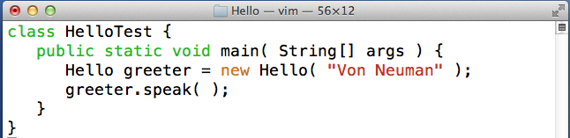
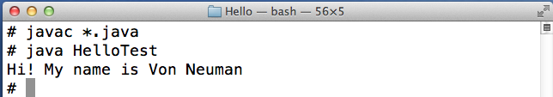
Java Program
Hello class
+
a method
Test class
has
main()
compile &
execute
HelloTest

Slide 22
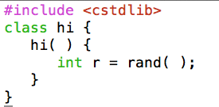
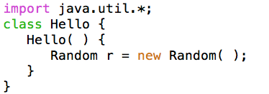
Names and Packages
C++ | Java
No rules on class names No correlation between class and file names Headers predefine various useful class interfaces. #include reads in a header file. | Class names in MixedCase starting with a capital letter Class and the corresponding file must have the same name. Packages predefine various useful classes. import omits the full package name.
Filename: hello.cpp | Filename hello.java

Slide 23
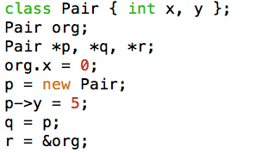
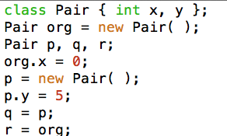
Values, Objects, and Pointers
C++ | Java
Variables: bool(true or false) char(8bits), short(16bits), int(32bits), long(32bits), float(32bits), double(64bits) Pointers: *, &, and -> operators | Variables: boolean(true or false) byte(8bits), char(16bits), short(16bits), int(32bits), long(64bits) float(32bits), and double(64bits) Pointers: NO *, &, and ->
x
y
x
y
r
org:
0
org
x
y
r
0
p
x
y
5
p
q
5
q

Slide 24
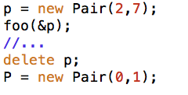
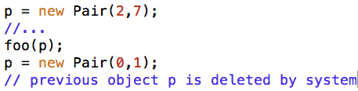
Pointers (Continued…)
C++ | Java
Function arguments: Primitive types: call by value Objects: call by reference (& needed) Garbage collection: delete needed (memory leaks!) | Function arguments: Primitive types: call by value Objects: call by reference (no & needed) Garbage collection: no delete needed

Slide 25
Public, Protected, Private, Static, and Final
C++ | Java
public protected private (default) Static (used as shared variables/functions) const | public (default) protected Private static (used as shared and global variables/functions) final

Slide 26
Arrays and Strings
C++ | Java
Array name Points to address of the 1st Elem Array size Have to memorize how long it is. Cannot change the size. int a[], *b; a = new int[10]; b = a; string class | Array name Points to the entire array object Array size Final field length returns the size. Cannot change the size. int a[]; a = new int[10]; int[] b = a; String class
Visit java.sun.com for details

Slide 27
Constructors and Overloading
C++ | Java
Object construction using new No parentheses needed if no arguments given Multiple constructors Allowed Overloading Including operators | Object construction using new Parentheses always needed even if no arguments given Multiple constructors Allowed Overloading Operators are not overloaded

Slide 28
Inheritance, Interfaces, and Casts
C++ | Java
Inheritance class Derived : public Base {…} Multiple inheritance allowed Pure virtual functions for abstract classes class Abstract { virtual func() = 0; } Constructors called from the base class Cast (typeName)var or typeName(var) | Inheritance class Derived extends Base {…} Single inheritance only (all objects are derived from Object class) Methods without a body can be described in an interface interface Runnable { void run(); } Methods without a body can be described in an interface Multiple interfaces are inherited. class Derived implements Runnable {…} Cast: (typeName)var

Slide 29
Exceptions
No core dump but exceptions occur in Java. Some API methods request you to catch exceptions
Catching Exceptions: → my recommendation public Disk( int blocks ) { try { FileInputStream ifstream = new FileInputStream(“DISK”); } catch ( FileNotFoundException e) { System.out.println(e); { }
Throwing Exceptions: public Disk( int blocks ) throws FileNotFoundException { FileInputStream ifstream = new FileInputStream(“DISK”); }
SEE: Throwing and Catching Java Exceptions

Slide 30
Threads
Threads are independent execution entities which run concurrently but share the same code and variables.
Definition: public class ThreadName extends Thread { ThreadName( String[] arg ) { ... } // constructor public void run() { ... while(true) { ... } } }
Invocation: ThreadName t1 = new ThreadName(“Thread 1”); ThreadName t2 = new ThreadName(“Thread 2”); t1.start(); // without waiting for t1’s term, start t2 t2.start();

Slide 31
Vector
Vector is a list of Objects
Declaration: Vector v = new Vector();
Any type of objects are inserted: v.add(new Integer(10)); v.add(0, new Integer(5));
When retrieved, values must be converted from Object to an appropriate type: Integer i1 = (Integer)v.get(0); Integer i2 = (Integer)v.lastElement();
C++ | Java
A | A

Slide 32
Exercises:
Programming Assignment 1:
Check the syllabus for its due date.
(Canvas) Turn-in problems (due 4/7 midnight):
Textbook Exercises: 2.2, 2.6, 2.15
List five commands and systems calls with regard to process management, file management, and I/O management respectively. Explain each of their behaviors.
 | Process management | File management | I/O management
Commands
System calls

Slide 33
IDE Demonstration…

Slide 34
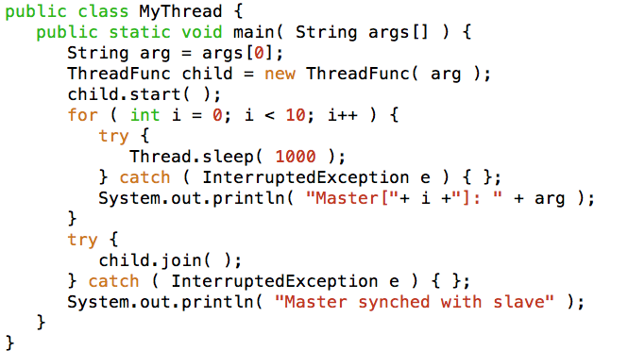
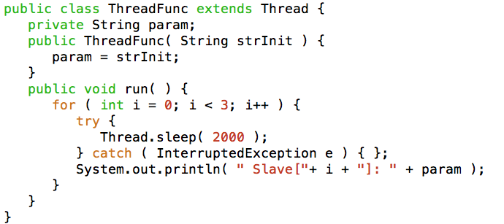
IDE Build Sample

Slide 35
SSH Keys
Checklist/Instructions
Change directory to your home “ssh” folder
Generate public and private key
Rename your public key file to something memorable
Copy the public key to the host’s ssh folder
Log in to the host and navigate to the ssh folder
APPEND! This public key to the end of the authorized_keys file
Log out and re-login to test
$ ssh uwnetid@uw1-320-lab.uwb.edu OR
$ ssh –l uwnetid uw1-320-lab.uwb.edu

Slide 36
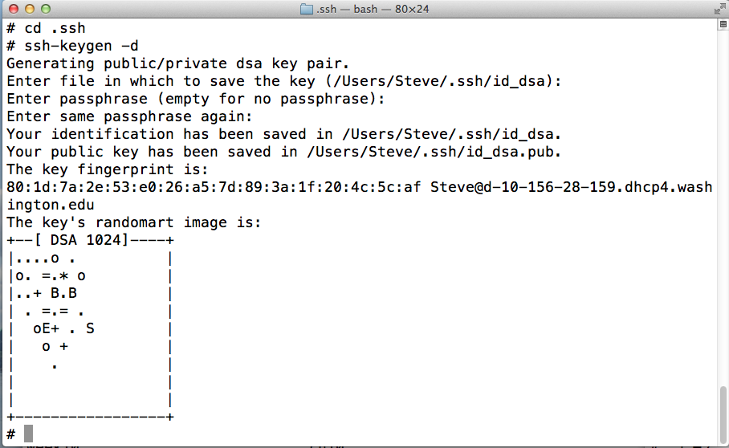
Generate with ssh-keygen
# ssh-keygen → RSA key
# ssh-keygen -d → DSA key
What’s the difference? CLICK

Slide 37
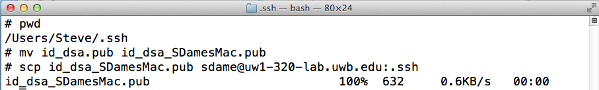
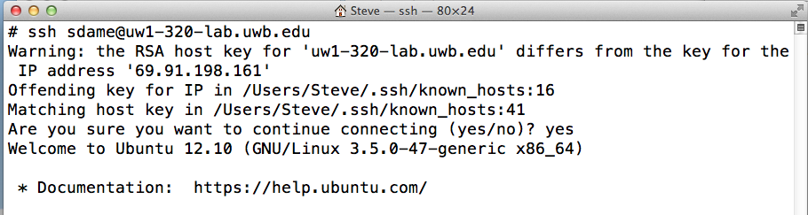
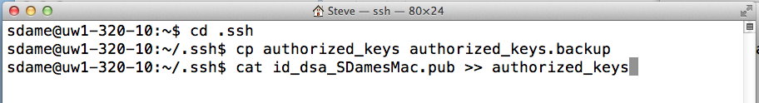
Copy public key to host
→ Voila!

