Slide 1
CSS430 Deadlocks Textbook Chapter 7
Instructor: Stephen G. Dame
e-mail: sdame@uw.edu
These slides were adapted from the OSC textbook slides (Silberschatz, Galvin, and Gagne), Professor Munehiro Fukuda and the instructor’s class materials.

Slide 2
WKP 17
“The competent programmer is fully aware of the strictly limited size of his own skull; therefore he approaches the programming task in full humility, and among other things he avoids clever tricks like the plague.”
- Edsger Dijkstra

Slide 3
Deadlock Examples 1
Kansas Legislature: “when two trains approach each other at a crossing, both shall come to a full stop and neither shall start up again until the other has gone.”
Two processes exchange a long message with each other, but their socket buffer
is smaller than the message.
Process
A
Process
B
message
message
Socket
buffer
Socket
buffer

Slide 4
Deadlock Examples 2
Bridge crossing example: traffic only in one direction where two cars are driving from the opposite direction. A deadlock is not resolved unless one gets back up.
Two processes try to go into the same nested critical section in a different order.
P₀ P₁
wait (A); wait(B)
wait (B); wait(A)

Slide 5
System Model
Resource types R₁, R₂, . . ., R_{m}
CPU cycles, memory space, I/O devices
Each resource type R_{i} has W_{i} instances
Each process utilizes a resource as follows:
request
use
release

Slide 6
Deadlock Characterization
Deadlock can arise if four conditions hold simultaneously:
Mutual exclusion: only one process at a time can use a resource.
Hold and wait: a process holding resource(s) is waiting to acquire additional resources held by other processes.
No preemption: a resource can be released only voluntarily by the process holding it upon its task completion.
Circular wait: there exists a set {P₀, P₁, …, P₀} of waiting processes such that P₀ is waiting for a resource that is held by P₁, P₁ is waiting for a resource that is held by P₂, …, P_{n–1} is waiting for a resource that is held by P_{n}, and P_{n} is waiting for a resource that is held by P₀.

Slide 7
Resource-Allocation Graph
A set of vertices V and a set of edges E
V is partitioned into two types:
P = {P₁, P₂, …, P_{n}}, the set consisting of all the processes in the system
R = {R₁, R₂, …, R_{m}}, the set consisting of all resource types in the system
request edge – directed edge P_{i} → R_{j}
assignment edge – directed edge R_{j} → P_{i}
P_{i}
R_{j}

Slide 8
Resource-Allocation Graph
Process
Resource Type with 4 instances
P_{i} requests instance of R_{j}
P_{i} is holding an instance of R_{j}
P_{i} releases an instance of R_{j}
P_{i}
R_{j}
P_{i}
Request edge
Sequence of
process resource
utilization
P_{i}
Assignment edge
P_{i}

Slide 9
Resource-Allocation Graph
R₁
R₃
CYCLE 1
P₁
YES!
P₂
P₃
R₂
Is deadlock possible?
R₄

Slide 10
Resource-Allocation Graph
R₁
R₃
P₁
P₂
YES!
P₃
CYCLE 2
R₂
R₄

Slide 11
Resource Allocation Graph With A Cycle But No Deadlock
P₂
If graph contains no cycles ⇒ no deadlock.
If graph contains a cycle ⇒
if only one instance per resource type, then deadlock.
if several instances per resource type, possibility of deadlock.
P₃
P₁
P₃

Slide 12
Methods for Handling Deadlocks
Ensure that the system will never enter a deadlock state. (Prevention and Avoidance)
Allow the system to enter a deadlock state and then recover. (Detection and Recovery)
Ignore the problem and pretend that deadlocks never occur in the system; used by most operating systems, including UNIX.

Slide 13
Deadlock Prevention
Restrain one of the following four conditions:
Mutual Exclusion – not required for sharable resources. (but not work always.)
Hold and Wait – must guarantee that whenever a process requests a resource, it does not hold any other resources.
Require a process to request and be allocated all its resources before its execution: Low resource utilization
Allow process to request resources only when the process has none: starvation possible.
No Preemption –
If a process holding some resources requests another resource that cannot be immediately allocated to it, all resources currently being held are released.
If a process P1 requests a resource R1 that is allocated to some other process P2 waiting for additional resource R2, R1 is allocated to P1.
Circular Wait – impose a total ordering of all resource types, and require that each process requests resources in an increasing order of enumeration.

Slide 14
Deadlock Prevention Circular Wait
Each process can request resources only in an increasing order of enumeration.
P₄
Not allowed Order(tape)=1 < Order(printer)=4
tape
disk
2
scanner
3
printer
4
1
P₁
P₂
P₃

Slide 15
Safe State
When a process requests an available resource, system must decide if immediate allocation leaves the system in a safe state.
System is in safe state if there exists a sequence
<P₁, P₂, …, P_{n}>
of ALL the processes in the systems such that for each P_{i}, the resources that P_{i} can still request can be satisfied by currently available resources + resources held by all the P_{j}, with j < i
That is:
If P_{i} resource needs are not immediately available, then P_{i} can wait until all P_{j} have finished.
When P_{j} is finished, P_{i} can obtain needed resources, execute, return allocated resources, and terminate.
When P_{i} terminates, P_{i +1} can obtain its needed resources, and so on.
A system is in a safe state only if there exists a only if there exists a safe sequence.

Slide 16
Basic Facts
If a system is in safe state ⇒ no deadlocks
If a system is in unsafe state ⇒ possibility of deadlock
Avoidance ⇒ ensure that a system will never enter an unsafe state.

Slide 17
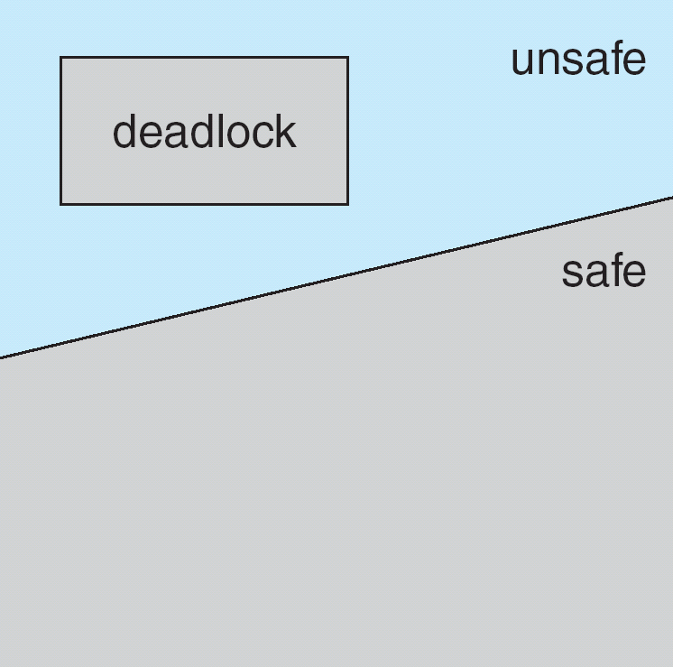
Safe, Unsafe , Deadlock State

Slide 18
Avoidance algorithms
Single instance of a resource type
Use a resource-allocation graph
Multiple instances of a resource type
Use the banker’s algorithm

Slide 19
Resource-Allocation Graph Scheme
Claim edge P_{i} → R_{j} indicated that process P_{j} may request resource R_{j}; represented by a dashed line
Claim edge converts to request edge when a process requests a resource
Request edge converted to an assignment edge when the resource is allocated to the process
When a resource is released by a process, assignment edge reconverts to a claim edge
Resources must be claimed a priori in the system

Slide 20
Resource-Allocation Graph
R₁
P₁
P₂
R₂

Slide 21
Unsafe State In Resource-Allocation Graph
R₁
P₁
P₂
R₂

Slide 22
Resource-Allocation Graph Algorithm
Suppose that process P_{i} requests a resource R_{j}
The request can be granted only if converting the request edge to an assignment edge does not result in the formation of a cycle in the resource allocation graph

Slide 23
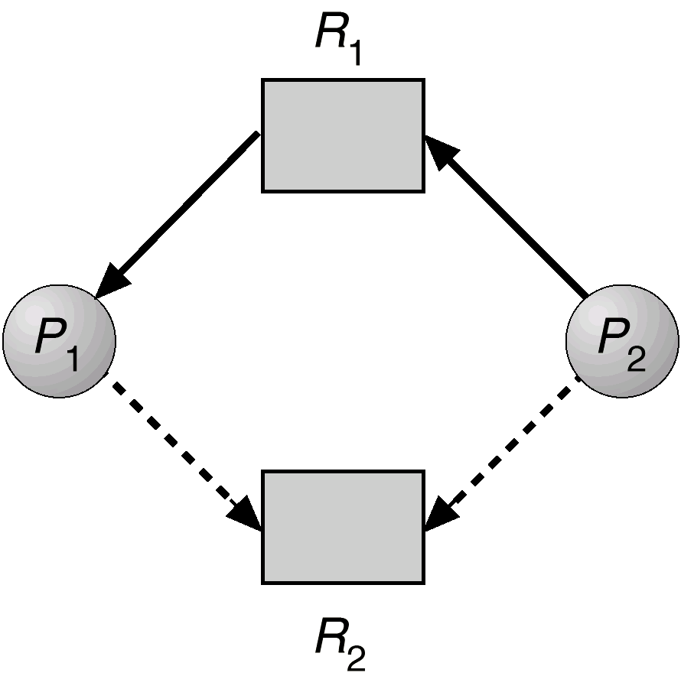
Deadlock Avoidance Resource-Allocation Algorithm
Processes supply OS with
future resource requests
Cycle possibly formed (unsafe state),
thus P2 has to wait for a safe state
Claim edge (future request)
Works only with single instance resource types.

Slide 24
Deadlock Avoidance Banker’s Algorithm - Definitions
Multiple resource instances
Each process must a priori claim maximum use
When a process requests a resource it may have to wait
When a process gets all its resources it must return them in a finite amount of time

Slide 25
Deadlock Avoidance Banker’s Algorithm - Definitions
Let n = number of processes, and m = number of resources types.
Available – Vector of length m indicates the number of available resources of each type. If Available[ j] = k, then k instances of resource type R_{j} are available.
Max : n × m matrix. Deﬁnes the maximum demand of each process. If Max[i,j] = k, then process P_{i} may request at most k instances of resource type R_{j}.
Allocation : n × m matrix. Deﬁnes the number of resources of each type currently allocated to each process. If Allocation[i,j] = k, then process P_{i} is currently allocated k instances of resource type R_{j}.
Need : n × m matrix. Indicates the remaining resource need of each process. If Need[i,j] = k, then process P_{i} may need k more instances of resource type R_{j} to complete its task. Note that
Need[i,j] = Max[i,j] − Allocation[i,j]

Slide 26
Safety Algorithm
1. Let Work and Finish be vectors of length m and n, respectively. Initialize:
Work = Available
Finish [i] = false for i = 0, 1, …, n- 1
2. Find an i such that both:
(a) Finish[i] = false
(b) Need_{i} ≤ Work
If no such i exists, go to step 4
3. Work = Work + Allocation Finish[i] = true go to step 2
4. If Finish [i] == true for all i, then the system is in a safe state

Slide 27
Resource-Request Algorithm for Process P_{i}
Request = request vector for process P_{i}. If Request_{i} [j] = k then process P_{i} wants k instances of resource type R_{j}
1. If Request_{i}  Need_{i} go to step 2. Otherwise, raise error condition, since process has exceeded its maximum claim
2. If Request_{i}  Available, go to step 3. Otherwise P_{i} must wait, since resources are not available
Pretend to allocate requested resources to Pi by modifying the state as follows:
Available = Available – Request;
Allocation_{i} = Allocation_{i} + Request_{i};
Need_{i} = Need_{i} – Request_{i}
If safe  the resources are allocated to P_{i}
If unsafe  P_{i} must wait, and the old resource-allocation state is restored

Slide 28
Deadlock Avoidance Banker’s Algorithm
5 processes P0 through P4
Each process must claim Max use in advance.
Resource Types: A (10 instances), B (5instances), and C (7 instances)
Process | Allocation | Max | Need | Initial | Avail
 | A B C | A B C | A B C | A B C | A B C
P0 | 0 1 0 | 7 5 3 | 7 4 3 | 10 5 7 | 3 3 2
P1 | 2 0 0 | 3 2 2 | 1 2 2
P2 | 3 0 2 | 9 0 2 | 6 0 0
P3 | 2 1 1 | 2 2 2 | 0 1 1
P4 | 0 0 2 | 4 3 3 | 4 3 1
Snapshot at time T₀:

Slide 29
Deadlock Avoidance Banker’s Algorithm – P₁ Request (1 0 2)
Check that Request  Available (that is, (1 0 2)  (3 3 2)  true
Execute safety algorithm shows that sequence < P1, P3, P4, P0, P2> satisfies safety requirement
Process | Allocation | Max | Need | Initial | Avail
 | A B C | A B C | A B C | A B C | A B C
P0 | 0 1 0 | 7 5 3 | 7 4 3 | 10 5 7 | 2 3 0
P1 | 3 0 2 | 3 2 2 | 1 2 2
P2 | 3 0 2 | 9 0 2 | 6 0 0
P3 | 2 1 1 | 2 2 2 | 0 1 1
P4 | 0 0 2 | 4 3 3 | 4 3 1
Snapshot at time T₁:

Slide 30
Deadlock Avoidance Banker’s Algorithm – P₄ Request (3 3 0)
Check that Request  Available (that is, (3 3 0)  (3 3 2)  true
Process | Allocation | Max | Need | Initial | Avail
 | A B C | A B C | A B C | A B C | A B C
P0 | 0 1 0 | 7 5 3 | 7 4 3 | 10 5 7 | 0 0 2
P1 | 2 0 0 | 3 2 2 | 1 2 2
P2 | 3 0 2 | 9 0 2 | 6 0 0
P3 | 2 1 1 | 2 2 2 | 0 1 1
P4 | 3 3 2 | 4 3 3 | 4 3 1
Snapshot at time T₁:

Slide 31
Deadlock Avoidance Banker’s Algorithm – P₀ Request (4 3 0)
Check that Request  Available (that is, (4 3 0)  (3 3 2)  false
Process | Allocation | Max | Need | Initial | Avail
 | A B C | A B C | A B C | A B C | A B C
P0 | 0 1 0 | 7 5 3 | 7 4 3 | 10 5 7 | 3 3 2
P1 | 2 0 0 | 3 2 2 | 1 2 2
P2 | 3 0 2 | 9 0 2 | 6 0 0
P3 | 2 1 1 | 2 2 2 | 0 1 1
P4 | 0 0 2 | 4 3 3 | 4 3 1
Snapshot at time T₁:

Slide 32
Deadlock Detection
Allow system to enter deadlock state
Detection algorithm
Recovery scheme

Slide 33
Single Instance of Each Resource Type
Maintain wait-for graph
Nodes are processes
P_{i}  P_{j} if P_{i} is waiting for P_{j}
Periodically invoke an algorithm that searches for a cycle in the graph. If there is a cycle, there exists a deadlock
An algorithm to detect a cycle in a graph requires an order of n² operations, where n is the number of vertices in the graph

Slide 34
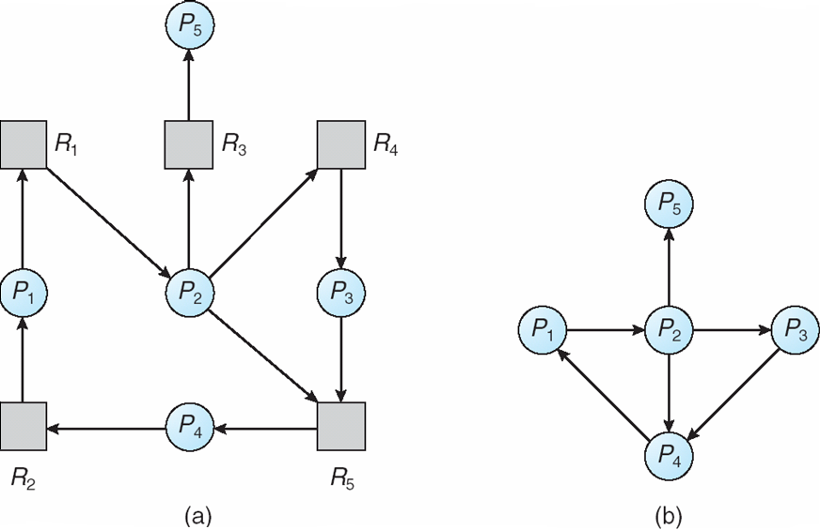
Resource-Allocation Graph and Wait-for Graph
Resource-Allocation Graph
Corresponding wait-for graph

Slide 35
Several Instances of a Resource Type
Available: A vector of length m indicates the number of available resources of each type.
Allocation: An n x m matrix defines the number of resources of each type currently allocated to each process.
Request: An n x m matrix indicates the current request of each process. If Request [i_{j}] = k, then process P_{i} is requesting k more instances of resource type. R_{j}.

Slide 36
Detection Algorithm
1. Let Work and Finish be vectors of length m and n, respectively Initialize:
(a) Work = Available
(b) For i = 1,2, …, n, if Allocation_{i} ≠ 0, then Finish[i] = false;otherwise, Finish[i] = true
2. Find an index i such that both:
(a) Finish[i] == false
(b) Request_{i} ≤ Work
If no such i exists, go to step 4
3. Work = Work + Allocation_{i} Finish[i] = true go to step 2
4. If Finish[i] == false, for some i, 1 ≤ i ≤ n, then the system is in deadlock state. Moreover, if Finish[i] == false, then P_{i} is deadlocked
This algorithm requires an order of O(m x n²⁾ operations to detect whether the system is in deadlocked state.

Slide 37
Detection Algorithm Example
Five processes P₀ through P₄;
Three resources types A (7 instances), B (2 instances), and C (6 instances)
Sequence <P0, P2, P3, P1, P4> will result in Finish[ i ] = true for all i
Process | Allocation | Request | Available
 | A B C | A B C | A B C
P0 | 0 1 0 | 0 0 0 | 0 0 0
P1 | 2 0 0 | 2 0 2
P2 | 3 0 3 | 0 0 0
P3 | 2 1 1 | 1 0 0
P4 | 0 0 2 | 0 0 2
Snapshot at time T₀

Slide 38
Example (Cont.)
P₂ requests an additional instance of type C
State of system?
Can reclaim resources held by process P₀, but insufficient resources to fulfill other processes; requests
Deadlock exists, consisting of processes P₁, P₂, P₃, and P₄
Process | Request
 | A B C
P0 | 0 0 0
P1 | 2 0 1
P2 | 0 0 1
P3 | 1 0 0
P4 | 0 0 2

Slide 39
Detection-Algorithm Usage
When, and how often, to invoke depends on:
How often a deadlock is likely to occur?
How many processes will need to be rolled back?
one for each disjoint cycle
If detection algorithm is invoked arbitrarily, there may be many cycles in the resource graph and so we would not be able to tell which of the many deadlocked processes “caused” the deadlock.

Slide 40
Recovery from Deadlock: Process Termination
Abort all deadlocked processes
Abort one process at a time until the deadlock cycle is eliminated
In which order should we choose to abort?
Priority of the process
How long process has computed, and how much longer to completion
Resources the process has used
Resources process needs to complete
How many processes will need to be terminated
Is process interactive or batch?

Slide 41
Recovery from Deadlock: Resource Preemption
Selecting a victim – minimize cost
Rollback – return to some safe state, restart process for that state
Starvation – same process may always be picked as victim, include number of rollback in cost factor

Slide 42
Exercises (No turn-in)
Why aren’t deadlock detection and recovery so attractive?
Solve Exercise 7.3, 7.6, 7.9, 7.10, 7.14, and 7.19
Can the Java code in the next slide cause a deadlock? If so, write a resource allocation graph with a deadlock.

Slide 43
public class Deadlock {
public Deadlock( ) {
Mutex mutex[] = new Mutex[4];
for ( int i = 0; i < 4; i++ )
mutex[i] = new Mutex( );
A threadA = new A( mutex );
B threadB = new B( mutex );
C threadC = new C( mutex );
threadA.start( );
threadB.start( );
threadC.start( );
}
public static void main( String arg[] ) {
Deadlock d = new Deadlock( );
}
class Mutex{ }
private class A extends Thread
{
private Mutex[] resource;
public A( Mutex[] m ) {
resource = m;
}
public void run( ) {
System.out.println( "A started" );
synchronized ( resource[1] ) {
System.out.println( "A got rsc 1" );
synchronized ( resource[0] ) {
System.out.println( "A got rsc 0" );
}
}
System.out.println( "A finished" );
}
}
private class B extends Thread
{
private Mutex[] resource;
public B( Mutex[] m ) {
resource = m;
}
public void run( ) {
System.out.println( "B started" );
synchronized ( resource[3] ) {
System.out.println( "B got rsc 3" );
synchronized ( resource[0] ) {
System.out.println( "B got rsc 0" );
synchronized ( resource[2] ) {
System.out.println( "B got rsc 2" );
}
}
}
System.out.println( "B finished" );
}
}
private class C extends Thread
{
private Mutex[] resource;
public C( Mutex[] m ) {
resource = m;
}
public void run( ) {
System.out.println( "C started" );
synchronized ( resource[2] ) {
System.out.println( "C got rsc 2" );
synchronized ( resource[1] ) {
System.out.println( "C got rsc 1" );
}
}
System.out.println( "C finished" );
}
}
}

