Slide 1
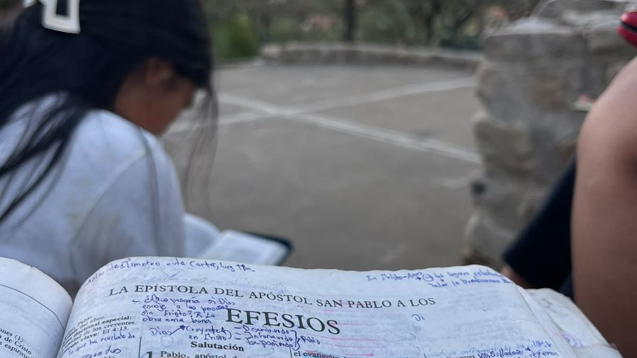
The Message Has Always Been One
Jesus Christ at the center
Notes:
Imagine opening the Bible tomorrow morning and discovering that something you have believed for twenty years is wrong.
What would you do?
Would you change your mind?
Or would you start looking for someone who could explain why you don’t have to?
*[Pause.]*
That question is easy to answer when we’re thinking about somebody else. We all know somebody who needs to reconsider a few things. Some of us could provide a list.
But leave their names off it for a moment.
What about me? What about you?
[CLICK → begin the presentation]

Slide 2

Which voice has authority?
Confident answers still need a foundation
02
Notes:
We live in a world where answers arrive faster than we can examine them. Type a question into a search engine, and the screen fills up. Ask AI, and an answer appears, polished, organized, and remarkably sure of itself.
But a confident answer still needs a foundation. Where did it come from? What supports it? Why should we believe it?
All day, voices ask for our trust. A teacher explains. A scientist reports a discovery. A news presenter tells us what happened. A podcast host tells us what it means. Politicians make promises. Religious leaders speak about God. Friends share posts. Family members say, “Trust me. I’ve been there.”
And somewhere in that crowd, our own feelings speak up: “Well, I just feel that it’s true.”
Some of these voices deserve careful attention. They do not all have the same expertise, and their claims do not all have the same support. We need to examine them. Just because someone on Youtube has 255K followers does not make them a trustworthy source.
Yet sometimes we accept an idea simply because it sounds familiar. We have heard it often. We like the person who said it. Or it fits what we already wanted to believe.
[CLICK → reveal: “Familiarity, sincerity, and offense cannot make a belief true”]

Slide 3
Which voice has authority?
Confident answers still need a foundation
Familiarity, sincerity, and offense cannot make a belief true
02
Notes:
Then somebody questions it, and we discover how attached we have become.
“Here’s what I think” becomes “How dare you disagree?”
We begin defending ourselves before we have examined the claim.
But being offended cannot make us right. Neither can being sincere. A belief can be deeply comforting and still be mistaken.
That matters when we’re discussing ordinary things. It matters profoundly when we’re asking about God, our standing before Him, and what lies beyond death.
When the voices disagree, which voice has the authority to correct the others?
[CLICK → reveal: “If God’s Word challenges me, am I willing to be corrected?”]

Slide 4
Which voice has authority?
Confident answers still need a foundation
Familiarity, sincerity, and offense cannot make a belief true
If God’s Word challenges me, am I willing to be corrected?
02
Notes:
And why should Scripture have that authority?
Today, I want us to listen to what Scripture claims and follow the connections its writers make. Watch how Jesus speaks about Moses, the Prophets, and the Psalms. Watch how Peter explains David and Isaiah. Watch how Paul reaches back to Abraham to explain the gospel.
You will hear different voices, speaking in different settings, directing our attention to the same Person.
Many books. One message. Jesus Christ at its center.
And as we listen, keep that opening question with you: **If God’s Word challenges what I believe, am I willing to be corrected?**
[CLICK → advance to the next slide]

Slide 5

The Scriptures testify about Christ
God spoke through the prophets and through His Son
03
Notes:
Hebrews 1:1–2 tells us that God spoke through the prophets and has now spoken through His Son. The God Scripture reveals communicates. He makes Himself known. He reveals our need and what He has provided through Jesus Christ.
If Scripture is His written revelation, its authority rests on the One who speaks through it. That claim deserves to be examined seriously. Calling a book authoritative does not settle every question about it. But we cannot assess its claim fairly without listening to what it actually says.
So begin with Jesus.
In John 5:39, He tells His hearers:
[CLICK → reveal: “Jesus says the Scriptures testify about Him”]

Slide 6
The Scriptures testify about Christ
God spoke through the prophets and through His Son
Jesus says the Scriptures testify about Him
03
Notes:
> “You search the Scriptures, because you think that in them you have eternal life; and these are they which testify about me.”
Then He adds:
> “Yet you will not come to me, that you may have life.”
Think about that. These people searched the Scriptures. Yet Jesus said they were refusing the very Person those Scriptures revealed.
[CLICK → reveal: “Knowledge of the words must lead us to Christ for life”]

Slide 7
The Scriptures testify about Christ
God spoke through the prophets and through His Son
Jesus says the Scriptures testify about Him
Knowledge of the words must lead us to Christ for life
03
Notes:
It is possible to become familiar with the words and resist their testimony.
We can know where a passage is found, discuss its meaning, perhaps even win an argument about it, while refusing to come to Christ for life.
Imagine studying a road sign so carefully that you never travel to the place it points to. You measure it, admire it, memorize it—and remain where you were.
Jesus says the Scriptures testify about Him. Their testimony calls for a response to Him.
[CLICK → advance to the next slide]

Slide 8
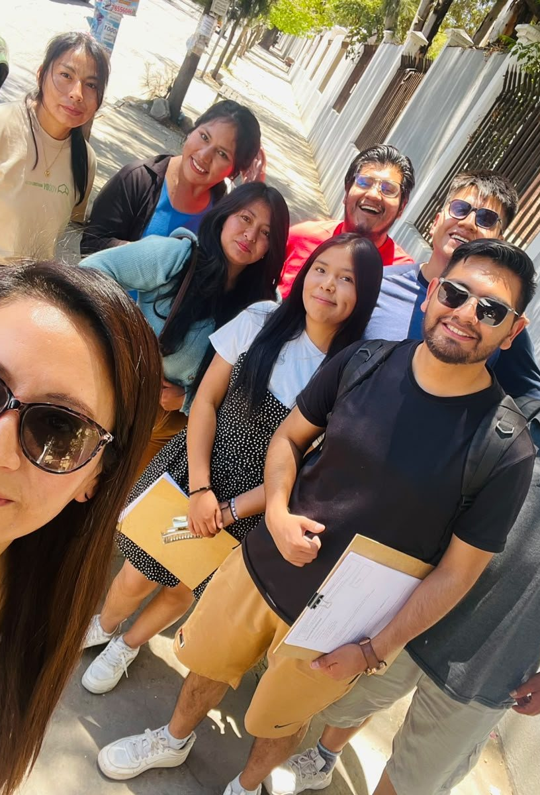
Come and receive life
Jesus is the root and offspring of David
04
Notes:
Now turn from John’s Gospel to the end of the Bible.
In Revelation 22:16, Jesus says:
> “I am the root and the offspring of David, the Bright and Morning Star.”
[CLICK → reveal: “The thirsty are invited to come”]

Slide 9
Come and receive life
Jesus is the root and offspring of David
The thirsty are invited to come
04
Notes:
Even here, on the Bible’s closing pages, He connects His identity to David and the promises recorded earlier.
Then comes the invitation:
> “He who is thirsty, let him come. He who desires, let him take the water of life freely.”
[CLICK → reveal: “The water of life is offered freely”]

Slide 10
Come and receive life
Jesus is the root and offspring of David
The thirsty are invited to come
The water of life is offered freely
04
Notes:
Freely.
Let that word have its weight. The thirsty person is invited to receive.
John records Jesus calling people to come to Him for life. Revelation closes with the invitation to take the water of life freely. The question presses upon us: Have we come to the One these words reveal?
[CLICK → advance to the next slide]

Slide 11
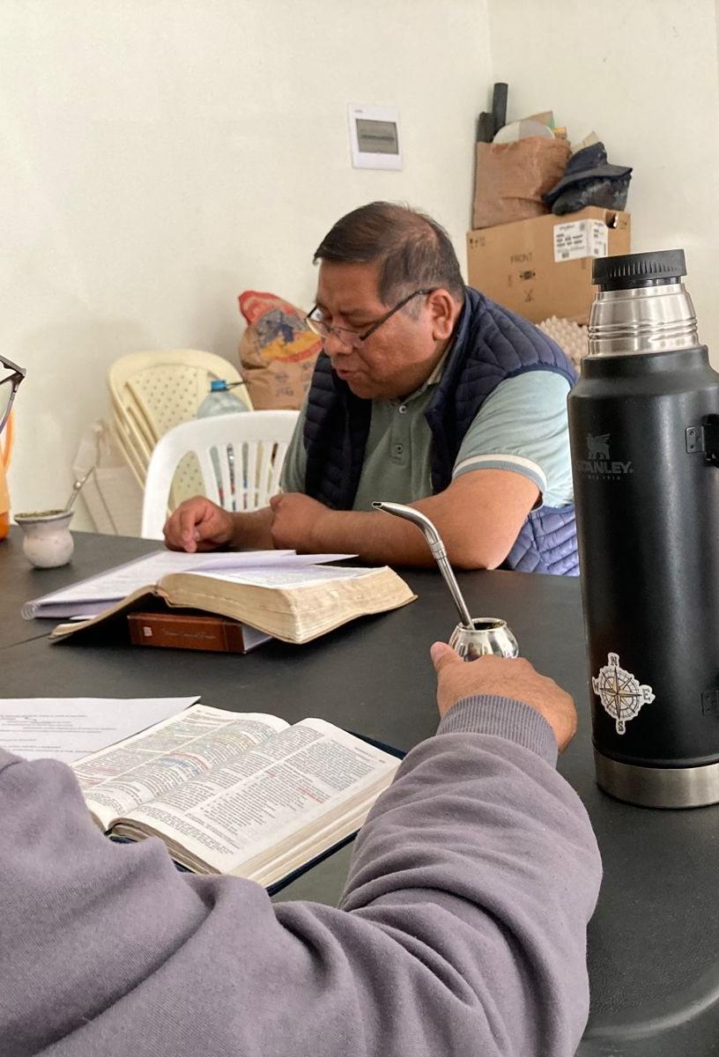
Jesus explains the connection
Moses, the Prophets, and the Psalms speak concerning Christ
05
Notes:
After His resurrection, Jesus gives His disciples an extraordinary explanation of their Scriptures.
Luke 24:27 says:
> “Beginning from Moses and from all the prophets, he explained to them in all the Scriptures the things concerning himself.”
Later, in verse 44, He says:
[CLICK → reveal: “The Christ would suffer and rise on the third day”]

Slide 12
Jesus explains the connection
Moses, the Prophets, and the Psalms speak concerning Christ
The Christ would suffer and rise on the third day
05
Notes:
> “All things which are written in the law of Moses, the prophets, and the psalms concerning me must be fulfilled.”
Notice where Jesus takes them. Back to the Scriptures they already possessed.
What did those Scriptures anticipate?
[CLICK → reveal: “Repentance and forgiveness would be proclaimed to all nations”]

Slide 13
Jesus explains the connection
Moses, the Prophets, and the Psalms speak concerning Christ
The Christ would suffer and rise on the third day
Repentance and forgiveness would be proclaimed to all nations
05
Notes:
He explains in verses 46–48: the Christ would suffer, rise from the dead on the third day, and repentance and forgiveness of sins would be proclaimed in His name to all nations. The disciples were witnesses of these things.
Suffering. Resurrection. Forgiveness proclaimed to the nations.
Jesus gives us the direction to follow. So let’s return to Genesis and ask why humanity needs the forgiveness and life He brings.
[CLICK → advance to the next slide]

Slide 14
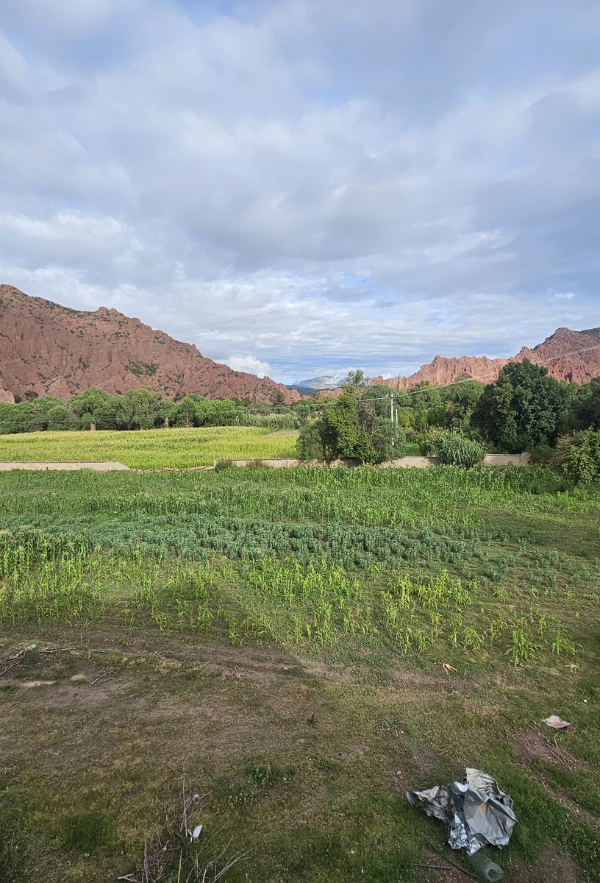
Two voices in the garden
God gives life, dignity, and a generous command
06
Notes:
“In the beginning, God created the heavens and the earth.”
That is where Genesis begins. God creates. Humanity bears His image, male and female. God looks upon everything He has made and declares it very good. (Genesis 1:1, 27, 31.)
Before we hear about human rebellion, we hear about human dignity. We belong to our Creator. Our life comes from Him.
Genesis 2:7 describes God forming man from the dust and breathing into him the breath of life. Then God places the man in the garden and speaks to him.
Listen to how His command begins:
[CLICK → reveal: “God warns that rebellion brings death”]

Slide 15
Two voices in the garden
God gives life, dignity, and a generous command
God warns that rebellion brings death
06
Notes:
> “You may freely eat of every tree of the garden.”
Generosity comes first. Then God identifies the forbidden tree and gives the warning:
> “In the day that you eat of it, you will surely die.”
In Genesis 3, another voice speaks:
> “You won’t really die.”
[CLICK → reveal: “The serpent directly contradicts God’s word”]

Slide 16
Two voices in the garden
God gives life, dignity, and a generous command
God warns that rebellion brings death
The serpent directly contradicts God’s word
06
Notes:
There it is. A direct contradiction.
God says one thing. The serpent says another. The serpent also questions God’s motives, suggesting that God is withholding something desirable: their eyes will be opened, and they will be like God, knowing good and evil. (Genesis 3:4–5.)
The question of authority is already before us, here in the garden. Whose word will they trust?
God had said, “In the day that you eat of it, you will surely die.”
The serpent said, “You won’t really die.”
[CLICK → advance to the next slide]

Slide 17
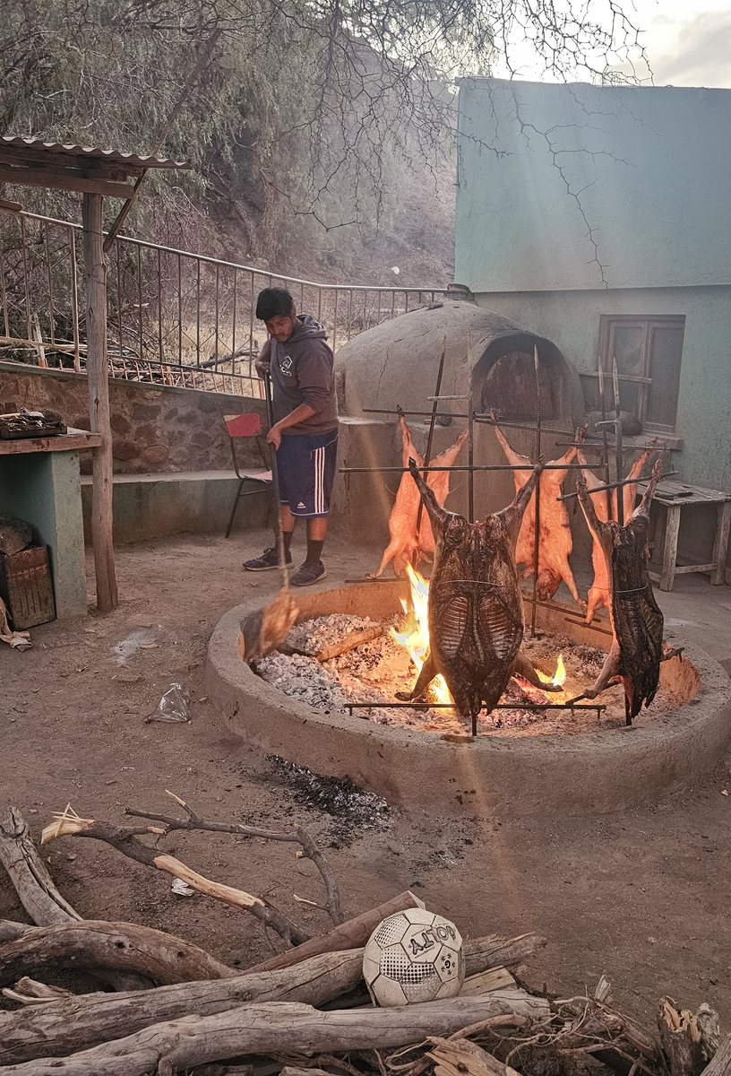
Sin brings death
Guilt and fear reveal a broken relationship with God
07
Notes:
Adam and Eve ate—and they were still breathing. If God’s warning referred only to immediate physical death, that would seem to support the serpent’s claim.
But look at what happened.
They hid. They were afraid. When God confronted them, they shifted the blame. The people He had created for fellowship with Himself were now trying to escape His presence.
They were physically alive, but spiritually dead. Their guilt, fear, and condemnation revealed the rupture sin had brought into their relationship with God. Spiritual death had taken place that very day.
*[Pause.]*
That is a sobering thought: a person can be breathing, speaking, and going about life while spiritually dead before God.
[CLICK → reveal: “Sin and death entered the world through Adam”]

Slide 18
Sin brings death
Guilt and fear reveal a broken relationship with God
Sin and death entered the world through Adam
07
Notes:
Physical death would follow. God told Adam, “For you are dust, and you shall return to dust.” Their eventual return to the ground would be another consequence of their rebellion.
The serpent had lied. Sin had brought death, even though Adam and Eve had not immediately stopped breathing.
*[Pause.]*
Now listen to Paul explain why this account concerns us.
Romans 5:12 says that sin entered the world through one man, and death through sin, and death passed to all because all sinned.
Paul traces our predicament back to Adam. But he also points us to Jesus Christ.
[CLICK → reveal: “Grace, righteousness, and reconciliation come through Jesus Christ”]

Slide 19
Sin brings death
Guilt and fear reveal a broken relationship with God
Sin and death entered the world through Adam
Grace, righteousness, and reconciliation come through Jesus Christ
07
Notes:
Romans 5:17 says that those who receive the abundance of grace and the gift of righteousness will reign in life through Jesus Christ.
Notice the language: **receive**. **Grace**. **Gift**.
Earlier in that chapter, Paul says that we were reconciled to God through the death of His Son, and that through Jesus Christ we have received reconciliation. (Romans 5:10–11.)
His explanation of salvation reaches back to the beginning. Humanity’s sin and death provide the setting in which we understand Christ’s death and the life He gives.
If we reduce our problem to needing a few improvements, we will underestimate what Christ came to accomplish. Paul speaks of people who need reconciliation with God and deliverance from the reign of death.
That is the depth of our need. And that is where God’s grace meets us.
[CLICK → advance to the next slide]

Slide 20
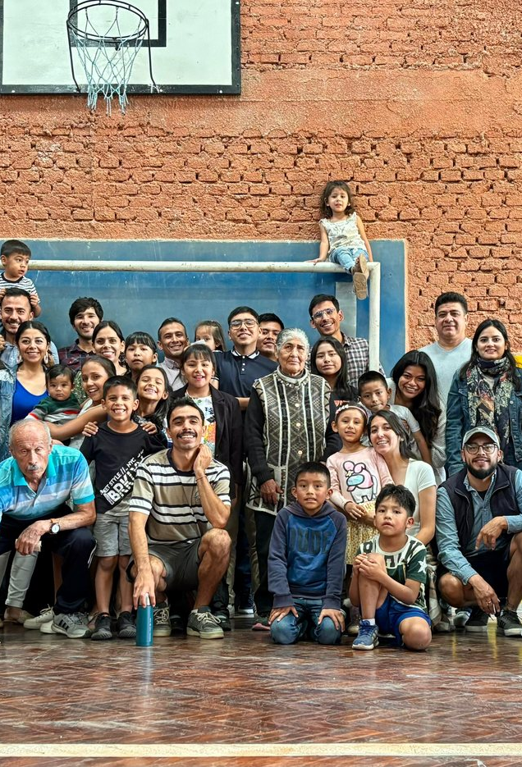
A promise for all nations
The serpent’s head would be bruised
08
Notes:
Return to Genesis 3. Alongside the judgment, God speaks to the serpent:
> **“He will bruise your head, and you will bruise his heel.”**
There is conflict ahead, but also the promise of a blow to the serpent’s head. Who will this offspring be? Genesis does not yet name Him. Let’s keep listening as Scripture unfolds.
[CLICK → reveal: “All families of the earth would be blessed through Abraham”]

Slide 21
A promise for all nations
The serpent’s head would be bruised
All families of the earth would be blessed through Abraham
08
Notes:
Later, God tells Abraham:
> **“All the families of the earth will be blessed through you.”**
Then, in Genesis 22:18:
[CLICK → reveal: “The promise reaches beyond one people to every nation”]

Slide 22
A promise for all nations
The serpent’s head would be bruised
All families of the earth would be blessed through Abraham
The promise reaches beyond one people to every nation
08
Notes:
> **“All the nations of the earth will be blessed by your offspring, because you have obeyed my voice.”**
Think about the reach of that promise. God speaks to one man about a blessing that will extend to all the nations.
But what is this blessing? And who is the offspring through whom it will come?
[CLICK → advance to the next slide]

Slide 23
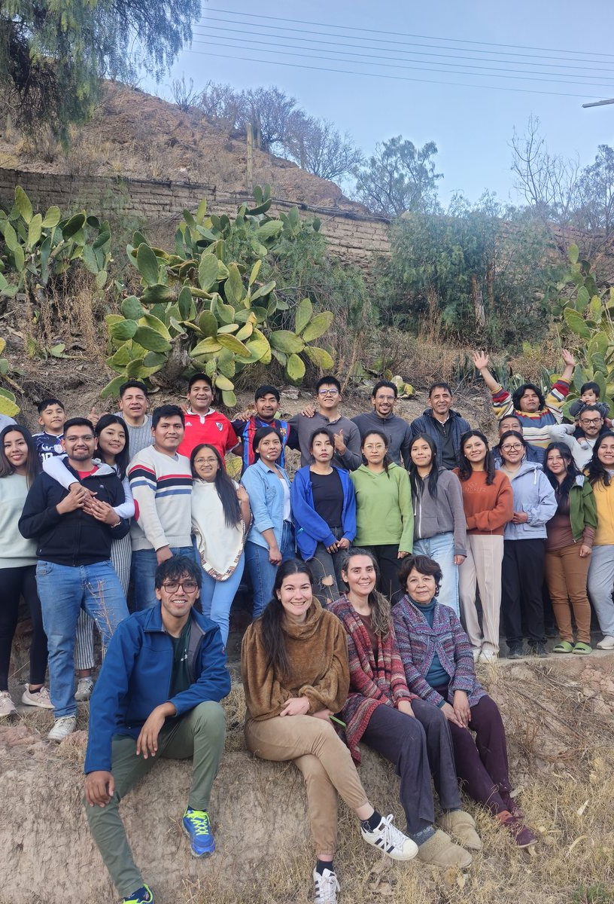
Christ is the promised offspring
Paul calls Abraham’s promise the gospel announced beforehand
09
Notes:
Listen to how Paul explains the promise in Galatians 3:8:
> **“The Scripture, foreseeing that God would justify the Gentiles by faith, preached the Good News beforehand to Abraham, saying, ‘In you all the nations will be blessed.’”**
*[Pause.]*
Paul calls that promise **the Good News—the gospel—preached beforehand to Abraham.**
That is a remarkable connection. As we read Genesis, we hear a promise of blessing. Paul explains that God was announcing beforehand that He would justify the Gentiles by faith—that people from the nations would be declared righteous before Him through faith.
[CLICK → reveal: “God justifies people from the nations by faith”]

Slide 24
Christ is the promised offspring
Paul calls Abraham’s promise the gospel announced beforehand
God justifies people from the nations by faith
09
Notes:
And who is the promised offspring?
Paul answers in verse 16:
> **“He doesn’t say, ‘To descendants’, as of many, but as of one, ‘To your offspring’, which is Christ.”**
Now the connection comes into focus. The blessing promised to Abraham reaches the nations through Jesus Christ.
[CLICK → reveal: “The promised offspring is Jesus Christ”]

Slide 25
Christ is the promised offspring
Paul calls Abraham’s promise the gospel announced beforehand
God justifies people from the nations by faith
The promised offspring is Jesus Christ
09
Notes:
Remember what we heard in Luke 24? Jesus said that repentance and forgiveness of sins would be proclaimed in His name **to all nations**.
Here, Paul takes us back to God’s promise to Abraham and shows us that this worldwide reach was already there.
We are beginning to see how these passages belong together. God gives the promise. Paul identifies it as the gospel announced beforehand and points to Christ as its fulfillment.
And that promise reaches far enough to include us.
[CLICK → advance to the next slide]

Slide 26
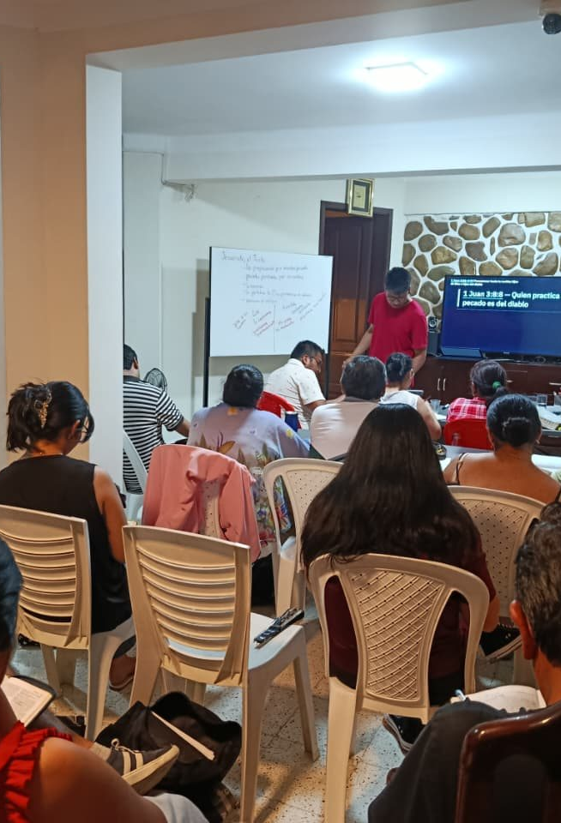
Moses and David bear witness
Moses promises a prophet whom the people must hear
10
Notes:
Next, listen to God’s promise through Moses in Deuteronomy 18:18–19. God will raise up a prophet from among the people, put His words in that prophet’s mouth, and hold people responsible for listening.
In Acts 3, Peter quotes that promise while proclaiming Jesus:
> “You shall listen to him in all things whatever he says to you.”
Then Peter brings Abraham into the same explanation, recalling the promised blessing for all families of the earth. He tells his hearers that God sent His servant Jesus to bless them by turning them from their wickedness. (Acts 3:22, 25–26.)
Moses. Abraham. Jesus.
[CLICK → reveal: “Peter identifies Jesus as the One God sent”]

Slide 27
Moses and David bear witness
Moses promises a prophet whom the people must hear
Peter identifies Jesus as the One God sent
10
Notes:
Peter connects them in his proclamation. The promised blessing carries a claim upon those who hear: listen to the One God has sent.
Now listen to David.
In Psalm 16:10, he writes:
> “For you will not leave my soul in Sheol, neither will you allow your holy one to see corruption.”
[CLICK → reveal: “David speaks ahead of Christ’s resurrection”]

Slide 28
Moses and David bear witness
Moses promises a prophet whom the people must hear
Peter identifies Jesus as the One God sent
David speaks ahead of Christ’s resurrection
10
Notes:
What does that mean? Peter addresses it in Acts 2:30–32. David was a prophet who knew God’s oath concerning a descendant who would sit on his throne. Peter explains that David spoke ahead of Christ’s resurrection.
Then Peter announces:
> “This Jesus God raised up, to which we all are witnesses.”
A promise in the Psalms. Its fulfillment proclaimed in Acts. And witnesses declaring that God raised Jesus from the dead.
[CLICK → advance to the next slide]

Slide 29
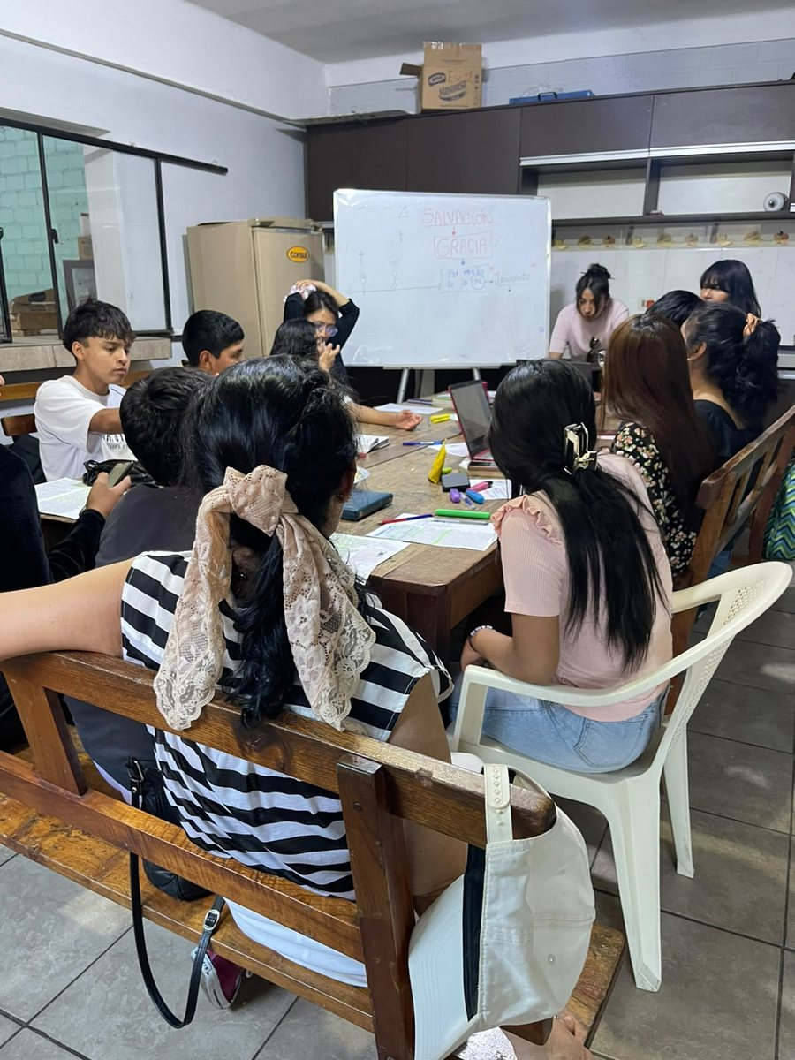
The servant bears our sin
He was pierced for our transgressions
11
Notes:
Now we come to Isaiah.
Isaiah 52:13 introduces God’s servant as one who will act wisely and be exalted. Then chapter 53 asks:
> “Who has believed our message?”
That question belongs in this speech. A message can be heard and still be rejected. What is the message Isaiah asks people to believe?
[CLICK → reveal: “The punishment that brought our peace was on Him”]

Slide 30
The servant bears our sin
He was pierced for our transgressions
The punishment that brought our peace was on Him
11
Notes:
Listen to verses 5–6:
> “But he was pierced for our transgressions.
> He was crushed for our iniquities.
> The punishment that brought our peace was on him;
> and by his wounds we are healed.
>
> All we like sheep have gone astray.
> Everyone has turned to his own way;
> and Yahweh has laid on him the iniquity of us all.”
Listen to the pronouns. He was pierced. Our transgressions. He was crushed. Our iniquities. The punishment was on Him. The peace comes to us.
The servant bears the consequences of other people’s sins.
[CLICK → reveal: “The innocent servant bears the iniquity of many”]

Slide 31
The servant bears our sin
He was pierced for our transgressions
The punishment that brought our peace was on Him
The innocent servant bears the iniquity of many
11
Notes:
And Isaiah’s description includes all of us: “Everyone has turned to his own way.”
We may take different roads, but every one of us understands wanting our own way. We know what it is to resist correction, defend ourselves, and want the authority to decide what is right for us.
Isaiah then describes the servant being cut off from the land of the living. He speaks of His grave with the wicked and with a rich man in His death, while affirming His innocence: He had done no violence, and there was no deceit in His mouth. (Isaiah 53:8–9.)
Yet the passage continues beyond His suffering. The servant will see His offspring; His days will be prolonged; God’s purpose will prosper in His hand. He will justify many and bear their iniquities. He receives a reward, having poured out His soul to death and made intercession for transgressors. (Isaiah 53:10–12.)
[CLICK → advance to the next slide]

Slide 32
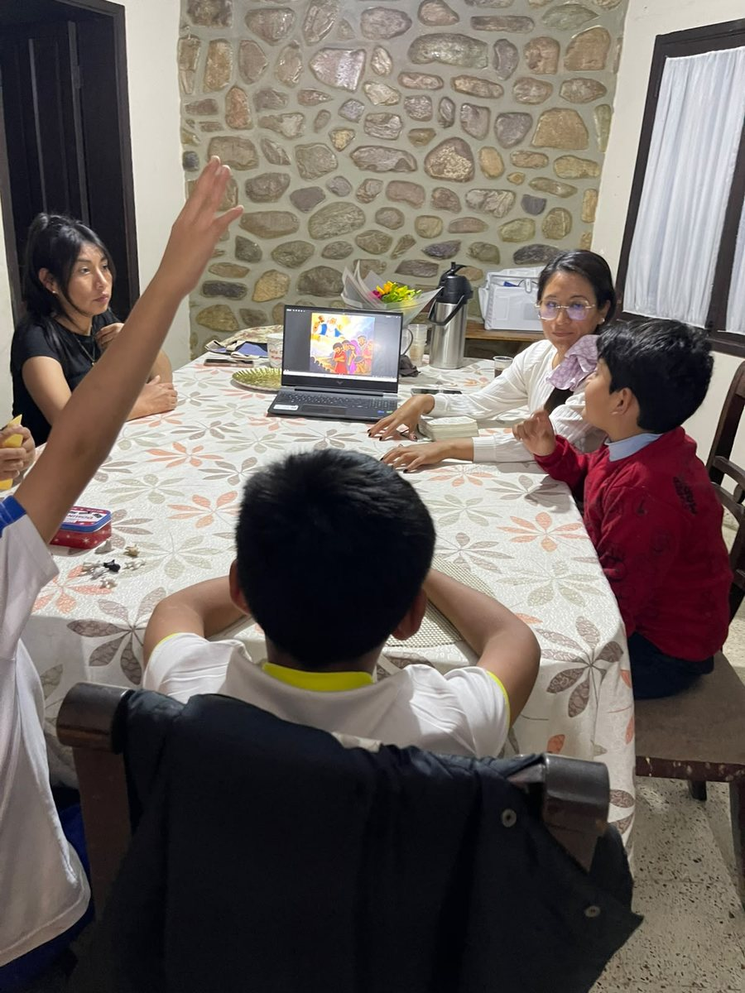
Isaiah directs us to Jesus
Philip begins with Isaiah 53 and preaches Jesus
12
Notes:
Who is this servant?
An Ethiopian official asked that very question while reading Isaiah 53. In Acts 8:34, he asks Philip whether the prophet is speaking about himself or someone else.
The next verse tells us:
[CLICK → reveal: “Paul connects Isaiah’s question to the response to the gospel”]

Slide 33
Isaiah directs us to Jesus
Philip begins with Isaiah 53 and preaches Jesus
Paul connects Isaiah’s question to the response to the gospel
12
Notes:
> “Philip opened his mouth, and beginning from this Scripture, preached to him about Jesus.”
Philip begins where the man is reading and tells him about Christ.
[CLICK → reveal: “The message brings us again to the question of belief”]

Slide 34
Isaiah directs us to Jesus
Philip begins with Isaiah 53 and preaches Jesus
Paul connects Isaiah’s question to the response to the gospel
The message brings us again to the question of belief
12
Notes:
Paul also connects Isaiah’s opening question with the response to the gospel. In Romans 10:16, he says that not everyone obeyed the Good News, and then quotes Isaiah: “Lord, who has believed our report?”
The connection is there in the apostolic testimony. Isaiah’s message directs us to Jesus—and brings us again to the question of belief.
[CLICK → advance to the next slide]

Slide 35
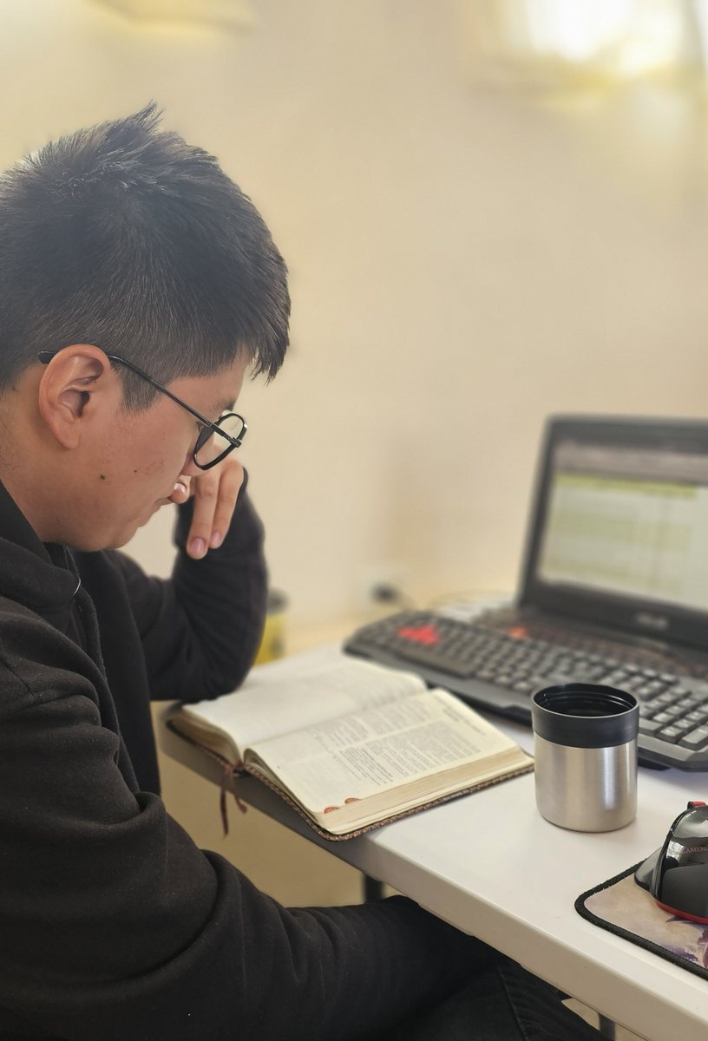
The prophets searched diligently
The Spirit testified beforehand about Christ’s sufferings and glory
13
Notes:
Did the prophets understand every detail of how and when these things would happen?
Peter gives us a careful answer in 1 Peter 1:10–12. They searched diligently. They investigated the time and circumstances indicated by the Spirit of Christ within them, who testified beforehand about Christ’s sufferings and the glories to follow.
They received revelation, and they sought to understand it. They knew they were serving people who would come later.
[CLICK → reveal: “The prophets served people who would come later”]

Slide 36
The prophets searched diligently
The Spirit testified beforehand about Christ’s sufferings and glory
The prophets served people who would come later
13
Notes:
Peter says that what they anticipated had now been announced through those who preached the gospel by the Holy Spirit sent from heaven. He adds that these are things angels desire to look into.
Consider that for a moment. The salvation we can become so accustomed to hearing about is described as something that commands the interest of angels.
[CLICK → reveal: “What they anticipated, the apostles announced”]

Slide 37
The prophets searched diligently
The Spirit testified beforehand about Christ’s sufferings and glory
The prophets served people who would come later
What they anticipated, the apostles announced
13
Notes:
Perhaps our familiarity has made us less attentive than we should be.
The prophets searched. The apostles proclaimed. We have the opportunity to listen to both.
[CLICK → advance to the next slide]

Slide 38
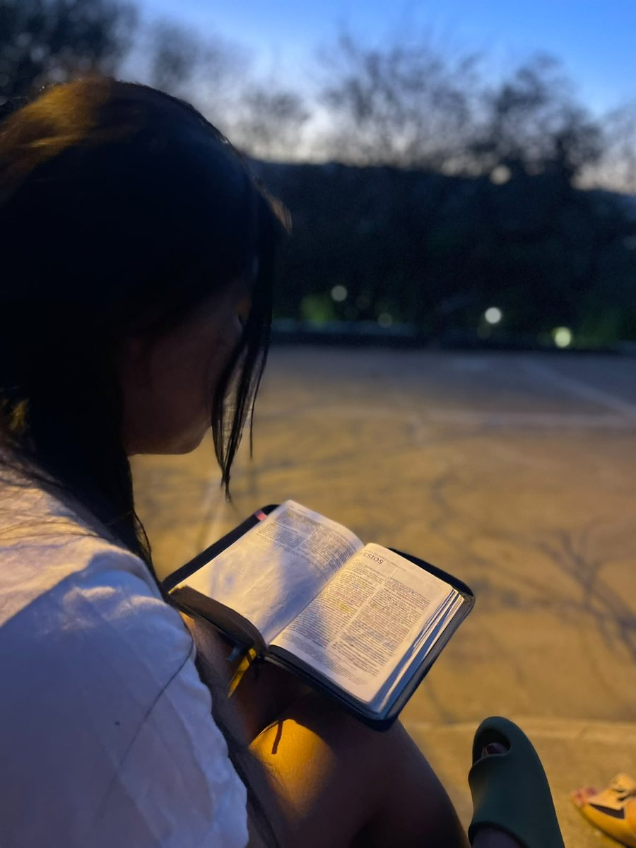
According to the Scriptures
Christ died for our sins
14
Notes:
Paul describes his own testimony in Acts 26:22–23 as saying what Moses and the prophets said would happen: Christ would suffer, rise from the dead, and proclaim light to Israel and the Gentiles.
We have heard that pattern before. It is the explanation Jesus gave in Luke 24.
Now hear Paul state the gospel in 1 Corinthians 15:3–4:
> “Christ died for our sins according to the Scriptures, that he was buried, that he was raised on the third day according to the Scriptures.”
[CLICK → reveal: “He was buried and raised on the third day”]

Slide 39
According to the Scriptures
Christ died for our sins
He was buried and raised on the third day
14
Notes:
Twice: “according to the Scriptures.”
Christ’s death and resurrection belong within the testimony we have been tracing. And notice why He died: **for our sins**.
This message concerns events, and it tells us their significance. Christ died. He was buried. He rose. His death addresses our sins.
[CLICK → reveal: “The apostles proclaimed the same gospel and called people to believe”]

Slide 40
According to the Scriptures
Christ died for our sins
He was buried and raised on the third day
The apostles proclaimed the same gospel and called people to believe
14
Notes:
After naming witnesses to the resurrection, Paul says:
> “Whether then it is I or they, so we preach, and so you believed.”
Paul and the other apostles proclaimed the same gospel. Their hearers were called to believe the same testimony about Jesus Christ.
[CLICK → advance to the next slide]

Slide 41
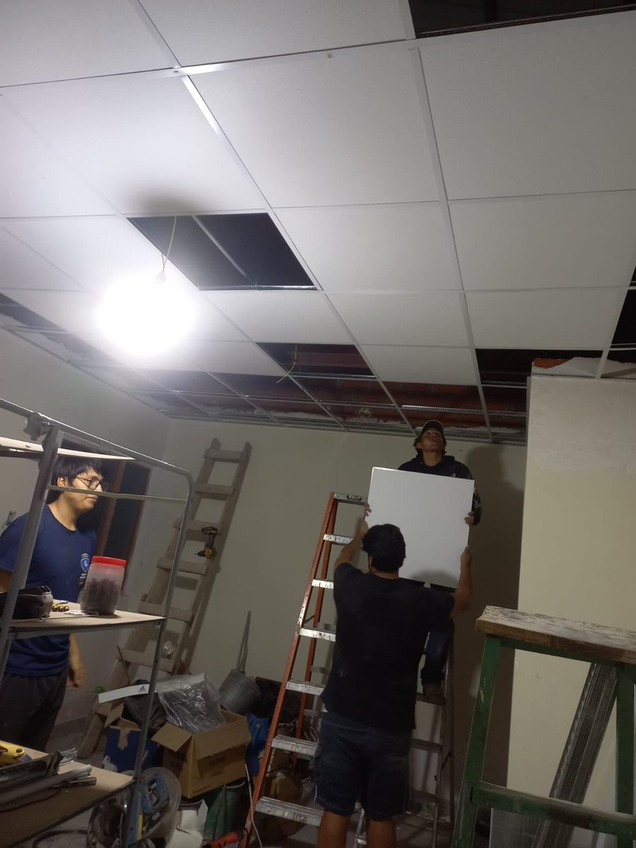
A message entrusted to us
Hold the pattern of sound words
15
Notes:
What happens when that message passes to another generation?
Paul tells Timothy to hold the pattern of sound words he has heard and guard what has been entrusted to him, through the Holy Spirit. He specifies the manner as well: in the faith and love that are in Christ Jesus. (2 Timothy 1:13–14.)
[CLICK → reveal: “Guard the message in faith and love”]

Slide 42
A message entrusted to us
Hold the pattern of sound words
Guard the message in faith and love
15
Notes:
There is something to preserve, and there is a way to preserve it. Faithfulness to the message belongs together with faith and love.
Then Paul says in 2 Timothy 2:2:
[CLICK → reveal: “Entrust the same teaching to faithful people”]

Slide 43
A message entrusted to us
Hold the pattern of sound words
Guard the message in faith and love
Entrust the same teaching to faithful people
15
Notes:
> “The things which you have heard from me among many witnesses, commit the same things to faithful men who will be able to teach others also.”
[CLICK → advance to the next slide]

Slide 44
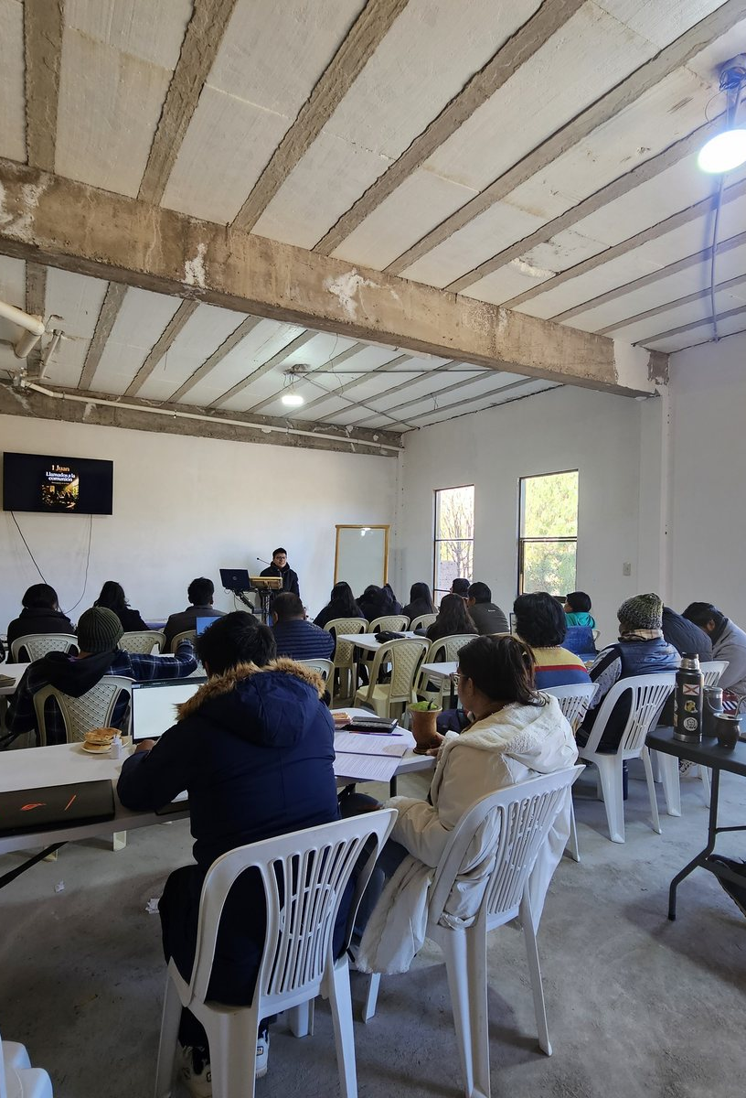
The same message for the next generation
Remember Jesus Christ, risen from the dead
16
Notes:
Notice the people in that sentence: Paul, Timothy, faithful teachers, and the people those teachers will teach.
Four stages of transmission in a single verse. And what is Timothy to entrust to the next teachers? “The same things.”
There is room for careful explanation. Every teacher must work to be understood. But the message being explained has been entrusted to us. We are responsible for what we pass on.
What remains at its center?
[CLICK → reveal: “The faith was delivered once for all to the saints”]

Slide 45
The same message for the next generation
Remember Jesus Christ, risen from the dead
The faith was delivered once for all to the saints
16
Notes:
Paul tells Timothy in verse 8:
> “Remember Jesus Christ, risen from the dead, of the offspring of David, according to my Good News.”
There is David again. There is the resurrection again. The promised Christ remains central as the gospel goes forward.
Jude likewise urges believers to contend earnestly for the faith “once for all delivered to the saints.” (Jude 3.)
[CLICK → reveal: “The promise to the nations now reaches our generation”]

Slide 46
The same message for the next generation
Remember Jesus Christ, risen from the dead
The faith was delivered once for all to the saints
The promise to the nations now reaches our generation
16
Notes:
And in Romans 16:25–26, Paul brings together the proclamation of Jesus Christ, the prophetic Scriptures, the command of the eternal God, and the message made known to all nations for the obedience of faith.
The promise to the nations reaches the nations. The testimony concerning Christ is proclaimed so that people will believe.
That responsibility now reaches our generation. It reaches this room. What are we receiving—and what are we passing on?
[CLICK → advance to the next slide]

Slide 47
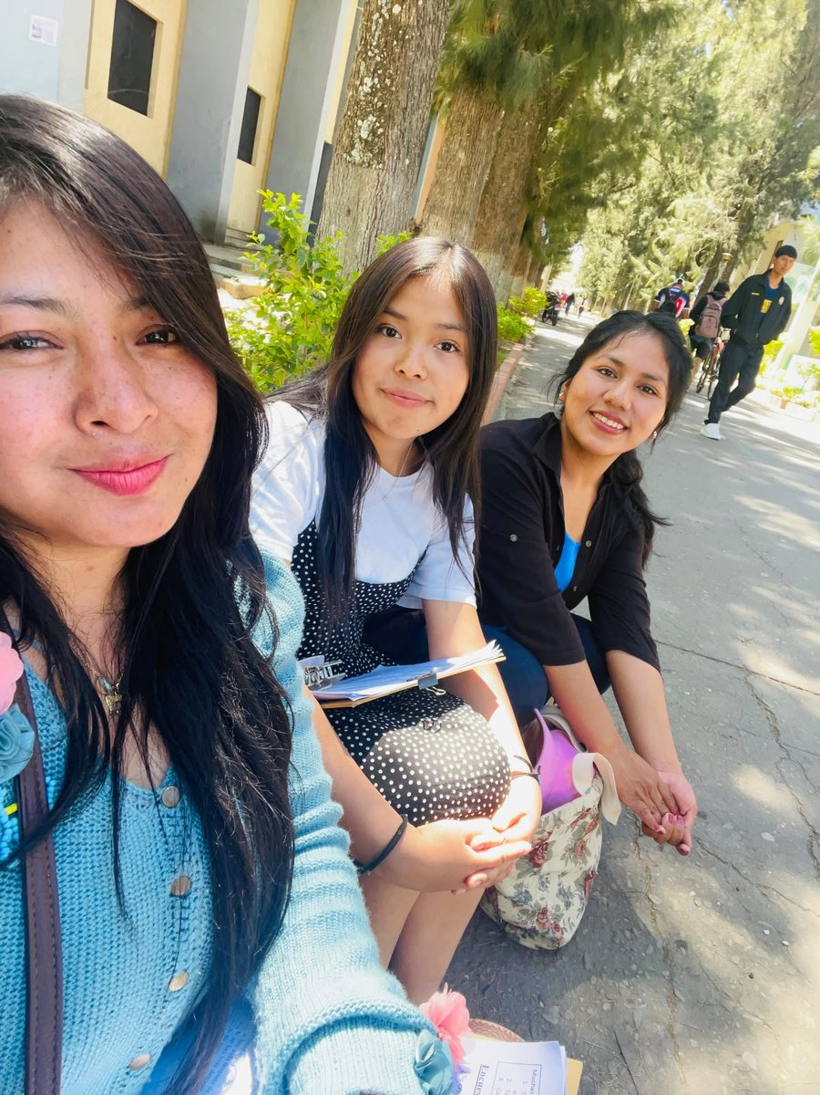
Every belief must answer to God’s Word
Length of belief does not establish truth
17
Notes:
We began with many voices competing for our trust.
Then we listened to the testimony of Scripture. We heard about creation and the God who gives life. We heard His warning about death and the voice that contradicted Him. We saw humanity’s disobedience and its consequences.
We followed the promise through Abraham. We listened to Moses, David, and Isaiah. We heard Jesus explain the Scriptures concerning Himself. We heard the apostles proclaim His death for our sins and His resurrection, and charge others to preserve that message.
Their agreement matters. But agreement alone does not prove a claim true. People can agree and be mistaken. We should be honest about that.
What we have traced is Scripture’s connected testimony: what it claims God promised, how it identifies the fulfillment in Jesus, and what the apostles testify they witnessed. That gives us something substantial to consider. It also shows why Christians receive Scripture as more than another human opinion: its claimed authority is the authority of God speaking.
[CLICK → reveal: “Respected teachers can still need correction”]

Slide 48
Every belief must answer to God’s Word
Length of belief does not establish truth
Respected teachers can still need correction
17
Notes:
And if God has spoken, then my beliefs must answer to His Word. So must the beliefs of my family, my teachers, my church, and the person giving this speech.
You should examine what I have said by the passages we have considered.
The question is whether we are willing to apply that examination to the ideas we most want to protect.
“I have always believed it” tells us how long we have held a conviction. It does not establish whether the conviction is true.
[CLICK → reveal: “Our feelings must also be examined”]

Slide 49
Every belief must answer to God’s Word
Length of belief does not establish truth
Respected teachers can still need correction
Our feelings must also be examined
17
Notes:
“Someone I respect taught me” explains where we learned it. Even someone we respect can need correction.
“It feels right” describes our response. Our feelings also need to be examined.
That examination can be uncomfortable. Sometimes changing our minds means admitting that we defended something we had never studied very carefully. Sometimes it means letting go of an idea we inherited from people we love.
But we can love those people and still examine what they taught us. We can acknowledge that we were mistaken and be grateful to learn what is true.
[CLICK → advance to the next slide]

Slide 50
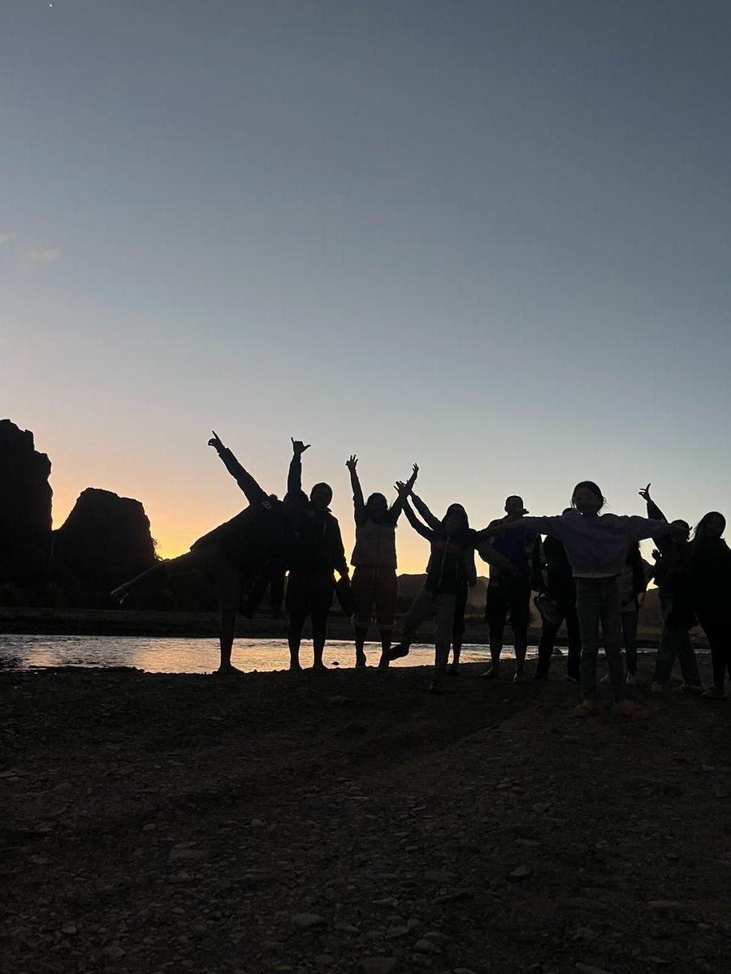
Come to Christ for life
Read the passage in its context
18
Notes:
So here is a practical place to begin. Take one belief you hold about God, salvation, or life after death. Ask yourself: Where did I learn this? What does Scripture actually say? Have I read the passage in its context? Would I accept its teaching if it required me to change my mind?
And keep the purpose of that examination before you. Jesus warned that people could search the Scriptures and still refuse to come to Him for life.
The message we have traced brings us to Him: the One who died for our sins and rose from the dead. Through Him, forgiveness is proclaimed. Through Him, reconciliation is received. In Him, God’s promise of blessing reaches the nations.
[CLICK → reveal: “Welcome correction when Scripture requires change”]

Slide 51
Come to Christ for life
Read the passage in its context
Welcome correction when Scripture requires change
18
Notes:
And the invitation at the end of Scripture still speaks with wonderful simplicity:
> “He who is thirsty, let him come. He who desires, let him take the water of life freely.”
*[Pause.]*
[CLICK → reveal: “Trust the One who died for our sins and rose again”]

Slide 52
Come to Christ for life
Read the passage in its context
Welcome correction when Scripture requires change
Trust the One who died for our sins and rose again
18
Notes:
Imagine opening the Bible tomorrow morning and discovering that something you have believed for twenty years is wrong.
That could be the beginning of a very good day.
You could put down the burden of defending it. You could receive the correction. You could come to know Christ more clearly and trust Him more fully.
[CLICK → reveal: “Take the water of life freely”]

Slide 53
Come to Christ for life
Read the passage in its context
Welcome correction when Scripture requires change
Trust the One who died for our sins and rose again
Take the water of life freely
18
Notes:
Many books. One message. Jesus Christ at its center.
Will we trust His testimony—and allow His Word to change our minds?
[CLICK → advance to the next slide]

