Slide 1
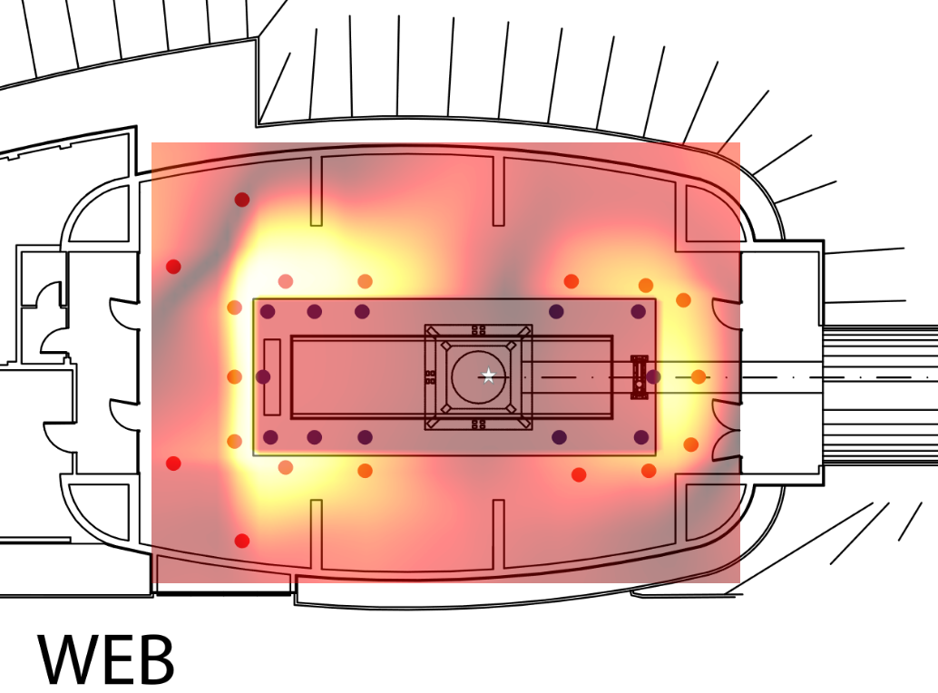
Summary of WEB/NEB
my target signal is: dx(L)

Slide 2
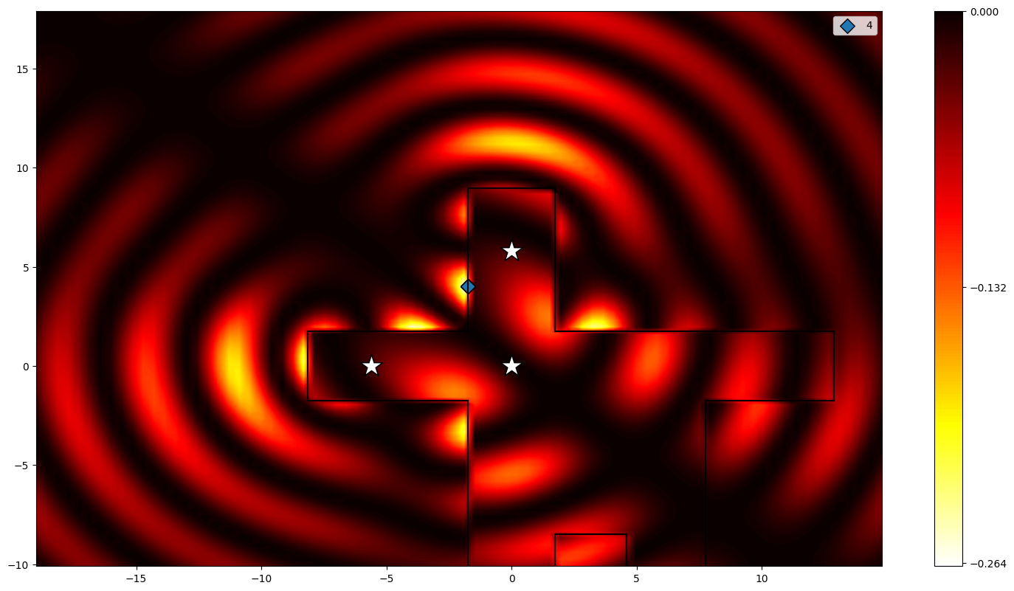
my target signal is: dy(0) - dx(0)
15 Hz

Slide 3
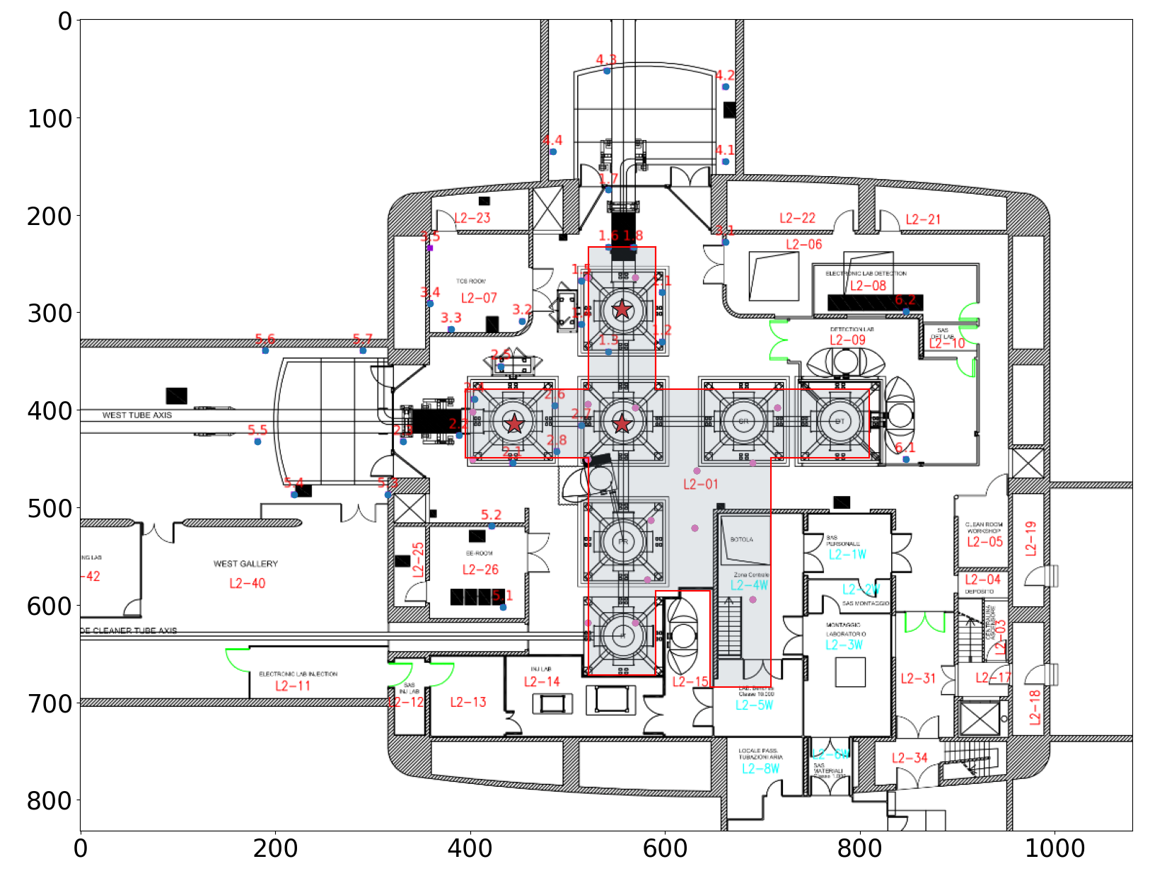

Slide 4
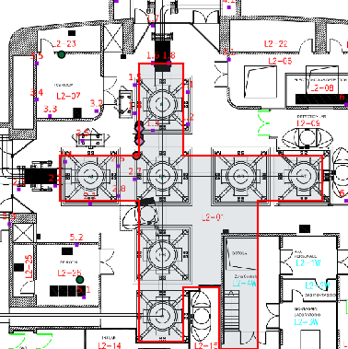
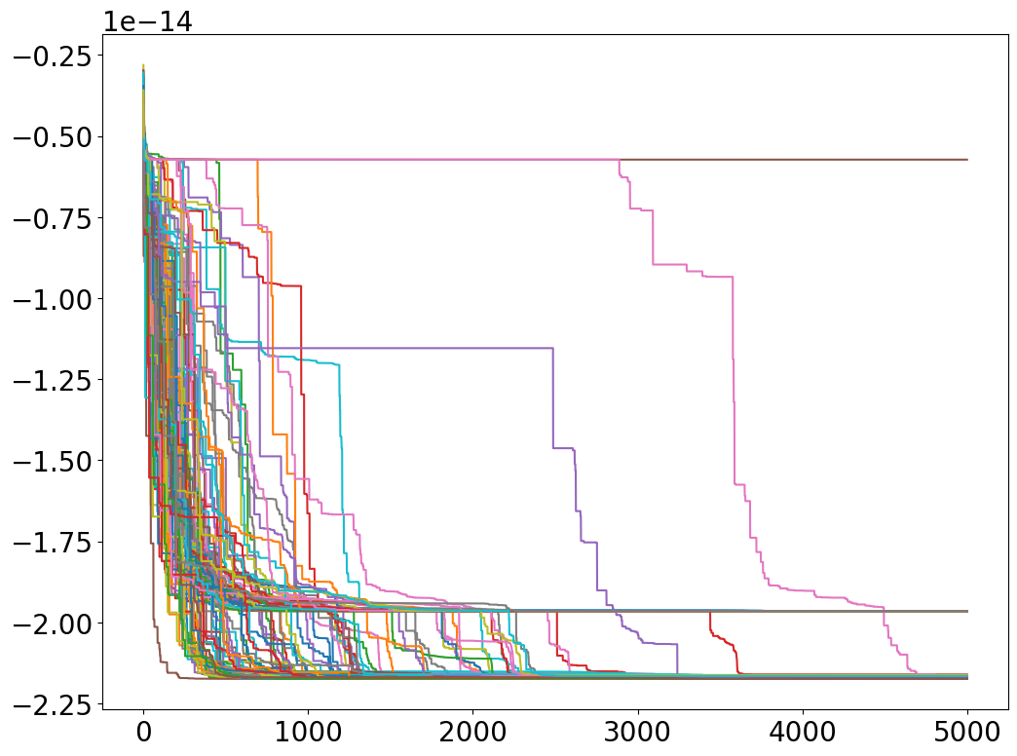
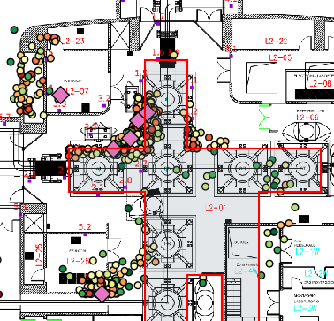
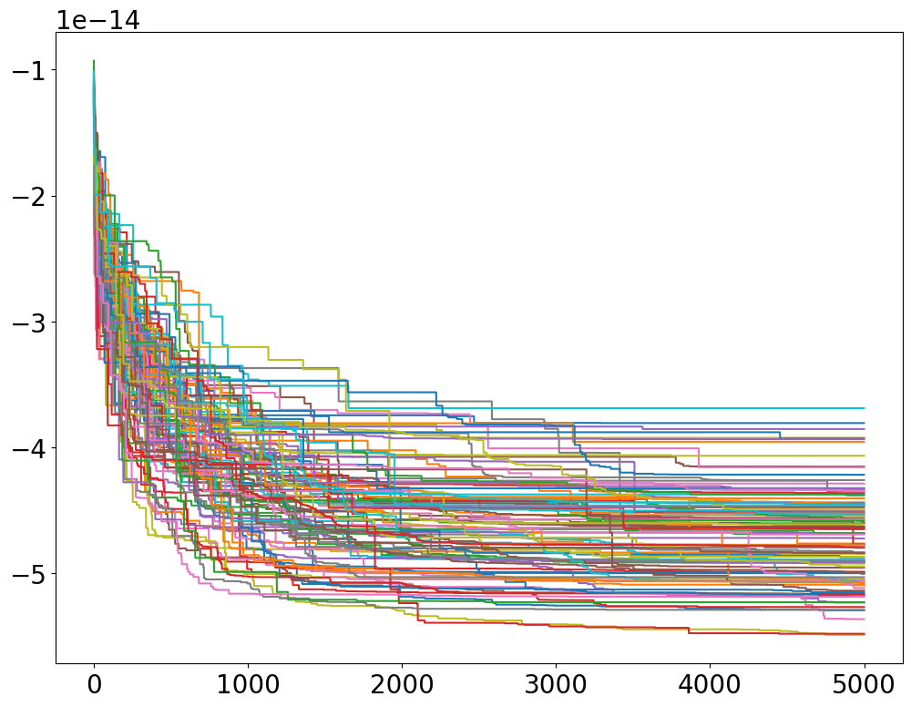
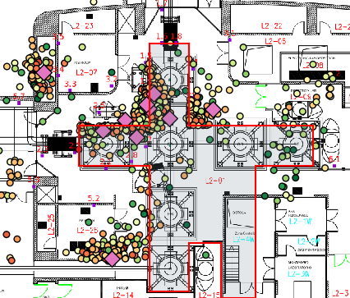
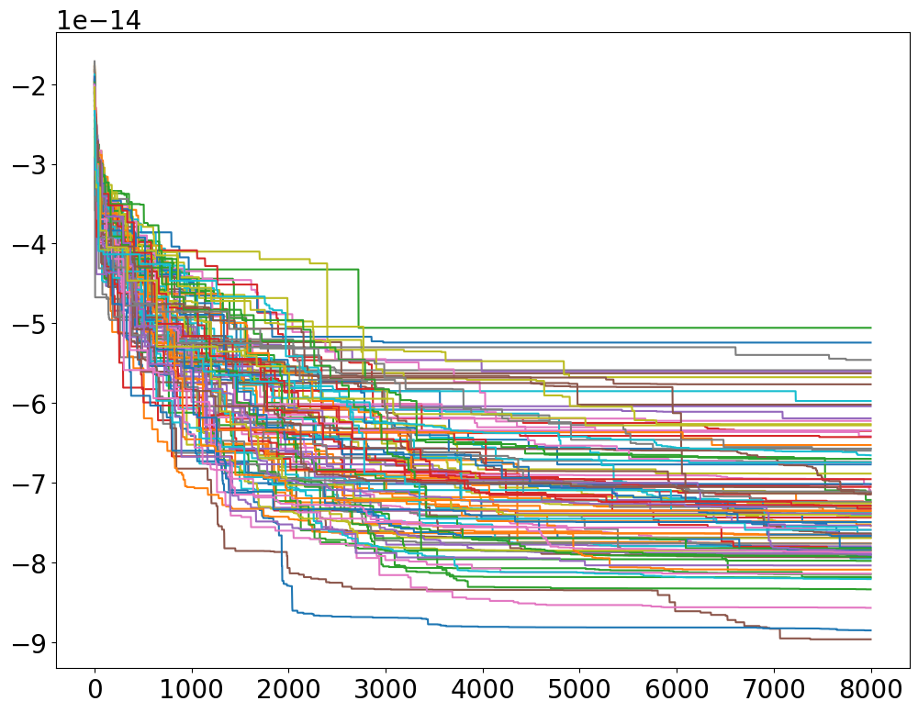
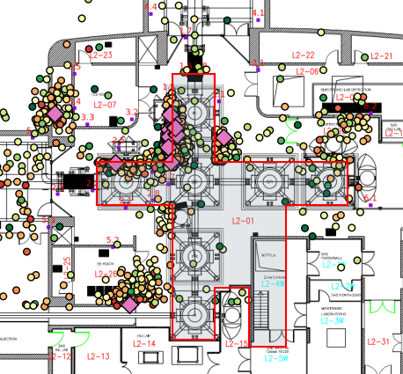
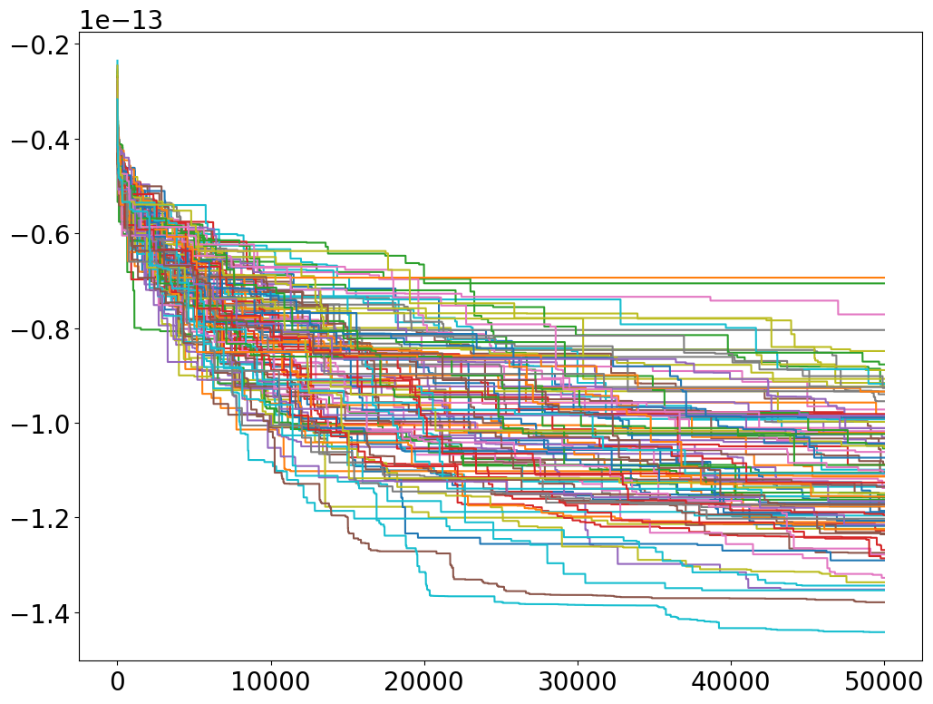
15 Hz
N = 2
N = 6
N = 2
N = 10
N = 16

Slide 5
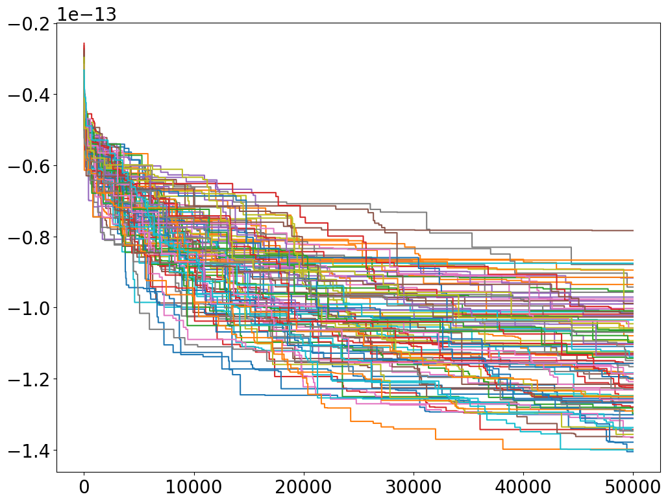
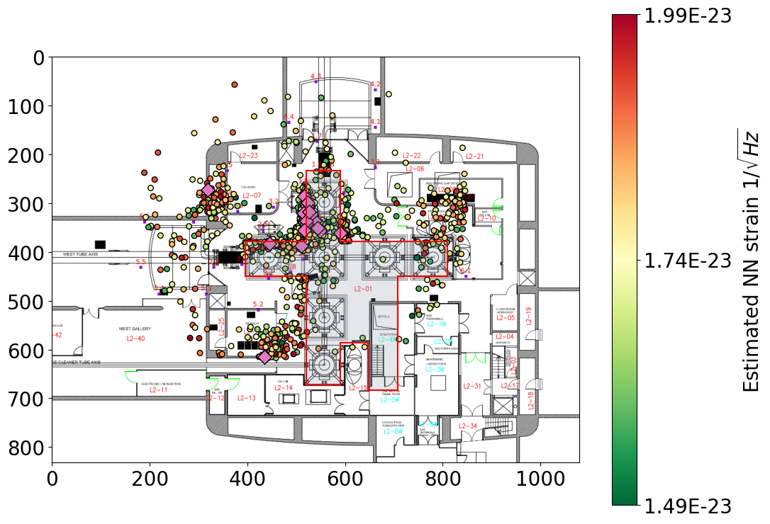
N = 18
15 Hz

Slide 6
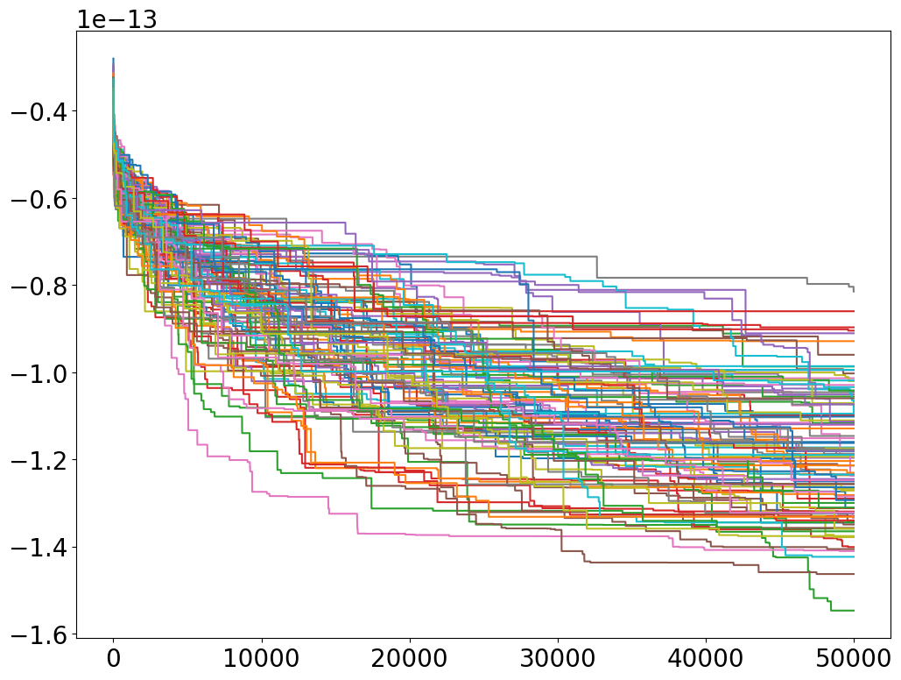
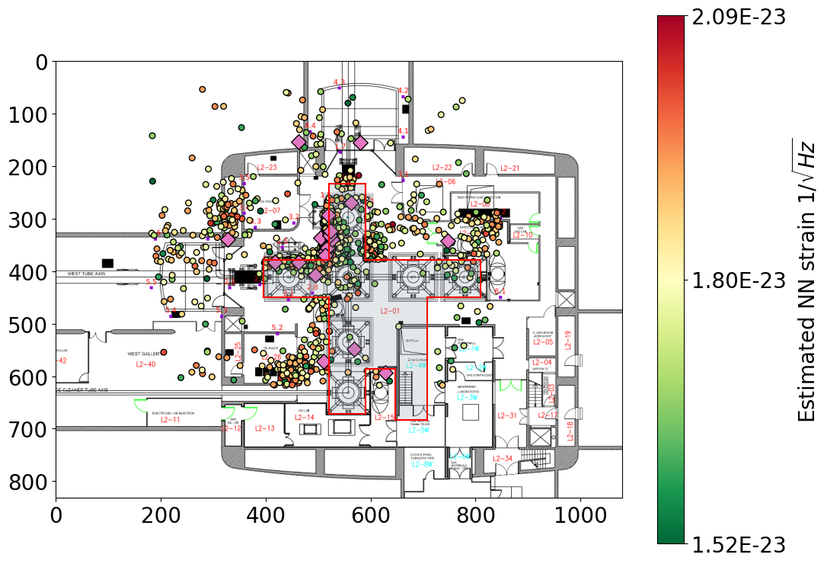
N = 20
15 Hz

Slide 7
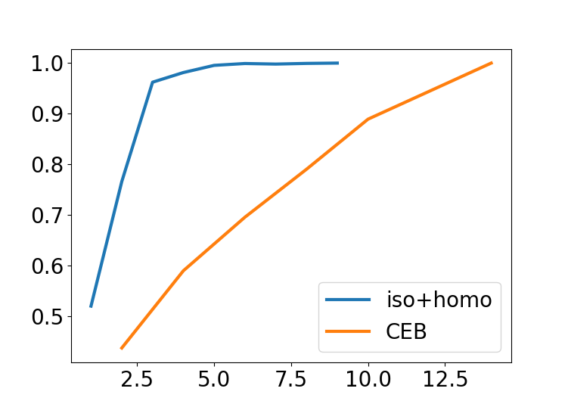

Slide 8
Lx = L0 + dx(L0) - dx(0)
Ly = L0 + dy(L0) - dy(0)
where dy(L0) is the displacement caused at the end test mass and the dy(0) at the input one for y and same for x.
So:
Delta_L = (dy(L0) - dx(L0)) - (dy(0) - dx(0))
But being that the only correlated terms are dy(0) and dx(0), the PSD becomes:
PSD(Delta_L) = PSD(dy(L0)) + PSD(dx(L0)) + PSD( dy(0) - dx(0) )
So my target signal is: dy(0) - dx(0)

