Slide 1
Return to Kronos
COMP 4449 – Data Science Capstone
Aaron LaFevers
Summer 2023

Slide 2
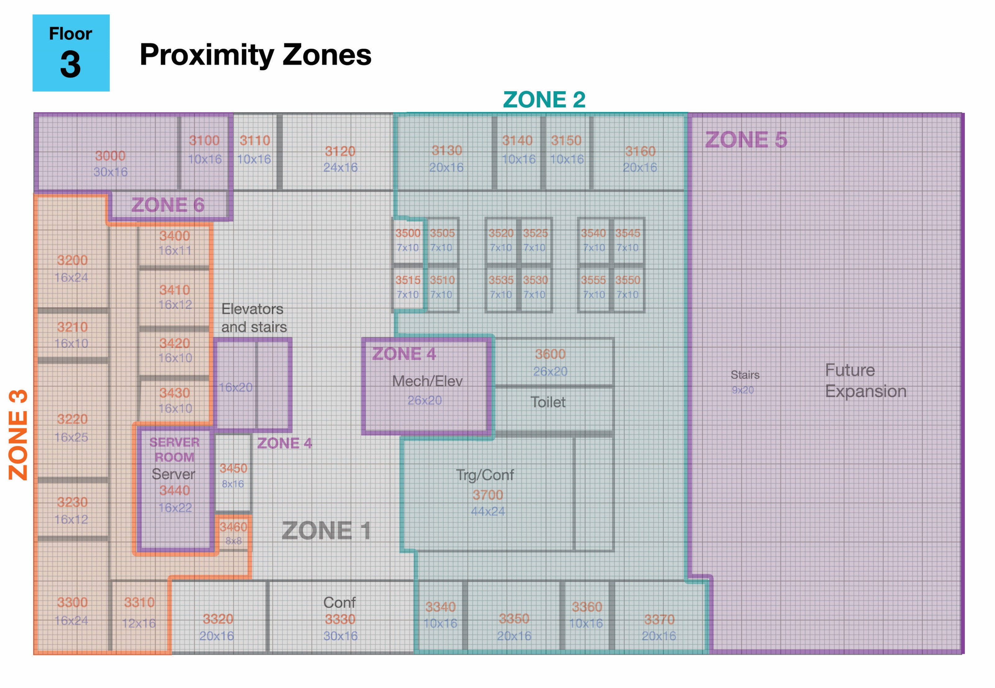
GAStech’s new office
GAStech has moved into a new office building!
Task: analyze building operations data to identify patterns and issues of concern
Building systems/HVAC data
Employee proximity (prox) data
Intrigue:
Pattern-of-Life (PoL) analysis
spatiotemporal data
Challenges:
Wrangling data into cluster-able or plottable forms
Distilling the maps into parse-able data
Pattern identification

Slide 3
Time Breakdown

Slide 4
Goals
Identify patterns for typical GAStech employees
Identify patterns in building systems data
Detect anomalies in the operations data
Discern relationships between personnel and building data

Slide 5

Data Exploration Data Summary
Employee directory
125 employees, their departments and office number
Static ‘prox’ data
29,764 entries
Timestamp, prox ID, floor, prox zone
Mobile ‘prox’ data
11,594 entries
Timestamp, prox ID, floor, x/y coordinates
Building systems data
415 columns (sensors)
4032 entries – 5 minute logging interval
JPEG building maps
3 each for floor plan, prox zones, and hvac zones
Hazium Sensors (new mystery gas )
4 sensors throughout the building

Slide 6
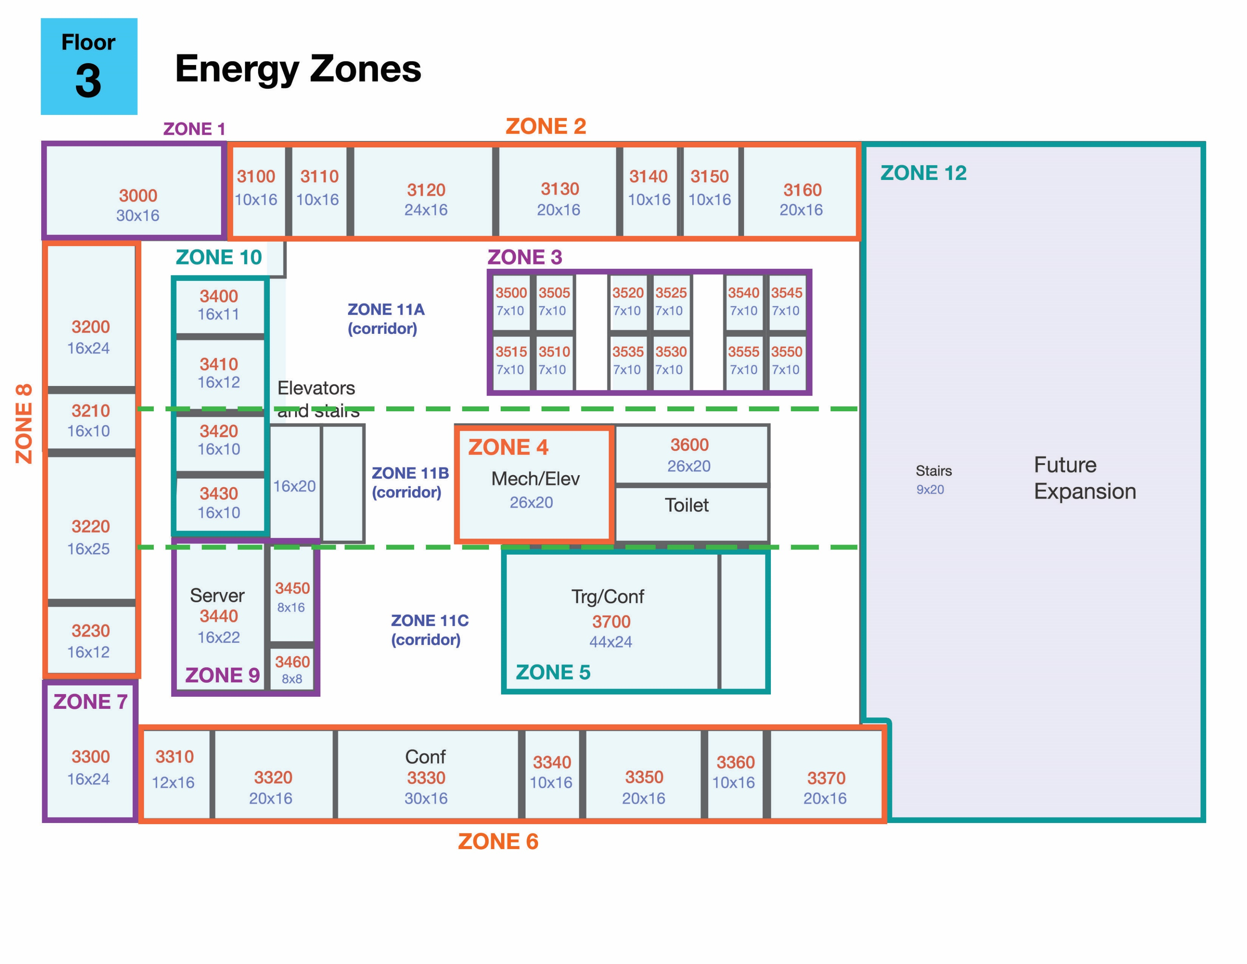


Data Exploration Distilling the maps
zone | left | top | right | bottom
1 | 0 | 111 | 30 | 95
10 | 21 | 89 | 37 | 46
11a | 125 | 91 | 133 | 69
11a | 16 | 95 | 21 | 67
11a | 16 | 95 | 133 | 89
11a | 37 | 91 | 72 | 68
11a | 72 | 70 | 133 | 68
11b | 16 | 68 | 21 | 45
11b | 37 | 68 | 67 | 45
11b | 67 | 68 | 133 | 64
11b | 93 | 65 | 133 | 45
11c | 118 | 45 | 133 | 20
11c | 16 | 45 | 21 | 16
11c | 20 | 21 | 133 | 16
11c | 45 | 46 | 75 | 21
12 | 133 | 111 | 189 | 16
12 | 137 | 20 | 189 | 0
2 | 30 | 111 | 133 | 95
3 | 72 | 90 | 125 | 69
4 | 67 | 65 | 93 | 45
5 | 75 | 45 | 118 | 21
6 | 16 | 16 | 137 | 0
7 | 0 | 23 | 16 | 0
8 | 0 | 95 | 16 | 24
9 | 21 | 47 | 45 | 21
111 ft
1890 x 1110 px
189 ft

Slide 7
Data Exploration Wrangling the prox data
Floor plan
DF
Prox ID | Location | Metadata
DF
Prox ID
(x,y)
Office #
Static prox data
Prox map
Prox zone
Employee data
Estimate prox ID
Employee Location Matrix
Timestamp
Mobile prox data
drop duplicates
Time (1 min)
(x,y)
HVAC zone
HVAC map
(x,y)
Prox zone
Prox map
Interpolate location
8:01 | ? |  | Away
8:02 | ? |  | Away
8:03 | ? |  | Away
8:04 | Floor 1 Zone 1 |  | Floor 1 Zone 1
8:05 | ? |  | Floor 1 Zone 1
8:06 | ? |  | Floor 1 Zone 1
8:07 | Floor 1 Zone 4 |  | Floor 1 Zone 4
… | … |  | …

Slide 8
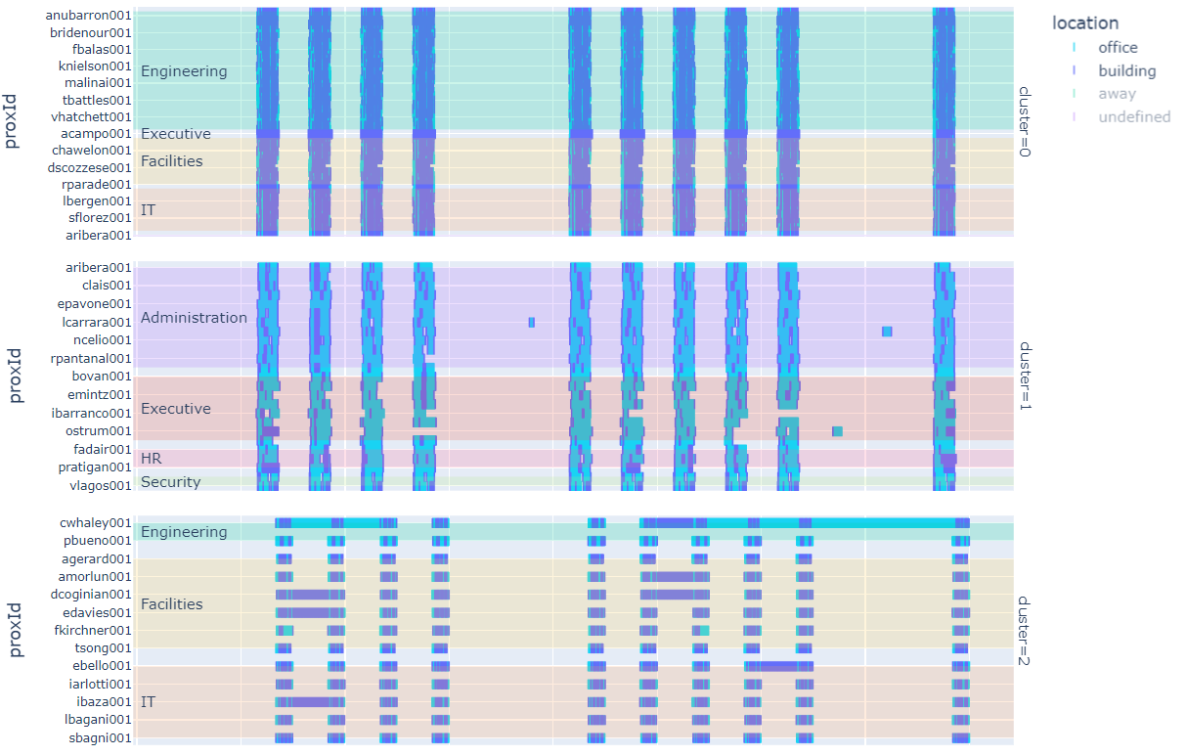
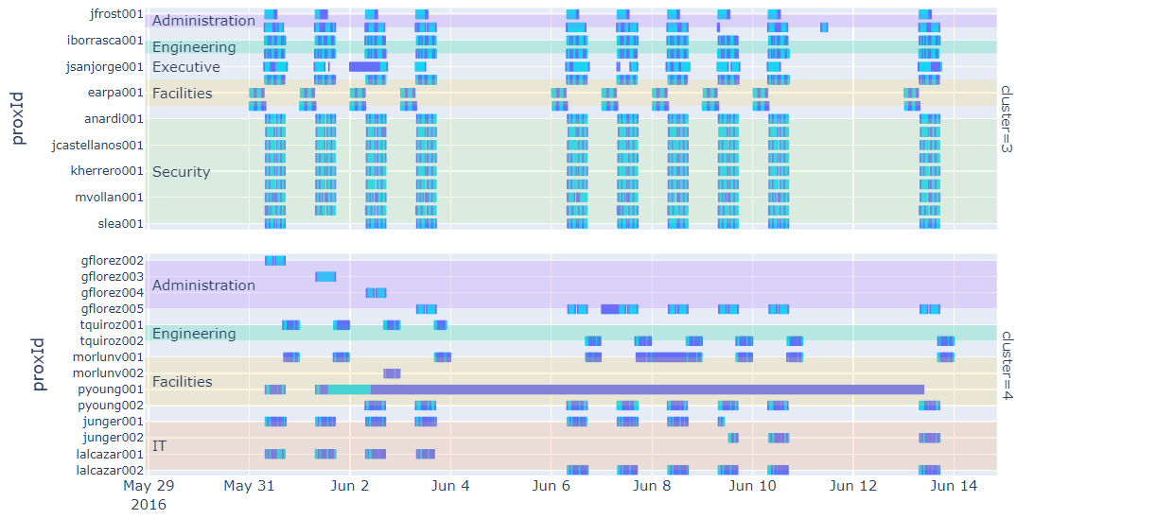
Data Analysis Employee Patterns of Life
Employee Location Matrix
transpose
DF
Time (5 min)
Wide matrix
Down-sampled to 5min intervals
Prox ID
DF.stack()
K-Means Clustering
each employee as an “instance”
4032 “features” (each 5 min interval)
5 clusters optimal (elbow plot)
Notes:
In the interest of time I’m having to skip over all the data prep and wrangling stages, which consumed at least 40% of my time.
But eventually I got the prox data into a form that I could feed to K-means clustering.
It resulted in 5 groups, of which I’m showing 3.
What you’re looking at here is the full 2-week sample window for all employees in these clusters. The dark blue indicates they are in the building somewhere, and the light blue indicates they are in their personal office.
You can see that it did a fairly good job of creating homogeneous groups that are distinct from one another.
Daily work patterns are easy to pick out, in that most of the employees work an 8-5 schedule, while this 3rd group works a late shift from 4-midnight.
You can also start to see some anomalies, with some weekend activity and executives who tend to leave early. You’ll also see some people in the 3rd group who like to leave their prox cards in the building overnight.

Slide 9
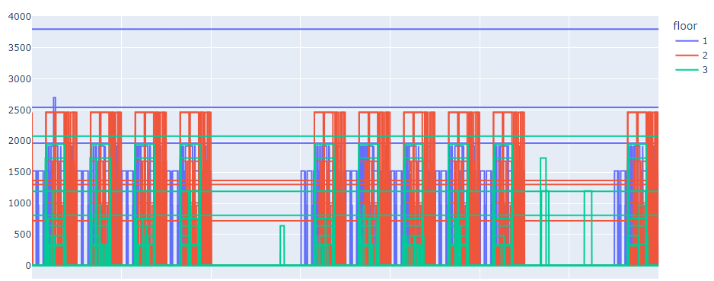
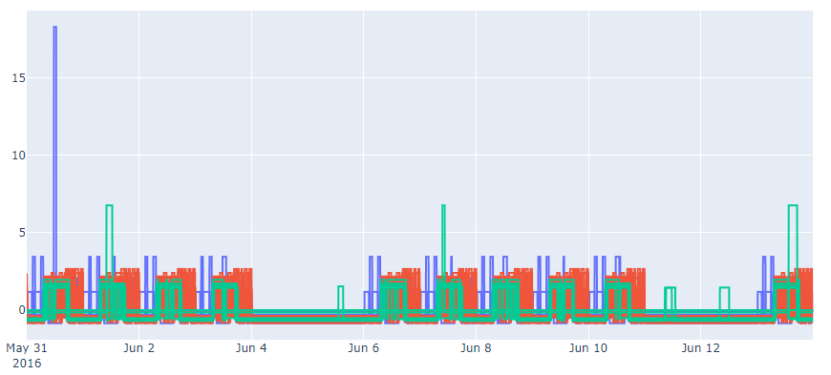
Data Analysis Building systems patterns
Lighting Power
high
+5
Power, W
med
+3
low
mean
+1
Bin by std
-1
-3
Power – Standardized
-5
Notes:
The building data consists of about two-dozen sensor types in each zone on every floor. If you plot the raw data from just one sensor type you get this first figure, which is hard to read.
So I standardized all the sensor data, allowing you to focus in on instances where the signal spiked above or below its mean value.
This is still difficult to digest, especially when considering all 419 sensors. So I took it a step further and binned the standardized signals by number of standard deviations. Anything between +/- 1 standard deviation I ignored, and then I had a low, medium, and high.

Slide 10
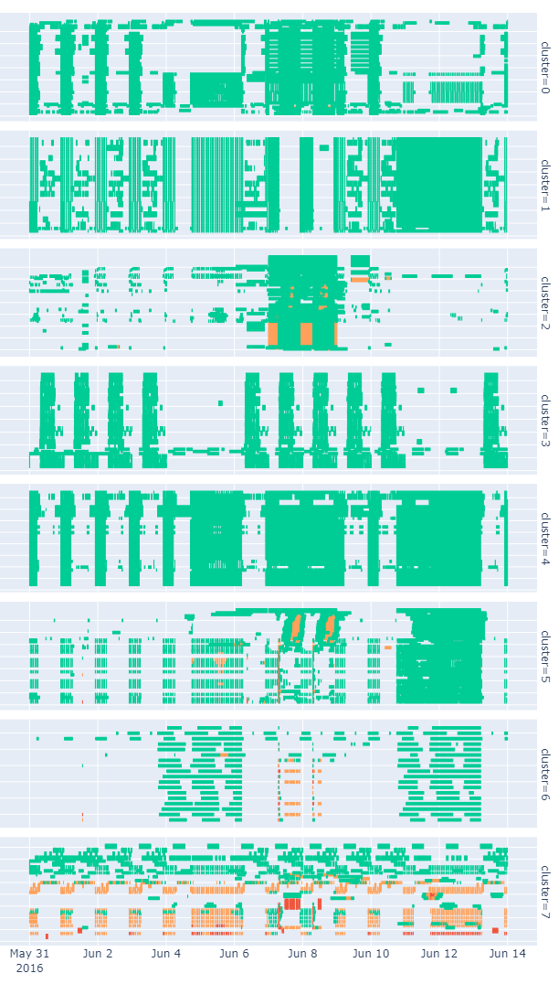
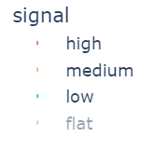
Data Analysis Building systems patterns
All building systems data – grouped by cluster
Lighting Power
Power, W
Bin by std
Power – Standardized
Notes:
That allowed me to cluster the data and create a plot similar to the prox data.
What you’re looking at is all 419 sensors, Hazium included, across the full 2-week sample window.
There are roughly 1.7 million data points here, so we’re fairly zoomed out, but the clustering has a done a decent job once again of creating homogenous groups.
We can see patterns in operations data aligning with business hours as in the 4th group, or in many cases, spikes aligning with non-business hours.
We can also see how many of these groups have an interruption to their pattern around the 7th and 8th of June, with some sensors spiking into the medium or high range. We’ll look into that more in a minute.

Slide 11
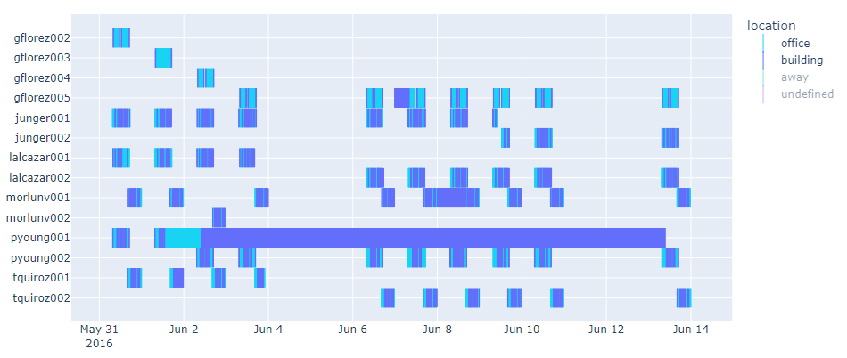
Evaluation Data anomalies
Multiple-ID holders
Notes:
In terms of anomalies in the data, there is a lot to look at. Here I’m showing you all employees who have had multiple prox cards issued.
The worst offender is ms. Florez who was losing her card every day there for a while.
Typically people lose their card, get a new one, and we never see the old card again.
That is not the case with mr. Young. We see that he loses his card sometime on the 1st, get’s a new card on the 2nd and goes about his usual business. However during this period his original prox card remains in the building and continues to be detected in different zones.

Slide 12
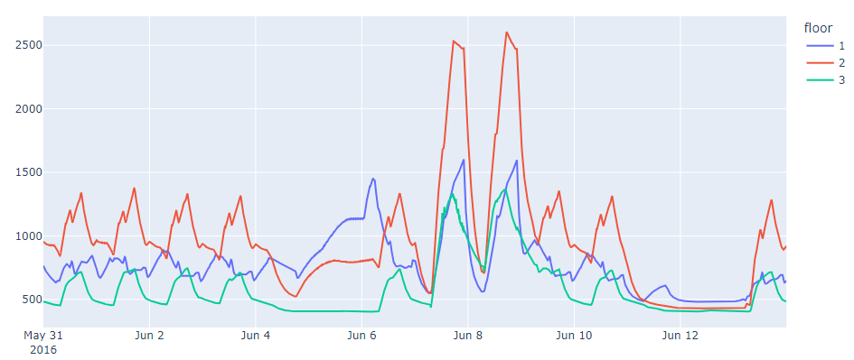
Evaluation Data anomalies
CO2 Concentration – Averaged by floor
CO2 (ppm)

Slide 13

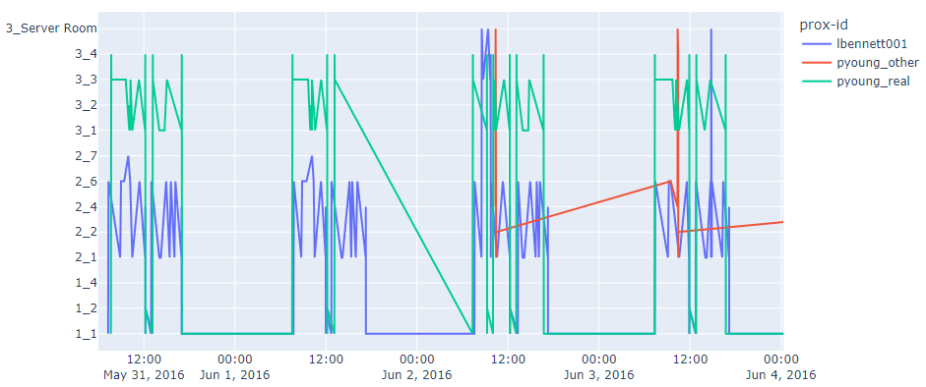
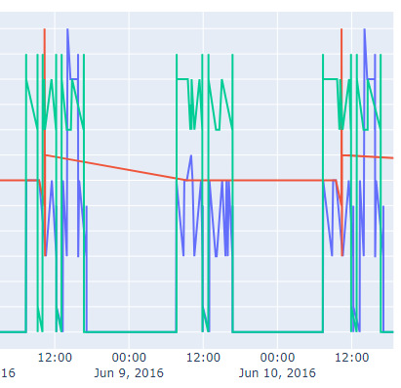
Evaluation Data anomalies
P. Young’s lost ID makes moves
first ID reappears
loses ID
Floor_Zone
mail bot regularly detects first ID in L. Bennett’s office on floor 2
Notes:
Digging into this further we can look at the location data in a slightly different format. We have the floor and zone here on the Y axis; you can see the first floor, second floor, and third floor. Mr. Young is shown in the green trace, and you can see him bouncing around the 3rd floor during the day. His office is on the 3rd floor. You see he loses his ID on the 2nd day, before picking up a new one on the 3rd day. I have combined the data from his first card prior to losing it, with the second card, so the green trace shows what I believe to be the authentic Mr. Young.
Meanwhile his original ID shows up in a 2nd floor stairwell, before going immediately to the server room. In Young’s usual routine he never visits the server room.
Now thanks to the mail bot, we detect Young’s ID in a second floor office every morning around 9:15. That office belongs to Ms. Bennett. Bennett’s activity is shown in blue, where you can see she typically bounces around the 2nd floor. Until the 3rd day when she starts making trips to the server room as well. Every day she visits the server room, Young’s ID visits as well, and every morning his ID is found back in her office.
It is noteworthy that Young’s office is directly across the hall from the server room, so the fact that Bennett visits the server room daily, and does not return his ID, is suspicious.

Slide 14
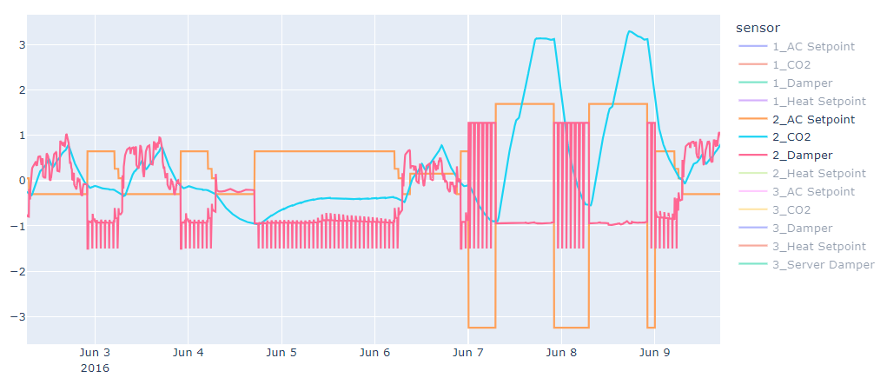

Evaluation Relationships in operations data
CO2 surges (and associated system spikes) due to thermostat spat
very regular AC program, setpoint lowers at 0500 and increases at 2200
someone messes with the AC setpoint
open damper with no people (Saturday morning) – CO2 falls
order is restored
Standardized Value
CO2 climbs during business hours despite open damper
closed damper – CO2 climbs
damper closes while building is full – CO2 surges
Notes:
That brings us to the evaluation of relationships within the data, and specifically looking back at the sensor spikes on the 7th and 8th of June.
Of all the sensors spiking during these times, the most concerning is probably the CO2 concentration.
There is a lot of detail on this page, but the main takeaway is that I’m suggesting a causal link between thermostat setpoints, HVAC damper positions, and CO2 concentrations.
The AC setpoint shown in orange followed a very regular pattern during the first week. When the AC kicks on, the damper opens up. The damper allows air to exhaust outside, which typically corresponds to a drop in CO2 level, shown in blue.
You can see that when the building is occupied, even with an open damper, the CO2 concentration climbs. But when the building is empty the open damper corresponds to a drop in CO2. <scroll>
Now everything was fine until someone or something changed the thermostat setting on the morning of the 6th. It was a couple degrees cooler that day, so maybe they were cold. This ends up disrupting the thermostat program however and sends it into a tailspin that night.
You first see the setpoint drop way down, kicking the damper open and dumping CO2. But then at 7am the setpoint flips to the other extreme, going so high that the heat actually turns on. With a closed damper and a full building the CO2 levels surge. The cycle repeats for another day before someone finally resets the thermostat program around midnight on the 8th.
So, I have a high degree of confidence in the causal chain between thermostat setpoint, damper position, and CO2 concentration. There are many other ancillary systems that spike in association with this, but I believe the thermostat setpoint is the start of the chain.
I was not able to determine a link between these setpoint changes and any of the prox data, and should note that nearly all zones on all floors had setpoint changes around the same time. So was it a group of people messing with the thermostats, a single bad actor, or a buggy program, I’m still unsure.
Now there are many many more anomalies and relationships to explore, but this is all we have time for today. Are there any questions?

Slide 15
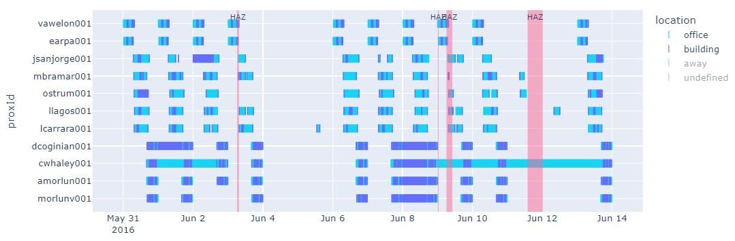
Evaluation Relationships in operations data
Anomalous personnel activity adjacent to Hazium spikes

