Slide 1
Shellcode

Slide 2
Outline
Challenges in writing shellcode
Two approaches
32-bit and 64-bit Shellcode

Slide 3
Introduction
In code injection attack: need to inject binary code
Shellcode is a common choice
Its goal: get a shell
After that, we can run arbitrary commands
Written using assembly code

Slide 4
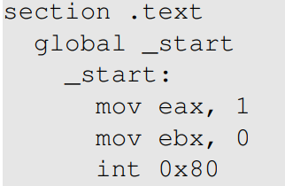
Writing a Simple Assembly Program
Invoke exit()
Compilation (32-bit)
Linking to generate final binary

Slide 5
The basic idea

Slide 6
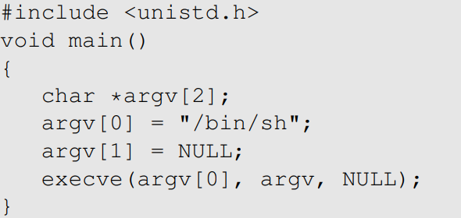
Writing Shellcode Using C

Slide 7
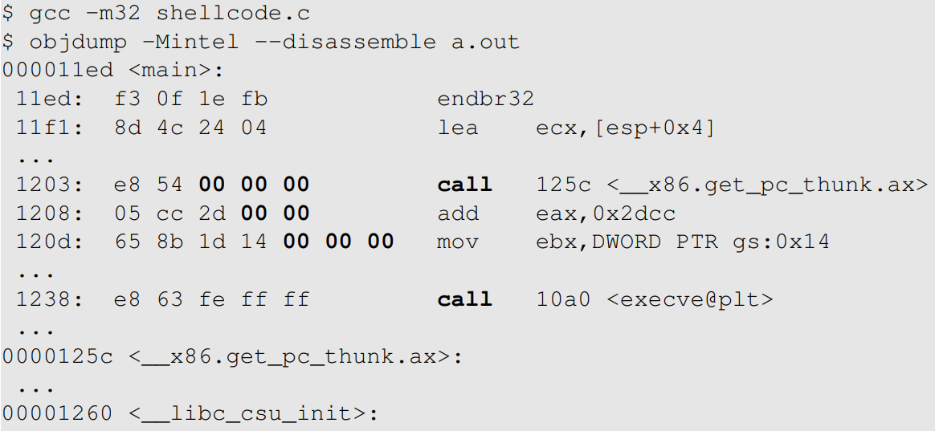
Getting the Binary Code
Notes:
From the printout, we immediately see two obvious problems. First, the program relies on so many library functions: there are call instructions in the main function, and there are many functions in the disassembled code (most are omitted in the printout above). Most of these functions are dynamic linked function, i.e., their actual code are not even included in the program. If we do want to include them, we can compile the program using static binding, and the size of the program will become 700K bytes, instead of 15K bytes. Second, from the machine code, we will see many zeros. This is a problem because string copying using strcpy() will stop when a zero is found in the source string.

Slide 8
Writing Shellcode Using Assembly
Invoking execve(“/bin/sh”, argv, 0)
eax = 0x0b: execve() system call number
ebx = address of the command string “/bin/sh”
ecx = address of the argument array argv
edx = address of environment variables (set to 0)
Cannot have zero in the code, why?

Slide 9
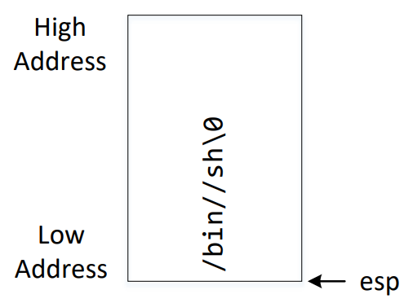
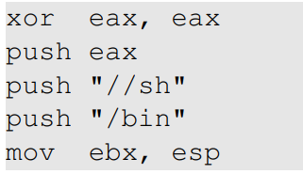
Setting ebx
Notes:
Explain the double // in “/bin//sh”.

Slide 10

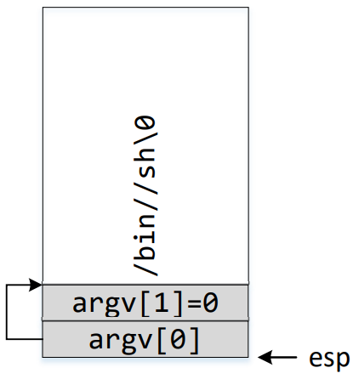
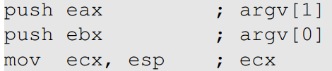
Setting ecx

Slide 11
Setting edx
Setting edx = 0
xor edx, edx

Slide 12
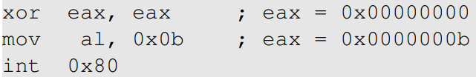
Invoking execve()
Let eax = 0x0000000b

Slide 13
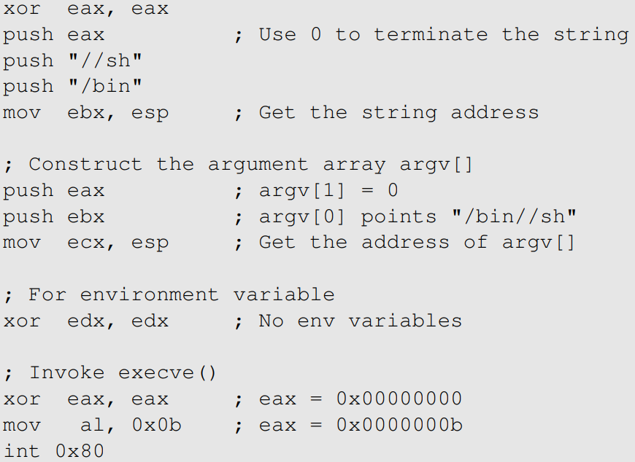
Putting Everything Together

Slide 14
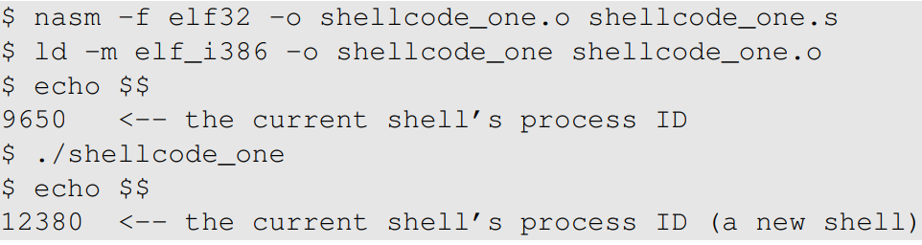
Compilation and Testing

Slide 15
Getting Rid of Zeros from Shellcode

Slide 16
How to Avoid Zeros
Using xor
“mov eax, 0”: not good, it has a zero in the machine code
“xor eax, eax”: no zero in the machine code
Using instruction with one-byte operand
How to save 0x00000099 to eax?
“mov eax, 0x99”: not good, 0x99 is actually 0x00000099
“xor eax, eax; mov al, 0x99”: al represent the last byte of eax

Slide 17
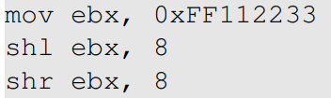
Using Shift Operator
How to assign 0x0011223344 to ebx?

Slide 18
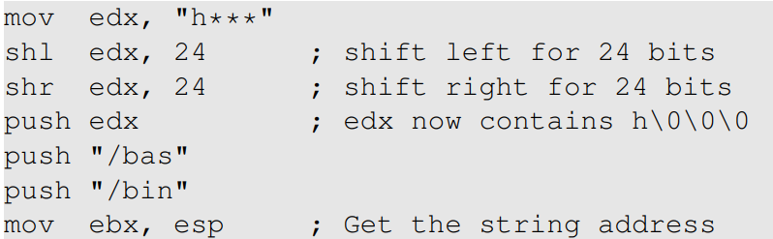
Pushing the “/bin/bash” String Into Stack
Without using the // technique
Notes:
Need to explain the byte order in order to understand why shifting left and right will replace the *** with zeros. Due to the little endian byte order, the three stars are actually in the three most significant bytes, so shifting left will move it out.

Slide 19
Another Approach

Slide 20
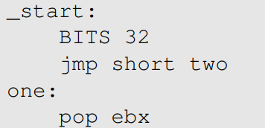
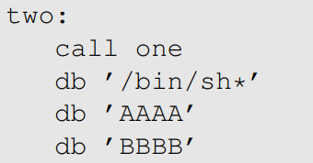
Getting the Addresses of String and ARGV[]
Pop out the address stored by “call”
…. code omitted …
This address is pushed into stack by “call”

Slide 21

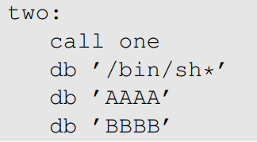
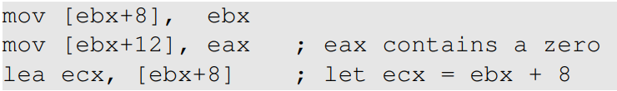
Data Preparation
Putting a zero at the end of the shell string
Constructing the argument array

Slide 22
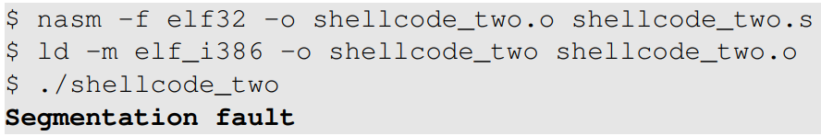
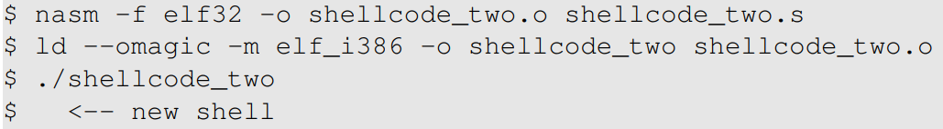
Compilation and Testing
Error (code region cannot be modified)
Make code region writable

Slide 23
64-bit shellcode

Slide 24
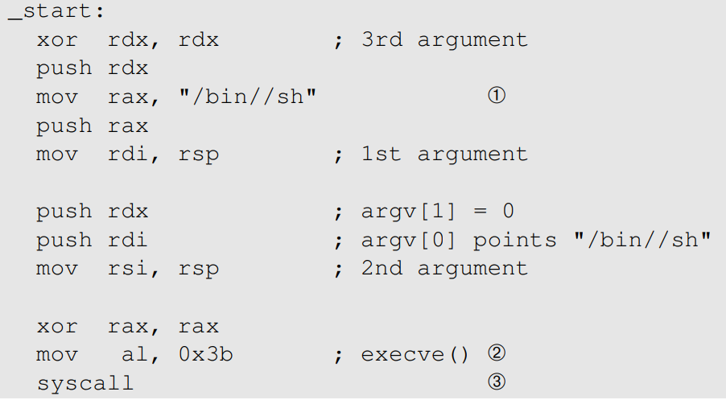
64-Bit Shellcode (elf64)

Slide 25
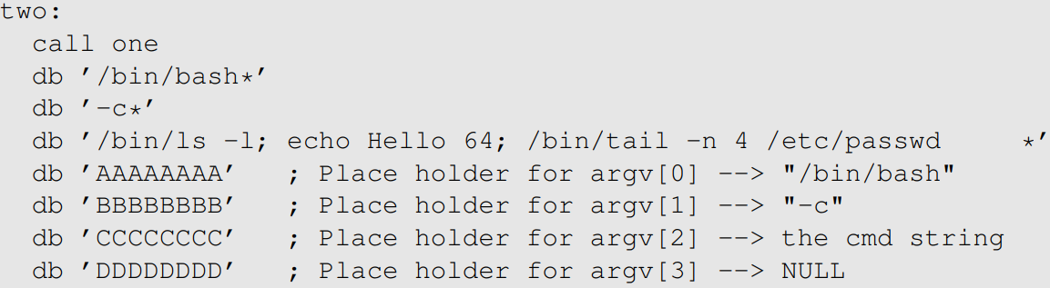
A Generic Shellcode (64-bit)
Goal: execute arbitrary commands
Data region
List of commands

Slide 26
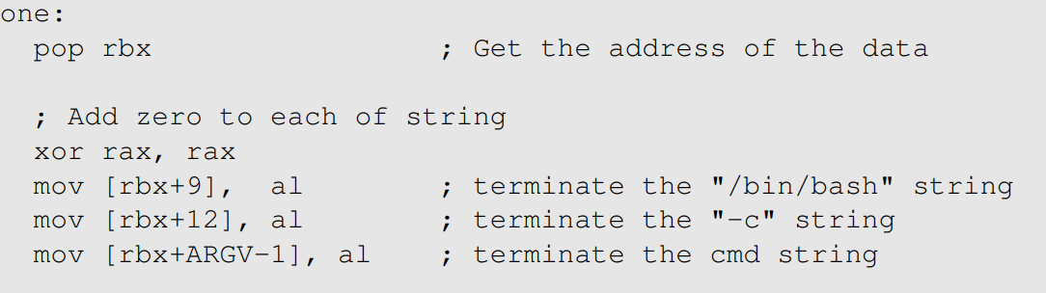
Data Preparation (1)

Slide 27
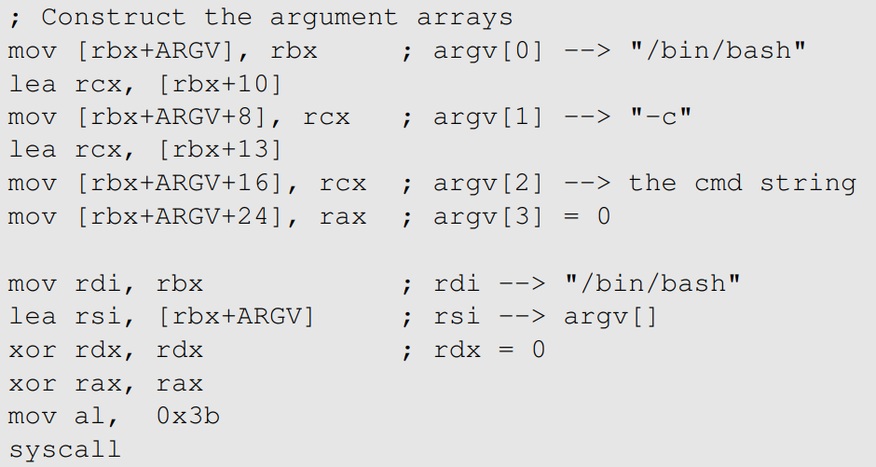
Data Preparation (2)

Slide 28
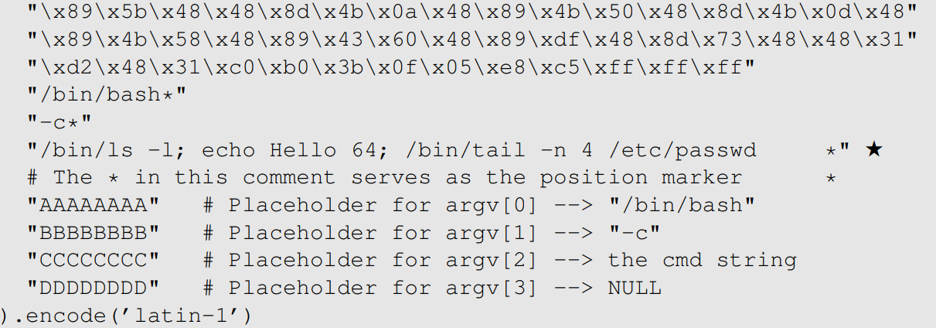
Machine Code
Notes:
We can easily modify the command string as long as we don’t change its length.
There is no need to recompile the source code.
Very useful for many labs, such as the buffer-overflow attack lab

Slide 29
Summary
Challenges in writing shellcode
Two approaches
32-bit and 64-bit Shellcode
A generic shellcode

