Slide 1
An introduction to the LAIS Agent-based Simulator
Nuno Fachada
23/01/2009

Slide 2
Summary
Features
Simulation paradigm and limitations
Architecture
Installing LAIS
Running LAIS
Simple predator-prey example
The LAIS API
Extending LAIS
Future work from me
Future work for you

Slide 3
Features
Modular and Flexible: lego like! simple classes = lego pieces => build complex models
Accessible: XML puts pieces together
Extensible: New pieces (classes) can be created
Transparently multithreaded

Slide 4
Simulation paradigm/limitations
  Simulation space is a 2D cellular automata neighborhood
  Simulation space has two layers (substance and agent layers)
  Agents are typical ABM discrete entities and have a mind of their own!
  Substances are real-valued entities, which obey to physical laws of diffusion, degradation and reaction: they are dumb!
  Agents can:
    Produce and consume substances
    Act depending on local substance concentration
    Display superficial substances
    React according to superficial substances displayed by other agents

Slide 5

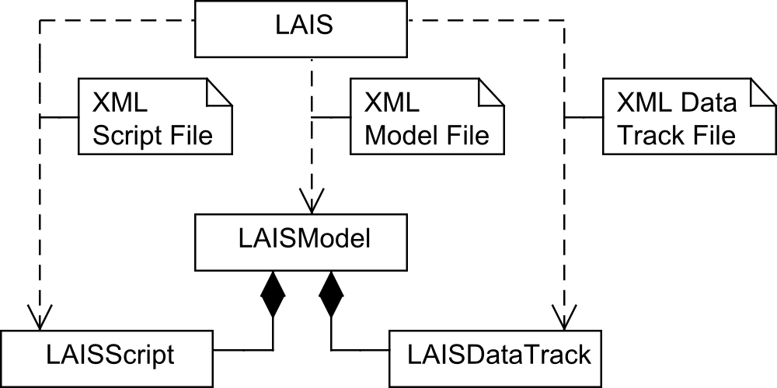
LAIS Architecture (1)

Slide 6
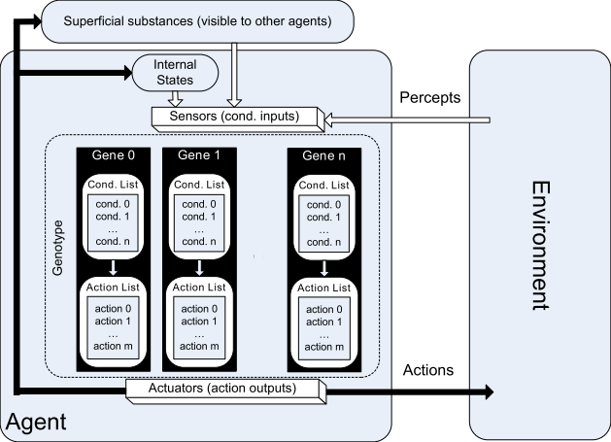
LAIS Architecture (2)
The agent

Slide 7
Installing LAIS
Temporary LAIS home on the web:
  http://web.ist.utl.pt/ist145239
Three files to download:
  LAIS_fullproject_version.zip
    Full eclipse project with ant builds, etc
  LAIS_light_version.zip
    Only binaries and examples
  LAIS_complete_version.zip
    Binaries, examples, source, docs
API also available directly online
Sourceforge soon?

Slide 8
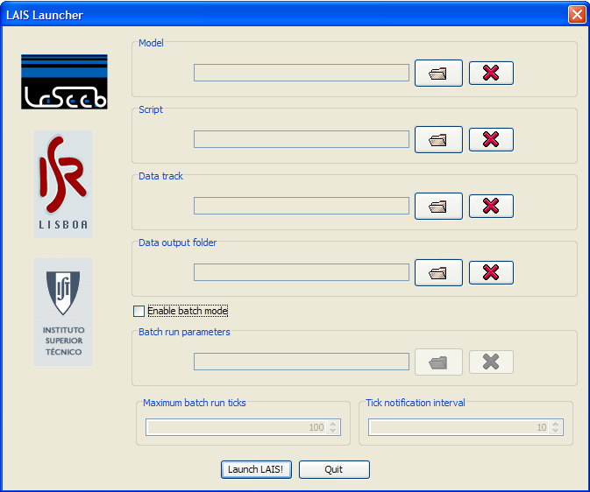
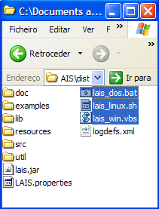
Running LAIS
Parameters can also be passed directly from the command line

Slide 9
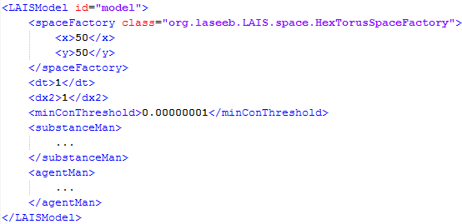
A simple predator-prey model (1)
The XML Model File

Slide 10
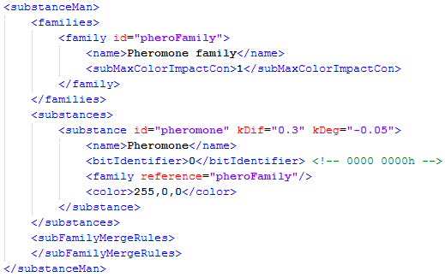
A simple predator-prey model (2)
The XML Model File: SubstanceManager

Slide 11
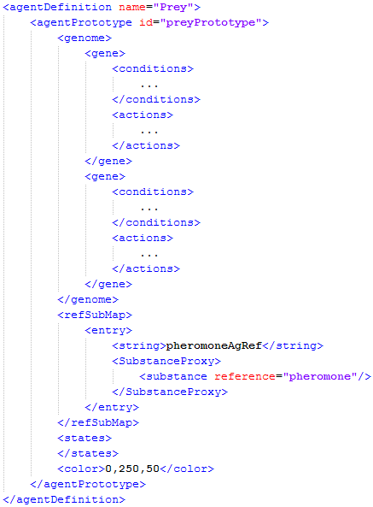
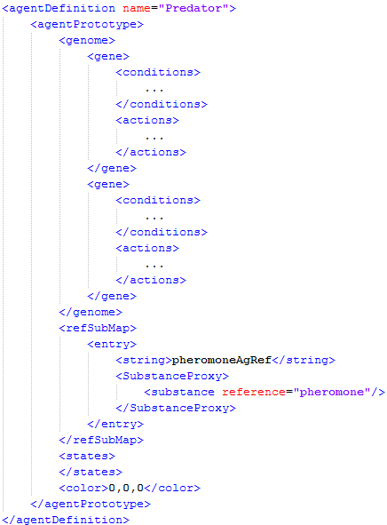
A simple predator-prey model (3)
The XML Model File: AgentManager

Slide 12
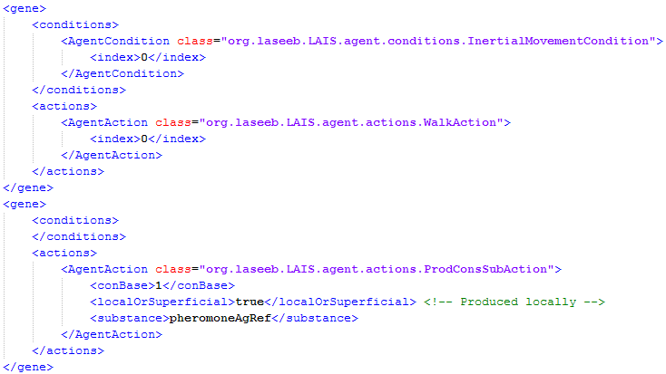
A simple predator-prey model (4)
The XML Model File: Prey genome

Slide 13
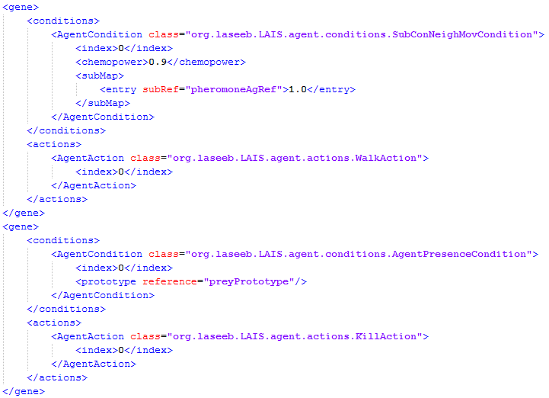
A simple predator-prey model (5)
The XML Model File: Predator genome

Slide 14
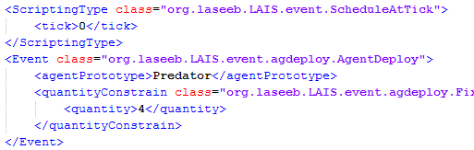
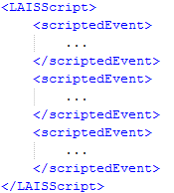
A simple predator-prey model (6)
The XML Script File

Slide 15
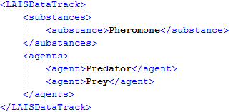
A simple predator-prey model (6)
The XML Data Track File

Slide 16
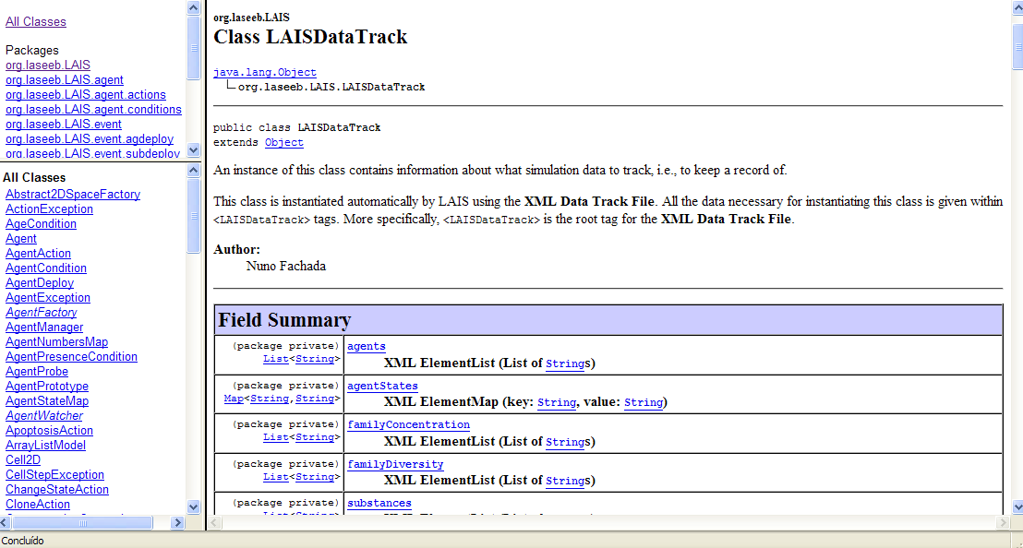
The LAIS API

Slide 17
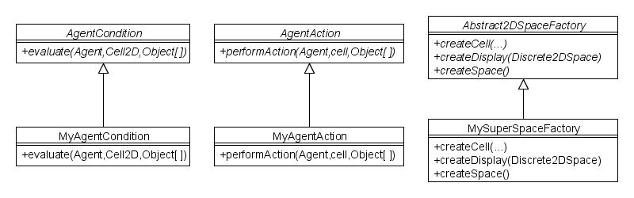
Extending LAIS
Other classes to extend:
Event (such as AgentDeploy, SubstanceDeploy)
Scheduling types (such as ScheduleAtTick, ScheduleAtInterval and PerformAtButtonPress)
Deployment constrains for AgentDeploy and SubstanceDeploy events.
Output (such as GraphicalOutput and FileOutput)
New classes can be directly referenced in XML and used in LAIS!

Slide 18
Future work from me
LAIS paper
Finish API (with XML examples, etc…)
Write user and developer manual (using API)
Perform some more unit tests Test
Develop 2D square space factory
Improve cell probing regarding agents
Improve InertialMovementCondition
SubstanceDeploy constrain: png deploy
AgentDeploy constrain: png deploy
Reproduce results with same random seed
Improve simulation display surface sizing and drawing

Slide 19
Future work for you
Users
  Models and Simulations
Developers (anyone?)
  Unit test non-unit-tested classes
  LAIS specific batch run parameters in XML (current Repast approach cannot access LAIS-specific parameters)
  Optimizer: optimizer calls LAIS in batch mode passing respective XML batch parameters, analyzes results, adjusts parameters and performs new tests automatically
  GUI for building simulations
  Investigate optimizations for the simulation engine (e.g. how to perform more efficient substance merging? Some type of hash merge?)

