Slide 1

Data analysis and insights for the tech industry
Winky Lee
2024 Dec 23

Slide 2



OUTLINE
Executive Summary
Introduction
Methodology
Results
Visualization – Charts
Dashboard
Discussion
Findings & Implications
Conclusion
Appendix

Slide 3

EXECUTIVE SUMMARY
Overview of data analysis process and finding
Point2
Sub Point 1
Sub Point 2
Sub Point 3
Point3
Point4
Point5

Slide 4

INTRODUCTION
Data from Stack Overflow annual Developer Survey
Purpose of the data analysis:
To identify emerging skills and trends in demand
Current and potential future developers in the digital and tech industry
Trending skills to pay attention to

Slide 5

METHODOLOGY
Survey data available from https://survey.stackoverflow.co/
Data wrangling
Exploratory data analysis
Analysising data distribution
Handling outliers
Correclations
Data visualization
Dashboard

Slide 6
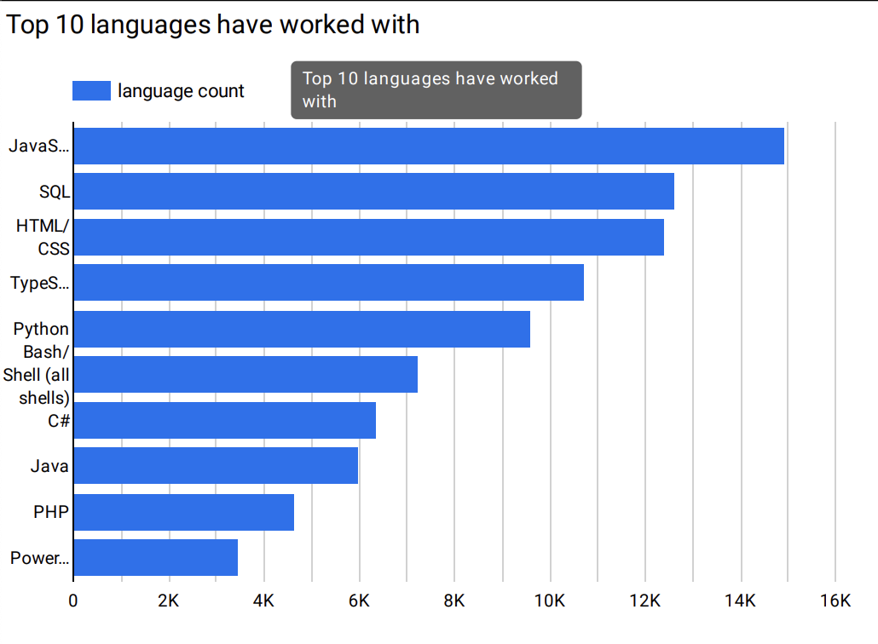
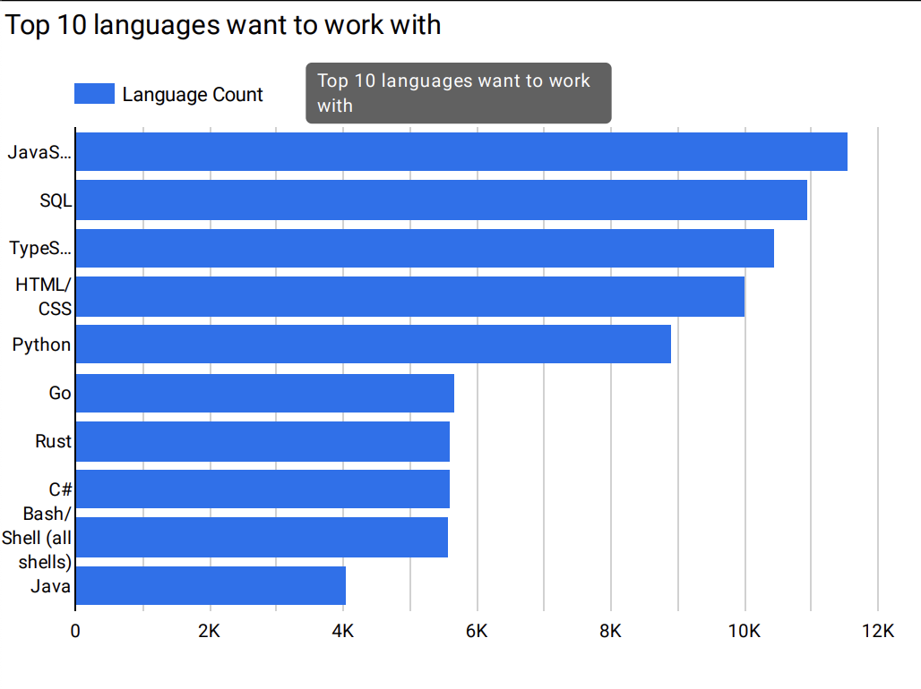
PROGRAMMING LANGUAGE TRENDS
Current Year
Next Year
<Bar chart of top 10 programming languages for the current year goes here.>
< Bar chart of top 10 programming languages for the next year goes here.>

Slide 7
PROGRAMMING LANGUAGE TRENDS - FINDINGS & IMPLICATIONS
JavaScript and SQL remain the leading programming languages this year and are projected to retain their top spots next year
Worth prioritizing training in JavaScript and SQL to strengthen frontend and backend development capabilities
Rust and Go are becoming increasingly popular
PHP and Java are experiencing a decline in popularity

Slide 8
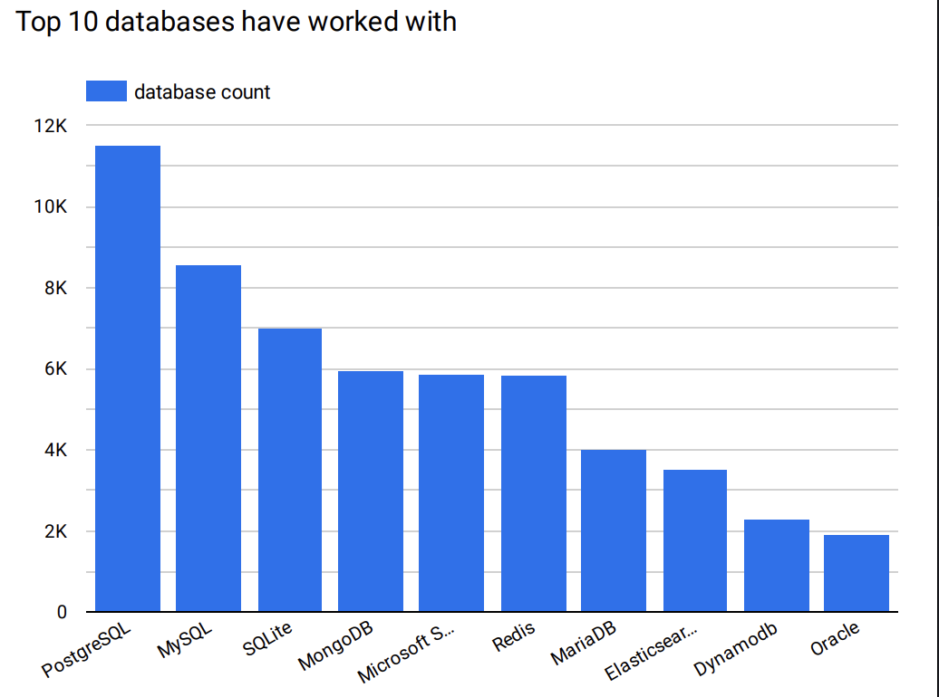
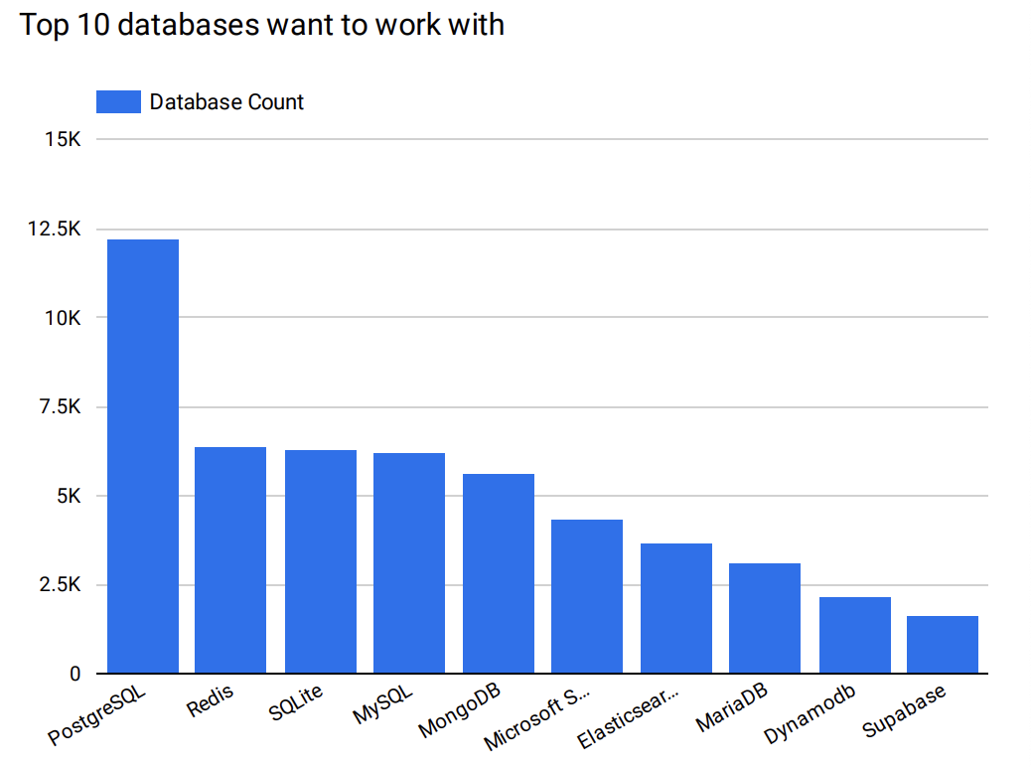
DATABASE TRENDS
Current Year
Next Year
< Bar chart of top 10 databases for the current year goes here >
< Bar chart of top 10 databases for the next year goes here.>

Slide 9
DATABASE TRENDS - FINDINGS & IMPLICATIONS
PostgreSQL continues to lead as the most popular database this year and is projected to maintain its position next year.
Redis is rapidly gaining popularity
Driven by the growing demand for low-latency databases.
SQLite, MySQL, MongoDB remain widely used and reliable choices

Slide 10

DASHBOARD
https://github.com/Laamkh/ibm-data-analyst-coursera.git

Slide 11
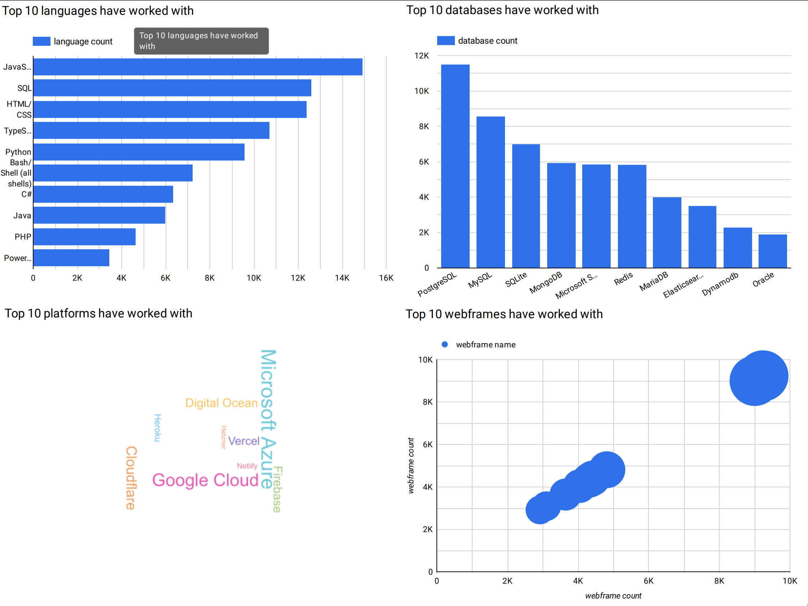
Current technology usage

Slide 12
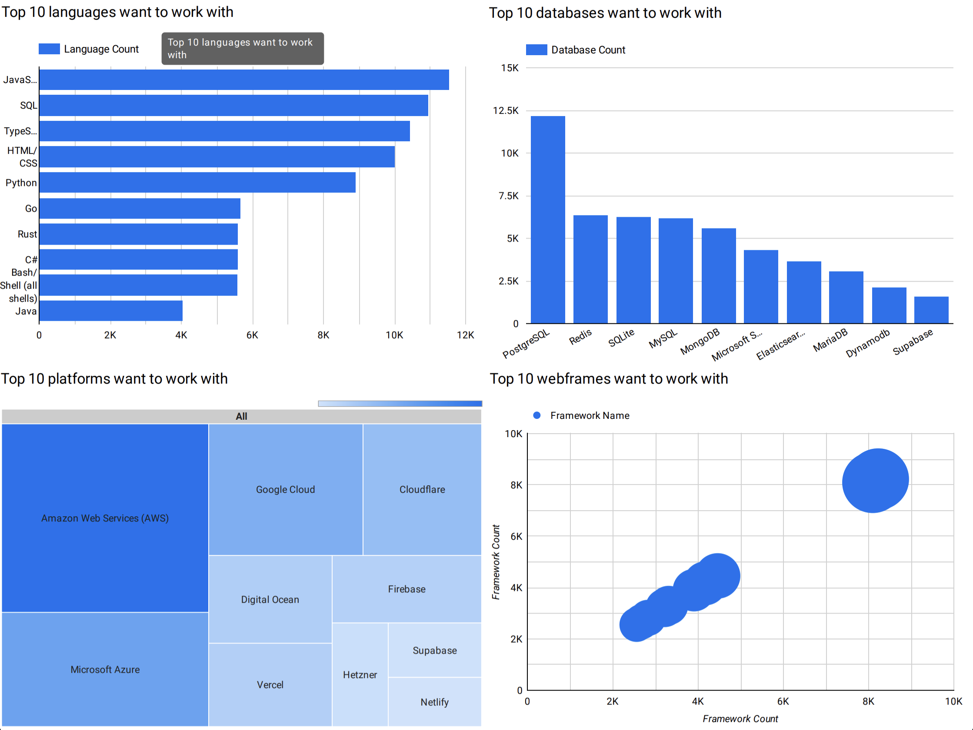
Future technology trend

Slide 13
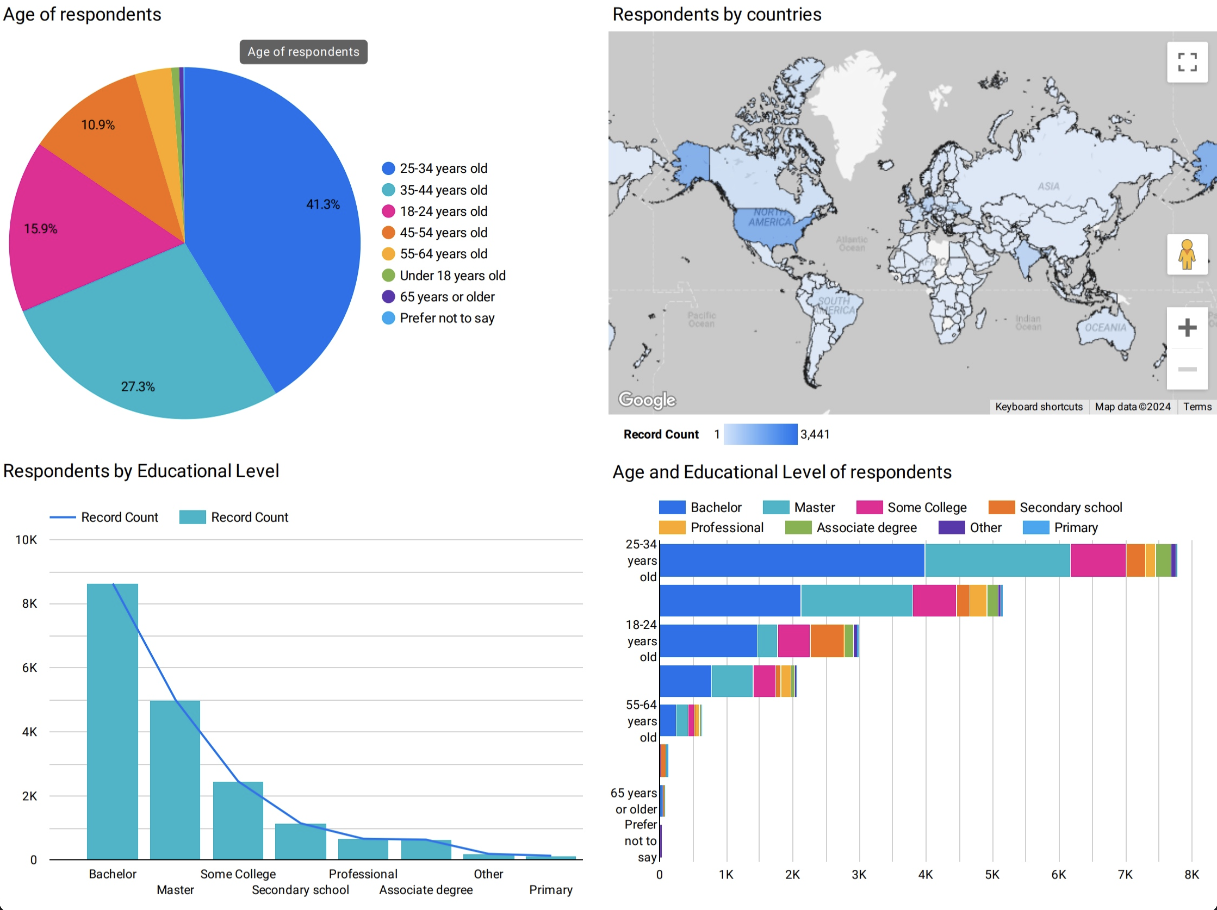
Demographics of respondents

Slide 14
DISCUSSION
The majority of respondents hold a bachelor's degree or higher
Most respondents are based in the United States
The largest age group among respondents is 25-34 years old

Slide 15
OVERALL FINDINGS & IMPLICATIONS
Javascript and SQL remains popular programming language choice
Worth investing training in Javascript and SQL
Growing interest in real-time data processing and cloud platforms
Redis
AWS and Google Cloud

Slide 16

CONCLUSION
Popular languages and database in use and future
Composition of developers
Tech industry is always evolving
Stay informed and Adapt

Slide 17

APPENDIX

Slide 18
JOB POSTINGS

Slide 19
POPULAR LANGUAGES

