Slide 1

Data analysis and insights for the tech industry
Winky Lee
2024 Dec 23

Slide 2

OUTLINE
Executive Summary
Introduction
Methodology
Results
Visualization – Charts
Dashboard
Discussion
Findings & Implications
Conclusion
Appendix

Slide 3

EXECUTIVE SUMMARY
Objective: Highlight emerging tools, skills, and technologies to guide developers, educators, and recruiters.
Key Insights:
Databases: PostgreSQL leads; Redis and Supabase are rising stars.
Languages: JavaScript and SQL dominate, with Rust and TypeScript gaining momentum.
Platforms: AWS remains top, but cloud-native solutions like Vercel are growing.
Frameworks: React and Node.js lead; Next.js and FastAPI are rapidly emerging.
Trend: A clear industry shift toward lightweight, scalable, and developer-friendly technologies.

Slide 4

INTRODUCTION
Source: Stack Overflow Developer Survey
Objective of Analysis:
Highlight emerging skills and technologies shaping the industry.
Inform aspiring and active tech professionals on future trends and in-demand expertise.
Provide actionable insights for developers, educators, and tech recruiters to adapt to evolving demands.

Slide 5

METHODOLOGY
Data collection
Survey data from https://survey.stackoverflow.co/
APIs and web scraping techniques
Data wrangling
Removing duplication, imputing missing values, normalising data
Exploratory data analysis
Analysing distribution, handling outliers, identifying correlation
Data visualization
Dashboard

Slide 6
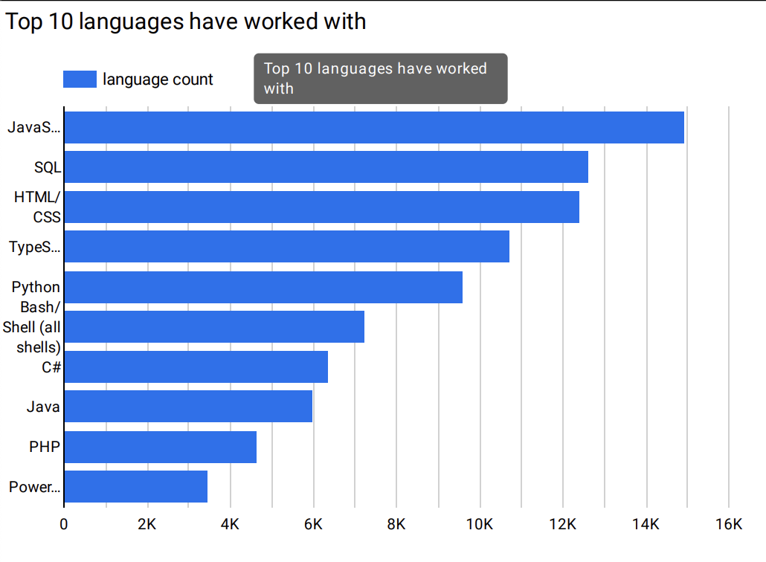
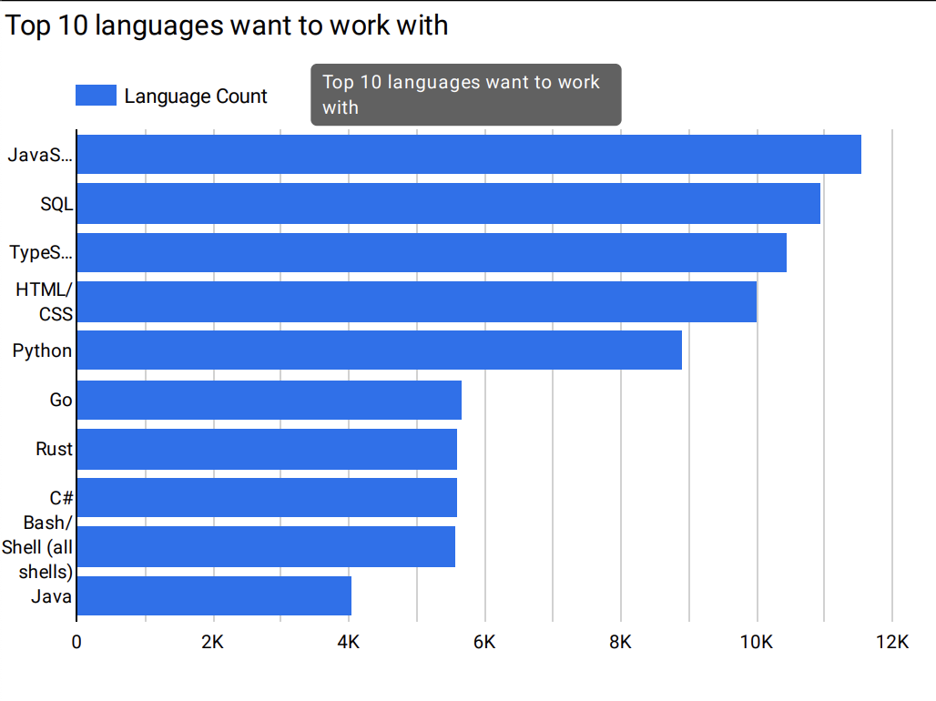
PROGRAMMING LANGUAGE TRENDS
Current Year
Next Year
<Bar chart of top 10 programming languages for the current year goes here.>
< Bar chart of top 10 programming languages for the next year goes here.>

Slide 7
PROGRAMMING LANGUAGE TRENDS - FINDINGS & IMPLICATIONS
JavaScript and SQL Dominance:
Investing in training for JavaScript and SQL is a safe bet for individuals and organizations aiming to stay competitive in software and data-related fields.
Rising Popularity of Rust and Go:
Learning Rust and Go can open opportunities in emerging tech sectors, such as distributed systems, DevOps, blockchain and cloud computing.
Decline of PHP and Java:
Organizations may start phasing out PHP and legacy Java systems in favor of modern tools, leading developers to adapt by learning newer technologies.

Slide 8
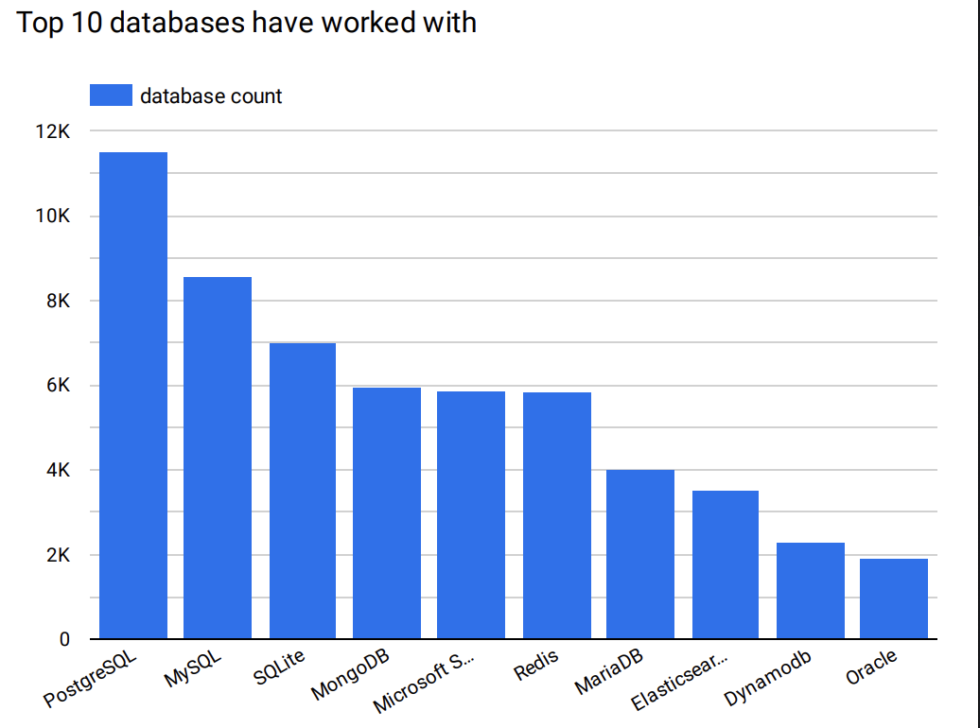
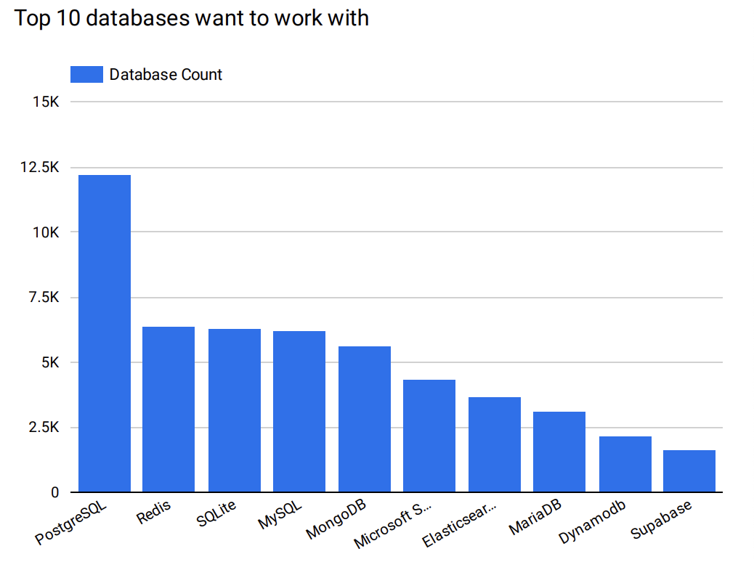
DATABASE TRENDS
Current Year
Next Year
< Bar chart of top 10 databases for the current year goes here >
< Bar chart of top 10 databases for the next year goes here.>

Slide 9
DATABASE TRENDS - FINDINGS & IMPLICATIONS
Continued Dominance of PostgreSQL:
Organizations and developers may prioritize PostgreSQL for its proven reliability, scalability, and widespread adoption.
Emerging Popularity of Redis:
Companies might consider Redis for for use cases requiring high-speed operations like caching, real-time analytics, and session management.
Steady popularity of SQLite, MySQL, and MongoDB:
These databases continue to be reliable and widely used, suggesting they will remain important choices for specific use cases:
SQLite for lightweight, embedded database needs.
MySQL for traditional relational database applications.
MongoDB for NoSQL solutions, particularly where flexibility in schema design is required.

Slide 10

DASHBOARD
https://github.com/Laamkh/ibm-data-analyst-coursera.git

Slide 11
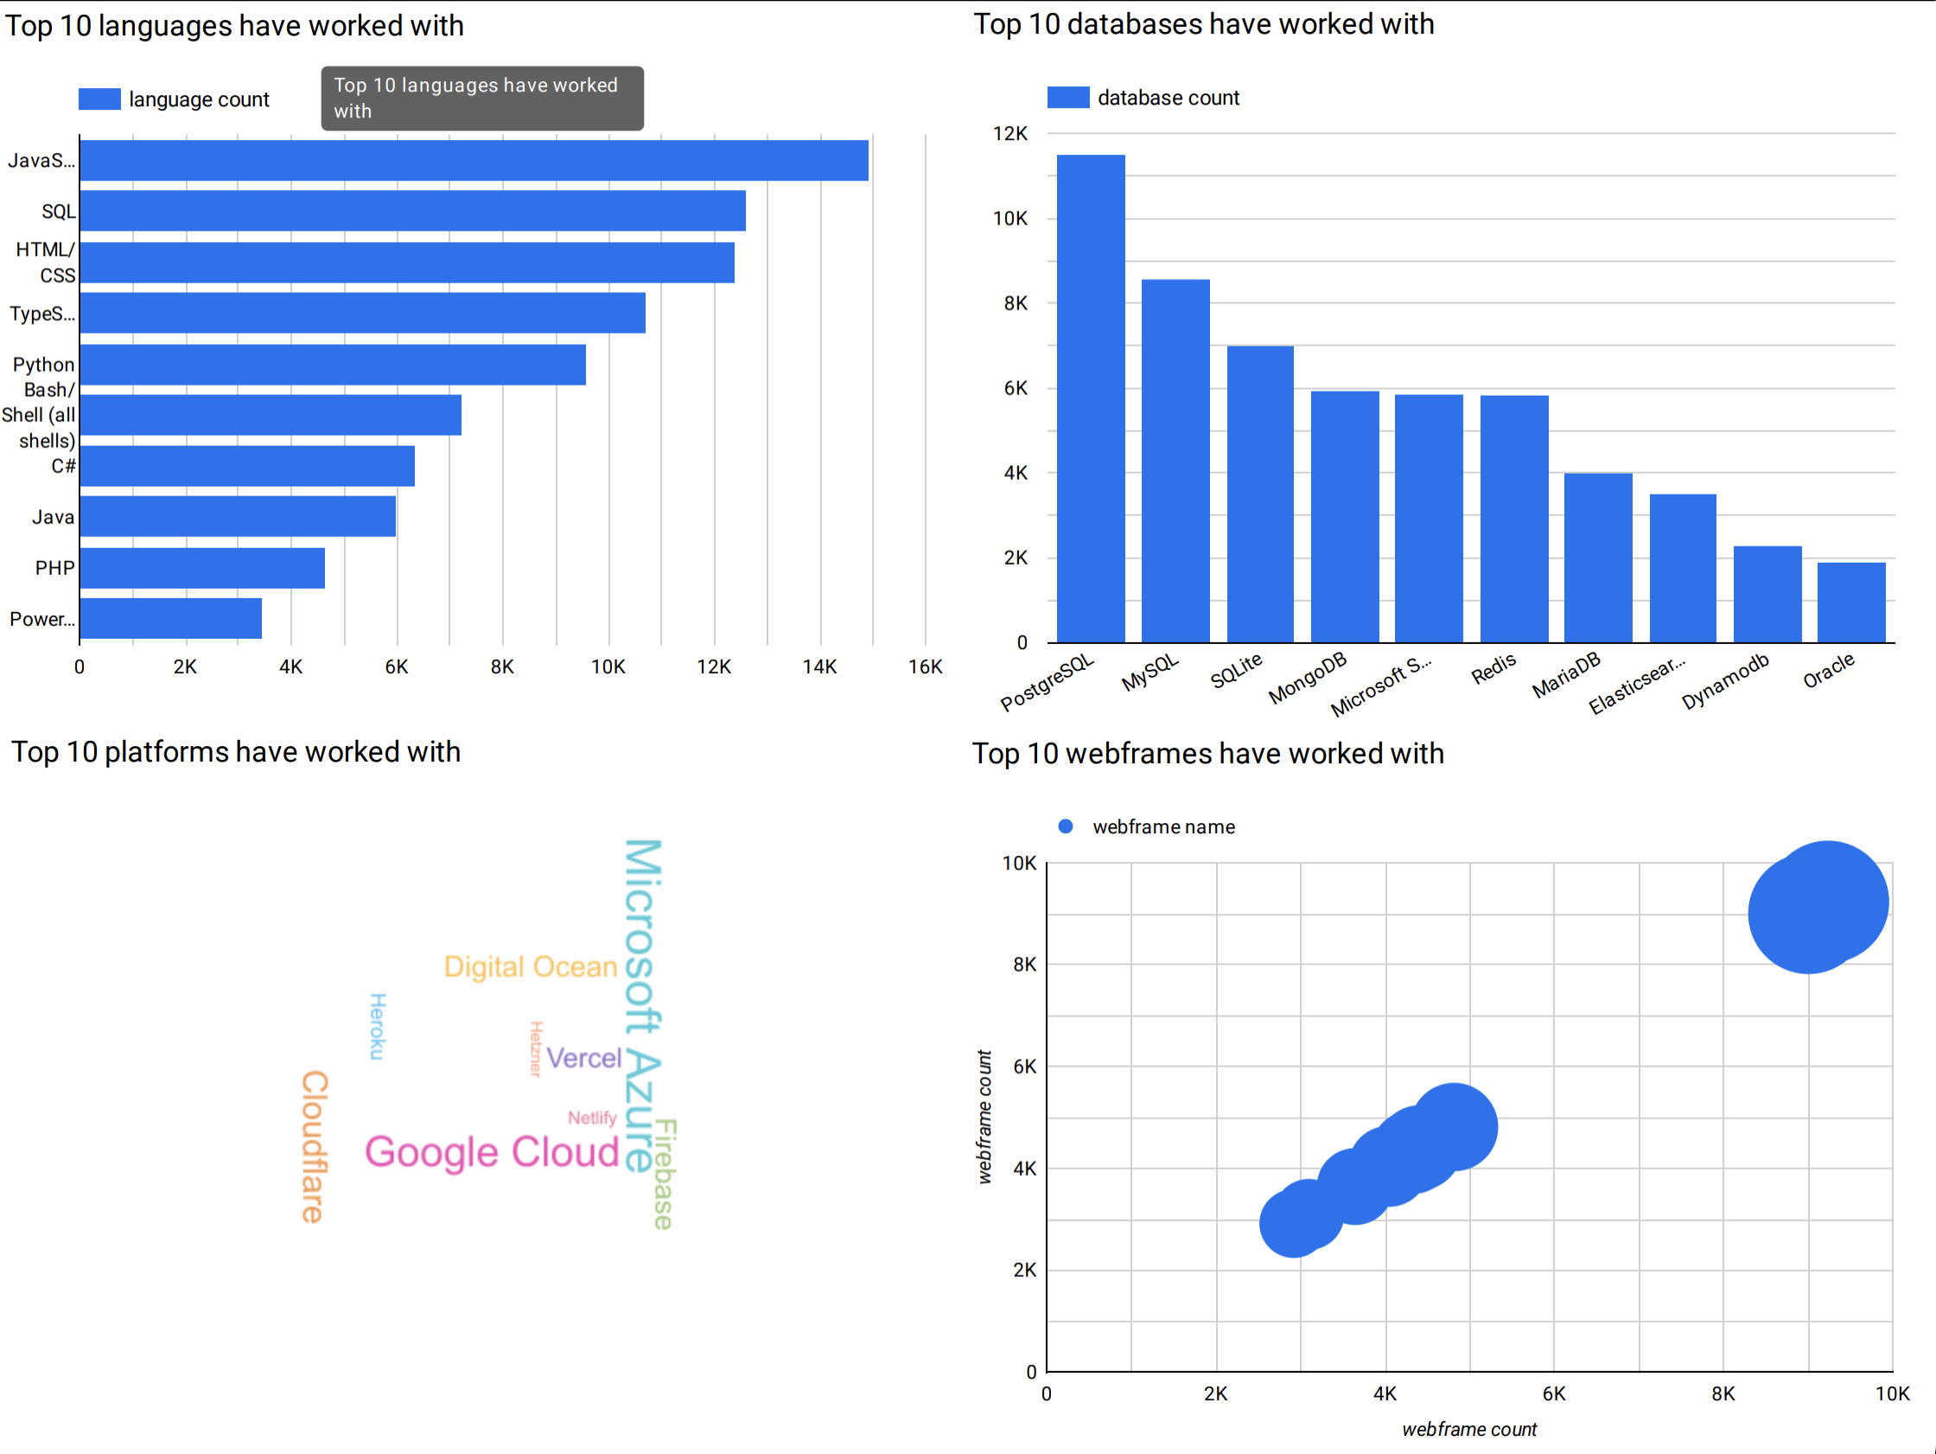
Current technology usage

Slide 12
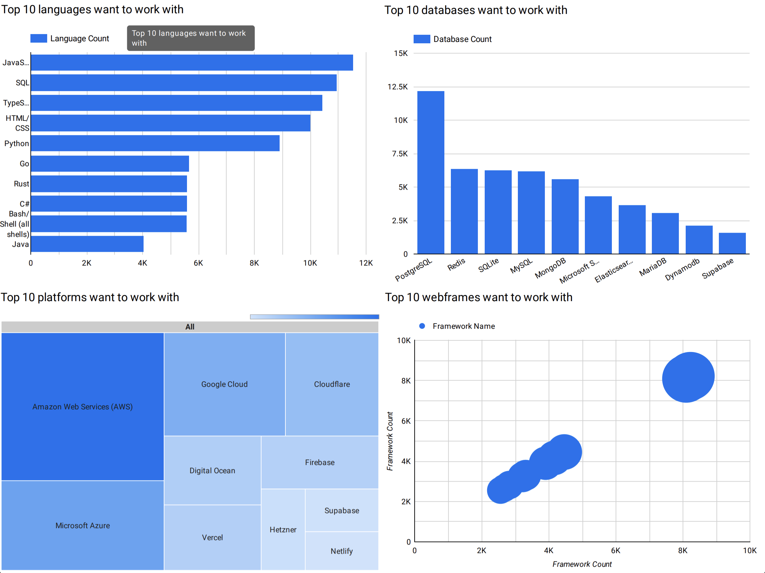
Future technology trend

Slide 13
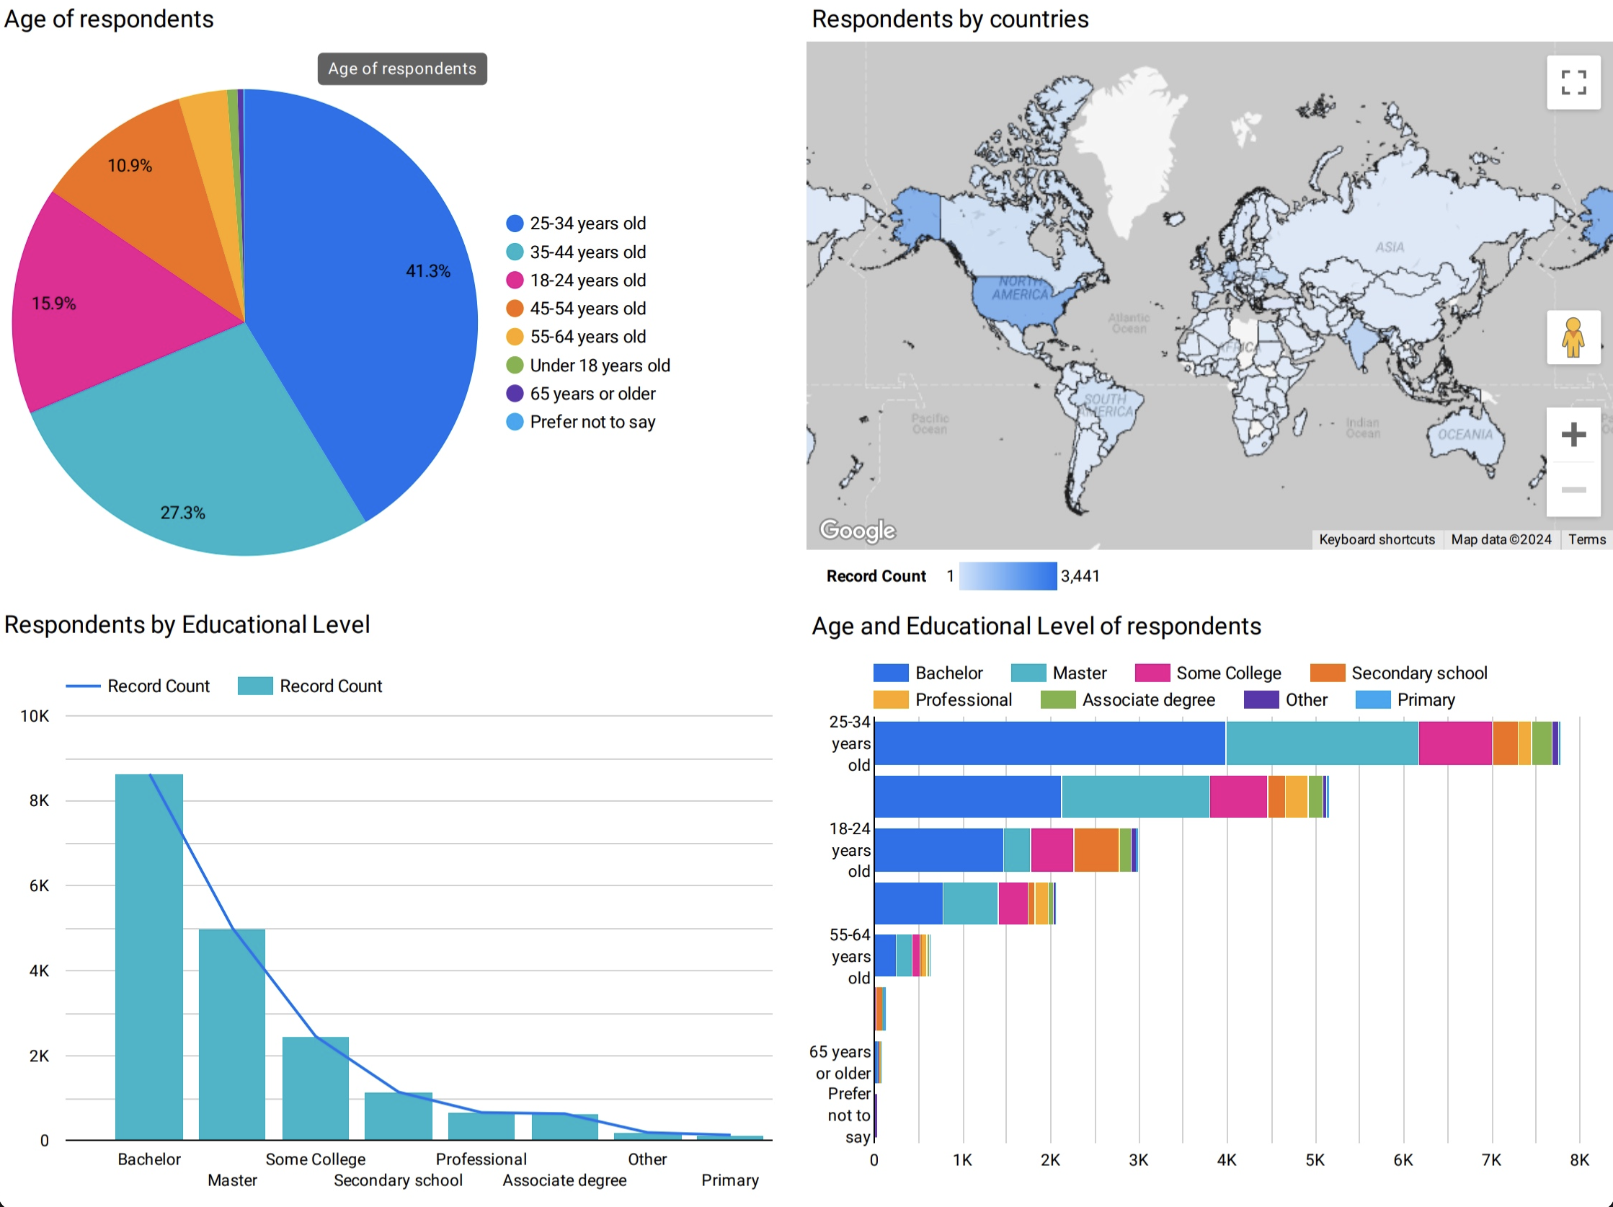
Demographics of respondents

Slide 14
DISCUSSION
PostgreSQL’s Leadership: It’s likely to remain the top choice for developers, but there’s a clear push toward modern solutions like Redis and Elasticsearch.
Programming Trends: Languages like Rust, Go, and TypeScript are emerging as the future, especially for performance-critical applications.
Cloud Platforms Evolution: While AWS dominates, smaller and modern platforms like Supabase are rapidly gaining interest.
Framework Shifts: Developers are leaning toward modern frameworks like Next.js, FastAPI, and Svelte for flexibility, performance, and simplicity.

Slide 15
OVERALL FINDINGS & IMPLICATIONS
Shift Toward Modernity: Developers prefer tools that are efficient, scalable, and developer-friendly, moving away from legacy systems.
Performance and Simplicity: There's a clear trend toward technologies that balance high performance (Rust, Redis) with ease of use (Supabase, Next.js).
Cloud-Native Ecosystem: Interest in lightweight, serverless, and cloud-native platforms and tools is growing across databases, platforms, and frameworks.
Full-Stack Integration: Popular tools show a focus on seamless frontend-backend integration (e.g., TypeScript with Next.js).

Slide 16

CONCLUSION
Key Takeaways:
Established tools (e.g., PostgreSQL, JavaScript, React, AWS) remain dominant.
Emerging technologies (e.g., Rust, Redis, Next.js) are gaining traction, reflecting industry shifts.
Implications:
Developers: Focus on in-demand skills and explore emerging technologies.
Educators/Recruiters: Align strategies with industry trends to address future needs.
Final Note: Adaptability and continuous learning are essential to thrive in the ever-evolving tech landscape.

Slide 17

APPENDIX

Slide 18
JOB POSTINGS

Slide 19
POPULAR LANGUAGES

