Slide 1



Sentiment Analysis on
COVID 19 Tweets
A high-level summary of the key objectives and scope of the project to analyze sentiment in COVID-19 tweets using R language.
by Laasya Kruthi

Slide 2

Team!
2110030019 – I N Chiranjeevi 2110030110 – J Laasya Kruthi
2110030281 – G Pranav Kumar 2110030287 – N Jahnavi
2110030313 – Mehak Goyal 2110030317 – Sayyed Sameer Basir

Slide 3
Problem Statement
The COVID-19 pandemic has significantly impacted people's lives globally, and social media platforms like Twitter have become a platform for sharing experiences and emotions. This project aims to analyze the sentiment of public opinion on COVID-19 by developing a sentiment analysis model for a dataset of COVID-19 related tweets.
The model will classify each tweet into one of three categories: positive, negative, or neutral sentiment. This analysis will provide insights into public perception of the pandemic, including anxieties, concerns, and potential areas of gratitude or hope expressed on social media.

Slide 4

Introduction to Sentiment Analysis
Sentiment analysis is a powerful technique that uses natural language processing to understand the emotional tone and subjective opinions expressed in text.
It helps organizations gauge public sentiment towards their products, services, or brand by analyzing customer reviews, social media posts, and other textual data.

Slide 5
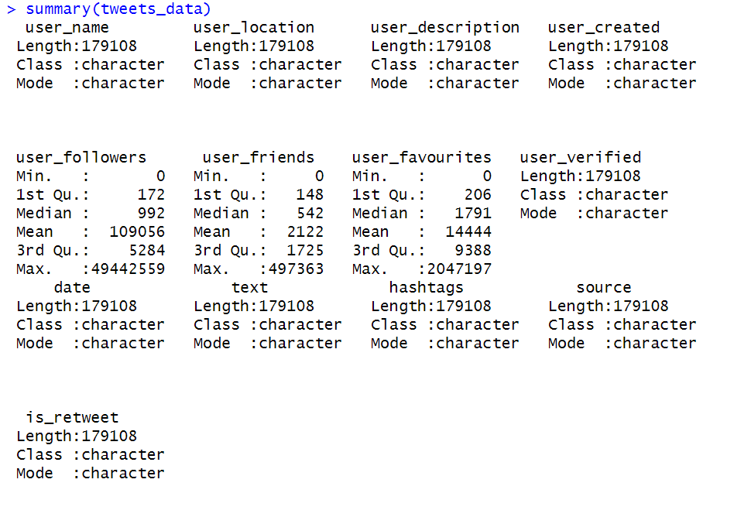
Dataset

Slide 6

Data Collection: Gathering COVID-19 Tweets
1
Twitter API
Leverage Twitter API to collect real-time COVID-19 tweets
2
Search Criteria
Filter tweets using relevant keywords and hashtags
3
Data Volume
Gather a large, representative sample of COVID-19 tweets

Slide 7
Data Preprocessing: Cleaning and Transforming the Data
Cleaned and preprocessed raw tweet data to remove noise, handle missing values, and standardize text format.
Applied text cleaning techniques like removing URLs, hashtags, mentions, and special characters.
Performed language detection and filtering to focus on English-language tweets.

Slide 8
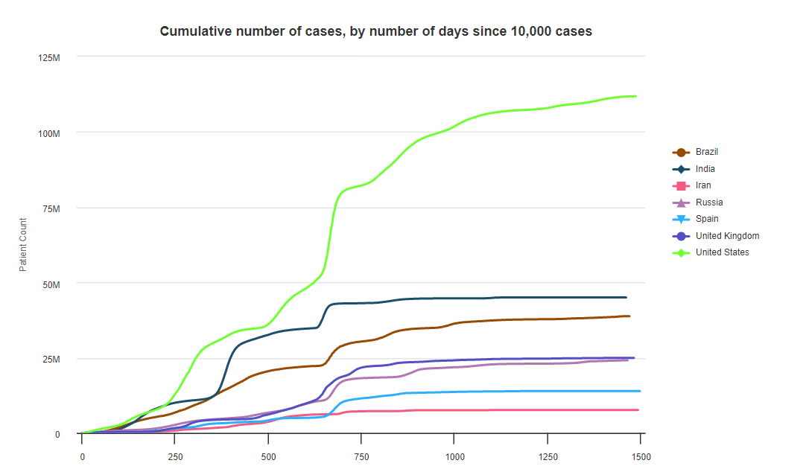

Slide 9
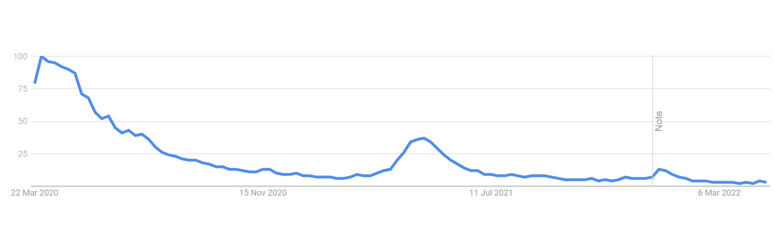
Interest on COVID-19 Overtime

Slide 10
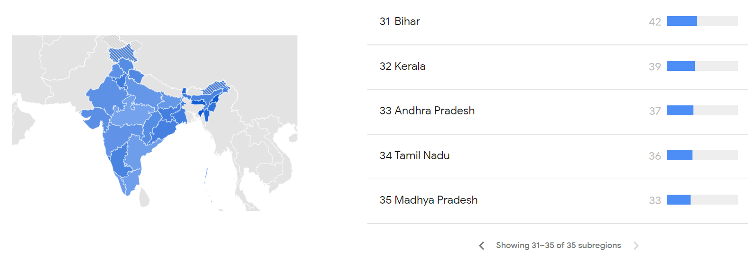
Interest spike by Sub-region

Slide 11
Sentiment Analysis Methodology
Leveraging natural language processing (NLP) techniques to analyze tweet text
Applying sentiment dictionaries to classify tweets as positive, negative, or neutral
Implementing machine learning models to improve sentiment classification accuracy
Accounting for COVID-19 context and domain-specific language in the analysis
Validating results through manual review and comparison to other sentiment analysis tools

Slide 12




Sentiment Classification: Positive, Negative, and Neutral
Positive Sentiment
Tweets expressing optimism, gratitude, and hope
Negative Sentiment
Tweets conveying frustration, fear, and despair
Neutral Sentiment
Tweets with factual, objective language

Slide 13
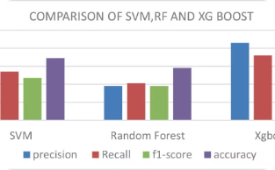
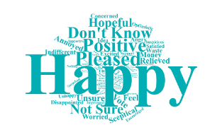
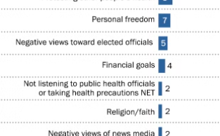

Visualizing Sentiment Trends
Sentiment Trends Over Time
Key Sentiment Words
Sentiment Polarity Distribution
Sentiment Heatmap
Track shifts in public sentiment on COVID-19 tweets
Analyze most frequent positive, negative, and neutral terms
Visualize percentage of positive, negative, and neutral tweets
Identify high and low sentiment areas over time and location

Slide 14
Insights and Findings
Prominent Sentiments
Shifts Over Time
Key Themes
Regional Variations
Negative sentiments initially dominated, but gradually shifted towards more positive outlooks.
Concerns about health, safety, and economic impacts
Tweets expressed a mix of negative, positive, and neutral sentiments towards the pandemic.
Sentiment patterns differed across countries, reflecting local contexts and experiences.
Gratitude for frontline workers and community support
Hopes for a return to normalcy

Slide 15
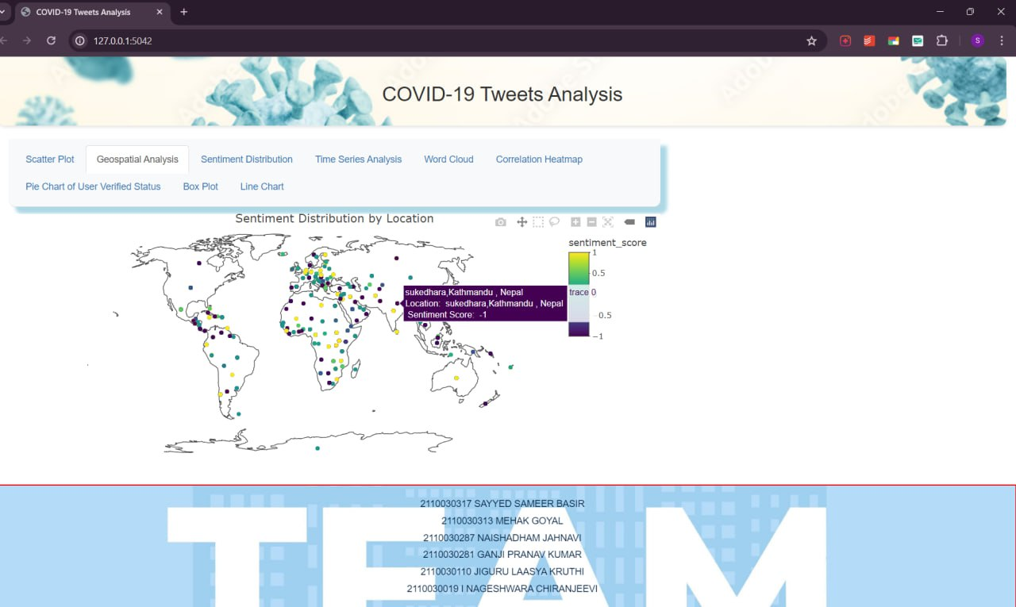
Outputs

Slide 16
Limitations and Future Improvements
1
Data Limitations
2
Methodology Improvements
Tweets may not represent full population sentiment
Enhance sentiment analysis with advanced ML techniques
3
Contextual Understanding
4
Longitudinal Analysis
Integrate external data to better interpret tweet meaning
Track sentiment shifts over time to identify trends

Slide 17
Conclusion and Key Takeaways
Powerful Insights
Informed Decision-Making
Sentiment analysis reveals meaningful trends in public reaction.
Insights can guide strategic responses to public sentiment.
Actionable Next Steps
Further research and application can unlock greater value.

Slide 18






Thank You
by Laasya Kruthi

