Slide 1

RESULTS
Auto Insurance Case Study

Slide 2
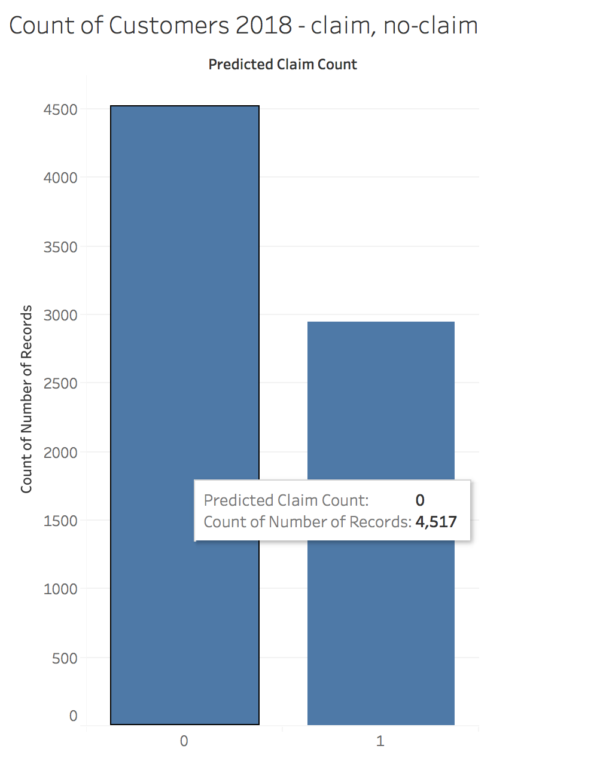
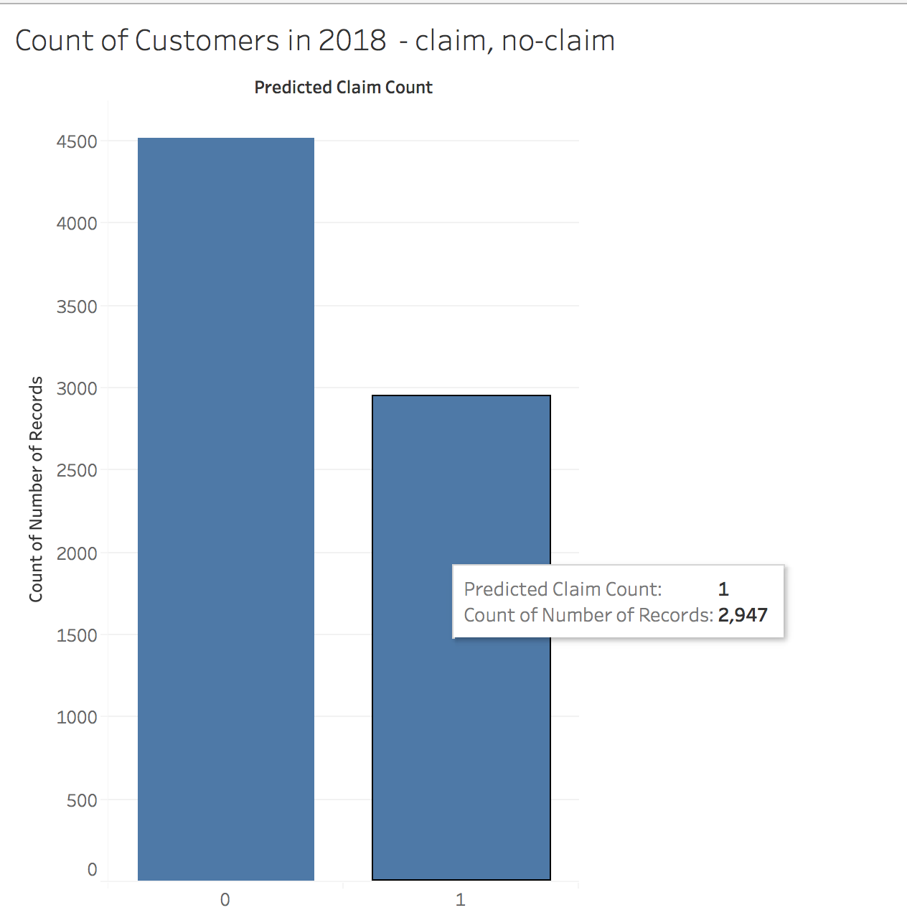
Customers with a low probability of having any claims
Move ahead with Risk Profile Groups

Slide 3
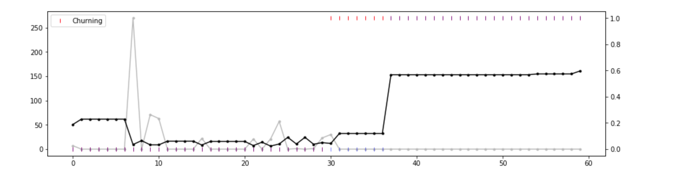
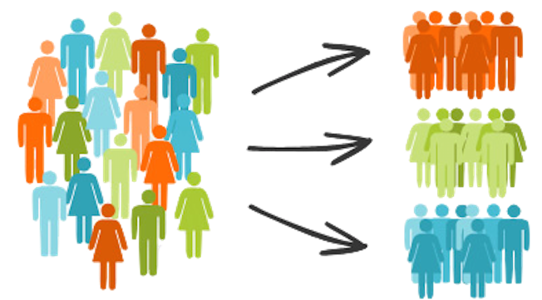
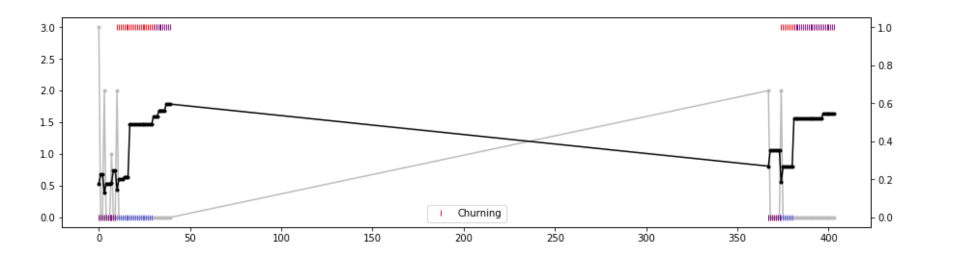
PROPOSAL 1
WHEN?
WHO?
Risk Profile Groups
Different epochs of high claim cost
Seasons to send out the marketing campaigns

Slide 4
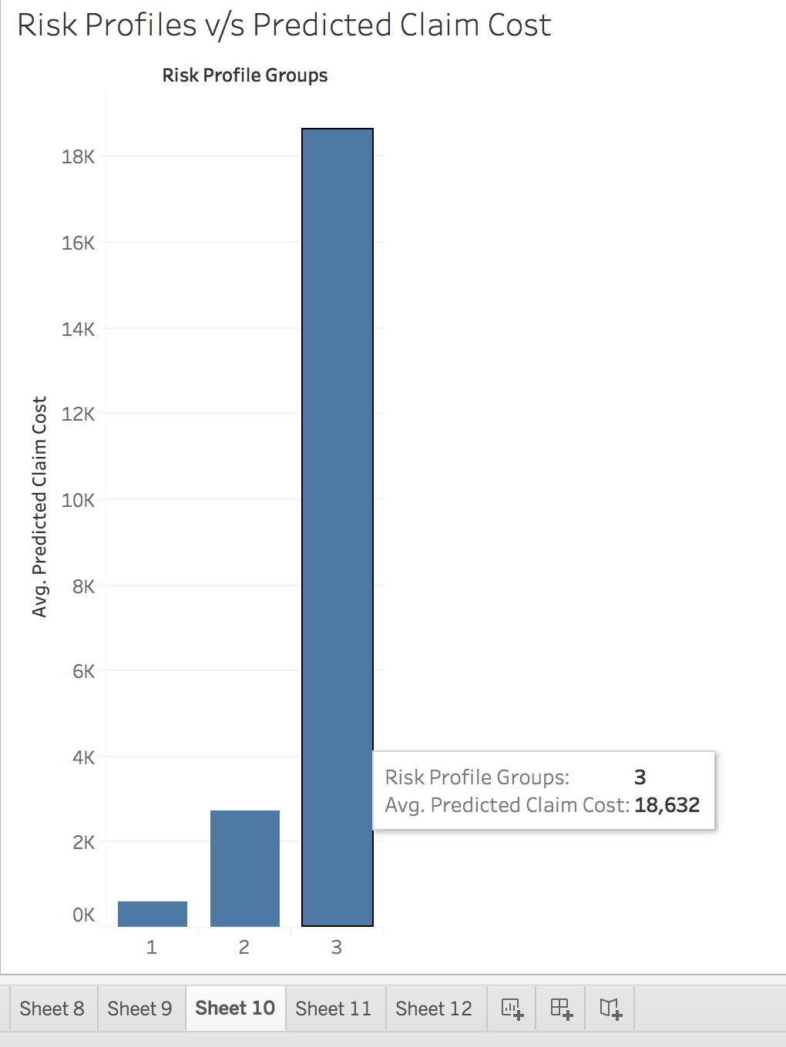
PROPOSAL 2
CHARACTERISTICS OF RISK PROFILE 3
Females have a larger claim cost than males
Oldest group of people, agecat 6 has the
largest claim cost
Area E has the largest cost of claims
HBACK, SEDAN, UTE and STNWG do not
contribute much to the higher cost of claims
The newer vehicles contribute more to the
claim cost than vehicles which are older in age

Slide 5
MARKETING CAMPAIGNS
A gender gap analysis can be done. The results of which can be utilized to target
Females having higher claim cost
An automated e-mail marketing can be scheduled to send out season campaigns
during the epochs when claim costs are high
Environmental awareness campaigns can be held in the areas with higher claim costs &
High traffic_index
Educational campaigns elucidating insurance claims with regards to the automobile sector
can be conducted to make the age groups having higher risks, higher claim costs
Brand loyalty can be analyzed with respect to the coupe of cars that contribute to
higher claim costs and campaigns to reduce the claims with such cars can be conducted

Slide 6

METHODOLOGY
Technologies Used: Python, Tableau

Slide 7
Data Munging
Train validate split
Probabilities of claim/No-claim
Claim Cost Prediction
Gini Index for Model Selection
K-fold
Predictions on test data + Binning for Risk Profile Groups

Slide 8
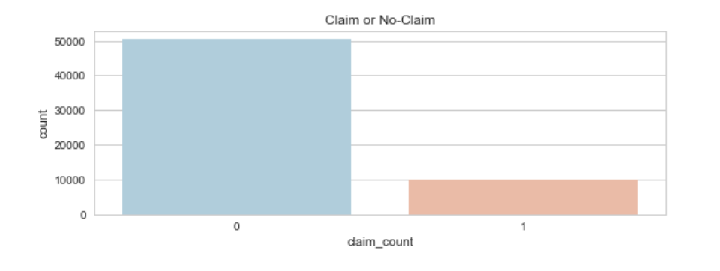
DATA EXPLORATION & PROCESSING
DATA IMPUTING (filling missing values - agecat, traffic_index, credit_score
DATA TRANSFORMATIONS – One Hot Encoding
DATA SPLIT

Slide 9

Logistic Regression
Random Forest Regressor
Decision Trees
Regressor
Extra Trees Regressor
Gradient Boosted
customers with a low probability of having any claims
customers with the lowest cost per claim, given that a claim occurs

Slide 10
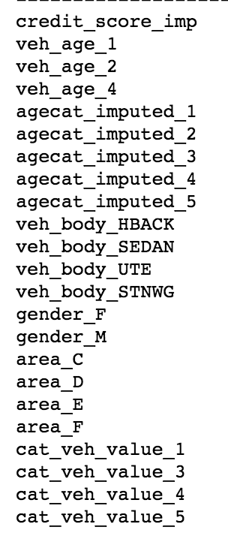
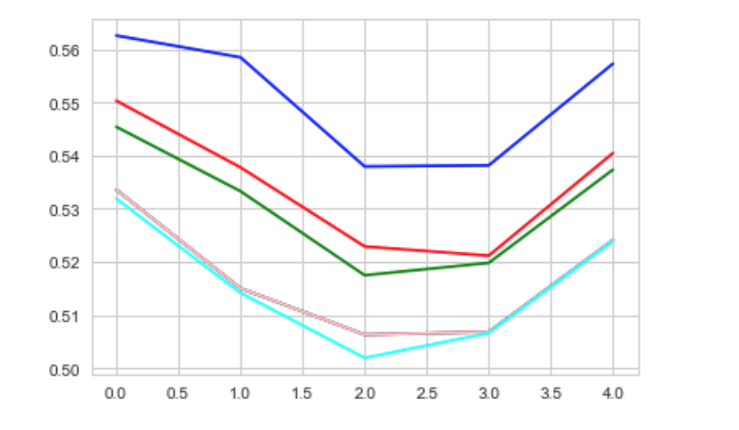
MODEL SELECTION AND EVALUATION
K-FOLD
- n_splits = 5
GINI INDEX
- Uncertainty removal
FEATURE IMPORTANCE
- Statistical significance
GLM
Gini scores
K-Fold sets

Slide 11
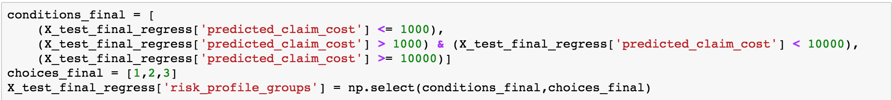
BINNING – Risk Profile Groups

Slide 12
FUTURE ROADMAP
-PREDICTIVE MODELING
Build a Clustering Model (K-means , Hierarchical) to get more characteristic risk profile groups
Use the risk profile groups as cluster labels and as a target variable for further classification algorithms (Decision Trees) to predict likelihood of a policy claim
Build a nested model (Neural Nets) and track the impact of marketing campaigns
Network Analysis to quantify the path of propagation of risk based on the risk profiles
Build a similar model that predicts profit through reduction in claim costs

Slide 13


