Slide 1
Install and Setup Simulink Support Package for Andriod Device

Slide 2
VERSION | DATE | DETAIL | AUTHOR | REVIEW
 | 16/02/2020 |  | Phi.DCH

Slide 3
1. Installation
Require:
Matlab version 2018b and beyond (cracked)
Android device (your smartphone, tablet, vv)
Matlab Simulink
Mathwork account

Slide 4
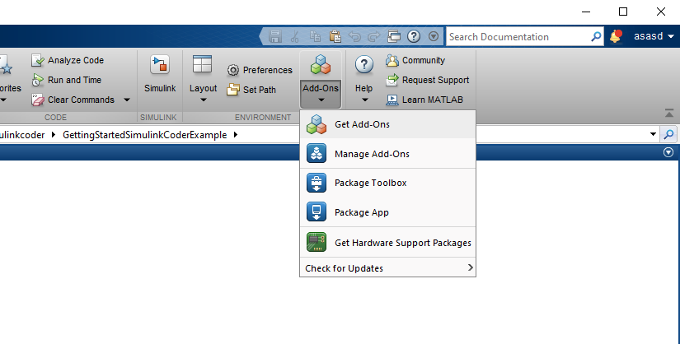
1. Installation
Step1: Sign in matlab with your mathwork account. Go to Add-ons, Get add-ons, search for Package for Android device

Slide 5
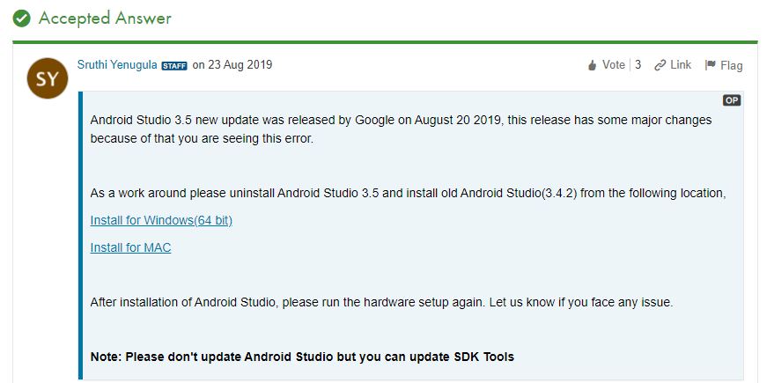
1. Installation
Step2: Install add-ons.
Step3: Install android studio. (Note that: you should download Android studio version 3.4 because the lastest version 3.6 is not compatible with simulink) for more detail: https://www.mathworks.com/matlabcentral/answers/477292-hardware-setup-failed-for-simulink-android-support-package-for-18a-18b-and-19a

Slide 6
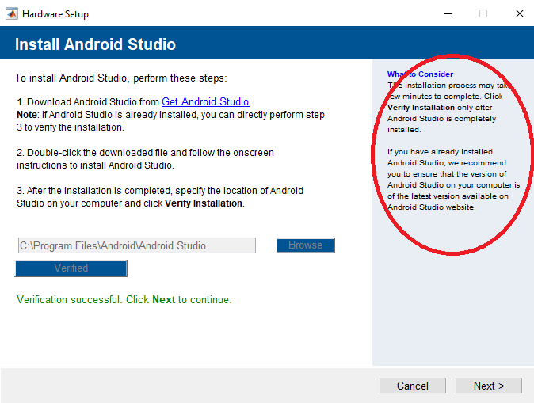
1. Installation
Step3: Follow cautiously the step on the right side

Slide 7
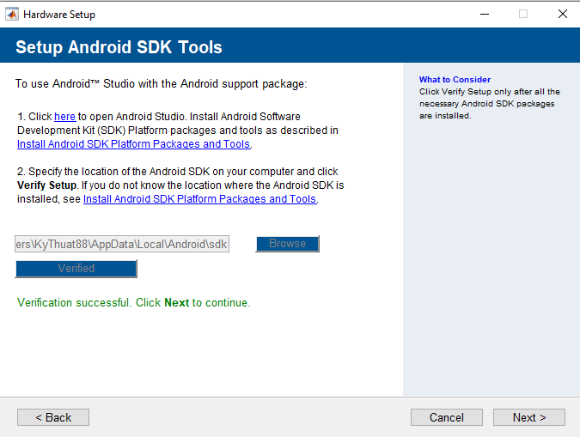
1. Installation

Slide 8
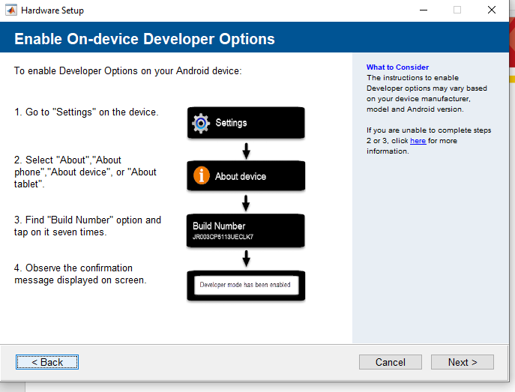
1. Installation

Slide 9
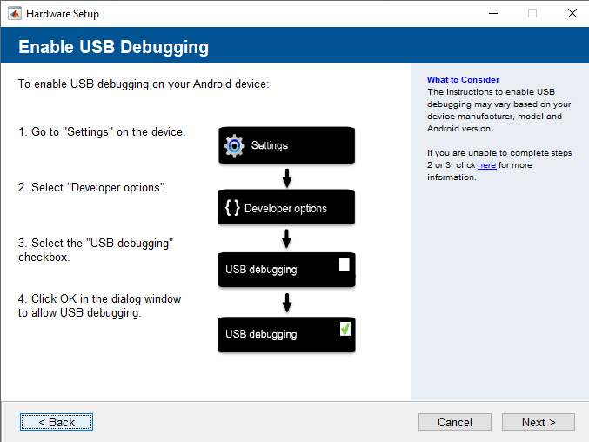
1. Installation

Slide 10
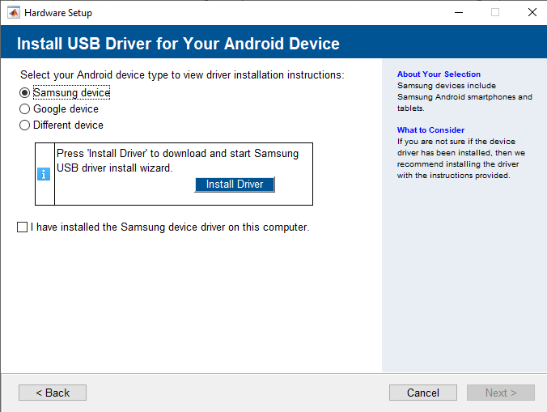
1. Installation
Step4:Install USB driver for your device. Follow rigorously the instruction ☺.

Slide 11
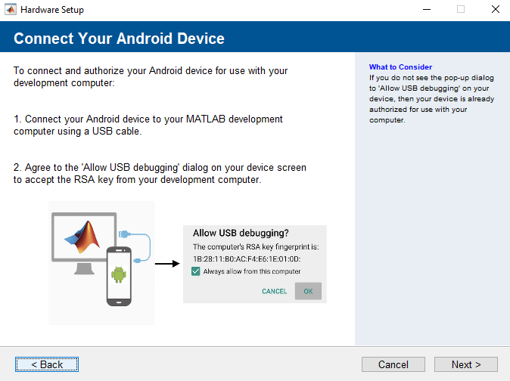
1. Installation

Slide 12
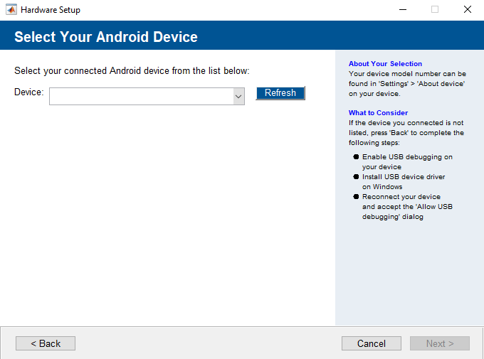
1. Installation
Now installation is done, plug your device in to laptop, and start setup.

Slide 13
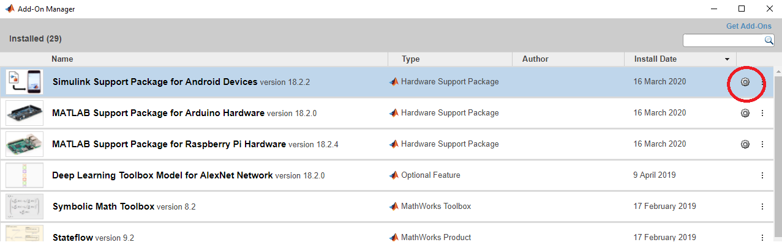
1. Installation
If some errors occur and you close Hardware Setup window. Don’t worry, re-open it.
Goto Add-ons manager and then:

Slide 14
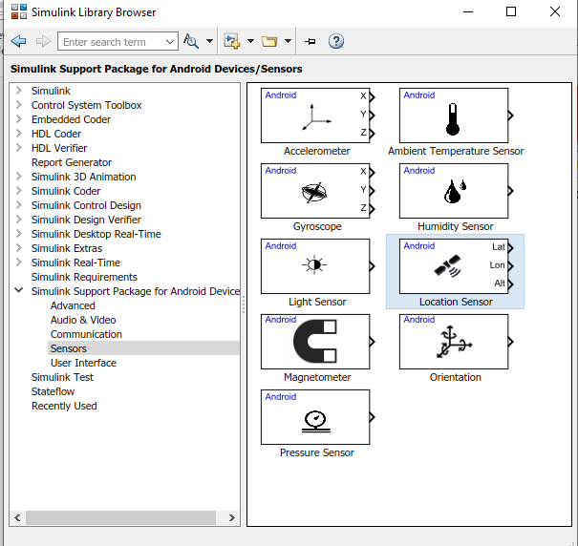
2. Setup
Open Simulink library browser, go for Simulink package for android device, sensors, location sensor

Slide 15
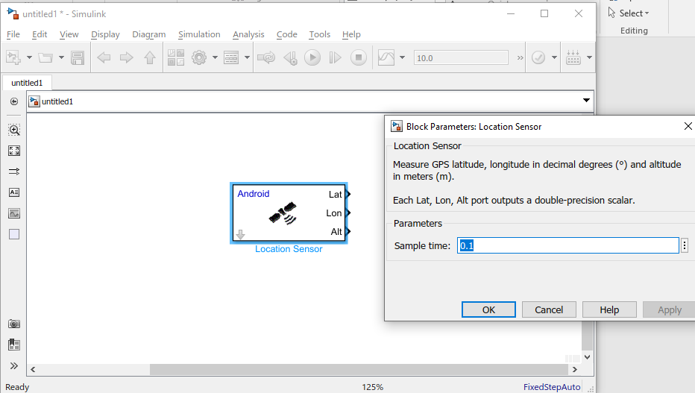
2. Setup
Drag it into your Simulink window, and start simulation ☺.

Slide 16
REFERENCES

Slide 17
THANK FOR
YOUR WATCHING !!!

