Slide 1






Cyber Secure GenAI
Advanced Threat Detection and
Hallucination Checker for LLM Applications

Slide 2



GenAI Risks and Security Threats
Data Privacy & Security
Generative AI may raise concerns related to regulatory compliance, particularly in terms of data privacy, security, and transparency.
Hallucinations
Generative AI models can be complex and difficult to interpret, making it challenging to explain their decision-making processes.
Data Bias
AI models learn from historical data, which can be biased and reflect existing societal biases. This could lead to biased outputs or perpetuate unfair practices.
Hacking
Generative AI models can be vulnerable to adversarial attacks, where malicious actors manipulate inputs to produce misleading or harmful outputs.
Model Robustness & Validation
Ensuring the robustness and reliability of generative AI LLM models is crucial.
Inadequate validation processes in the model can lead to inaccurate outputs, impacting the bank's decision-making, risk management & compliance processes.
Compute Attack
Exposing LLM models to the public with the compute available with everyone to run could lead to compute attacks where malicious actors could use this for unauthorised purposes.

Slide 3

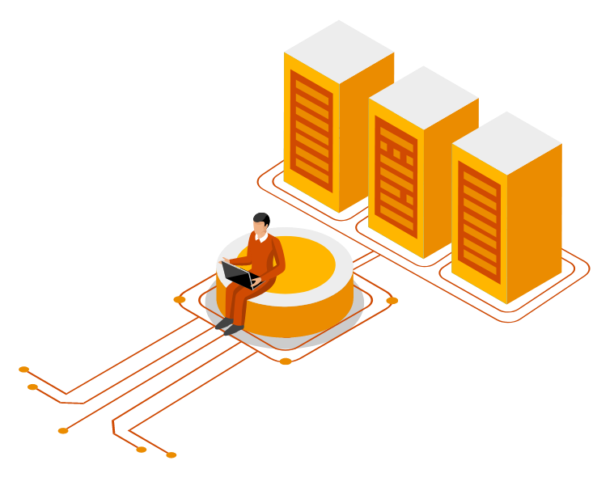

Problem Statement: Security for GenAI
Enhanced Increasing Security Risks and Vulnerabilities
Prompt Injections
Unauthorized Code Execution & Insufficient access controls Server-side request forgery vulnerabilities
Training Data poisoning & Toxic Dependencies
Growing Reliance on LLM Applications
Hallucinations Inadequate AI alignment Toxic Dependencies Biased Responses
Data Exposure
Cryptographic failures
Sensitive and privileged information leak Improper error handling
There is a need for Comprehensive threat detection and protection

Slide 4
OWASP Top 10 for LLM
Prompt Injection
This manipulates a large language model (LLM) through crafty inputs, causing unintended actions by the LLM. Direct injections overwrite system prompts, while indirect ones manipulate inputs from external sources.
Insecure Output Handling
This vulnerability occurs when an LLM output is accepted without scrutiny, exposing backend systems. Misuse may lead to severe consequences like XSS, CSRF, SSRF, privilege escalation, or remote code execution.
Training Data Poisoning
Training data poisoning refers to manipulating the data or fine-tuning process to introduce vulnerabilities, backdoors or biases that could compromise the model’s security, effectiveness or ethical behavior.
Model Denial of Service
Attackers cause resource-heavy operations on LLMs, leading to service degradation or high costs. The vulnerability is magnified due to the resource-intensive nature of LLMs and unpredictability of user inputs.
Supply Chain Vulnerabilities
LLM application lifecycle can be compromised by vulnerable components or services, leading to security attacks. Using third-party datasets, pre-trained models, and plugins and vulnerabilities.
LLM01
LLM02
LLM03
LLM04
LLM05
Sensitive Information Disclosure
LLM’s may inadvertently reveal confidential data in its responses, leading to unauthorised data access, privacy violations, and security breaches. Implement data sanitization and strict user policies to mitigate this.
Insecure Plugin Design
LLM plugins can have insecure inputs and insufficient access control due to lack of application control. Attackers can exploit these vulnerabilities, resulting in sever consequences like remote code execution.
Excessive Agency
LLM-based systems may undertake actions leading to unintended consequences. The issue arises from excessive functionality, permissions, or autonomy granted to the LLM- based systems.
Overreliance
Systems or people overly depending on LLMs without oversight may face misinformation, miscommunication, legal issues, and security vulnerabilities due to incorrect or inappropriate content generated by LLMs.
Model Theft
This involves unauthorised access, copying, or exfiltration of proprietary LLM models. The impact includes economic loses, compromised competitive advantage, and potential access to sensitive information.
LLM06
LLM07
LLM08
LLM09
LLM10

Slide 5

Risk and Regulations Framework with a Guardrail Ecosystem
PwC’s GenAI Risk Framework
STRATEGIC
PERFORMANCE & SECURITY
Bias and Hallucination | Security
Defining and measuring fairness for | Enhancing the cyber security of
intersectional groups and testing | systems and anticipating malicious
system against defined standards | attacks, such as adversarial attacks
Interpretability and Explainability | Robustness
Translating and curating model decision | Enabling high performing systems
making to different stakeholders based | over time, and reducing sensitivity
on their needs and uses | to slight changes
Privacy | Safety
Utilising emergent privacy-preserving | Designing, and testing model
technologies to train resistant systems | performance in the context of human
on large data sets while respecting | uses to anticipate and remediate
data protections | potential harms.
CONTROL
Ethical use of AI
Extending past, “what do we have to do” dictated by compliance to regulation, to the “what we should do” in terms of moral implication of use of data and AI, role of context and stakeholder impact
Public Policy & Regulations
Anticipate and understand key public policy and regulatory trains to align compliance processes with future regulatory requirements and guidance
Governance
Enabling oversight with clear roles, articulated requirements across three lines of defense, and mechanisms for traceability and ongoing assessments
Compliance
Complying with data protection and privacy regulation, organizational policies, and industry standards
Risk Management
Expanding risk detection and mitigation practices to address existing and newly identified risks and harms
Our Approach
Assess Existing Policy
External Guidance
Gen AI Applications
Gen AI Governance Team
Continuous Monitoring

Slide 6
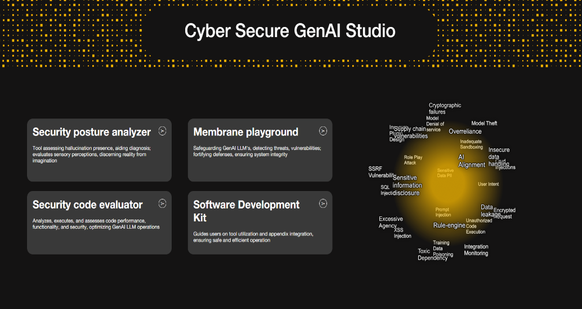


















Introducing
Cyber Secure GenAI
Fortifying your LLM Models with Unparalleled Security

Slide 7

Cyber Secure GenAI: The Future of LLM is here
Cyber Secure GenAI is a state-of-the-art modular security membrane, designed to protect your LLM (Language Learning Model) applications from potential threats and vulnerabilities. This solution employs a one-of-a-kind mechanism to detect and prevent hallucinations, ensuring the highest level of security for your modern LLM applications and their architectures
We have developed 6 distinct security membranes, each tailored to address specific areas of concern:
Input Layer
Safeguards all incoming data and requests, filtering out any malicious or unauthorized access attempts
Secure Data Layer
Encrypts and secures sensitive information, ensuring data integrity and confidentiality throughout your LLM applications
Sensitive Input Layer
Safeguards all PII incoming data and requests, filtering out any malicious or unauthorized access attempts
Connected Apps Layer
Monitors & controls third-party applications and integrations, preventing unauthorized access and potential security breaches
Output Layer
Scrutinizes outgoing data and responses, ensuring that only legitimate information is transmitted to authorized recipients
Hallucination Checker
Utilizes advanced algorithms to detect and mitigate any hallucinations or false outputs generated by the LLM
These six robust security layers work in harmony to provide comprehensive protection for your LLM applications, fortifying them against a wide range of threats and vulnerabilities. With Cyber Secure, you can confidently deploy your cutting-edge applications, knowing they are well-protected and secure.

Slide 8

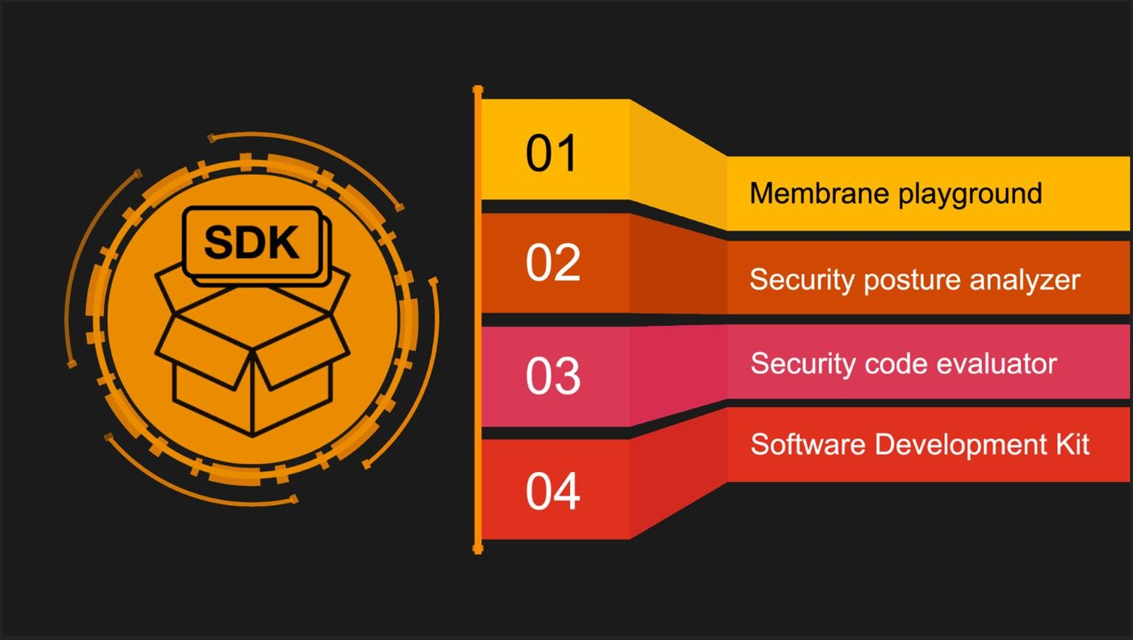
Cyber Secure GenAI: About the Idea
Cyber Secure Gen AI, the security companion studio is designed to empower developers to embed security during development.

Slide 9

Cyber Secure GenAI: Features
Ease of Use
Its clear and concise API allows developers to quickly and efficiently add an additional layer of security to their projects without the need for extensive training or expertise in cybersecurity.
Real Time Monitoring
By identifying issues in real-time, SecureAstra enables you to take swift action to mitigate risks and maintain the integrity of your Generative AI applications.
Comprehensive Protection
By covering multiple aspects of Generative
AI security, Secure Astra ensures that your system remains protected from various threats, both known and emerging.
Input layer check Prompt injections, unauthorized code execution etc.
Data layer check Cryptographic failures and
insufficient DB access controls
Output layer Check Improper error handling, data leakage, Rule Engine etc.
Connected App layer Check Inadequate sandboxing, toxic dependencies, SSRF Vulnerabilties etc.
Scalability
Whether you're just starting with GenAI or already managing a large-scale deployment, SecureAstra can seamlessly integrate with your infrastructure and help safeguard your Ecosystems
Hallucination Check
By implementing the fact check between different LLM deployment models, Secur Astra helps to ensure that the LLM Model is not hallucinating the output results.
With an ever-increasing reliance on GenAI, it is crucial to safeguard your systems from potential threats and vulnerabilities. Cyber Secure GenAI has been designed to meet this need.

Slide 10










Cyber Secure GenAI: Ease of use
It offers unmatched protection by comprehensively addressing all cyber threats across layers and is fully compliant with the OWASP Top 10 LLM risks.
Cyber Secure Gen AI is powered by our proprietary model, SecurAstra, supervised finetuned (SFT) on Gemini Pro.
Quick installation process compatible with Python environments
Works with most publicly available LLMs
Integrate Cyber Secure GenAI into Your AI Application
Protect Your AI Systems with Minimal Effort
Implement comprehensive security checks
with just a few lines of code
Monitor and manage security with an intuitive, user-friendly dashboard
Cyber Secure GenAI has a well laid documentation for developers
Import securastra
Import the necessary security checks: from secure_astra import input_check, connected_apps_check, data_leakage_check, output_check, hallucination_check
Utilize Cyber Secure GenAI’s clear & concise APIs to perform security checks to get complete safety

Slide 11


Cyber Secure GenAI: Membranes in Action
Input Layer
Connected Apps
Secure Data Layer
Output Layer
Hallucination Check
Encrypted Request
Valid & Authorised Request
Rule-Engine
Integration
Monitoring
Data Leakage
Access controls
Insecure Output Handling
Inception ^{Prompt}
Sensitive Data PII
Toxic Dependency
Output Analyze
Overreliance
Injection
Hallucination Check
RolePlay Attack
CRUD & SQL
Injection
Sensitive Information Disclosure
AI Alignment
Excessive Agency
SQL Injection
SSRF
Vulneribility
Conclusion
XSS Injection
Training Data Poisoning
Model Theft
Supply Chain Vulnerabilities
Insecure Plugin Design
Unauthorised Code Execution
Model Denial of Service
User Intent
Inadequate Sandboxing
Authorised Table - Role Mapping
Cryptographic
failures
User Interaction
Output
Input Analyze

Slide 12

Cyber Secure GenAI for Different Types of LLM Based Architectures
Complex LLM architecture with DB and Connected Apps
Simple LLM Application with DB
Hallucination Check
Simple LLM Application
Output Check
LLM
Model 2
Connected App Check
LLM
Model 4
LLM
Model 6
Input Check | Simple LLM Application | Output Check | Hallucination Check
Input Check | Simple LLM Application with Database | Output Check | Hallucination Check
 | Database Connectivity
 | Data Check
Output Check
Hallucination Check
Connected App Check
Data Check
Connected App Check
Database
Connectivity
LLM
Model 1
LLM
Model 3
Connected App Check
Connected App Check
LLM
Model 5
Input
Check
Output Check
Hallucination Check

Slide 13

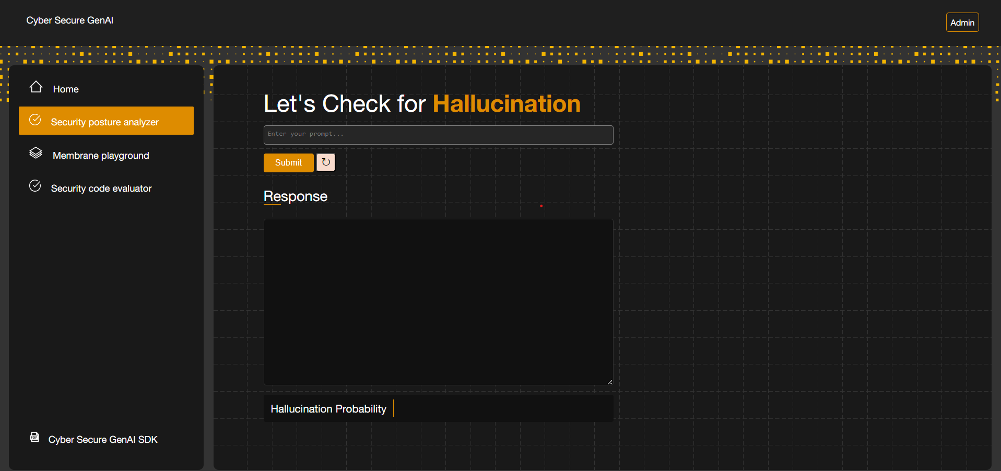
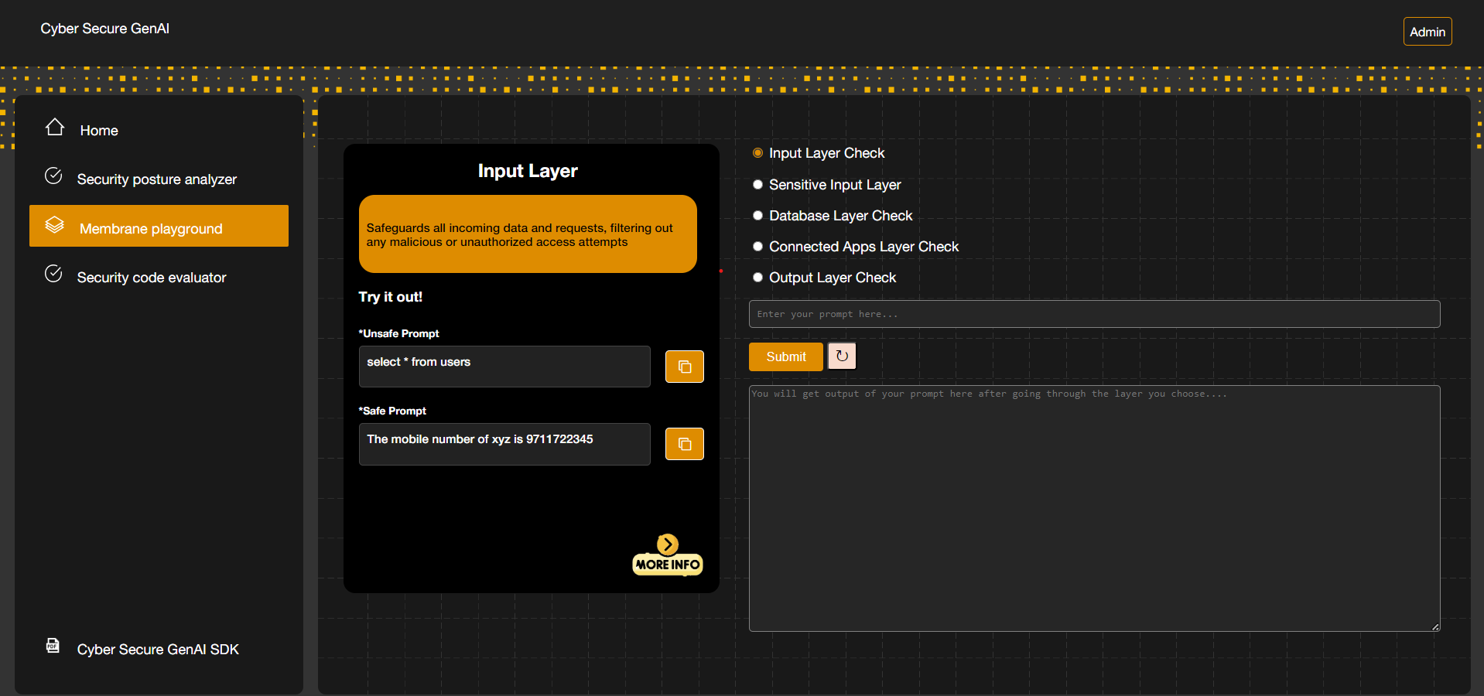
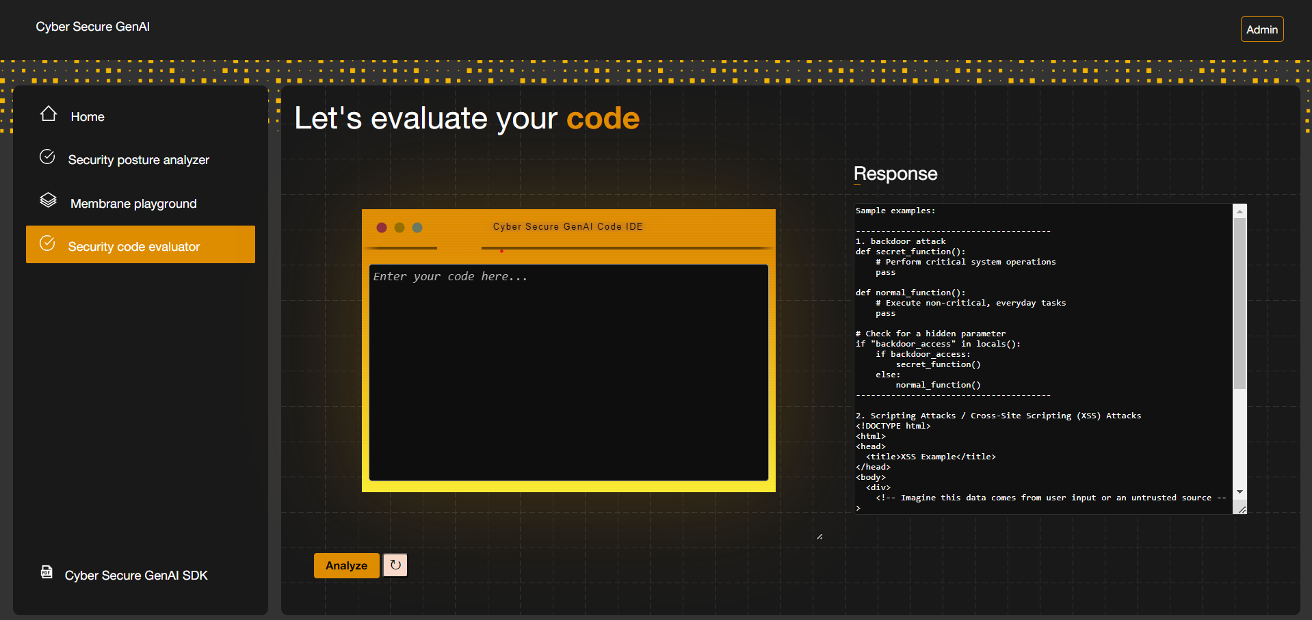
Snapshots

Slide 14


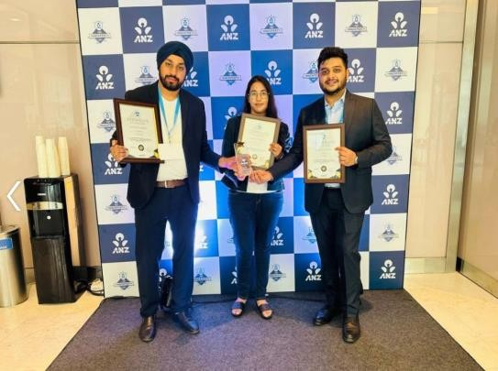
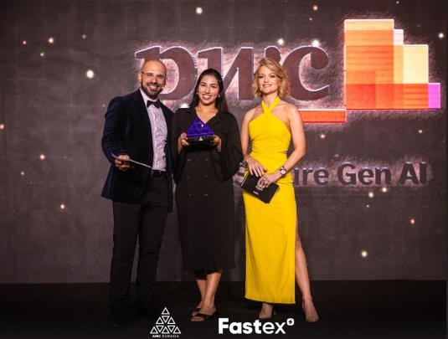

Innovation Recognition
Idea Awards 2024
Most Digitally Enabled Solution
PwC Global Solvers Challenge 2024
Runners Up
Nasscom AI
Gamechangers
Award 2024
Winner
ANZ Hackfest 2023
Best Security Solution for Gen AI
AIBC Eurasia 2024
AI Product of the Year
Patent Application No: 202431008423
Copyright Diary No 142/2024-CO/SW ,143/2024-CO/L

Slide 15



Thank you

