Slide 1
USER GUIDE TO INSTALL AUDELA
Install AudeLA with SVN
Compile AudeLA
Windows
Linux
Launching AudeLA
Alain KLOTZ (2012 dec)

Slide 2

Installing AudeLA from the sourceforge SVN server
and compiling under Windows
1. Installation of Tortoise SVN
Download Tortoise SVN from http://tortoisesvn.tigris.org/
Install Tortoise SVN
2. Installation de Visual C++ 2008
Download the Visual C++ 2008:
https://www.microsoft.com/downloads/details.aspx?FamilyID=3254c868-bcb9-412c-95c6-d100c872ec60&DisplayLang=fr
http://www.microsoft.com/en-us/download/details.aspx?id=13276
Unzip the ISO image with 7-Zip (or write a CDROM)
Launch Setup.hta
Select VisualC++ 2008 Express Edition
unvalid “Allow Visual studio to receive and display online RSS content”
unvalid "Microsoft SQL Server Express Edition”
install in C:\Program Files\Microsoft Visual Studio 9.0\ (by default)

Slide 3
Installing AudeLA from the sourceforge SVN server
and compiling under Windows
3. Download AudeLA (1/4)
Create an AudeLA folder. Example: C:\audela using the file manager:

Slide 4
Installing AudeLA from the sourceforge SVN server
and compiling under Windows
3. Download AudeLA (2/4)
Right click on the audela
folder and choice:
"SVN Checkout"
in the contextual menu.

Slide 5
Installing AudeLA from the sourceforge SVN server
and compiling under Windows
3. Download AudeLA (3/4)
A window propose a form. One must complete the URL of repository:
https://audela.svn.sourceforge.net/svnroot/audela/trunk/audela

Slide 6
Installing AudeLA from the sourceforge SVN server
and compiling under Windows
3. Download AudeLA (4/4)
Role of the folders:
.svn : hidden folder used for the SVN synchronisation. Do not delete and do not modify it.
bin : binary files (DLL and executable) of AudeLA.
gui : script files Tcl/Tk of graphical interfaces of AudeLA.
lib : files of Tcl extensions used by AudeLA.
images : some test images.
src : C/C++ source files of AudeLA.
The audela.exe file and the DLL extensions of AudeLA does not exist in the bin folder
downloaded by SVN because these files are created by the compilation.

Slide 7
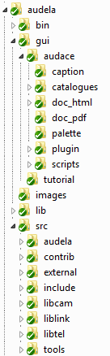
AudeLA architechture : AudeLA important folders (same Windows/Linux)
bin
Executables and libraries (.so, .dll)
Tcl/Tk codes for GUI definition
Tcl/Tk codes for “Plugin GUI tools”
Tcl libraries (FTP, plots, HTTP, SOAP, MySQL,...)
C/C++ source codes
C/C++ codes of Fitsio, Sextractor, DLL for drivers
Camera plugin C/C++ codes
Mount plugin C/C++ codes
Tcl
C
C++

Slide 8

Installing AudeLA from the sourceforge SVN server
and compiling under Windows
4. Compiling AudeLA
Open the audela/src folder and double-clic on the audela.sln file.
Select Release
Menu Generate → Build Solution (F7)

Slide 9
Installing AudeLA from the sourceforge SVN server
and compiling under Windows
5.Updating AudeLA
Right click on the
audela folder and choice
"SVN Update"
After update
you must recompile.

Slide 10
Installing AudeLA from the sourceforge SVN server
and compiling under Linux
1. Install packages
Suse : gcc, g++, make, tcl-devel, tk-devel, gsl, gsl-devel, subversion
Ubuntu : tcl-dev, tk-dev, libgsl0, libgsl0-dev, subversion
Fedora : gcc, gcc-c++, subversion
Debian Raspberry : make, tcl, tk, tcl-dev tk-dev, subversion
2. Prepare the srv folder
root> mkdir /srv
root> chown -R USER.users /usr/local /srv (replace USER by your login)
cd /srv
mkdir develop
3. Download AudeLA from SVN
cd /srv/develop
svn co https://audela.svn.sourceforge.net/svnroot/audela/trunk/audela
Use the 8.5 version

Slide 11
Installing AudeLA from the sourceforge SVN server
and compiling under Linux
4. Compile AudeLA
cd /srv/develop/audela/src
chmod +x configure
./configure
make external
make contrib
make
cd ../bin
chmod +x audela.sh
5. Set the library path for AudeLA
root> cd /etc/ld.so.conf.d
root> touch audela.conf
root> vi audela.conf
write the three lines and save
root> ldconfig
/srv/develop/audela/bin
/usr/local/lib
/srv/develop/audela/lib

Slide 12

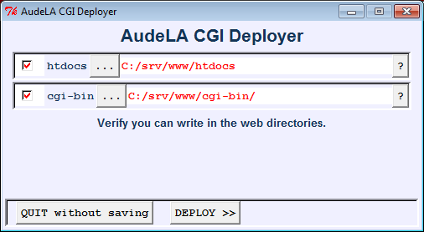
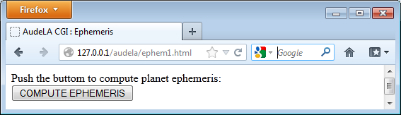
Many ways to launch AudeLA
1. Launch AudeLA and Aud'ACE graphical interface (standard)
Windows : Click on the audela.exe icon
Linux : ./audela &
2. Launch AudeLA without Aud'ACE graphical interface (console mode)
Windows command: audela.exe --console
Linux : ./audela --console
3. Launch AudeLA without Aud'ACE graphical interface and launch a script
Windows command: audela.exe --console --file c:\test\analysis.tcl
Linux : ./audela --console --file ~/test/analysis.tcl
4. Launch AudeLA without Aud'ACE graphical interface as a CGI script
Install Apache server before.
Install through the AudeLA terminal: source $audace(rep_install)/bin/cgi_install.tcl ; ::cgi_install::run

Slide 13
What appends when you launch AudeLA ?
Anatomy of the executable file audela.exe / audela
Entry point
main(int argc, char **argv)
Load the Tcl library
#include <tcl.h>
Declare a Tcl interpreter
void *interp
Launch the Tcl event loop
Tcl_Main(argc, argv, init)
Define the init of the interpreter
    int init(Tcl_Interp *interp) {
      Tcl_Init(interp);
      return TCL_OK;
    }
Load
libaudela
libmc
etc...
Load
libaudelatk
etc...
Launch a starting Tcl script
source audela/bin/audela.tcl (default)

Slide 14
Special notes: Raspberry Pi (http://www.raspberrypi.org/)
There is no asm, cli and sti commands in the kernel of Rasberry Pi computers
so the compilation aborts. You must change two files to compile AudeLA (add
the redened characters):
File audela/src/contrib/ethernaude/src/UDPSocketComponent.c
double GetTimeStamp(void)
{
#if defined(LINUX) && !defined(OS_MAC)
unsigned long long x=0;
//__asm__ volatile (".byte 0x0F, 0x31":"=A" (x));
return ((double) x / 897000000);
#endif
File audela/src/include/system.h
/* Override of the local irq functions */
//#define AUDELA_CLI() __asm__ __volatile__ ("cli": : :"memory")
//#define AUDELA_STI() __asm__ __volatile__ ("sti": : :"memory")
#define AUDELA_CLI()
#define AUDELA_STI()

