Slide 1
BASICS OF AUDELA
AudeLA level 1 (180 min)
The graphical interface (menus, docs),
the terminal (info commands),
the Tcl basics (set, expr, proc),
celestial mechanics (angle and date conversions,ephemeris),
image processing (buf1, libtt),

Slide 2
HISTORY OF AUDELA
During the '90:
- Increasing of the popular CCD cameras (Sbig, Apogee)
- In France, the AUDE association
Association des Utilisateurs de Detecteurs Electroniques
Funded in 1994 in Toulouse to promote the CCD astronomy
Training periods (CESR, Ferme des étoiles, observatoire de Strasbourg, Paris)
Many professionals joined the group (F. Colas, A. Klotz, etc.)
Promote the Pro-am collaborations (CNRS schools)
In 1998, creation of the Audine caméra (< 1 500 €)
In 1998, a reflexion about the software by A. Klotz and D. Marchais
In 1999, software brain storming helped by Ph. Ambert
In 2000, technichal choices and creation of AudeLA 1.0
- Open source project (C/C++)
- Window and Linux compatibility
- Provide a develoment platform that includes standards (FITSIO, Sextractor, etc.)
- A platform to share algorithms (image processing, celestial mechanics)
- A tool to develop easily new instrumental projects → driving Audine
- Object based philosophy (buffer, display, telescope, camera)
- A simple scripting language for astronomers → Tcl/Tk
- Inherite of Tcl libraries (internet tools, etc)
- Aud'ACE: The standard graphical user interface but not unique
- Possibility to launch AudeLA as command line only (daemon, CGI)

Slide 3
HISTORY OF AUDELA
During the last decade:
- Audeladev mailing list to help individual developers and to solve bugs
- Core Team Group (R. Delmas, M. Pujol, D. Marchais, J. Michelet, R. Zachankte, etc.)
- Source force SVN
- Plugin tools to include easily new project inside the Aud'ACE GUI
- Drivers of many cameras and telescopes are now included
- Use of AudeLA in Master teaching at University of Toulouse (electronics, astronomy)
- 2003 to 2010 : AudeLA replaces progressively the old TAROT software
- TAROT uses AudeLA as daemons that executes specifics scripts → ROS
Robotic Observatory Software = AudeLA + ROS scripts
- 2008 ROS adapted to the Zadko 1 meter telescope in Australia
AudeLA in professional observatories:
- libmc, libtt are used in the TBL software (Pic du Midi)
- libmc is used in the MeO software (Laser ranging at Calern)
- AudeLA is used to drive the T193 (Observatoire de Haute Provence)
- AudeLA is used to drive the cameras of the T80 (OHP), T1M (Pic du Midi)
- AudeLA should be adopted in the upgrade of ClimSO (Pic du Midi)
- AudeLA is used to drive the full sky camera at the VLT (ESO, Chile)
Things that remain to do:
- The Mac OS X Makefile to compile with Apple compiler
- Documentation is not complete (user and reference guides)
- Upgrade the Aud'ACE GUI

Slide 4
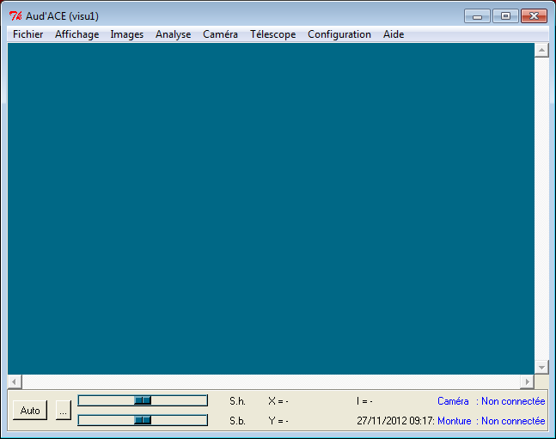
FIRST STEPS WITH AUDELA: The Aud'ACE display
Aud'ACE is written in Tk
Robert Delmas
Raymond Zachantke
Everything can be changed
(only scripts)
The code is in
audela/gui/audace
Pluggin system that can
add items in menus
The parameters are
C:\Users\UserName\AppData\Roaming\AudeLA\audace.ini

Slide 5
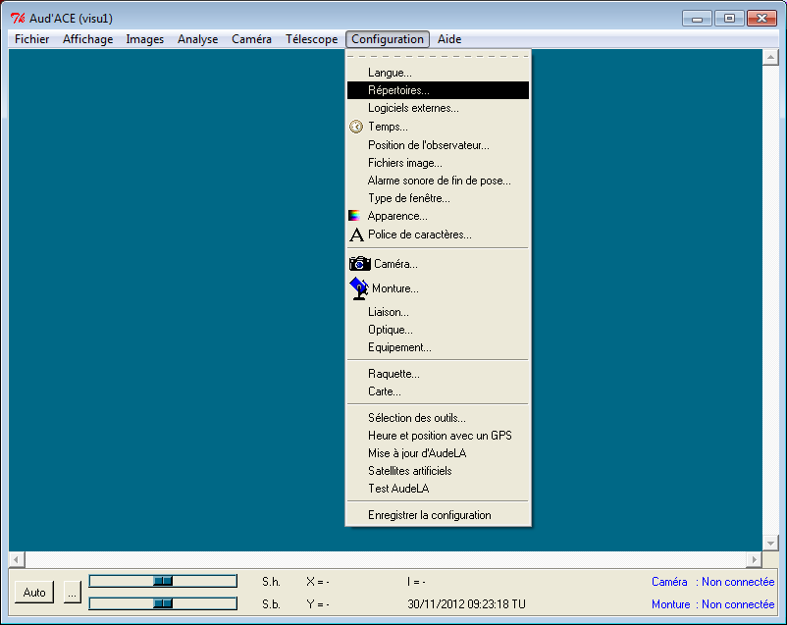
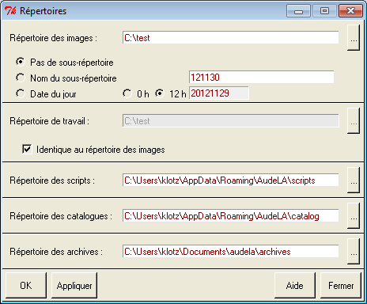
FIRST STEPS WITH AUDELA: The Aud'ACE configuration

Slide 6
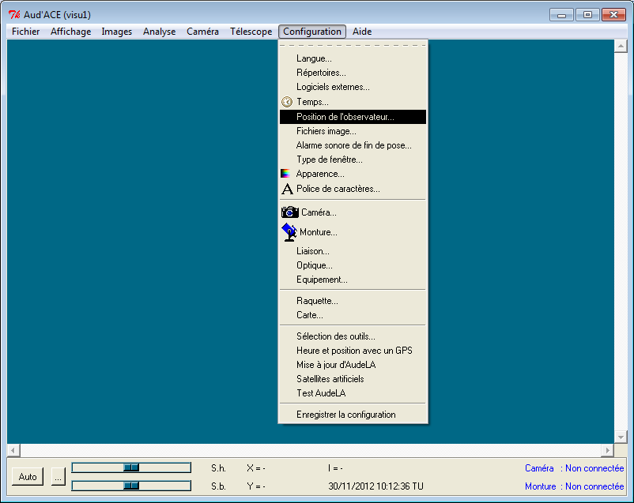
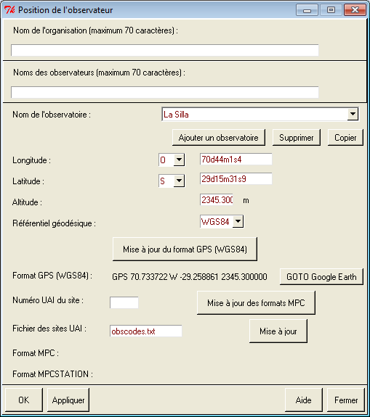
FIRST STEPS WITH AUDELA: The Aud'ACE configuration
La Silla : 809
Calern : 910

Slide 7
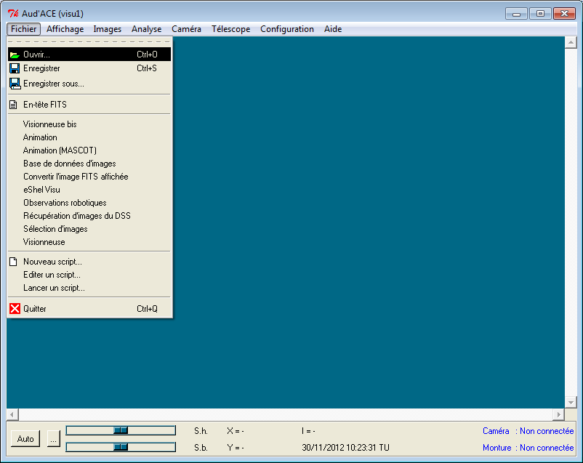
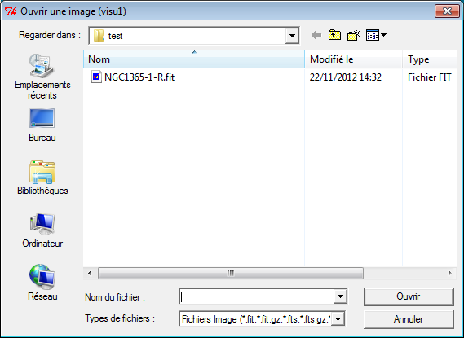
FIRST STEPS WITH AUDELA: Load an image in memory

Slide 8
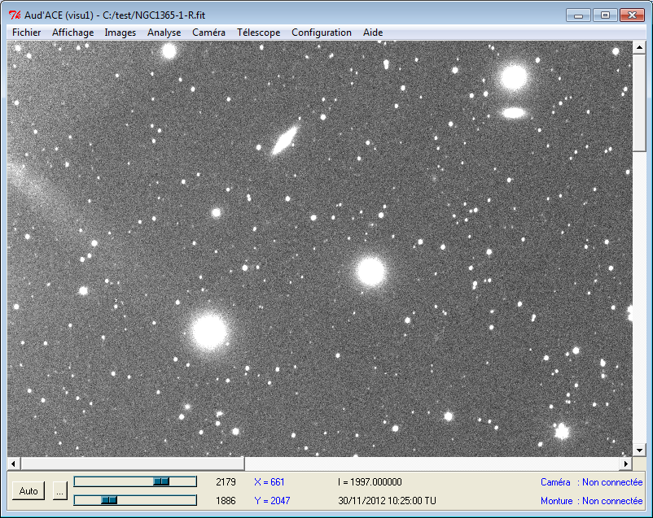
FIRST STEPS WITH AUDELA: Visualization
Cut bars
Toggle (x,y)<->(ra,dec)

Slide 9
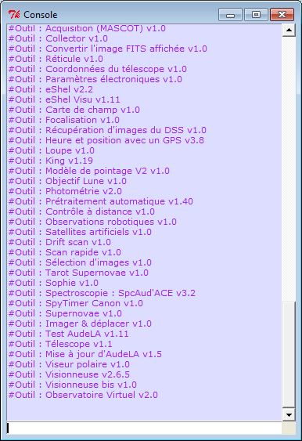
FIRST STEPS WITH AUDELA: The terminal
loadima
loadima NGC1365-1-R
buf1 load c:/test/NGC1365-1-R.fit
visu1 disp
expr 2+5
# 7
info commands *expr*
# expr vexpr
expr
# wrong # args: should be "expr arg ?arg ...?"
Only one syntax: Command param1 param2 etc.
Parameters can be mandatory or optionals (case of loadima)

Slide 10
FIRST STEPS WITH AUDELA: The terminal
Tcl commands (set, expr, for)
set a 5
expr $a+4
# 9
set b [expr $a+4]
# 9
set b [expr $a+4] ; set c 10
# 10
set b
# 9
set c
# 240

Slide 11
FIRST STEPS WITH AUDELA: Everything is string
Tcl commands (string)
set a "I love"
# I love
set b GRBs
# GRBs
set c "$a $b"
# I love GRBs
set car [string index $c 3]
# o
set car [string index $c end]
# s
set car [string index $c end-1]
# B
string length $c
# 11
set word [string range $c 2 5]
# love
Concatenation is trivial
First character has index 0
string aaa
# unknown or ambiguous subcommand "aaa": must be bytelength, compare, equal, first, index, is, last, length, map, match, range, repeat, replace, reverse, tolower, totitle, toupper, trim, trimleft, trimright, wordend, or wordstart

Slide 12
FIRST STEPS WITH AUDELA: Everything is string
Tcl commands (lindex lrange lappend list)
set c "$a $b"
# I love GRBs
set word [lindex $c 1]
# love
set word [lrange $c 0 1]
# I love
set c ""
lappend c I
lappend c love
lappend c GRBs
# I love GRBs
set c [list I love GRBs]
# I love GRBs
set d [list I love " " GRBs]
# I love { } GRBs
A list is a string
Elements of a list are separated by blanks
First element at index 0
Add an element at the end of the list
Build a list
Role of the { }

Slide 13
FIRST STEPS WITH AUDELA: Control structures
Tcl commands (if for foreach while)
set a toto
if {$a=="toto"} {
set b 1
} else {
set b 0
}
# 1
set c ""
for {set k 0} {$k<9} {incr k} {
lappend c [expr 30*$k]
}
set c
# 0 30 60 90 120 150 180 210 240
set d ""
foreach e $c {
lappend d [expr 2*$e]
}
set d
# 0 60 120 180 240 300 360 420 480
set a 0
while {$a<10} {
incr a
}

Slide 14
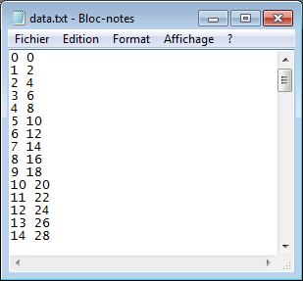
FIRST STEPS WITH AUDELA: Text file write and read
Tcl commands (open puts close read split)
set lines ""
for {set k 0} {$k<100} {incr k} {
append lines "$k [expr 2*$k] \n"
}
set f [open c:/test/data.txt w]
puts $f $lines
close $f
set f [open c:/test/data.txt r]
set lines [split [read $f] \n]
close $f
lindex [lindex $lines 5] 1
# 10
set lines
# {0 0 } {1 2 } {2 4 } {3 6 } {4 8 } {5 10 } {6 12 } {7 14 } {8 16 } {9 18 } {10 20 } {11 22 } {12 24 } {13 26 } {14 28 } {15 30 } {16 32 } {17 34 } {18 36 } {19 38 } {20 40 } {21 42 } {22 44 } {23 46 } {24 48 } {25 50 } {26 52 } {27 54 } {28 56 } {29 58 } {30 60 } {31 62 } {32 64 } {33 66 } {34 68 } {35 70 } {36 72 } {37 74 } {38 76 } {39 78 } {40 80 } {41 82 } {42 84 } {43 86 } {44 88 } {45 90 } {46 92 } {47 94 } {48 96 } {49 98 } {50 100 } {51 102 } {52 104 } {53 106 } {54 108 } {55 110 } {56 112 } {57 114 } {58 116 } {59 118 } {60 120 } {61 122 } {62 124 } {63 126 } {64 128 } {65 130 } {66 132 } {67 134 } {68 136 } {69 138 } {70 140 } {71 142 } {72 144 } {73 146 } {74 148 } {75 150 } {76 152 } {77 154 } {78 156 } {79 158 } {80 160 } {81 162 } {82 164 } {83 166 } {84 168 } {85 170 } {86 172 } {87 174 } {88 176 } {89 178 } {90 180 } {91 182 } {92 184 } {93 186 } {94 188 } {95 190 } {96 192 } {97 194 } {98 196 } {99 198 } {} {}

Slide 15
FIRST STEPS WITH AUDELA: Extensions of the language
Tcl commands (proc, load)
Creating a new command:
proc multiplication2 { a } {
set b [expr 2*$a]
return $b
}
multiplication2 4
# 8
Extension libraries:
load libmc.dll
It adds new procs written in pure C
The library is in the folder audela/bin
The C source code is in the folder audela/src
AudeLA is a collection of extension libraries (libaudela, libaudelatk, libmc, libtt, etc.)

Slide 16
FIRST STEPS WITH AUDELA: Extensions of the language
Tcl commands (package )
Packages of extension libraries:
package require http
# 2.7.6
It adds new procs written in pure C and/or Tcl
The libraries are in the folder audela/lib
A non exhautive list of extensions: http://wiki.tcl.tk/940
set url http://www.google.com
set tok [ ::http::geturl $url ]
upvar #0 $tok state
set contents [ ::http::data $tok ]
::http::cleanup $tok
set contents
# <HTML><HEAD><meta http-equiv="content-type" content="text/html;charset=utf-8">
<TITLE>302 Moved</TITLE></HEAD><BODY>
<H1>302 Moved</H1>
The document has moved
<A HREF="http://www.google.fr/">here</A>.
</BODY></HTML>

Slide 17
FIRST STEPS WITH AUDELA: AudeLA extensions
AudeLA core extensions
libaudela : Image buffers, plugin system for cameras, telescopes
libaudelatk : Visualization tools for astronomical images
libtt : Image processing library (not a Tcl extension) used by libaudela (+ libfitsio)
libmc : Celestial mechanics procs (mc_*)
libak, libml, libyd, libjm : Personnal procs
libgsltlc : GNU Scientific Library
AudeLA device extensions
Cameras: libandor, libcagire, libsbig, libascomcam, libwabcam, etc.
Telescopes: liblx200, libascom, libcelestron, etc.
Aud'ACE procs
console::affiche_resultat, loadima, etc.

Slide 18
FIRST STEPS WITH AUDELA: AudeLA buffers
buf::create 1 (create a buffer object in the Tcl interpretor)
# 1
"Buf::create 1" is already done in the Aud'ACE interface
The proc buf1 is created. To list the sub-commands:
buf1
# buf1 choose sub-command among add autocuts barycenter binx biny bitpix centro cfa2rgb clear clipmax clipmin compress copykwd copyto create3d div delkwd delkwds extension fibercentro fitellip fitgauss fitgauss2d flux fwhm getkwd getkwds getnaxis getpix getpixels getpixelsheight getpixelswidth histo imaseries imageready initialcut load load3d log mergepixels mirrorx mirrory mult new ngain noffset offset opt phot photom pointer radec2xy rot save save1d save3d savejpeg scale scar setkwd setpix setpixels slitcentro sub substars stat synthegauss type unsmear xy2radec window A_starlist ubg region
buf1 load c:/test/NGC1365-1-R.fit
"buf1 load" does not display the image which is only loaded in the memory
buf1 getpix {300 400}
# 1 2000.000000
"buf1 getpix" returns a list. the second element is the intensity of the pixel (ADU)

Slide 19
FIRST STEPS WITH AUDELA: AudeLA buffers + Aud'ACE binding
Aud'ACE procs simplify the use of the buffer functions :
Tcl procs of Aud'ACE
C code and C/Tcl library functions
C pure code
loadima NGC1365-1-R
buf1 load c:/test/NGC1365-1-R.fit

Slide 20
FIRST STEPS WITH AUDELA: AudeLA buffers + Aud'ACE binding
Aud'ACE procs simplify the use of the buffer functions :
Aud'ACE procs AudeLA
loadima NGC1365-1-R buf1 load $audace(rep_images)/NGC1365-1-R.fit
saveima tmp buf1 save $audace(rep_images)/tmp.fit
sub tmp 0 buf1 imaseries "SUB offset=0"
Aud'ACE procs Comments
div flat 10000 Divide the buf1 image by flat.fit and mlutiply by 10000
ngain 10000 Background flux normalisation at the 10000 level
offset 40 Add 40 to all pixels
window Crop the buf1 image by the box defined with the mouse.
Aud'ACE procs Comments
div flat 10000 Divide the buf1 image by flat.fit and mlutiply by 10000
ngain 10000 Background flux normalisation at the 10000 level
offset 40 Add 40 to all pixels
window Crop the buf1 image by the box defined with the mouse.

Slide 21
FIRST STEPS WITH AUDELA: AudeLA buffers + Aud'ACE binding
THE GOAL
Input file series: i1.fit, i2.fit, i3.fit, …, i300.fit
Input file calibration: dark.fit
Output file series will be j1.fit to j300.fit. Each file will be corrected by dark.fit
THE SOLUTION 1
set n 300
for {set k 1} {$k<=$n} {incr k} {
console::affiche_resultat "Image $k\n"
loadima i$k
sub dark 0
saveima j$k
}
THE SOLUTION 2
sub2 i dark j 0 300

Slide 22
FIRST STEPS WITH AUDELA: AudeLA buffers + Aud'ACE binding
THE GOAL
Input file series: j1.fit, j2.fit, j3.fit, …, j300.fit
Input file calibration: flat.fit
Output file series will be k1.fit to k300.fit. Each file will be corrected by flat.fit
flat.fit is normalized to 10000
THE SOLUTION 1
set n 300
for {set k 1} {$k<$n} {incr k} {
console::affiche_resultat "Image $k\n"
loadima j$k
div flat 10000
saveima k$k
}
THE SOLUTION 2
div2 j flat k 10000 300

Slide 23
FIRST STEPS WITH AUDELA: AudeLA buffers + Aud'ACE binding
ONE IMAGE
add
div
convgauss
delete
div
mult
ngain
noffset
sub
subsky
trans
window
calibwcs
IMAGE SERIES
add2
div2
convgauss2
delete2
div2
mult2
ngain2
noffset2
sub2
subsky2
trans2
window2
calibwcs2
registerbox
registerwcs
IMAGE STACK
sadd
smean
sprod
spythagore
ssigma
ssk
ssort
smedian

Slide 24
FIRST STEPS WITH AUDELA: Exercice
Load NGC1365-1-R
Display the image
Use the scrollbars to center the spiral galaxy in the center
Drag a box aroud the galaxy
Crop the image
Display the croped image
Save the croped image in the file a1.fit
Save the croped image in the file a2.fit
Build b.fit as the co addition of a1.fit and a2.fit

Slide 25
FIRST STEPS WITH AUDELA: Exercice (correction)
Load NGC1365-1-R
Display the image
loadima NGC1365-1-R
Use the scrollbars to center the spiral galaxy in the center
Drag a box aroud the galaxy
Crop the image
Display the croped image
window
Save the croped image in the file a1.fit
saveima a1
Save the croped image in the file a2.fit
saveima a2
Build b.fit as the co addition of a1.fit and a2.fit
sadd a b 2 1 bitpix=-32
bitpix=16 for integer 16 bits
bitpix=-32 for float 32 bits

Slide 26
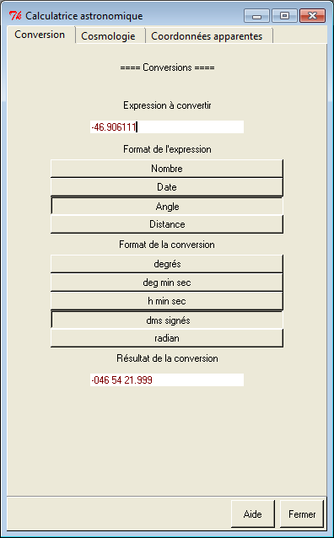
FIRST STEPS WITH AUDELA: Celestial mechanics - angles
Menu Affichage → Calculatrice astronomique
set ra 12h05m34s
set dec -46d54m22s
mc_angle2deg $ra
# 181.391667
mc_angle2deg $dec
# -46.906111
mc_angle2hms 181.391667
# 12 5 34.000080
mc_angle2dms -46.906111
# +313 5 38.000400
mc_angle2dms -46.906111 90
# -46 54 21.999600

Slide 27
FIRST STEPS WITH AUDELA: Celestial mechanics - angles
Multiple angle formats:
mc_angle2hms 181.391667
# 12 5 34.000080
mc_angle2hms
# Usage: mc_angle2hms Angle ?limit? ?nozero|zero? ?subsecdigits? ?auto|+? ?list|string?
mc_angle2hms 181.391667 360 zero 2 auto string
# 12h05m34s00
mc_angle2hms 181.391667 360 nozero 1 + string
# +12h5m34s0

Slide 28
FIRST STEPS WITH AUDELA: Celestial mechanics - angles
Angle of separation of two coordinates:
mc_anglesep [list 2h 34d 3h -45d]
# 80.1636811723 169.295536556
Angle of separtion Position angle (N=0 E=90 S=180 W=270)
Locations on the Earth:
Example for an observatory located at 3 degrees western from Greenwich, a latitude of 46 degrees and an altitude of 456 meters :
set home { GPS 3 W 46 456 }
This list is used in the coordinate transform functions.

Slide 29
FIRST STEPS WITH AUDELA: Celestial mechanics - angles
Angle authorized syntaxes:
45°34'28" :
45d34m28s : is equal to 45°34'28"
45d34m28s9 : is equal to 45°34'28.9"
45d34m28.9s : is equal to 45°34'28.9"
45d34 : is equal to 45°34'
45.34 : is interpreted as 45.34 décimal degrees.
-45d34.5 : is interpreted as -45°34'30"
1h30m : is interpreted as 22.5 decimal degrees
1.57r : is interpreted as 1.57 radians.
{45 34 28.4} : is interpreted as 45d34m28.4s
{1 30 h} : is interpreted as 1h30m.
{1.57 r} : is interpreted as 1.57 radians

Slide 30
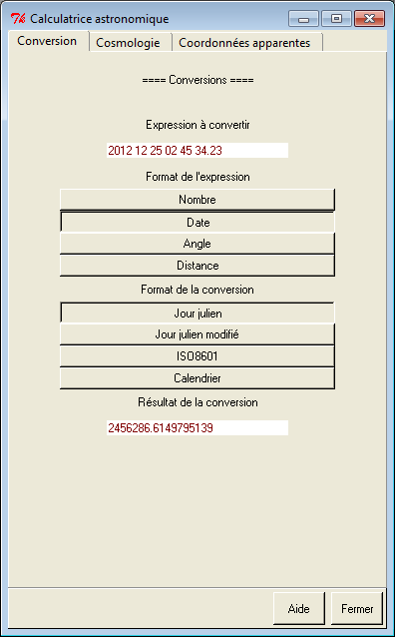
FIRST STEPS WITH AUDELA: Celestial mechanics - dates
Menu Affichage → Calculatrice astronomique
set date {2012 12 25 02 45 34.23}
mc_date2jd $date
# 2456286.6149795139
mc_date2ymdhms $date
# 2012 12 25 2 45 34.230003
mc_date2iso8601 $date
# 2012-12-25T02:45:34.230
mc_date2iso8601 now
set home {GPS 2 E 42 100}
mc_date2lst $date $home -format deg
# 137.4171639
Local Sideral Time

Slide 31
FIRST STEPS WITH AUDELA: Celestial mechanics - dates
Date in the frame of the solar system barycenter:
set ra 12h45m05s
set dec -56d01m23s
set date {2012 12 25 02 45 34.23}
set home {GPS 2 E 42 100}
set tt [mc_date2tt $date]
# 2456286.615757106300000
mc_date2ymdhms [mc_tt2bary $tt $ra $dec J2000 $home]
# 2012 12 25 2 44 32.390306
Dates computations:
mc_date2ymdhms [mc_datescomp $date + [expr 35/86400.]]
# 2012 12 25 2 46 9.230014

Slide 32
FIRST STEPS WITH AUDELA: Celestial mechanics - coordinates
Conversion of coordinates in various systems
set ra 12h45m05s
set dec -56d01m23s
set date {2012 12 25 02 45 34.23}
set home {GPS 2 E 42 100}
mc_radec2altaz $ra $dec $home $date
# 331.444267307 -7.07955076635 316.025497231 -31.3294324133
azimuth elevation hour angle parallactic angle
mc_radec2altaz
mc_hadec2altaz
mc_altaz2radec
mc_altaz2hadec
mc_radec2altalt
mc_hadec2altalt
mc_altalt2radec
mc_altalt2hadec
mc_radec2galactic
mc_galactic2radec
mc_radec2ecliptic
mc_ecliptic2radec

Slide 33
FIRST STEPS WITH AUDELA: Celestial mechanics - coordinates
Corrections of coordinates
mc_refraction
mc_precessradec
mc_nutationradec
mc_aberrationradec
mc_parallaxradec
set hip [list 0 0 $ra $dec J2000 J2000 0 0 0]
mc_hip2tel $hip $date $home 101325 290
Return all apparent coordinates (+pointing model options)
mc_tel2cat (=the inverse of mc_hip2tel)
Corrections of radial velocities (for spectrospcopy)
mc_baryvel
mc_lsr

Slide 34
FIRST STEPS WITH AUDELA: Celestial mechanics - miscelaneous
Cosmology calculator (based on the Ned Wright formulae)
mc_cosmology_calculator redshift ?Hubble_constant_km/s/Mpc? ?Omega_matter? ?Omega_vacuum?
mc_cosmology_calculator 3.5 71 0.27 0.73
# {H0 71.000000 {current Hubble constant km/s/Mpc}} {Omega_M 0.270000 {Omega_matter}} {Omega_vac 0.730000 {Omega_vac = 1-Omega_M gives a flat Universe}} {z 3.500000 redshift} {cz 1049273.603000 {non relativistic velocity km/s}} {DTT_Gyr 11.838041 {time from z to now in Gyr}} {age_Gyr 13.679140 {age of Universe in Gyr}} {zage_Gyr 1.841099 {age of Universe at redshift z in Gyr}} {DCMR_Mpc 6920.308109 {comoving radial distance in Mpc}} {V_Gpc 1388.179492 {comoving volume within redshift z in Gpc3}} {DA_Mpc 1537.789364 {angular size distance in Mpc}} {kpc_DA 7.455413 {angular scale in kpc/arcsec}} {DL_Mpc 31140.234614 {luminosity distance in Mpc}}

Slide 35
FIRST STEPS WITH AUDELA: Celestial mechanics - miscelaneous
Ephemeris calculator
# Usage: mc_ephem ListObjects ?ListDates_UTC ListFormat? ?-topo Home? ?-equinox Date|apparent? ?-tt-utc seconds?
mc_ephem {sun moon} [list $date] -topo $home
# {Sun 273.848481448405 -23.391400730758 } {Moon 54.696731588444 18.902492917070 } {Ok {J2000.0 coordinates} 2}
Default outputs are Ra, Decl J2000
mc_ephem {sun moon} [list $date] {ALTITUDE MAG} -topo $home
# {-49.450425597942 -26.878035 } {17.809728763301 -11.468534 } {Ok {J2000.0 coordinates} 2}
Here we asked for elevation and magnitude (physical properties)

