Slide 1
SCRIPTING WITH AUDELA
AudeLA level 2 (60 min)
Scripting (source, catch, Tk)
Application to astrometry
Application to photometry

Slide 2
The force = Coupling AUDELA and MATLAB scripts
File analysis.tcl
set lines ""
for {set k 1} {$k<10} {incr k} {
loadima ic$k
set res [buf1 stat {34 8 61 30}]
set mean [lindex $res 4]
set std [lindex $res 5]
set line "$k $mean $std\n"
console::affiche_resultat $line
append lines $line
}
set f [open c:/test/results.txt w]
puts $f $lines
close $f
File analysis.m
clear all;
table=load('result.txt');
means=table(:,1);
stds=table(:,2);
plot(means,stds,'o');

Slide 3
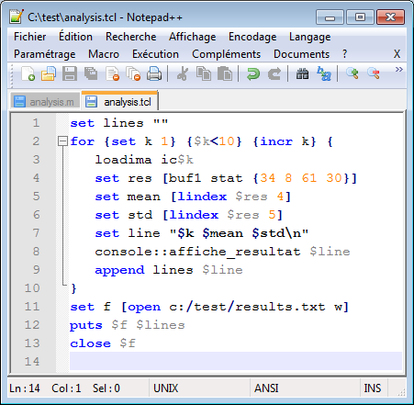
NotePad++ a good editor for Tcl, AUDELA and MATLAB
File analysis.tcl
set lines ""
for {set k 1} {$k<10} {incr k} {
loadima ic$k
set res [buf1 stat {34 8 61 30}]
set mean [lindex $res 4]
set std [lindex $res 5]
set line "$k $mean $std\n"
console::affiche_resultat $line
append lines $line
}
set f [open c:/test/results.txt w]
puts $f $lines
close $f

Slide 4
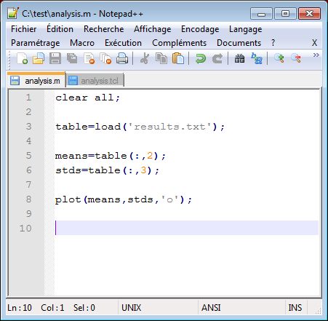
NotePad++ a good editor for Tcl, AUDELA and MATLAB
File analysis.m
clear all;
table=load('result.txt');
means=table(:,1);
stds=table(:,2);
plot(means,stds,'o');

Slide 5
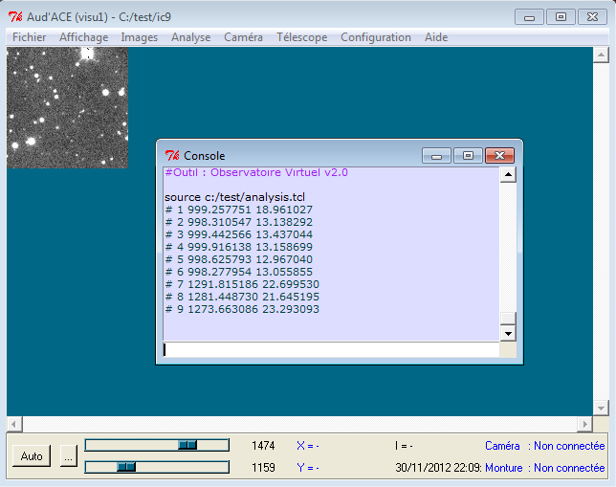
To launch a script in a terminal: source

Slide 6
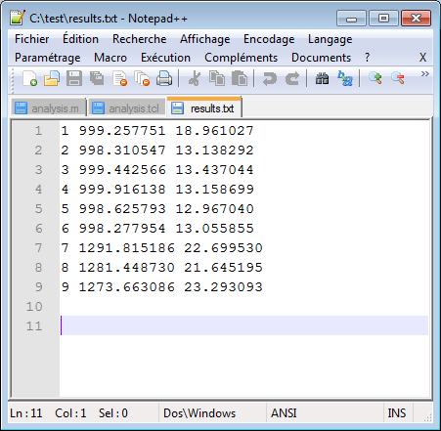
Check the results.txt file

Slide 7
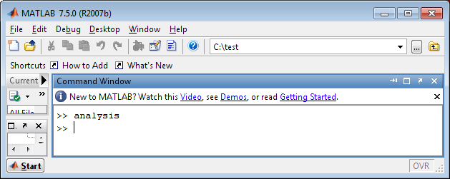
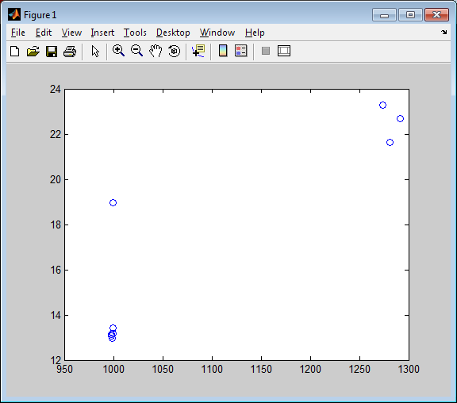
To launch a script in Matlab

Slide 8
Catch an error in a Tcl/AudeLA script
set res [expr sqrt(-1)]
This line returns an error and stop the script.
To avoid the stop of the script when an error is encountered,
use the catch command:
set err [ catch {
set res [expr sqrt(-1)]
} msg ]
err = 1 (there is an error)
msg = domain error: argument not in valid range (cause of the error)
set err [ catch {
set res [expr sqrt(1)]
} msg ]
err = 0 (there is no error)
msg = 1.0 (this is the numerical result)

Slide 9
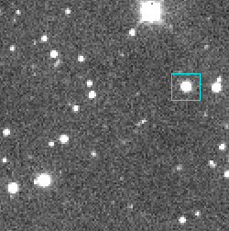
Basics of astrometry measures with Tcl/AudeLA
loadima ic1
set box [::confVisu::getBox 1]
# 96 72 111 87
set res [buf1 fitgauss $box]
# 17424.091416 103.712280 1.760520 1018.317840 17909.578856 79.886766 2.012684 1012.588817
The order of output list elements is:
ipeakx xc fwhmx backgroundx ipeaky yc fwhmy backgroundy
set xc [lindex $res 1]
set yc [lindex $res 5]
set radec [buf1 xy2radec [list $xc $yc]]
# 273.823079 69.292561

Slide 10
Basics of astrometry measures with Tcl/AudeLA
Exercice: Create a proc box2radec that returns the (ra,dec) coordinates
in the dragged box. Coordinates will be expressed in HMS +DMS
proc box2radec { } {
return [list $ra_hms $dec_dms]
}
Copy this code in the file c:/test/myscripts.tcl
source c:/test/myscripts.tcl
loadima ic1 (then drag a box)
box2radec
# 18h15m17s53 +69d17m33s2

Slide 11
Basics of astrometry measures with Tcl/AudeLA
Exercice: Create a proc box2radec that returns the (ra,dec) coordinates
in the dragged box. Coordinates will be expressed in HMS +DMS
proc box2radec { } {
set box [::confVisu::getBox 1]
set res [buf1 fitgauss $box]
set xc [lindex $res 1]
set yc [lindex $res 5]
set radec [buf1 xy2radec [list $xc $yc]]
set ra [lindex $radec 0]
set dec [lindex $radec 1]
set ra_hms [mc_angle2hms $ra 360 zero 2 auto string]
set dec_dms [mc_angle2dms $dec 90 zero 1 + string]
return [list $ra_hms $dec_dms]
}
Copy this code in the file c:/test/myscripts.tcl
source c:/test/myscripts.tcl
loadima ic1 (then drag a box)
box2radec
# 18h15m17s53 +69d17m33s2

Slide 12
Basics of photometry measures with Tcl/AudeLA
loadima ic1
set box [::confVisu::getBox 1]
# 96 72 111 87
set res [buf1 phot $box]
# 74826.000000 89 1022.000000
The order of output list elements is:
integralflux background_nbpix background_flux
set flux [lindex $res 0]
# 74826.000000

Slide 13
Basics of photometry measures with Tcl/AudeLA
HOW TO CALIBRATE FLUX INTO MAGNITUDES ?
set flux [lindex $res 0]
# 74826.000000
set radec [buf1 xy2radec [list $xc $yc]]
# 273.823079 69.292561
magnitude = zmag – 2.5 *log10 ( flux )
1) My star is known in catalogues and I can determine zmag
set res [ vo_neareststar [lindex $radec 0] [lindex $radec 1] ]
# {{NOMAD-1 1592-0145615} 273.8216778 +69.2926056 12.850 15.600 12.180 11.490 11.255 11.182}
set magr [lindex [lindex $res 0] 5]
# 12.180
set zmagr [expr $magr + 2.5*log10($flux) ]
# 24.3651313240238

Slide 14
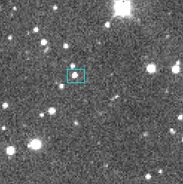
Basics of photometry measures with Tcl/AudeLA
HOW TO CALIBRATE FLUX INTO MAGNITUDES ?
magnitude = zmag – 2.5 *log10 ( flux )
1) My star is known in catalogues and I can determine zmag
set zmagr [expr $magr + 2.5*log10($flux) ]
# 24.3651313240238
2) Drag the unknown star
set box [::confVisu::getBox 1]
# 47 70 59 79
set res [buf1 phot $box]
# 8711.000000 29 1018.000000
set flux [lindex $res 0]
# 8711.000000
set magr [expr $zmagr - 2.5*log10($flux) ]
# 14.514961289675419

Slide 15
Basics of astrometry measures with Tcl/AudeLA
Exercice: Create a proc box2zmag that returns zmag from the star
in the dragged box. Modify box2radec add the magnitude as the
third element of the output list
proc box2zmag { } {
return $zmagr
} Copy this code in the file c:/test/myscripts.tcl
source c:/test/myscripts.tcl
loadima ic1 (then drag a box)
set zmagr [box2zmag]
# 24.367711062866064

Slide 16
Basics of astrometry measures with Tcl/AudeLA
Exercice: Create a proc box2zmag that returns zmag from the star
in the dragged box. Modify box2radec add the magnitude as the
third element of the output list
proc box2zmag { } {
set box [::confVisu::getBox 1]
set res [buf1 fitgauss $box]
set xc [lindex $res 1]
set yc [lindex $res 5]
set radec [buf1 xy2radec [list $xc $yc]]
set res [ vo_neareststar [lindex $radec 0] [lindex $radec 1] ]
set magr [lindex [lindex $res 0] 5]
set res [buf1 phot $box]
set flux [lindex $res 0]
set zmagr [expr $magr + 2.5*log10($flux) ]
return $zmagr
} Copy this code in the file c:/test/myscripts.tcl
source c:/test/myscripts.tcl
loadima ic1 (then drag a box)
set zmagr [box2zmag]
# 24.367711062866064

Slide 17
Basics of astrometry measures with Tcl/AudeLA
Exercice: ...Modify box2radec add the magnitude as the
third element of the output list
set zmagr [box2zmag]
proc box2radec { zmagr } {
set box [::confVisu::getBox 1]
set res [buf1 fitgauss $box]
set xc [lindex $res 1]
set yc [lindex $res 5]
set radec [buf1 xy2radec [list $xc $yc]]
set ra [lindex $radec 0]
set dec [lindex $radec 1]
set ra_hms [mc_angle2hms $ra 360 zero 2 auto string]
set dec_dms [mc_angle2dms $dec 90 zero 1 + string]
set res [buf1 phot $box]
set flux [lindex $res 0]
set magr [expr $zmagr - 2.5*log10($flux) ]
return [list $ra_hms $dec_dms $magr]
} source c:/test/myscripts.tcl
box2radec $zmagr
# 18h15m49s43 +69d17m17s2 14.517541028517684

