Slide 1
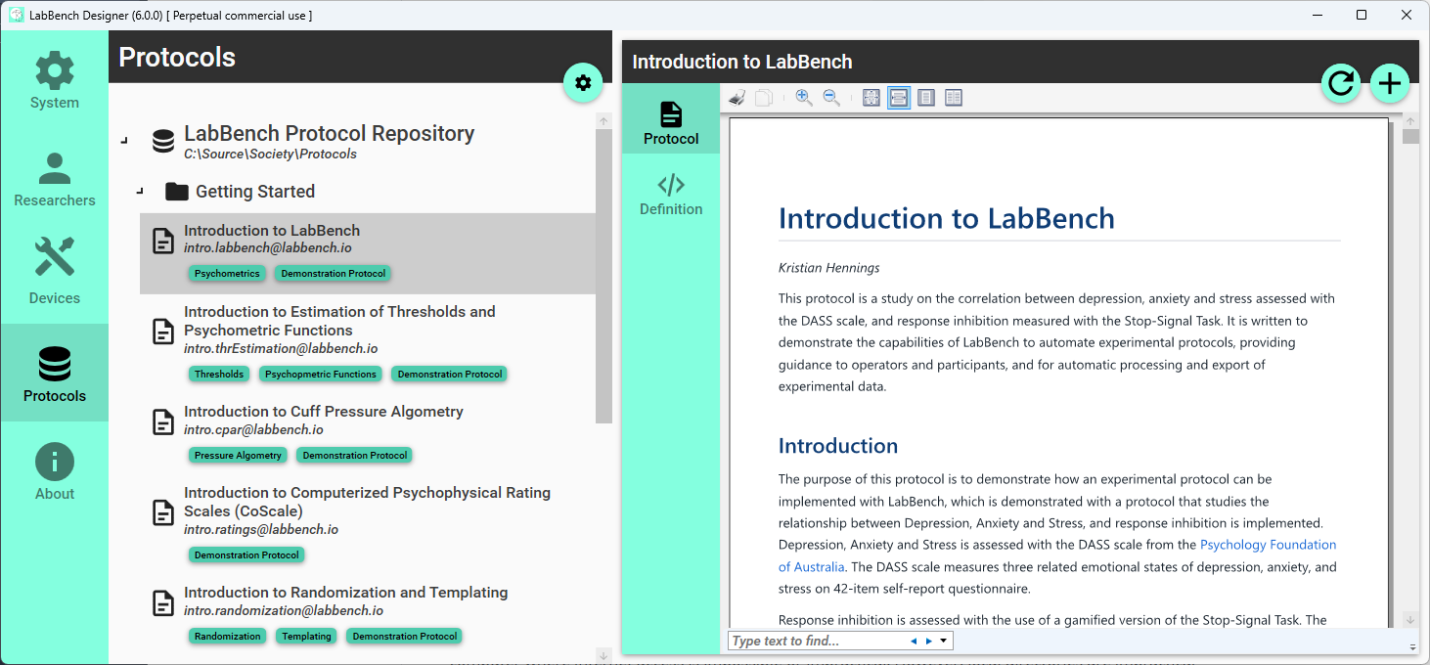
Configure repositories
Reload protocol
Create experiment
List of repositories
Selected repository
Notes:
Joystick

Slide 2
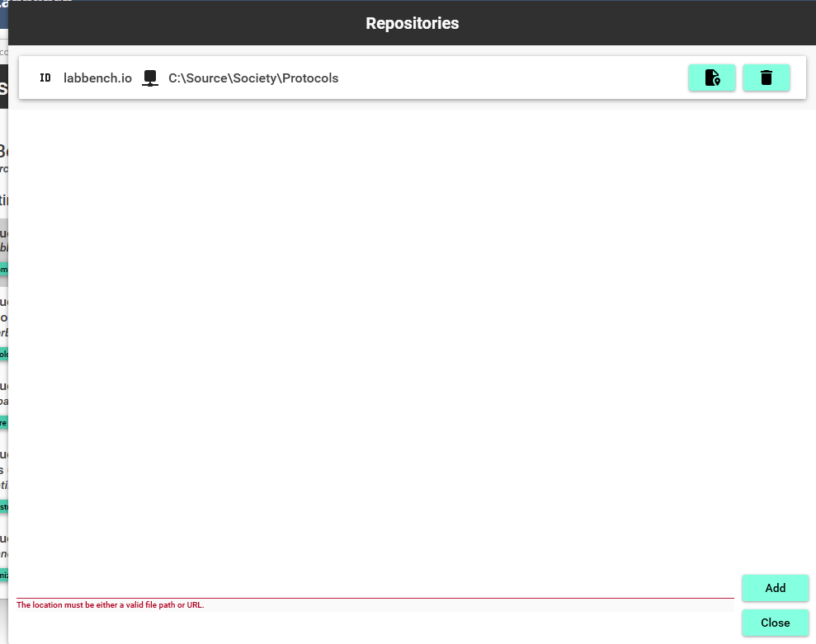
Update location
Remove repository
Location
Add repository
Close dialog
Notes:
LabBench I/O

Slide 3
