Slide 1
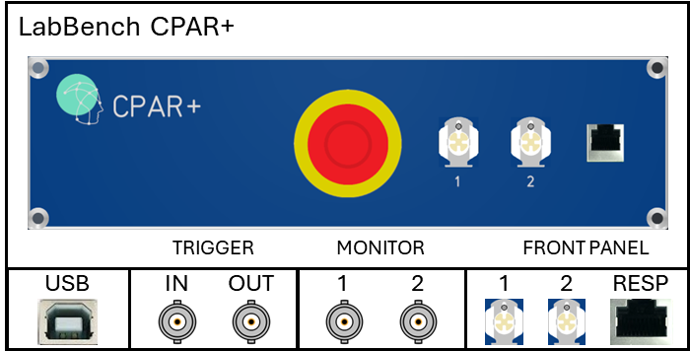
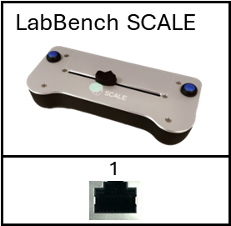
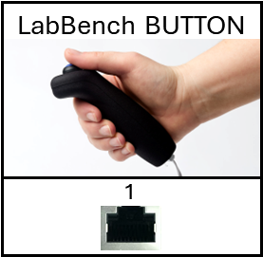
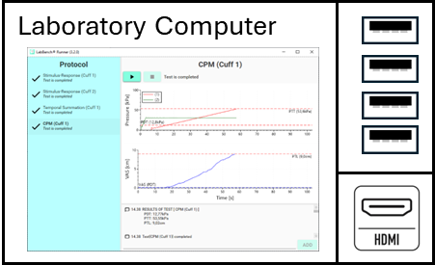
OR
Notes:
Joystick

Slide 2
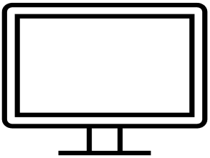
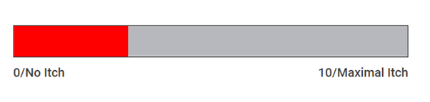
OR
LabBench DISPLAY
Notes:
Joystick

Slide 3
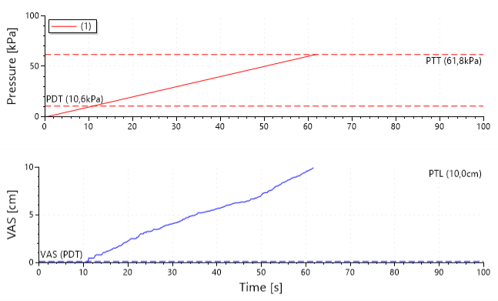
Pressure outlets used in the test
Applied pressure
Psychophysical ratings
Notes:
Stimulus Response: Illustration of the test UI

Slide 4
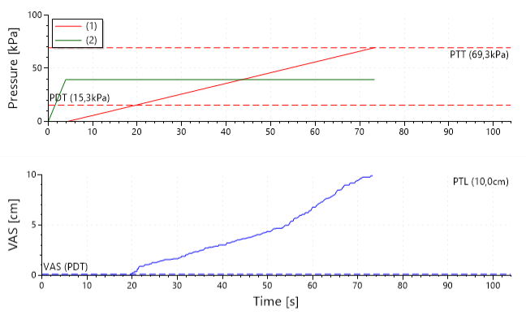
Pressure outlets used in the test
Applied pressures
Psychophysical ratings
Notes:
CPM Test: UI used in the test

Slide 5
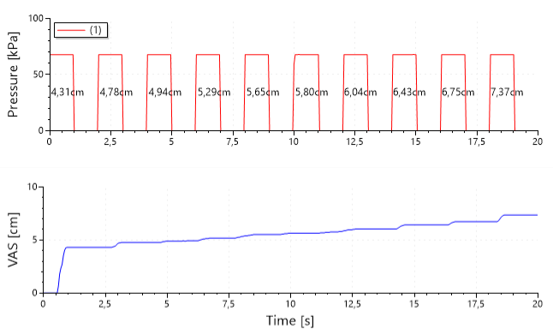
Pressure outlets used in the test
Applied pressure
Psychophysical ratings
Notes:
Temporal summation: UI used in the test

Slide 6
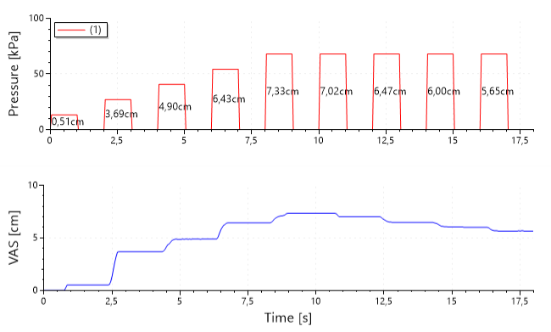
Pressure outlets used in the test
Applied pressure
Psychophysical ratings
Notes:
Arbitrary: UI used in the test

Slide 7
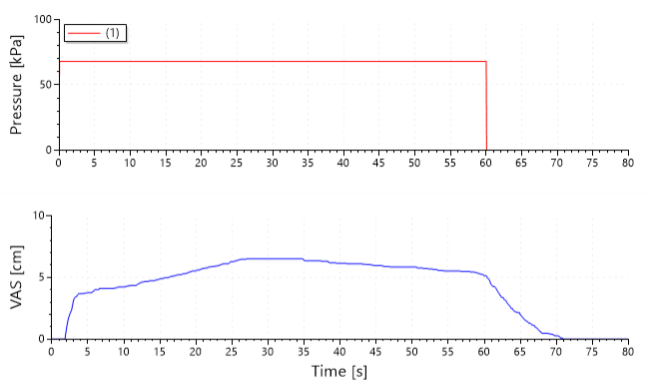
Pressure outlets used in the test
Applied pressure
Psychophysical ratings
Notes:
Static Temporal Summation: UI used in the test

Slide 8
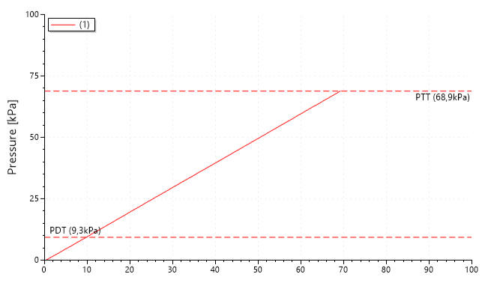
Pressure outlets used in the test
Applied pressure
Notes:
Arbitrary: Stimulus Rating

Slide 9
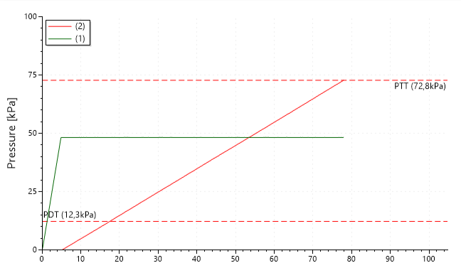
Pressure outlets used in the test
Applied pressures
Notes:
Conditioned Pain Rating: Stimulus Rating

Slide 10
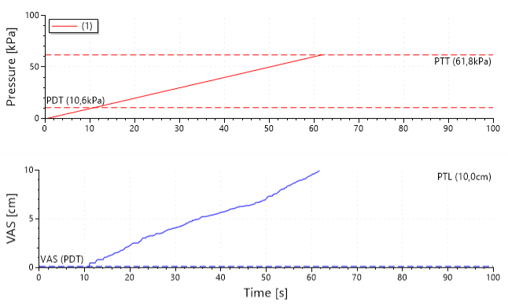
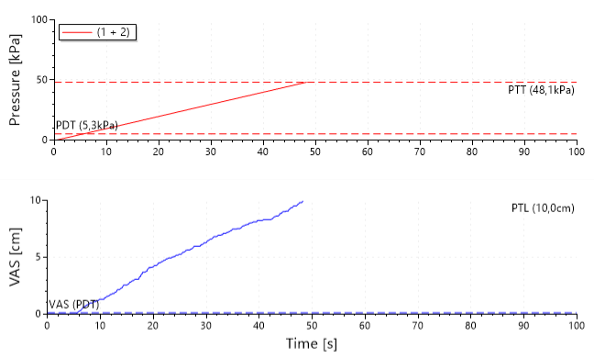
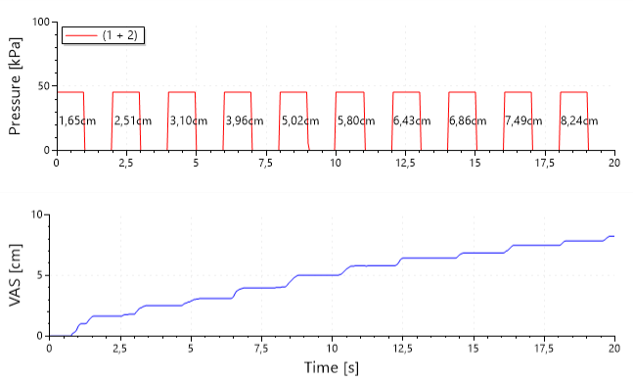
A
B
C
D
second-cuff="false"
second-cuff=“true"
Notes:
SR Test

Slide 11
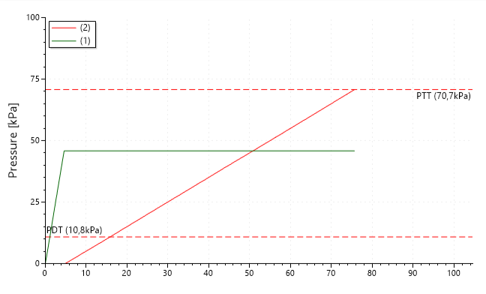
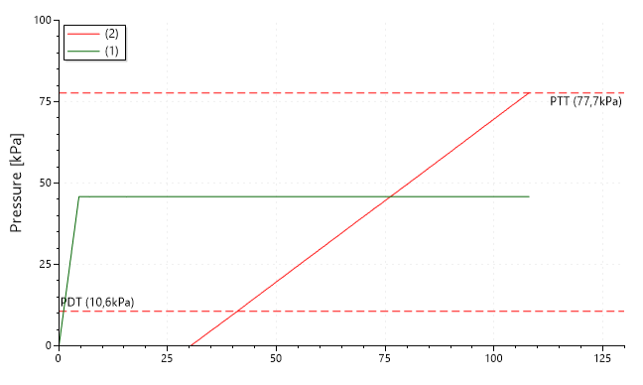
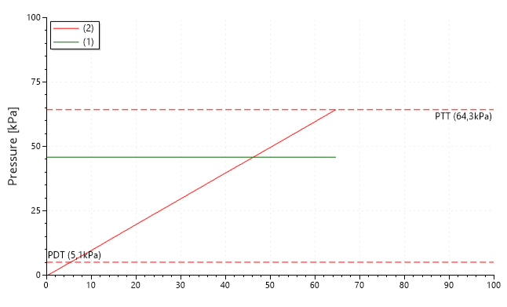
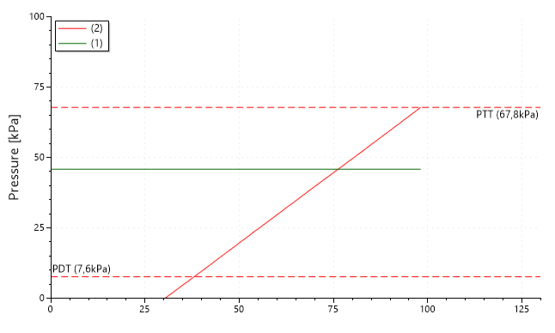
A
B
delta-conditional-pressure="10“
conditioning-time="0"
delta-conditional-pressure="10“
conditioning-time="30"
C
D
delta-conditional-pressure="0“
conditioning-time="0"
delta-conditional-pressure="0“
conditioning-time="30"
Notes:
CPM Rating: Options for Conditioning stimulation

Slide 12
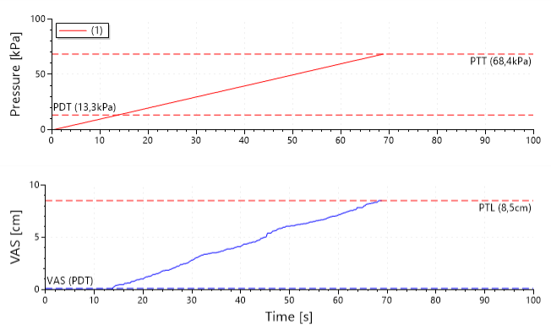
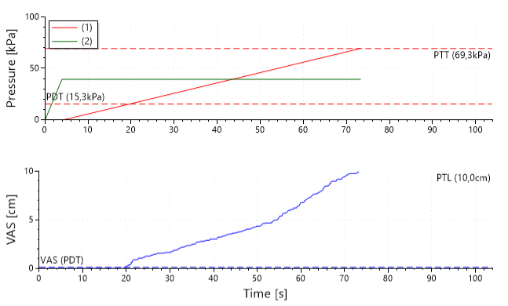
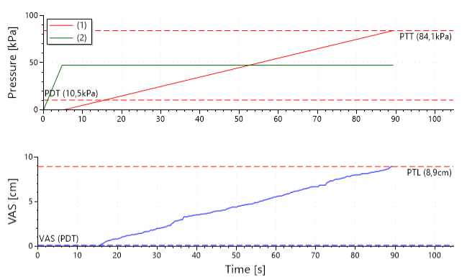
A
B
C
D
stop-mode="stop-on-maximal-rating"
stop-mode="stop-when-button-pressed"
Notes:
SR Test

Slide 13
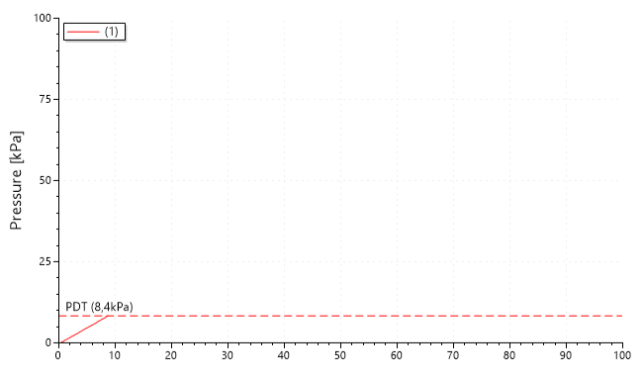
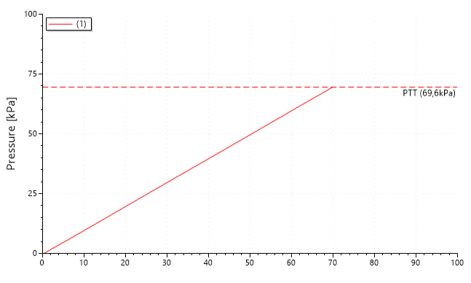
A
B
measurement=“PDT"
measurement=“PTT"
C
measurement="BOTH"
Notes:
Stimulus Rating: Threshold Determinations

